Slide 1
Work Sample

Slide 2
Initial Investigations
First consider the task from a human perspective
Identify features with strongest predictive power
Consider potential issues with using certain features

Slide 3
Preparing data and considerations
Clean data to remove potential distractions and to focus on most important vocabulary in features
Remove very similar orders to avoid data leakage between Training and Test data which would inflate performance statistics

Slide 4
Valuing Simplicity
Valuing simplicity, start simple and build up
Investigate how much value can be extracted from the strongest features before adding in others, rather than pouring all the data into the model
This allows for faster training and therefore more frequent iteration in development
Faster retraining in future
Greater explainability with regards to decisions based upon the model’s predictions

Slide 5
The Model
Two-layer model
Open-source embedding layer trained on Google News
Dense layer straight to output labels
Performance on Test data:
Accuracy: 0.895

Slide 6
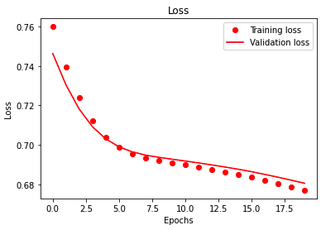
Loss against Epochs of Training

Slide 7
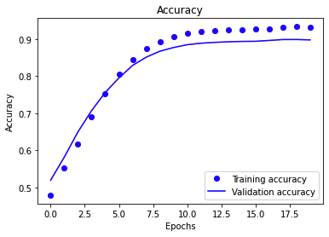
Accuracy against Epochs of Training

Slide 8
Future Work
Investigate performance of other features.
Investigate whether there is any semantic value in language features in which case an alternative model approach (eg LSTM) may extract greater performance.
Investigate other embeddings or extending an available model to better perform with rare vocabulary within orders.
Investigate add adding additional layers to the model.
Investigate using alternative loss or optimizer functions.

