Slide 1
Topic Modeling for Comprehending Work Scope at HHS OIG
Scott Hirabayashi, Summer 2022

Slide 2
01
Table of Contents
02
03
04
05
Introduction
Data Source/Scraping
Method and Source
Exploratory Data Analysis
Exploring the text trends
Modeling
LDA and BerTopic
Conclusions
Findings and Next Steps

Slide 3
01
Introduction
Introducing the Problem

Slide 4


OIG's mission is to provide objective oversight to promote the economy, efficiency, effectiveness, and integrity of HHS programs, as well as the health and welfare of the people they serve.
• Safeguarding the Medicare Trust Funds
• Strengthening Medicaid protections against fraud, waste, and abuse
• Protecting beneficiaries from prescription drug abuse, including opioids
• Ensuring health and safety for children served by HHS programs
• Combatting cybersecurity threats within HHS and healthcare
• Promoting patient safety and accuracy of payments in home and community settings
• Leveraging technology as it intersects with HHS programs
• Ensuring HHS managed care and new healthcare models produce value
• Identifying opportunities to lower prescription drug spending for patients and programs
See: 2020-2025 OIG-Specific Priorities

Slide 5
What is topic modeling?
Topic modeling is an unsupervised machine learning technique for scanning documents and determining patterns for clustering by finding word and phrase patterns
Because we do not assume any initial labels per each topic, we will utilize unsupervised learning techniques, defined as algorithms to discover hidden patterns or data groupings without the need for human intervention.
Essentially, topic modeling is a natural language processing technique that ingests text data and returns a logical classification of topics that are frequent across each of the texts- we are using text cleaning and clustering techniques to tell us what topics appear most-frequently within a body of texts.

Slide 6
Project Questions
Question 1
Question 2
Question 3
Are plans (work plans) and findings (reports) similar in terms of topics identified and scope?
How closely do the topics of work identified in the models connect to the priorities outlined by HHS OIG?
Are there any topics that appear to be underrepresented from the reports and data?

Slide 7
Table of Contents
01
02
03
04
Step 2: Topic Modeling Comparison
Data Source/Scraping
STEP 1: Identify and Pull Data
Data Cleaning:
Tokenize
Remove Stopwords and Redundant Phases
Lemmatize
Highlight Data Sources
OIG: Work Plan Summaries
-Basic Component Data
-Summary/Overview Data of a project
EDA
Initial Discoveries with EDA
BertTopic
LDA Topic Modeling
Website Scrapers
Modeling
Check for best # of topics
Umass coherence score graphing
Modeling and Results
OIG: Reports
-Reports data
- Outlines Summary of Findings and Work
Conclusions
Test and Create Model
Analysis of Discoveries
OIG Work Plan and Reports
Topic Modeling Text Analysis
Step 3: Models Created

Slide 8
02
Data Source/ Scraping
Method and Source

Slide 9
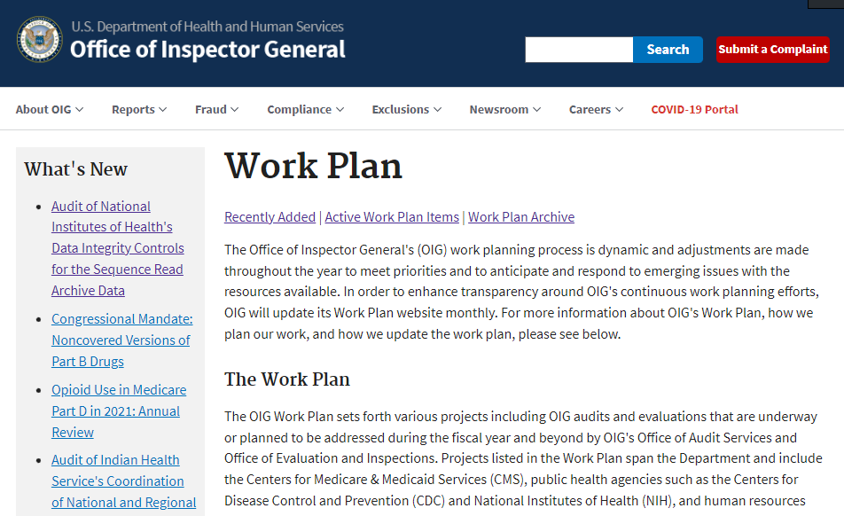
Data Source
To better understand the projects being undertaken, we’re going to leverage the OIG Work Plan, a reporting of publicly-declared
Audits (projects from the Office of Audit Services- OAS) and
Evaluations/Inspections (projects from Office of Evaluations and Inspections- OEI
that OIG commits to, as well as each item’s connected report, OIG’s summarization of larger reports based on findings.
https://oig.hhs.gov/reports-and-publications/workplan/active-item-table.asp

Slide 10
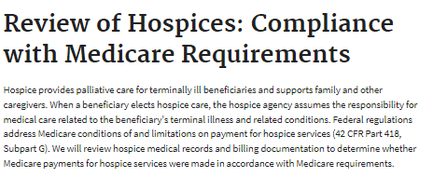
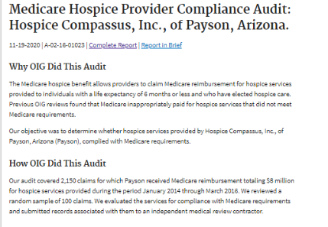
OIG Work Plans: Contain work scope and focus of work to be undertaken.
They connect to specific Reports, as:
OIG Reports: Contain Summaries, findings, methodology, and recommendations. They provide a more-specific picture of the work that was accomplished.
Note:These are summaries of a larger report and communication log that OIG also publishes.

Slide 11
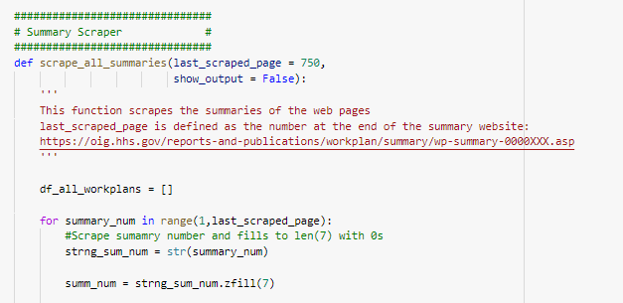
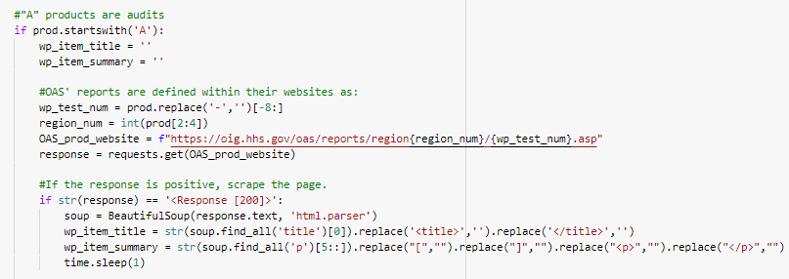
OIG Work Plan Scrape
Items were scraped using Beautifulsoup & requests.
Work Plan Scraping was straightforward- scraped the summaries, and any links to connected reports.
Reports were more challenging, as OAS and OEI’s websites took longer to find.

Slide 12
2018-2022
659 Work Plans
584 Reports
Work Scope:
Years Analyzed

Slide 13
03
EDA
Exploring the text trends
Main points

Slide 14
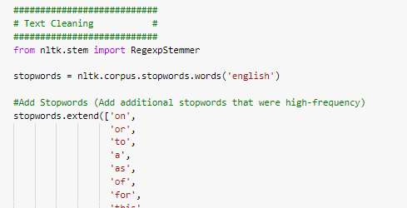
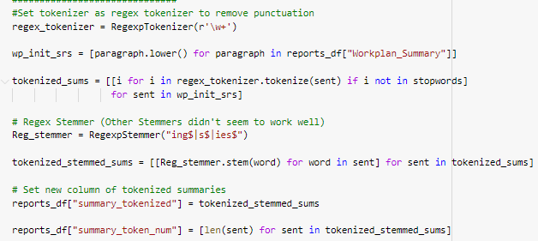
Text Cleaning
1. Stopwords were removed- the list was added to with frequent words, some relics of the scrape (href, a, etc.) as well as unnecessary terms (OIG, OAS, OEI)
2. Used a simple stemmer/tokenizer here- one of the issues was that a lot of words that are domain-specific would be better to be left alone.

Slide 15
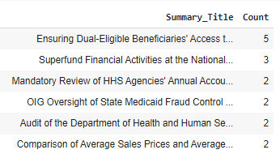
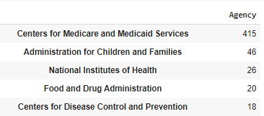
EDA
There are duplicate work plans/reports. These are left in the dataset, as it is possible for recurring work plans and reports (both audits and evaluations) to be published year to year.
Additionally, language can change year-to-year in work scope.
OIG’s work focuses primarily on CMS, due to focusing on Medicare/Medicaid oversight.

Slide 16
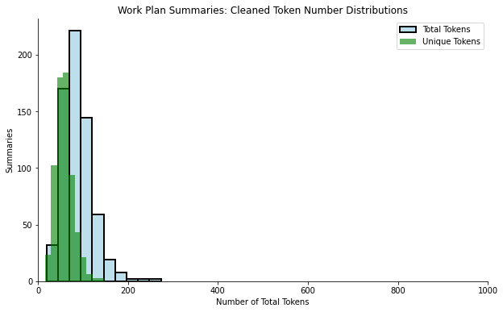
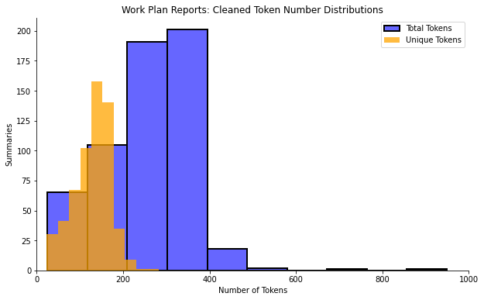
Length of Reports
As a whole, most work plan reports are significantly longer than work plan summaries.
Work plan Average total tokens: 88 words (~⅓ page)
Report Average total tokens: 257 words (>1 page)
However, this difference is slightly less prominent in the number of unique tokens.
Work plan avg unique tokens: 59 tokens
Report avg unique tokens: 129 tokens
Notes:
https://wordcounter.net/blog/2015/11/22/10915_how-many-words-on-a-page.html

Slide 17
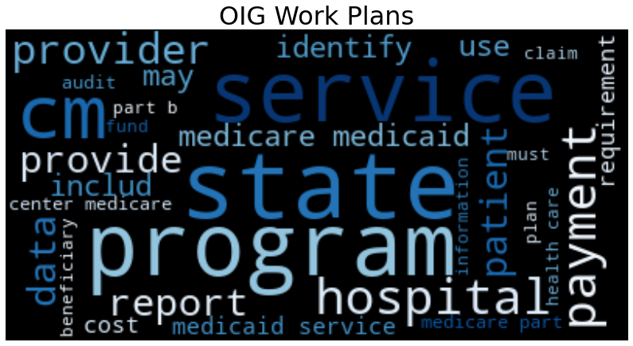
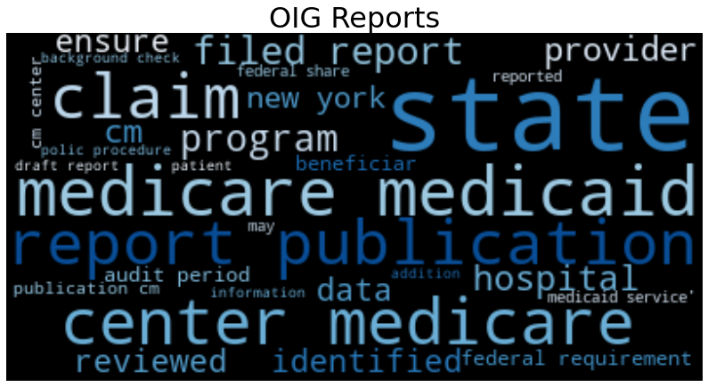
Included Words
At a high level, generated word clouds between OIG’s planned work plans and its reports yielded similar results although the emphasis on certain words appeared to be different.

Slide 18
04
Modeling
Topic Models: LDA/ BerTopic for Reports

Slide 19
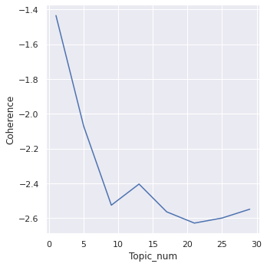
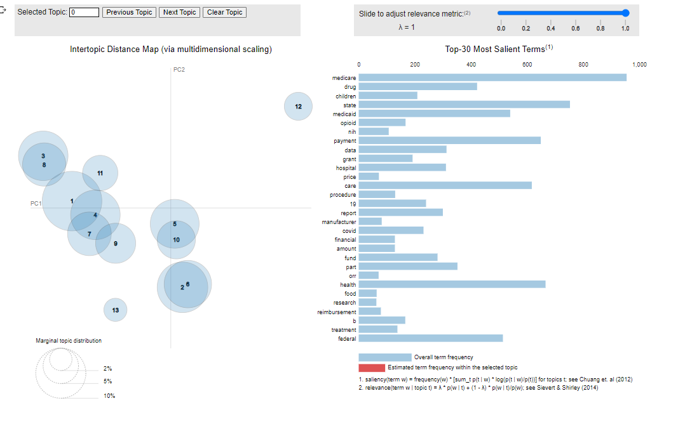
LDA Topic Modeling
Latent Dirichlet Allocation, created by David Blei, Andrew Ng, and Michael Jordan, is an unsupervised technique and generative model- in text mining, it introduces a way to attach topical content to text documents. Each document is viewed as a mix of multiple distinct topics.
Packages: NLTK, Pyldavis, Gensim
Clean Summary/Report Data
Remove Stopwords
Stem plurals
Tokenize
Convert to dictionary/corpus data
Run the topic model
Run the model against various # of topics to see which topics is best
Visualize with PyLDAvis
Notes:
Ref: https://www.sciencedirect.com/topics/computer-science/latent-dirichlet-allocation#:~:text=4.4.&text=The%20LDA%20is%20a%20technique,(2003).

Slide 20
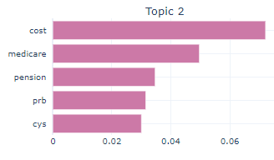
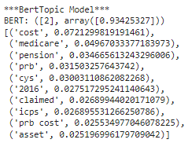
BerTopic
BERTopic is an unsupervised topic modeling technique that leverages BERT embeddings and a class-based TF-IDF to create dense clusters allowing for easily interpretable topics whilst keeping important words in the topic descriptions. (Grootendorst)
Packages: Bertopic, NLTK
Clean Summary/Report Data (CountVectorizer)
Run the topic model and visualize with BerTopic Package
Visualization of Topic 2
Summary
Assigned Topic
The Centers for Medicare &amp; Medicaid Services (CMS) reimburses Medicare contractors for a portion of their nonqualified plan costs., The Department of Health and Human Services, Office of Inspector General (OIG), Office of Audit Services, Region VII…
Notes:
Ref: https://towardsdatascience.com/interactive-topic-modeling-with-bertopic-1ea55e7d73d8#:~:text=BERTopic%20is%20a%20topic%20modeling,words%20in%20the%20topic%20descriptions.

Slide 21
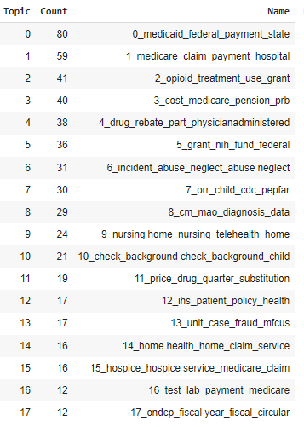
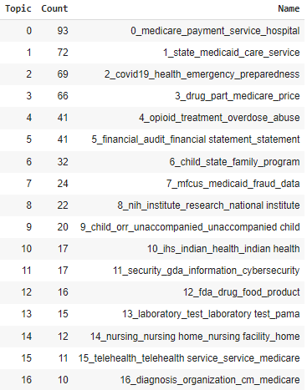
Work Plan Data
Reports Data

Slide 22
05
Conclusions
Findings and Next Steps

Slide 23
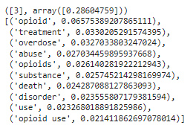
Value of the Topic Model
These two topic models can be used for categorizing future work plans and reports.
On the right, a work plan created very recently was checked against the model, correctly categorizing it primarily as focusing on Opioids.
Ill-fitting work plans may indicate a change in scope of work for OIG, suggesting a review and update of the model and connecting it back to OIG’s intended focus areas.
It may also signal the need for funds to be allocated or redirected to different focus areas.
"The opioid crisis remains a public health emergency. In 2021, there were nearly 103,000 opioid-related overdose deaths in the United States. Identifying patients who are at-risk of overdose or abuse is key to addressing this crisis. The COVID-19 pandemic has made this need even more pressing. The pandemic has put people with opioid use disorder at particular risk, as they are more susceptible to COVID-19 infection and are more likely to be hospitalized or die from the illness. This data brief would provide information on opioid utilization among beneficiaries enrolled in Medicare Part D in 2021. It would build off our series of annual reports. It will provide 2021 data on the number of beneficiaries who received extreme amounts of opioids through Part D and those who appeared to be doctor shopping. It will also identify prescribers who ordered opioids for large numbers of these beneficiaries. In addition, it will provide data on the number of beneficiaries receiving drugs to treat opioid use disorder and overdose-reversal drugs."
Example
Prediction

Slide 24
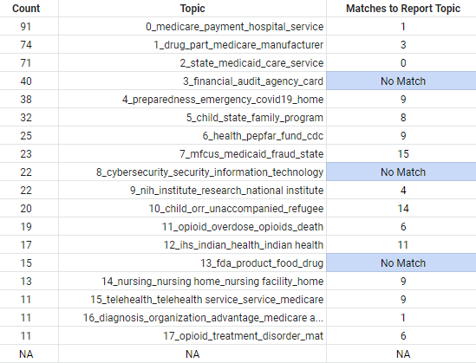
1. Are plans (work plans) and findings (reports) similar in terms of topics identified and scope?
Manual comparison was done between topics. Medicare, medicaid, opioids, and drug rebates were all major focuses in work plans and their reports.
However, there were some differences:
The financial audit topic may have been too general, but did not have any obvious match to a reports topic.
Work plans included a distinct topic on information and cybersecurity that was not captured in the scope of the reports.

Slide 25
2. How closely do the topics of work identified in the models connect to the priorities outlined by HHS OIG?
Priority | Description | Work Plan Topic | Report Topic
1 | • Safeguarding the Medicare Trust Funds | 0,16 | 1,2,12,18
2 | • Strengthening Medicaid protections against fraud, waste, and abuse | 1,2,7 | 0,15
3 | • Protecting beneficiaries from prescription drug abuse, including opioids | 11,17 | 6,16,17
4 | • Ensuring health and safety for children served by HHS programs | 5,10 | 4,8
5 | • Combatting cybersecurity threats within HHS and healthcare | 8
6 | • Promoting patient safety and accuracy of payments in home and community settings | 14 | 5,9,13
7 | • Leveraging technology as it intersects with HHS programs
8 | • Ensuring HHS managed care and new healthcare models produce value | 15
9 | • Identifying opportunities to lower prescription drug spending for patients and programs | 1 | 3,10
COVID | Other | 4,6
IHS | Other | 12 | 11
Nursing Homes | Other | 4,14 | 9
The topic connected well overall. The first four priorities were represented highly for both work plans and reports.
Additionally, the BERTopic model identified Covid, IHS, and Nursing Homes as other categories of priorities for HHS OIG.
However, priorities five (cybersecurity), and 7 (leveraging technology) were not identified frequently within the topic modeling, suggesting more future focus to align with the strategic priorities.

Slide 26
3. Are there any topics that appear to be underrepresented from the reports and data?
Cybersecurity and technology work did not seem to factor strongly into either the current work plans or reports that BerTopic identified. This indicates that OIG should consider greater investment into those fields.
Interestingly, one topic that was missed was IHS (Indian Health Service) work. While not a specific priority, it was obvious from the scope of the topics that IHS oversight was an important area of work for OIG.
Another missing topic was the significance of focus on nursing homes. HHS OIG outlines their prioritization of nursing homes on their website, but may be a consideration for outlining a future priority with specific regards to that work.
COVID-19 oversight was not outlined as a specific priority in the strategic plan, although it was an obvious scope of work, heavily into the work that OIG is committing to. Further research revealed that COVID was designated as another priority area with specific asks (https://oig.hhs.gov/coronavirus/). However, it did not appear as significantly in OIG’s reports- indicating a likelihood in ongoing work.

Slide 27
Questions/
References

Slide 28
References
Works Cited
Kapadia, Shashank. “Topic Modeling in Python: Latent Dirichlet Allocation (LDA).” Medium, 29 Dec. 2020, https://towardsdatascience.com/end-to-end-topic-modeling-in-python-latent-dirichlet-allocation-lda-35ce4ed6b3e0.
Kelechava, Marc. “Using LDA Topic Models as a Classification Model Input.” Medium, 6 Aug. 2020, https://towardsdatascience.com/unsupervised-nlp-topic-models-as-a-supervised-learning-input-cf8ee9e5cf28.
Khalid, Irfan Alghani. “Implement Your Topic Modeling Using The BERTopic Library.” Medium, 25 Jan. 2022, https://towardsdatascience.com/implement-your-topic-modeling-using-the-bertopic-library-d6708baa78fe.
“PyLDAvis: Topic Modelling Exploration Tool That Every NLP Data Scientist Should Know.” Neptune.Ai, 16 Nov. 2020, https://neptune.ai/blog/pyldavis-topic-modelling-exploration-tool-that-every-nlp-data-scientist-should-know.
Yadav, Kajal. “The Complete Practical Guide to Topic Modelling.” Medium, 22 Jan. 2022, https://towardsdatascience.com/topic-modelling-f51e5ebfb40a.
BERTopic Topic Modeling
BERTopic is a topic modeling technique that leverages 🤗 transformers and c-TF-IDF to create dense clusters allowing for easily interpretable topics whilst keeping important words in the topic descriptions. BERTopic supports guided, (semi-) supervised, and dynamic topic modeling. (MaartgenGr)
Repo
https://github.com/MaartenGr/BERTopic
Papers
https://arxiv.org/pdf/2203.05794.pdf
https://arxiv.org/pdf/2107.02173.pdf
https://hackernoon.com/nlp-tutorial-topic-modeling-in-python-with-bertopic-372w35l9
On removing stopwords:
https://stackoverflow.com/questions/68127754/removal-of-stop-words-and-stemming-lemmatization-for-bertopic#:~:text=In%20conclusion%2C%20the%20BERTTopic%20does,both%20processing%20time%20and%20results.

Slide 29
Thanks!
Do you have any questions?
Please keep this slide for attribution

