Slide 1
Music Recommendation
System

Slide 2

Purpose
Using user-artist matrix to analyze the similarity of each artist and divide them into 20 clusters. Similarity, do this process on users data.
Make the recommendation according to the similarity of style of artists.

Slide 3
Dataset
Last.fm dataset
Total Lines: 17,559,530
Unique Users: 359,347
Artists with MBID: 186,642
Artists without MBID: 107,373
List of features:
user ID, artist ID, artist Name, play times

Slide 4
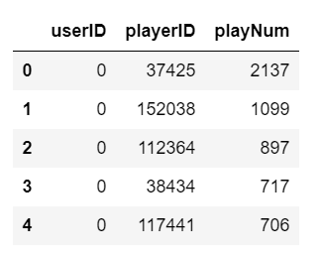
Data Gathering and Preparation
Rename the columns
Cleaned dataset: remove the missing values
Turned the complicated ID format to the simple ones

Slide 5
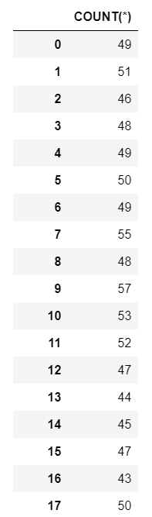
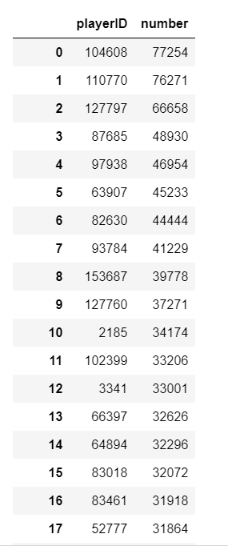
Using SQL to do the data exploration
Count the total play times of a user
Count the total play times group by artist with a descent order

Slide 6
Feature Engineering
Turned dataset using sparse matrix (358858,160111)
 | Artist1 | Artist2 | Artist3 | Artist4 | Artist5 | … | Artist160110
User1 | play times | play times | play times | play times | play times | … | play times
User2 | play times | … | … | … | … | … | …
User3 | play times | … | … | … | … | … | …
User4 | play times | … | … | … | … | … | …
User5 | play times | … | … | … | … | … | …
… | … | … | … | … | … | … | …
User358857 | play times | … | … | … | … | … | …

Slide 7
Dimension reduction LDA
This is a unsupervised Problem. We used Latent Dirichlet allocation(LDA) to do the dimensions reduction which is clustering. We divided 160k artists into 20 class, according to the taste of users which is the latent variable.

Slide 8
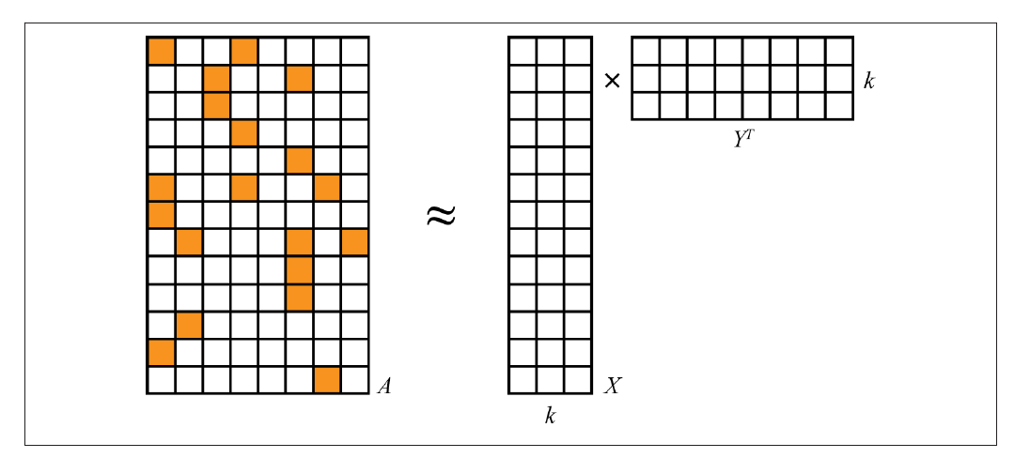

Matrix factorization
A = X$Y^{T}$
(358858,160111) = (358858,20)*${(20,160111)}^{T}$

Slide 9
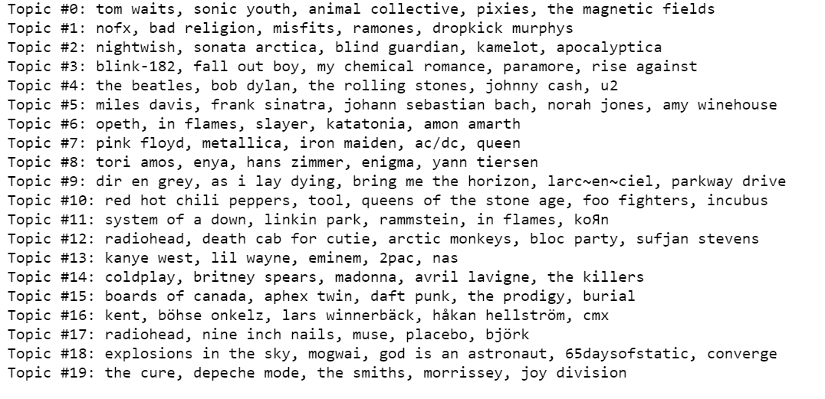

Slide 10
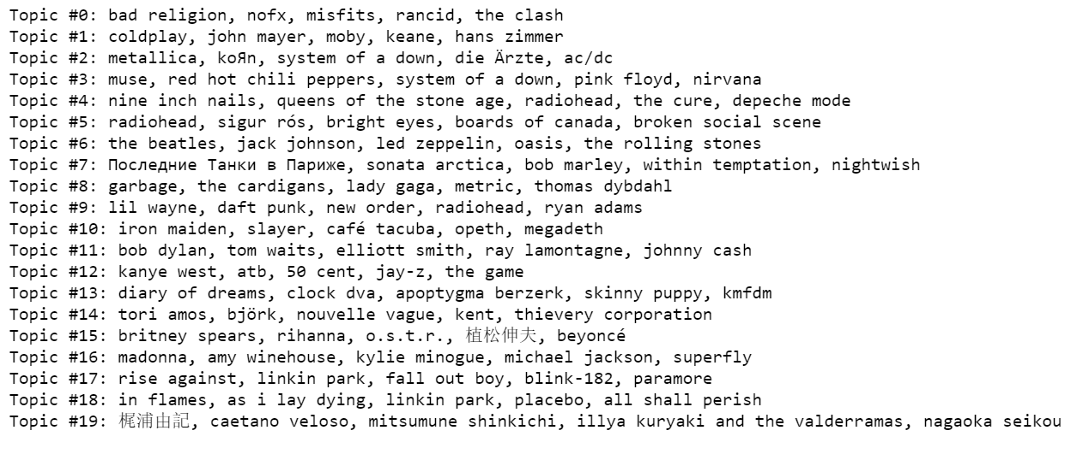
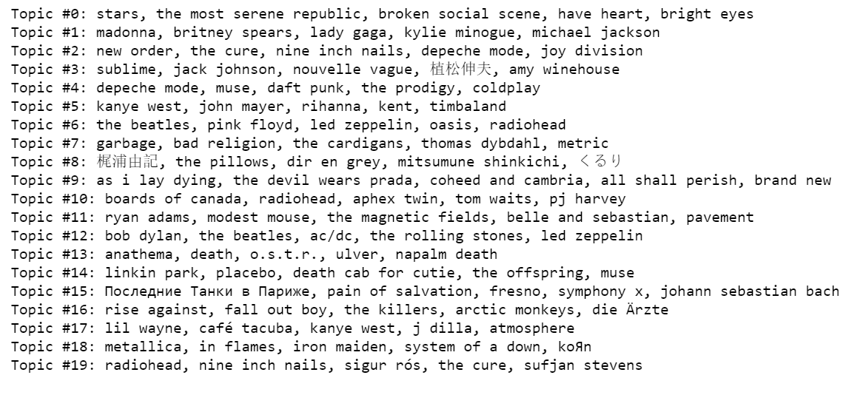
Stability
Because out dataset has 17000K rows, so we take 100K row of the, and run LDA 3 times, and check the topics of them, we can see that LDA is not stable.

Slide 11
Collaborative Filtering
Topic 1
Artist1
User A
like
Artist1
Artist2
Artist3
Recommend for A
Artist4
The highest score in this topic
.
.
.

Slide 12
Problem Statement and Usefuleness
Problem: given the artists a user like, how can we recommend him the other artists he would also like.
We used LDA to divided artists into 20 classes means 20 styles.
We will recommend him the artist(s) who is(are) the most representative in the same style.

Slide 13
Extra interesting ideas
Input user features on artist into a neural network and get a output with n dimensions which is latent features represent the style of the user. Do the same thing to artist and get a output represent the style of artist. The inner product of these latent features is the play times. This is the process similar to LDA, but is non-linear. We hope this kind of non-linear model could explore more deep relationship between users and artists

Slide 14
