Slide 1

Dexterity Check
Introduction to data science spring 2018

Slide 2
Flowchart
Upload Image
Standardize data, resize images, reshape data, apply PCA
METHOD 1
METHOD 2
METHOD 3
Assign score
Assign score
Assign score

Slide 3
PREPROCESSING

Slide 4
METHOD 1

Slide 5
METHOD 2

Slide 6
METHOD 3

Slide 7
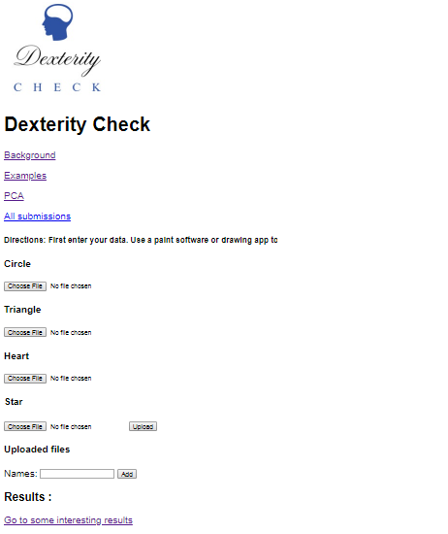
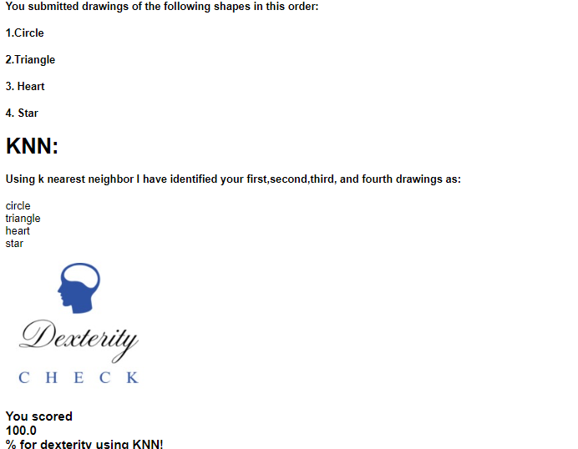
Dexterity check TOOL

