Slide 1
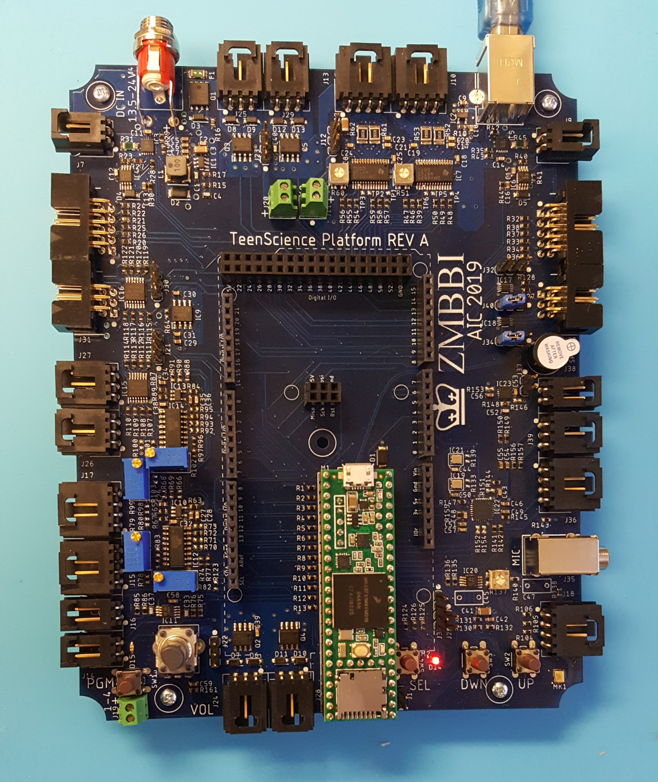
GPO
5-6
J25
PWR
J4
GPO
7-8
J29
STPR
LEFT
J13
STPR
RIGHT
J10
USB
J5
DC M
LEFT
J7
DC M
RIGHT
J9
GPO 5-8
J23
STPR
J12
ENC
LEFT
J6
GPO
5-8
J20
STPR
J11
ENC
RIGHT
J8
SPI LEV
J30
GP LEV
J32
GPIO
J33
S4-SPI
J31
GP I/O
J40
I2C 0/1
J21
GP I/O
J34
I2C
1
J27
INT.SPK
J37
SPK
J38
I2C
0
J26
LIN
OUT
J39
INS
2
J17
LIN
IN
J36
INS
1
J15
MIC
J35
DAC
2
J16
DEB. J3
GPO 1-4
J22
3.3V J2
TOUCH
J18
DAC
1
J14
POT/VOL
GPO
1-4
J19
GPO
1-2
J24
GPO
3-4
J28
BATT J1

