Slide 1
Starting from ImageNet Model: Fine-Tuning and Adversarial Attack
Liangliang Cao
https://columbia6894.github.io/

Slide 2
Administrative
By this week you should:
form final project team (3 ppl per team)
decide the topic of your final projects
Then you can
finish 1st problem in your homework 3
receive google cloud credits (by contacting TA)
2
Notes:
2

Slide 3
Administrative (Continued)
Have problems with your final project? Try the following
Choose a recent paper that you are interested in
Implement it or test it by yourself
Then you can
If it fails in some scenario, try to improve it
If it works great, apply it to a new application
For more details, refer to
http://llcao.net/cu-deeplearning17/lecture/lecture5_llc.pdf
3
Notes:
3

Slide 4
Outline
Last vision lecture discussed learning from ImageNet/Celeb 1M
You can impress others with a model pretrained from ImageNet:
Fine-tuning
Adversarial attack
4
Notes:
4

Slide 5
Fine Tuning Models from ImageNet
Models trained from ImageNet have learned effective feature presentation.
We can treat deep CNNs as feature extractors, and fine tune a new model over it.
Several ways to do the fine tuning:
Train Linear SVM over deep features (least training examples)
Fine tuning only the cross-entropy (more training examples)
Fine tuning both classifier and deep CNNs ( about thousands of examples)

Slide 6
1. Fine-tuning using linear SVM
Recommend Liblinear for linear SVM: https://www.csie.ntu.edu.tw/~cjlin/liblinear/
Steps:
Take the last layer of ImageNet model as feature extractor
Extract the feature for all the training examples
Optimize liblinear model and fine the global minimization

Slide 7
2. Fine-tuning the top layers
Steps:
Freeze the convolutional layers of pre-trained model
model = applications.VGG16(weights='imagenet', include_top=False)
for layer in model.layers[:25]:
layer.trainable = False
Add a top model for the new classification task
3. Train the top model using SGD optimization
One easy-to-follow reference: https://towardsdatascience.com/a-comprehensive-guide-on-how-to-fine-tune-deep-neural-networks-using-keras-on-google-colab-free-daaaa0aced8f

Slide 8
Differences
 | SVM | New Top layer
Extra toolkit | Liblinear | Keras/Tensorflow
Optimization | Global minimum | SGD may fall to local minimum
Number of training | A few images to dozens | Dozens to hundreds
Tricks of improve fine-tuning:
For SGD, use slow training rate first, do not use RMSProp
Data augmentation may be very helpful
In deep learning, people usually do not add regularization. But for fine-tuning, regularization may help.

Slide 9
3. One Step Further
When there are more training samples, we shall consider fine-tune the convolutional filters as well:
Use smaller learning rates for CNN filters but bigger rates for the top layer.
Monitor the training loss whether training accuracy = 100%
Reference: http://caffe.berkeleyvision.org/gathered/examples/finetune_flickr_style.html
Future research questions you may consider for final projects:
Actively choose samples to label? (with a budget)
Efficiently learn new categories, e.g., for face recognition

Slide 10
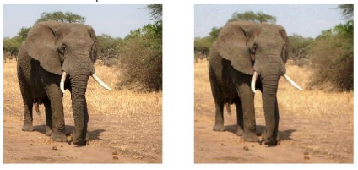
Adversarial Attack
How many of you think deep CNNs are very reliable?
Guess what an ImageNet model will predict:

Slide 11
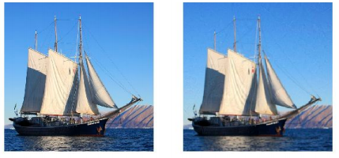
Adversarial Attack
How many of you think deep CNNs are very reliable?
Guess what an ImageNet model will predict:

Slide 12
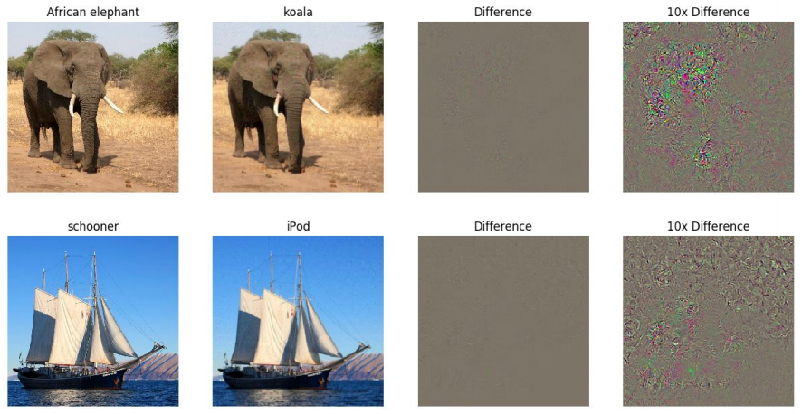
Adversarial Attack
Examples are courtesy to Stanford cs231n lecture slides.

Slide 13




How to Compute the Adversarial Example
Maximize
Subject to
So the adversarial example can be generated by
The Fast Gradient Sign Method

Slide 14
How to Implement?
There are a number of toolboxes such as cleverhans, Foolbox, etc
from cleverhans.attacks import FastGradientMethod
fgsm = FastGradientMethod(model, sess=sess)
fgsm_params = {'eps': 0.3, 'clip_min': 0., 'clip_max': 1.} adv_x = fgsm.generate_np(orgin_x, **fgsm_params) But fundamentally it is just to compute the gradient subject to input x. You should read the code of cleverhans or Foolbox by yourself.

Slide 15
From White-box Attack to Black-box Attack
Fast Gradient Sign Method (fgsm) requires to know the model parameters to compute the adversarial attack. It is called a white-box attack coz we know the details of the model.
In practice attacker does not know the model. They can
evaluate the model multiple times to approximate the gradient
attack some venerable tasks such as object detection or QA
For final projects you may refer to:
NIPS 2017 adversarial attack competition
Percy Liang and Dawn Song’s work on adversarial attack systems
The Elephant in the Room attack for object detection

