Slide 1
Convolutional Neural Networks
Liangliang Cao
https://columbia6894.github.io/

Slide 2
Outline
Discussing conv. filters from traditional viewpoints
The first popular deep CNN: LeNet in 1998
The second popular deep CNN: AlexNet in 2012
Why 14 years? Challenges of implementing AlexNet?
Improving CNNs
1x1 convolution - Residual network
2
Notes:
2

Slide 3
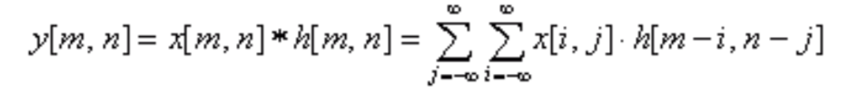
Convolutional Filters
Image filtering are usually represented by the convolution between an image and a mask.

Slide 4

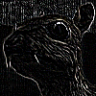
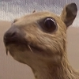



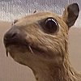
Image Filters
Image filtering are usually represented by the convolution between an image and a mask.
Edge detection
Blurring
Sharpen
4
Notes:
4

Slide 5
Discussions
Filters are powerful for many vision applications
We can use filters for recognition, enhancement…
That is why nowadays CNNs almost dominate all vision applications
Notes:
That is why NVidia has kept its competence with CNN libraries

Slide 6
Discussions
Filters are powerful for many vision applications
Convolutions are expensive
At every pixel we need do multi-multiplication with its neighborhood values
Algorithms of speedup*: integral image, separable filters, time domain convolution -> frequency multiplication, etc
Hardware of speedup: GPU, TPU
*This suggests a number of research ideas of improving deep cnn
Notes:
convolutions used for MOST (or all)

Slide 7
Discussions
Filters are powerful for many vision applications
Convolutions are expensive
How many filters can we learn?
Dozens? Hundreds? Millions? More?

Slide 8
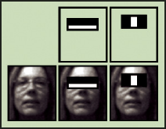
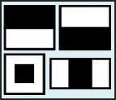
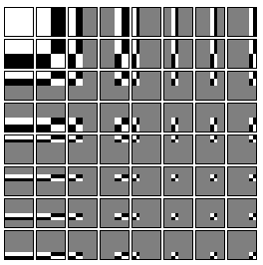

Huge Amount of Filters: An Example
[Viola and Jones]: face detection via millions* of simple filters
Haar Wavelet
Haar like features
Efficient computation
Given two adjacent rectangular regions, sums up the pixel intensities in each region and calculates the difference between the two sums
*This suggests to find ways to train numerous filters…
Notes:
each location saves the sum of gray scale pixel value of the sub-image to the left top corner.
How cascade works:
https://www.youtube.com/watch?v=nVbaNcRldmw

Slide 9
Discussions
Filters are powerful for many vision applications
Convolutions are expensive
How many filters can we learn?
How to manage larger neighborhood?
Sub-sample the image
Larger receptive fields (i.e., filter size)
Stack multi convolutional layers together -> deep CNNs

Slide 10
Let’s Go to Multi-Layer CNNs (deep CNNs)!

Slide 11
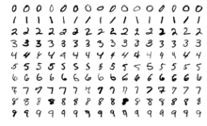
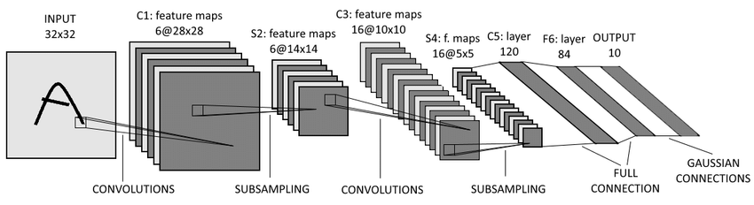
The First Popular Deep CNN
LeCun, Bottou, Bengio, Haffner, Gradient-based learning applied to document recognition, Proc. IEEE, 1998
11
Notes:
11

Slide 12

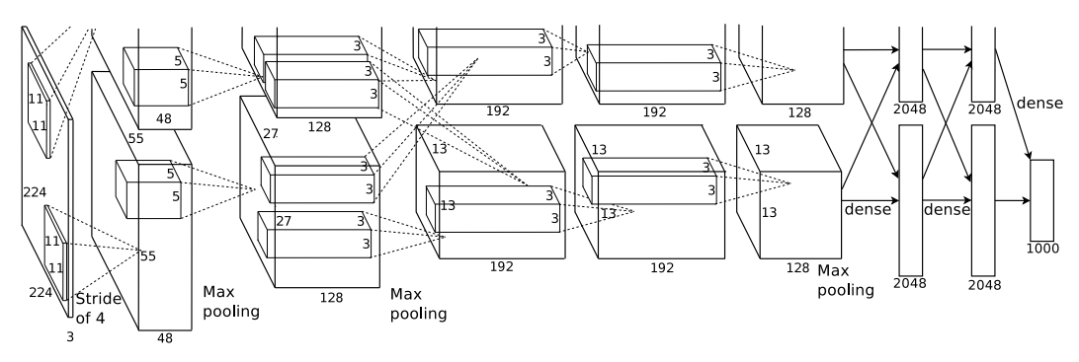
The Second Popular Deep CNN
Krizhevsky, Sutskever, Hinton, ImageNet Classification with Deep Convolutional Neural Networks, NIPS 2012
12
Notes:
12

Slide 13
Why Took 14 years? (1998-2012)
People do not trust local minimum and may be annoyed by SGD failures.
Which of the following will fail CNNs on MNIST?
Use the raw pixel values between [0, 255]
Initialize all the CNN weights as 0
Use no intercept (i.e., Wx instead of Wx+b) in the fully connect layer
The batch size is too small (i.e., one sample per batch)
Use the whole dataset as one batch
Do not shuffle the data before training

Slide 14
Why Took 14 years? (1998-2012)
People do not trust local minimum and may be annoyed by SGD failures.
Which of the following will fail CNNs on MNIST?
Use the raw pixel values between [0, 255]
Yes. Almost all CNNs prefer to normalize pixel value normalized between [0,1]

Slide 15
Why Took 14 years? (1998-2012)
People do not trust local minimum and may be annoyed by SGD failures.
Which of the following will fail CNNs on MNIST?
Initialize all the CNN weights as 0
Yes. network weights should be initialized randomly
Notes:
Use no intercept (i.e., Wx instead of Wx+b) in the fully connect layer

Slide 16
Why Took 14 years? (1998-2012)
People do not trust local minimum and may be annoyed by SGD failures.
Which of the following will fail CNNs on MNIST?
Use no intercept (i.e., Wx instead of Wx+b) in the fully connect layer
No. Network with zero intercepts will still work.

Slide 17
Why Took 14 years? (1998-2012)
People do not trust local minimum and may be annoyed by SGD failures.
Which of the following will fail CNNs on MNIST?
The batch size is too small (i.e., one sample per batch)
No. Small batch size will still work, but make the optimization smaller

Slide 18
Why Took 14 years? (1998-2012)
People do not trust local minimum and may be annoyed by SGD failures.
Which of the following will fail CNNs on MNIST?
Use the whole dataset as one batch
Yes. We will lose the “stochastic” factor by taking whole dataset as one batch, and the optimization will fall into bad local minimum.

Slide 19
Why Took 14 years? (1998-2012)
People do not trust local minimum and may be annoyed by SGD failures.
Which of the following will fail CNNs on MNIST?
Do not shuffle the data before traiing
Yes. Random shuffling is important.

Slide 20
Why Took 14 years? (1998-2012)
People do not trust local minimum and may be annoyed by SGD failures.
Which of the following will fail CNNs on MNIST?
Use the raw pixel values between [0, 255]
Initialize all the CNN weights as 0
Use no intercept (i.e., Wx instead of Wx+b) in the fully connect layer
The batch size is too small (i.e., one sample per batch)
Use the whole dataset as one batch
Do not shuffle the data before training

Slide 21
Why Took 14 years? (1998-2012)
People do not trust local minimum and may be annoyed by SGD failures.
On MNIST CNN is not significant better than others
Model | Testing Error
KNN, subsample 16 x 16 | 1.1%
Boosted tree | 1.53%
Non-linear SVM by LeCun’98 | 1.0%
Non-linear SVM by DeCoste’02 | 0.56%
2-layer MLP | 2.45%
CNN LeNet-5 | 0.95%
Results from http://yann.lecun.com/exdb/mnist/

Slide 22
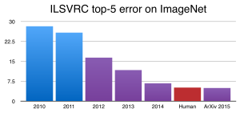
Why Took 14 years? (1998-2012)
People do not trust local minimum and may be annoyed by SGD failures.
On MNIST CNN is not significant better than others
But on ImageNet things changed!

Slide 23
Differences between MNIST and ImageNet
 | MNIST | ImageNet LSVRC
Image size | 28 x 28 x 1 | 224 x 224 x 3*
Num of images | 60K | 1,200K
Num of category | 10 | 1000
In-class variation | small | large
*Resized size. Can be as large as 512 x 512

Slide 24
Differences between MNIST and ImageNet
 | MNIST | ImageNet LSVRC
Image size | 28 x 28 x 1 | 224 x 224 x 3
Num of images | 60K | 1,200K
Num of category | 10 | 1000
In-class variation | small | large
SVMs
More data
Bigger model
CNNs

Slide 25
Let’s implement these two popular models.

Slide 26
To implement LeNet is easy …
Download MNIST data and load them into memory
Build a 5 layer CNN model
Train model and evaluate
You can even run on your laptop without GPU

Slide 27
Implement LeNet-5 using Keras
model = Sequential()
model.add(Conv2D(filters = 6, kernel_size = 5, strides = 1, activation = 'relu', input_shape = (32,32,1)))
model.add(MaxPooling2D(pool_size = 2, strides = 2))
model.add(Conv2D(filters = 16, kernel_size = 5, strides = 1, activation = 'relu', input_shape = (14,14,6)))
model.add(MaxPooling2D(pool_size = 2, strides = 2))
model.add(Flatten())
model.add(Dense(units = 120, activation = 'relu'))
model.add(Dense(units = 84, activation = 'relu'))
model.add(Dense(units = 10, activation = 'softmax'))
model.compile(optimizer = 'adam', loss = 'categorical_crossentropy', metrics = ['accuracy'])
model.fit(X_train ,Y_train, steps_per_epoch = 10, epochs = 40)

Slide 28
Explain LeNet-5
filters
kernel_size
Strides
pool_size
model.add(Flattern())
activation=relu/sigmoid/softmax

Slide 29
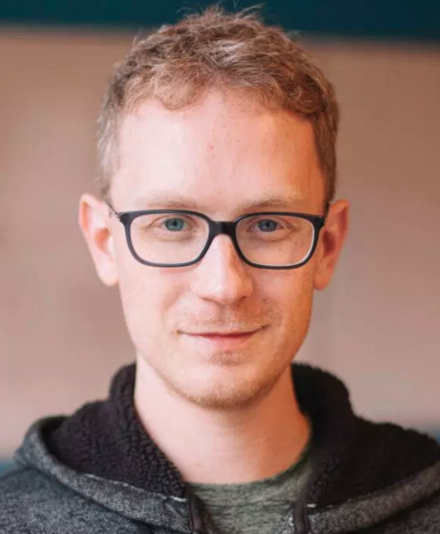
But to implement AlexNet is hard…
Alex Krizhevsky was working on CNNs in 2011. He recalled:
“Ilya convinced me that with an additional week of effort, we could get equally good results on ImageNet. It actually took five months to match the 2010 state-of-the-art, and several more months to improve on it convincingly.”
“Time scales aside, his intuition was correct.”
Notes:
in the summer of 2011 I had been training similar models on the CIFAR-10 dataset and getting some good results. Ilya convinced me that with an additional week of effort, we could get equally good results on ImageNet. It actually took five months to match the 2010 state-of-the-art, and several more months to improve on it convincingly. Geoff later explained to me that I had taken Ilya much too literally. He had clearly been speaking of a logical week, one whose relationship to real time is indeterminate. Time scales aside, his intuition was correct.

Slide 30
But to implement AlexNet is hard…
Suppose you are the chief architect, what is the solution for
load 1.2M images into memory
do convolution via GPUs
AlexNet model: two stream using 2 GPUs (not necessary though)
Notes:
in the summer of 2011 I had been training similar models on the CIFAR-10 dataset and getting some good results. Ilya convinced me that with an additional week of effort, we could get equally good results on ImageNet. It actually took five months to match the 2010 state-of-the-art, and several more months to improve on it convincingly. Geoff later explained to me that I had taken Ilya much too literally. He had clearly been speaking of a logical week, one whose relationship to real time is indeterminate. Time scales aside, his intuition was correct.

Slide 31
Challenge 1: Cannot Load All ImageNet Data into Memory
Can not load into memory: 1.2M x 224 x 224 x 3 = 180G
Keras’ solution: use data iterator
class NaiveImageNetIterator:
def __init__(self, total_batches):
self.ib, self.nb = 0, total_batches
def __iter__(self):
return self
def next(self): # Python 3: def __next__(self)
if self.ib >= self.nb: raise StopIteration
else:
self.ib += 1
return Load_Batch_from_Disk(self.ib)
Notes:
Iterators are objects that have an __iter__ and a __next__ (next in Python 2) method

Slide 32
Challenge 1: Cannot Load All ImageNet Data into Memory
Can not directly load into mem: 1.2M x 224 x 224 x 3 = 180G
Keras’ solution: use data iterator
class NaiveImageNetIterator: ….
data_iterator = NaiveImageNetIterator(120)
model.fit_generator(data_iterator, sample_per_epoch=1000)
Notes:
Iterators are objects that have an __iter__ and a __next__ (next in Python 2) method
model.fit_generator

Slide 33
Challenge 1: Cannot Load All ImageNet Data into Memory
Can not directly load into mem: 1.2M x 224 x 224 x 3 = 180G
Keras’ solution: use data iterator
Tensorflow’s low level API: use tf.data.Dataset
- tf.data.Dataset can generate an iterator of Tensor objects https://www.tensorflow.org/api_docs/python/tf/data
- Many detection toolkits use TFRecord to organize many images
tensorpack provides an efficient & easy to use 3rd party implementation
https://github.com/tensorpack/tensorpack
Notes:
Iterators are objects that have an __iter__ and a __next__ (next in Python 2) method
model.fit_generator

Slide 34
Challenge 1: Cannot Load All ImageNet Data into Memory
Can not directly load into mem: 1.2M x 224 x 224 x 3 = 180G
Keras’ solution: use data iterator
Tensorflow’s native solution: use tf.data.Dataset
3rd Party implementation: Tensorpack (https://github.com/tensorpack/tensorpack)
Use Tensorpack.dataflow
See example: ImageNetModels/imagenet_utils.py
The most efficient solution so far
I may provide a note with more details after the class.
But you may have to dig into these examples to play with these solutions
Notes:
Iterators are objects that have an __iter__ and a __next__ (next in Python 2) method
model.fit_generator

Slide 35
Challenge 2: Convolution via GPUs
Convolution in GPU is not trivial
Multi-channel (traditional CV do single channel)
Multi kernel size (optimization of 5x5 filter differs from 7x7)
See Alex’s dizzying code https://code.google.com/archive/p/cuda-convnet/
Notes:
Iterators are objects that have an __iter__ and a __next__ (next in Python 2) method
model.fit_generator

Slide 36
Challenge 2: Convolution via GPUs
Convolution in GPU is not trivial
Multi-channel (traditional CV do single channel)
Multi kernel size (optimization of 5x5 filter differs from 7x7)
Use NVida’s library:
cuBLAS in early days (converting conv to matrix multiply)
cuDNN: Nvidia’s dominant weapon in GPU market
Notes:
Iterators are objects that have an __iter__ and a __next__ (next in Python 2) method
model.fit_generator

Slide 37
Challenge 3: Two Stream CNN
Amazing hacks in 2012
No longer necessary with the new GPU cards

Slide 38
Implement AlexNet with Keras
# layer 1
alexnet.add(Conv2D(96, (11, 11), input_shape=img_shape, padding='same', kernel_regularizer=l2(l2_reg)))
alexnet.add(BatchNormalization())
alexnet.add(Activation('relu')) alexnet.add(MaxPooling2D(pool_size=(2, 2)))
# layer 2
alexnet.add(Conv2D(256, (5, 5), padding='same'))
alexnet.add(BatchNormalization())
alexnet.add(Activation('relu'))
alexnet.add(MaxPooling2D(pool_size=(2, 2)))
What is the number of para. in Layer 1
- (11 x 11 x 3) * 96 = 35K
What is the output size of layer 1?
224 /4 = 55
Output size (55 x 55 x 96)
What is the number of para in layer 2?
(5 x 5 x 96) * 256 = 710K
What is the output size of layer 2?
55/2 = 27
Output size (27 x 27 x 256)
Notes:
# Layer 1
# Layer 2 # Layer 3 # Layer 4 # Layer 5 alexnet.add(ZeroPadding2D((1, 1))) alexnet.add(Conv2D(1024, (3, 3), padding='same')) alexnet.add(BatchNormalization()) alexnet.add(Activation('relu')) alexnet.add(MaxPooling2D(pool_size=(2, 2))) # Layer 6 alexnet.add(Flatten()) alexnet.add(Dense(3072)) alexnet.add(BatchNormalization()) alexnet.add(Activation('relu')) alexnet.add(Dropout(0.5)) # Layer 7 alexnet.add(Dense(4096)) alexnet.add(BatchNormalization()) alexnet.add(Activation('relu')) alexnet.add(Dropout(0.5)) # Layer 8 alexnet.add(Dense(n_classes)) alexnet.add(BatchNormalization()) alexnet.add(Activation('softmax'))

Slide 39
Implement AlexNet with Keras
# layer 1
alexnet.add(Conv2D(96, (11, 11), input_shape=img_shape, padding='same', kernel_regularizer=l2(l2_reg)))
alexnet.add(BatchNormalization())
alexnet.add(Activation('relu')) alexnet.add(MaxPooling2D(pool_size=(2, 2)))
# layer 2
alexnet.add(Conv2D(256, (5, 5), padding='same'))
alexnet.add(BatchNormalization())
alexnet.add(Activation('relu'))
alexnet.add(MaxPooling2D(pool_size=(2, 2)))
# layer 3
alexnet.add(ZeroPadding2D((1, 1))) alexnet.add(Conv2D(512, (3, 3), padding='same'))
alexnet.add(BatchNormalization())
alexnet.add(Activation('relu'))
alexnet.add(MaxPooling2D(pool_size=(2, 2)))
# layer 4
alexnet.add(ZeroPadding2D((1, 1)))
alexnet.add(Conv2D(1024, (3, 3), padding='same'))
alexnet.add(BatchNormalization())
alexnet.add(Activation('relu'))
Notes:
# Layer 1
# Layer 2 # Layer 3 # Layer 4 # Layer 5 alexnet.add(ZeroPadding2D((1, 1))) alexnet.add(Conv2D(1024, (3, 3), padding='same')) alexnet.add(BatchNormalization()) alexnet.add(Activation('relu')) alexnet.add(MaxPooling2D(pool_size=(2, 2))) # Layer 6 alexnet.add(Flatten()) alexnet.add(Dense(3072)) alexnet.add(BatchNormalization()) alexnet.add(Activation('relu')) alexnet.add(Dropout(0.5)) # Layer 7 alexnet.add(Dense(4096)) alexnet.add(BatchNormalization()) alexnet.add(Activation('relu')) alexnet.add(Dropout(0.5)) # Layer 8 alexnet.add(Dense(n_classes)) alexnet.add(BatchNormalization()) alexnet.add(Activation('softmax'))

Slide 40
Implement AlexNet in Keras (con’t)
# layer 5
alexnet.add(ZeroPadding2D((1, 1)))
alexnet.add(Conv2D(1024, (3, 3), padding='same'))
alexnet.add(BatchNormalization())
alexnet.add(Activation('relu'))
alexnet.add(MaxPooling2D(pool_size=(2, 2)))
# layer 6
alexnet.add(Flatten())
alexnet.add(Dense(3072))
alexnet.add(BatchNormalization())
alexnet.add(Activation('relu'))
alexnet.add(Dropout(0.5))
# layer 7
alexnet.add(Dense(4096))
alexnet.add(BatchNormalization())
alexnet.add(Activation('relu'))
alexnet.add(Dropout(0.5)) #
# layer 8
alexnet.add(Dense(n_classes))
alexnet.add(BatchNormalization())
alexnet.add(Activation('softmax'))
Notes:
# Layer 1
# Layer 2 # Layer 3 # Layer 4 # Layer 5 # Layer 6 # Layer 7

Slide 41
From Keras to TF Estimator
Keras is easy to use but not efficient
Large memory consumption
Difficulty to scale to multiple GPUs
Use tensorflow’s estimator for large datasets:
TF Estimator can use Keras’ layers
TF Estimator can replace Keras Sequential() model in large scale

Slide 42
Improving AlexNet
Try smaller receptive fields, more filters, with more layers
Matt Zeiler Network
VggNet
Concatenate multiple size of filters
- GoogLeNet
Two techniques are important:
1x1 conv (aka “network in network”)
Residual Network
Notes:
Iterators are objects that have an __iter__ and a __next__ (next in Python 2) method
model.fit_generator

Slide 43
1x1 convolution
Consider two layers of CNN
Input: 56x 56 x 3
Layer A: (11x11)*96 filters, output (56 x 56 x 96),
Layer B: (5 x 5) *256 filters output (56 x 56 x 256)
Layer B has (5 x 5 x 96)* 256 parameters, also consumes a lot of GPU memory. How to reduce the parameter?
Add a new layer between A and B
Layer A’: (1x1)*32 filters, output (56 x 56 x 32)
Now layer B has (5 x 5 x 32)*256 filters. 3x less parameters!
Notes:
Iterators are objects that have an __iter__ and a __next__ (next in Python 2) method
model.fit_generator

Slide 44
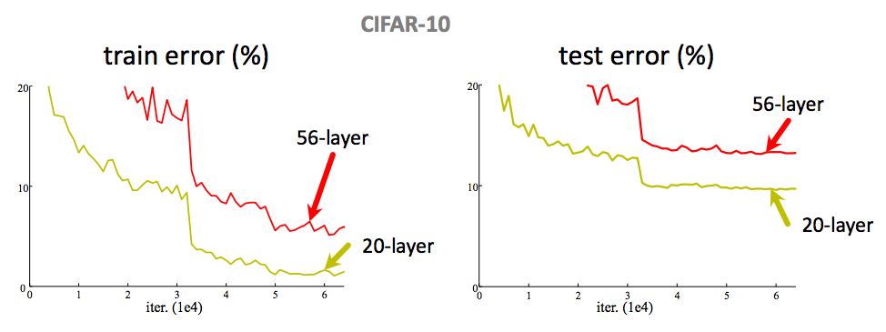
Why Residual Network?
Problem: Is learning better networks as simple as stacking more layers?
Deep network + residual learning can solve this problem.

Slide 45
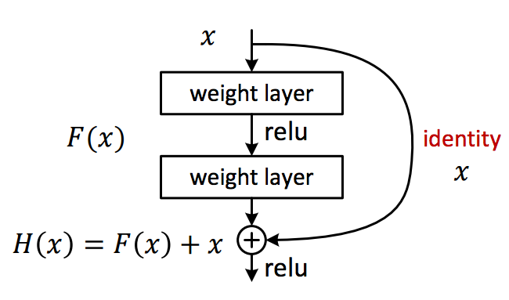
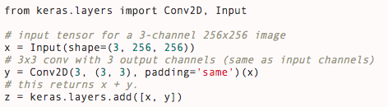
Residual Net

Slide 46
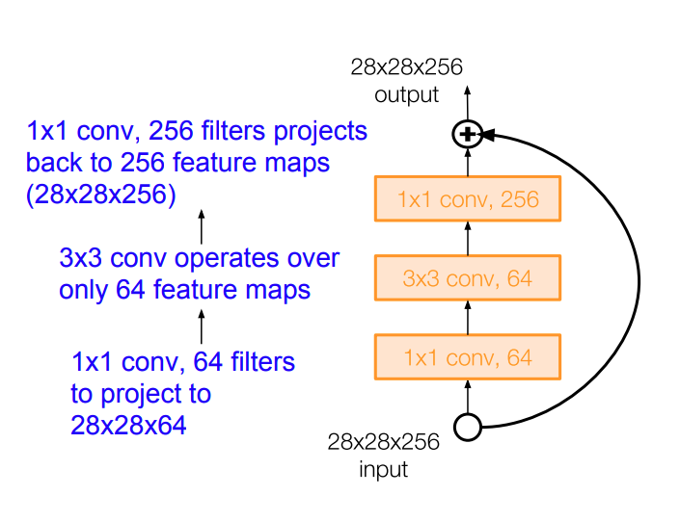
Residual Net With Bottleneck Structure
A number of future improvement

Slide 47
Treasure from ImageNet Dataset
By adapting models trained from ImageNet, we can build a decent classifier with limited data.
Very few new label
Tune the last layer
Or last layer as feature for SVM
Enough new labels
Tune the whole network
Example code :
http://caffe.berkeleyvision.org/gathered/examples/finetune_flickr_style.html
New tasks

Slide 48
But ImageNet May NOT Be Ideal For Course Projects
Too crowded in the competition
Relatively difficulty to find novel ideas
If you want to try a final project on large scale recognition, we recommend Celebrity1M faces
After break (8:30pm), will join us our guest lecture Dr. Lei Zhang, who is the creator of Microsoft Celebrity1M.

