Slide 1
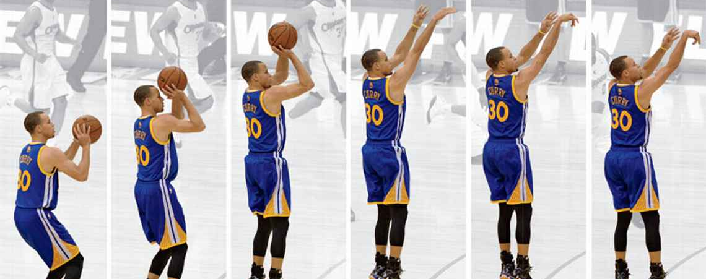
Optimization of Basketball’s 3-pt Shot
MECE 4602 Course Project Group 7
Brian Jin bj2464
Jacob Joseph jcj2131
Rayal Raj Prasad rpn2108
Yan Song-Chen yc3240
Applying principles of Robotics to improve the energy efficiency of the best 3-pt shooter in the NBA
12/6/16

Slide 2
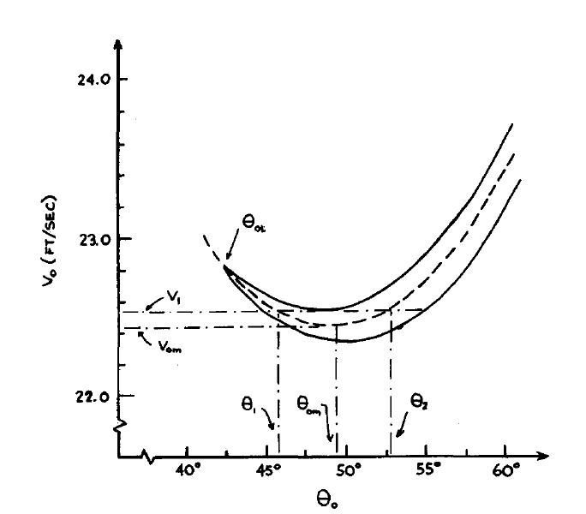
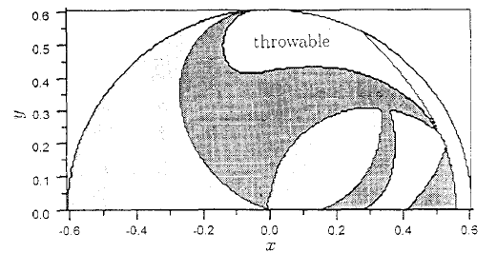
Literature Review
Struzik, Pietraszewski, Zawadzki. “Biomechanical Analysis of the Jump Shot in Basketball”
Empirical data on jump shot ground reaction force
Clauser. et al.“Weight, Volume, and Center of Mass of the Segments of the Human Body”
Estimation of anthropometric dimensions
Okuboa, Hubbard. “Kinematics of arm joint motions in basketball shooting”
Estimate arm joint motions for a set of desired release speed, angle
Infinite combinations of angular velocities for successful shot
Figure 1: Throwable Domain (Nato, Matsuda, Nakamura “Adaptive Control for a Throwing Motion of a 2 DOF Robot”)
Figure 2: Optimal release angle for lowest energy release or highest probability of successful shot-- 45-55 (Brancazio.”Physics of Basketball”)
Notes:
Started with throwing robot-industrial, then moved to basket specific throwing motion
Figure 1: Throwable domain for given link lengths, mass of projectile, release angle and flight time
Figure 2: Optimal release angle to minimize energy is based on release position and distance to hoop. For steph Curry’s release point and three point distance the angle is 48 to 50 degrees
Uniqueness about problem:
No papers were found that model jump shot
No other paper attempted to find an optimal trajectory in order to minimize energy output of throwing/shooting motion
Most focused on accuracy, free throws, three points are becoming a dominant factor in the modern game.

Slide 3
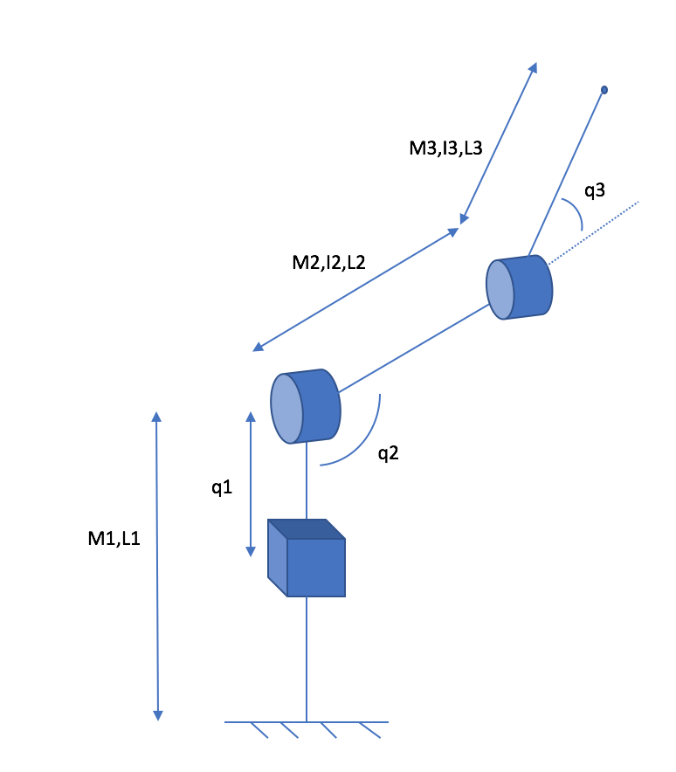

Methods and Models
Figure 3: Experimental data from video analysis
Simulation 1: Steph Curry modeled as a PRR Robot
Figure 4: Model-Prismatic Joint with two rotational Joints
Notes:
Modeling Steph Curry
Comparison: Optimized Shot
Dynamics derived using Lagrangian method
Constraints determined from body measurements
Find Minimum total energy values while satisfying acceptable shooting motion constraints
Body measurements taken from official NBA records
Link Length calculated as a percent of total body length and mass, center of mass of each link found
Actual data taken from video processing software
Measured Joint Variables for a number of frames
Create curve using linear regression fit for each joint vairbale to model motion
Optimized Dynamic Model
Dynamics of model using Lagrangian equation
Final Velocity and angle constraint equation
Initial/release velocity found from Jacobian
Joint Variable constraints
Optimize combination of Joint variables within constraints to obtain motion, find minimum energy
Explain shooting motion constraints that we chose
Jump
Workspace
Max/min q2
max/min q3
Release velocity
Release angle
End point (swoosh)

Slide 4
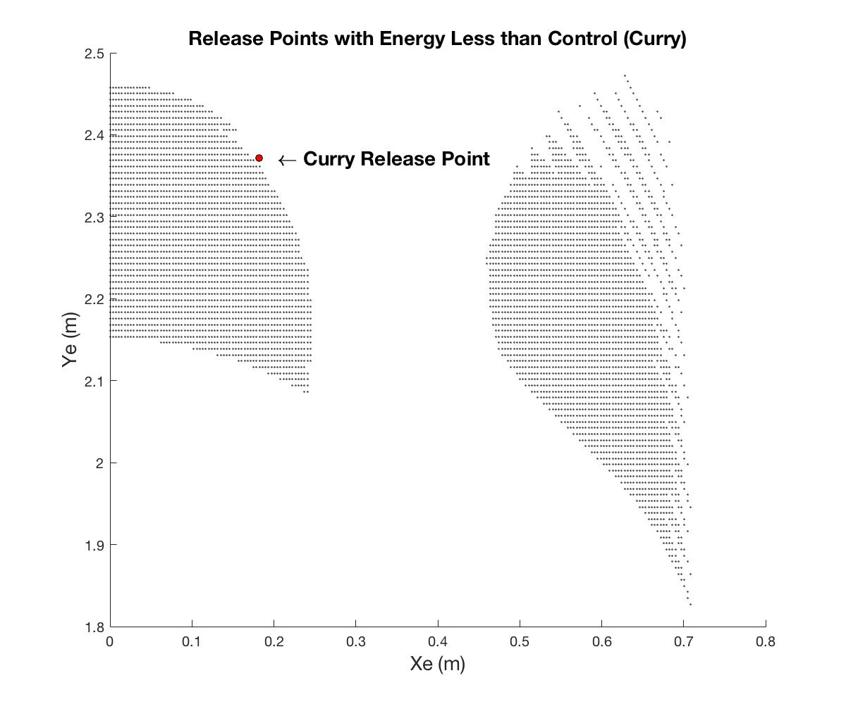
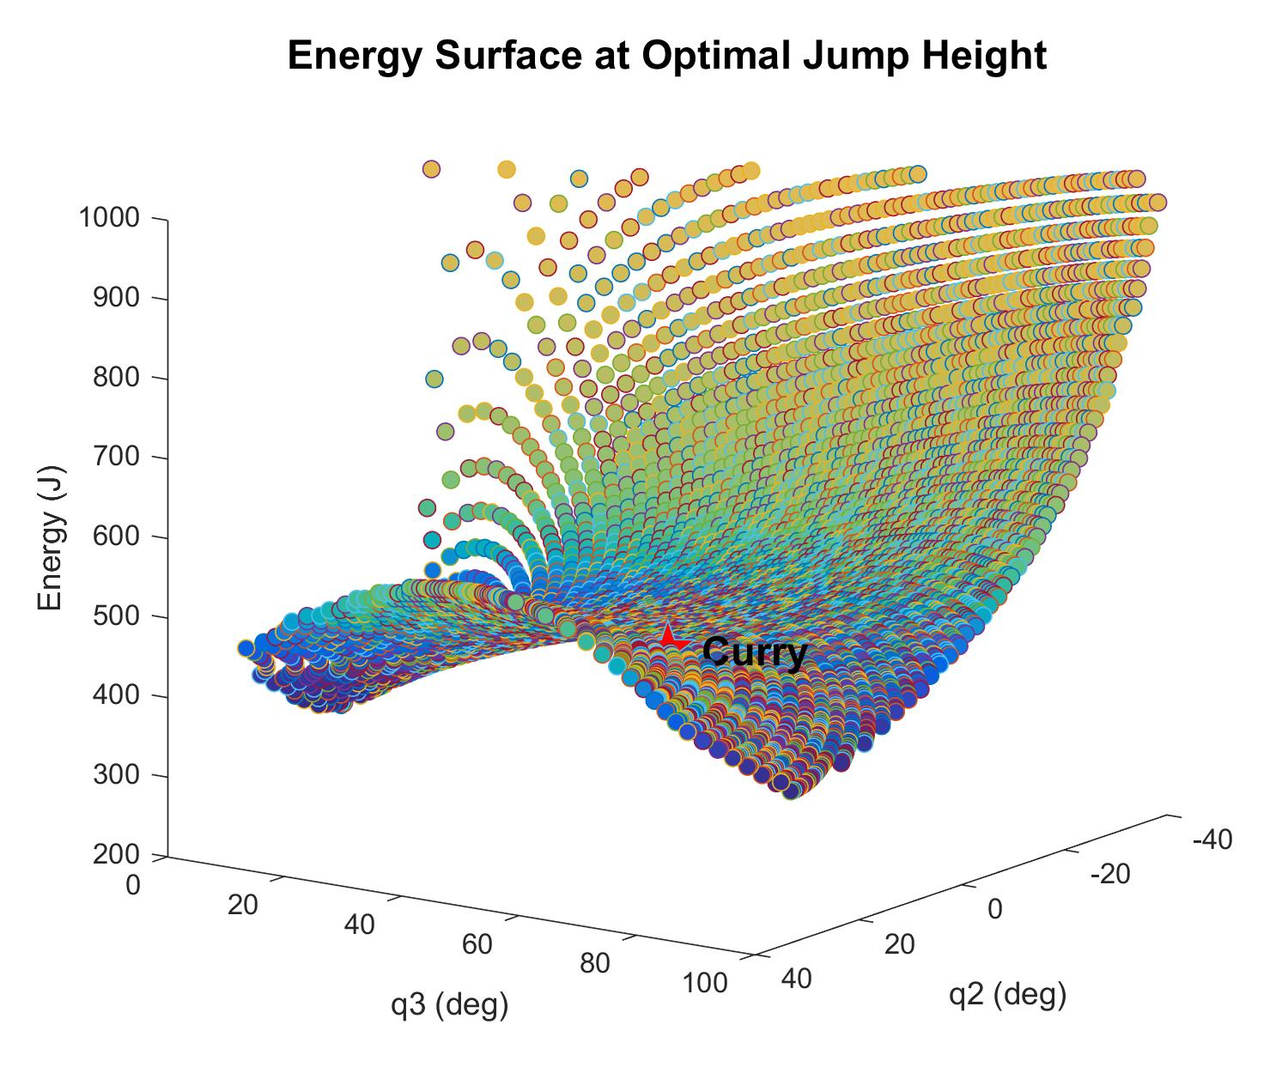

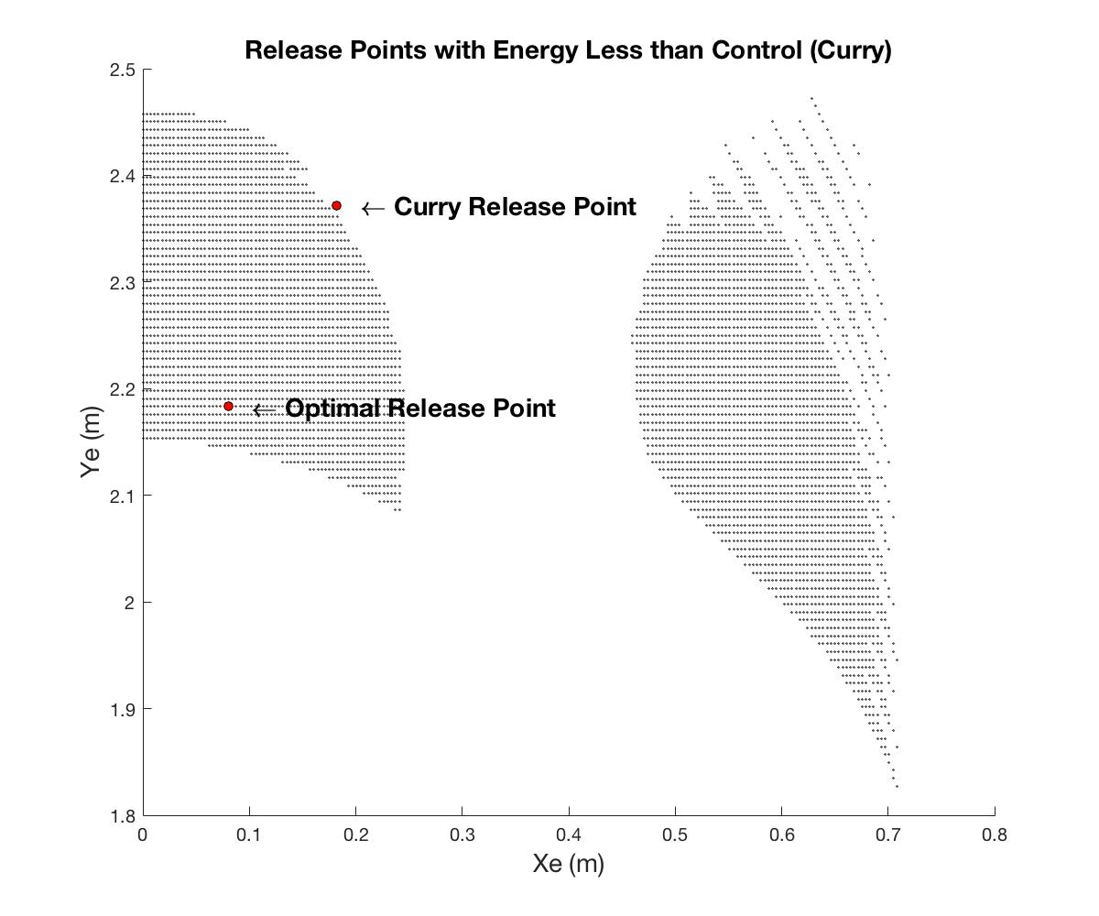
Results

Slide 5
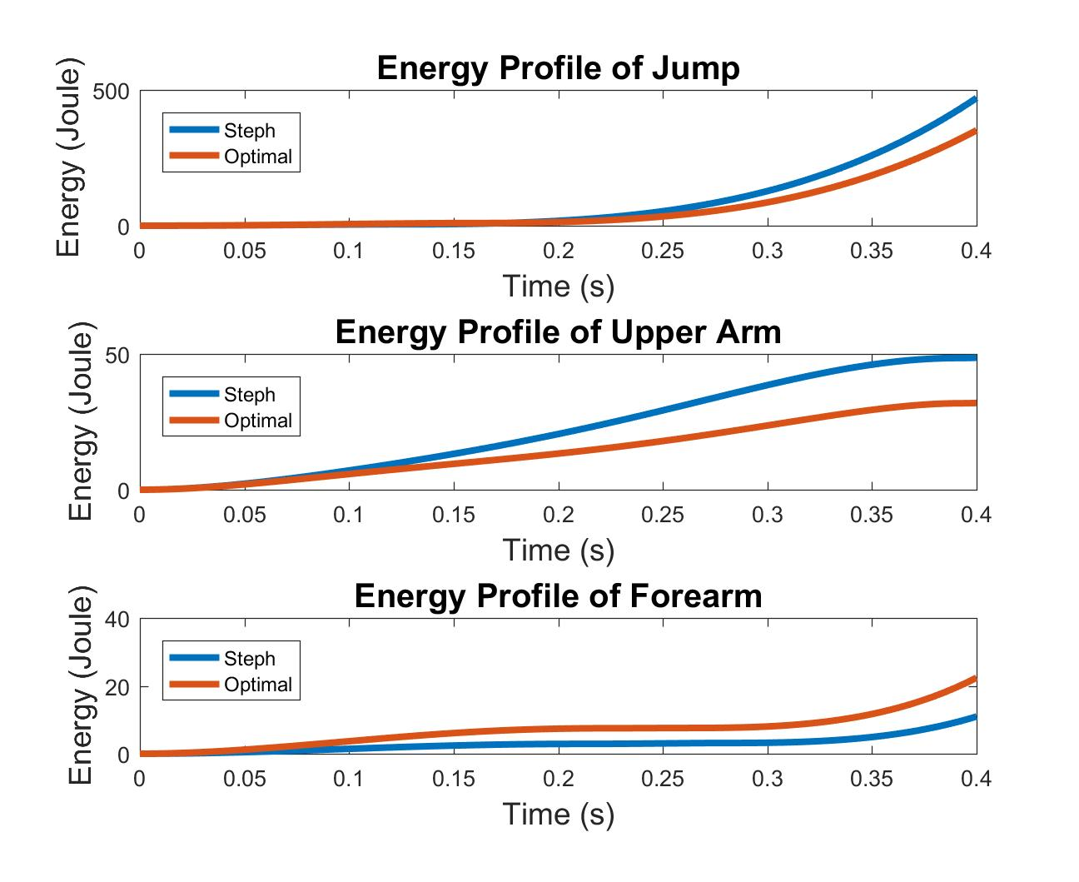
Simulation and Results
Optimal Throw
(23% Less Energy)
Notes:
Percent Change in motion:
Equal weights were given to percent change in energy and percent change in motion
This optimal throw represents a 23% decrease in energy expenditure but also requires a 40% change in motion
If a player wanted to optimize their shot while keeping a similar motion an increased weight can be given to percent change in motion and a new optimal value for % decrease in energy can be calculated
Energy Profile:
The energy profile curve shows that reducing the energy output of the jump and upper arm movement, while increasing the output of the forearm will provide the lowest total energy output
These results makes sense because the most energy expenditure will come from the larger muscles involved in the motion. As you can see the energy output of the jump is an order of magnitude greater than the other two motions. Therefore, any reduction in this value will have a greater impact on total energy of the system. This is why a decrease in both Jump and upper arm energies outweigh the increase in energy of the forearm movement and provide a more optimal shooting motion.

Slide 6
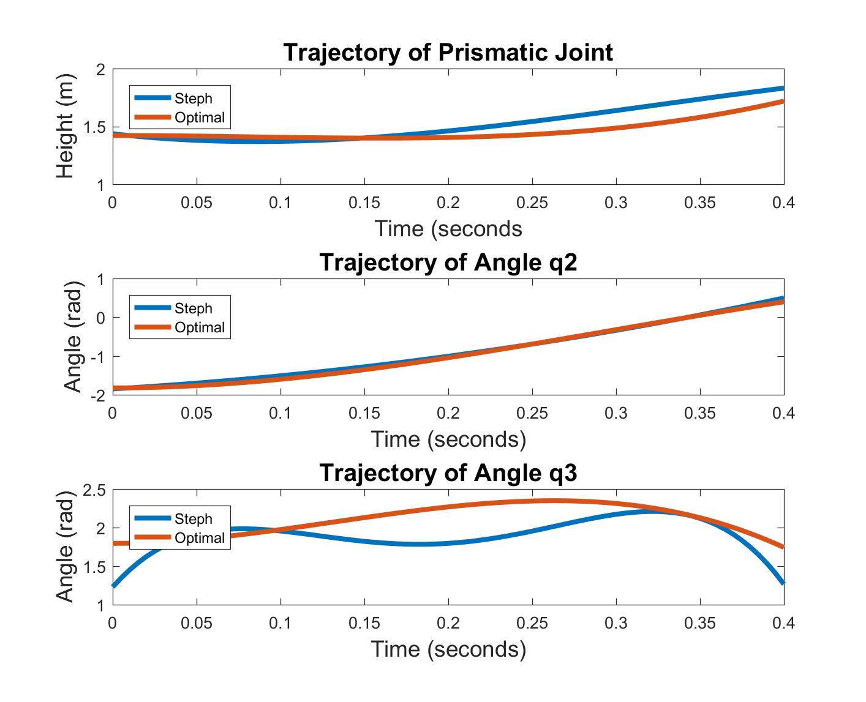
Conclusion and Future Extension

