Slide 1
foodfight
Web application by Team 14
Avik Dureja, Janki Patel, Liam Crumm, Nikhil Ramanan, Shobhit Srivastava

Slide 2
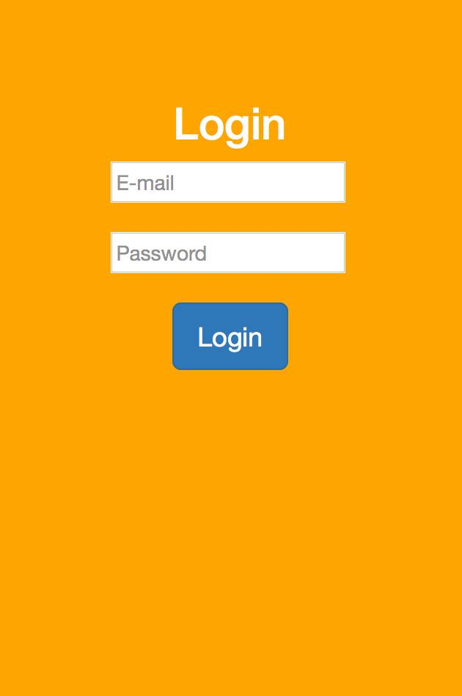
Main Objectives
Incentivize education/participation
Group participation
Challenge friends
Social Media push
Product purchases
Notes:
Incentivize education and participation through competition
Provide group participation, with winning group decided by more points earned by participants in given timeframe
Allow friends to challenge each other to quizzes on hunger information, with winner earning points
Connect through a variety of social media and share participation activity in the app
Points can be earned by purchasing participating products

Slide 3
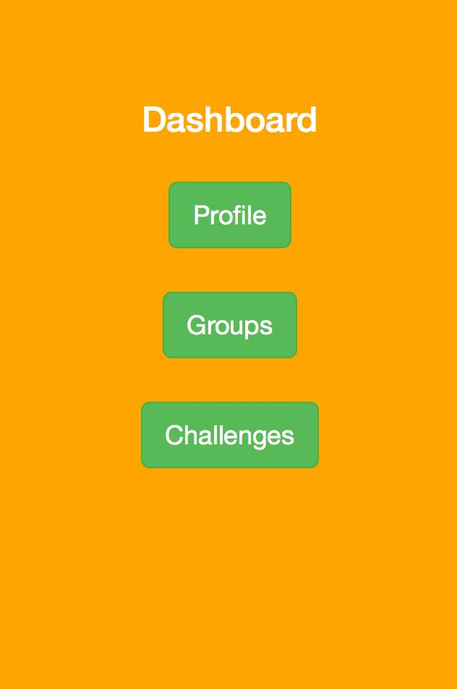
Ideas
Store data
Multiple-platform
Track points
Team-building and incentives
Easy to update points
Notes:
A way to store user data
Multiple-platform web application for users to track their points and competitions with other groups
Think team-building exercise for corporate groups, or large-scale competitions between universities/organizations that could be incentivized by other prizes provided by event organizers
Easy system to update points based on purchases

Slide 4
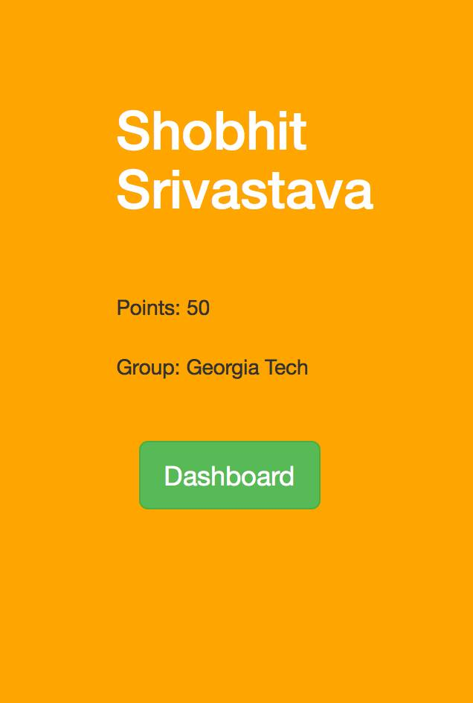
Technologies
AngularJS
Bootstrap
Mozilla Firefox Developer Tools

Slide 5
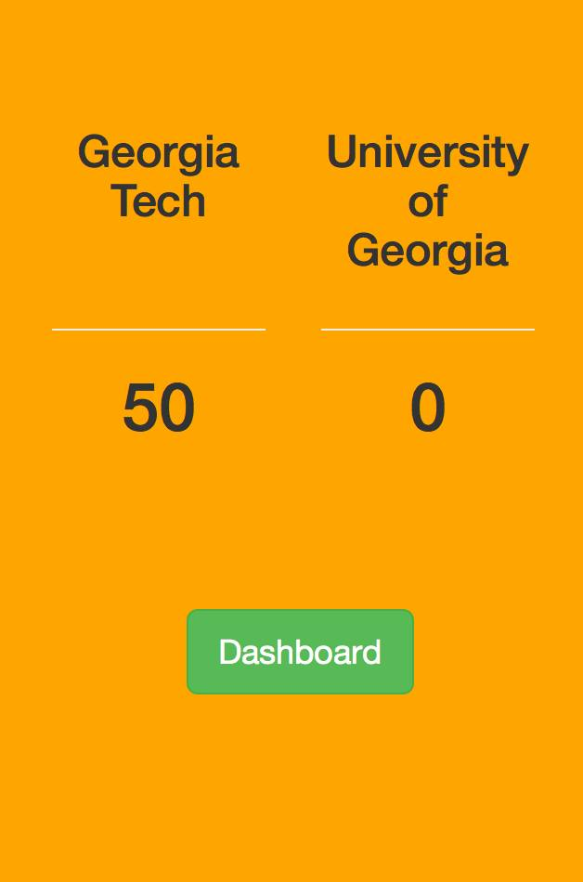
Product
Decent user interface
Track points in groups
Basic competition infrastructure
Clear scoreboard
Simple menu
Input products purchased
Points registered immediately
Notes:
Application consists of decent user interface and allows a user to log in and track points with a theoretical group of other users
Basic competition infrastructure allows teams to compete against each other with a clean and clear scoreboard
Simple menu to input products purchased, points are registered immediately

Slide 6
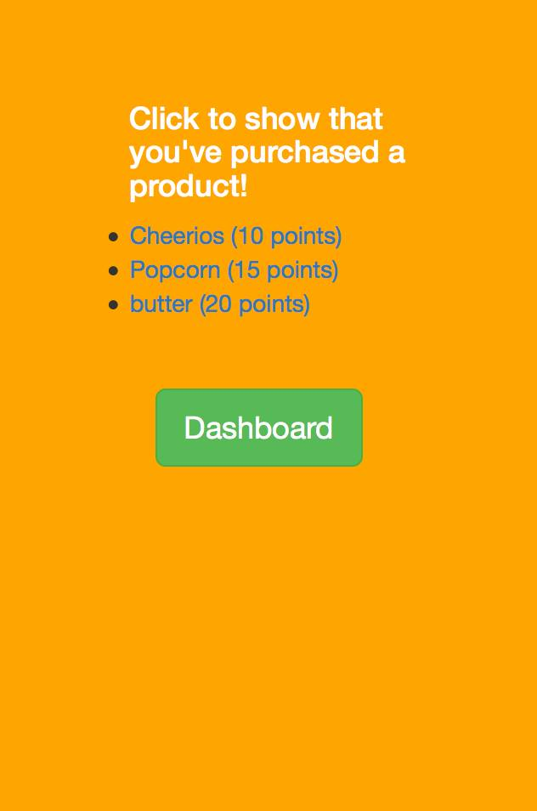
Potential Features
Verification on purchases
Structured database
Challenge others to quizzes
Social media integration
Notes:
Verification on purchases by users
Structured database of user data
Challenge others to quizzes that can be completed for points
Social media integration and point rewards for doing so

