Slide 1
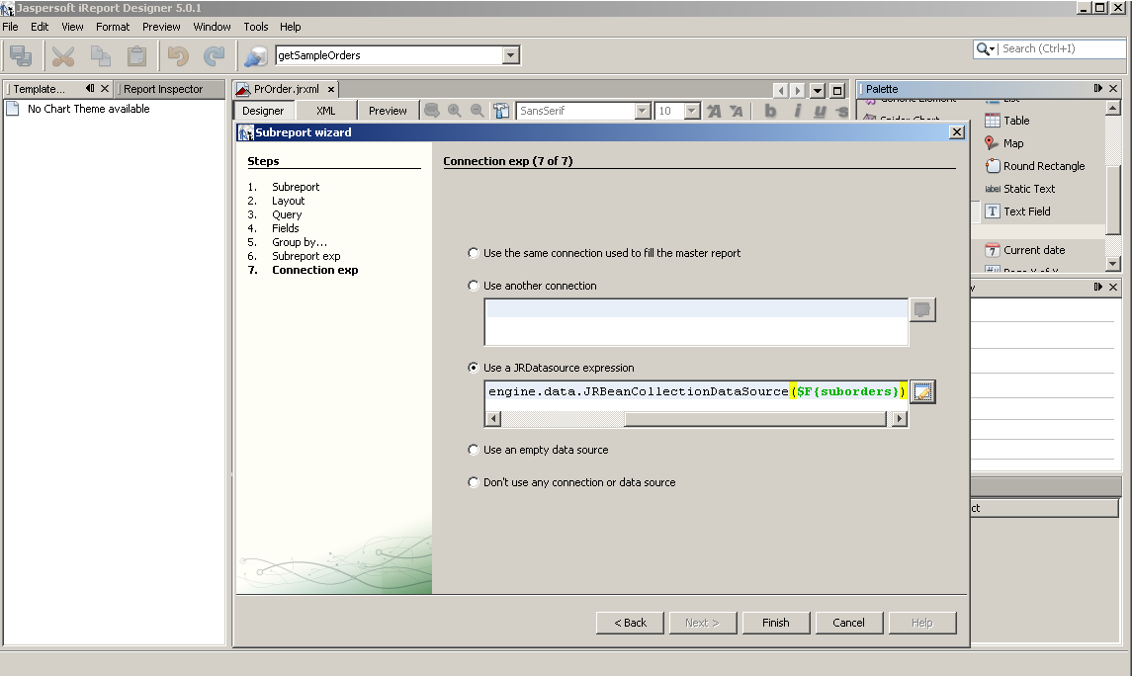
new net.sf.jasperreports.engine.data.JRBeanCollectionDataSource($F{sales})
Источник <http://www.richardnichols.net/2010/02/simple-guide-to-sub-reports-in-jasperreports-ireport/

Slide 2
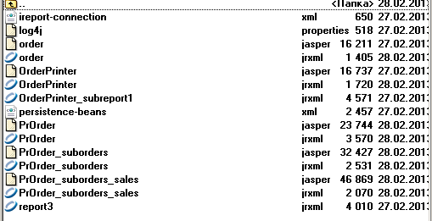
iReport connection
iReport connection settings

