Slide 1
Data Structures
Programming Project #4

Slide 2
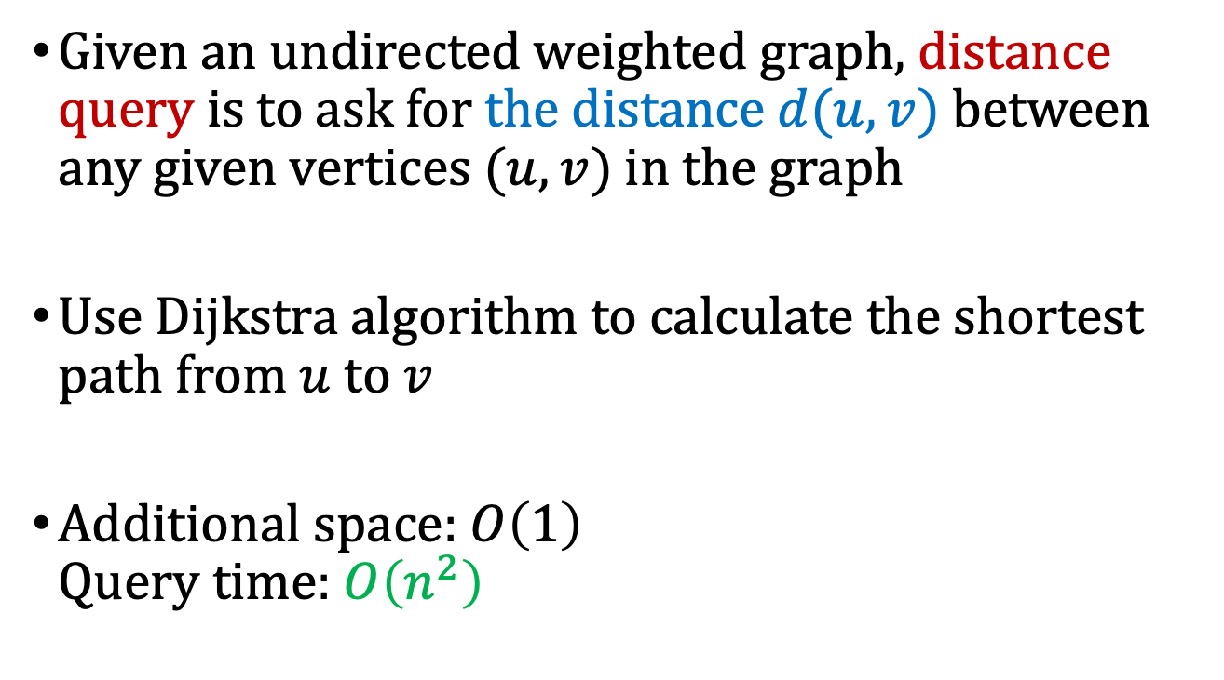
Exact Distance Query (shortest path distance)
Given an undirected weighted graph, distance query is to ask for the distance $d(u,v)$ between any given vertices $(u, v)$in the graph
Use Dijkstra algorithm to calculate the shortest path from $u$ to $v$
Additional space: $O\left(1\right)$ Query time: $O\left(n^{2}\right)$

Slide 3
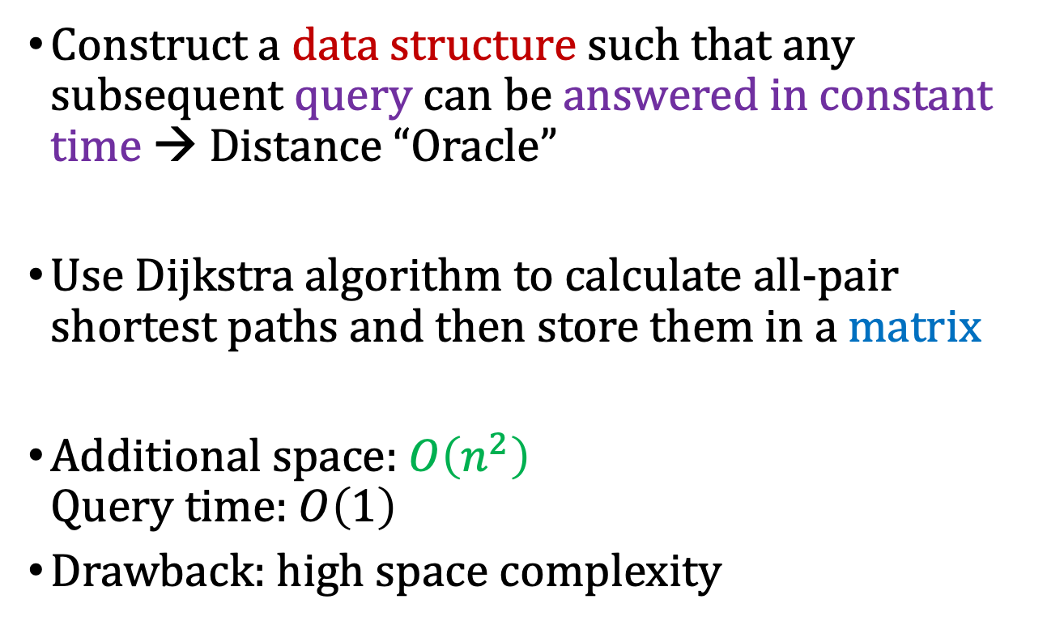
Exact Distance Query and Distance Oracle
Construct a data structure such that any subsequent query can be answered in constant time → Distance “Oracle”
Use Dijkstra algorithm to calculate all-pair shortest paths and then store them in a matrix
Additional space: $O\left(n^{2}\right)$ Query time: $O\left(1\right)$
Drawback: high space complexity
Distance Oracles beyond the Thorup–Zwick Bound, in IEEE FOCS 2010

Slide 4
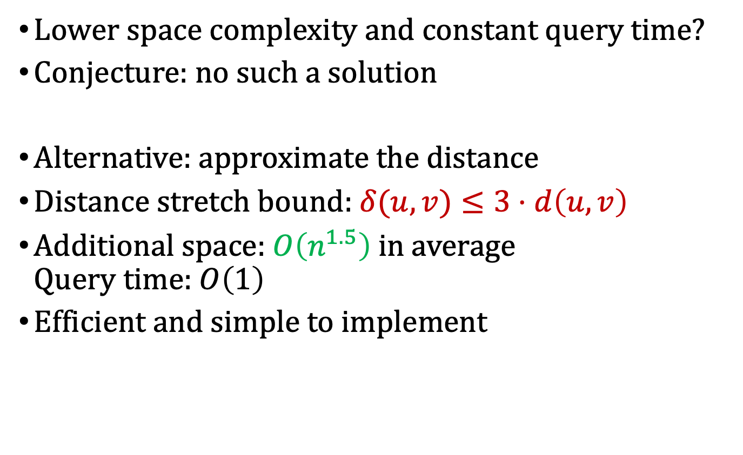
Approximate Distance Oracle
Lower space complexity and constant query time?
Conjecture: no such a solution
Alternative: approximate the distance
Distance stretch bound: $δ(u,v)≤3⋅d\left(u,v\right)$
Additional space: $O\left(n^{1.5}\right)$ in average Query time: $O\left(1\right)$
Efficient and simple to implement
Approximate distance oracles, in Journal of ACM 2005

Slide 5
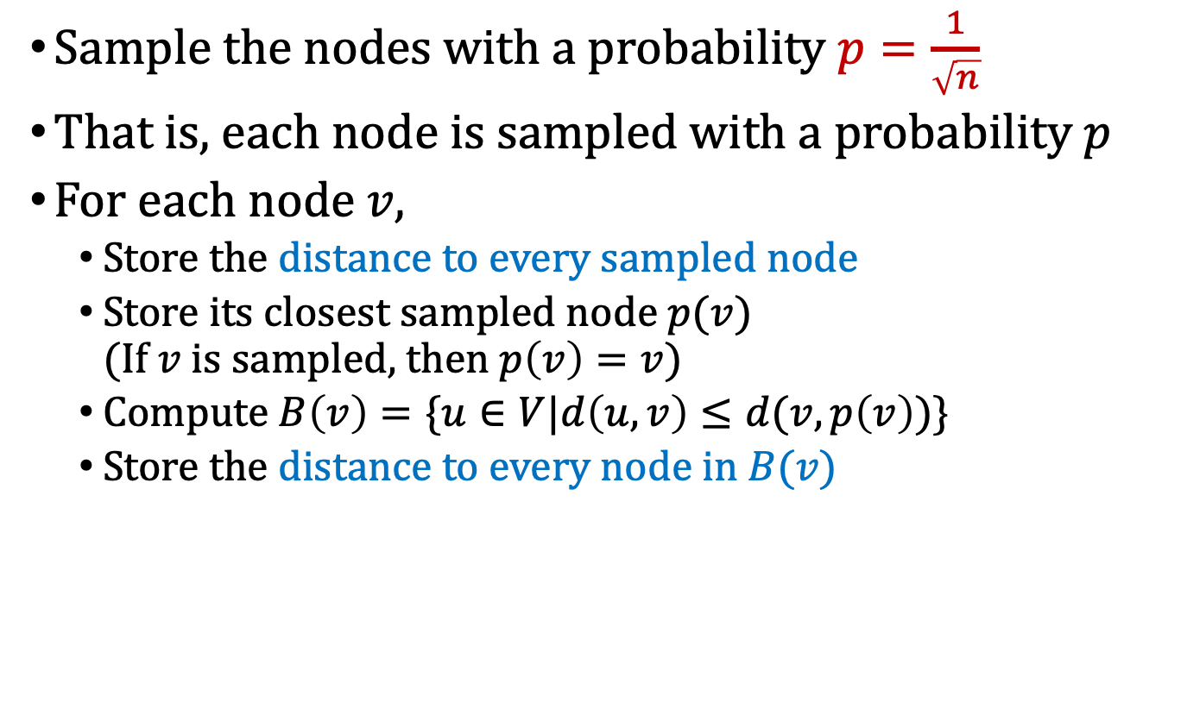
Data Structure for Approximate Distance Oracle (We don’t implement this oracle)
Sample the nodes with a probability $p=\frac{1}{\sqrt{n}}$
That is, each node is sampled with a probability $p$
For each node $v$,
Store the distance to every sampled node
Store its closest sampled node $p(v)$ (If $v$ is sampled, then $p\left(v\right)=v$)
Compute $B\left(v\right)=\{u∈V|d\left(u,v\right)≤d(v,p\left(v\right))\}$
Store the distance to every node in $B(v)$
Approximate distance oracles, in Journal of ACM 2005

Slide 6
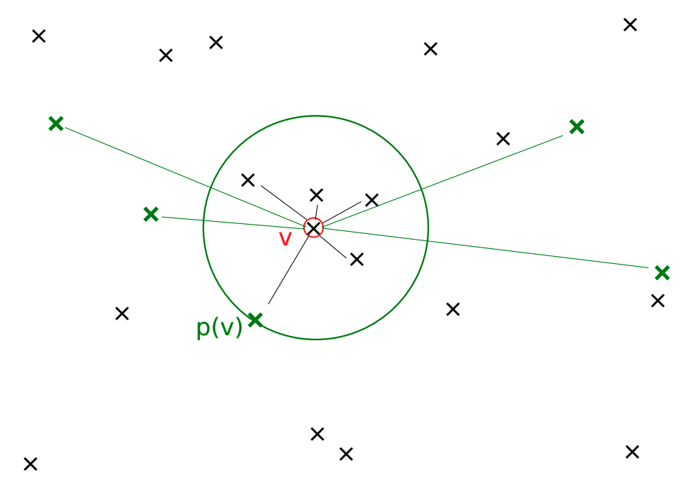


Data Structure for Approximate Distance Oracle (We don’t implement this oracle)
$$B\left(v\right)$$
$$p\left(v\right)$$
Approximate distance oracles, in Journal of ACM 2005

Slide 7
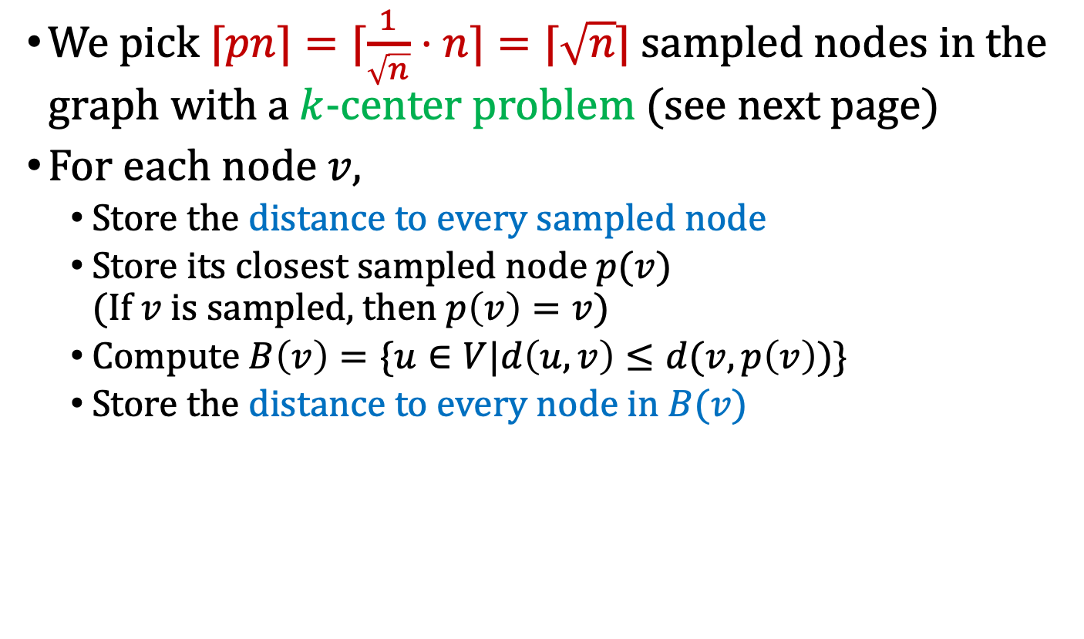
Modified Data Structure (We implement this modified oracle)
We pick $⌈pn⌉=⌈\frac{1}{\sqrt{n}}⋅n⌉=⌈\sqrt{n}⌉$ sampled nodes in the graph with a $k$-center problem (see next page)
For each node $v$,
Store the distance to every sampled node
Store its closest sampled node $p(v)$ (If $v$ is sampled, then $p\left(v\right)=v$)
Compute $B\left(v\right)=\{u∈V|d\left(u,v\right)≤d(v,p\left(v\right))\}$
Store the distance to every node in $B(v)$

Slide 8
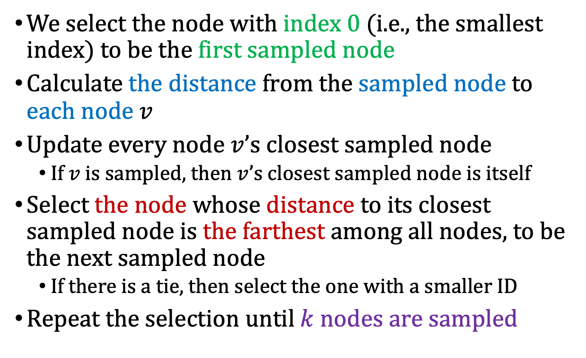

Greedy algorithm for $k$-center problem
We select the node with index 0 (i.e., the smallest index) to be the first sampled node
Calculate the distance from the sampled node to each node $v$
Update every node $v$’s closest sampled node
If $v$ is sampled, then $v$’s closest sampled node is itself
Select the node whose distance to its closest sampled node is the farthest among all nodes, to be the next sampled node
If there is a tie, then select the one with a smaller ID
Repeat the selection until $k$ nodes are sampled

Slide 9







Method of Approximate Distance Query
Answer the subsequent query $d(u,v)$
If $u$ is in $B\left(v\right)$ or $v$ is in $B\left(u\right)$ or $v$ or $u$ is sampled, then return $δ\left(u,v\right)=d\left(u,v\right)$ (note that $d\left(u,v\right)=d\left(v,u\right)$)
Otherwise, return $δ\left(u,v\right)=min\{d\left(v,p\left(v\right)\right)+d\left(p\left(v\right),u\right), d\left(u,p\left(u\right)\right)+d(p\left(u\right),v)\}$
$$B\left(v\right)$$
$$B\left(v\right)$$
$$u$$
$$p\left(v\right)$$
$$p\left(v\right)$$
$$u$$
Approximate distance oracles, in Journal of ACM 2005

Slide 10
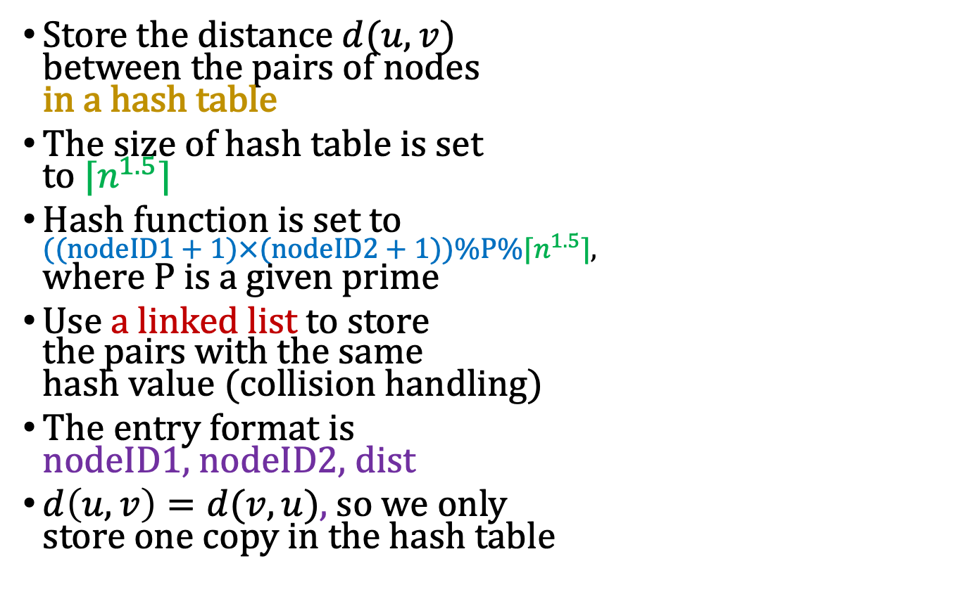

Implementation Rules
[0]
0,16, 4
Assume $P=17$ and $\left\lceil n^{1.5}\right\rceil =17$
$$\left(\left(0+1\right)×\left(16+1\right)\right)\%17\%17=0$$
[4]
Store the distance $d(u,v)$ between the pairs of nodes in a hash table
The size of hash table is set to $⌈n^{1.5}⌉$
Hash function is set to $((nodeID1+1)×(nodeID2+1))\%P\%⌈n^{1.5}⌉$, where $P$ is a given prime
Use a linked list to store the pairs with the same hash value (collision handling)
The entry format is nodeID1, nodeID2, dist
$d\left(u,v\right)=d(v,u)$, so we only store one copy in the hash table
$$\left(\left(3+1\right)×\left(9+1\right)\right)\%17\%17=6$$
3, 9, 8
7, 4, 9
$$\left(\left(7+1\right)×\left(4+1\right)\right)\%17\%17=6$$
[8]
Get the same position in the hash table → collision → linked list
[12]
[16]

Slide 11
Programming Project #4: Modified approximate distance oracle
Input:
Number of nodes and undirected links (connected graph)
Each link has a distance cost
Number of distance queries and each queried pair
A specific prime number
Procedure:
Use the greedy algorithm to sample the nodes
Store the necessary distance information in the hash table
Output:
Number of queried pairs
The distance information for each queried pairs

Slide 12
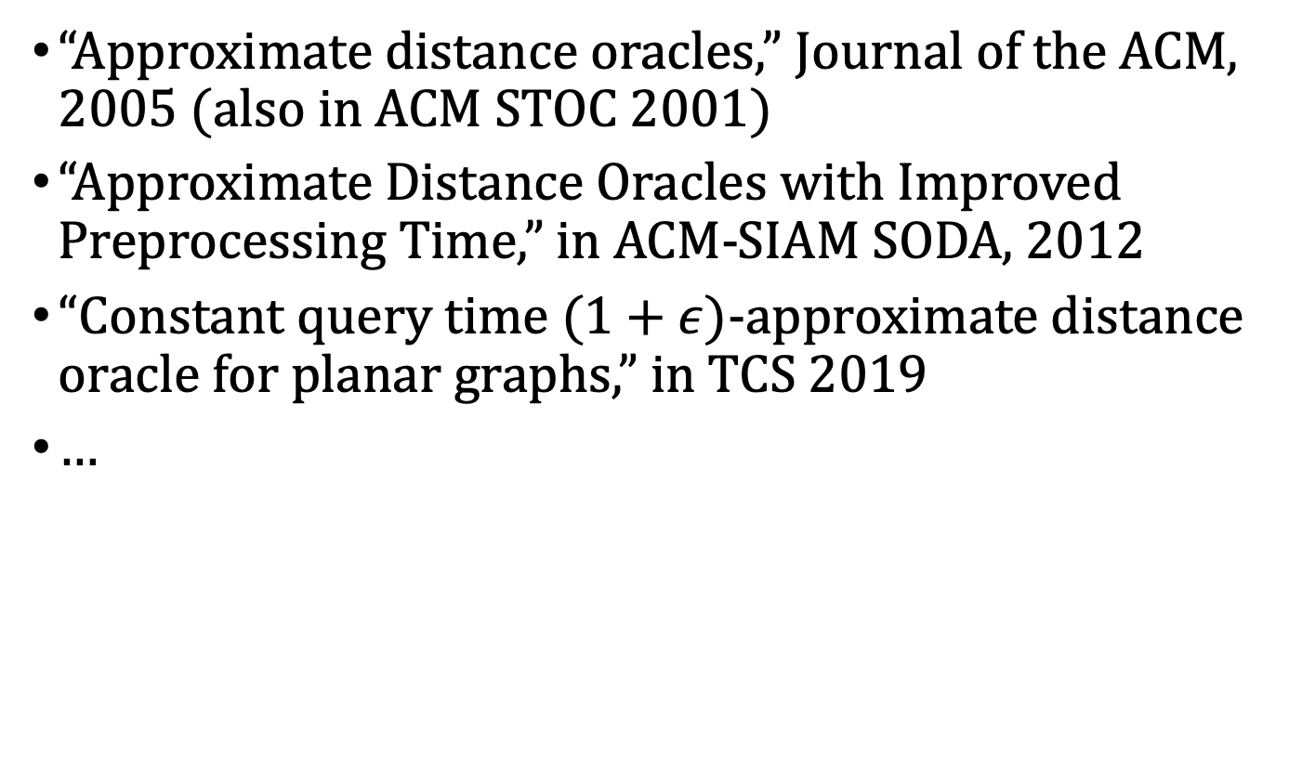
Reference and Reading Materials
“Approximate distance oracles,” Journal of the ACM, 2005 (also in ACM STOC 2001)
“Approximate Distance Oracles with Improved Preprocessing Time,” in ACM-SIAM SODA, 2012
“Constant query time $(1+ε)$-approximate distance oracle for planar graphs,” in TCS 2019
…

Slide 13
Input Sample: use scanf
Format:
#nodes #undirectedLinks prime
linkID nodeID1 nodeID2 distCost
…
#queriedPairs
pairID nodeID1 nodeID2
…

Slide 14
Input Sample: use scanf
A
4
3
G
B
10
12
Format:
7 10 3
0 0 1 3
1 0 3 12
2 0 6 4
3 1 2 7
4 1 4 6
5 2 3 5
6 2 6 10
7 3 4 4
8 4 5 7
9 5 6 1
3
0 1 4
1 6 5
2 1 5
1
6
7
F
C
7
5
E
D
4
Pairs:
(B, E)
(G, F)
(B, F)

Slide 15

Input Sample: use scanf
#sample nodes = $⌈\sqrt{7}⌉=3$
A
4
3
G
B
10
12
1
6
7
F
C
Pairs:
(B, E)
(G, F)
(B, F)
7
5
E
D
4

Slide 16
Input Sample: use scanf
#sample nodes = $⌈\sqrt{7}⌉=3$
0
A
4
4
3
G
B
3
10
12
1
6
7
5
F
C
10
Pairs:
(B, E)
(G, F)
(B, F)
7
5
E
D
4
9
12

Slide 17
Input Sample: use scanf
#sample nodes = $⌈\sqrt{7}⌉=3$
0, 12
A
4, 12
4
3
G
B
3, 10
10
12
1
6
7
5, 11
F
C
10, 5
Pairs:
(B, E)
(G, F)
(B, F)
7
5
E
D
4
9, 4
12, 0

Slide 18
Input Sample: use scanf
#sample nodes = $⌈\sqrt{7}⌉=3$
0, 12, 10
A
4, 12, 10
4
3
G
B
3, 10, 7
10
12
1
6
7
5, 11, 11
F
C
10, 5, 0
Pairs:
(B, E)
(G, F)
(B, F)
7
5
E
D
4
9, 4, 9
12, 0, 5

Slide 19
Input Sample: use scanf
10 + 4 = 14
#sample nodes = $⌈\sqrt{7}⌉=3$
9 + 3 = 12
0, 12, 10
A
4, 12, 10
4
3
G
B
3, 10, 7
10
12
1
6
7
5, 11, 11
F
C
10, 5, 0
Pairs:
(B, E)
(G, F)
(B, F)
7
5
12
E
D
4
9, 4, 9
12, 0, 5

Slide 20
Input Sample: use scanf
#sample nodes = $⌈\sqrt{7}⌉=3$
0, 12, 10
A
4, 12, 10
4
3
G
B
3, 10, 7
10
12
1
6
7
5, 11, 11
F
C
10, 5, 0
Pairs:
(B, E)
(G, F)
(B, F)
7
5
12
E
D
4
1
9, 4, 9
12, 0, 5

Slide 21
Input Sample: use scanf
3 + 5 = 8
#sample nodes = $⌈\sqrt{7}⌉=3$
5 + 3 = 8
0, 12, 10
A
4, 12, 10
4
3
G
B
3, 10, 7
10
12
1
6
7
5, 11, 11
F
C
10, 5, 0
Pairs:
(B, E)
(G, F)
(B, F)
7
5
12
E
D
4
1
9, 4, 9
8
12, 0, 5

Slide 22
Output Sample: use printf
Format:
#storedDistances
pairID nodeID1 nodeID2 approxDist
…

Slide 23
Output Sample: use printf
A
4
3
G
B
10
12
Format:
16
0 1 4 12
1 6 5 1
2 1 5 8
1
6
7
F
C
7
5
E
D
4
A, B
A, C
A, D
A, E
A, F
A, G
B, C
B, D
C, D
C, E
C, F
C, G
D, E
D, F
D, G
F, G
Pairs:
(B, E)
(G, F)
(B, F)

