Slide 1
Computational Resources at UW-Madison

Slide 2
Computation in Biology
Biology is often very data heavy
Most biologists aren’t trained in computation/programming (yet)
But most of you will need some of these skills
Your PI/labmates might not be able to help you but…
You don’t have to struggle through this alone!

Slide 3
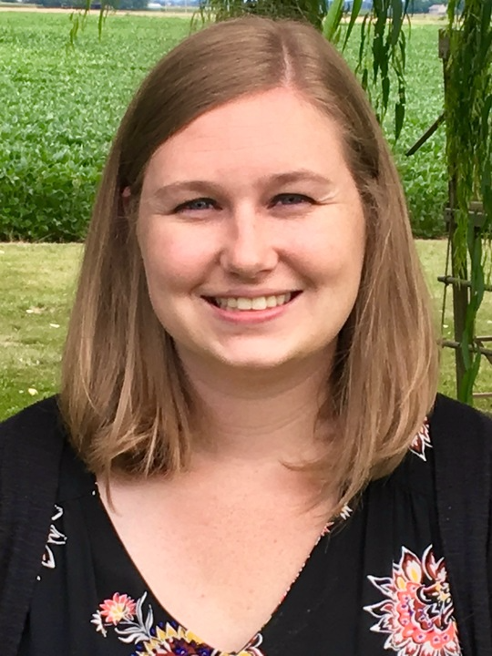
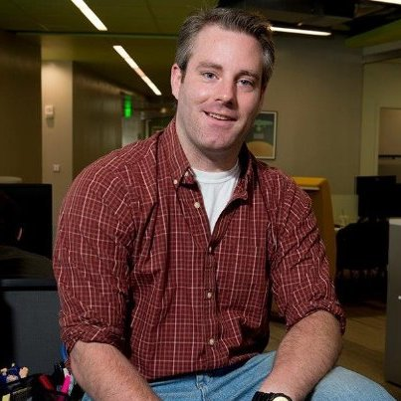
ComBEE
Computational Biology, Ecology, and Evolution Group
Student organized group
Monthly Meetings about Computational Biology or Theoretical Ecology/Evolution
Social gathering Sept. 15th @ 4pm in 6201 MSB
Bi-weekly R/python study groups
https://combee-uw-madison.github.io
Sign up for our listserv to get updates!
Elizabeth McDaniel
MDTP Student
McMahon Lab
Marc Chevrette
Genetics Student
Currie Lab

Slide 4
ComBEE R/Python Study Groups
These groups meet on opposite weeks
Generally informal discussion of topics
Topics decided on based on group interests
Meet on Thursdays at 2pm in MSB 5503
Python Study Group website
Starts on Sept. 21st
R Study Group website
Starts on Sept. 28th
Different format this semester
Sign up for their individual listservs if you are interested

Slide 5




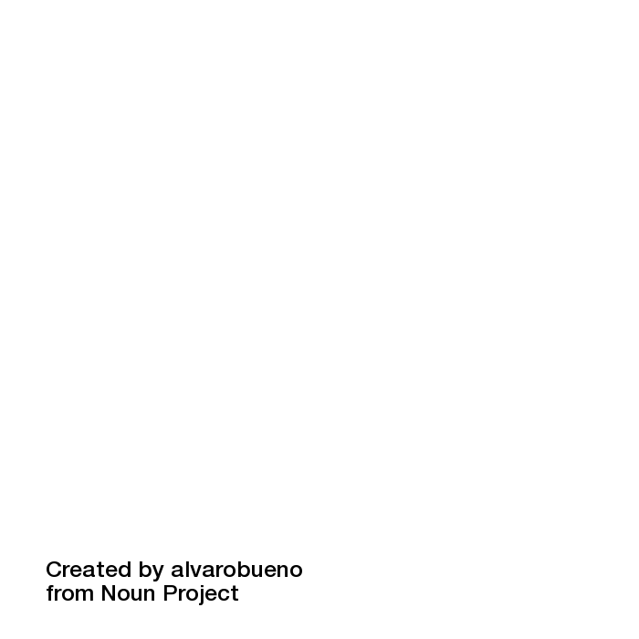




What are Software and Data Carpentry?
Two formal organizations* + international community of volunteers
that develop lessons, train instructors + organize workshops
in data management and software development
best practices
For and by researchers across disciplines
* soon to be restructured into a combined organization
Slide from Christina Koch

Slide 6
Software/Data Carpentry
2 free workshops hosted at beginning of each semester
Next workshops probably January 2018
SWC: Unix shell, python (or R), and version control (git)
DC: excel, openRefine, SQL, R
Large local community of instructors
If interested you can help out or instruct these workshops
Professional Development/Teaching opportunity
For updates about registration (and other computational events on campus) sign up for ACI (advanced computing initiative) listserv
aci.wisc.edu

Slide 7
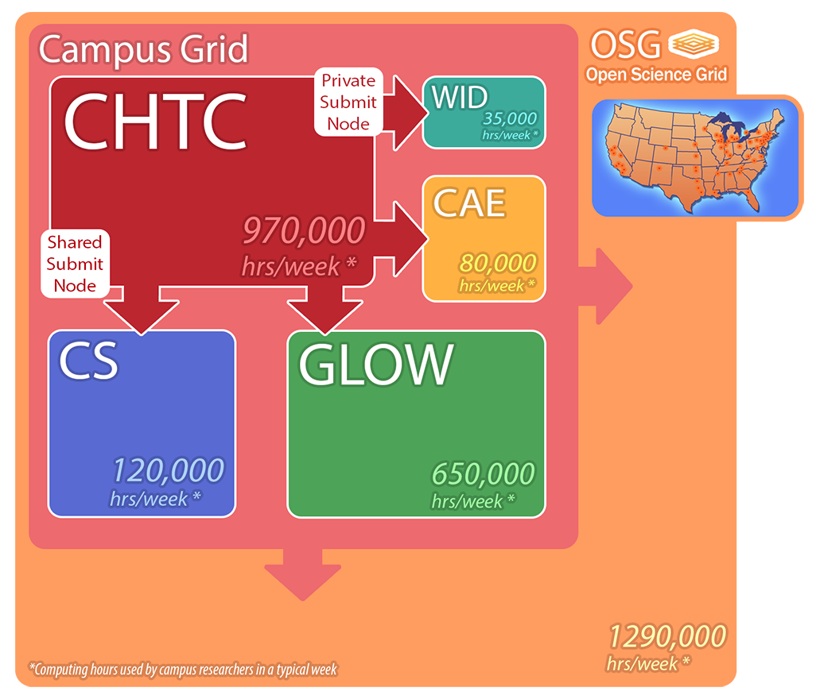
Center for High Throughput Computing (CHTC)
Campus resource
Scale up your computational work
Can run more analyses (and bigger jobs) using their resources
Facilitators who can help you get started

Slide 8
Quantitate Biology Initiative
Initiative to bring together quantitative biology on campus
https://qbi.wisc.edu/
New minor available!
https://qbi.wisc.edu/education/phd-minor/
Weekly Seminar Series
https://wid.wisc.edu/seminars/qbio/

Slide 9
Other courses
MICROBIO 875: Bioinformatics for Microbiologists (Might change numbers for Spring 2018)
BMI 541 - Introduction to biostatistics
BMI 576 - Introduction to bioinformatics
BMI 776 - Advanced bioinformatics
CS301 - Introduction to Data Programming

Slide 10
Biotech Center
Biotech Center on campus also offers Bioinformatics workshops (cost $$)
Workshops include:
Linux Basics for NGS Data Analysis
Intro to NGS Data Analysis
Microbiota Processing in mothur
Microbiota Analysis in R
http://www.biotech.wisc.edu/services/brc/workshop

Slide 11
ComBEE
Computational Biology, Ecology, and Evolution Group
Social gathering Sept. 15th @ 4pm in 6201 MSB
Bi-weekly R/python study groups
https://combee-uw-madison.github.io
Sign up for our listserv to get updates!

