Slide 1
Computational Resources at UW-Madison

Slide 2
Computation in Biology
Biology is often very data heavy
Most biologists aren’t trained in computation/programming (yet)
But most of you will need some of these skills
Your PI/labmates might not be able to help you but…
You don’t have to struggle through this alone!

Slide 3
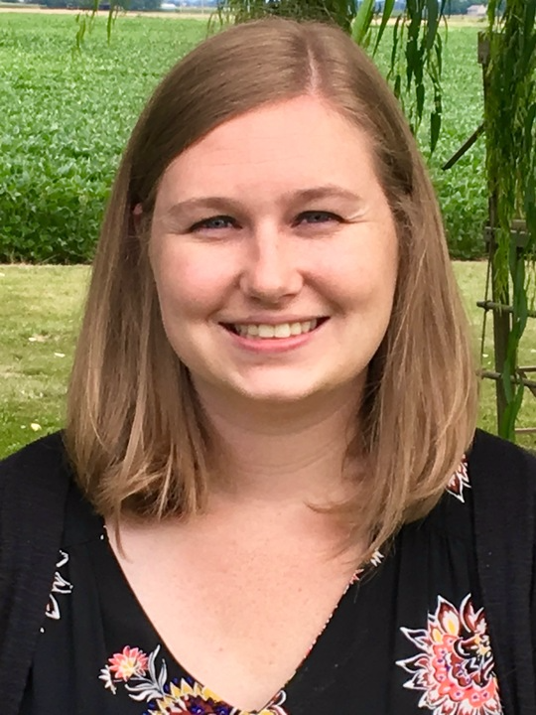

ComBEE
Computational Biology, Ecology, and Evolution Group
Student organized group
Monthly Meetings about Computational Biology or Theoretical Ecology/Evolution
Social gathering Sept. 15th @ 4pm in 6201 MSB
Bi-weekly R/python study groups
https://combee-uw-madison.github.io
Sign up for our listserv to get updates!
Elizabeth McDaniel
MDTP Student
McMahon Lab
Marc Chevrette
Genetics Student
Currie Lab

Slide 4
ComBEE R/Python Study Groups
These groups meet on opposite weeks
Generally informal discussion of topics
Topics decided on based on group interests
Python Study Group website
Meets on every other XXX at YYY in ZZZ
R Study Group website
Meets on every other XXX at YYY in ZZZ
Different format this semester

