Slide 1
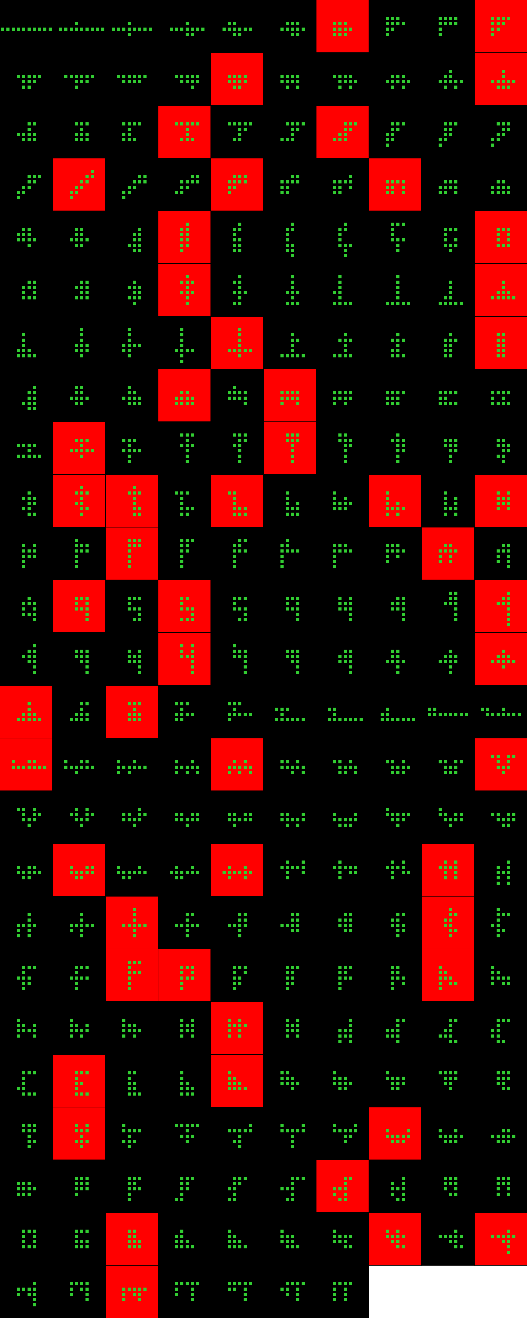
Player 020

Slide 2

Player 020

Slide 3
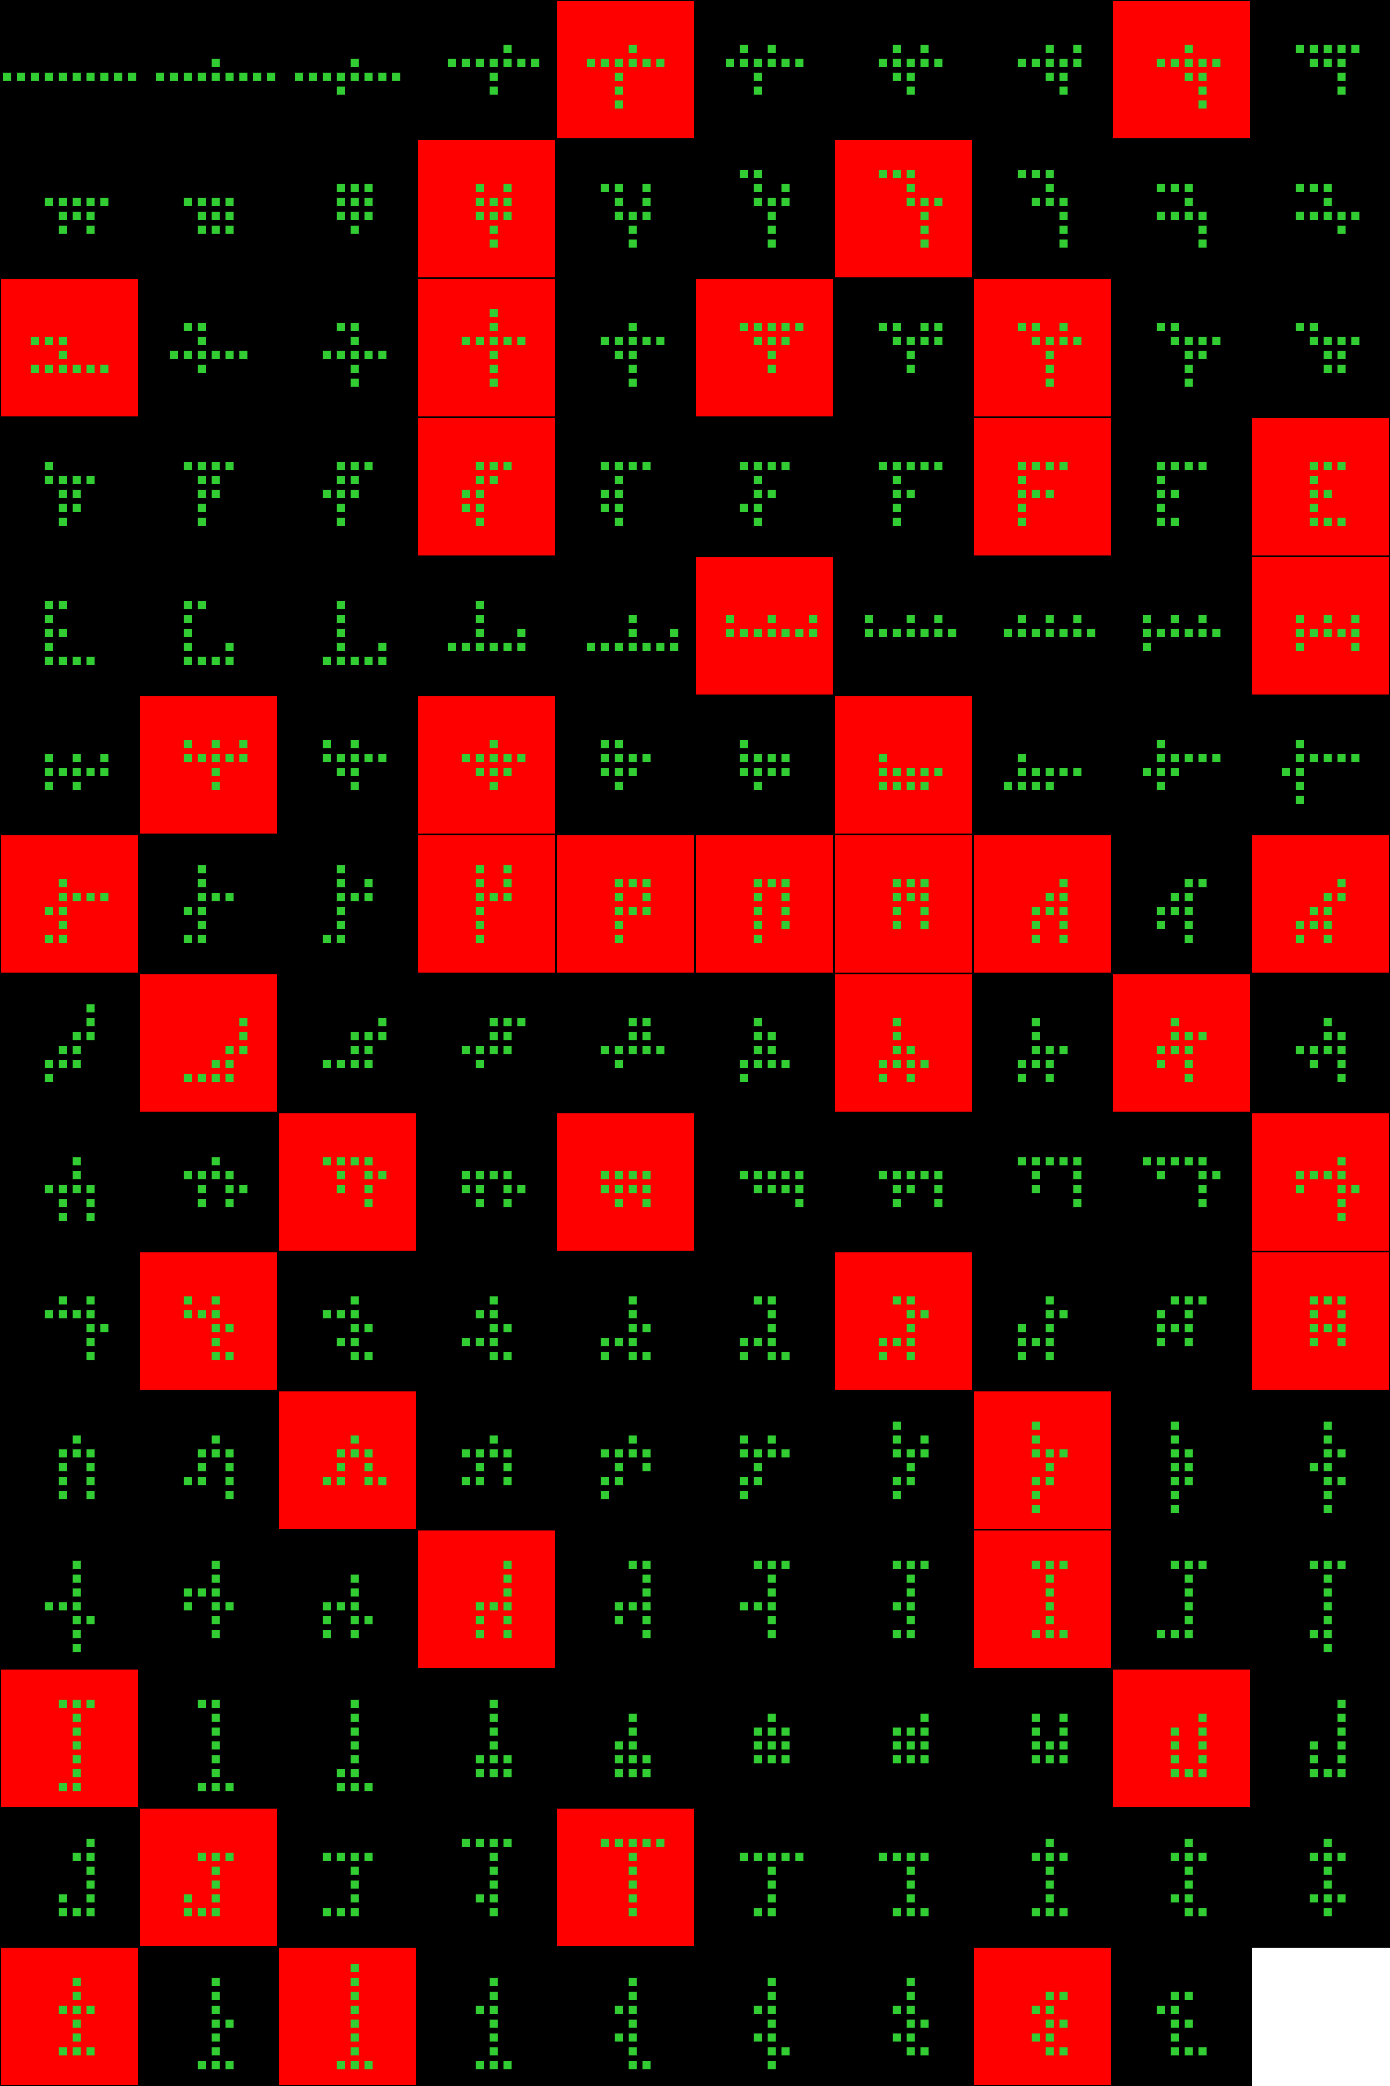
Player 021

Slide 4
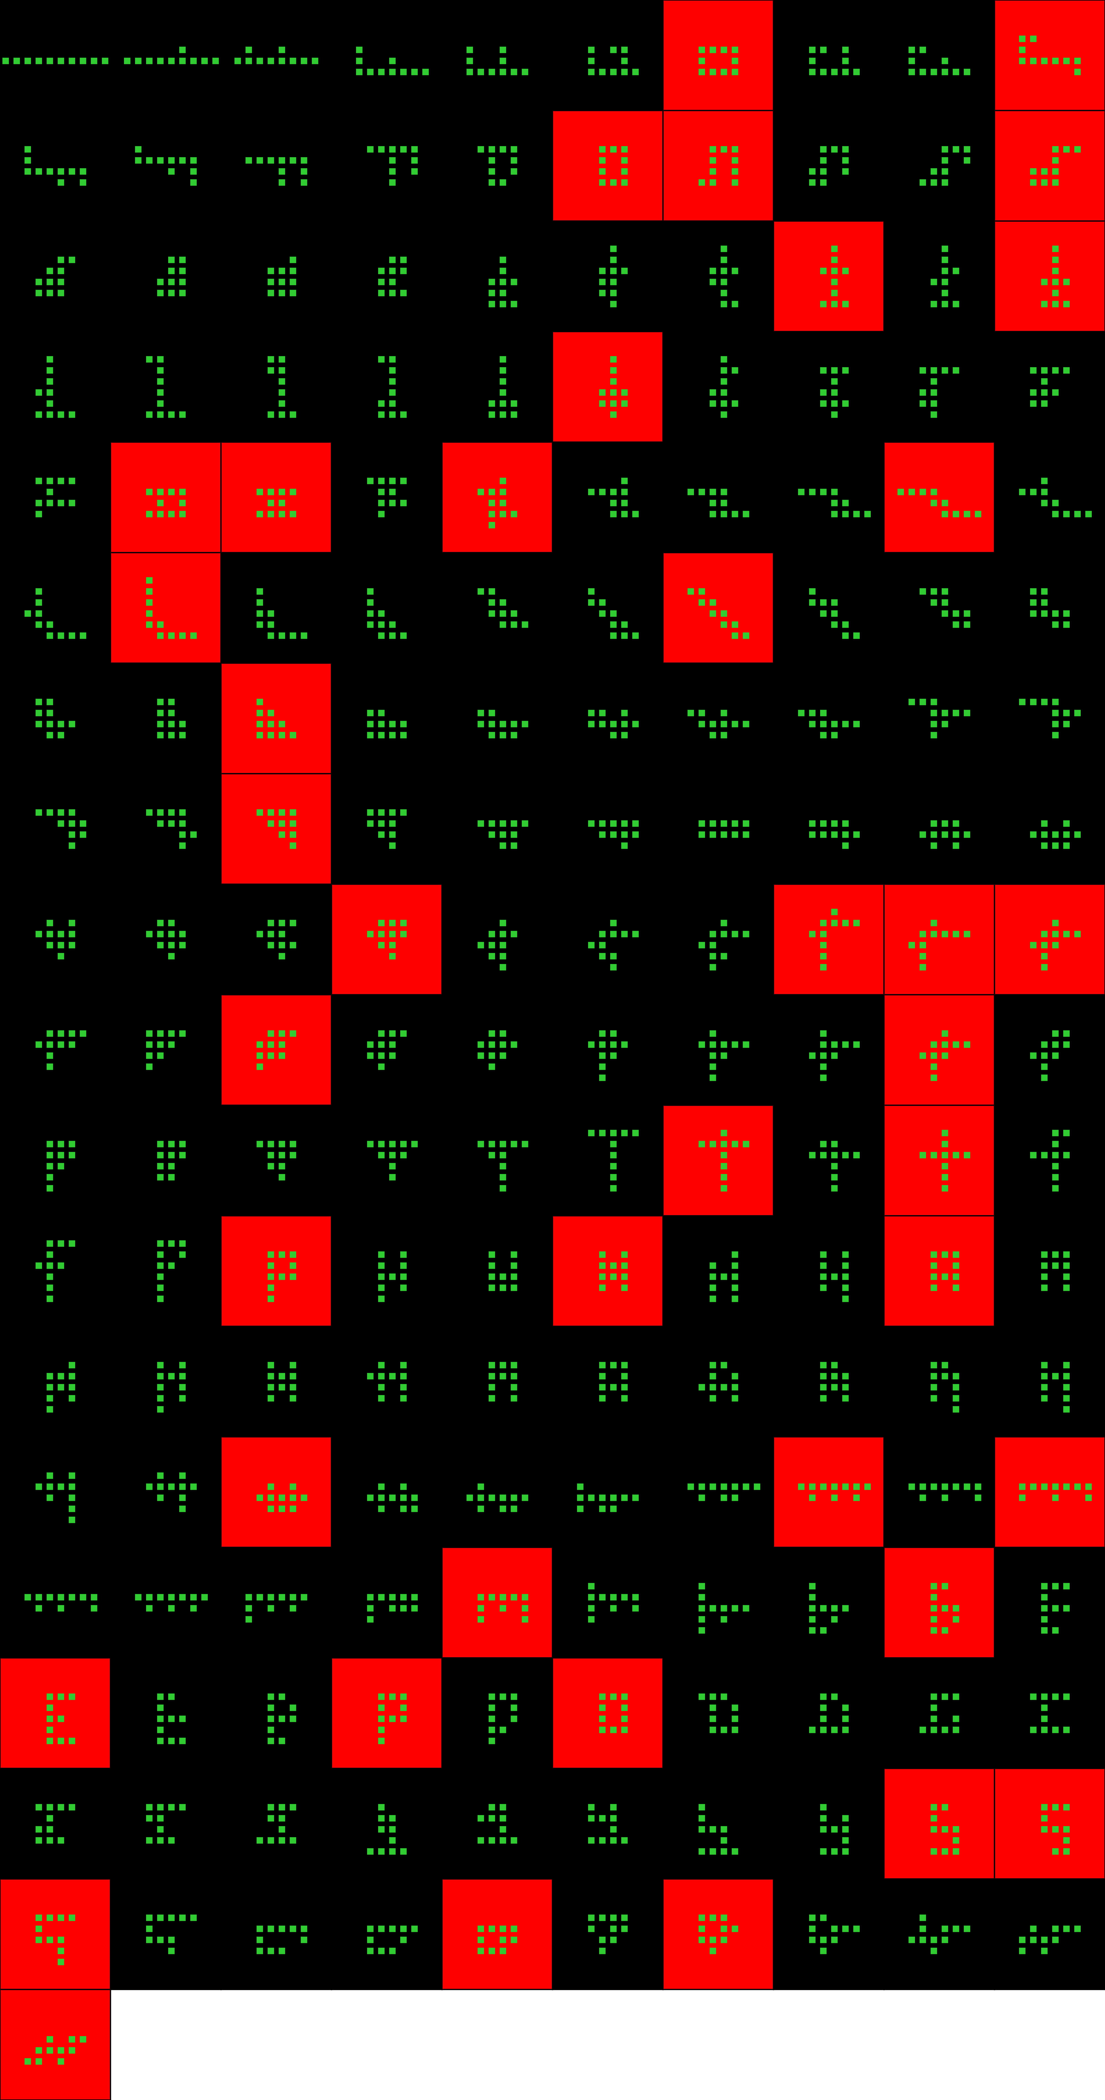
Player 022

Slide 5
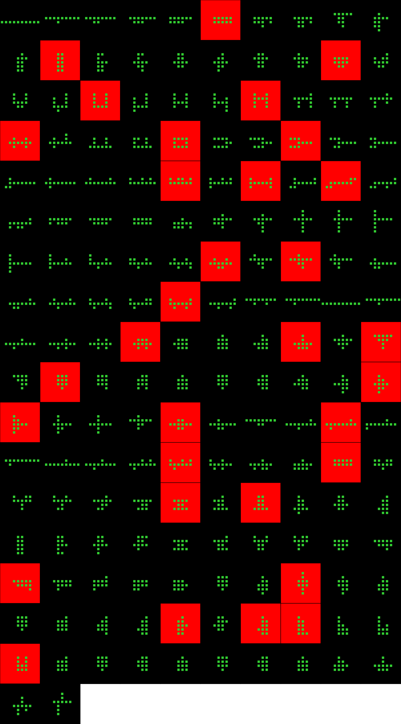
Player 023

Slide 6
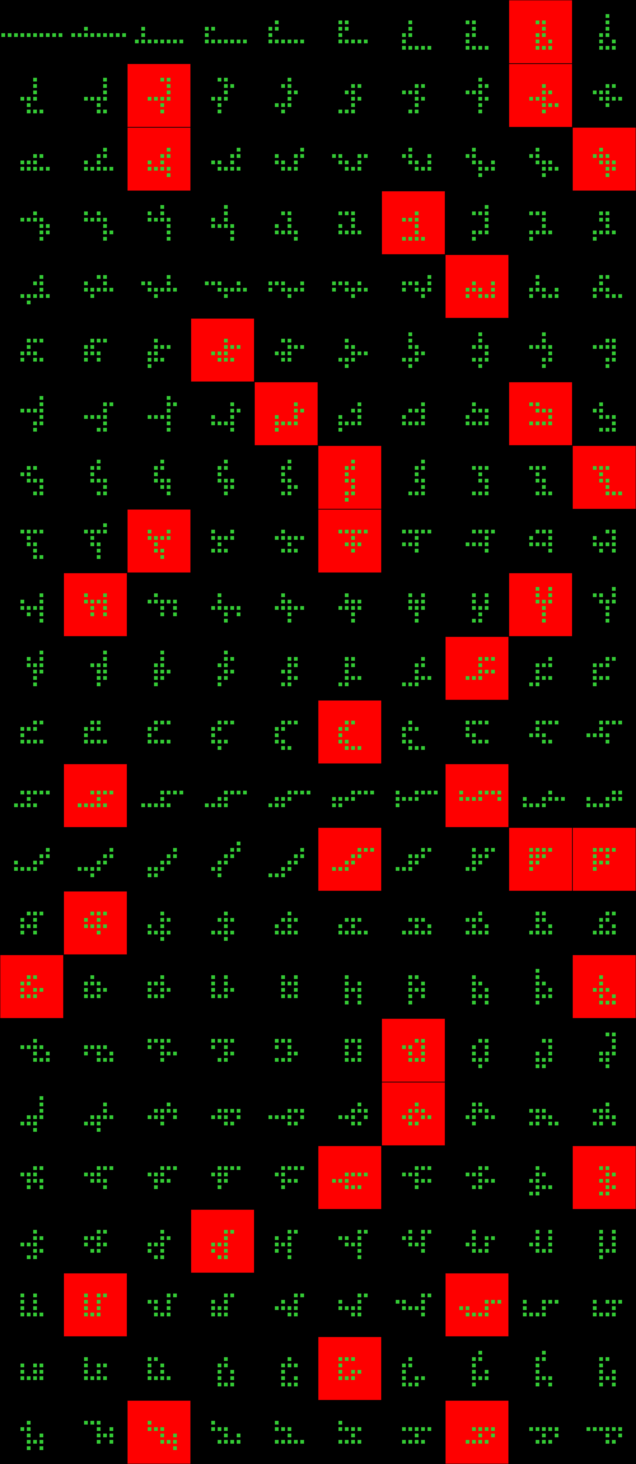
Player 024

Slide 7
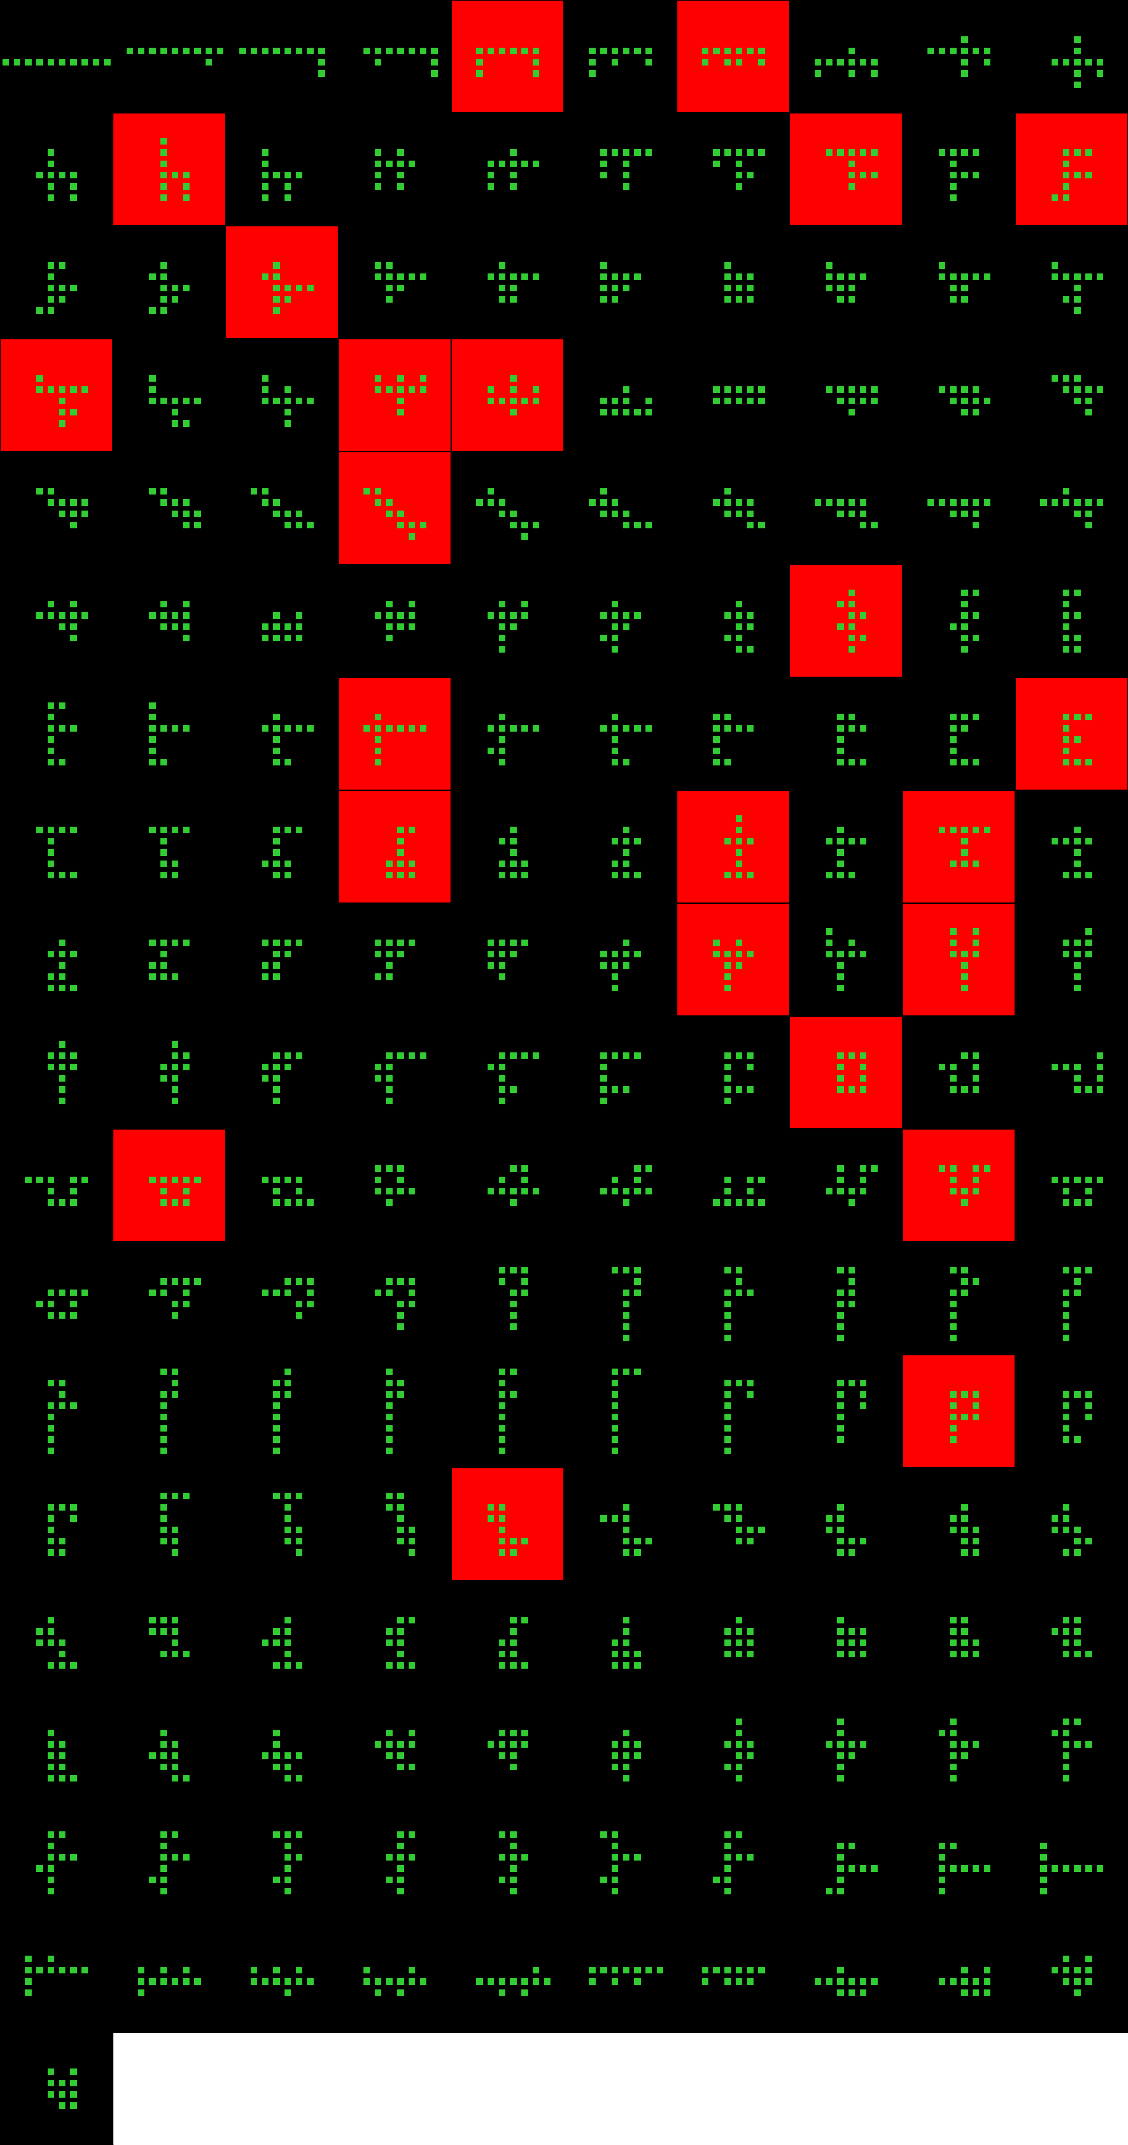
Player 025

Slide 8
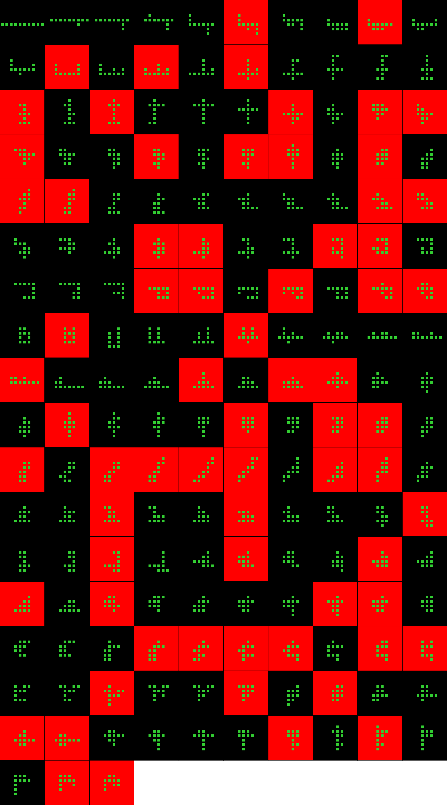
Player 026

Slide 9
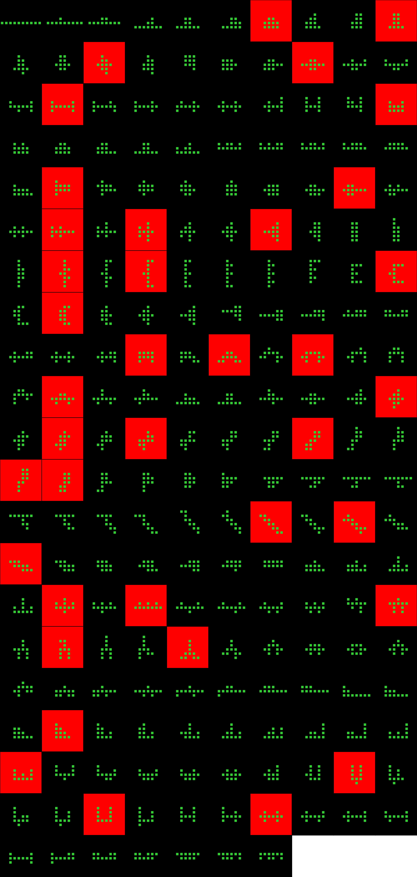
Player 027

Slide 10
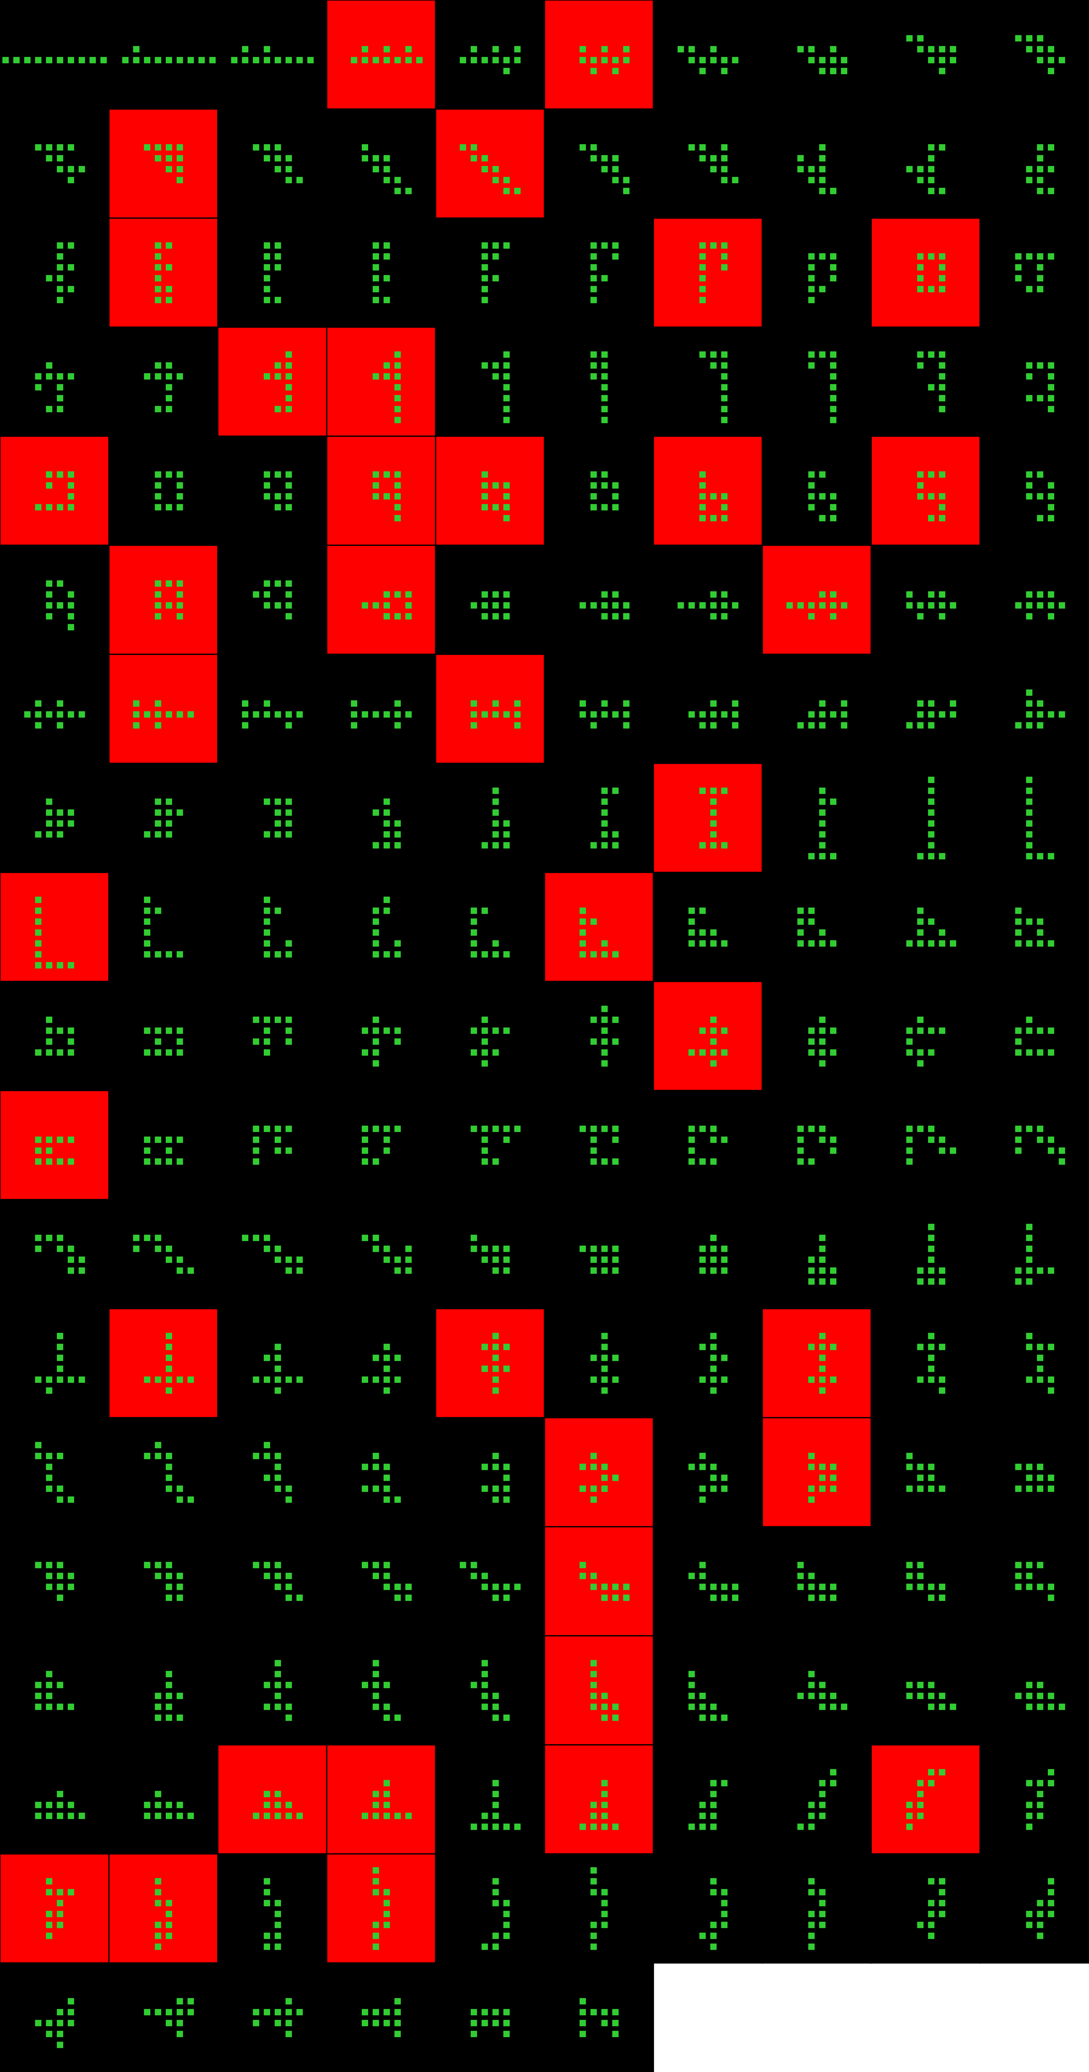
Player 028

Slide 11
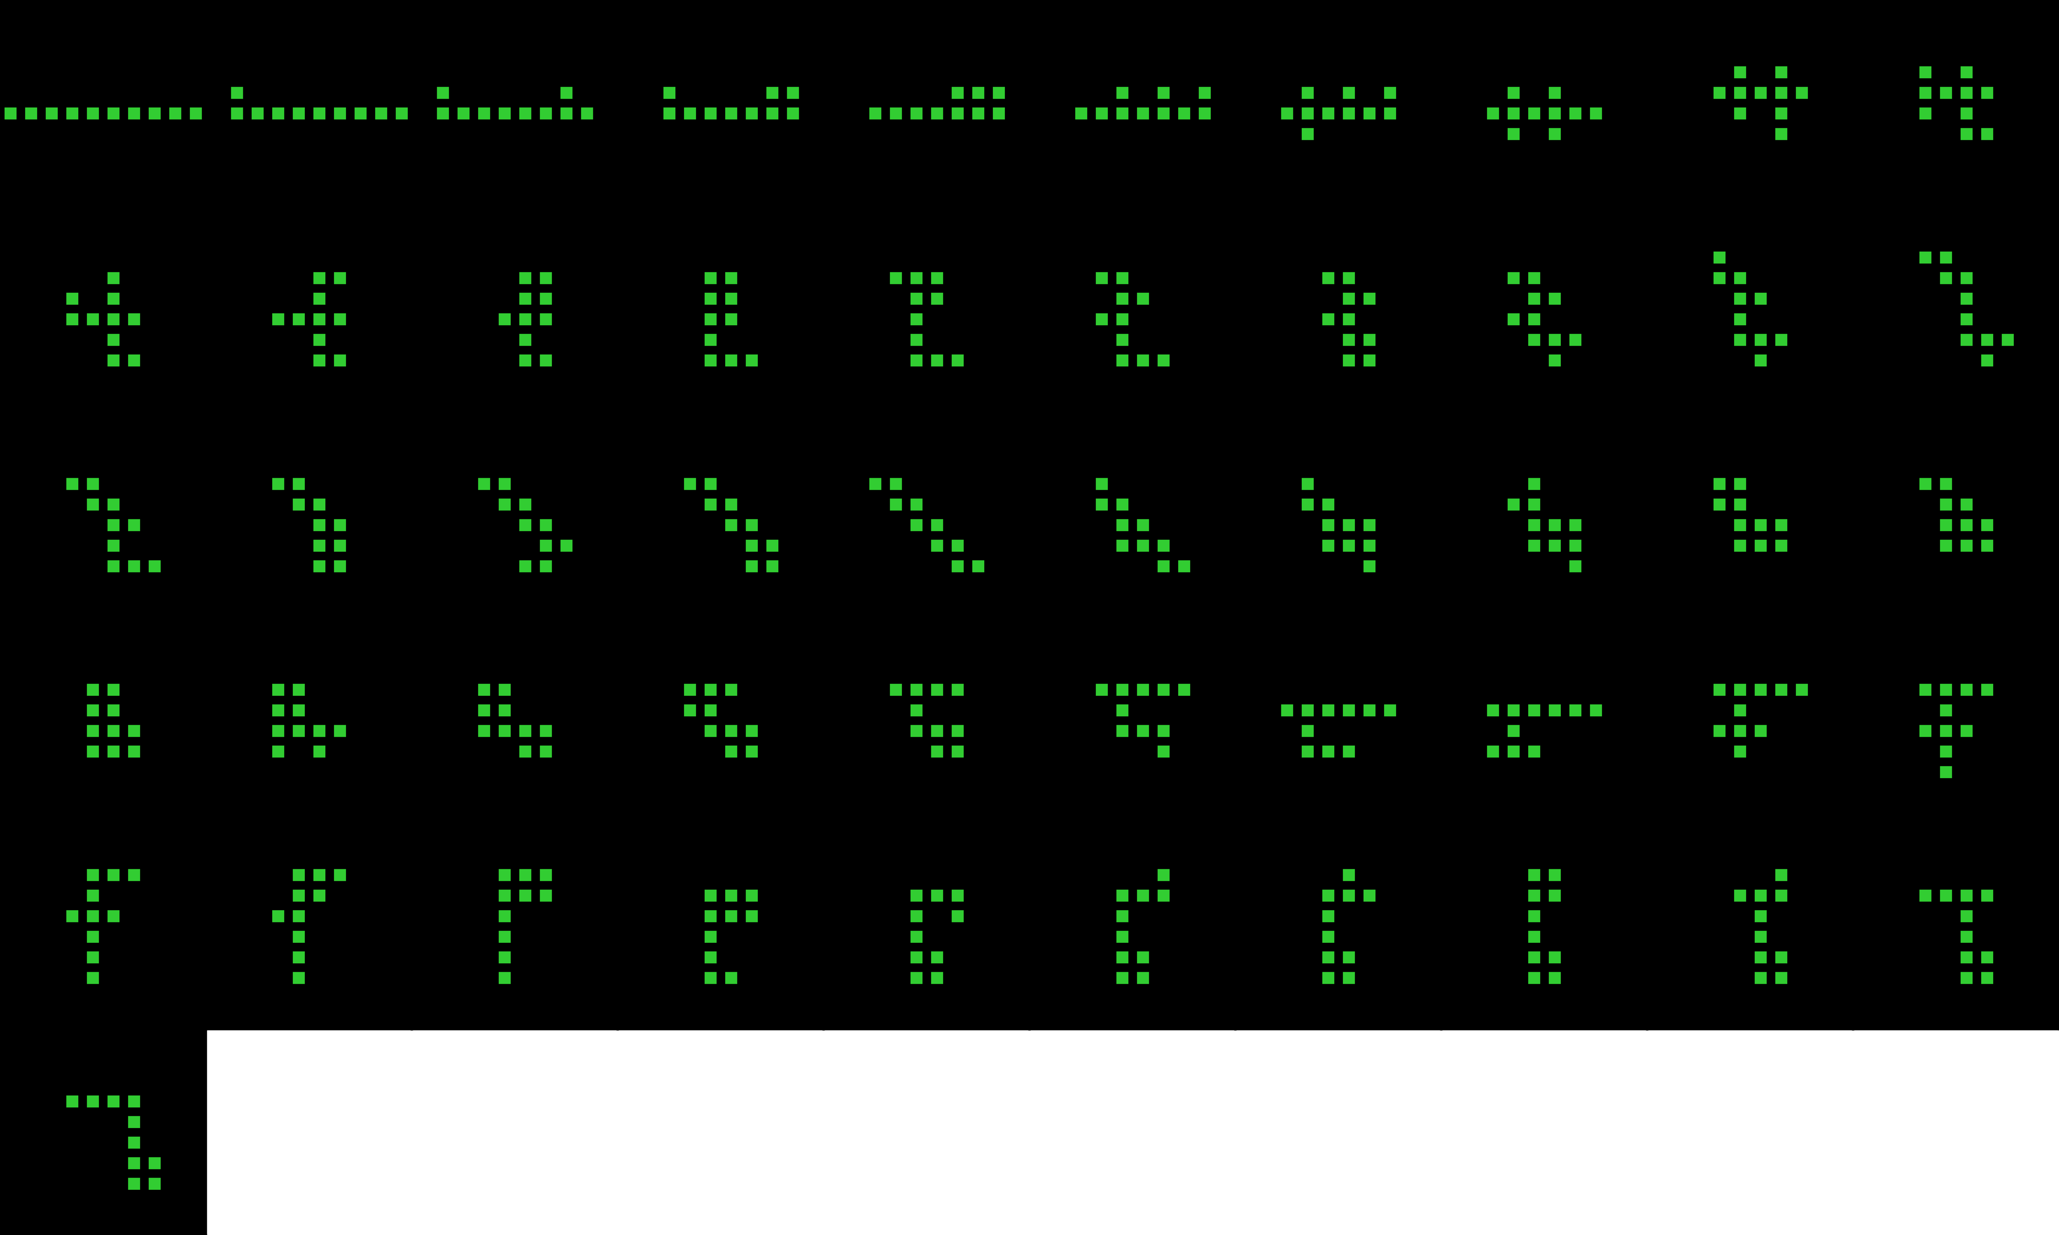
Player 028b

Slide 12
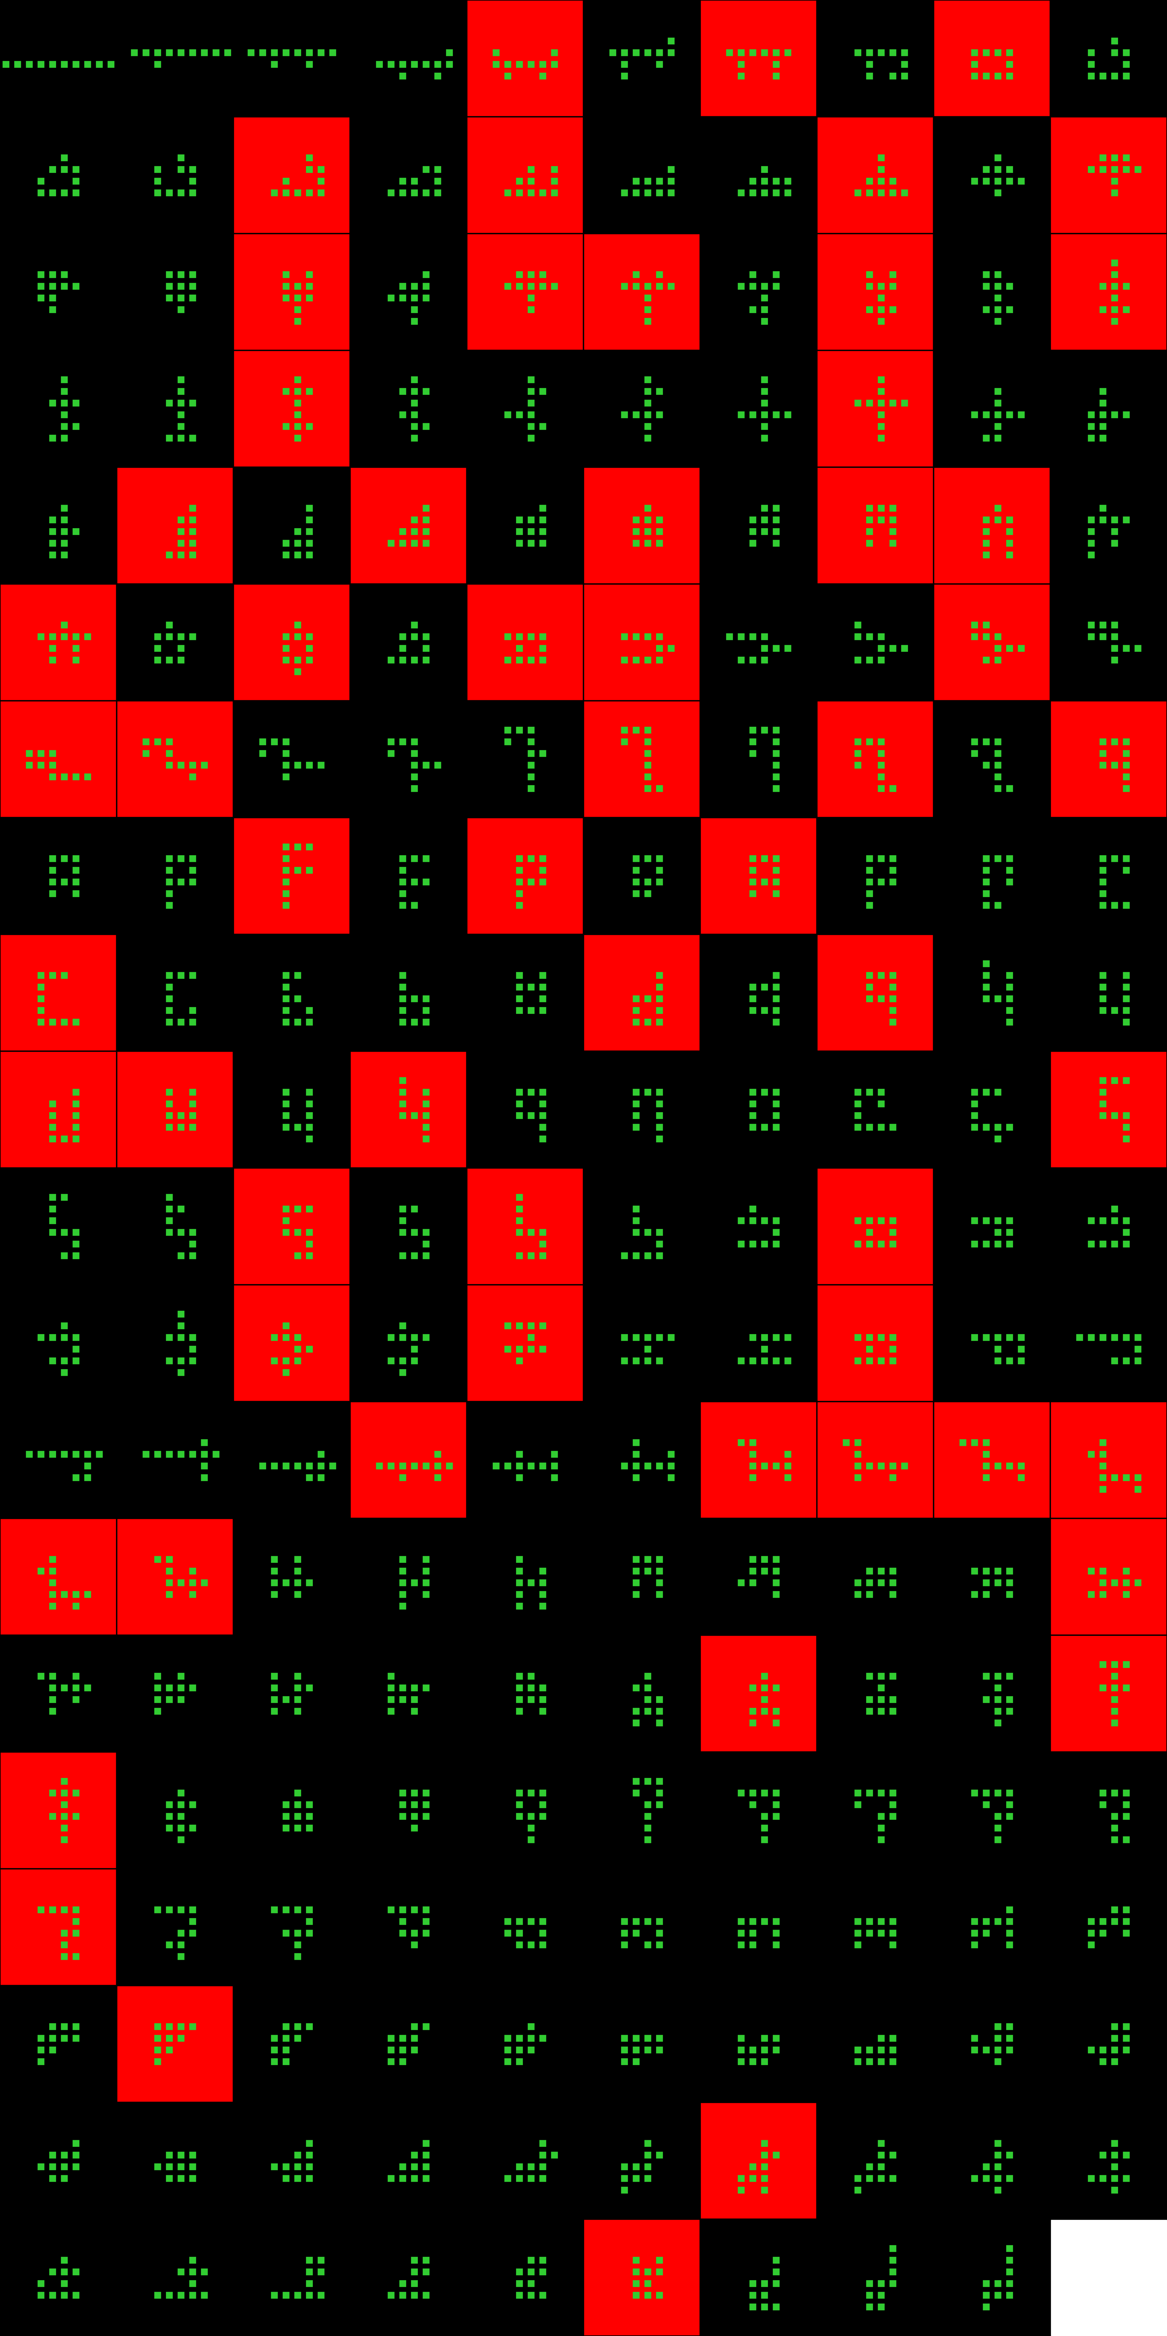
Player 029

Slide 13
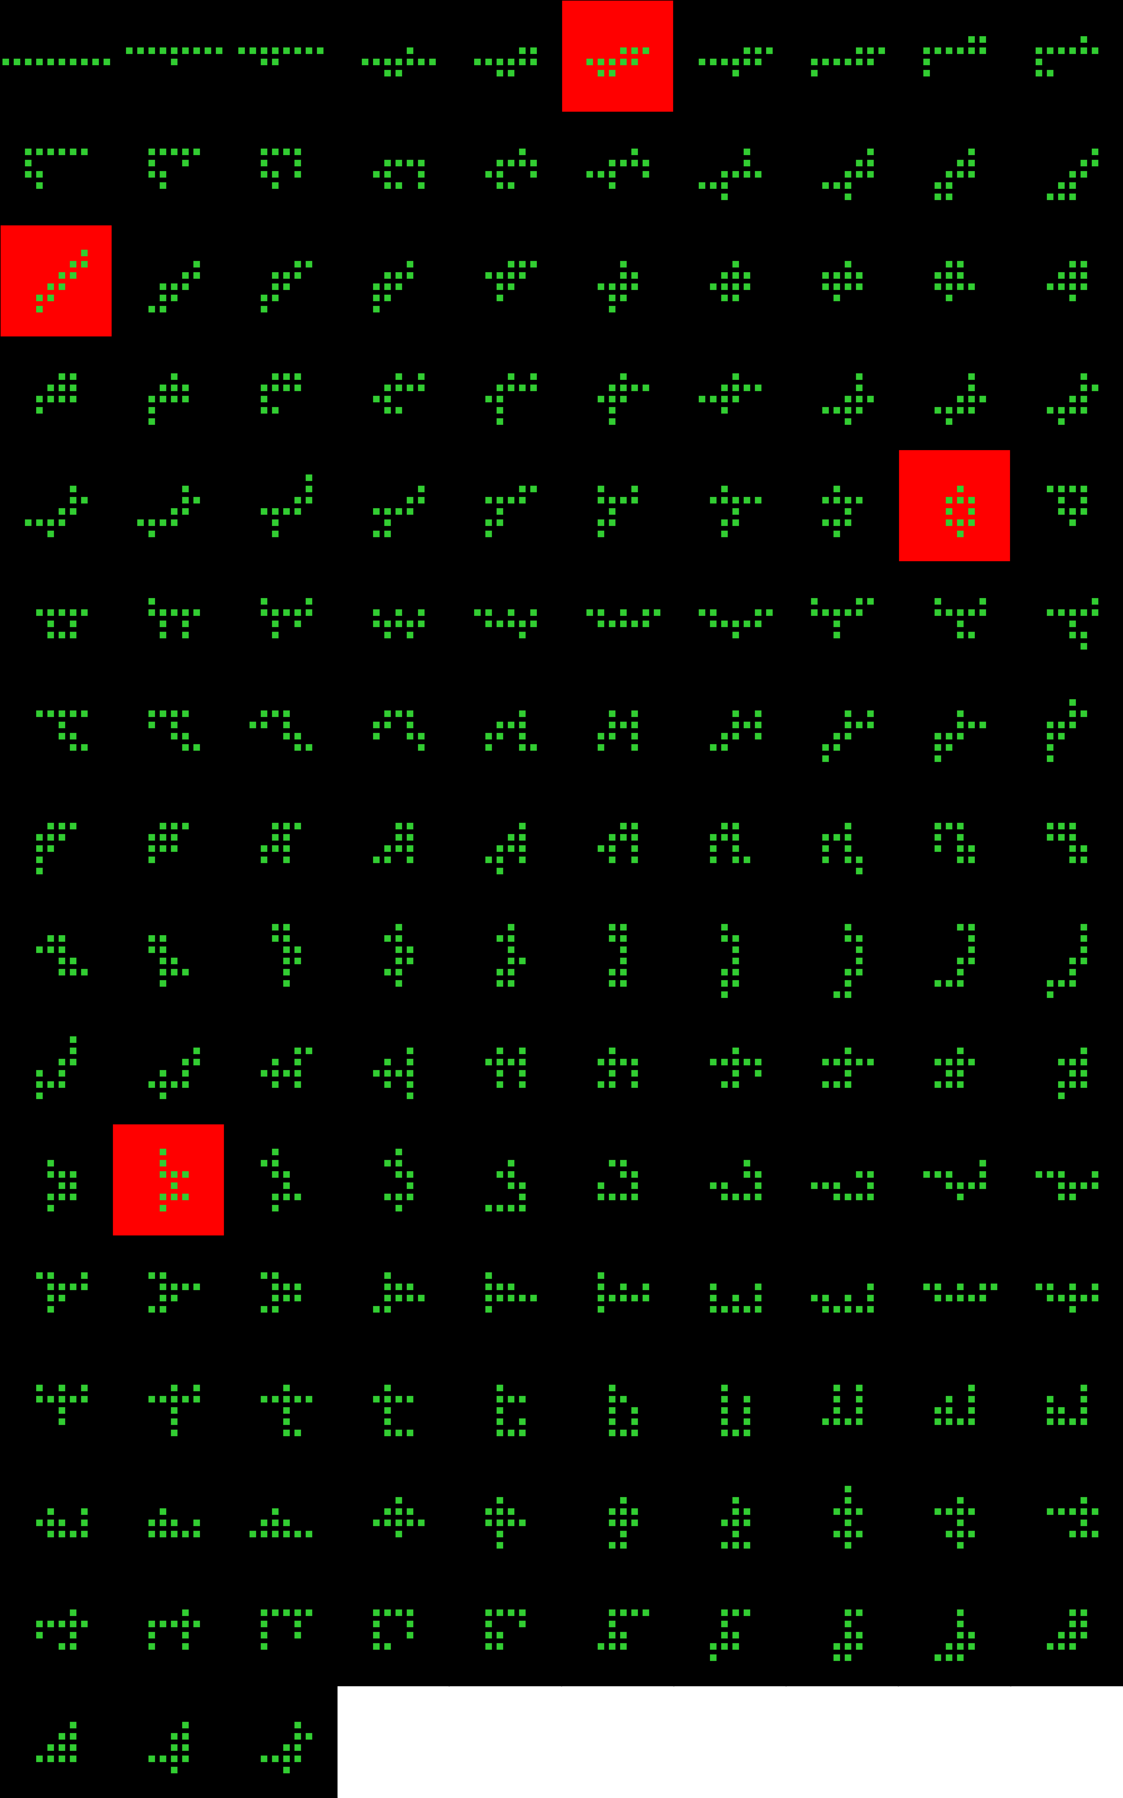
Player 030

Slide 14
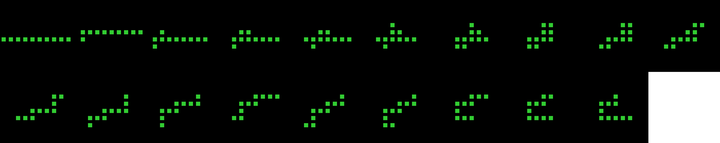
Player 030

Slide 15
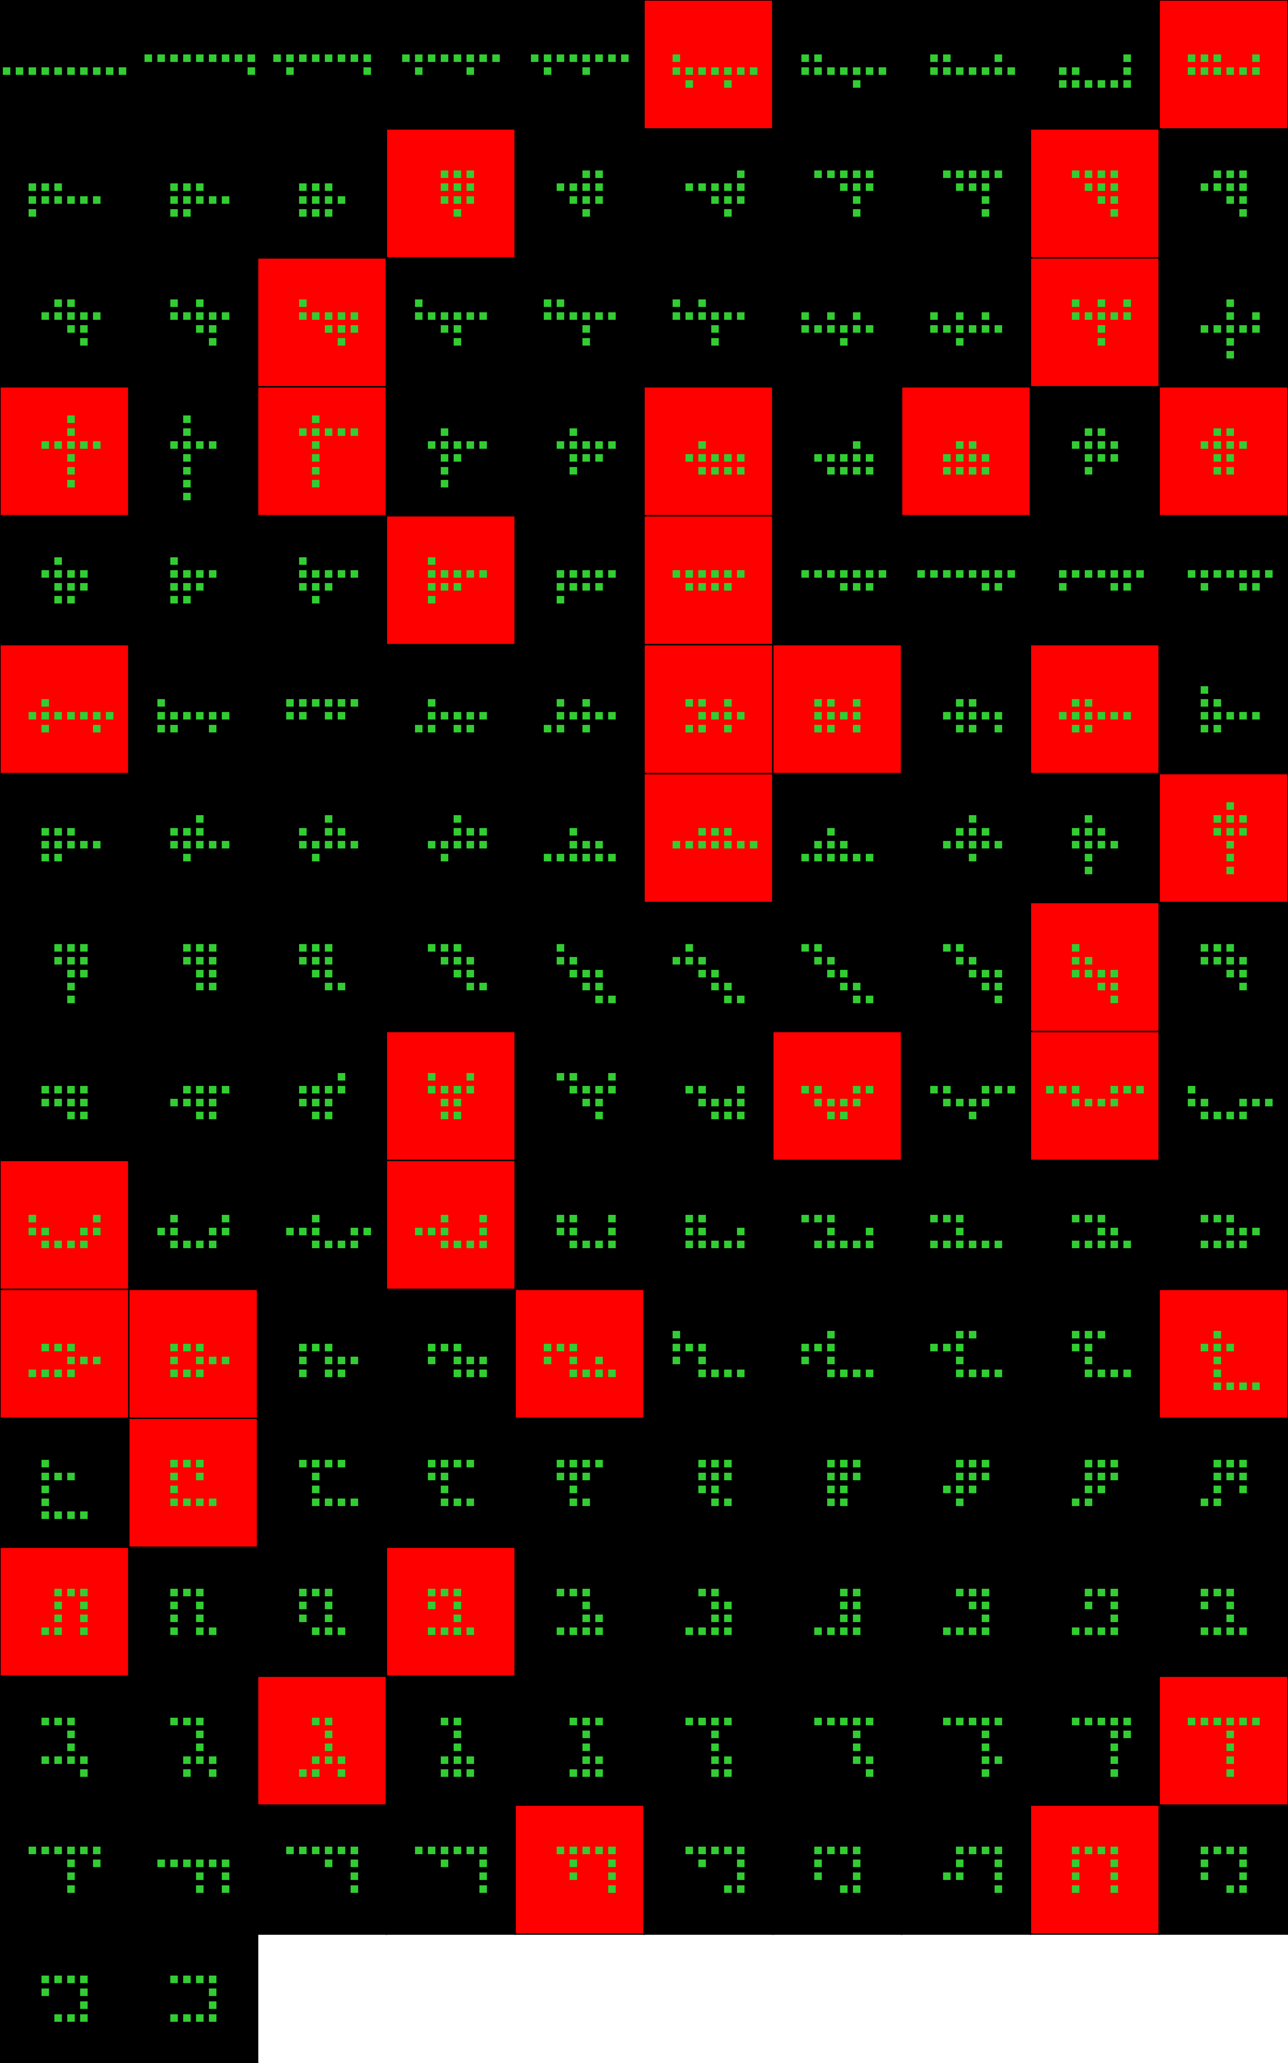
Player 031

Slide 16
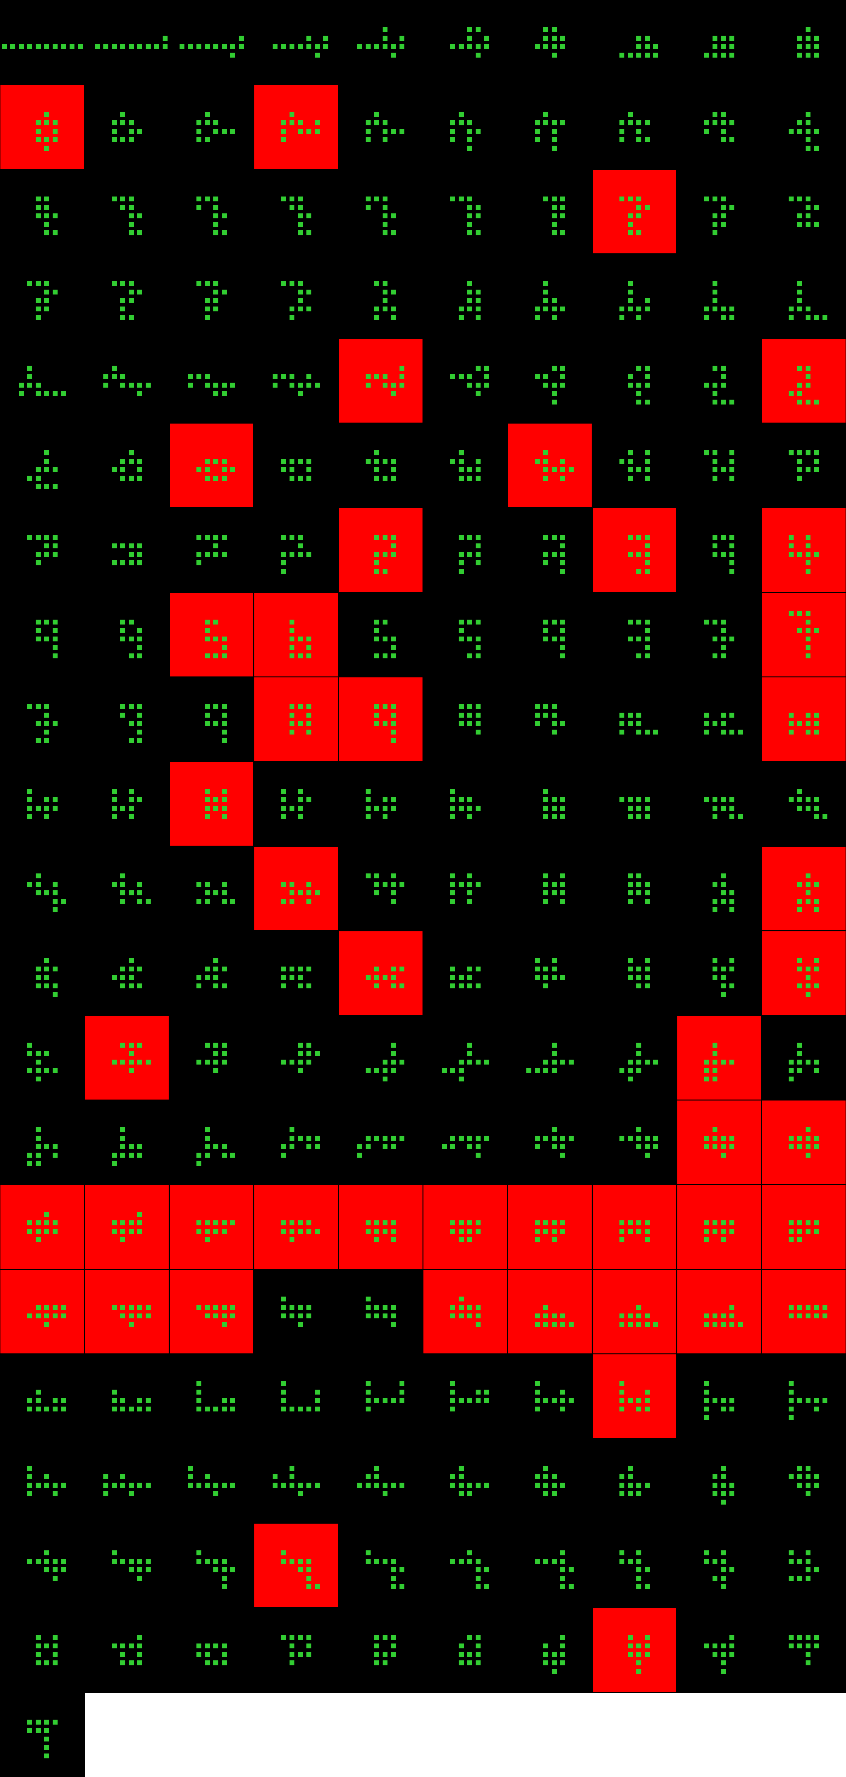
Player 032

Slide 17
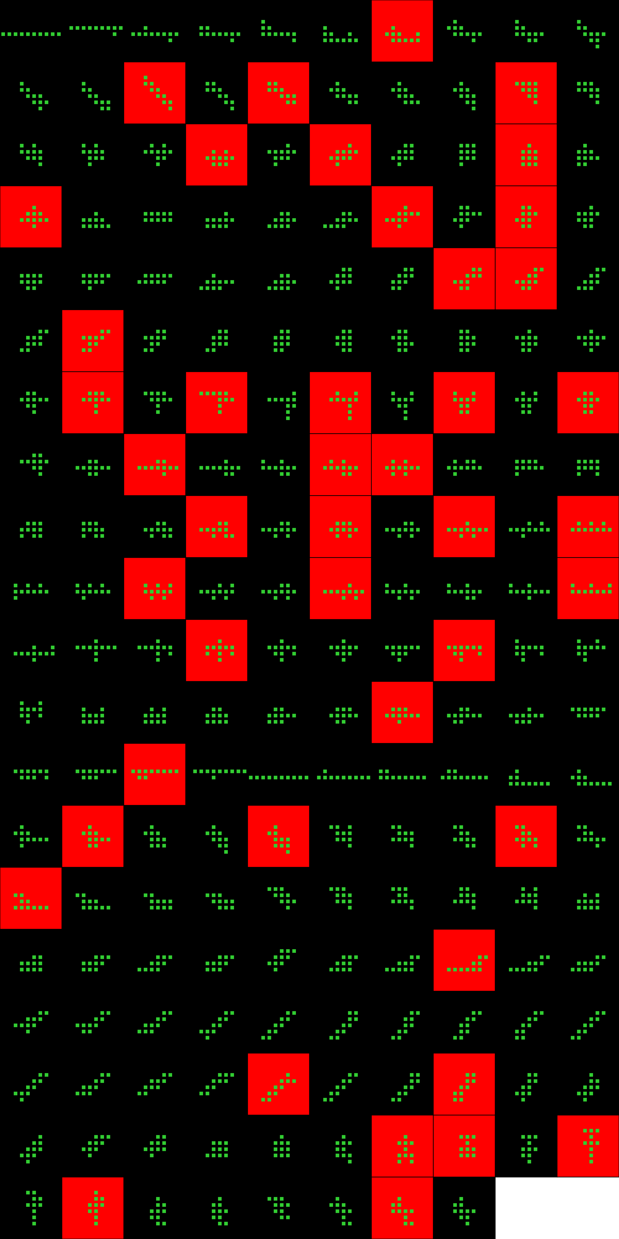
Player 033

Slide 18
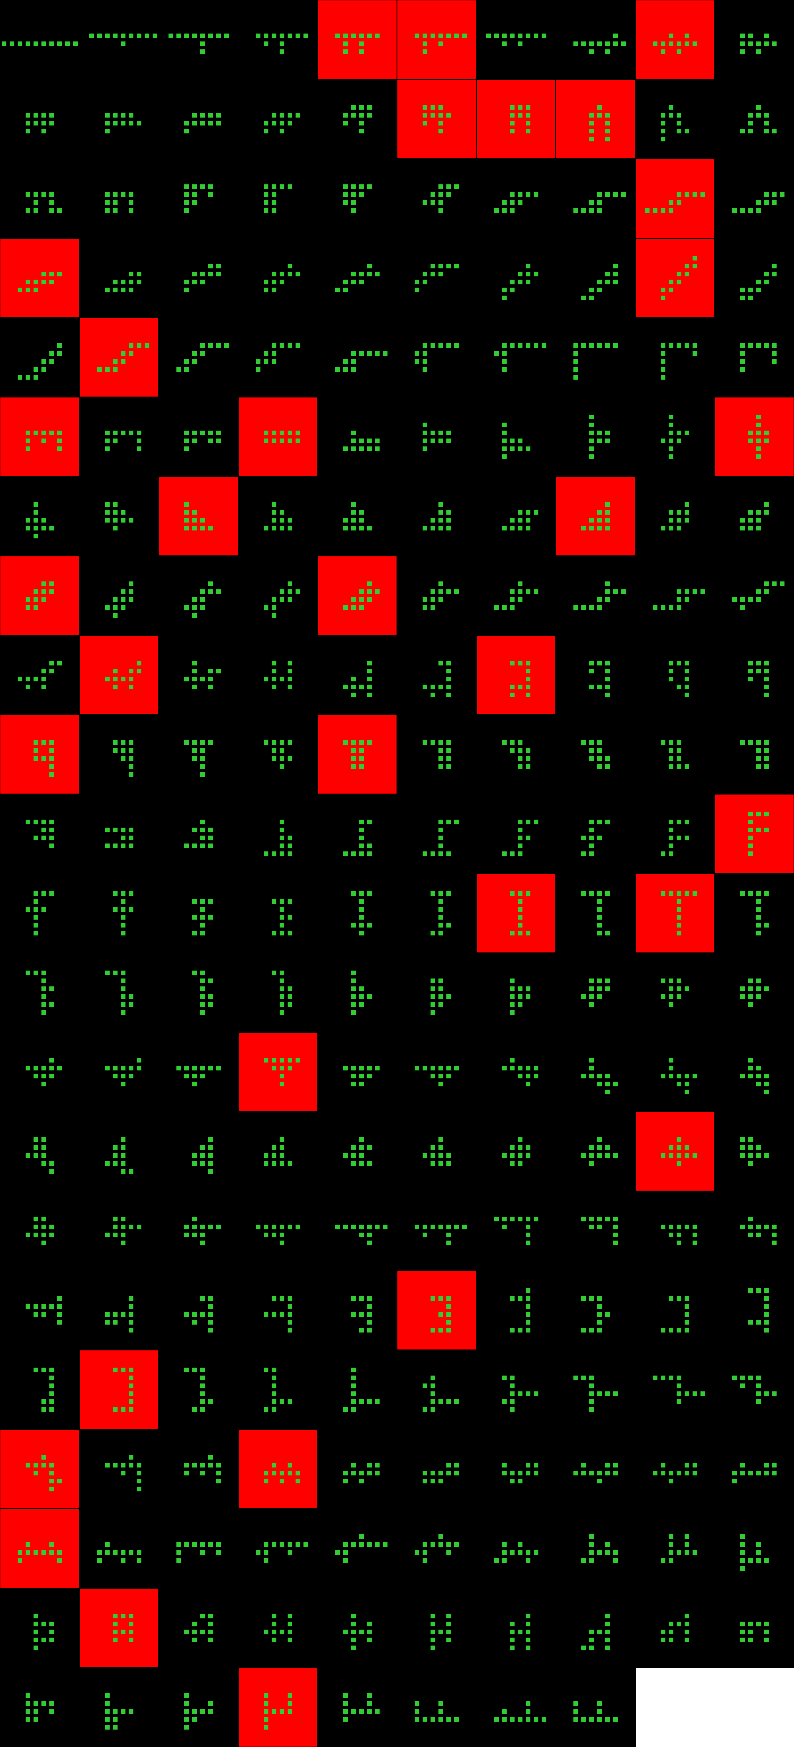
Player 034

Slide 19
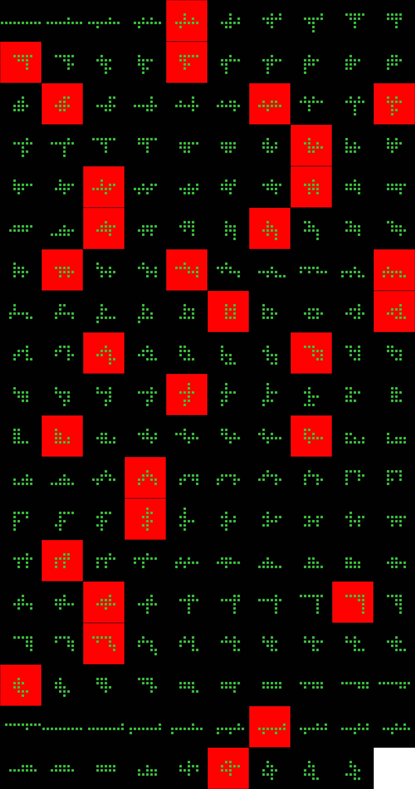
Player 035

Slide 20
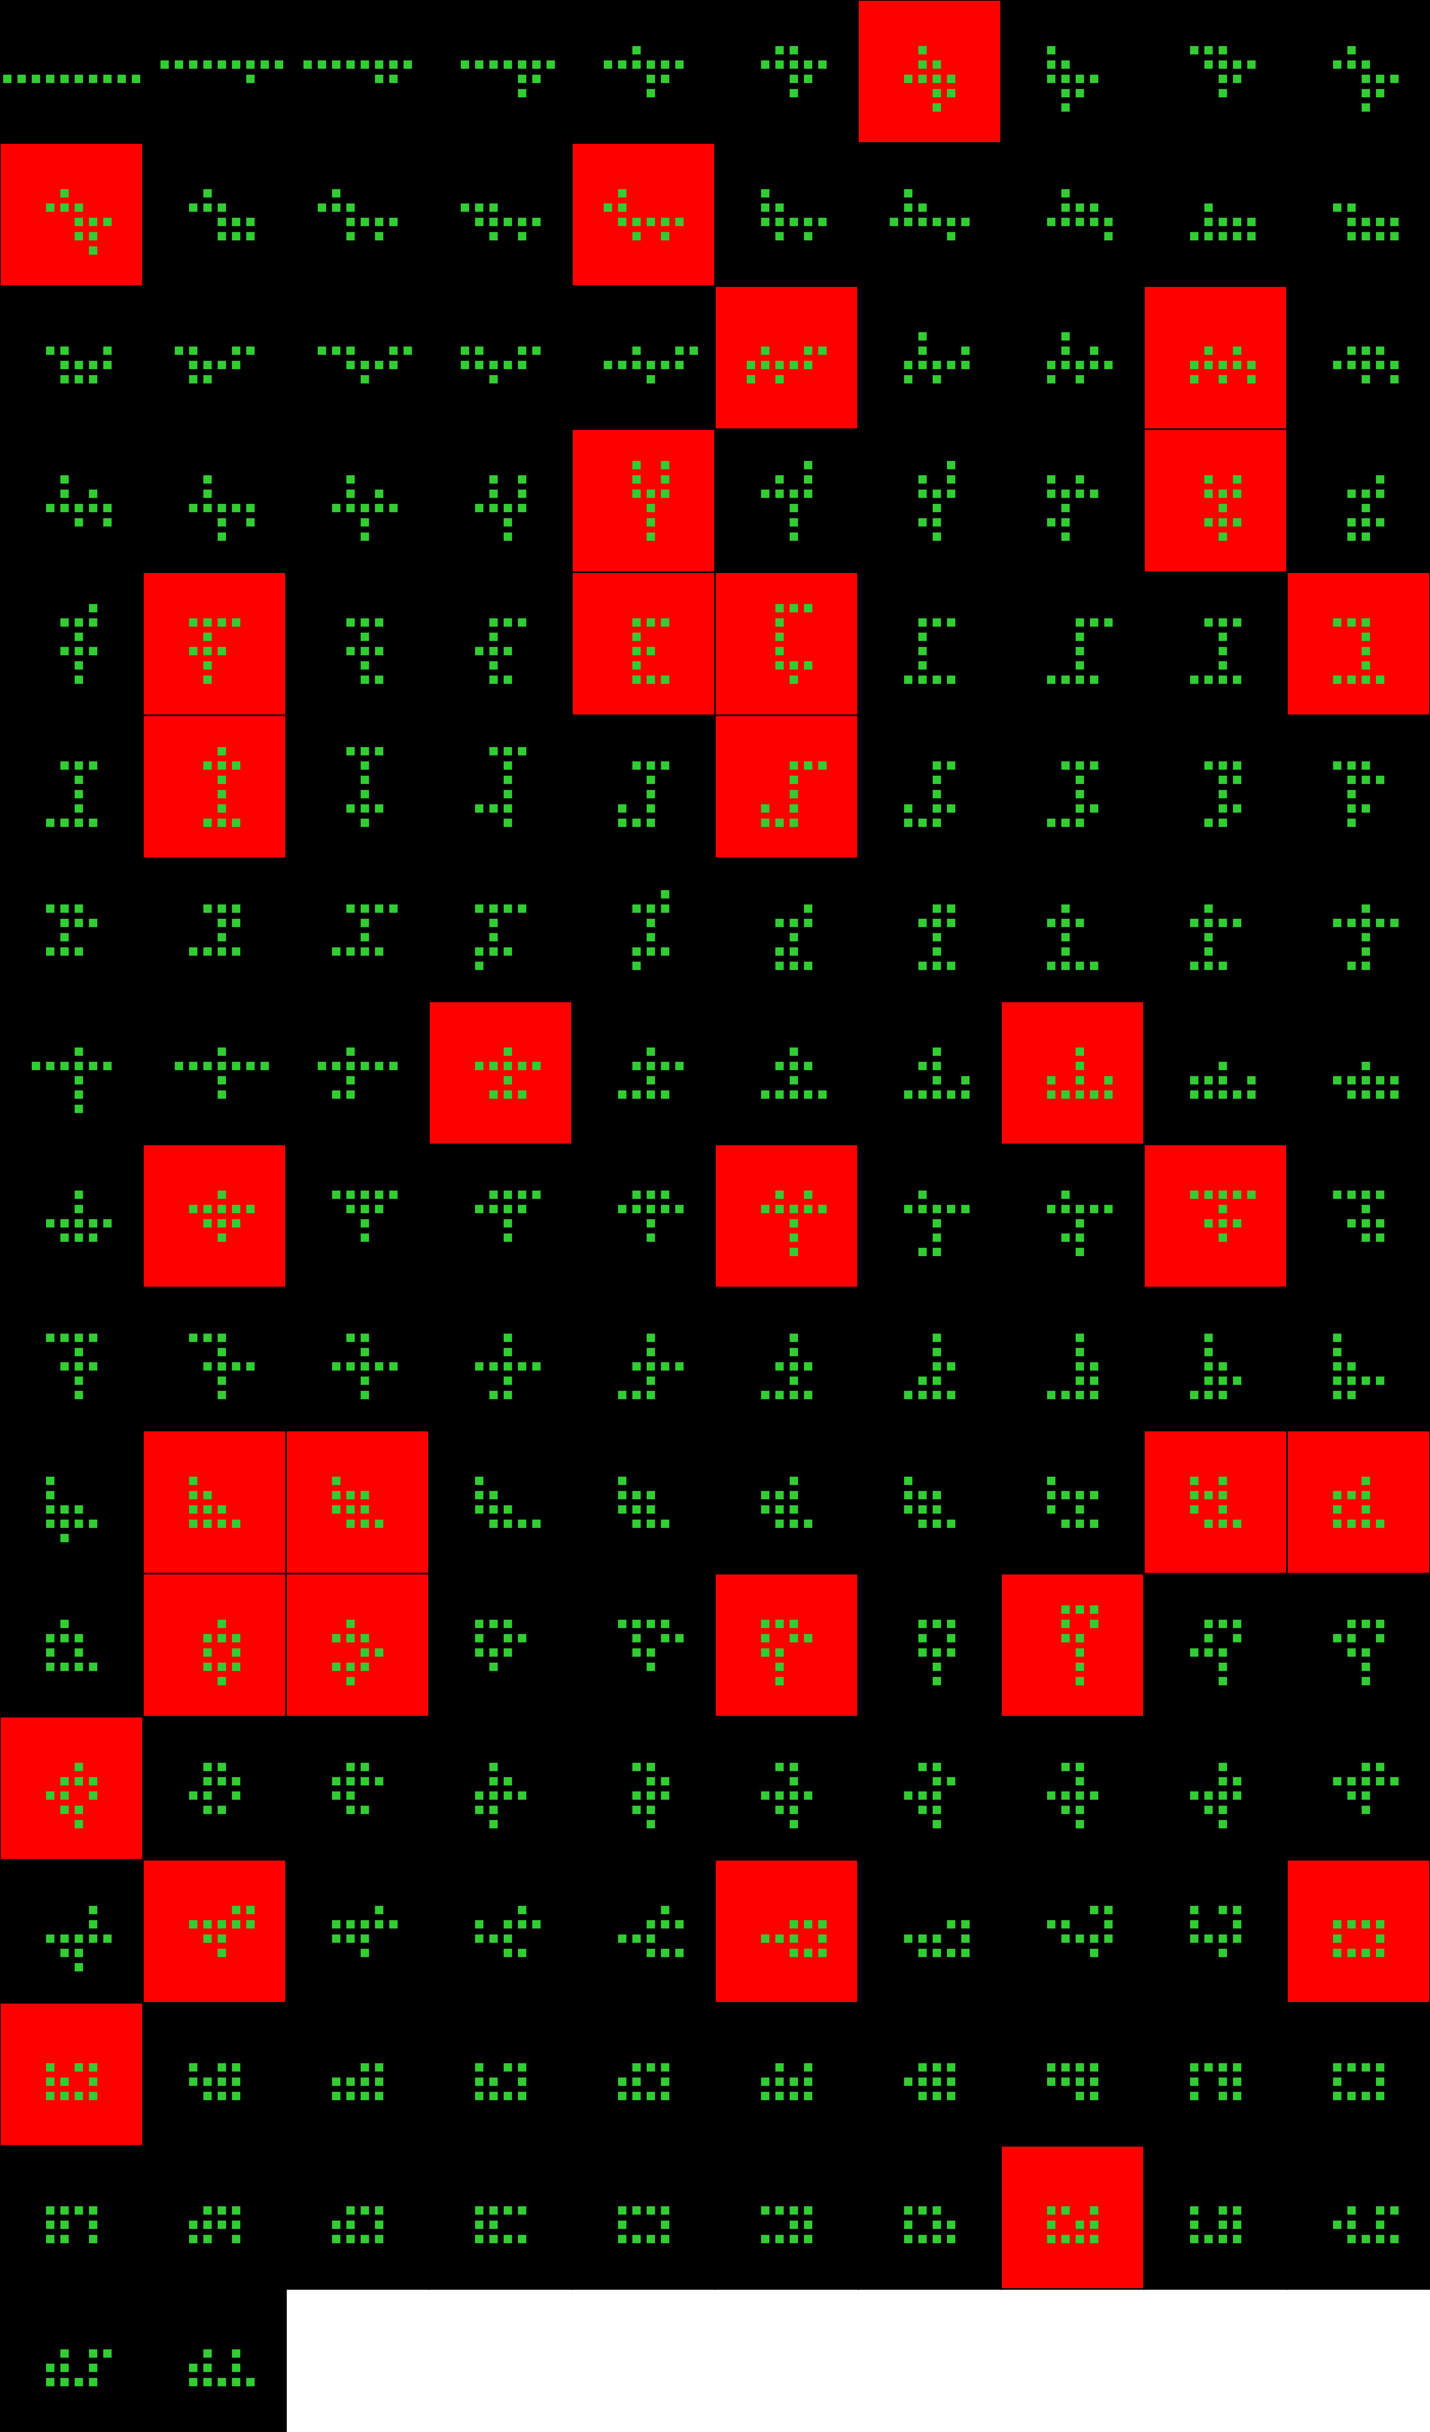
Player 036

Slide 21
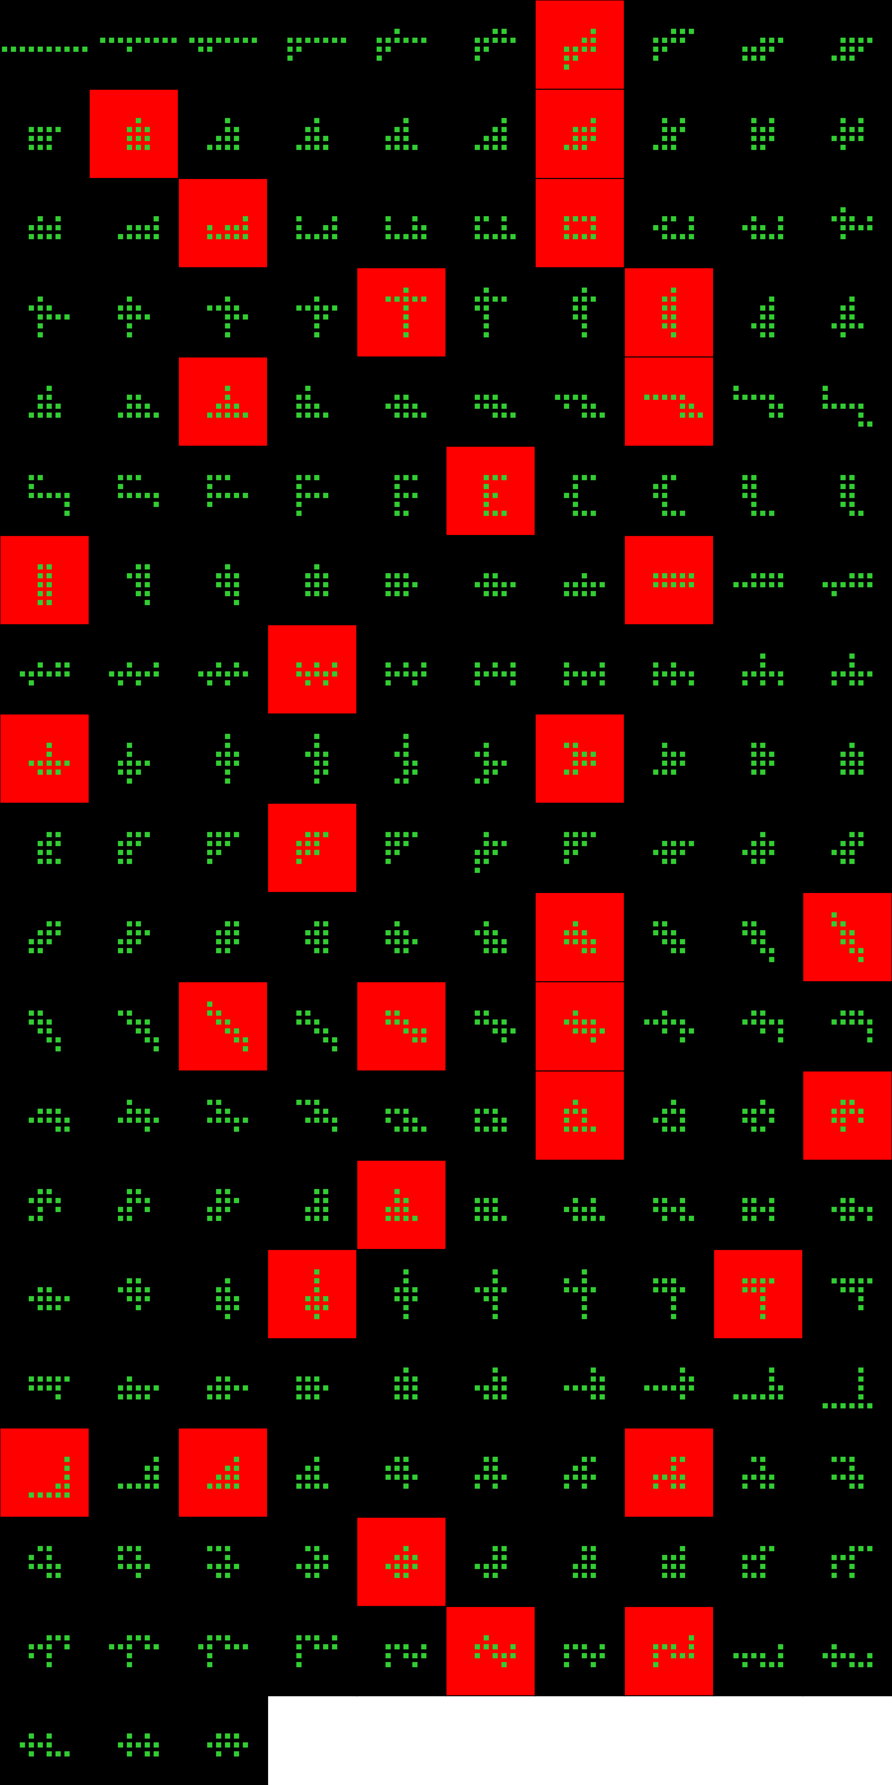
Player 037

Slide 22
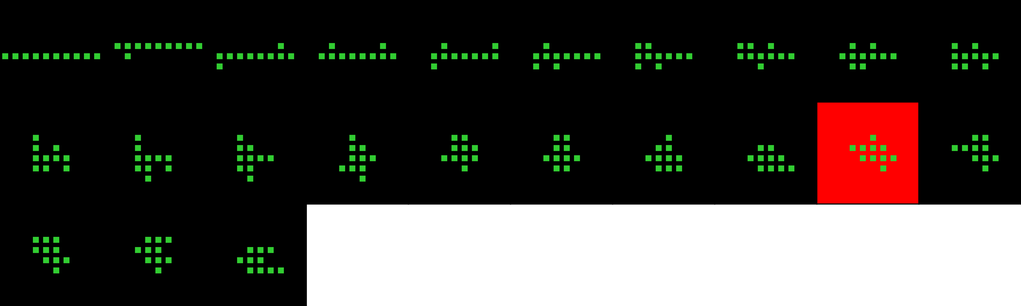
Player 038

Slide 23
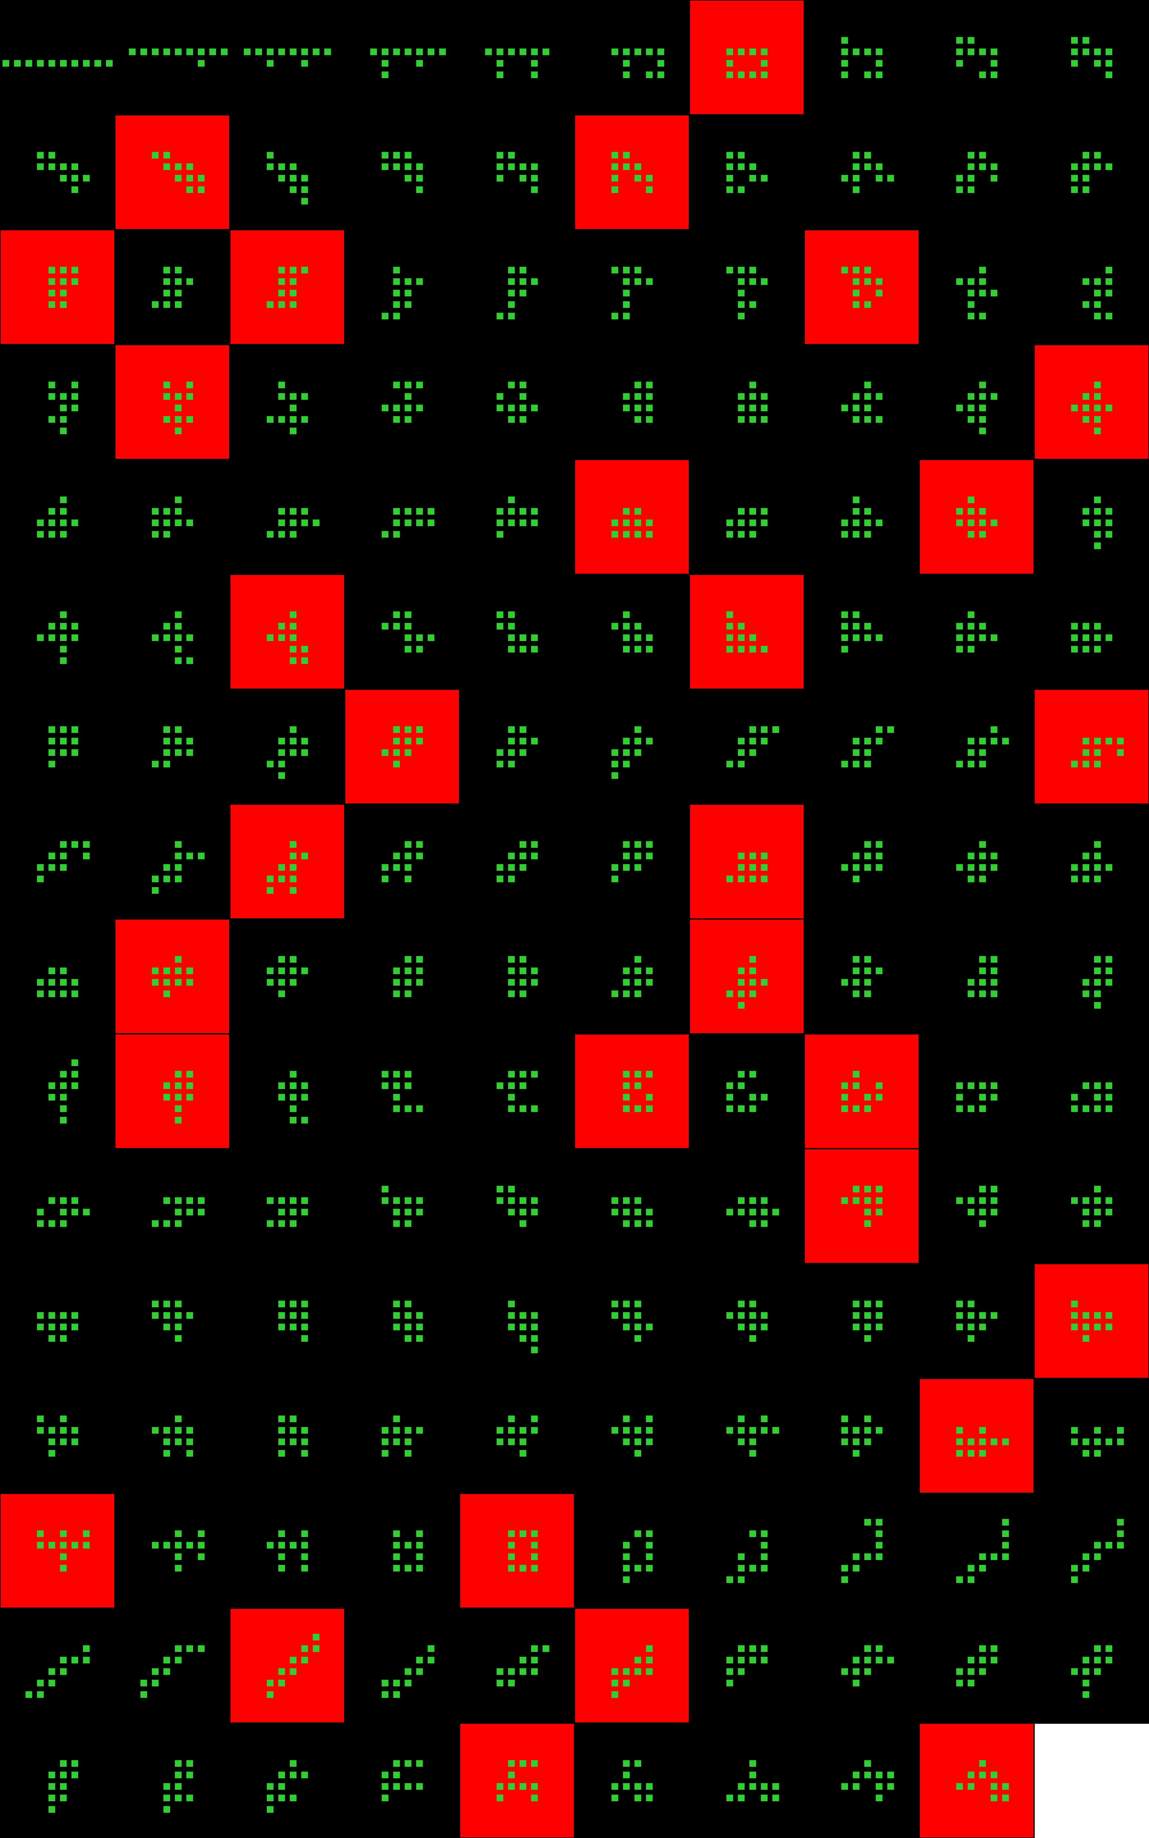
Player 038

Slide 24
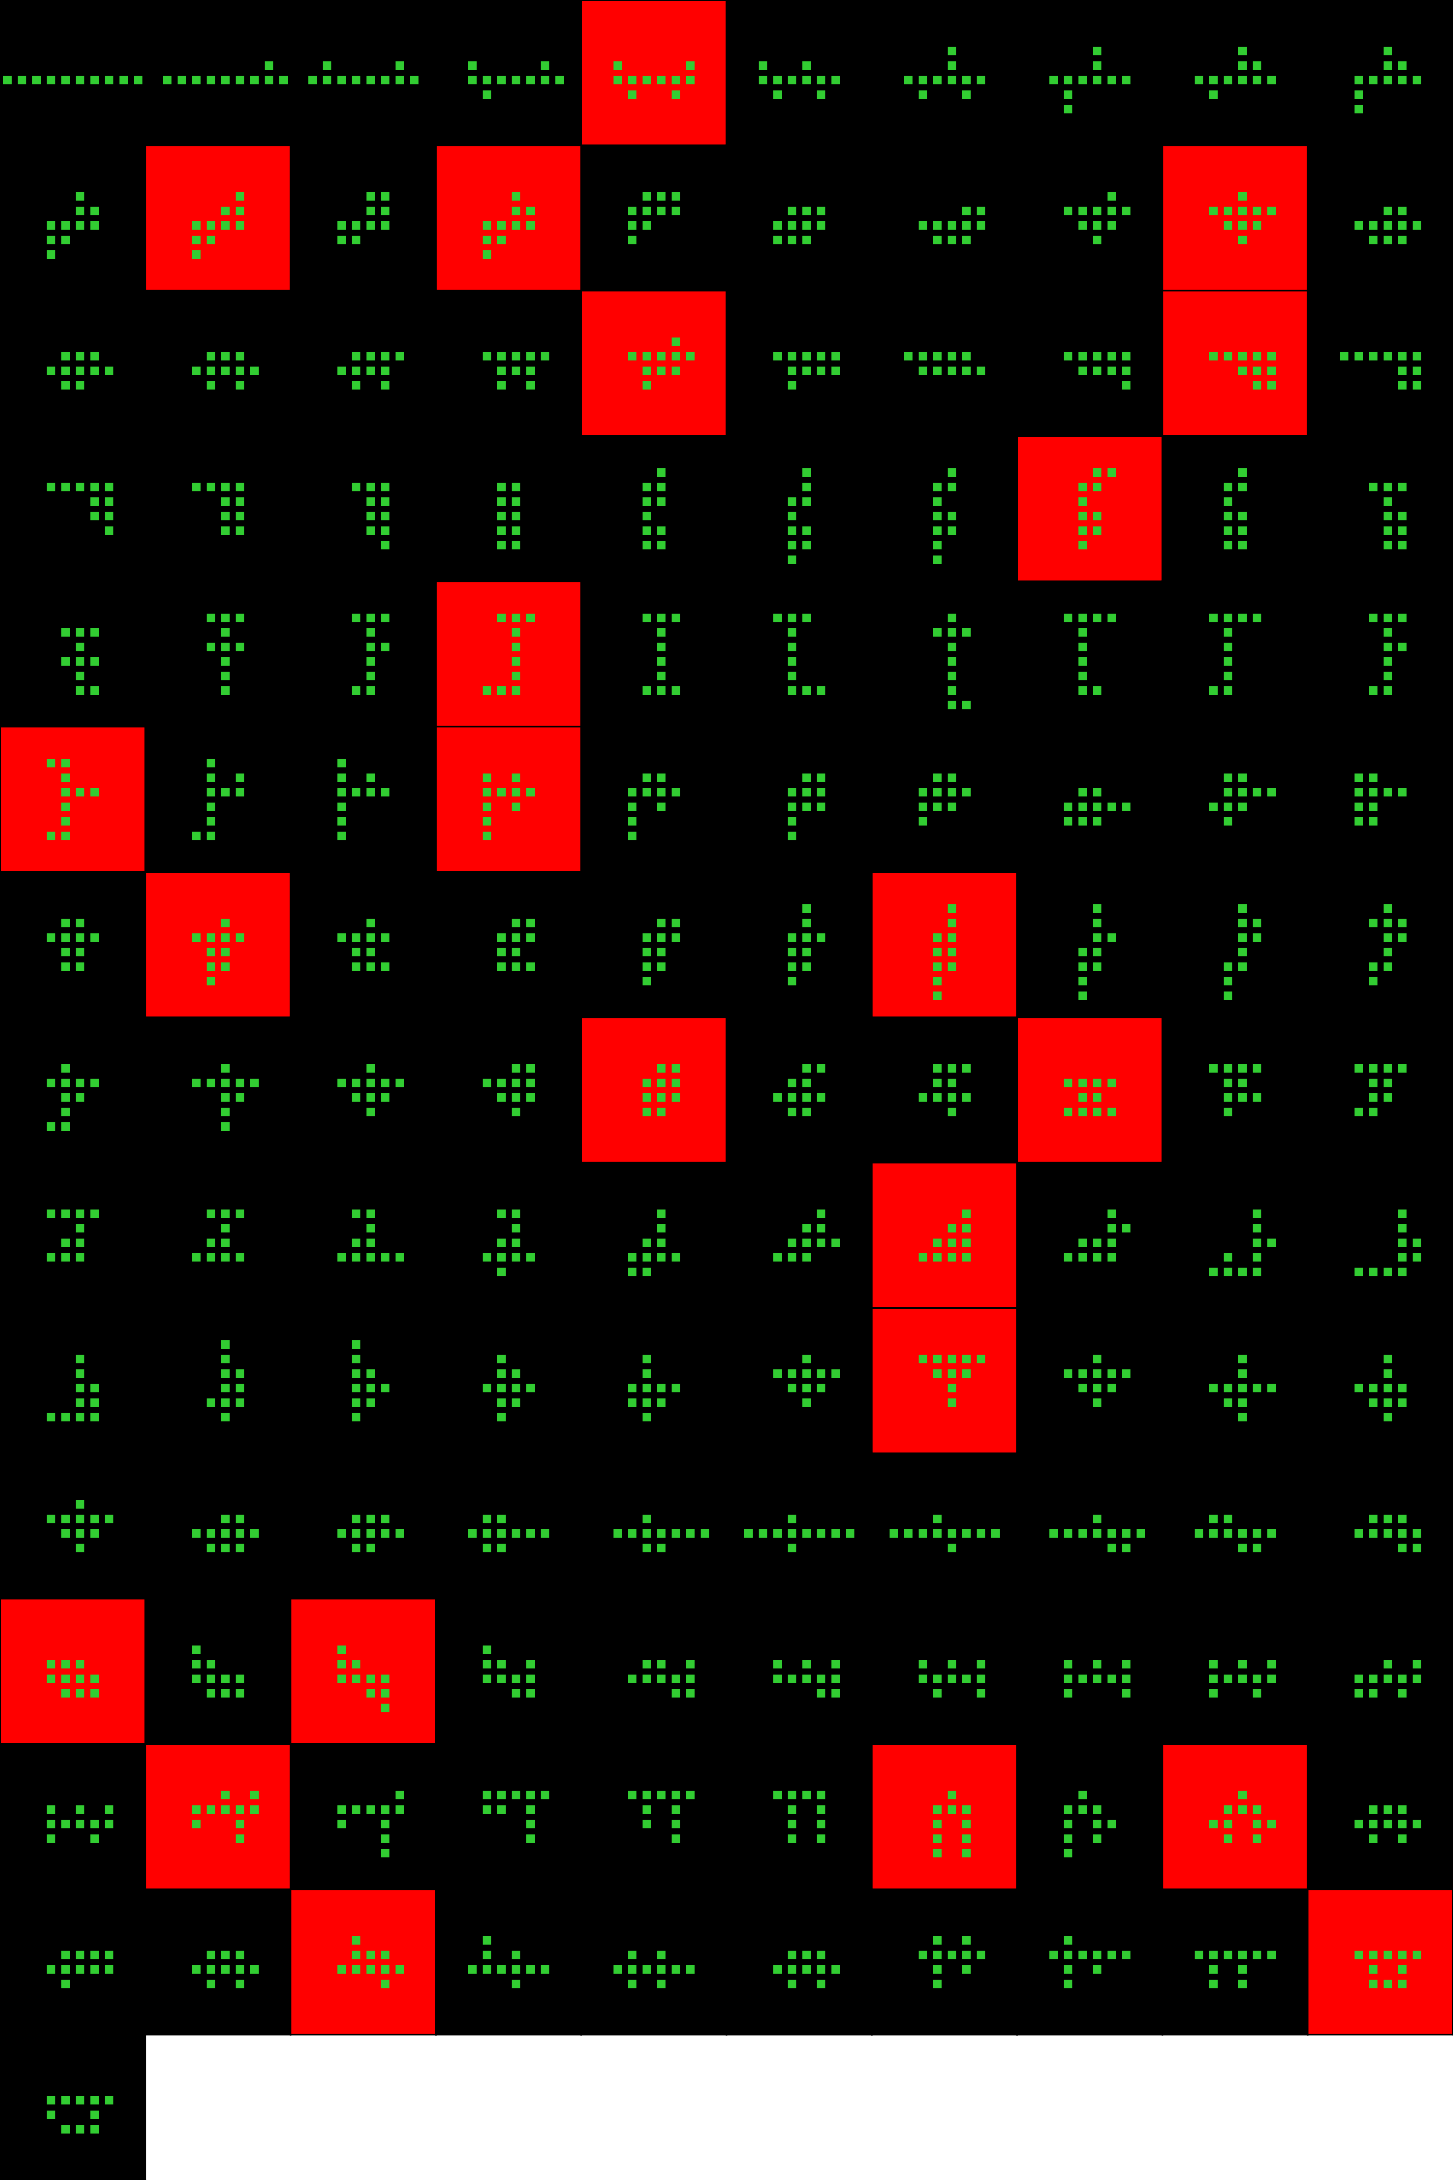
Player 039

Slide 25
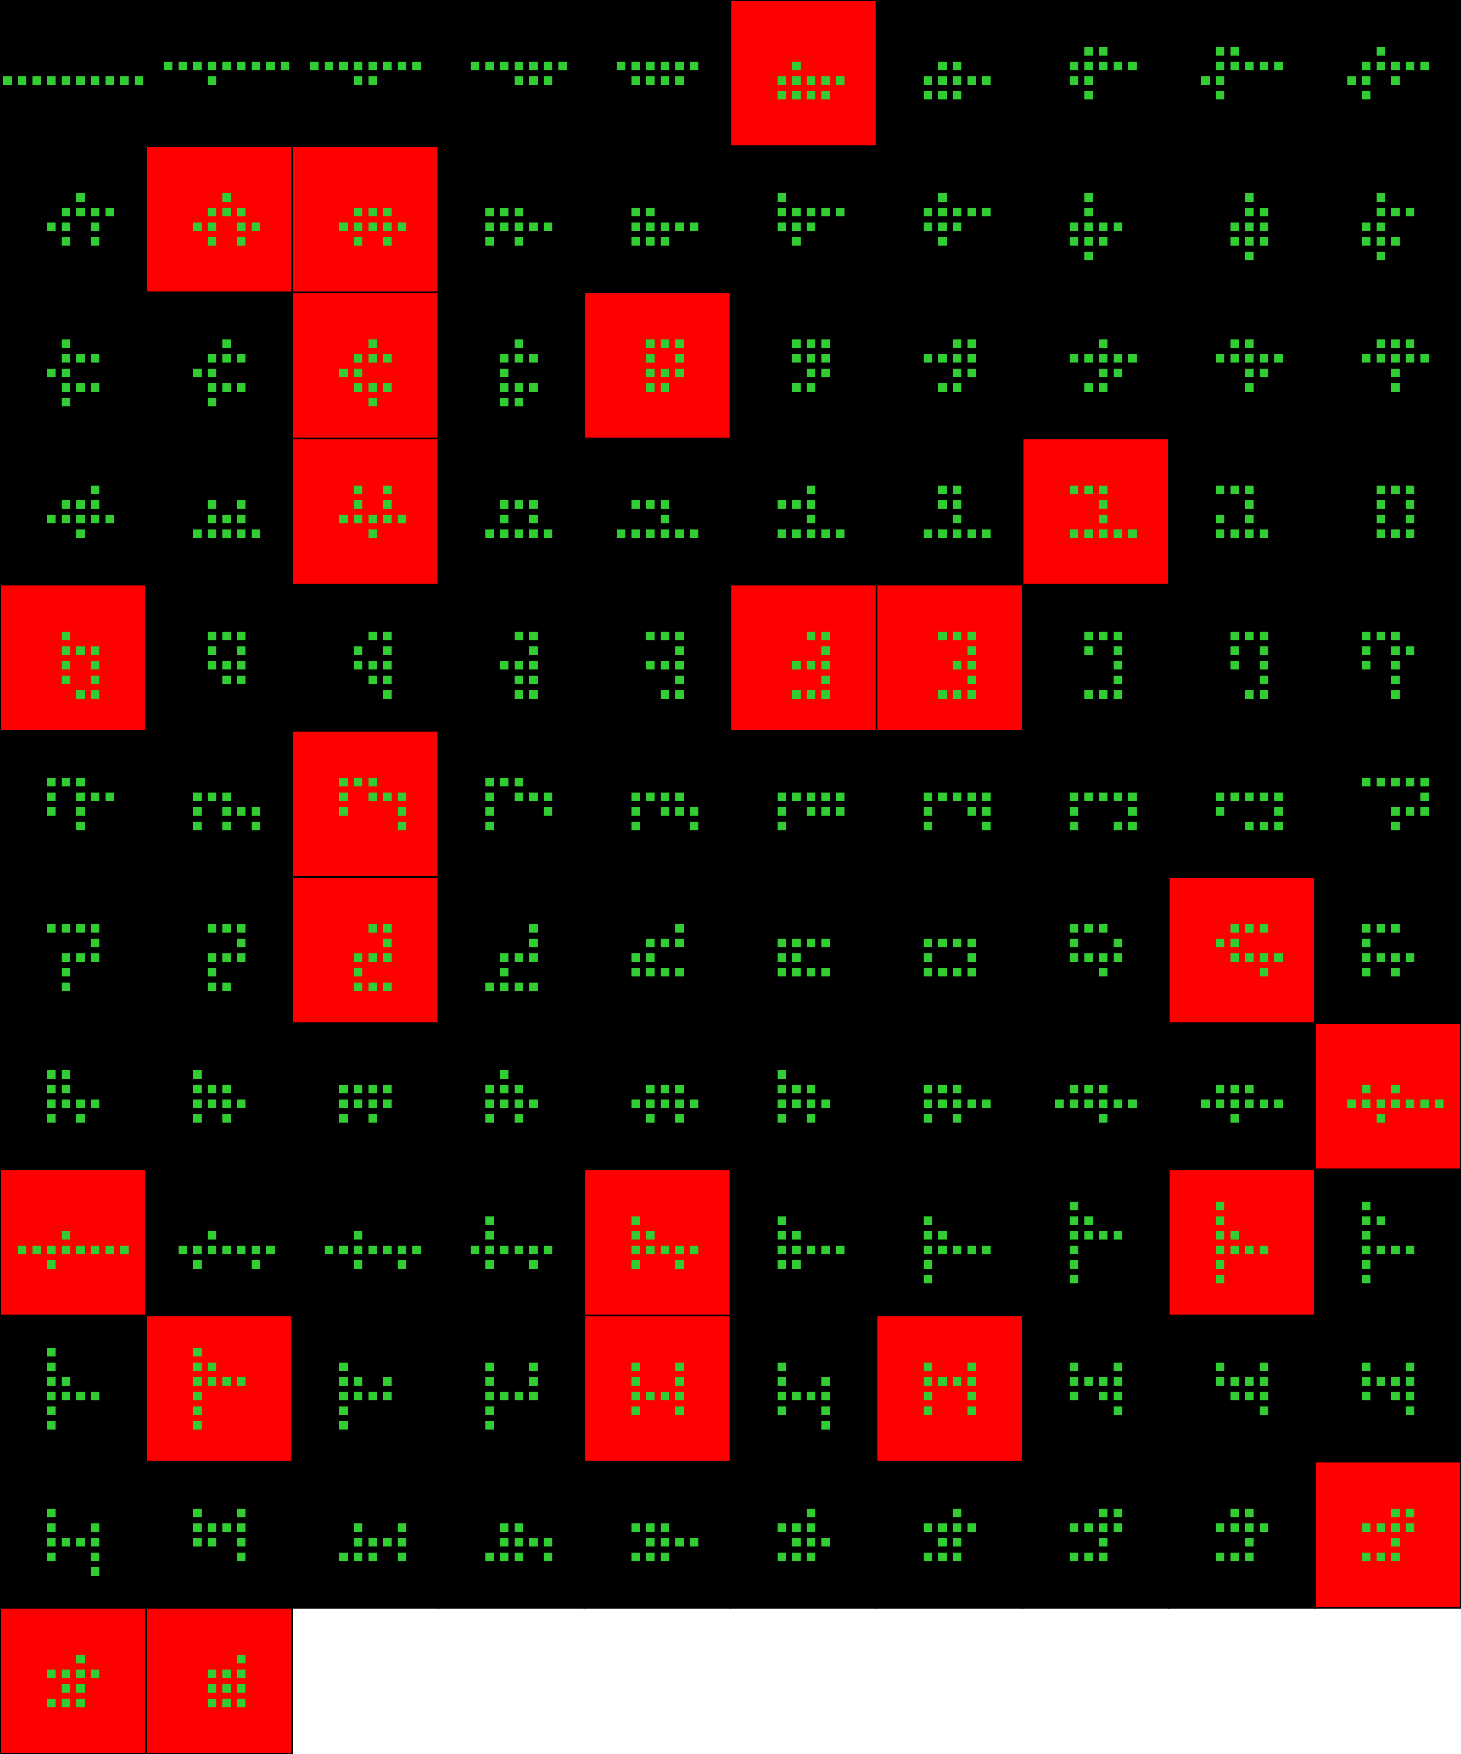
Player 040

Slide 26
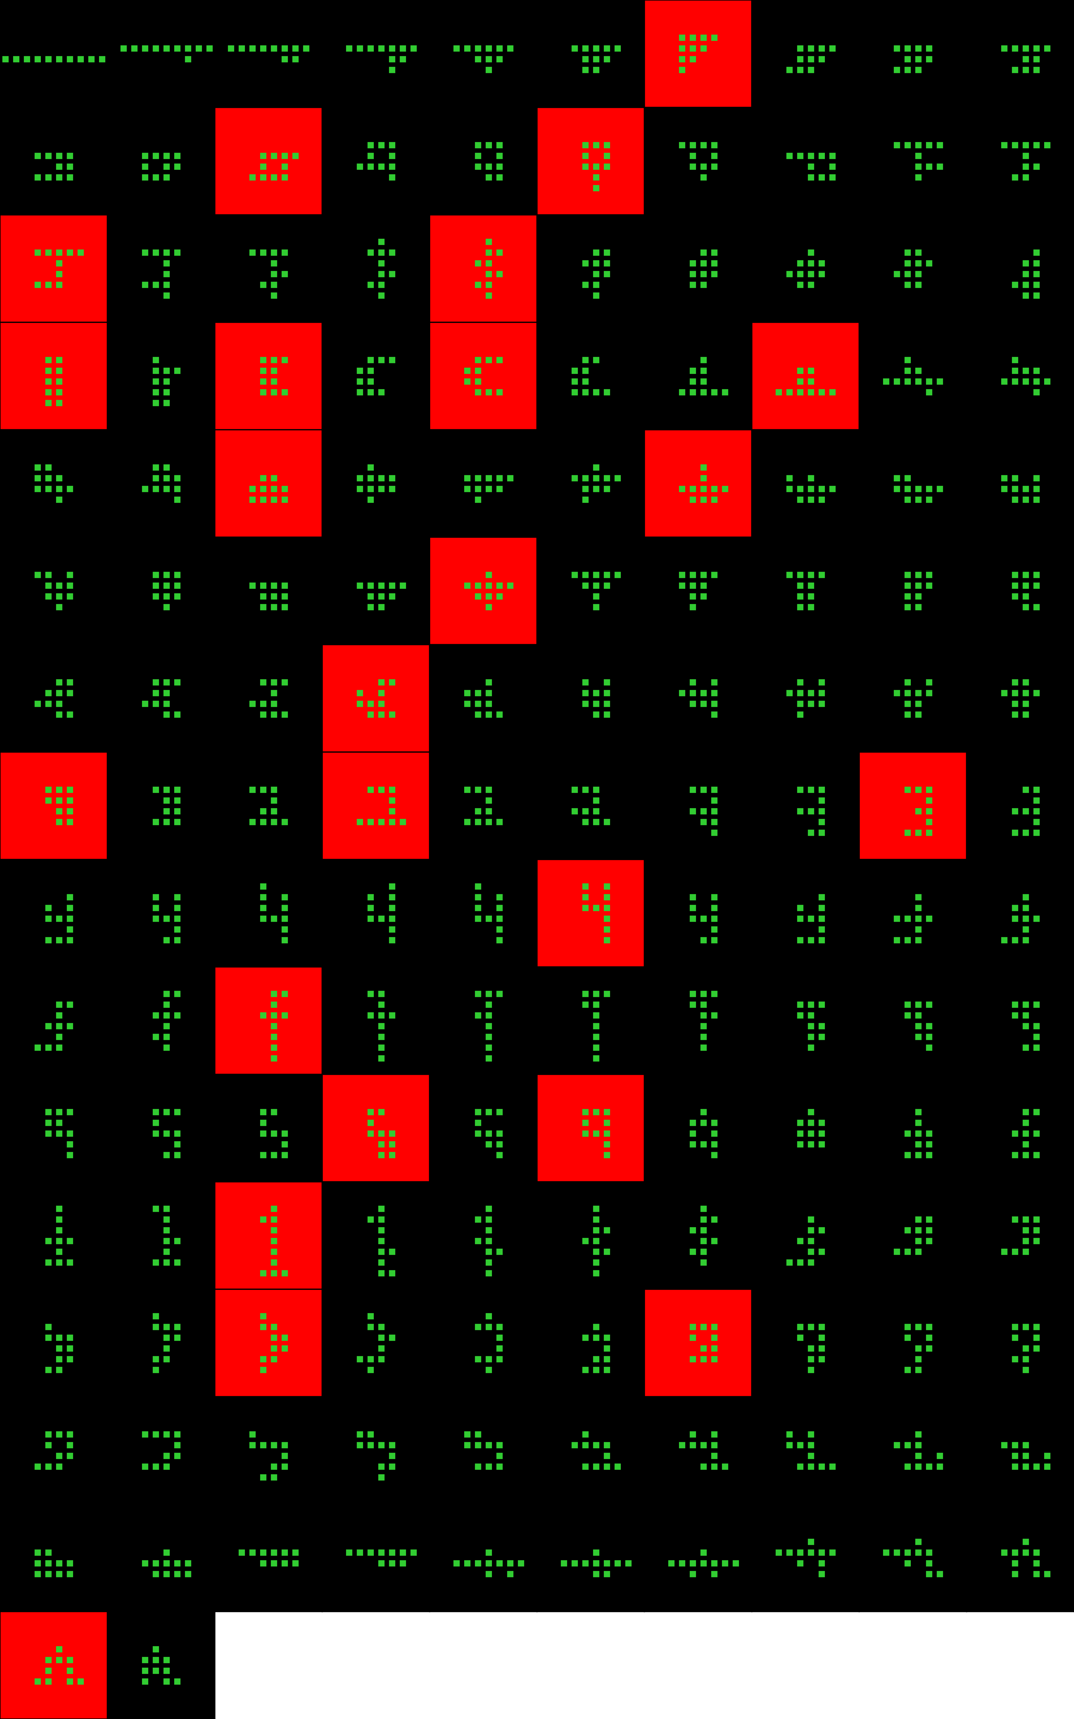
Player 041

Slide 27
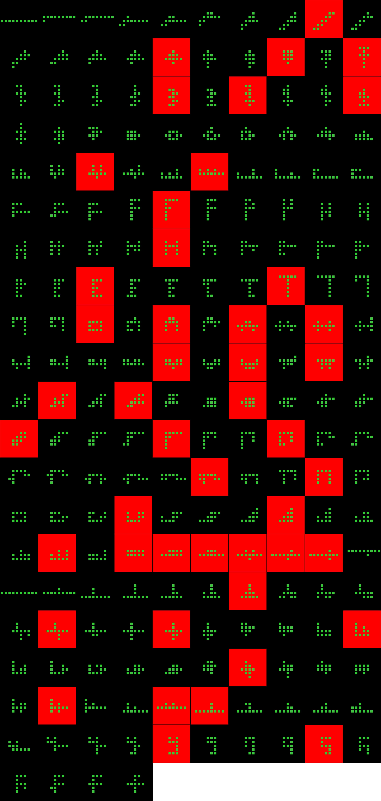
Player 042

Slide 28
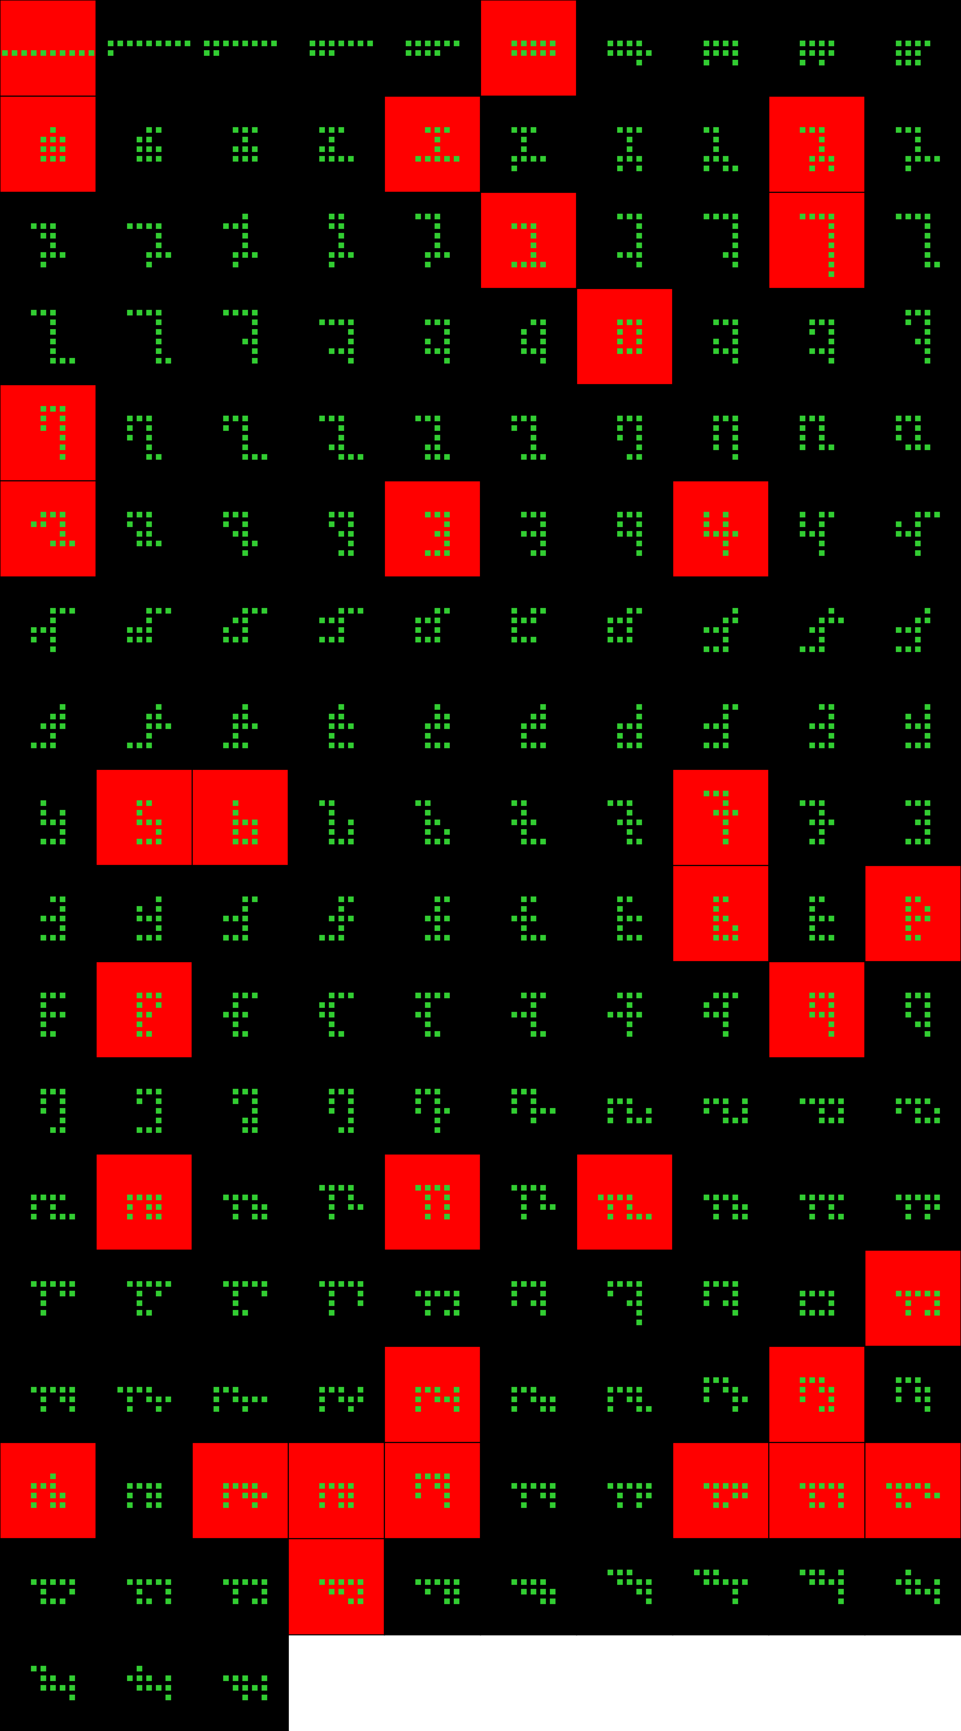
Player 043

Slide 29
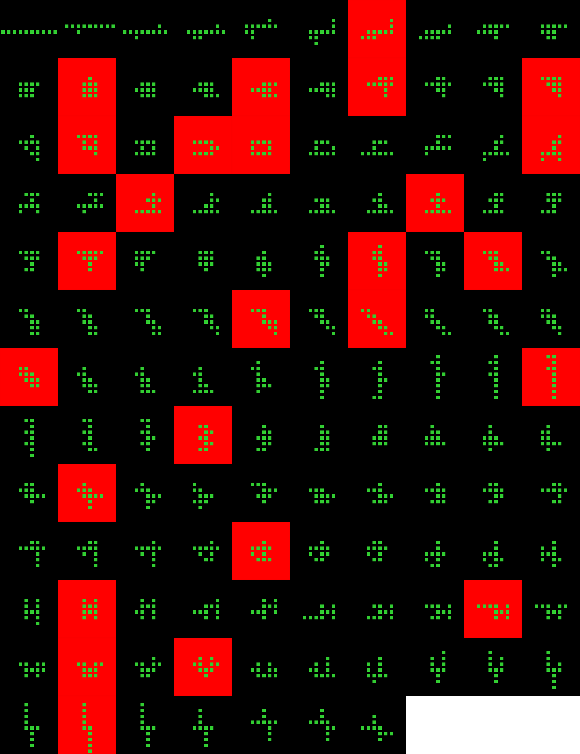
Player 044

Slide 30
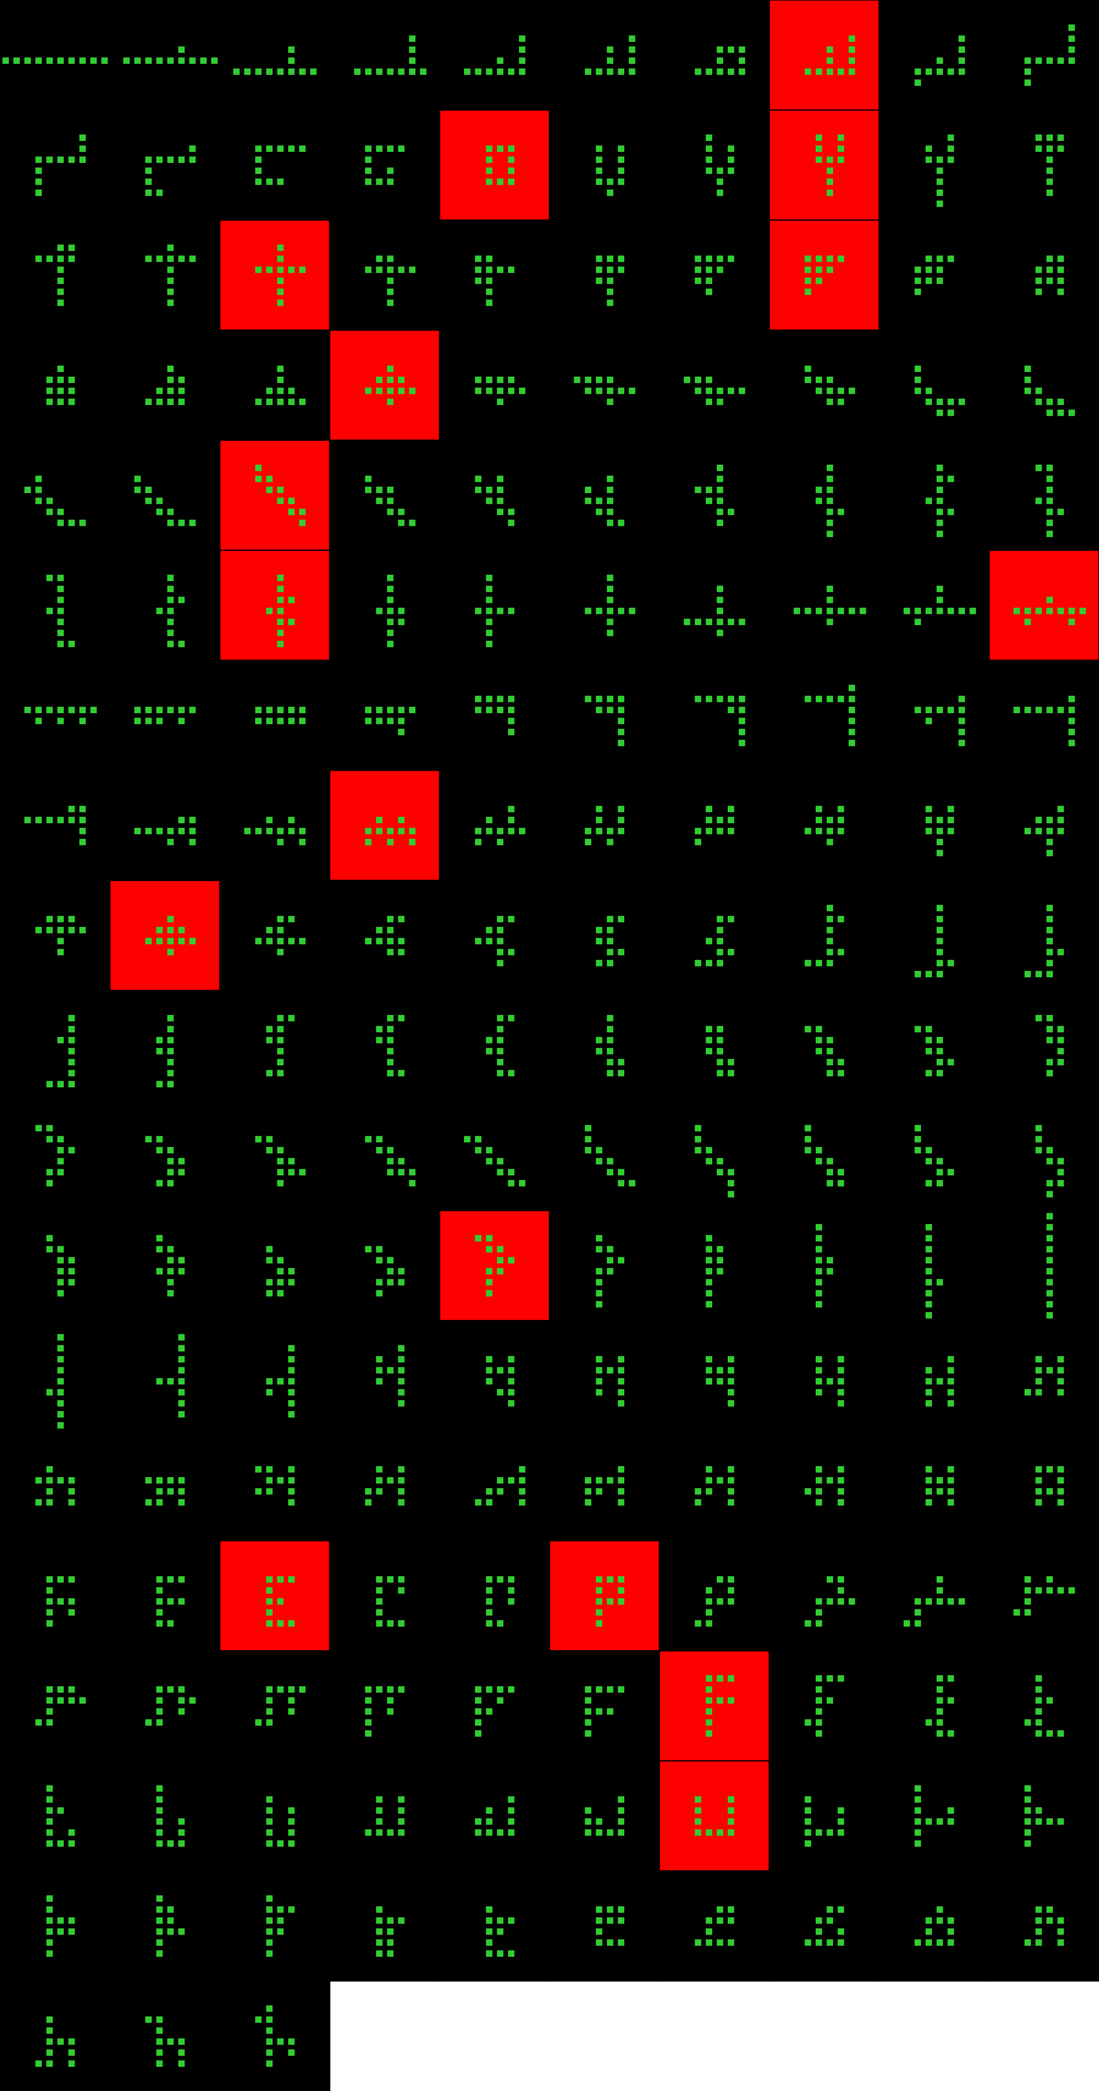
Player 045

Slide 31
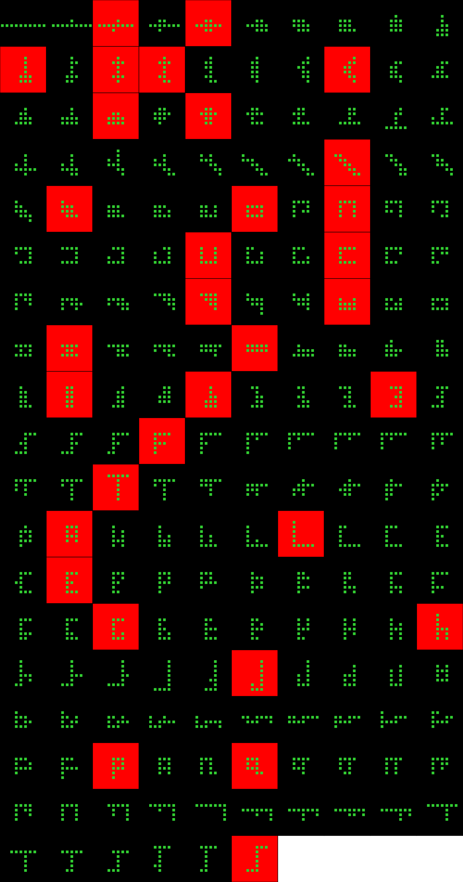
Player 046

Slide 32
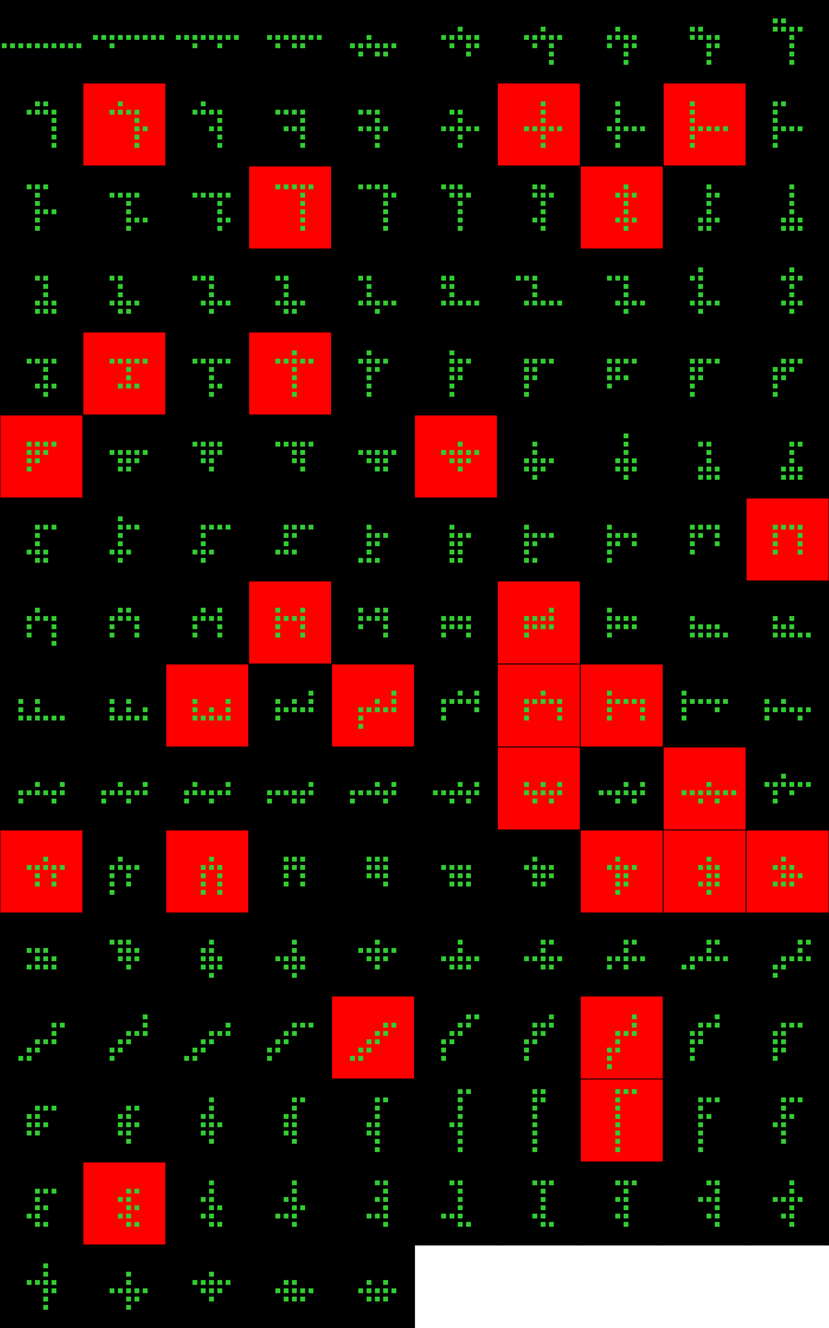
Player 047

Slide 33
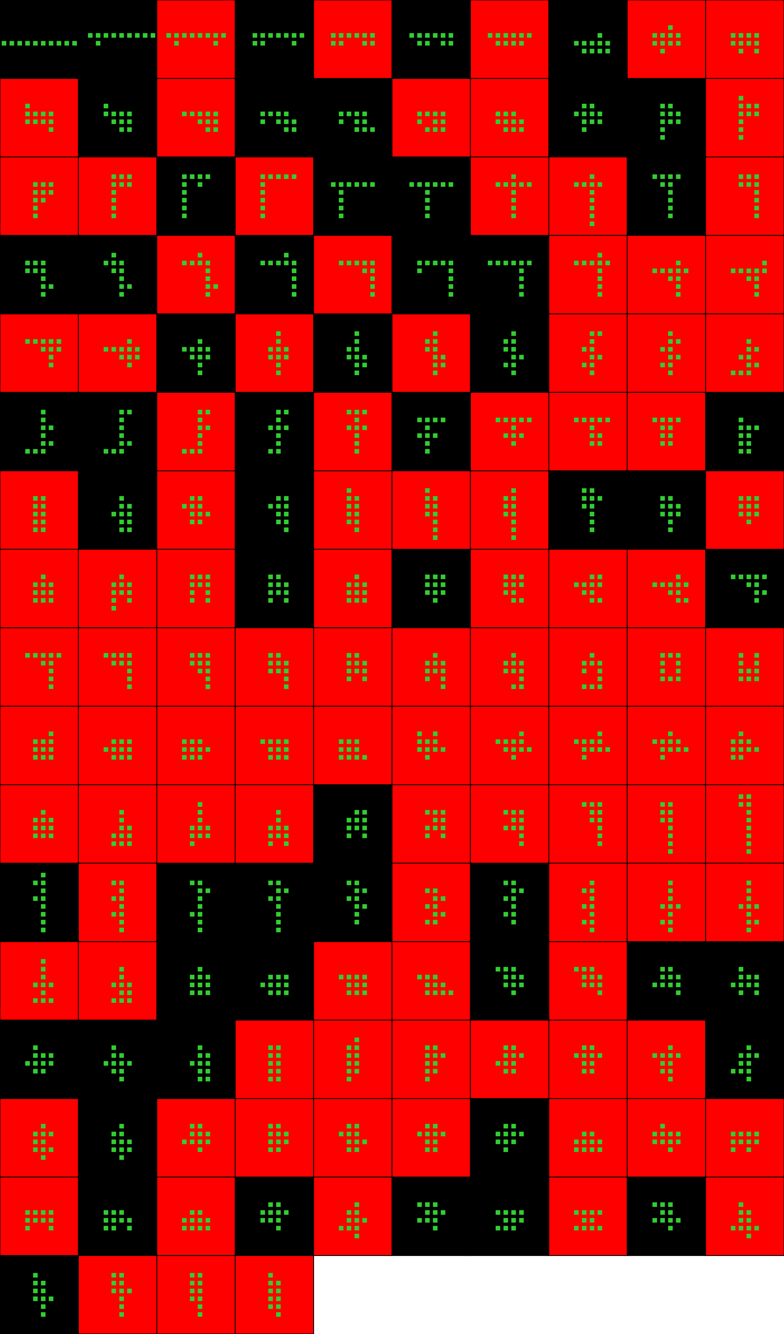
Player 048

Slide 34
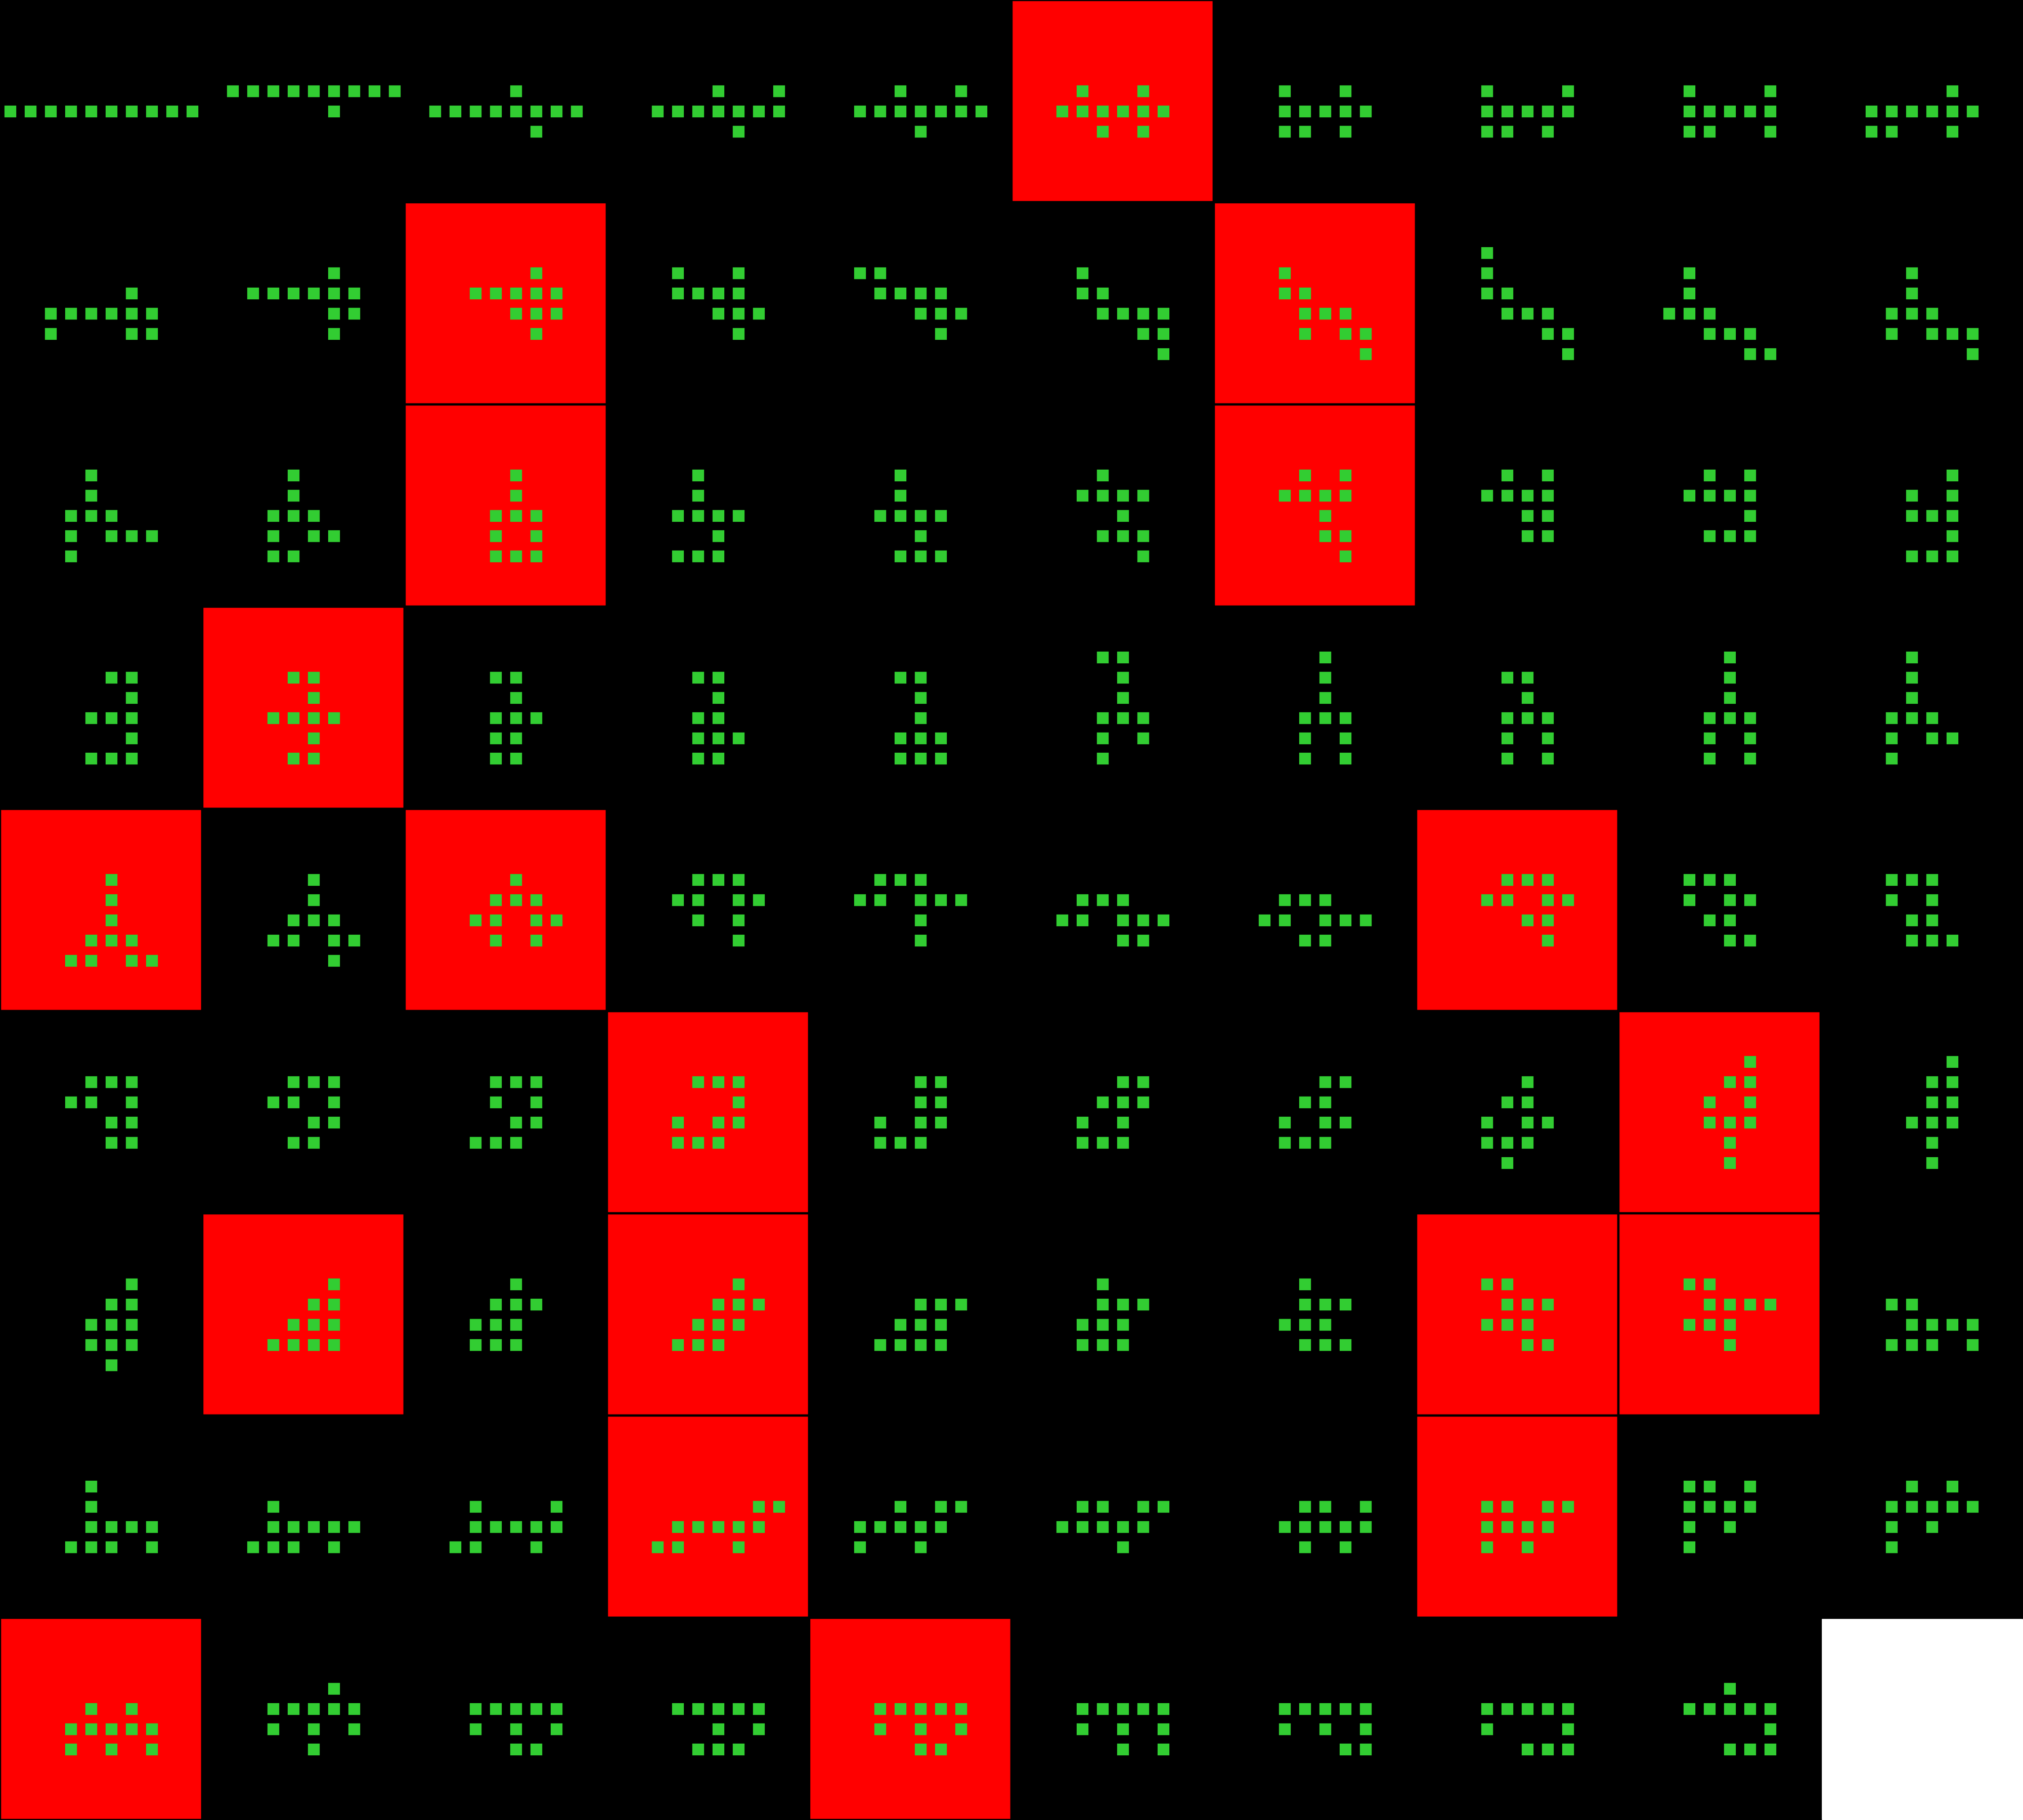
Player 049

Slide 35
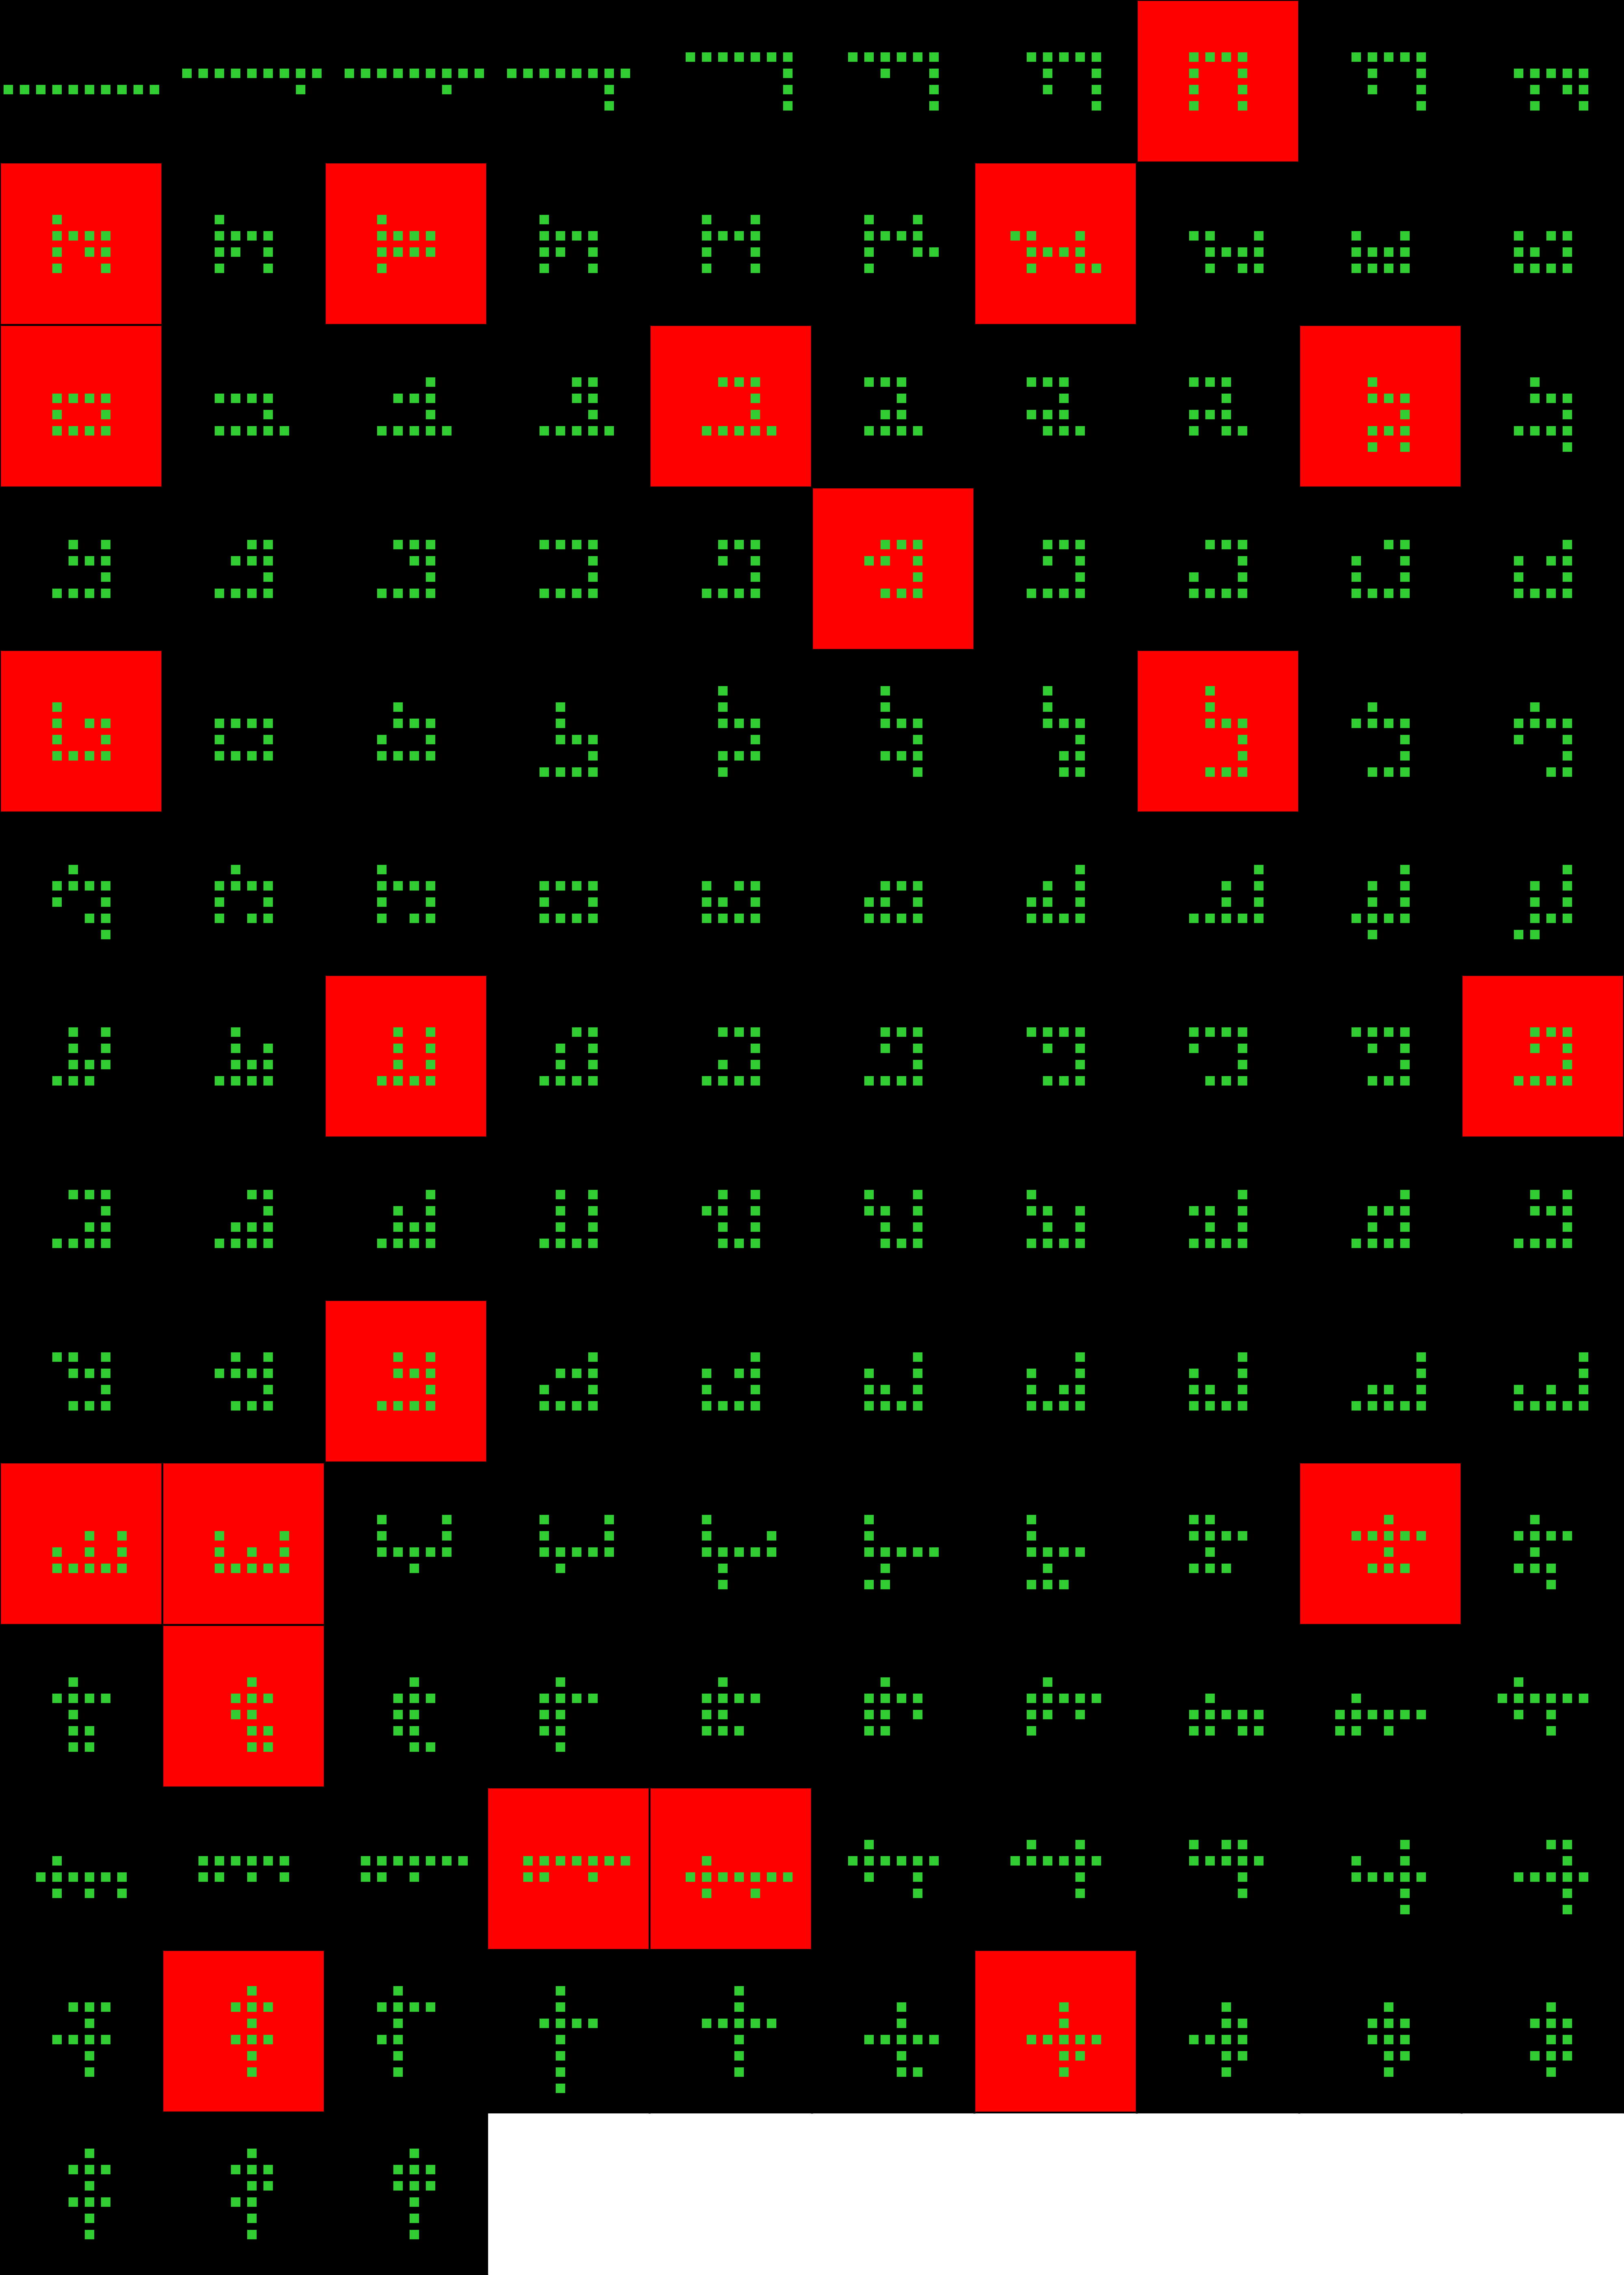
Player 050

Slide 36
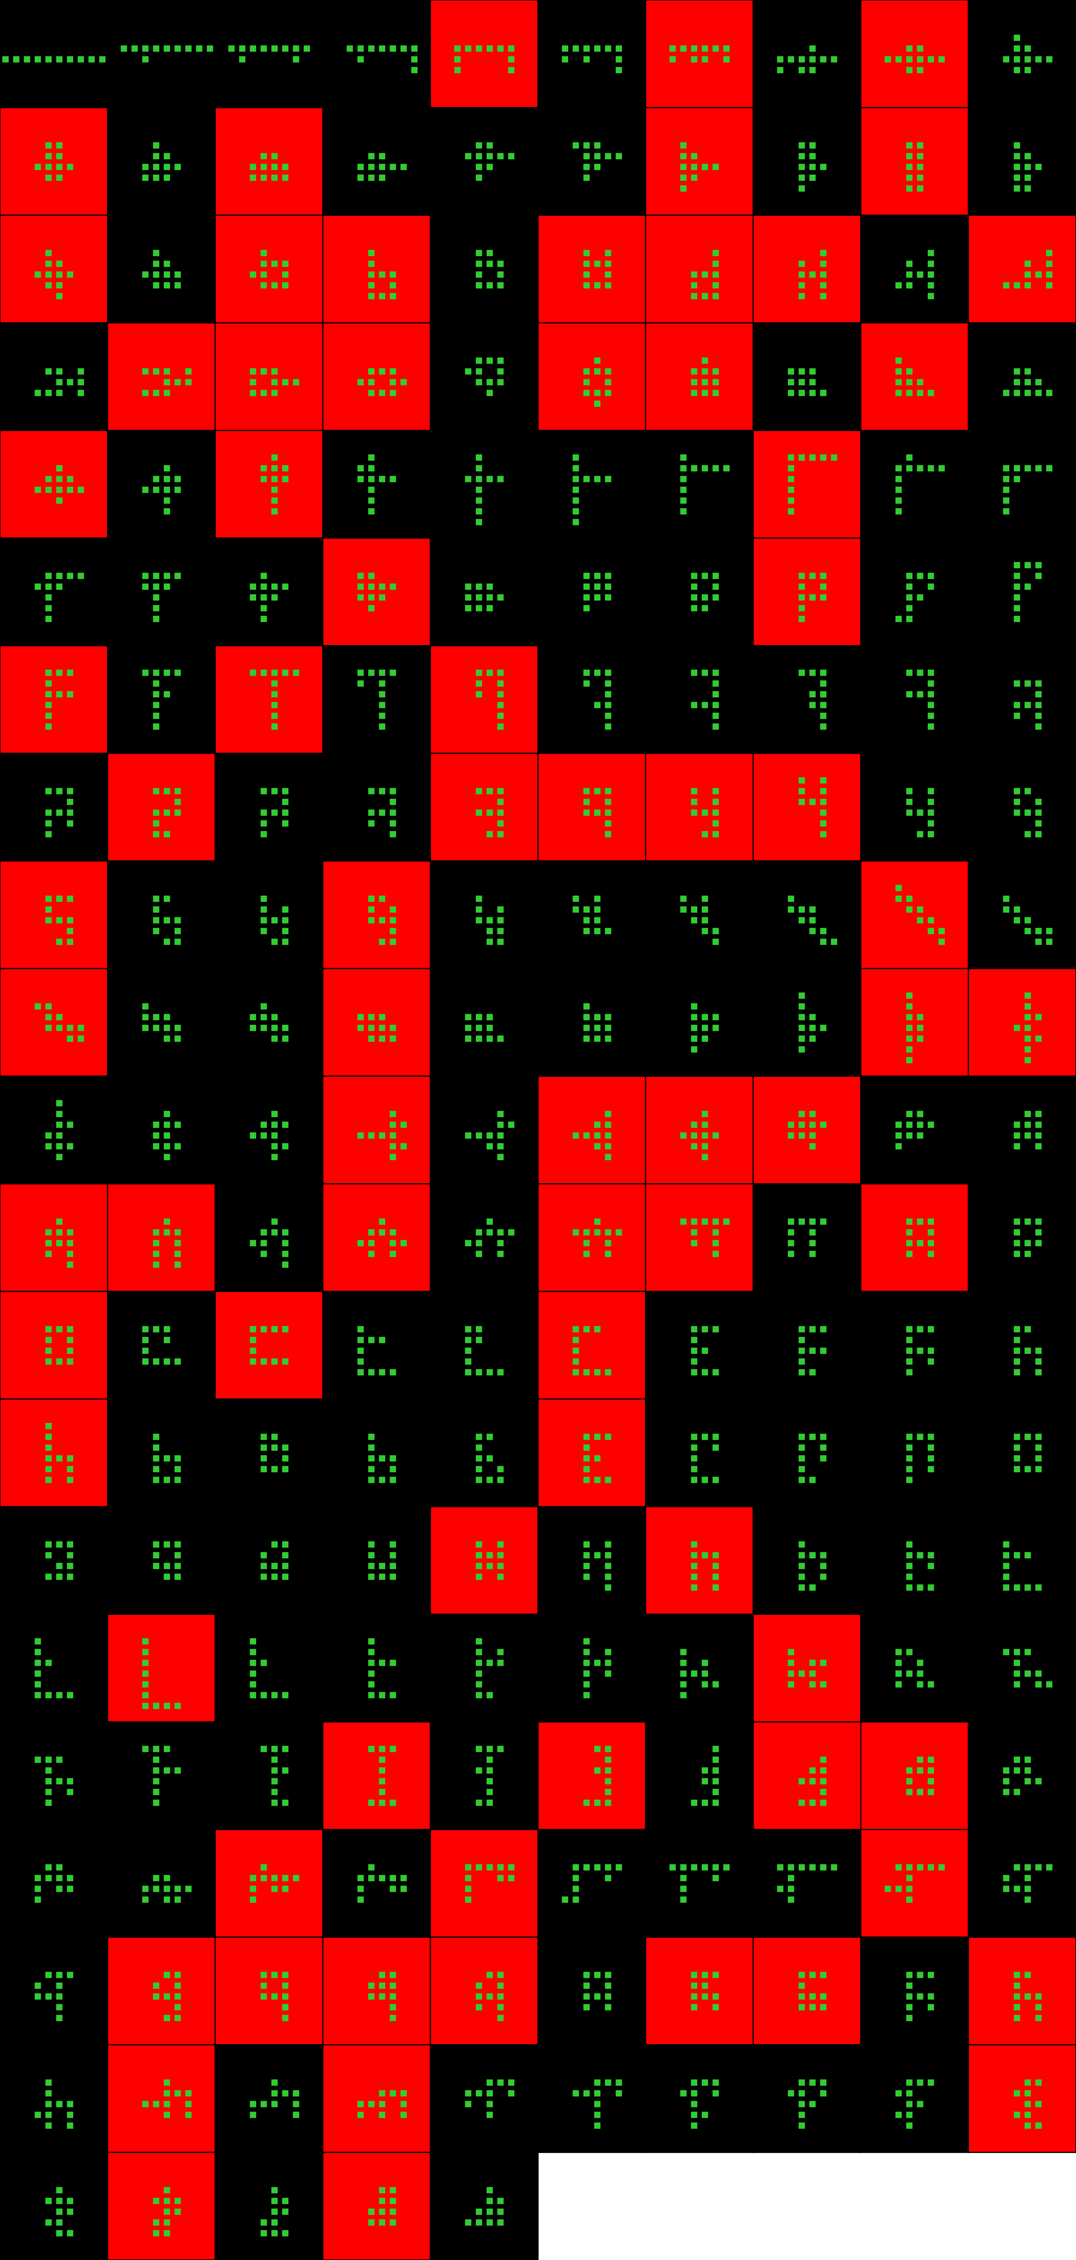
Player 051

Slide 37
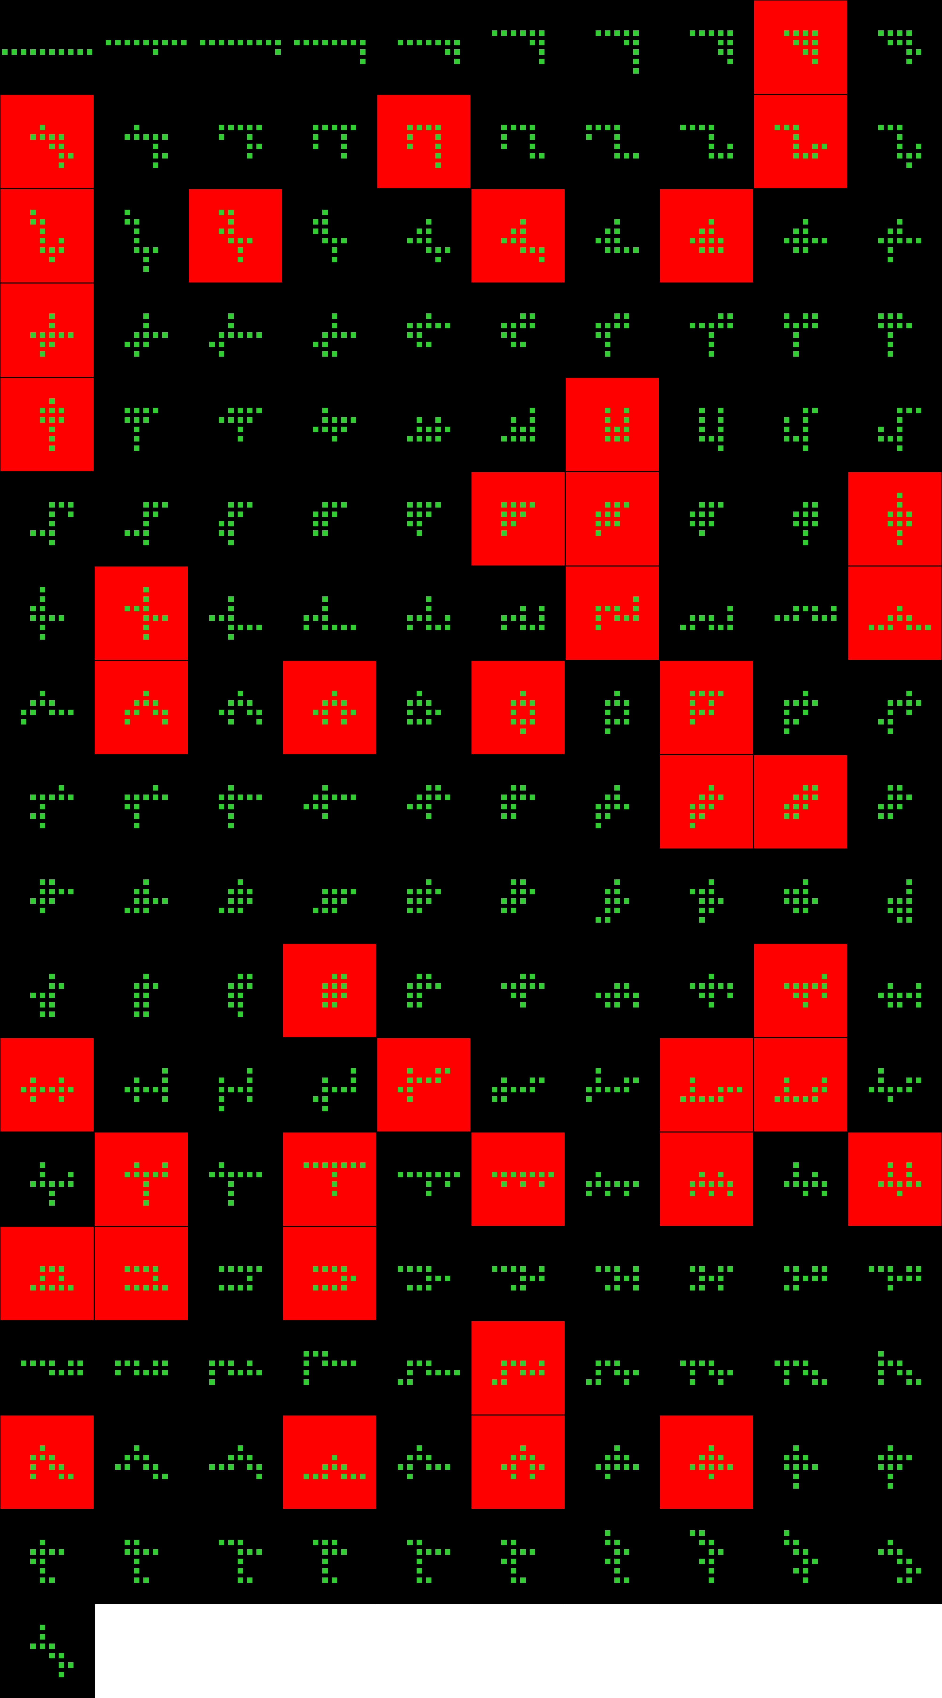
Player 052

Slide 38
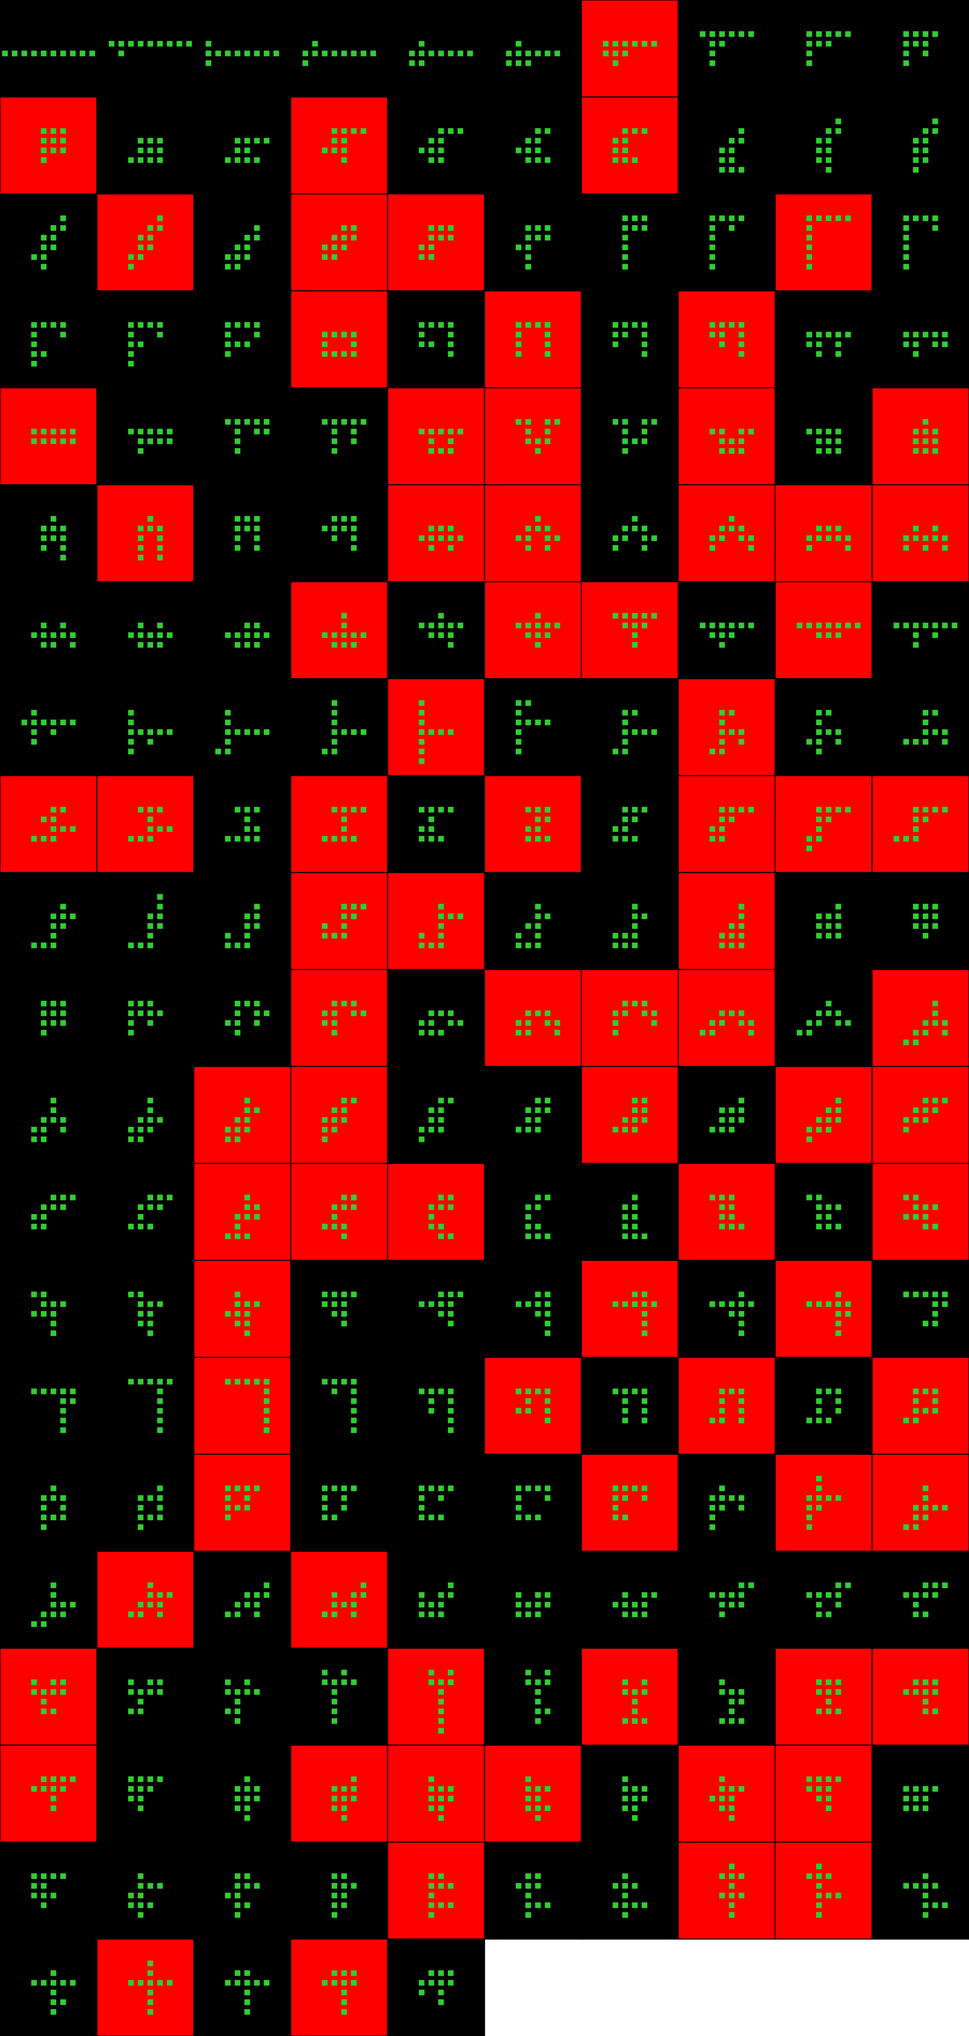
Player 053

Slide 39
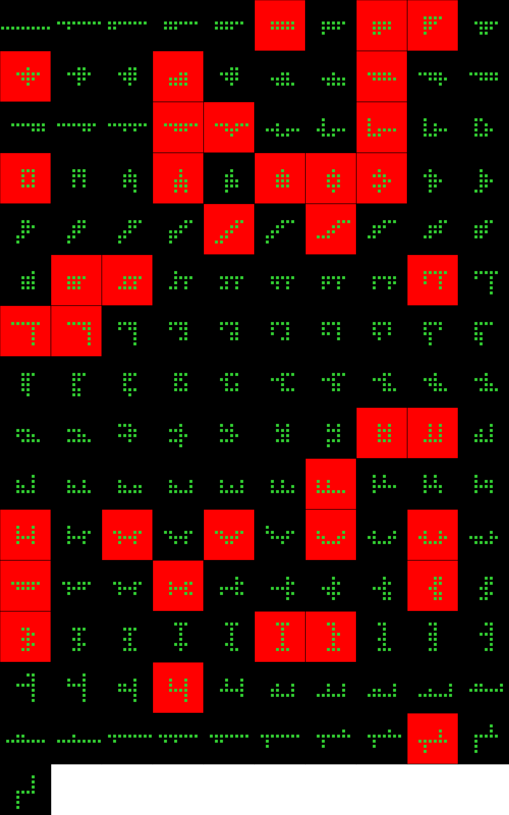
Player 054

Slide 40
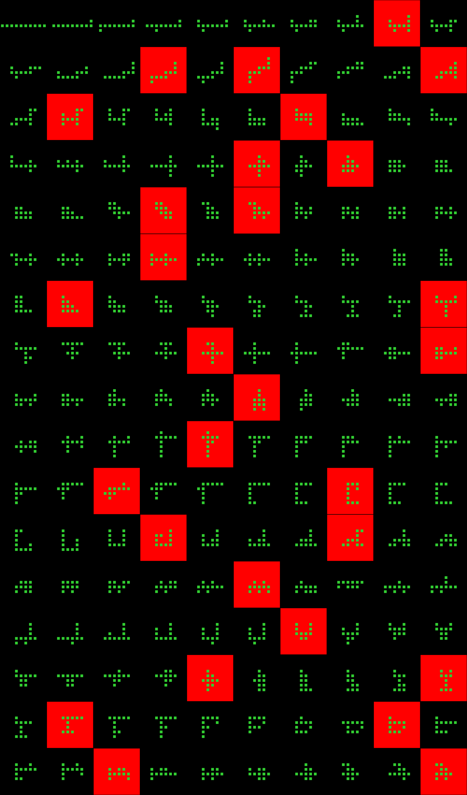
Player 055

Slide 41
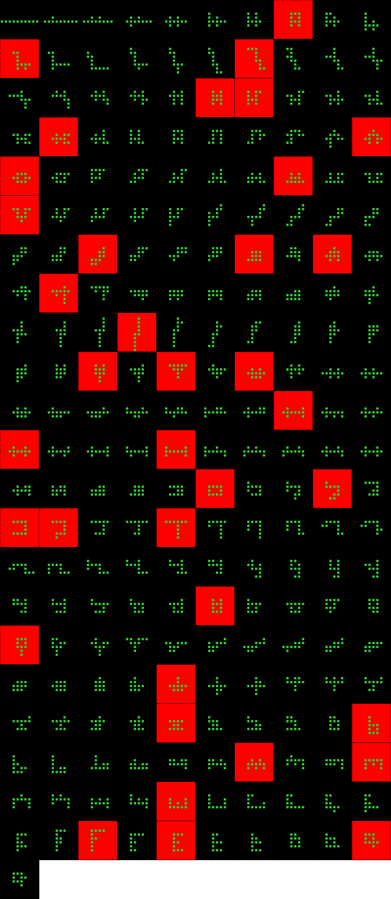
Player 056

Slide 42

Player 057

Slide 43
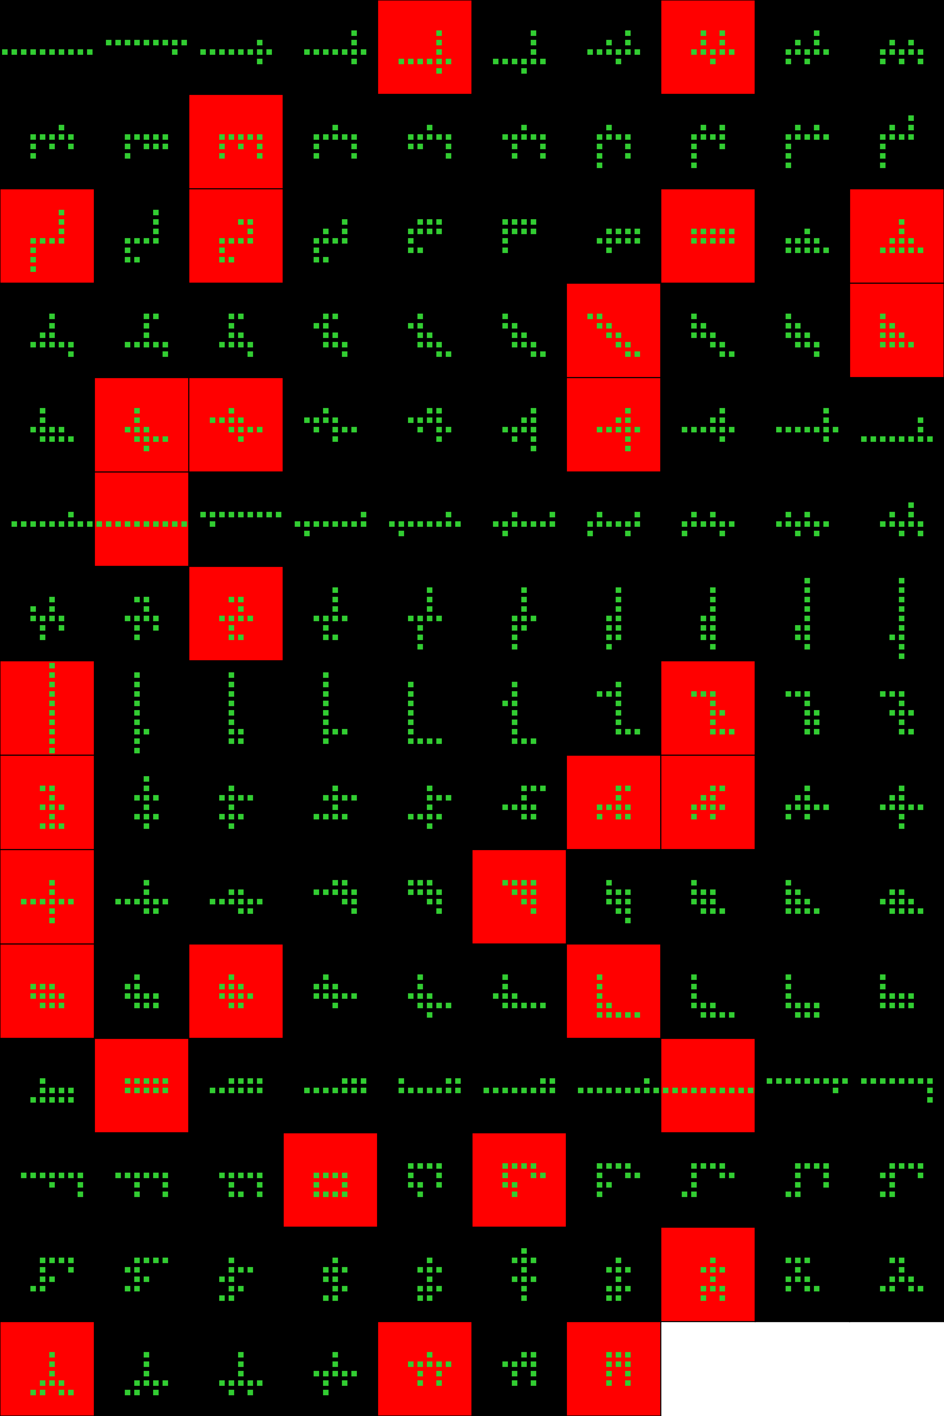
Player 057b

Slide 44
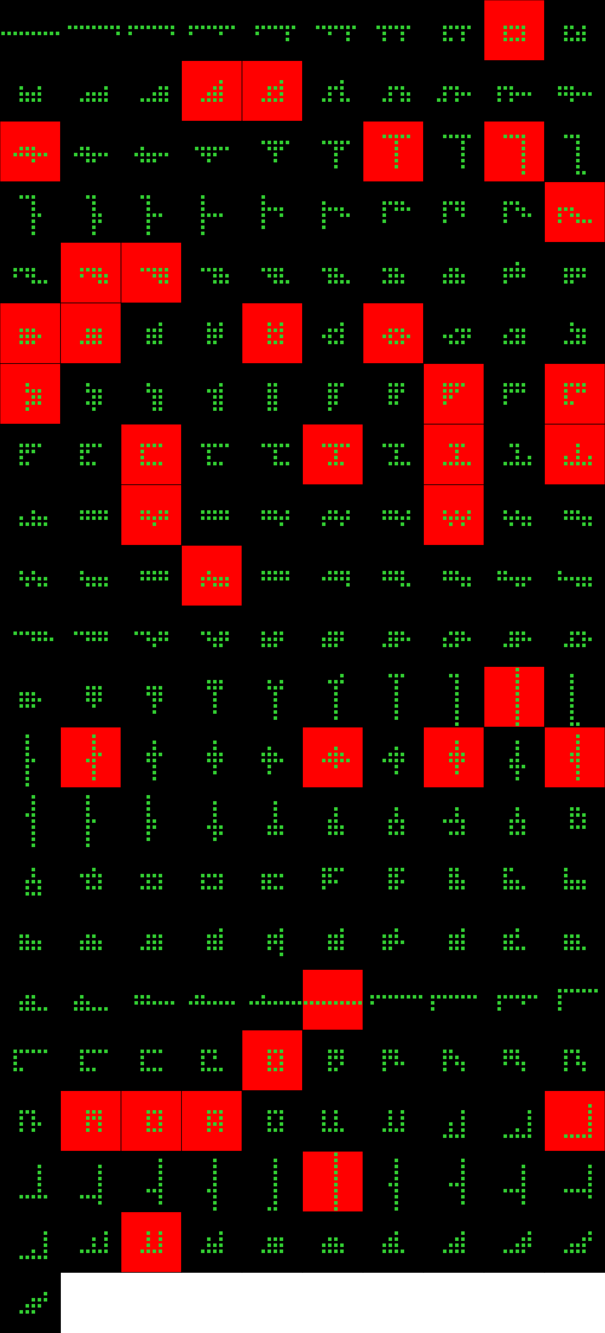
Player 058

Slide 45
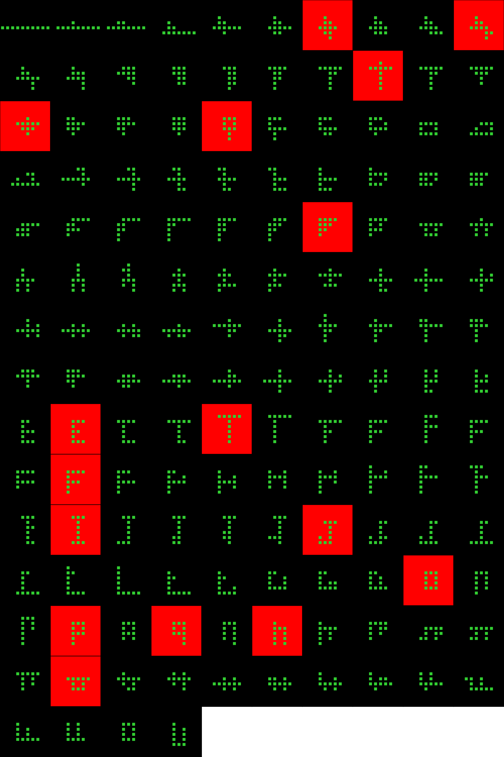
Player 059

Slide 46
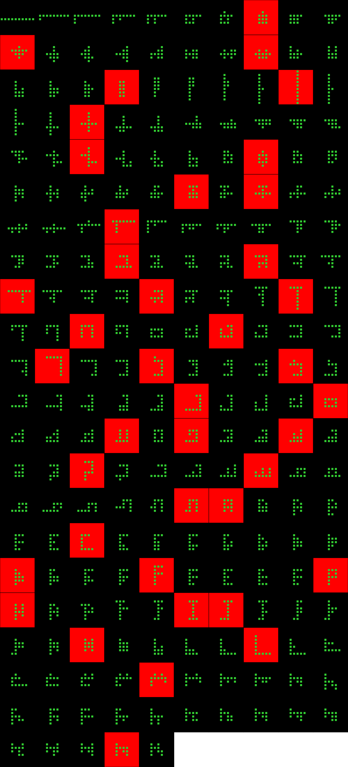
Player 060

Slide 47
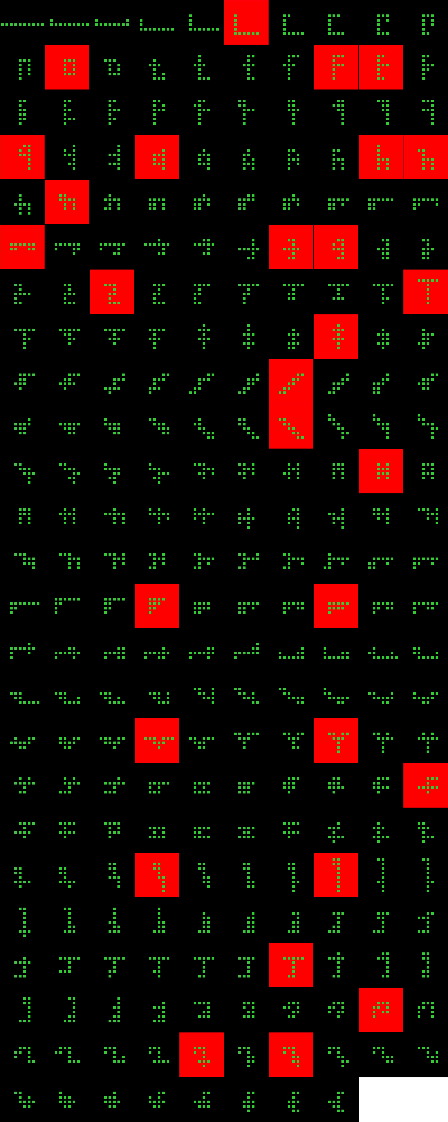
Player 061

Slide 48
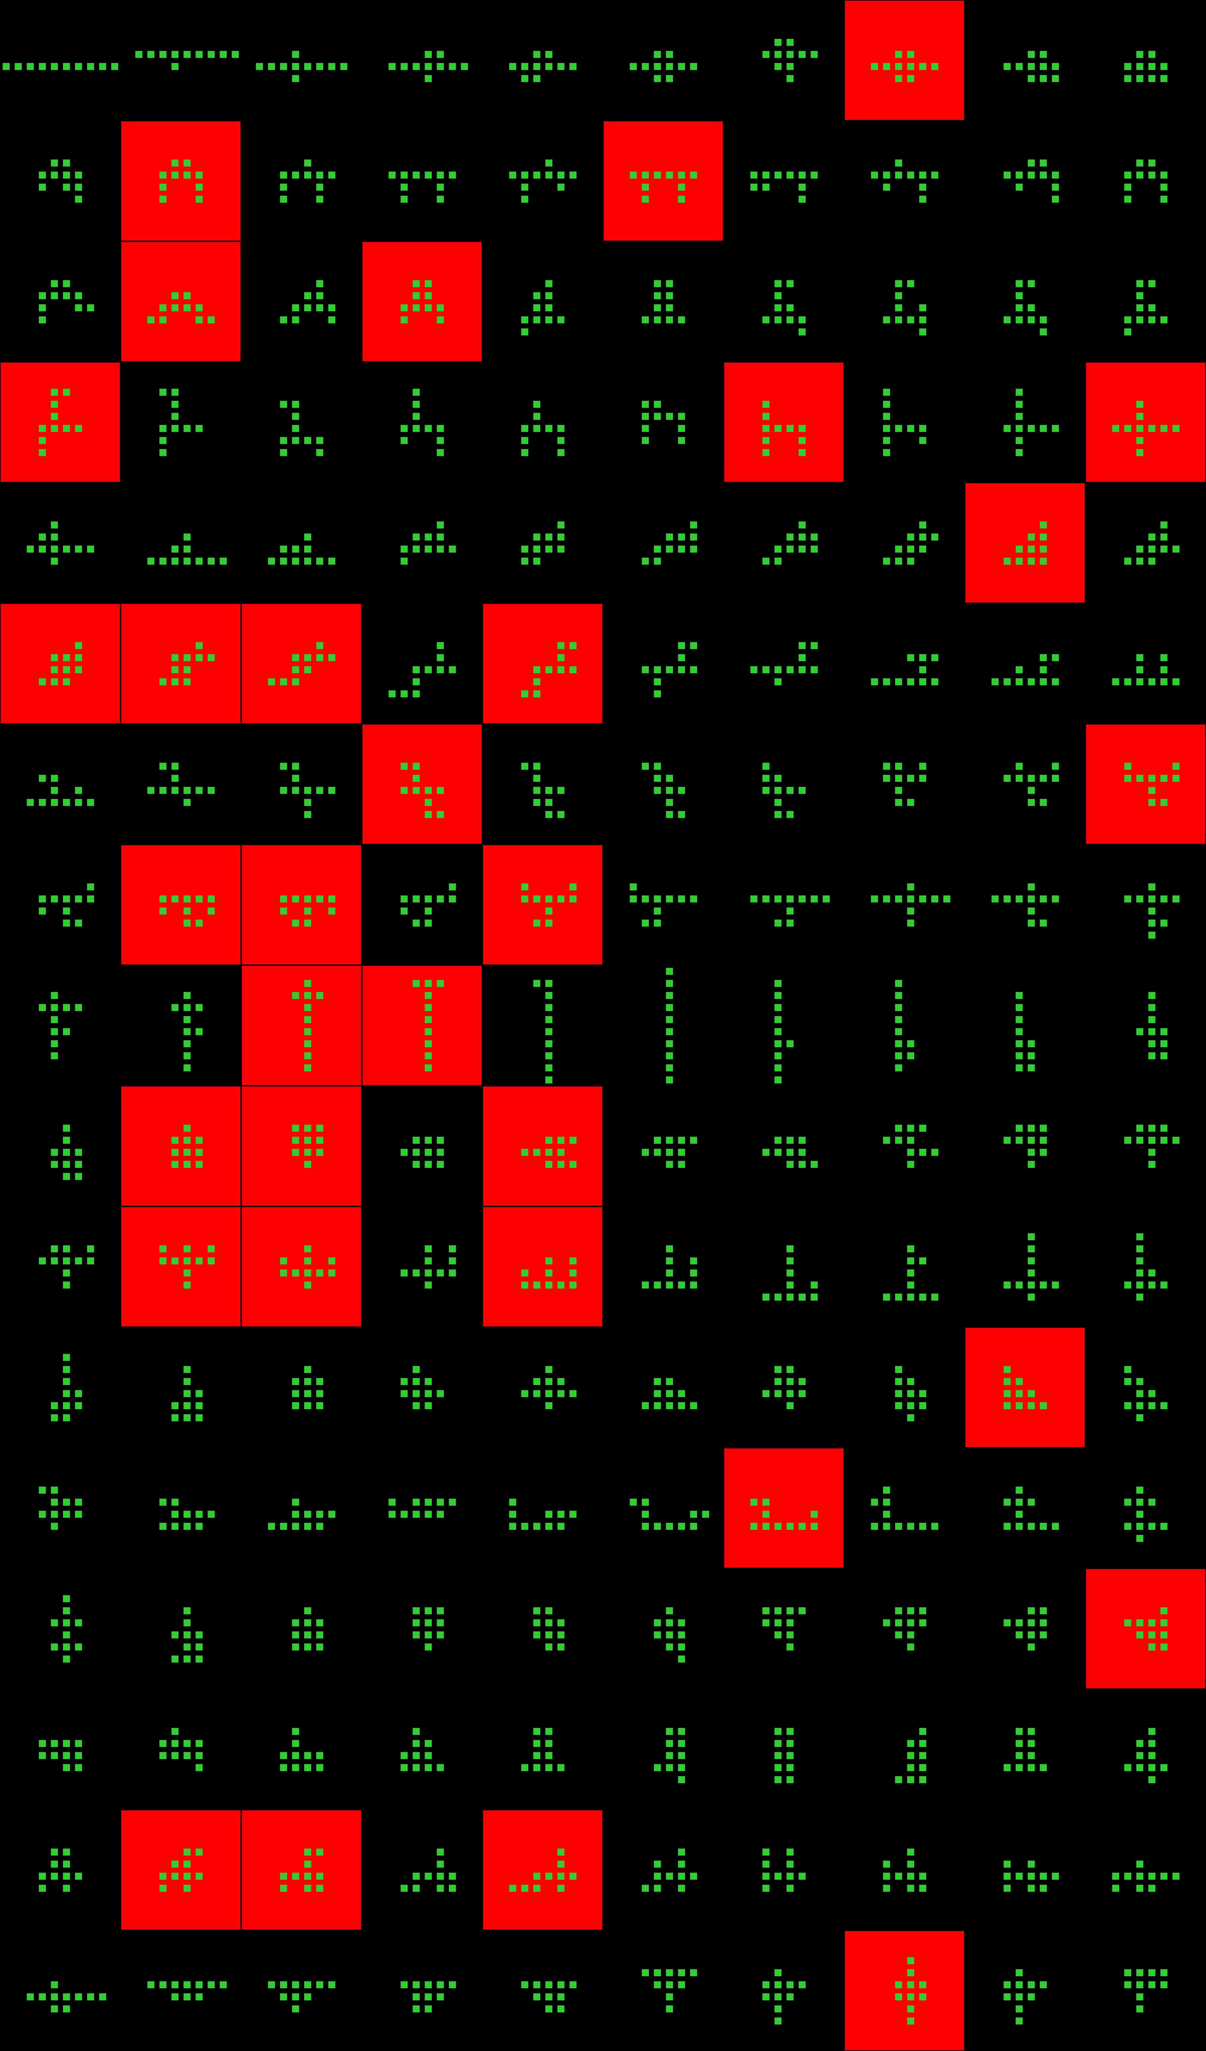
Player 062

Slide 49
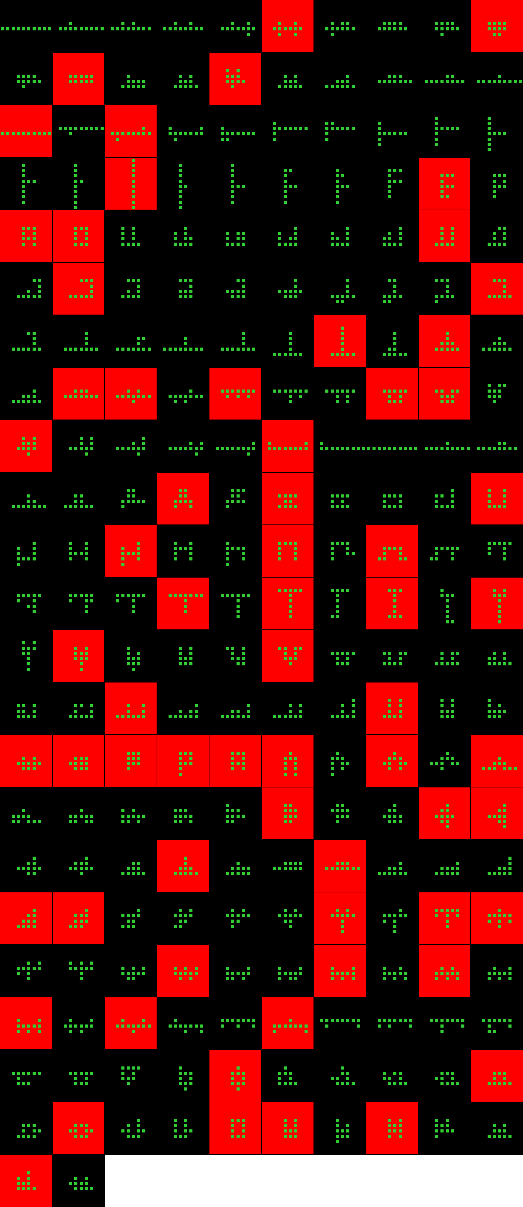
Player 063

Slide 50
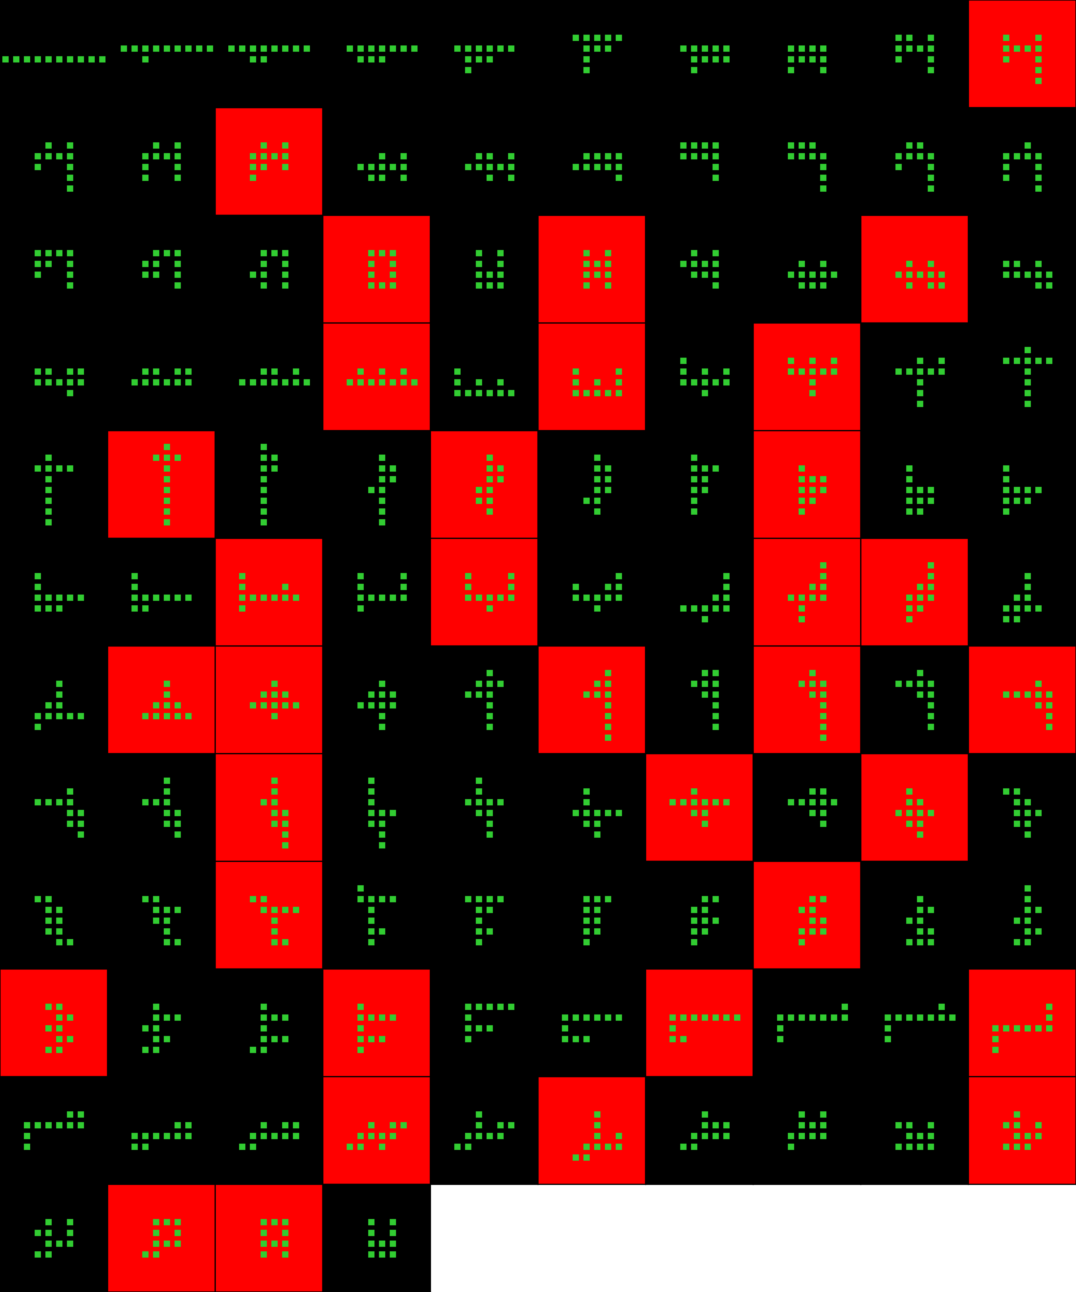
Player 064

Slide 51
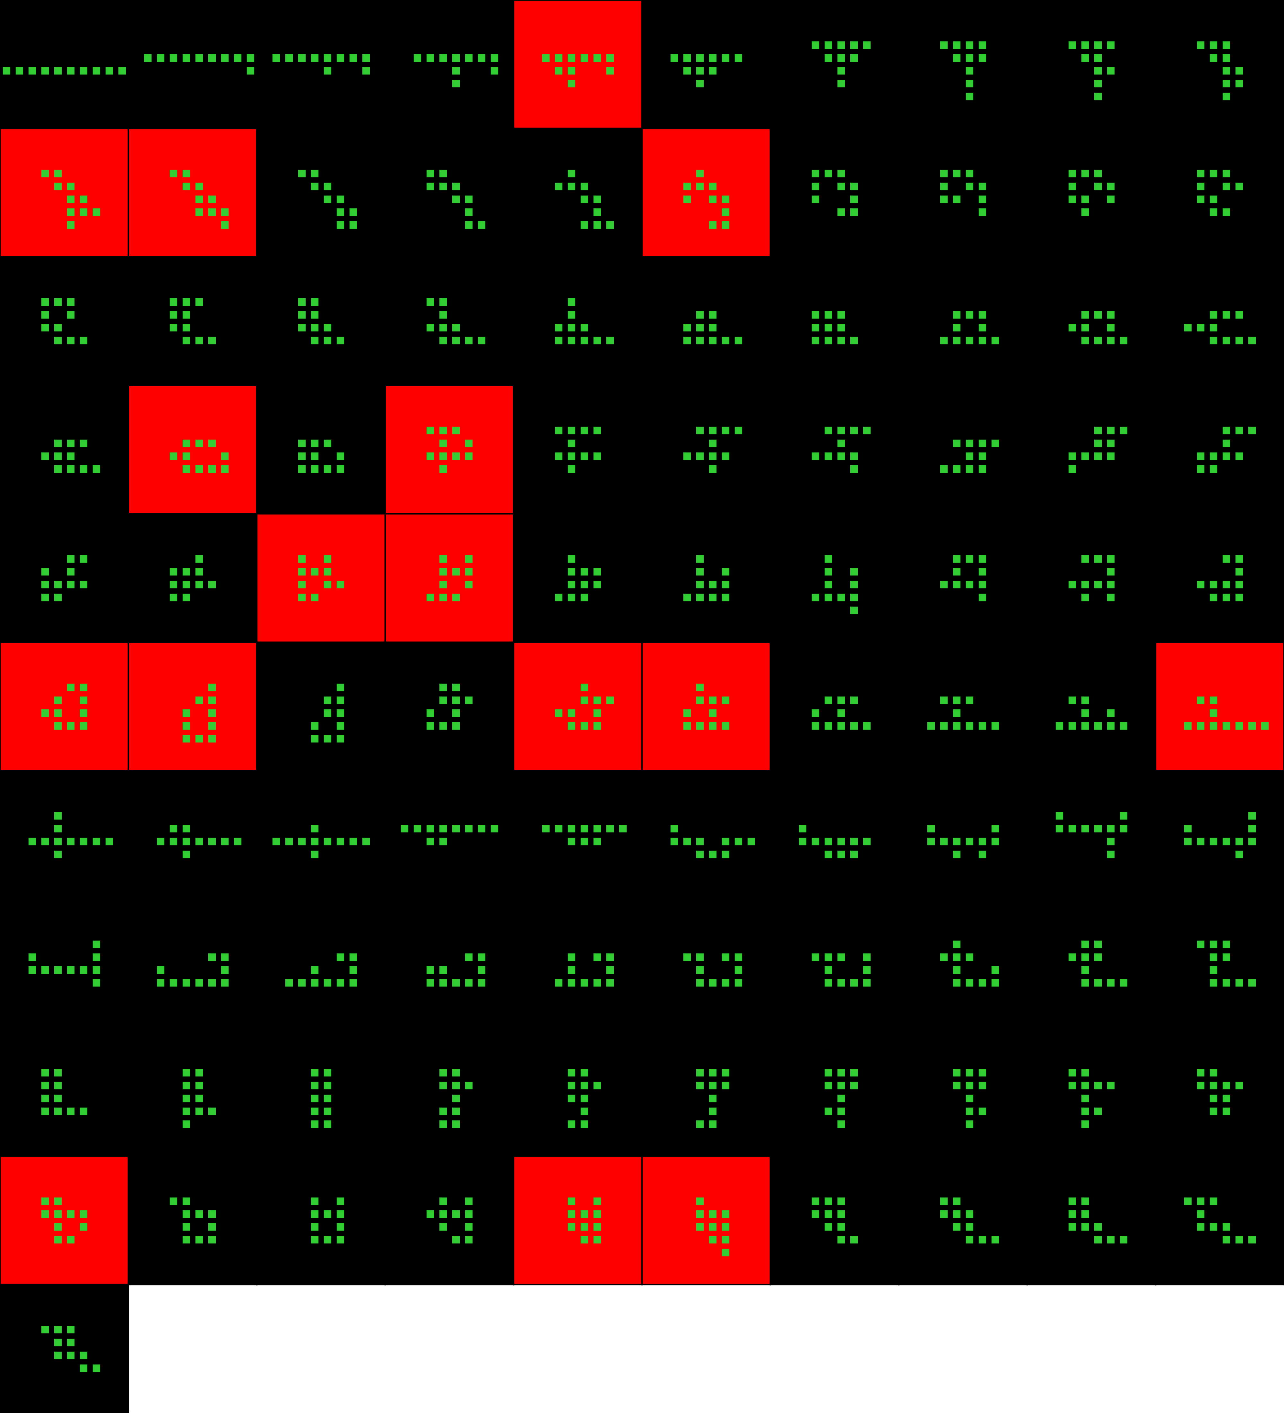
Player 065

Slide 52
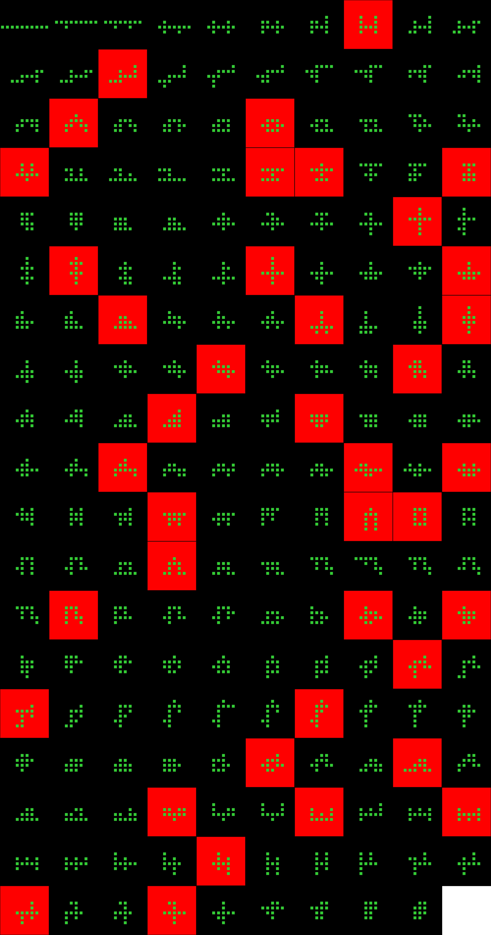
Player 066

Slide 53

Player 067

Slide 54

Player 067

Slide 55
Player 068

Slide 56

Player 069

Slide 57
Player 070

Slide 58

Player 070

Slide 59

Player 071

Slide 60

Player 072

Slide 61

Player 073

Slide 62

Player 074

Slide 63

Player 074

Slide 64

Player 075

Slide 65

Player 075

Slide 66

Player 076

Slide 67

Player 077

Slide 68

Player 078

Slide 69

Player 079

Slide 70
Player 079

Slide 71

Player 080

Slide 72

Player 081

Slide 73

Player 082

Slide 74

Player 083

Slide 75

Player 084

Slide 76

Player 085

Slide 77

Player 086

