Slide 1
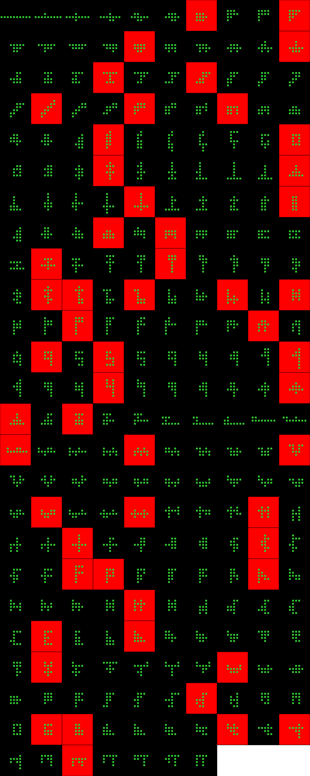
Player 020

Slide 2
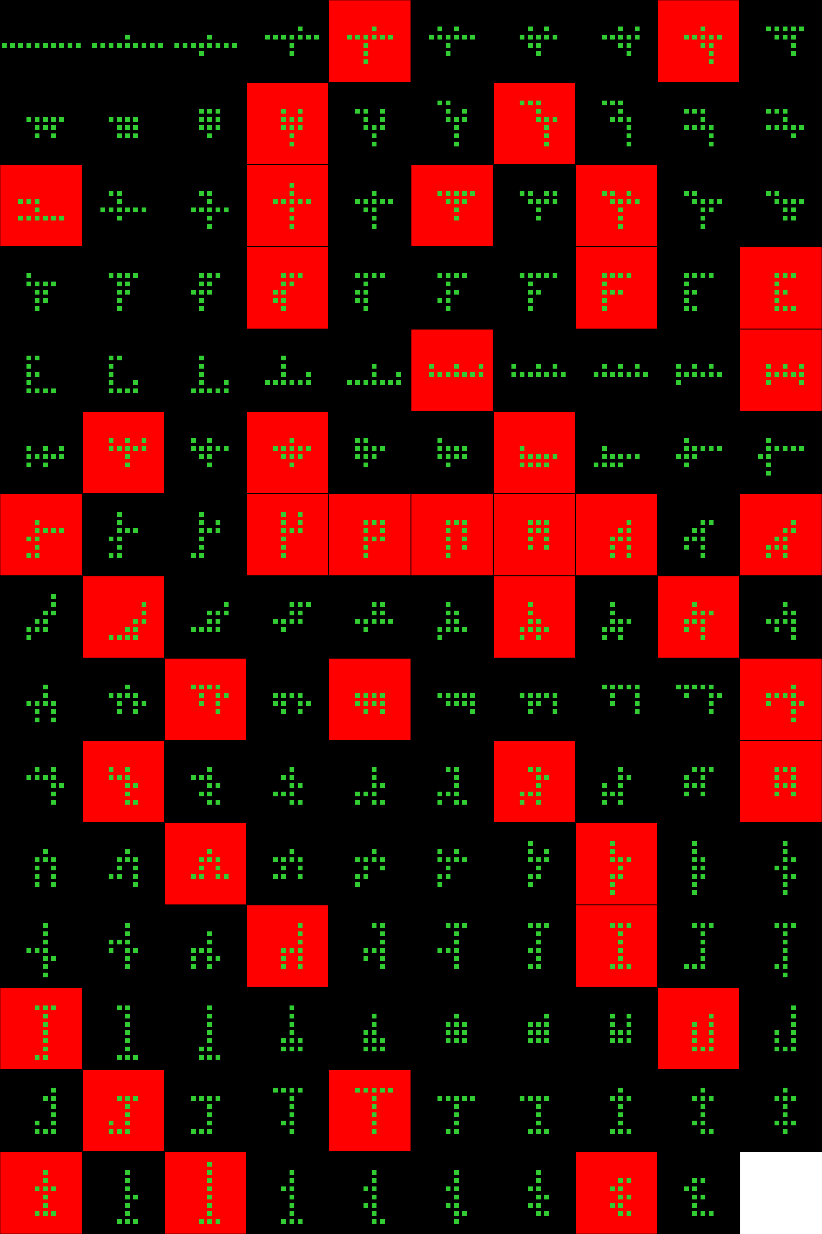
Player 021

Slide 3
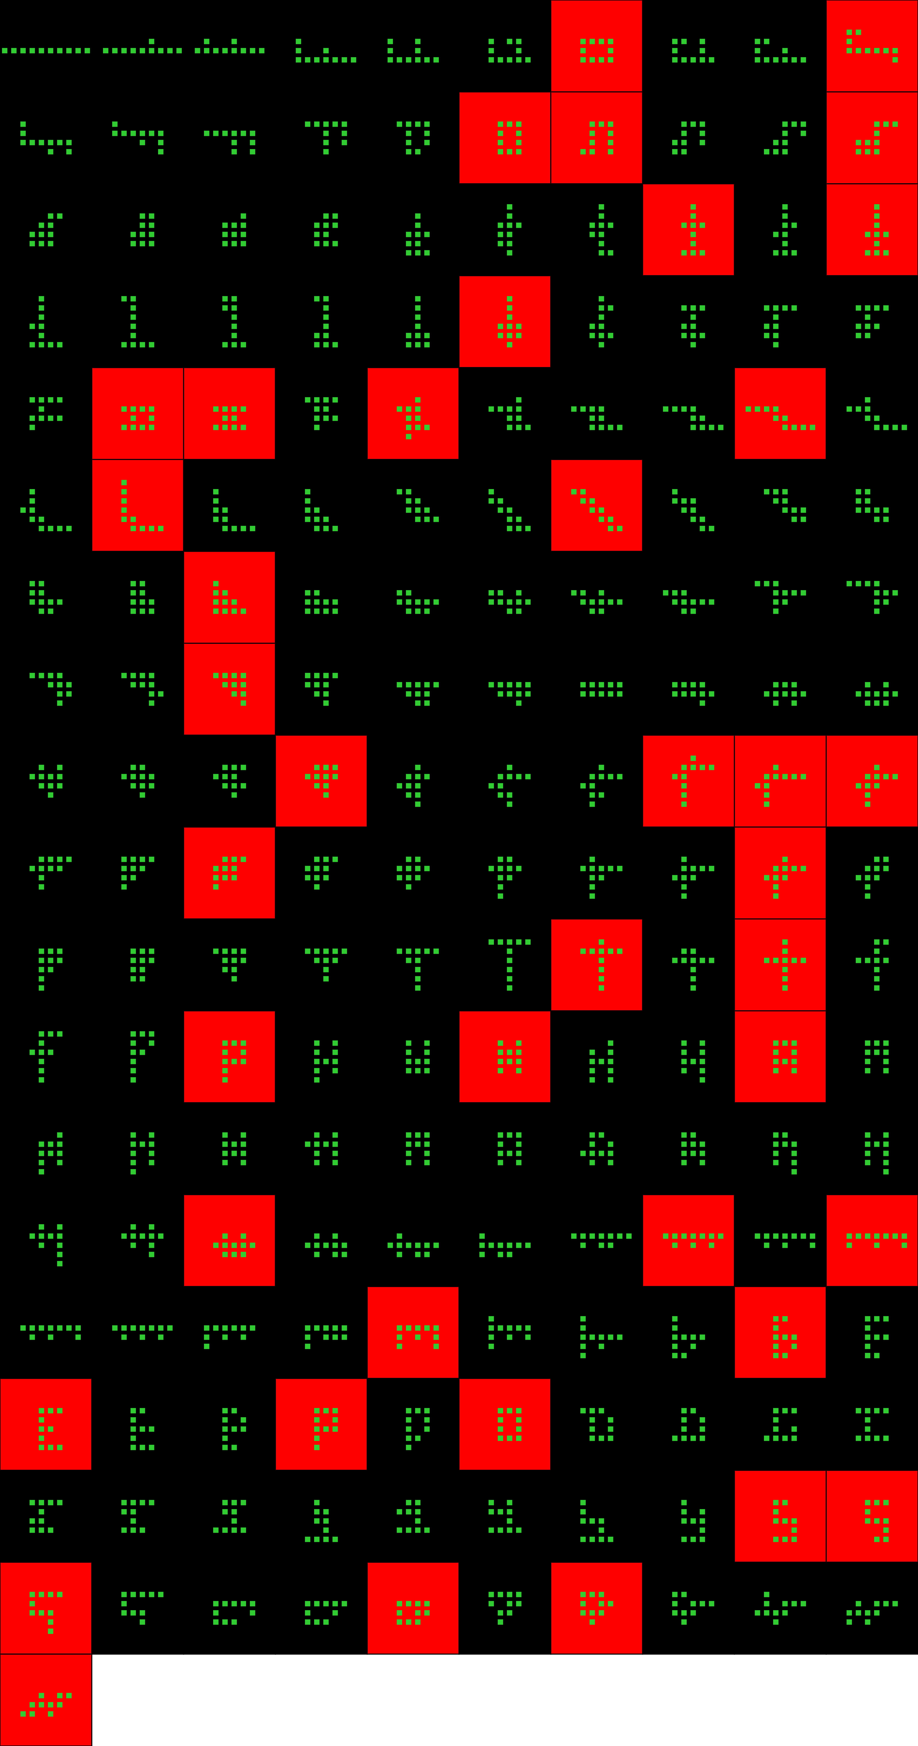
Player 022

Slide 4
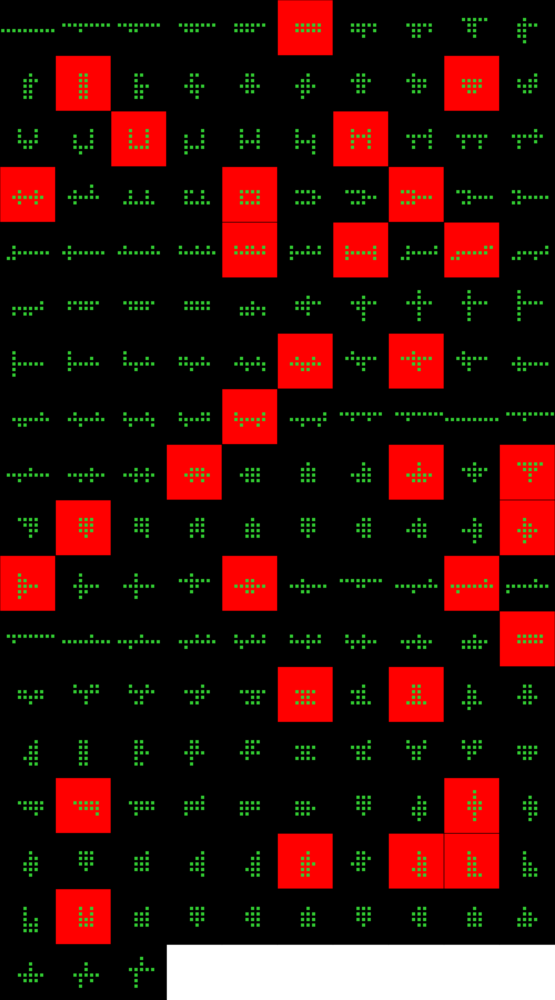
Player 023

Slide 5
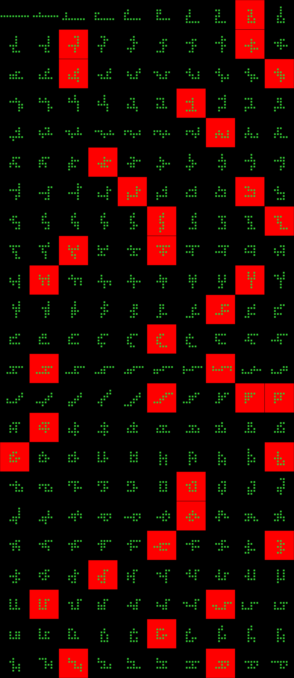
Player 024

Slide 6
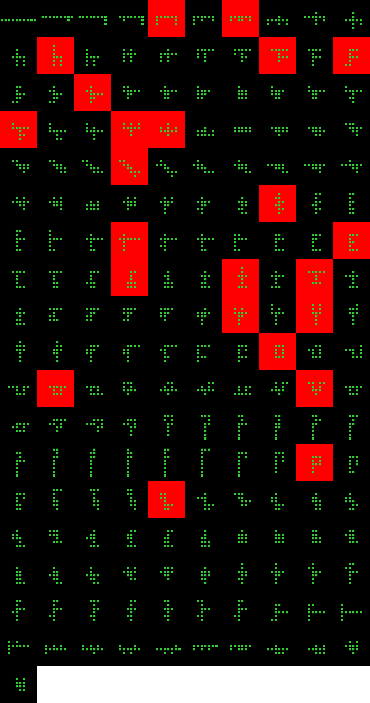
Player 025

Slide 7
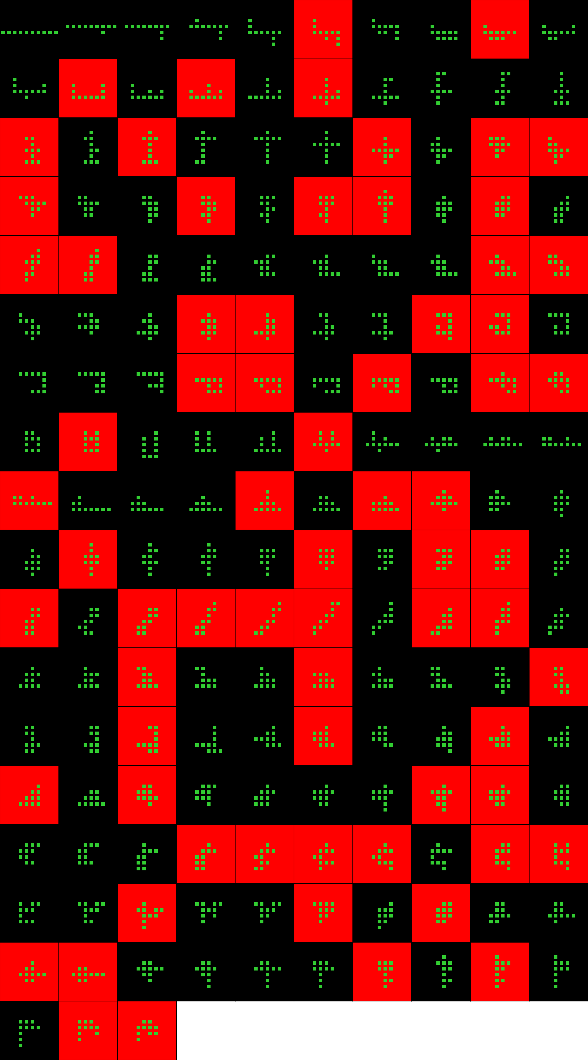
Player 026

Slide 8
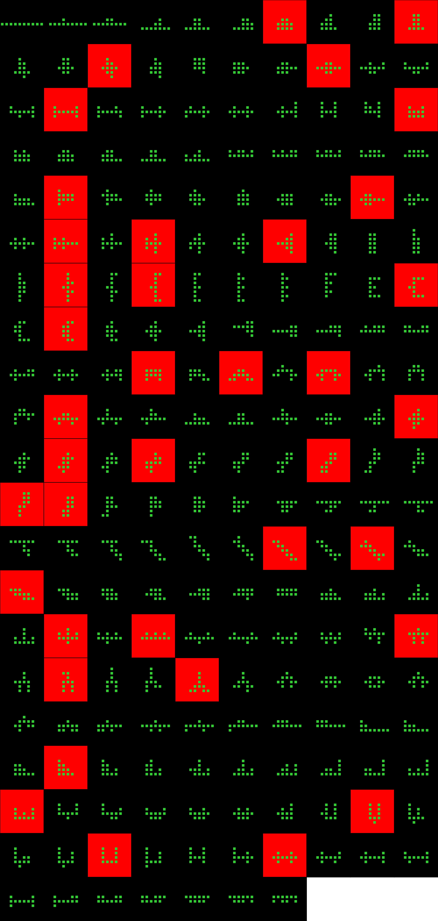
Player 027

Slide 9
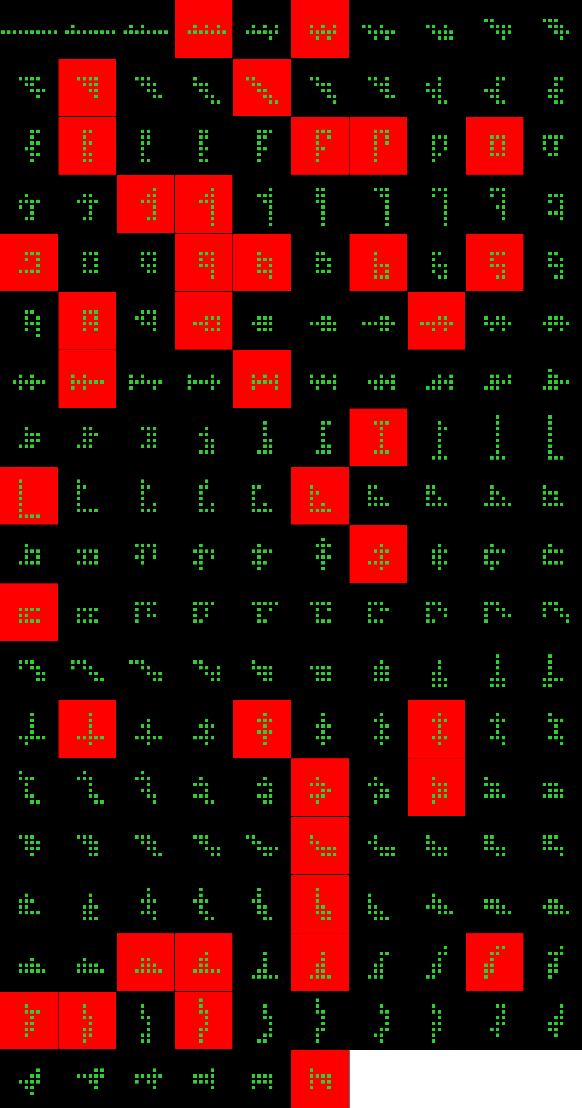
Player 028

Slide 10
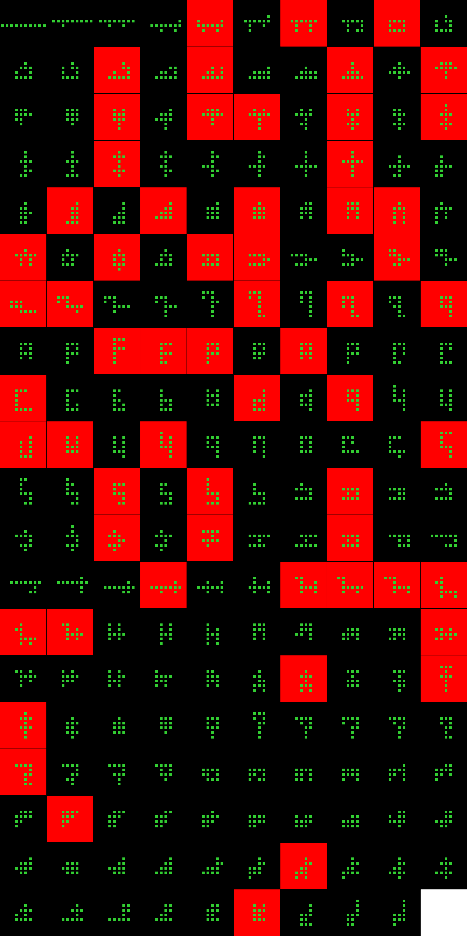
Player 029

Slide 11
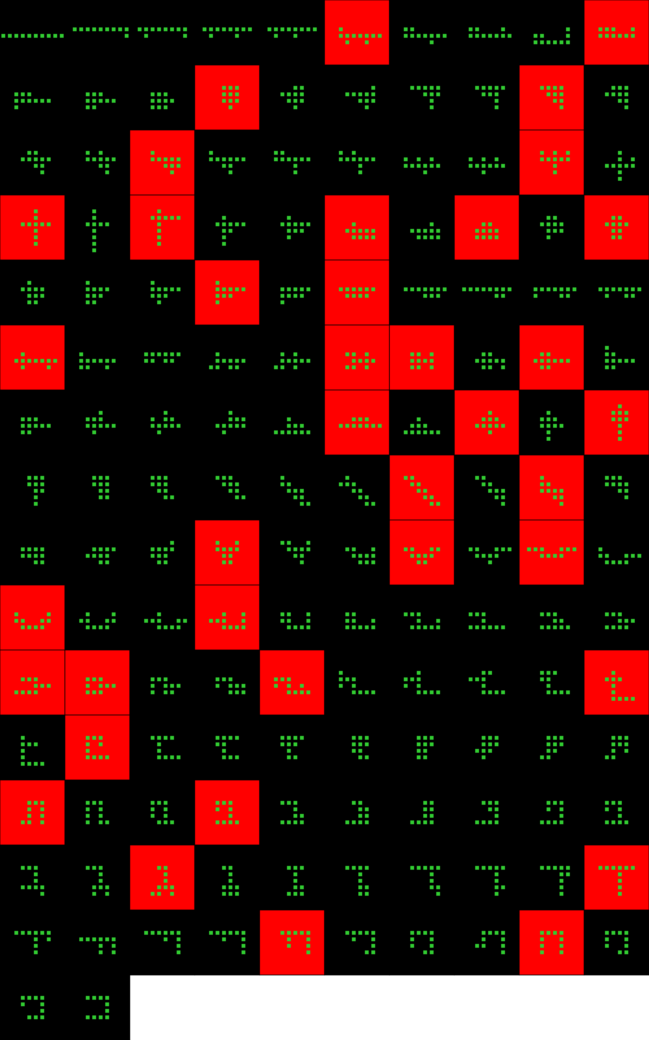
Player 031

Slide 12
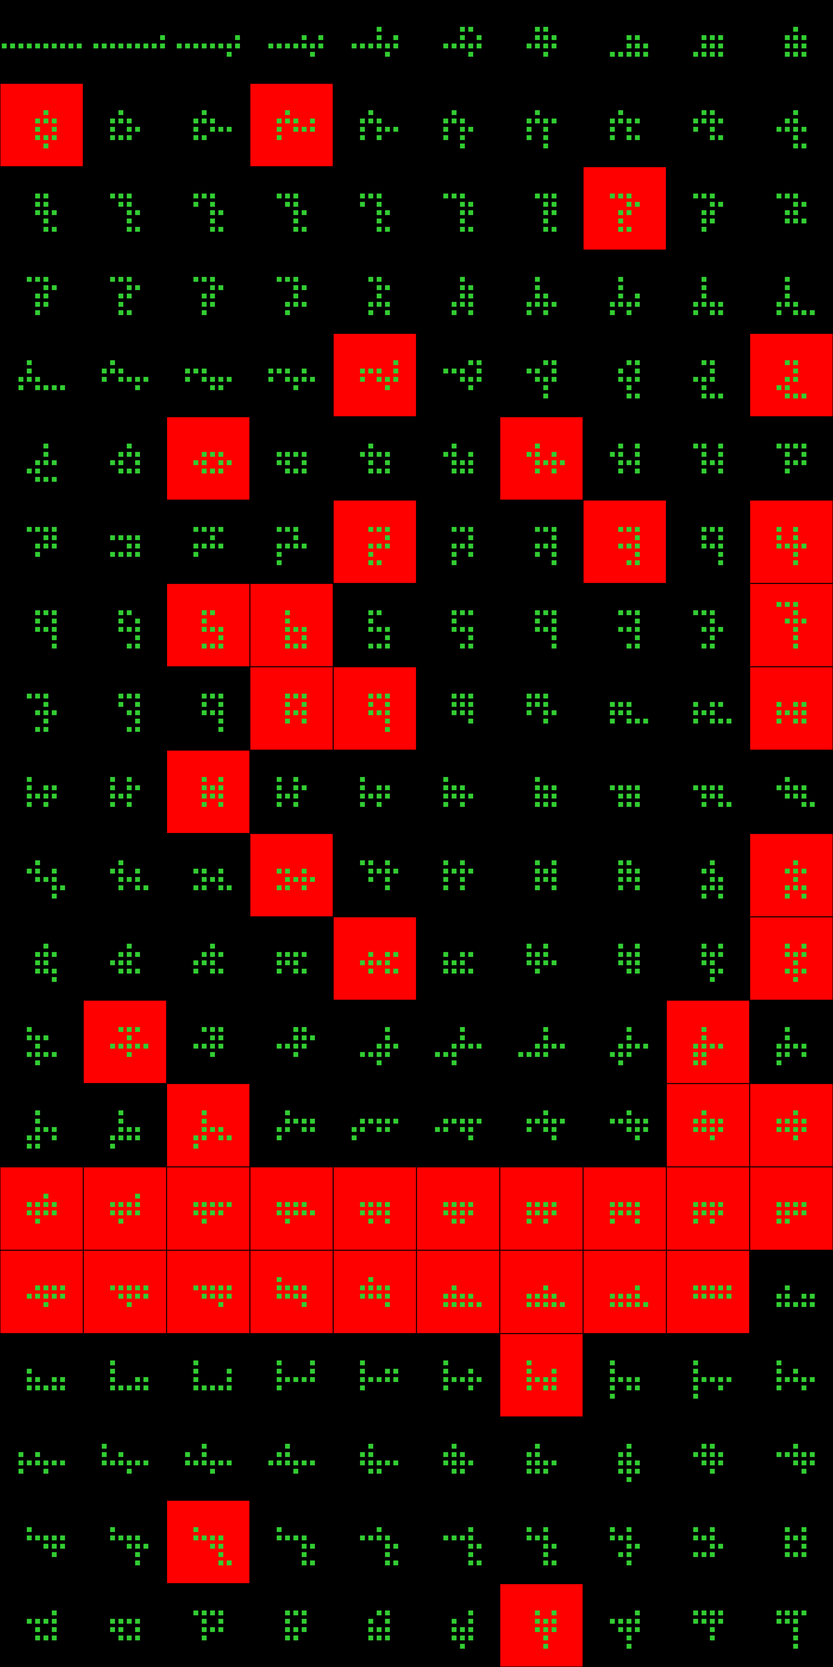
Player 032

Slide 13
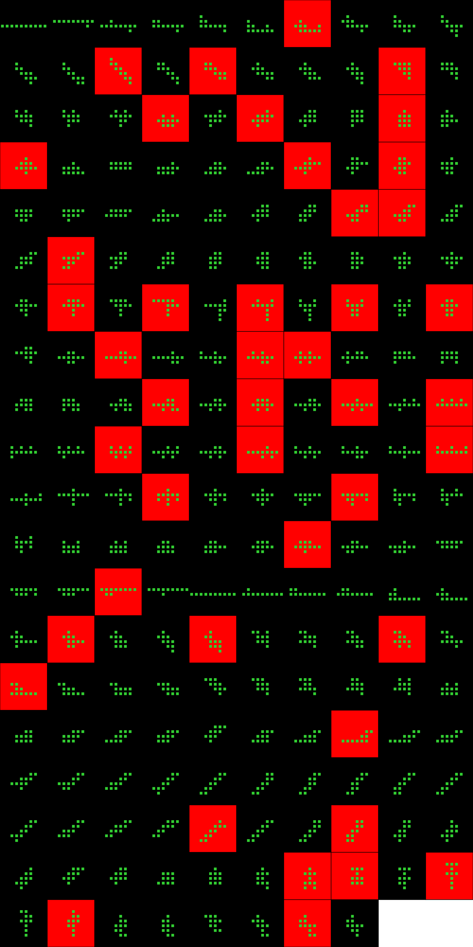
Player 033

Slide 14
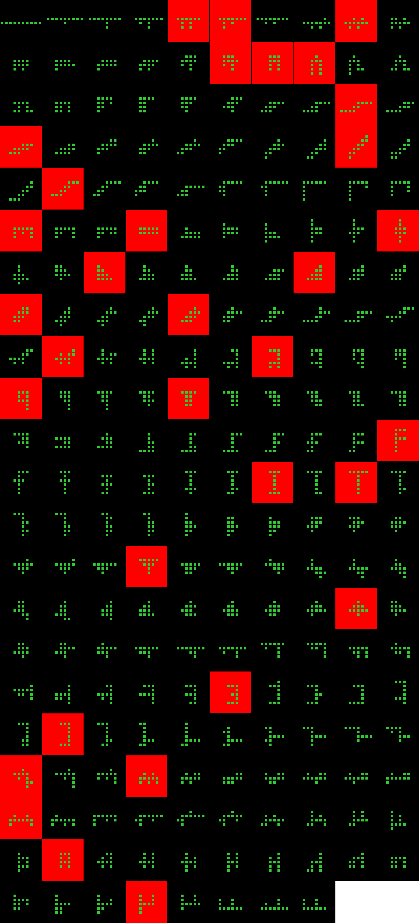
Player 034

Slide 15
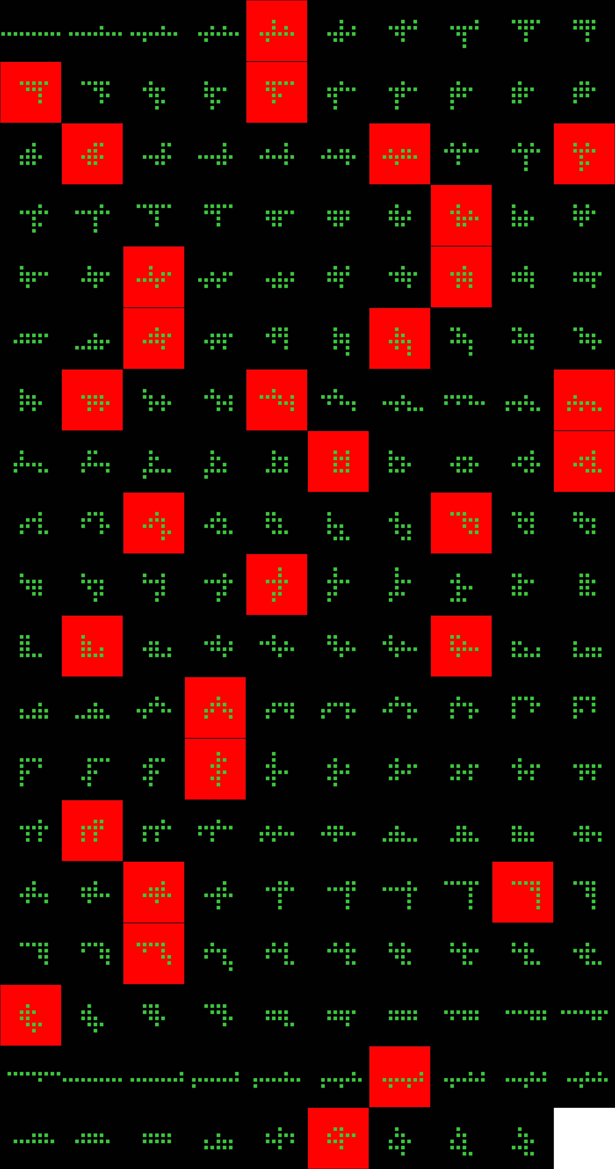
Player 035

Slide 16
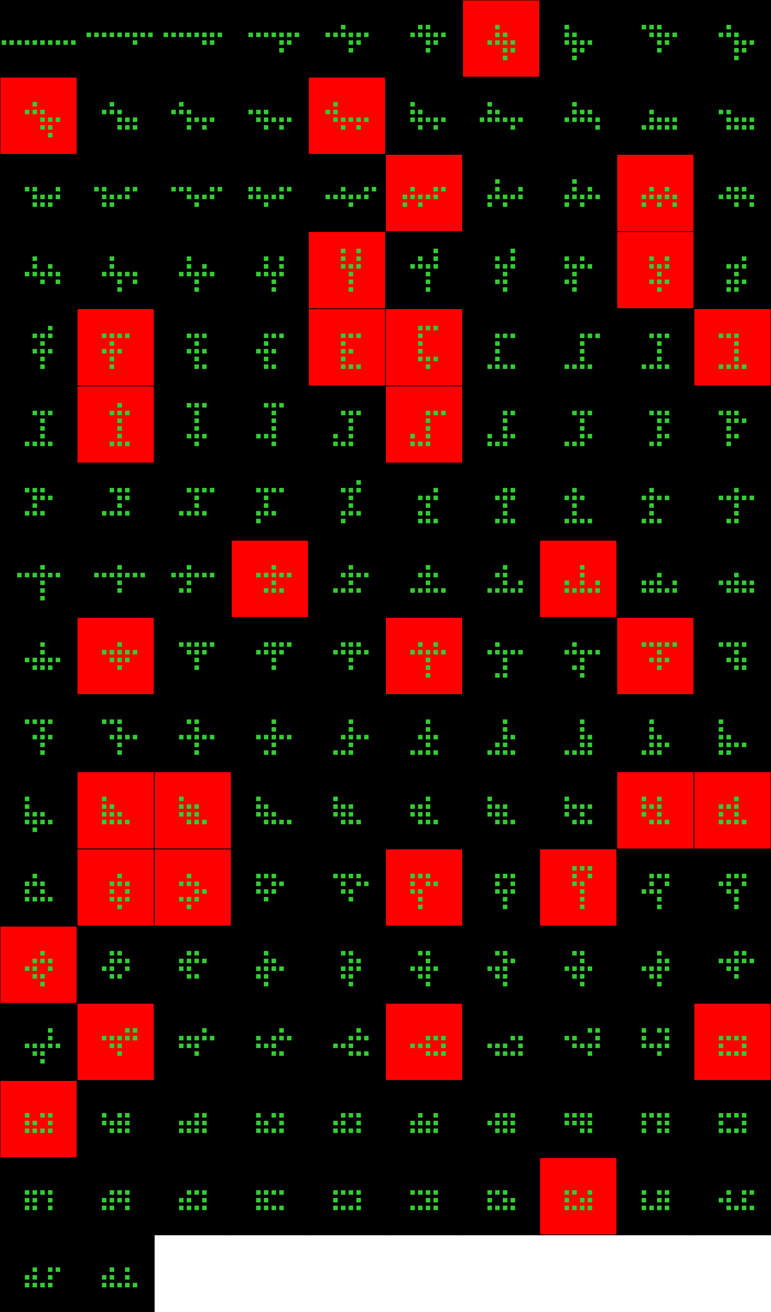
Player 036

Slide 17
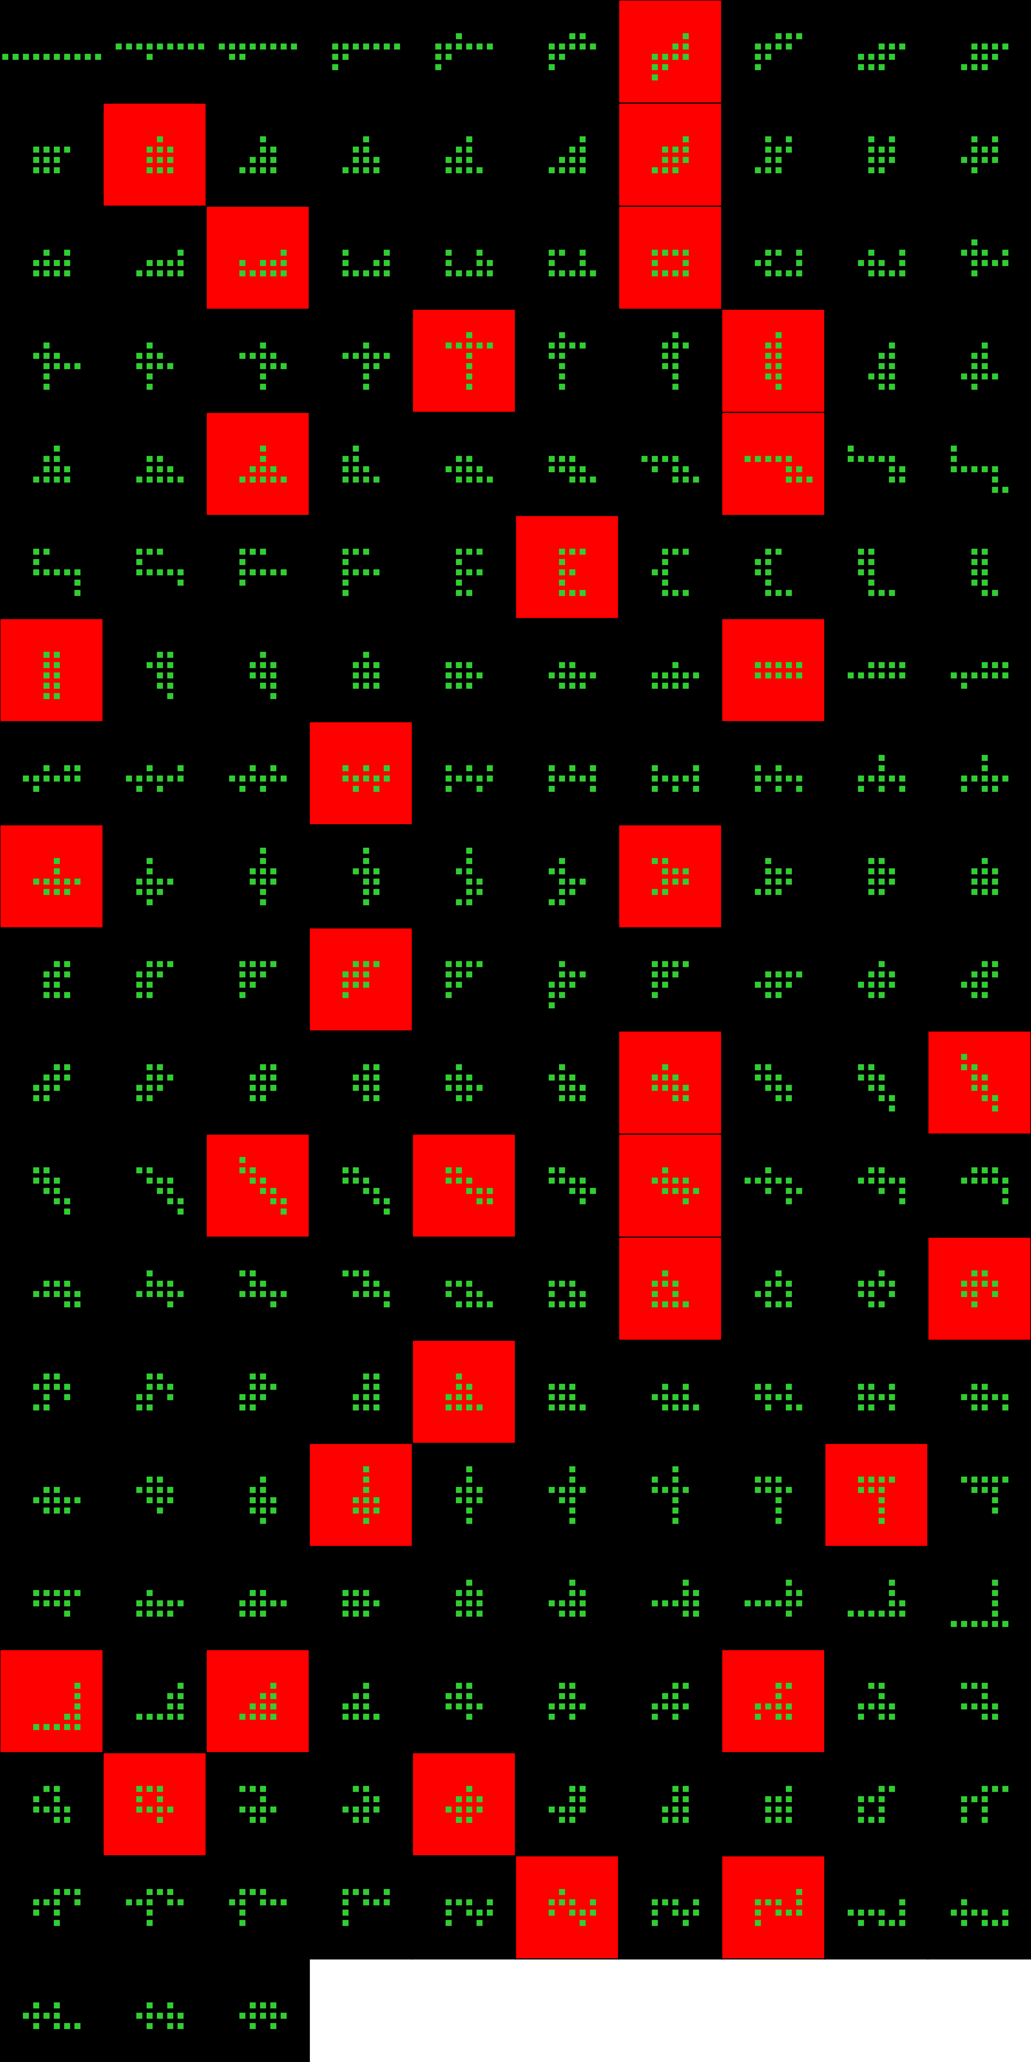
Player 037

Slide 18
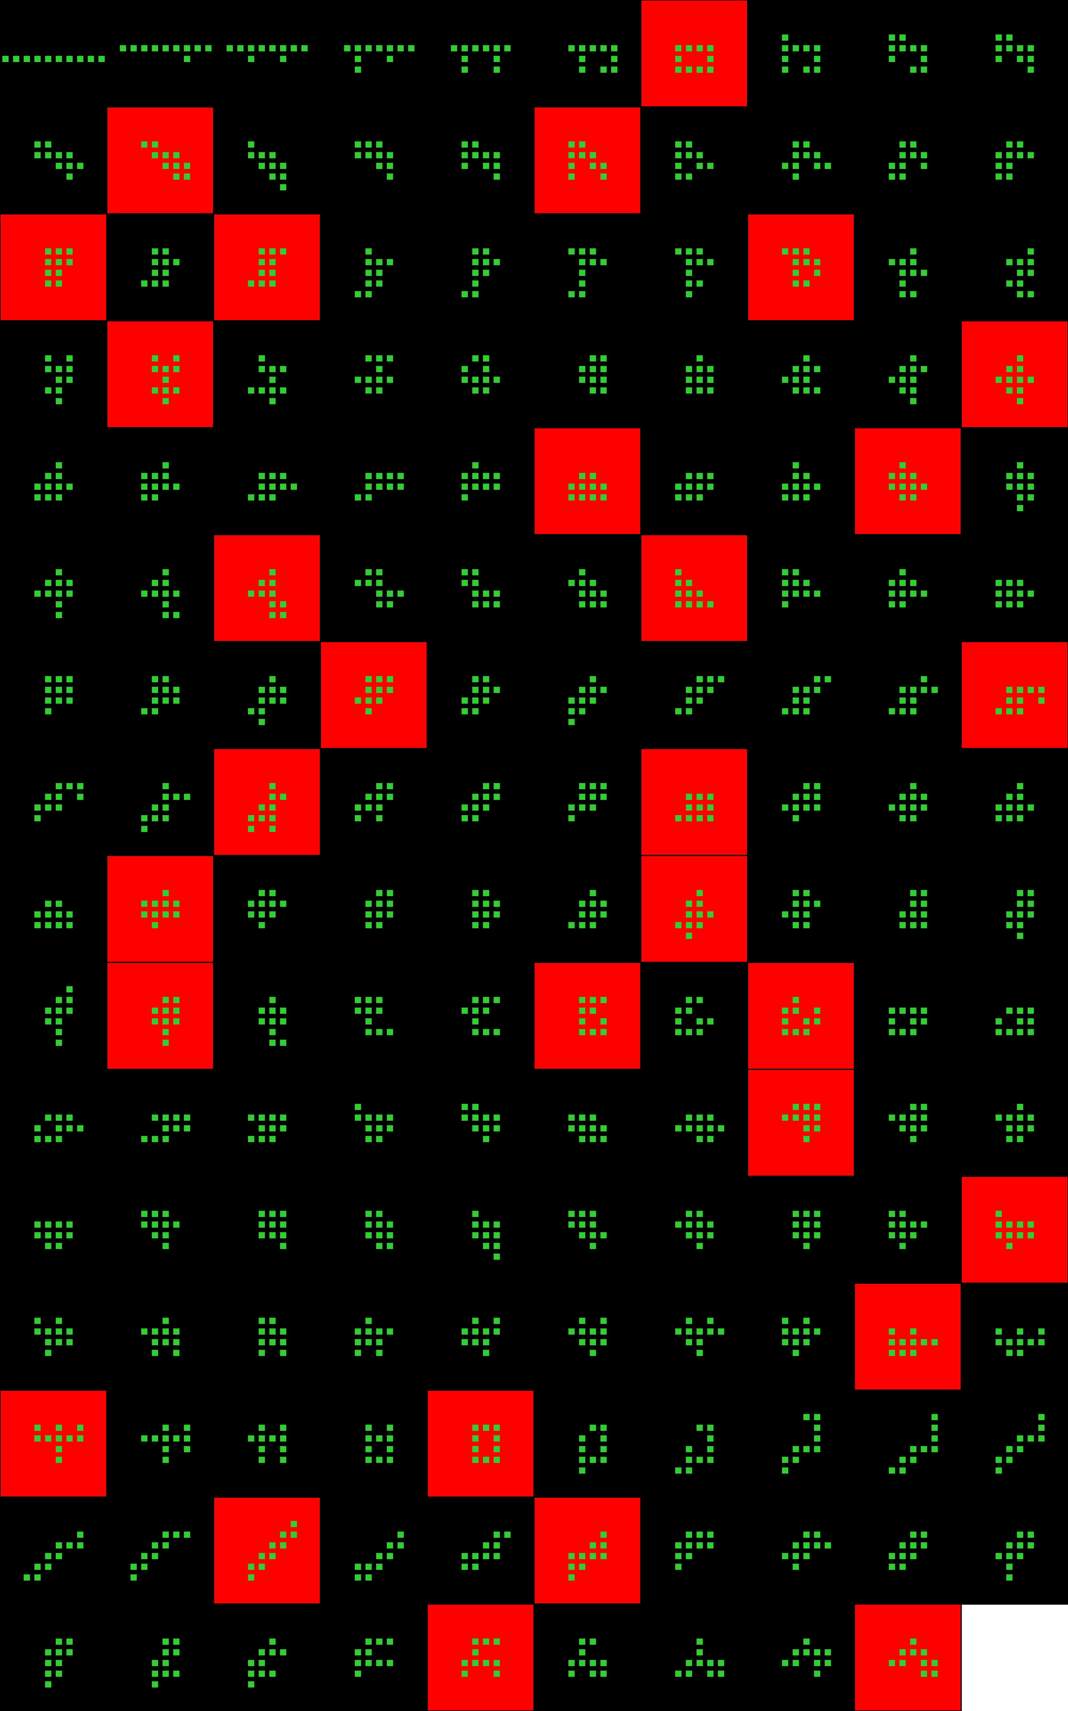
Player 038

Slide 19
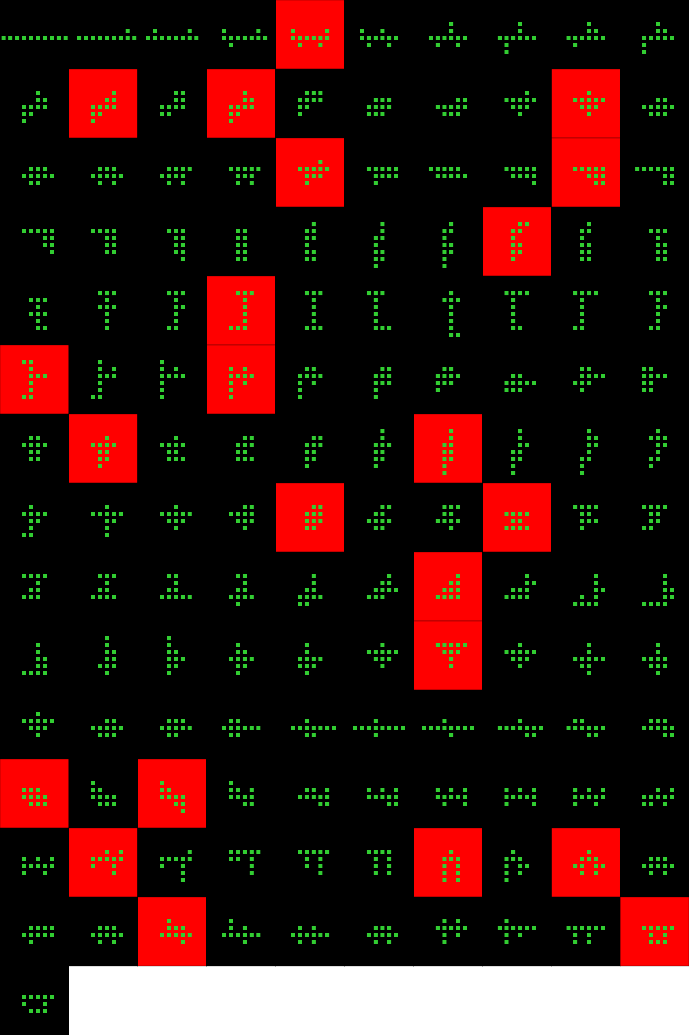
Player 039

Slide 20
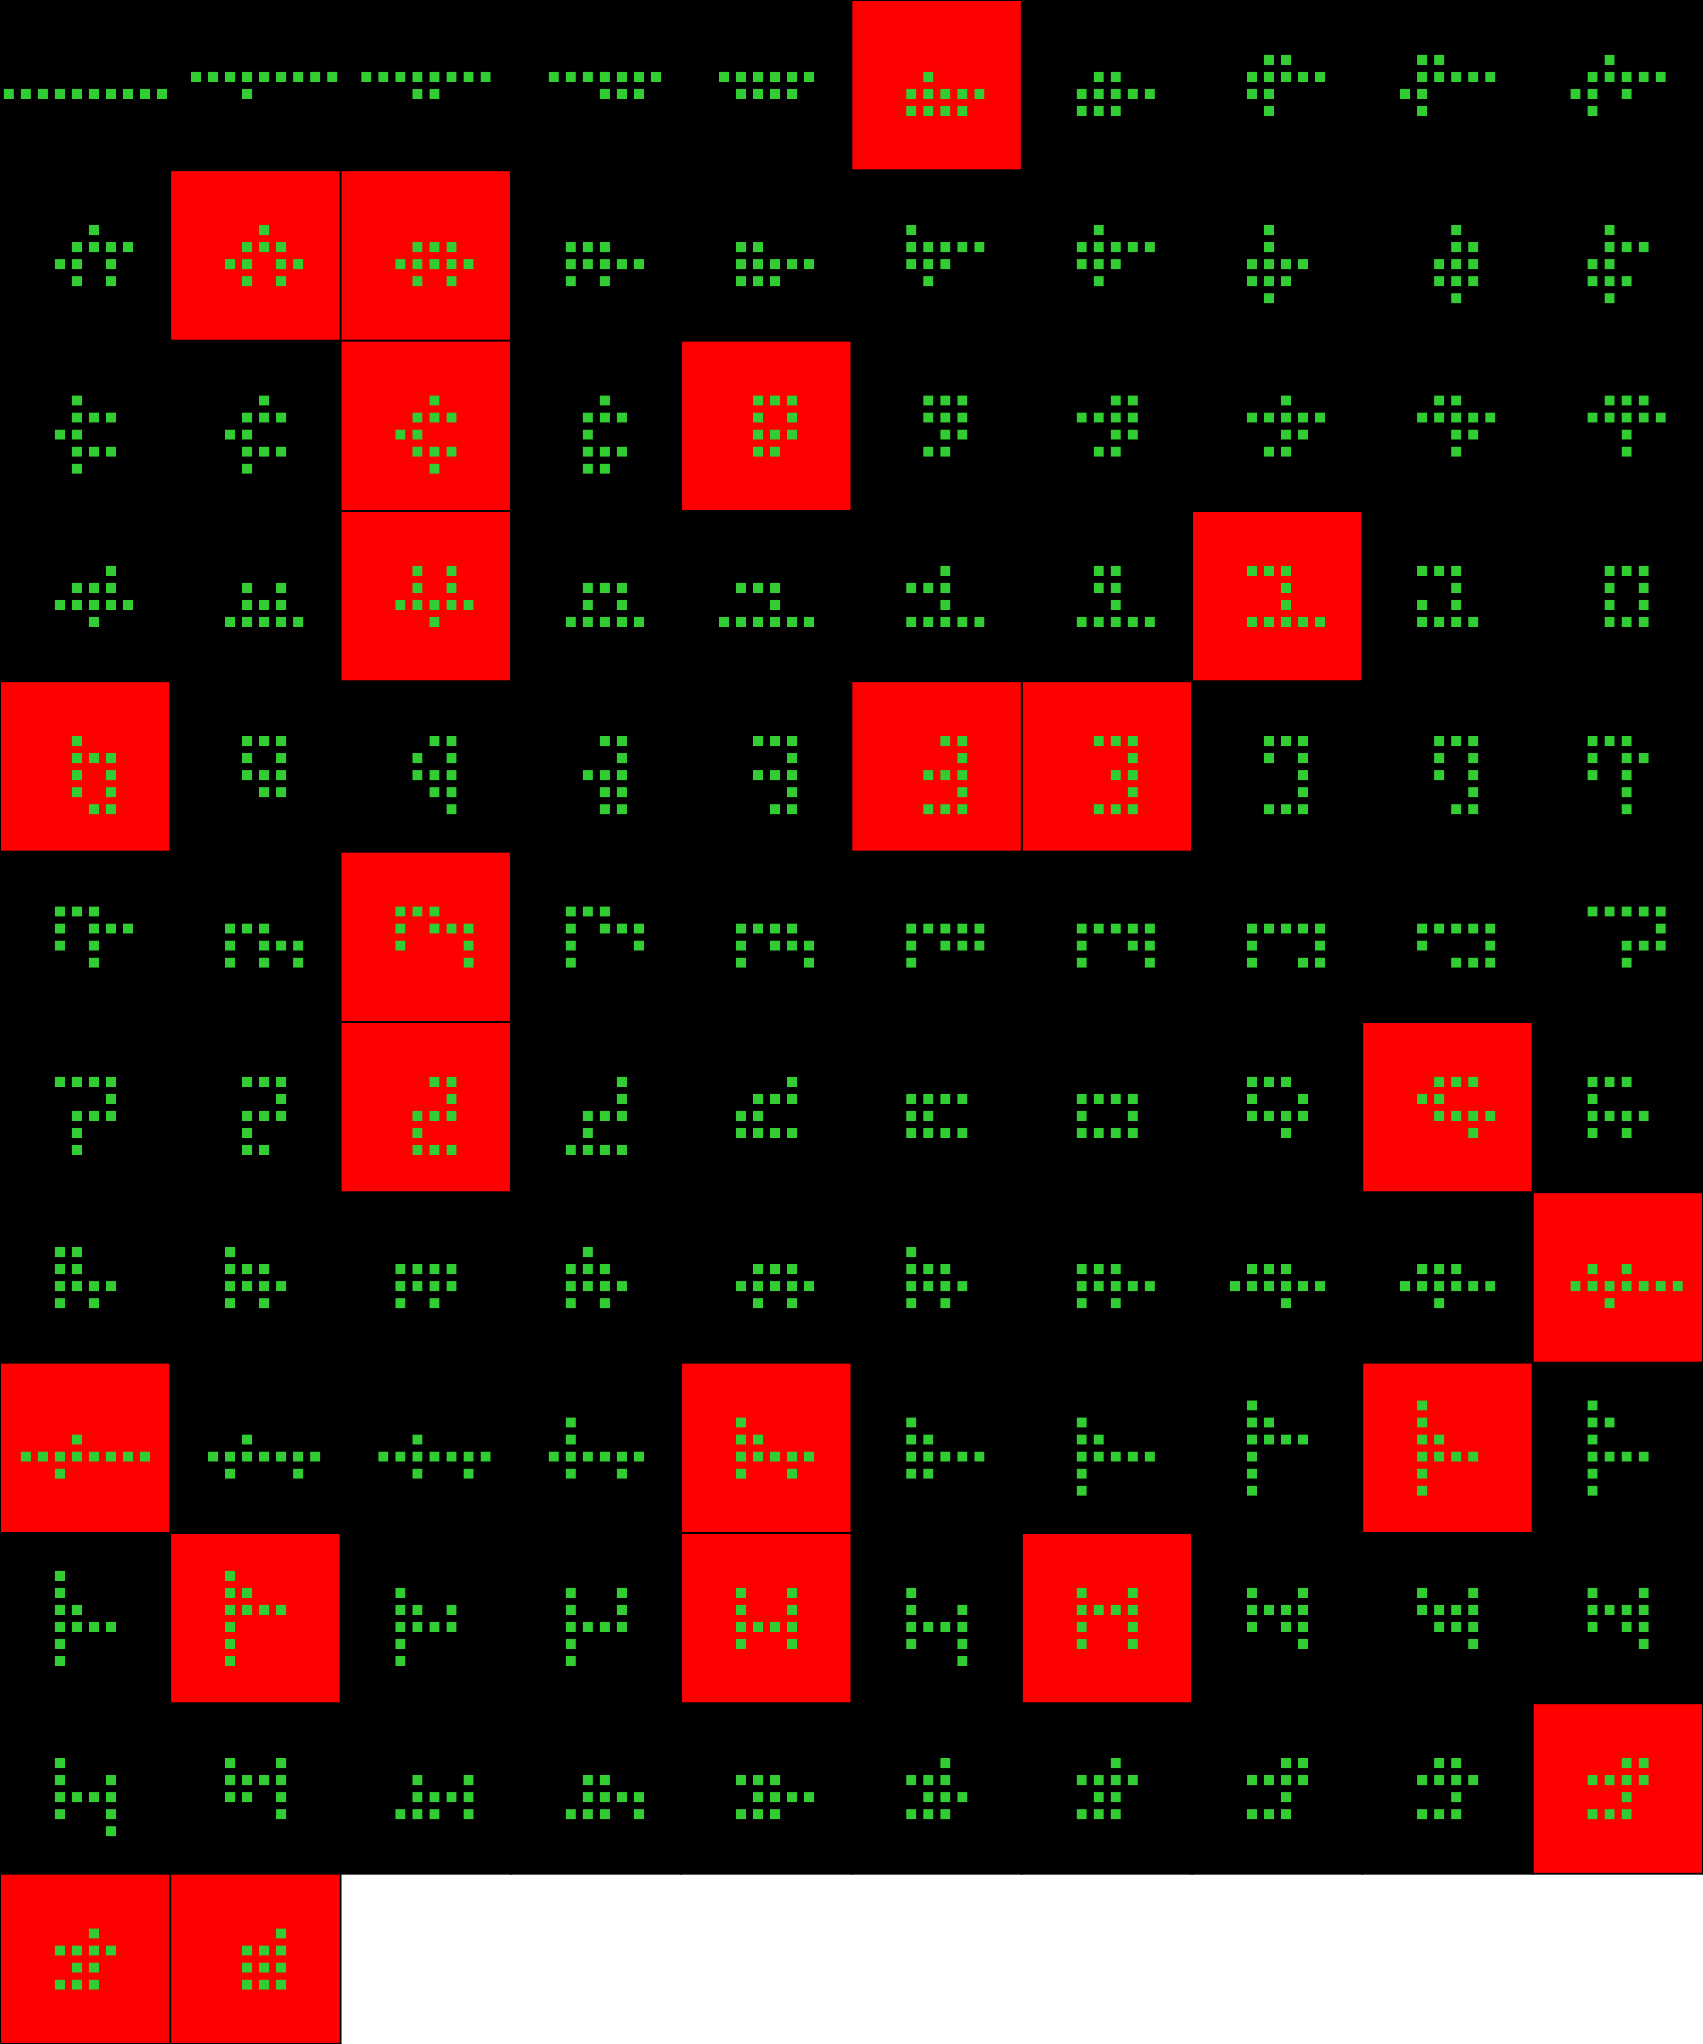
Player 040

Slide 21
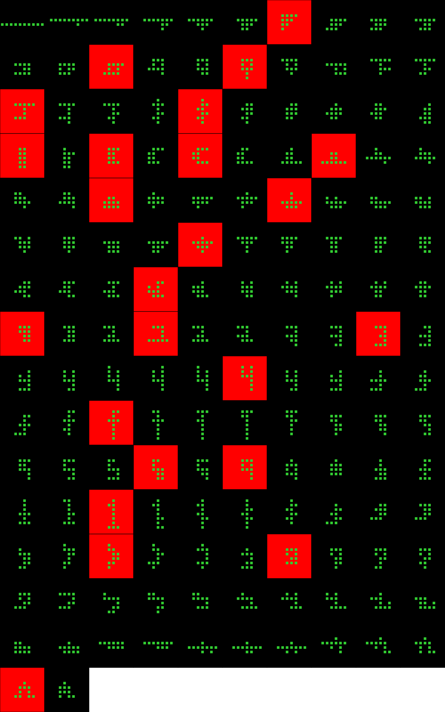
Player 041

Slide 22
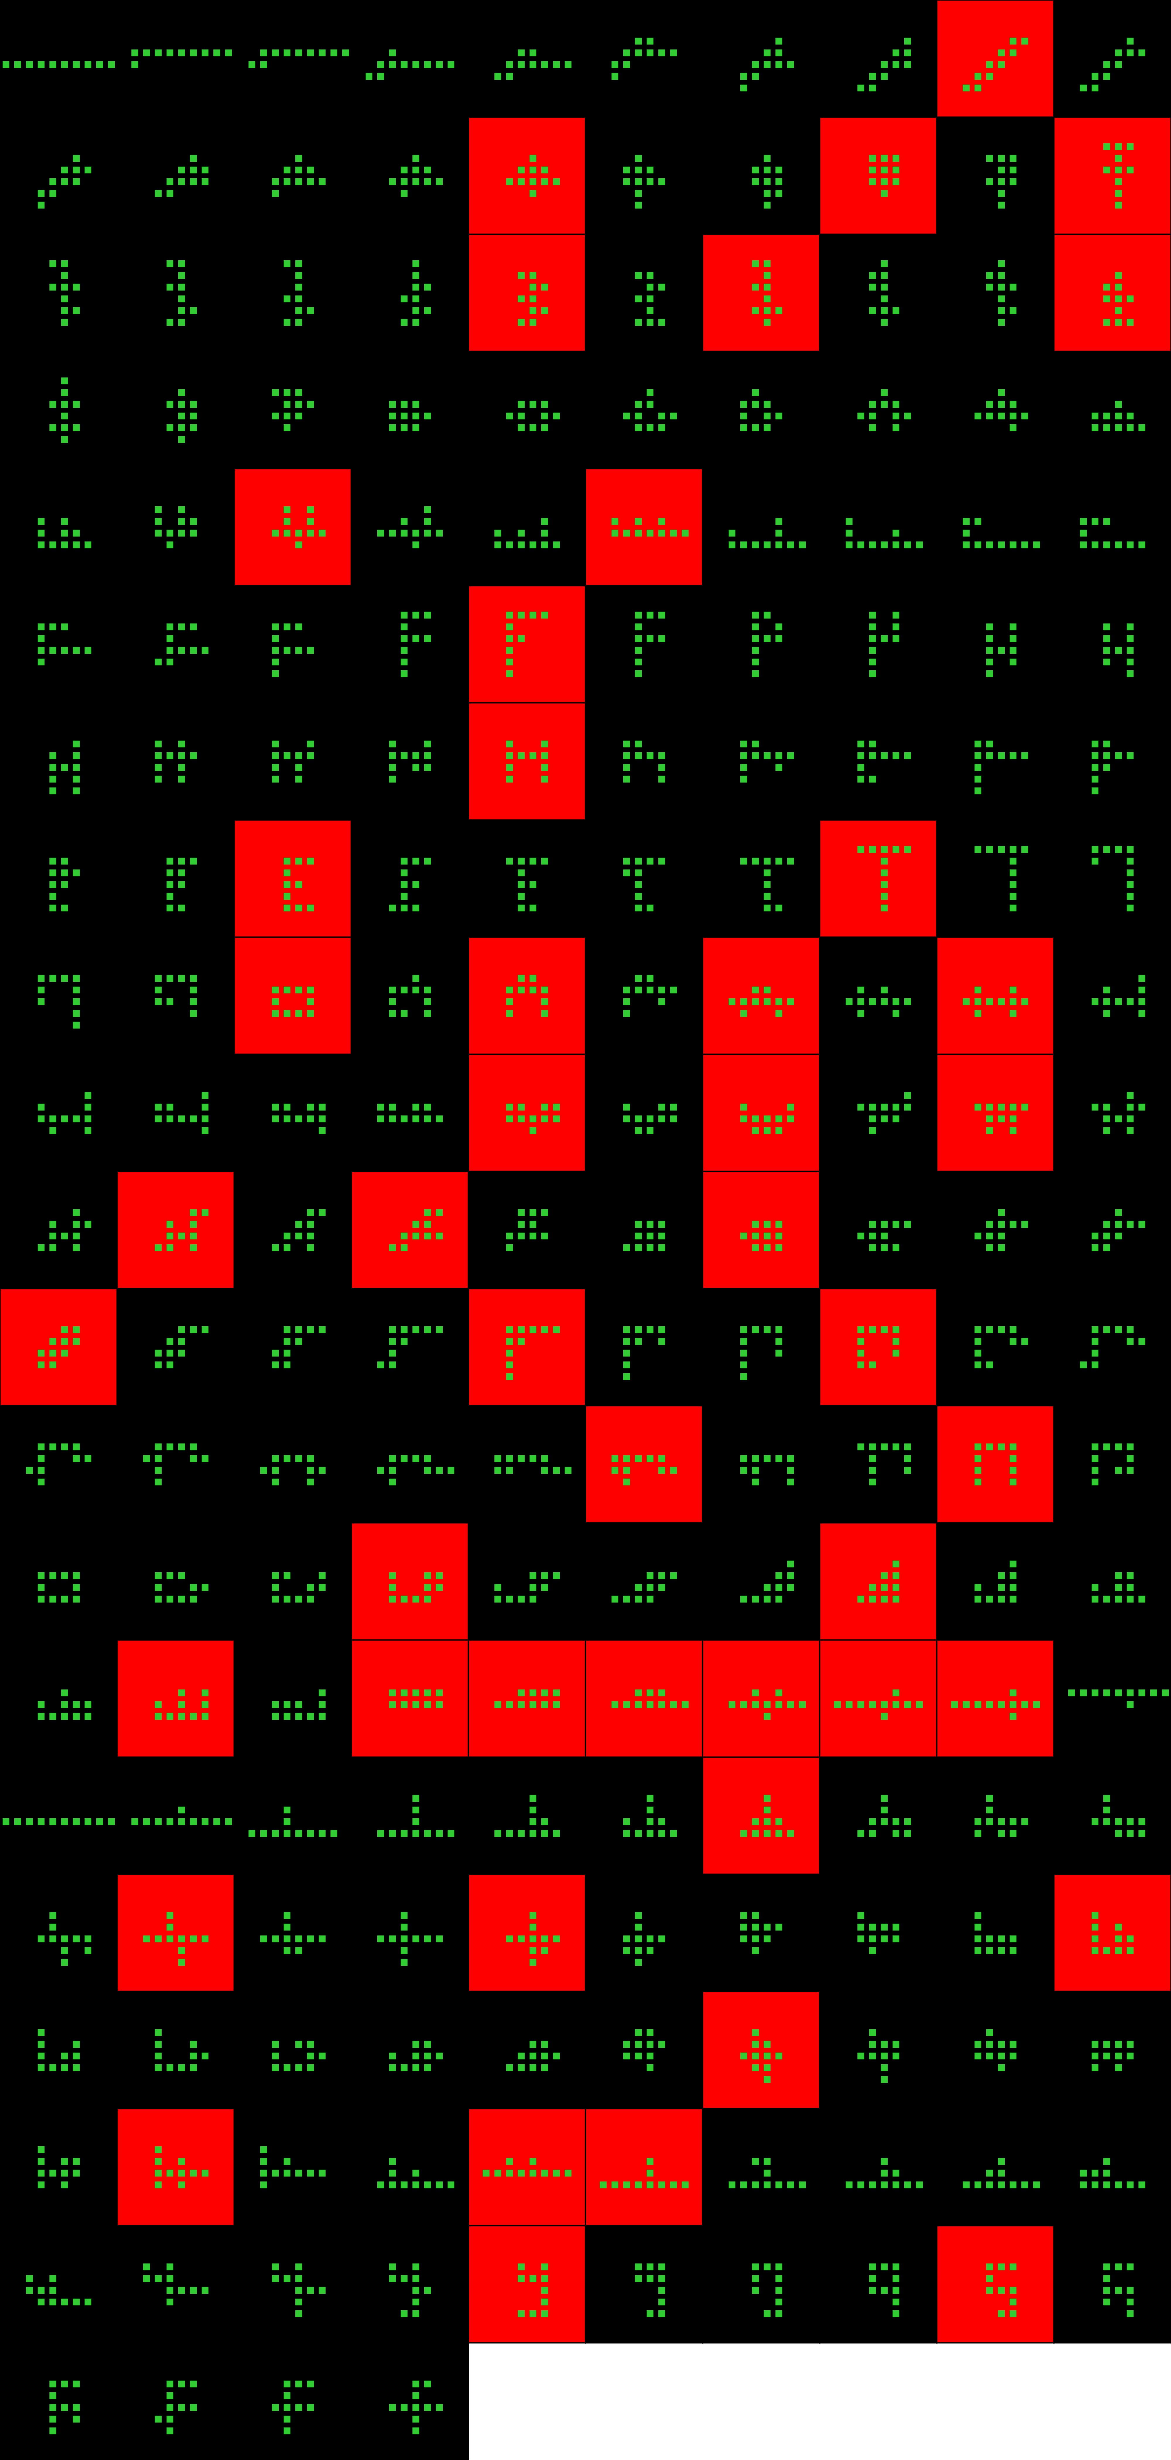
Player 042

Slide 23
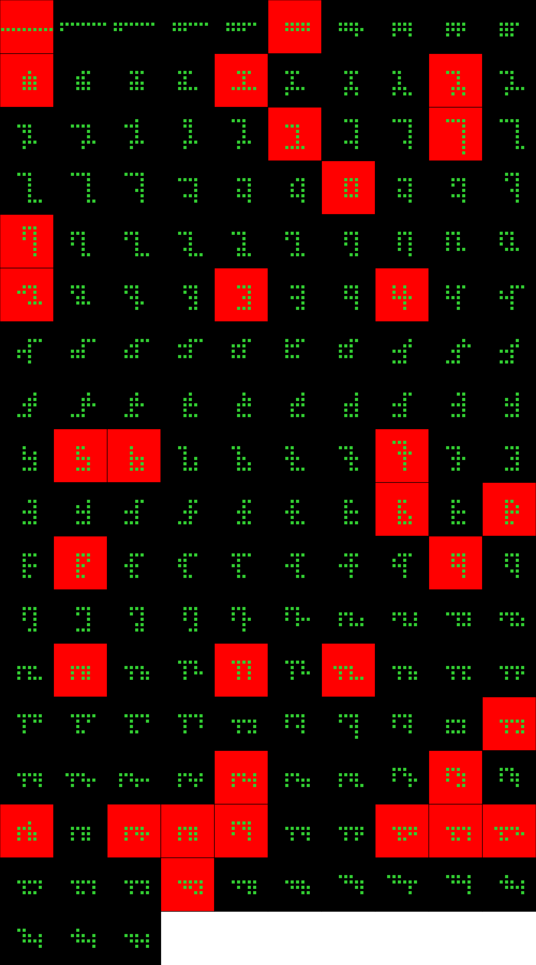
Player 043

Slide 24
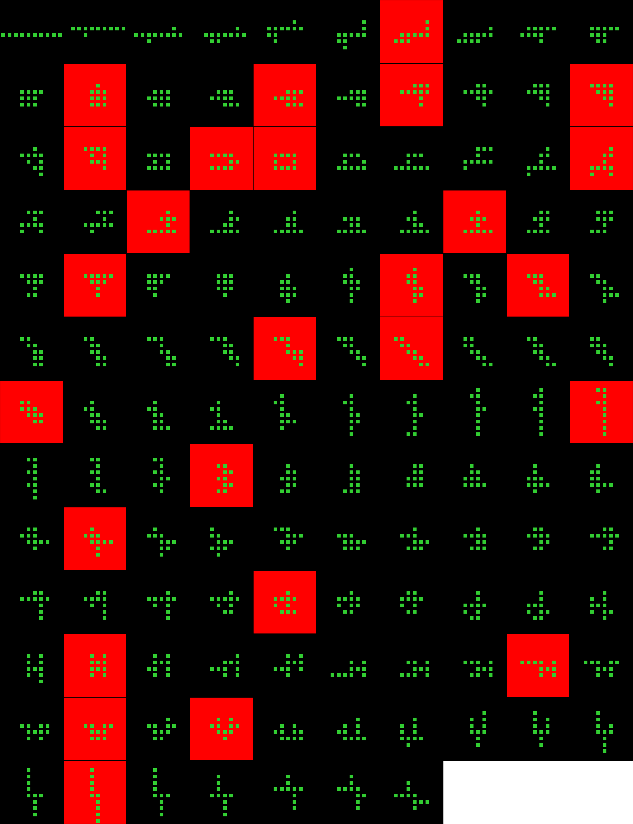
Player 044

Slide 25
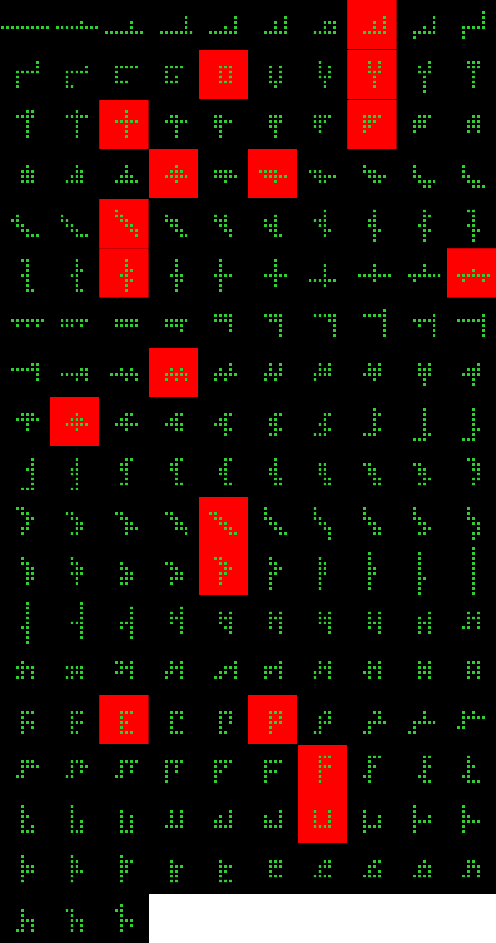
Player 045

Slide 26
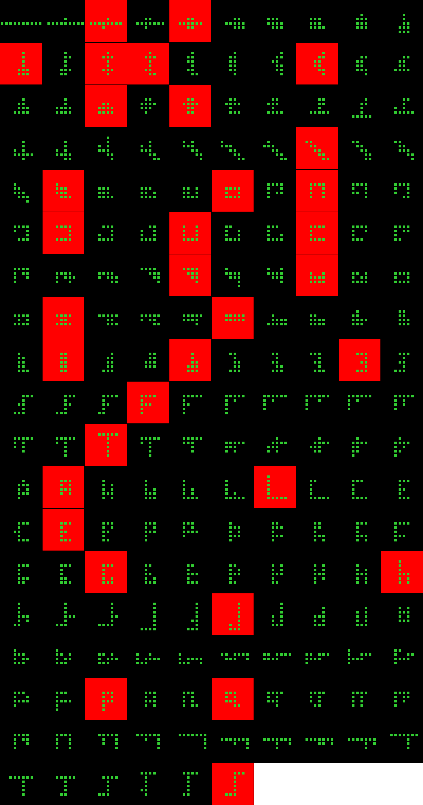
Player 046

Slide 27
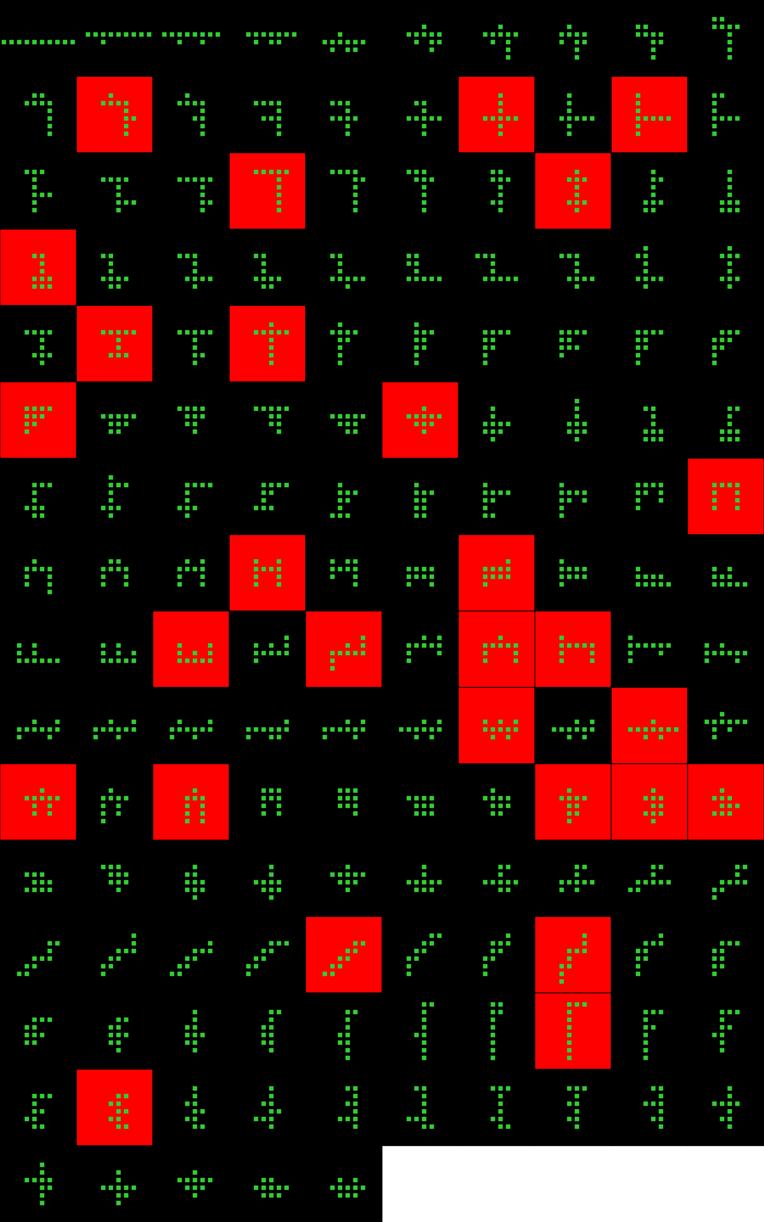
Player 047

Slide 28
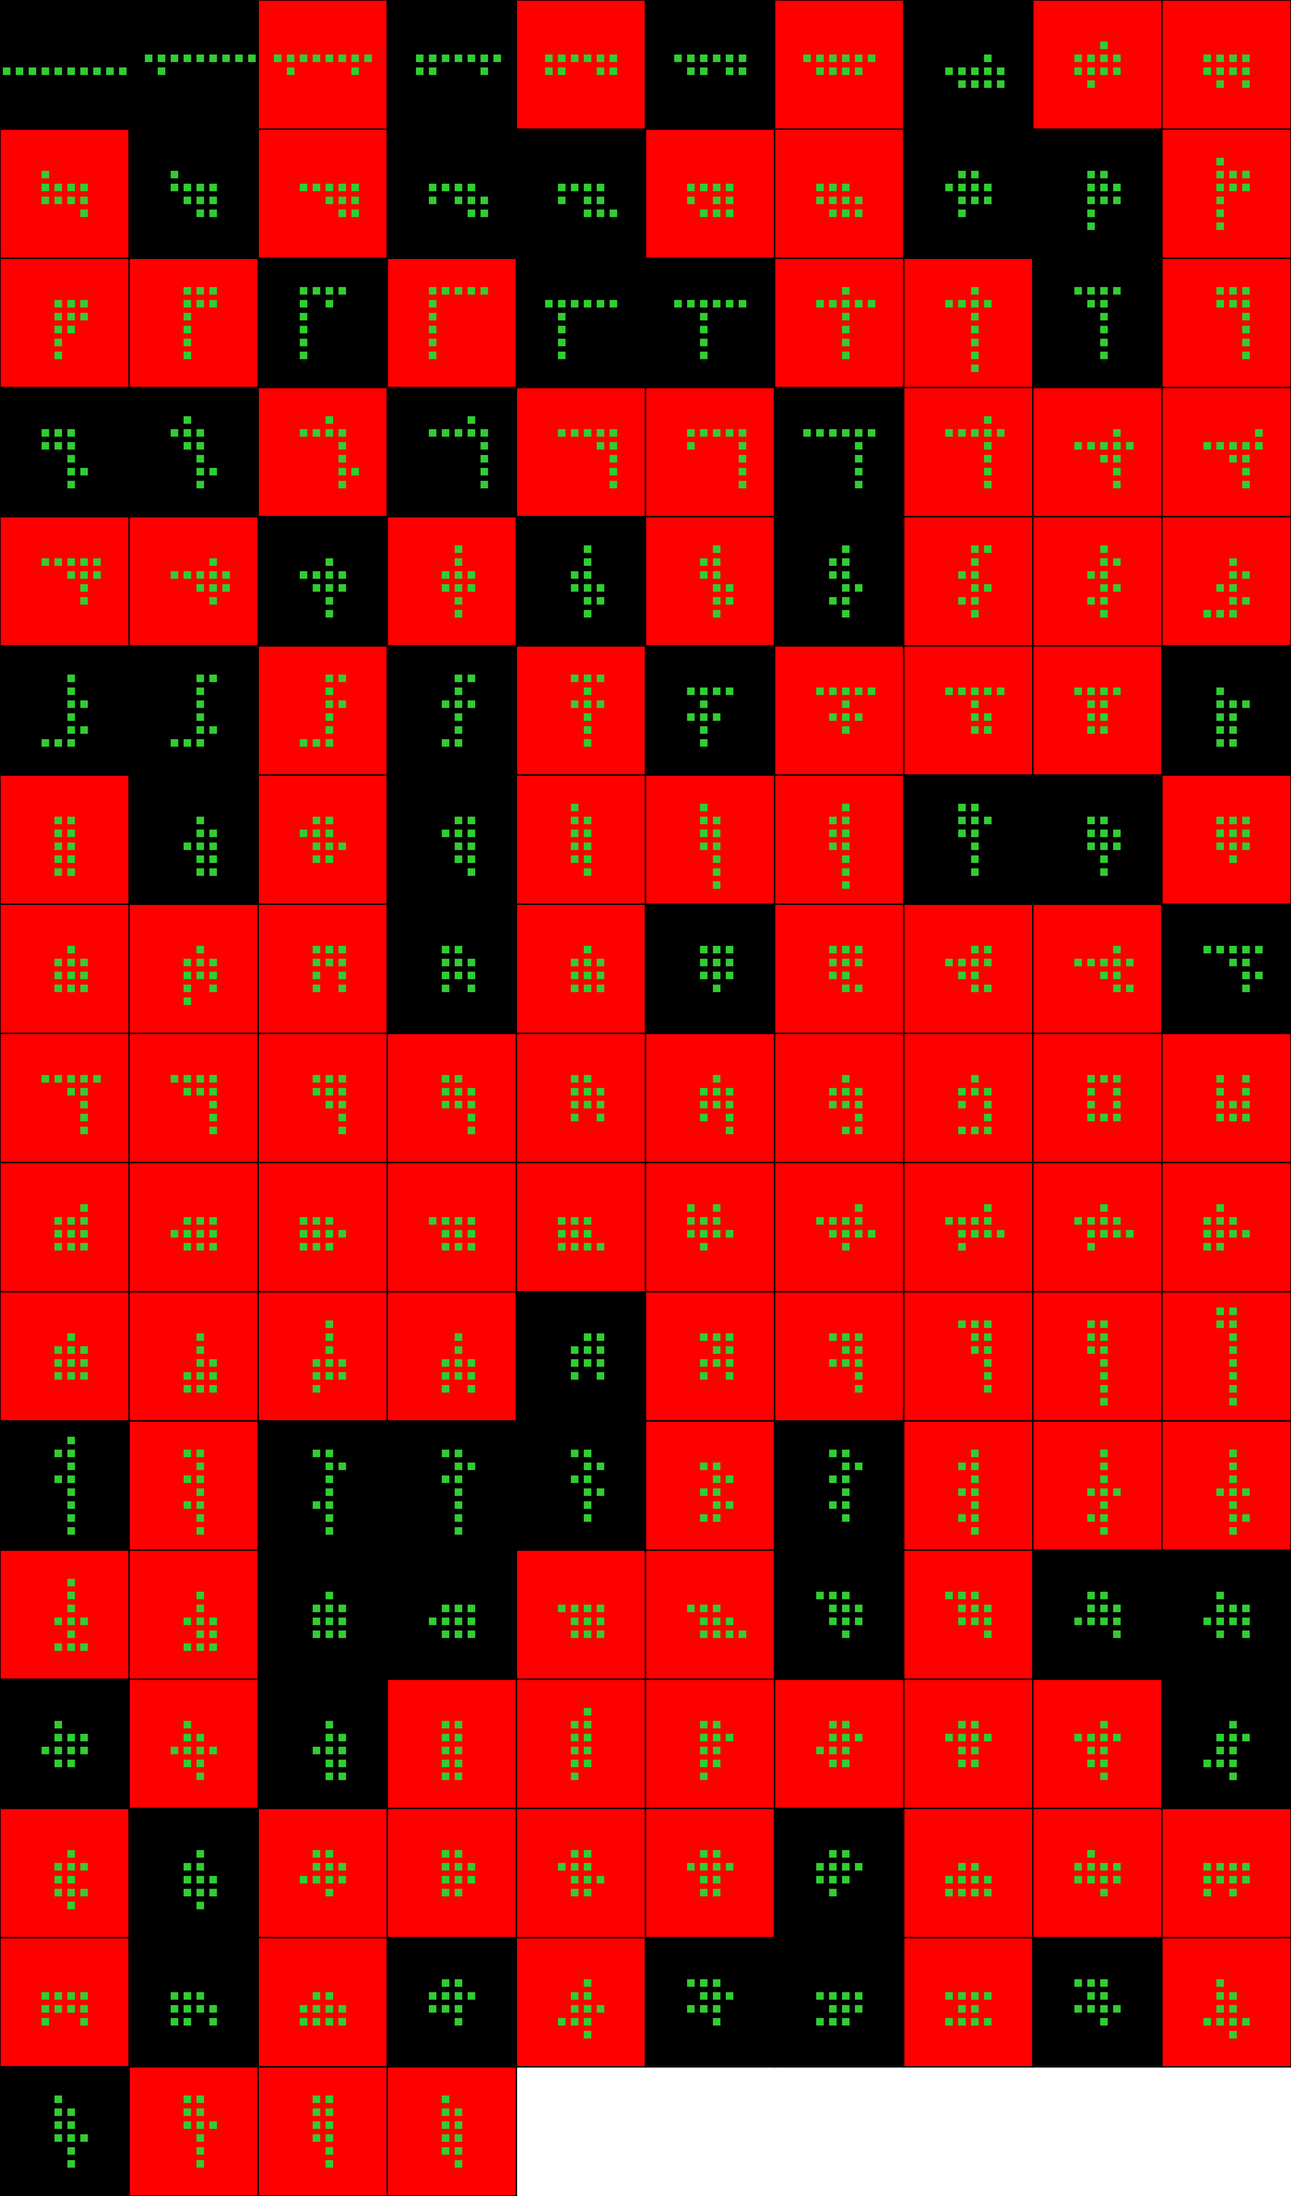
Player 048

Slide 29
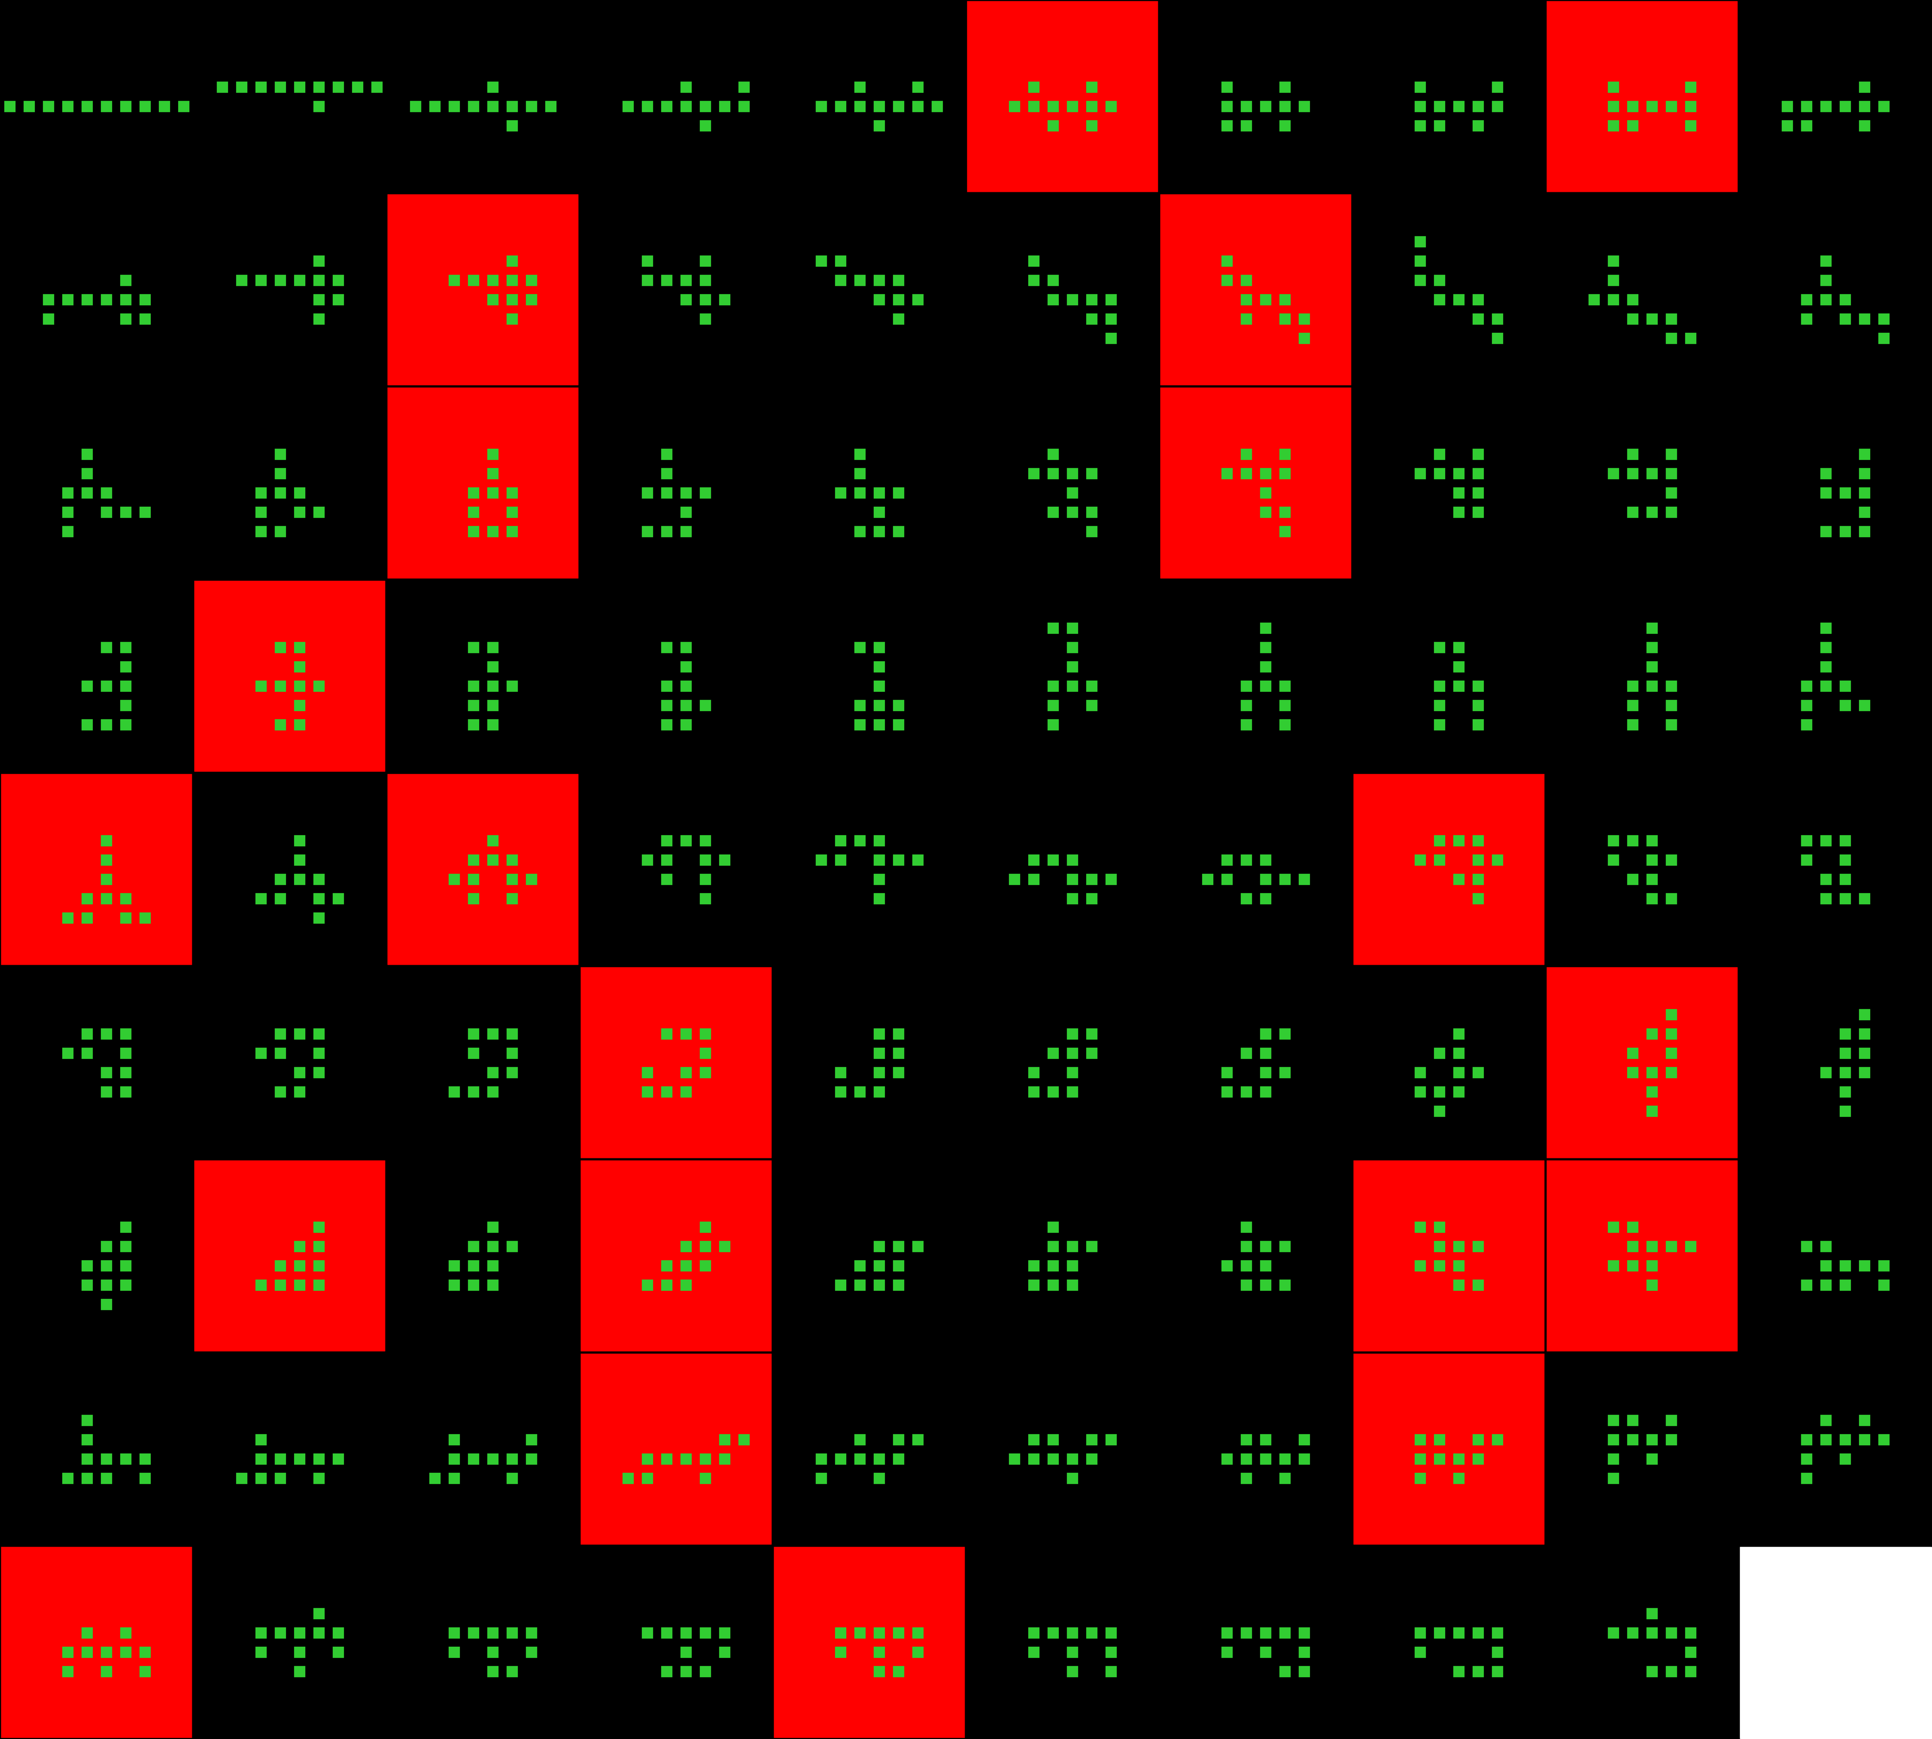
Player 049

Slide 30
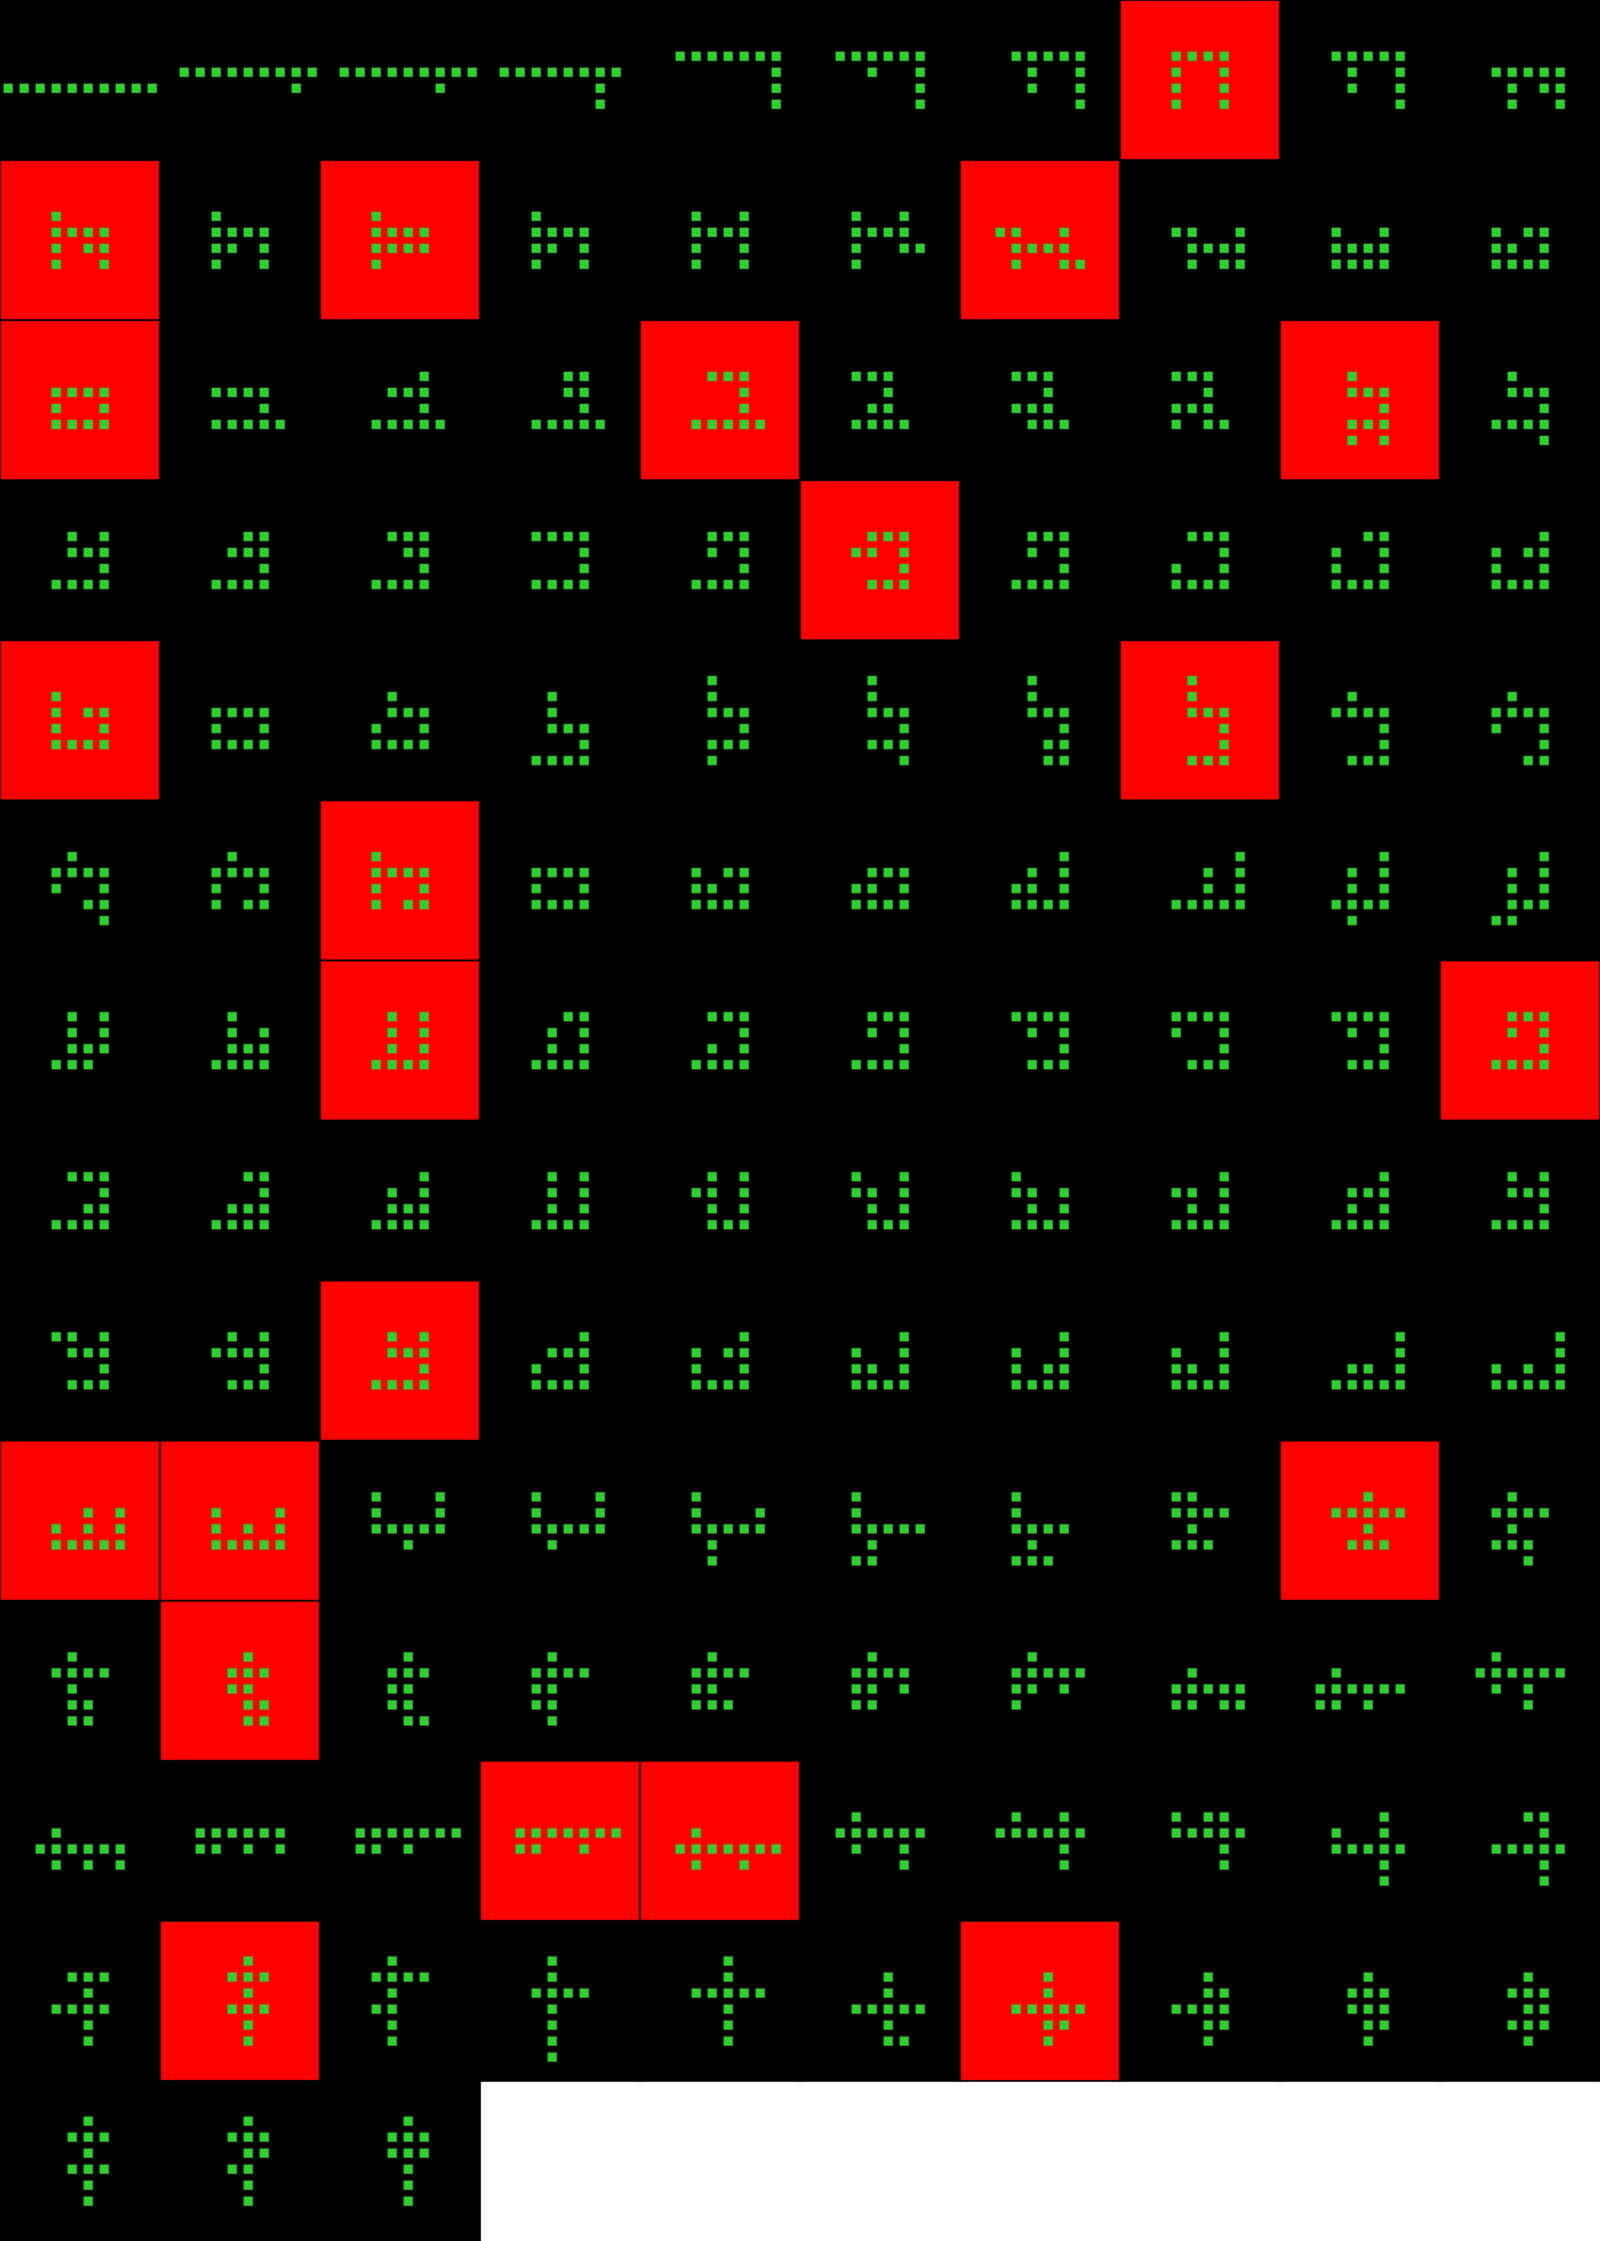
Player 050

Slide 31
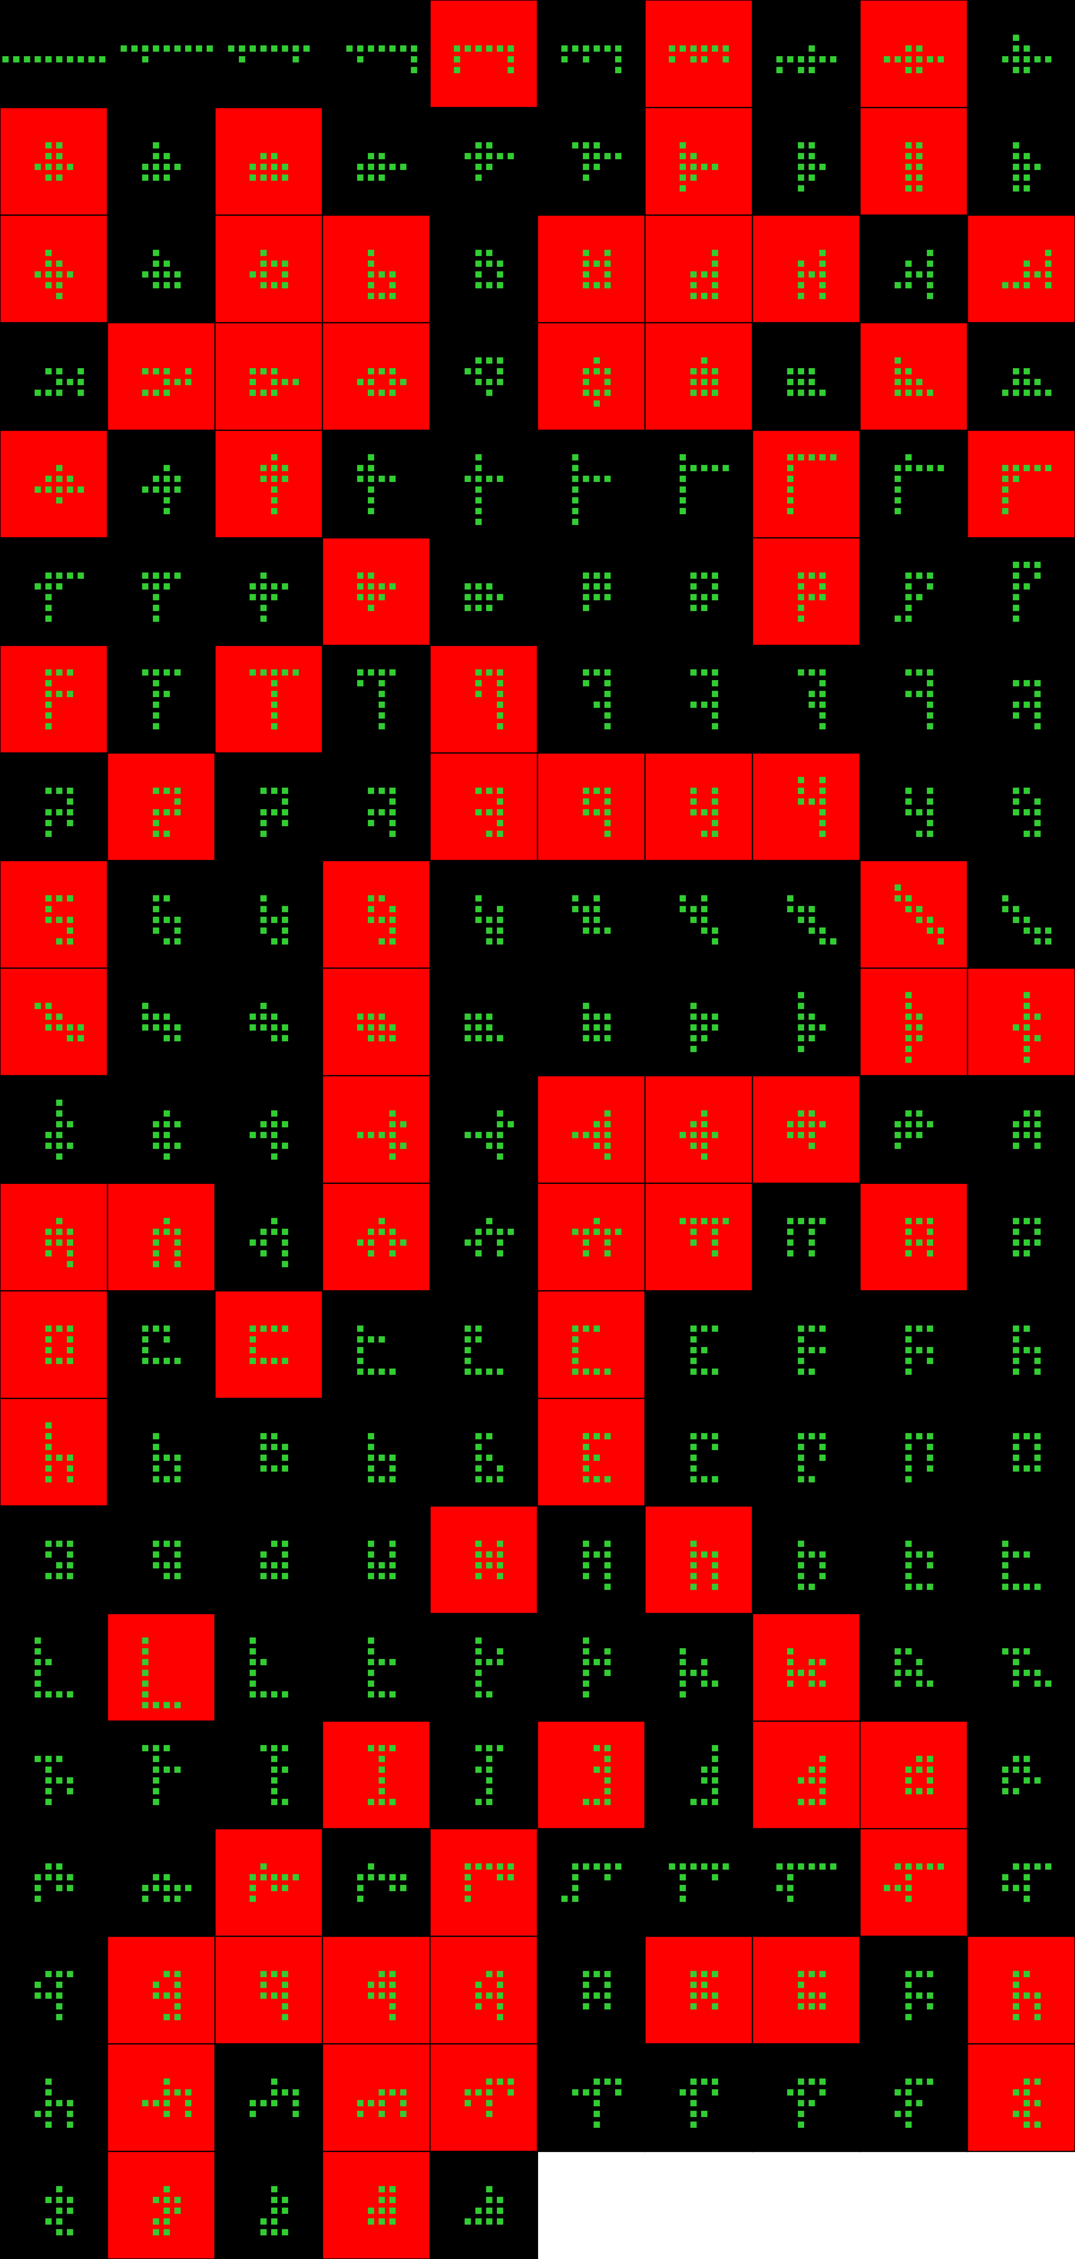
Player 051

Slide 32
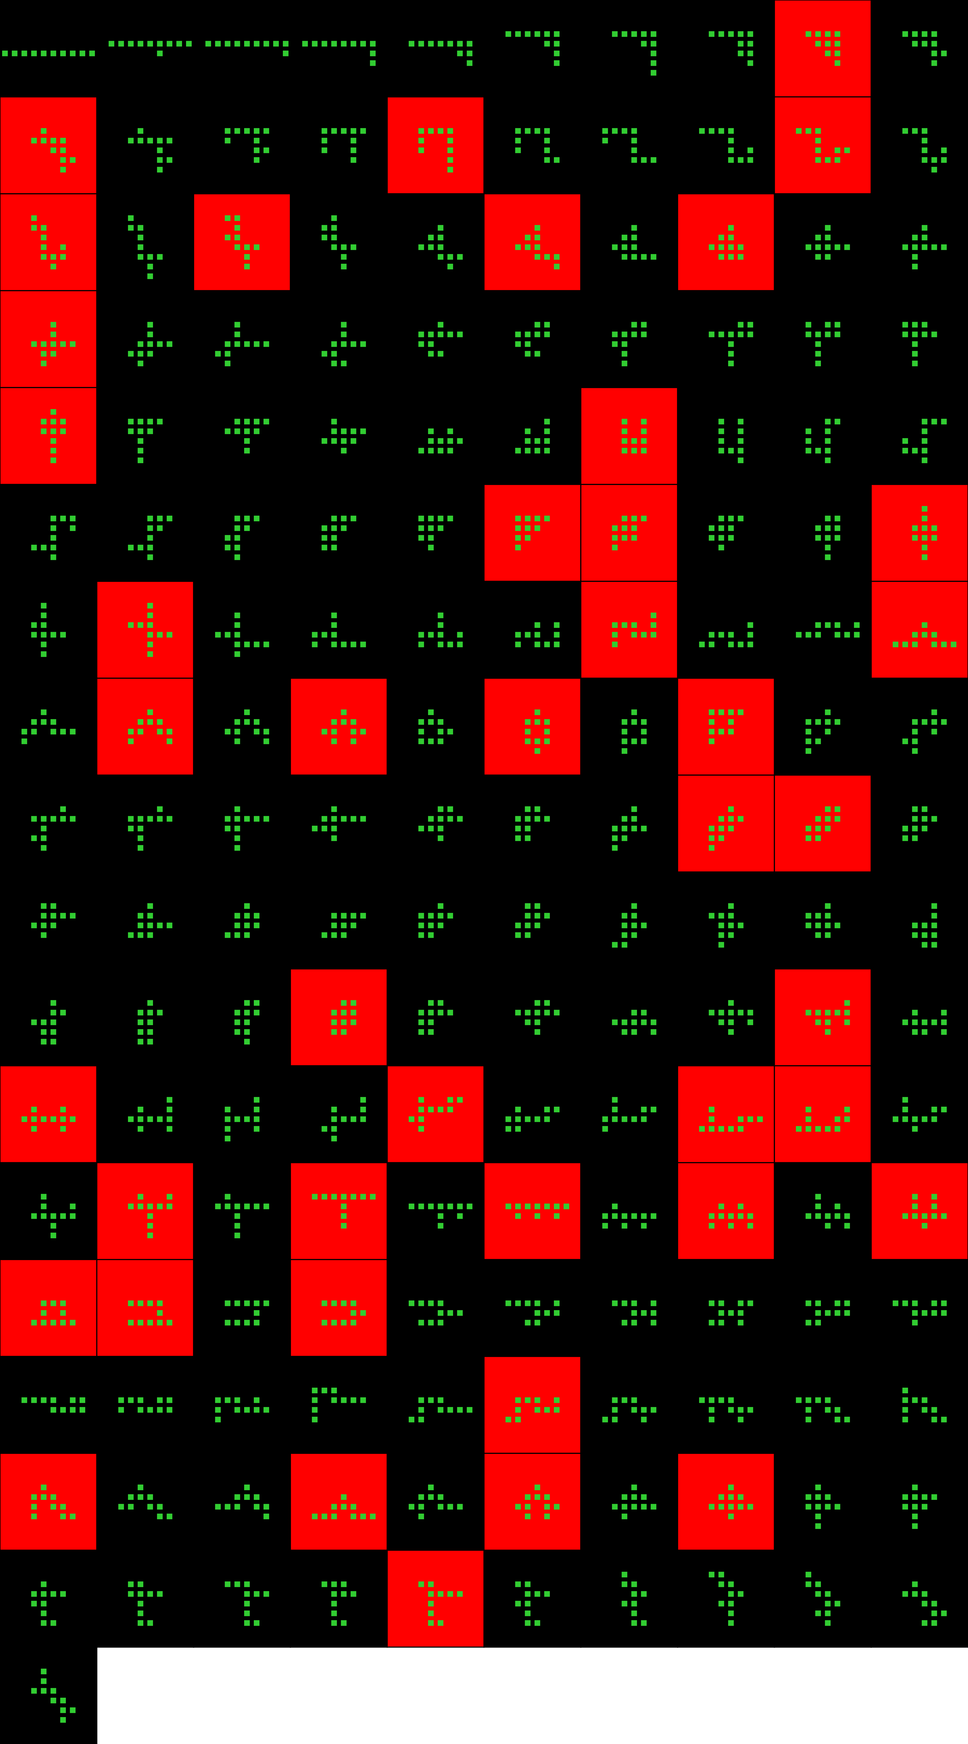
Player 052

Slide 33
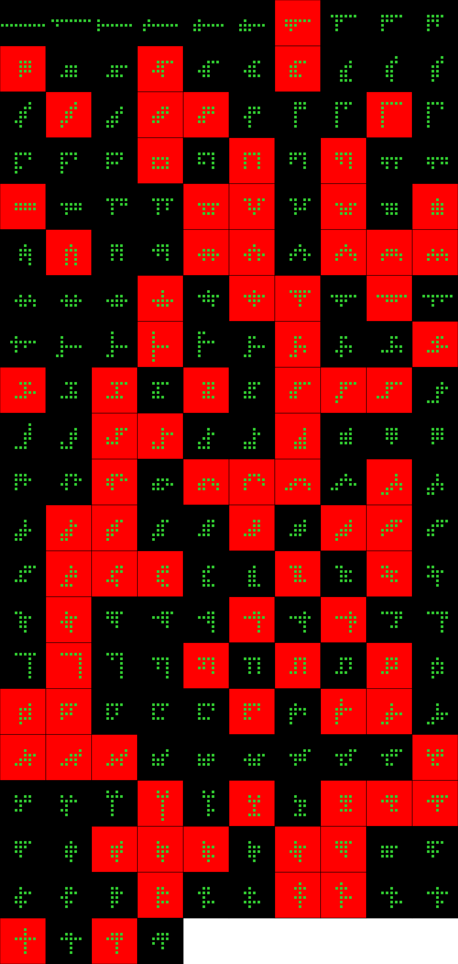
Player 053

Slide 34
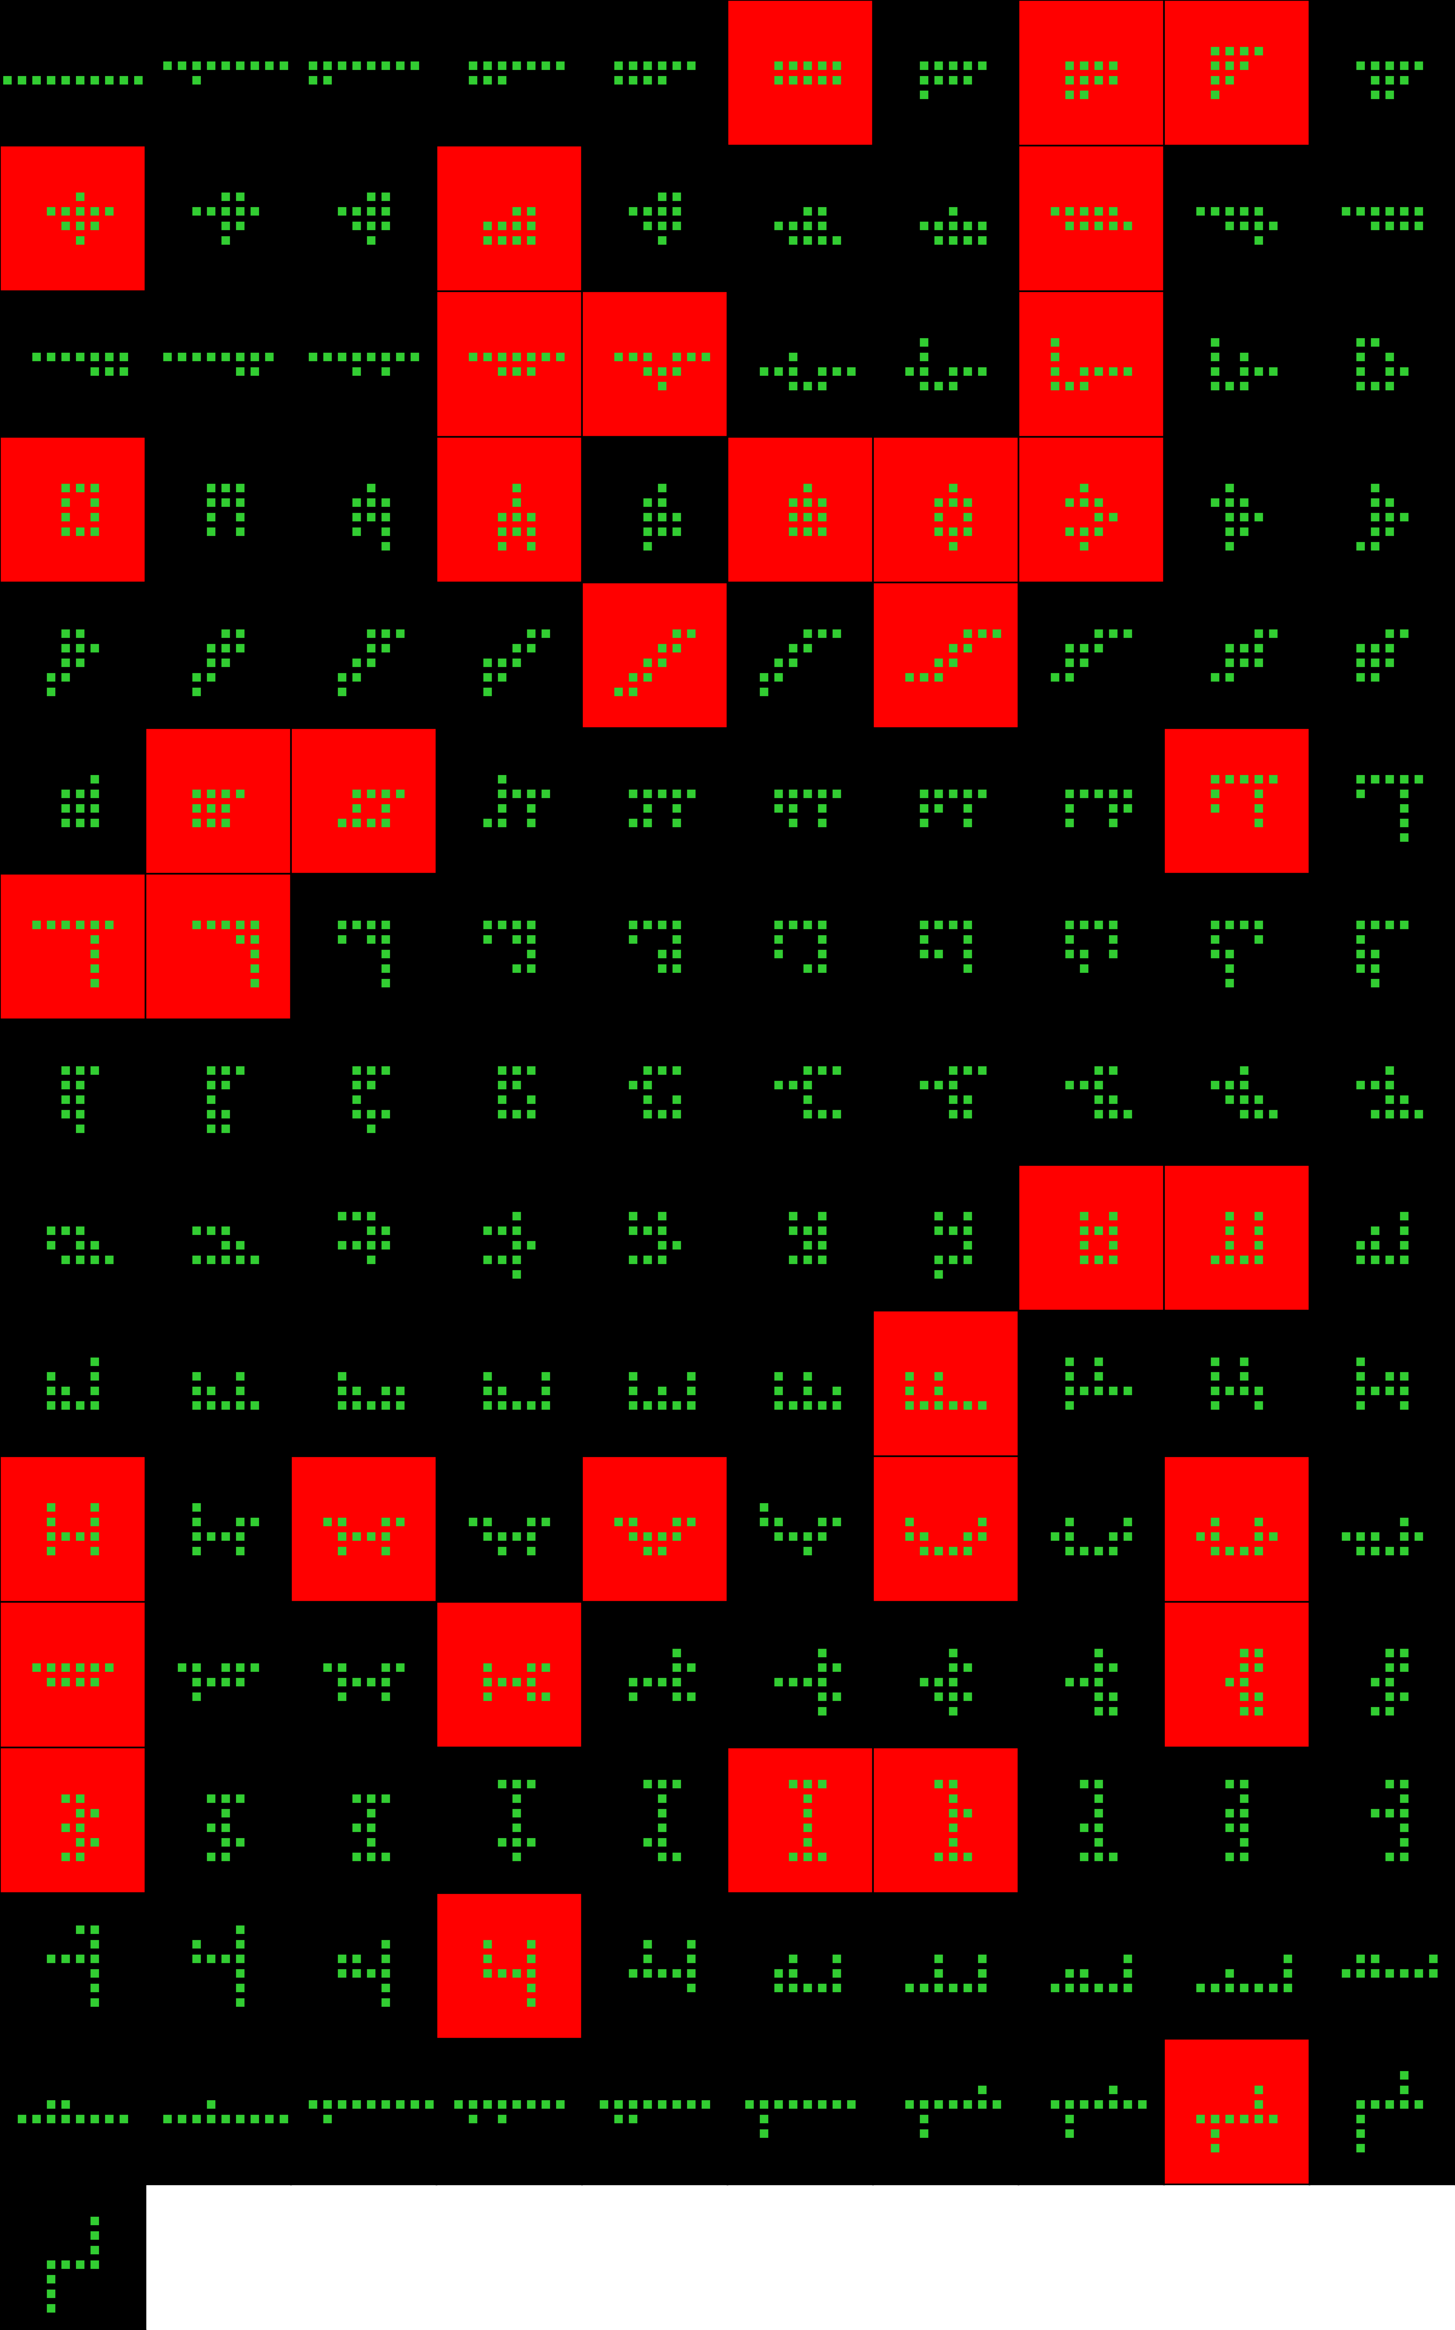
Player 054

Slide 35
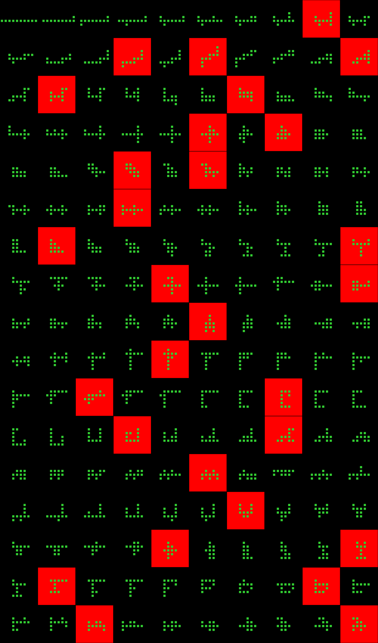
Player 055

Slide 36
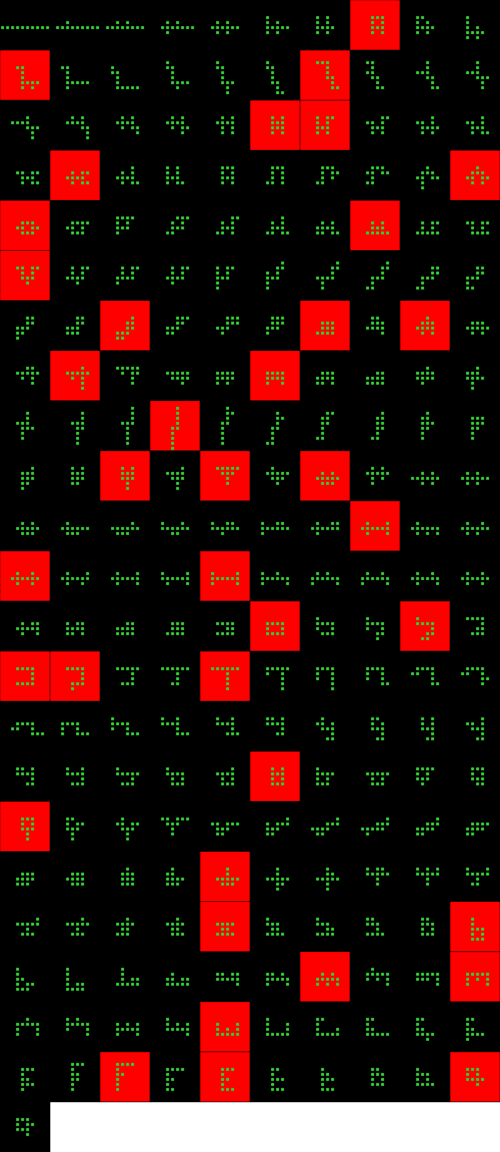
Player 056

Slide 37
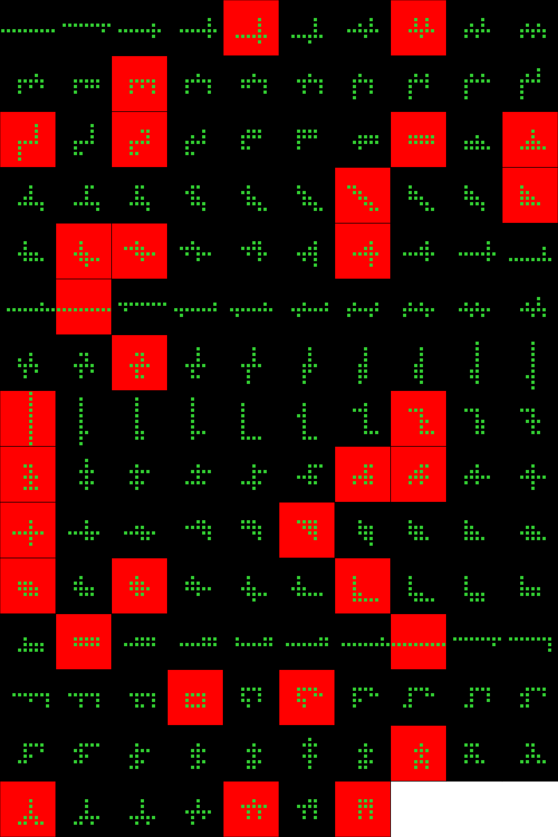
Player 057b

Slide 38
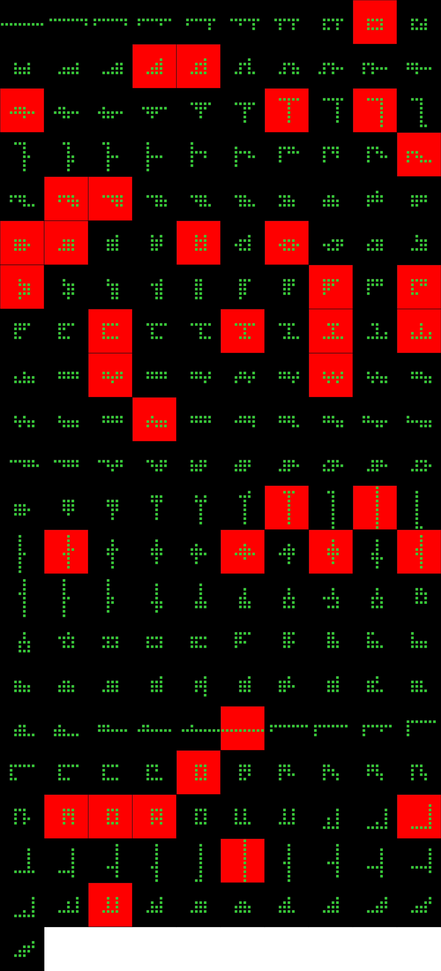
Player 058

Slide 39
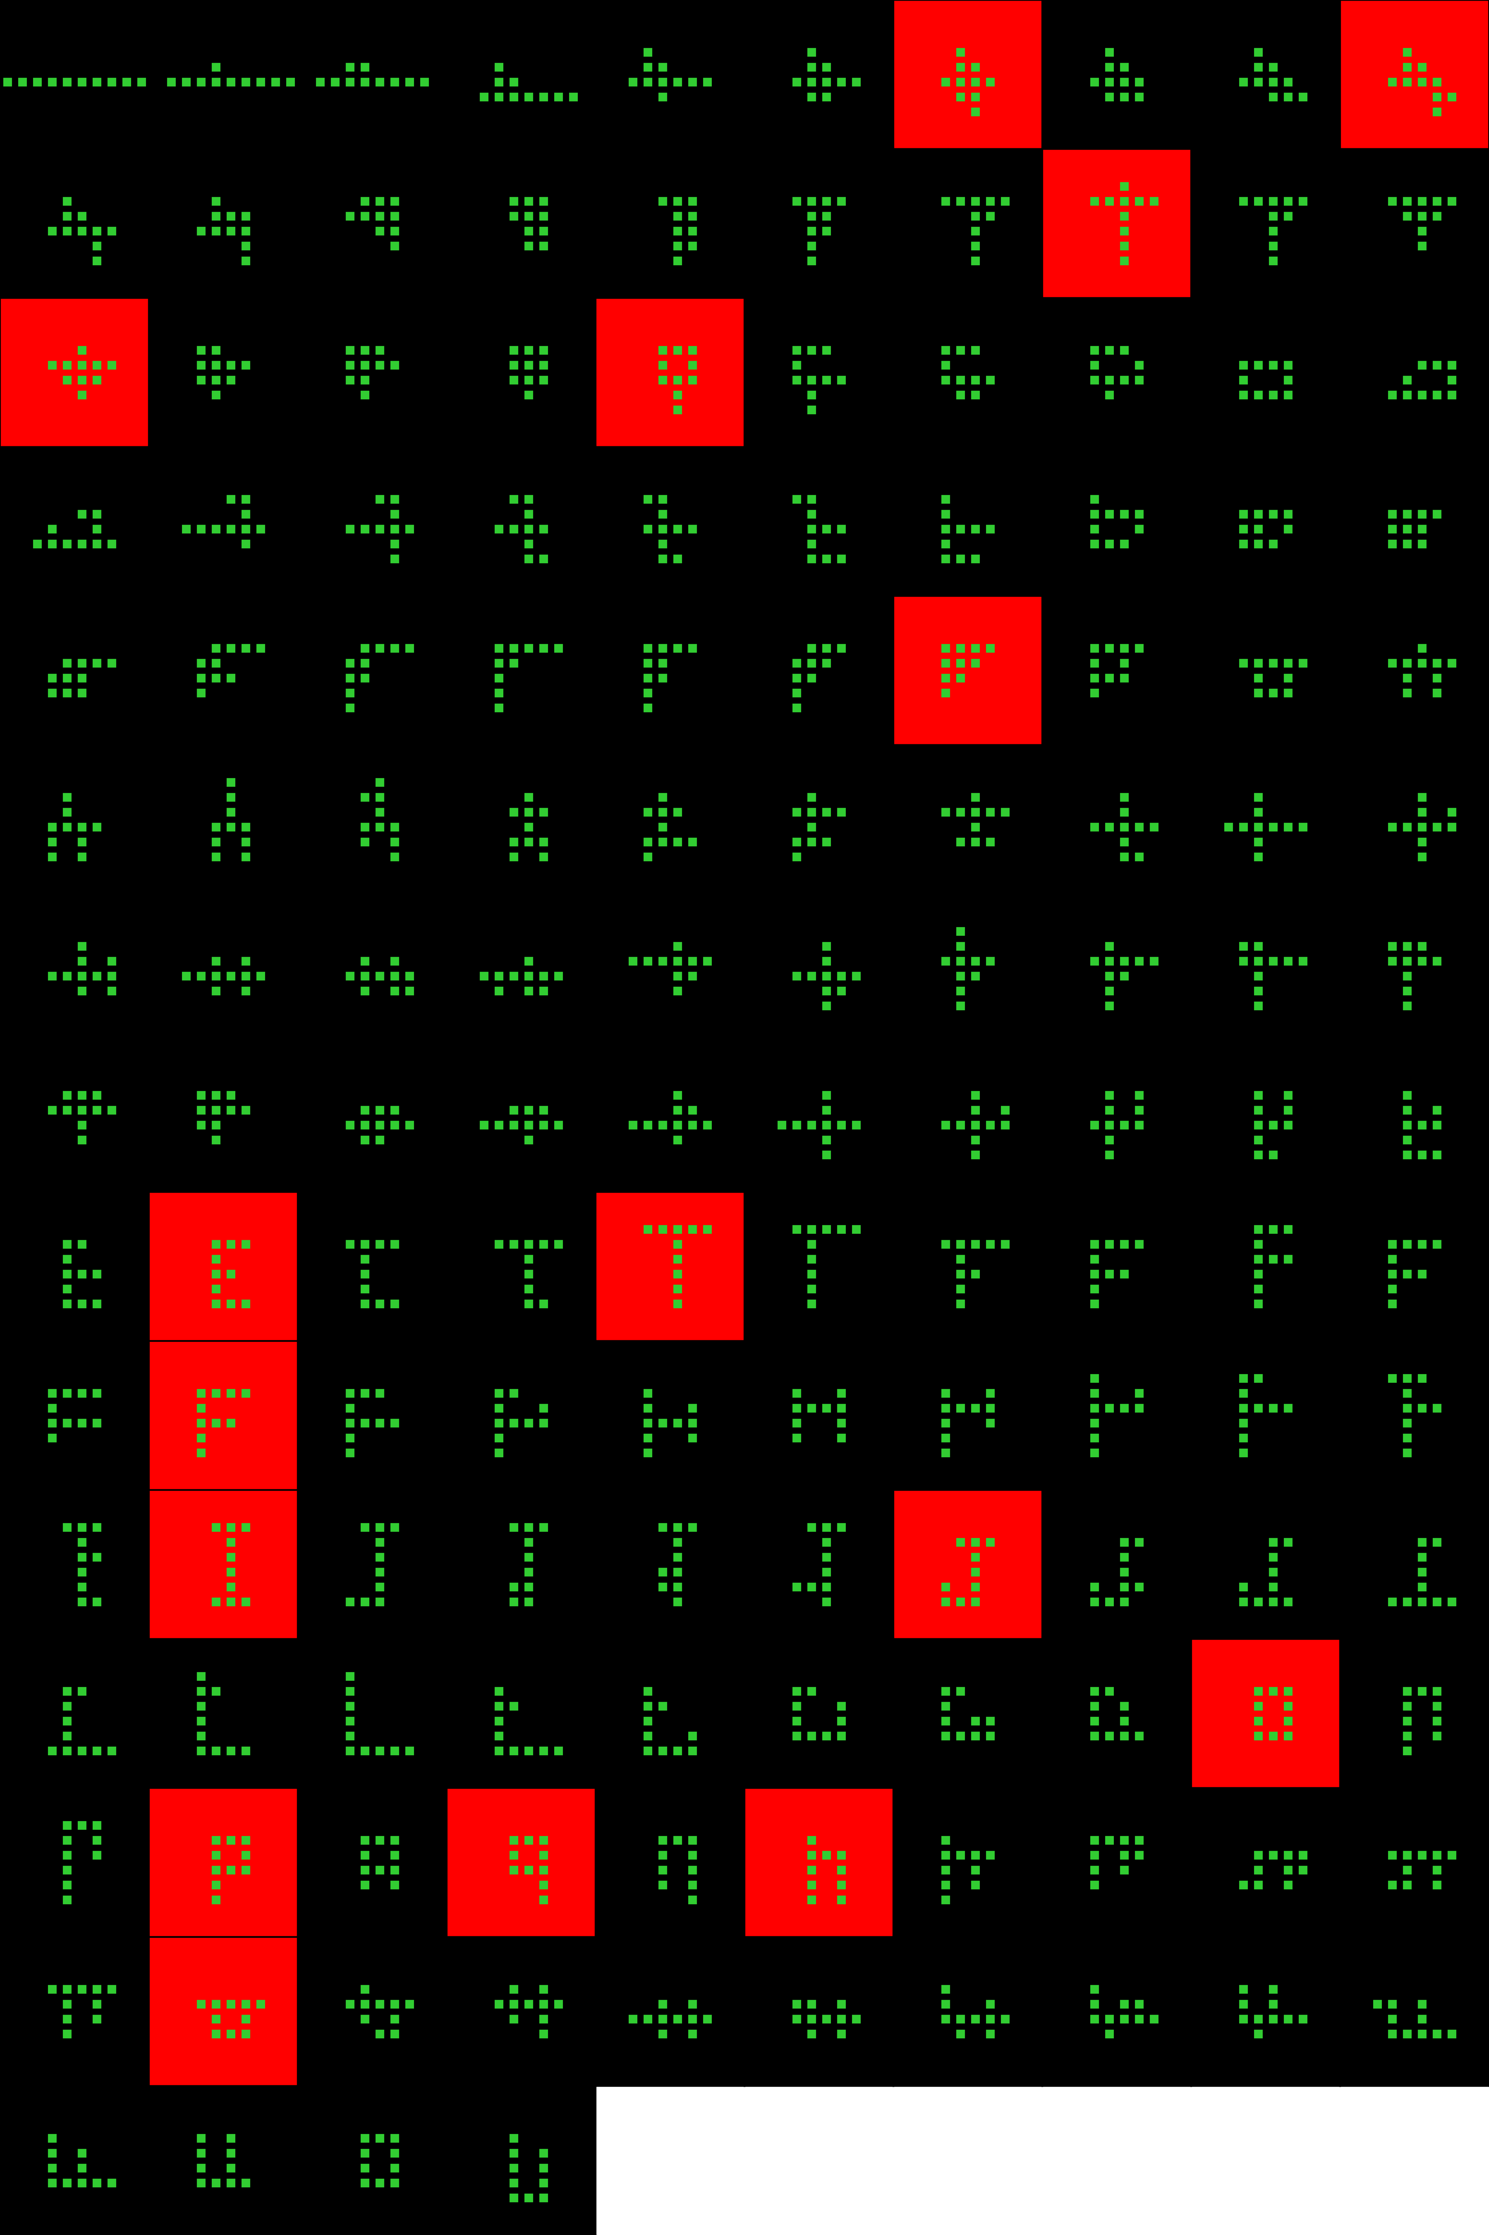
Player 059

Slide 40
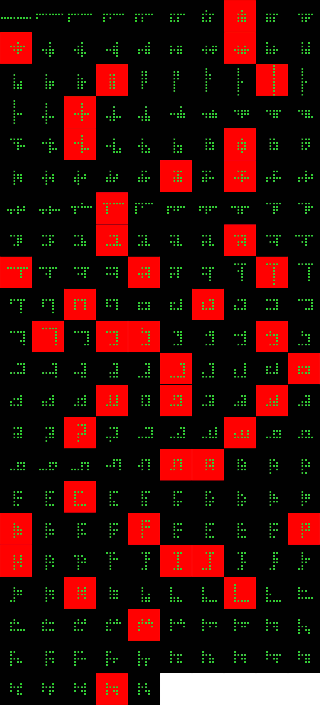
Player 060

Slide 41
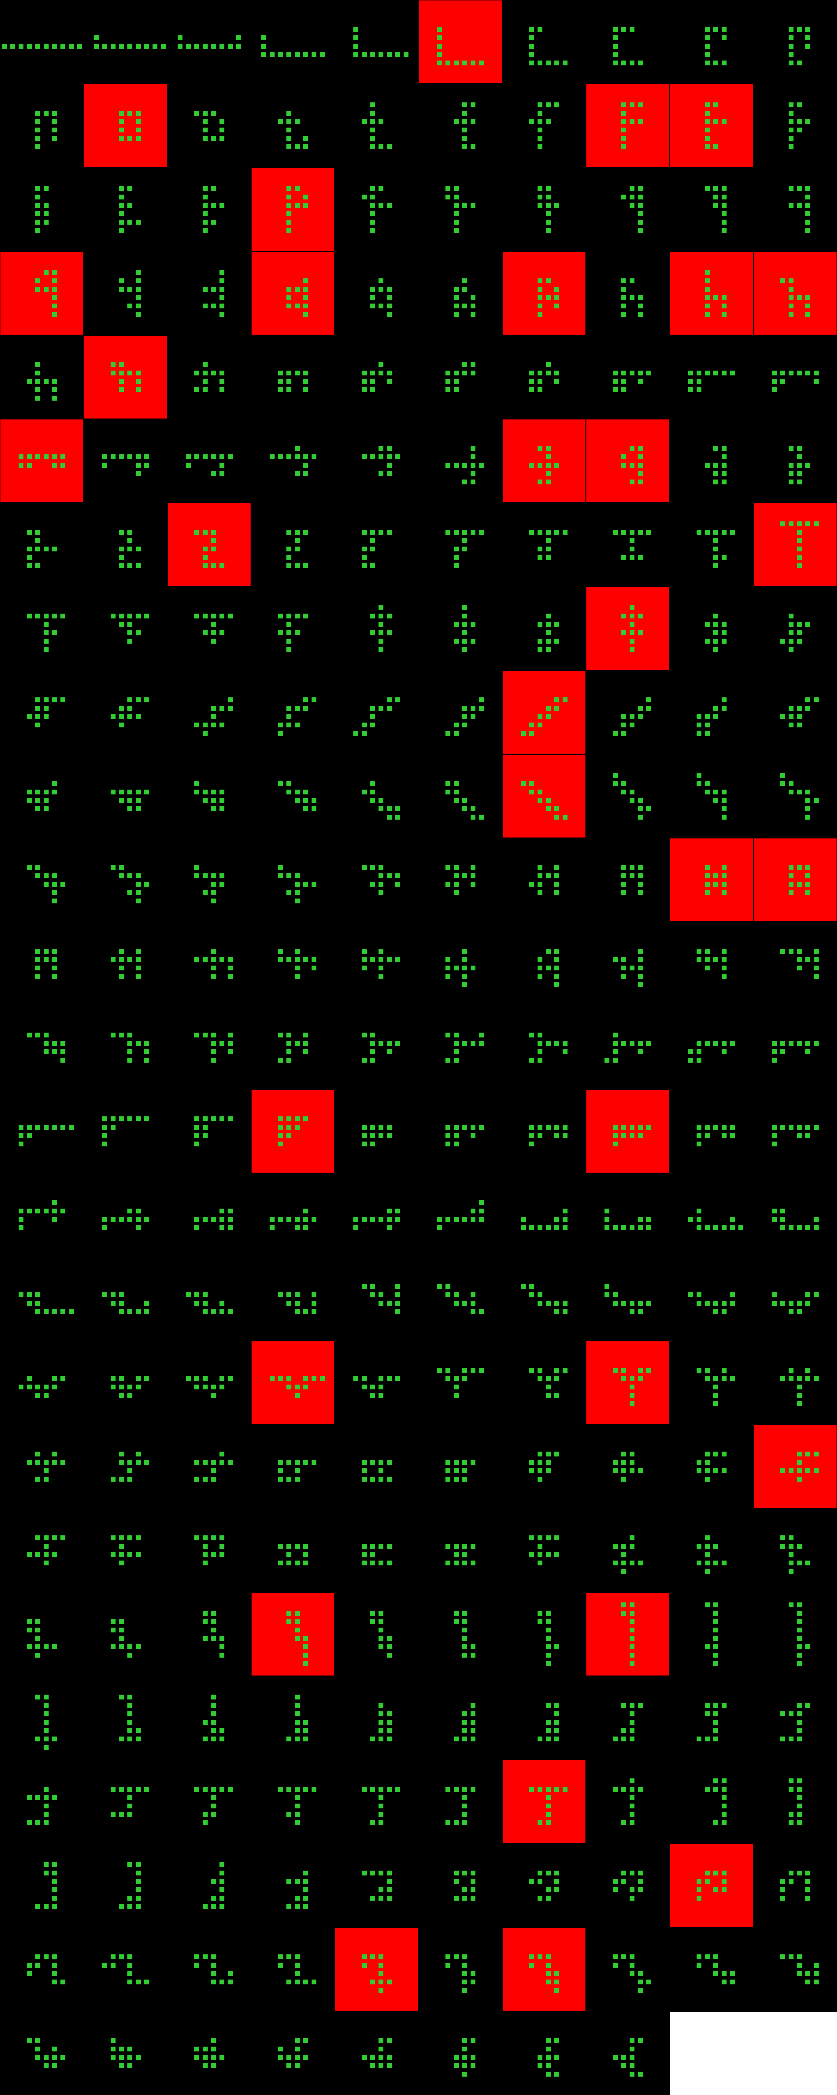
Player 061

Slide 42
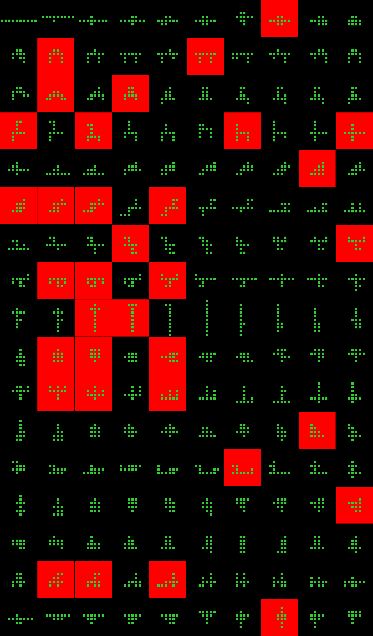
Player 062

Slide 43
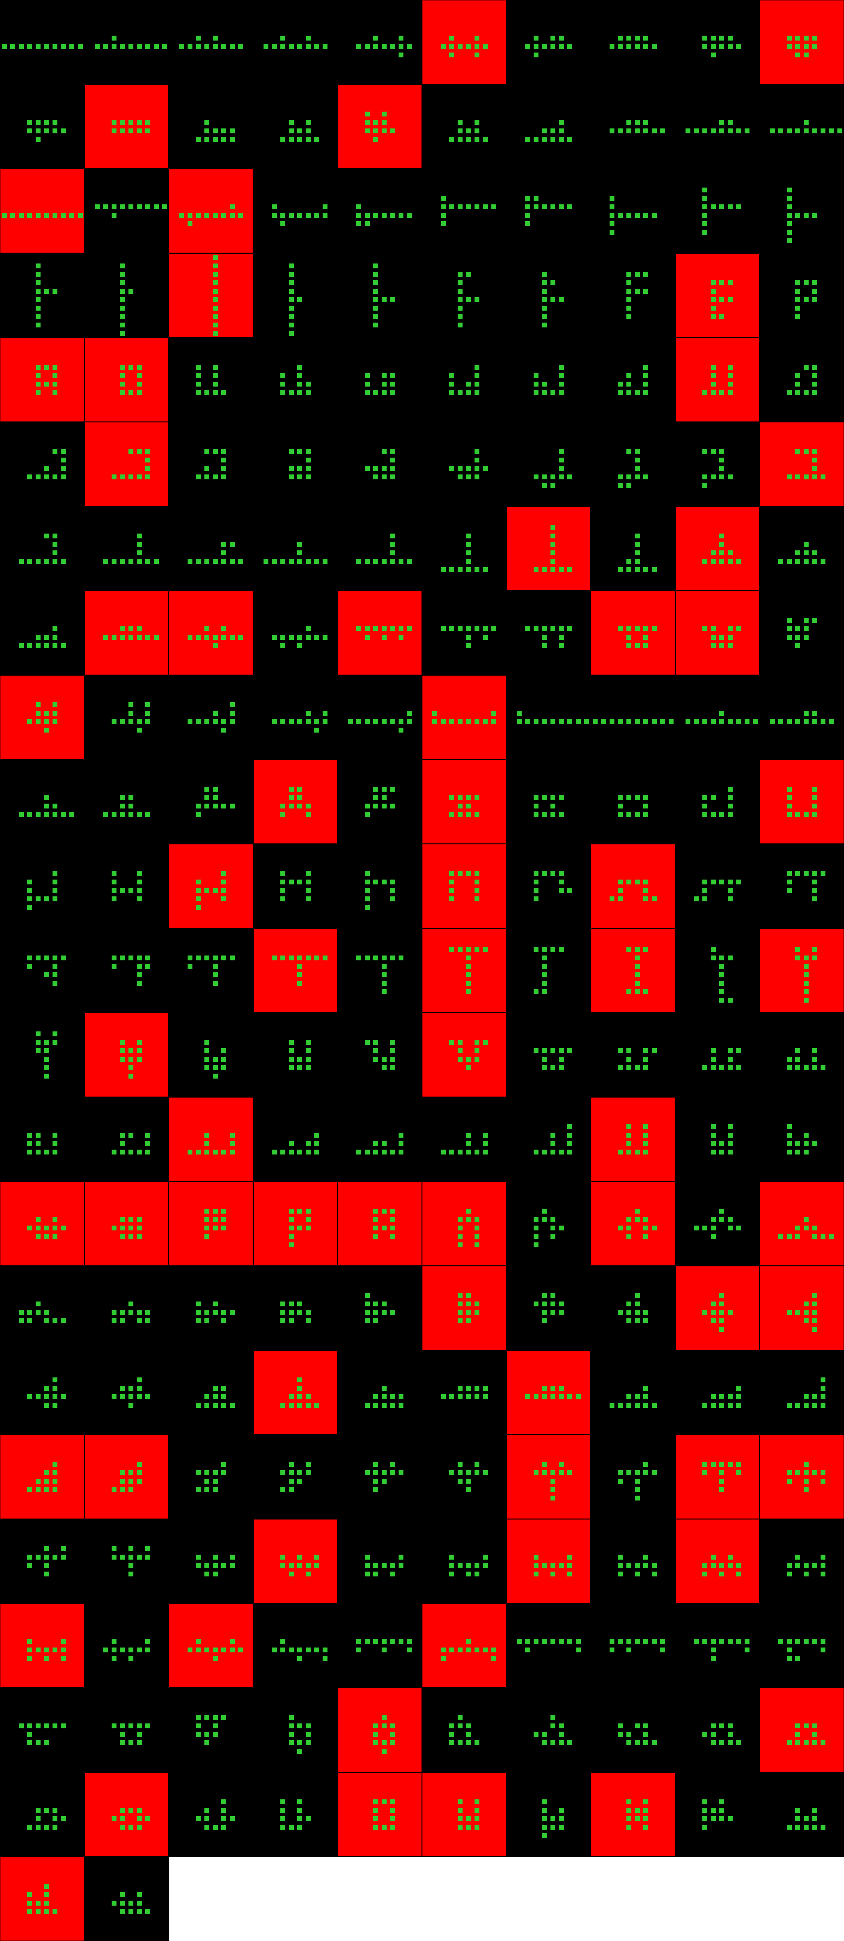
Player 063

Slide 44
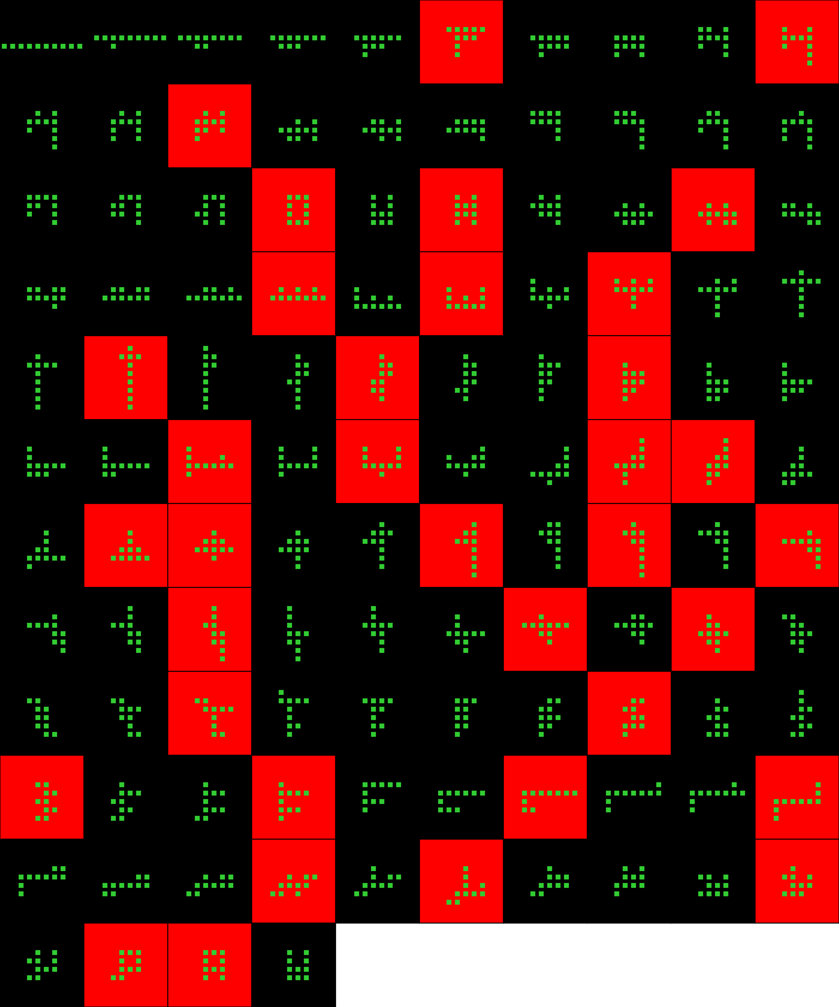
Player 064

Slide 45
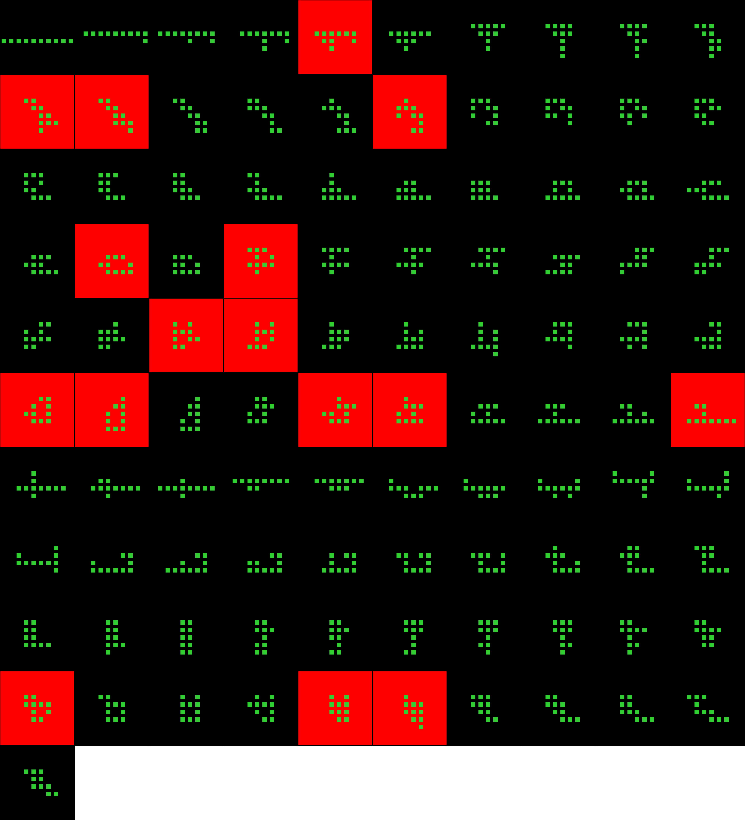
Player 065

Slide 46
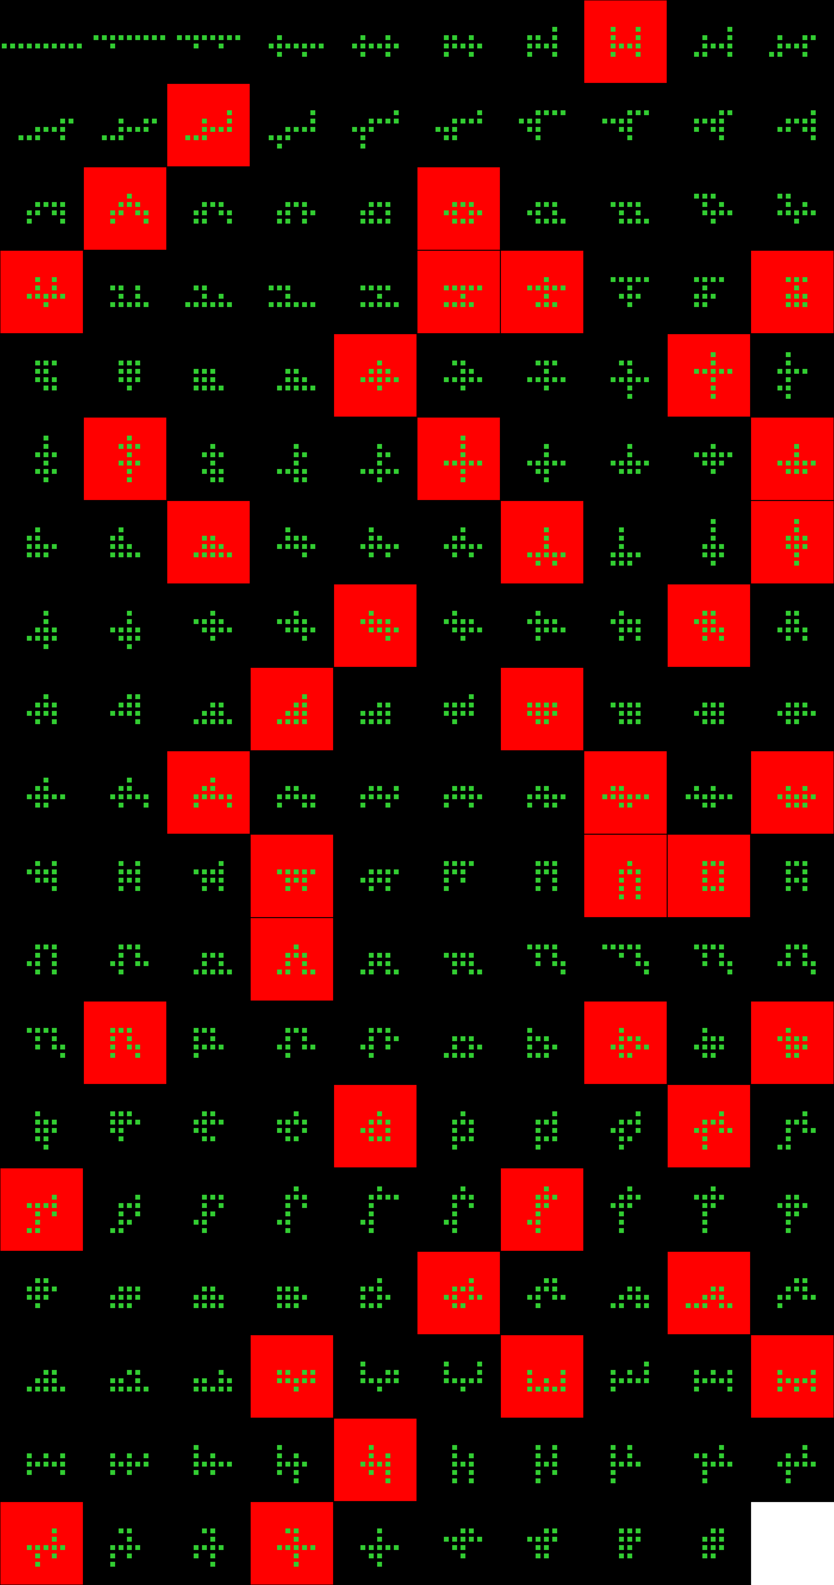
Player 066

Slide 47
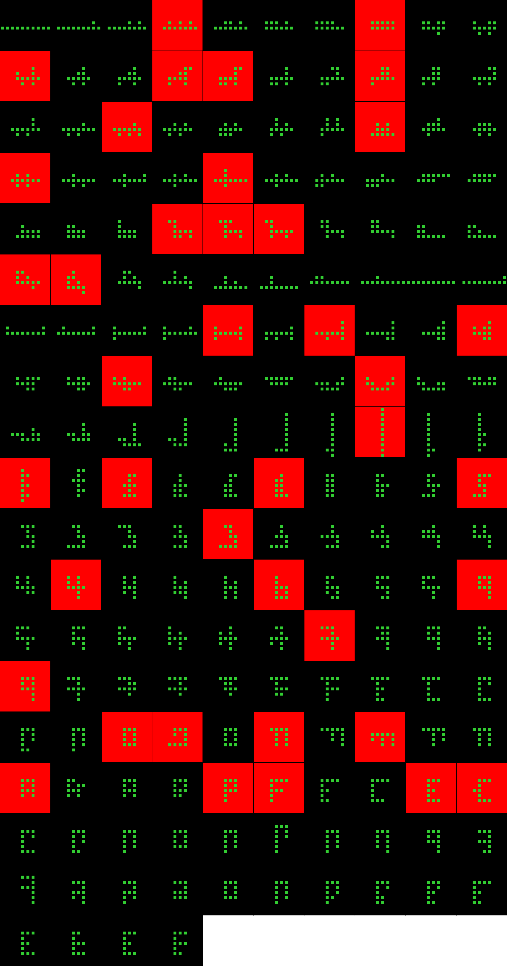
Player 067

Slide 48
Player 068

Slide 49
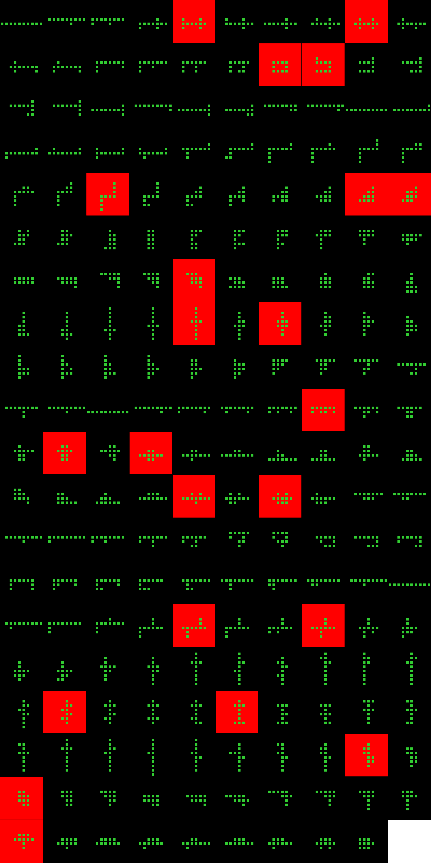
Player 069

Slide 50
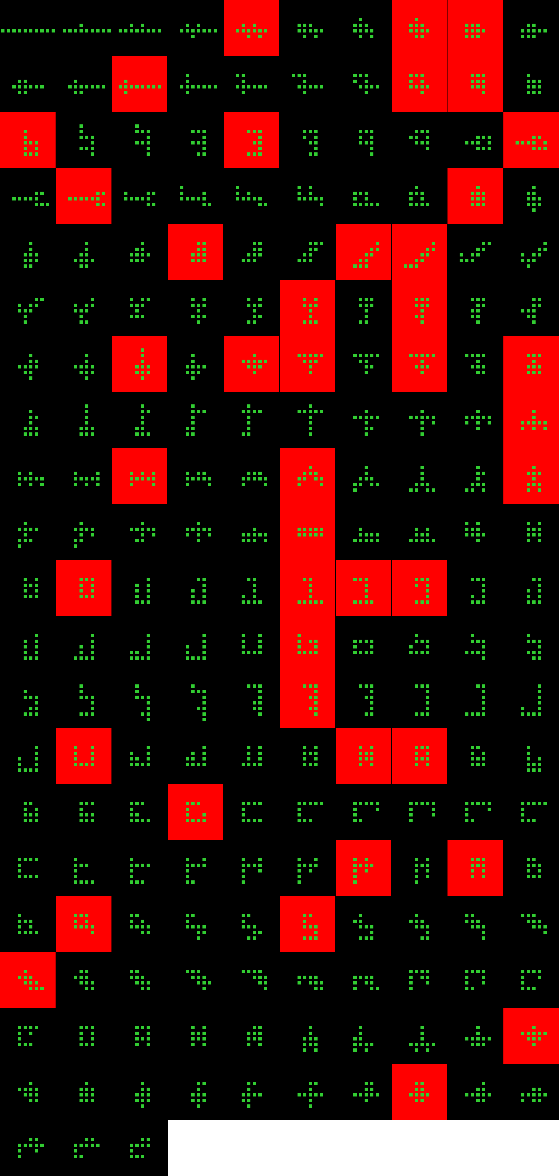
Player 070

Slide 51
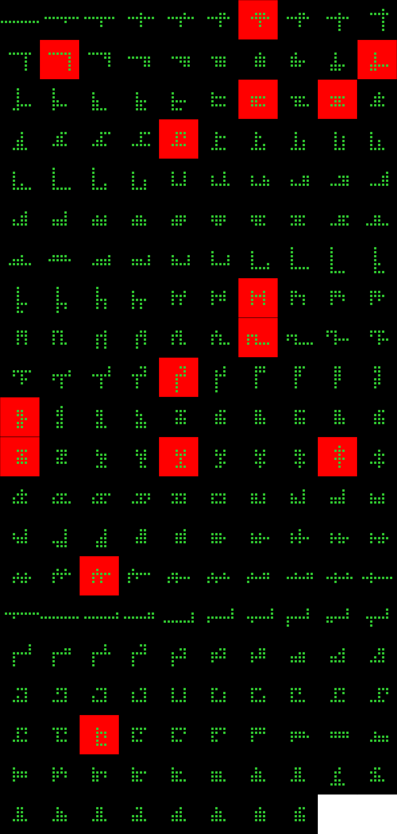
Player 071

Slide 52

Player 072

Slide 53

Player 073

Slide 54

Player 074

Slide 55

Player 075

Slide 56

Player 076

Slide 57

Player 077

Slide 58

Player 078

Slide 59

Player 079

Slide 60

Player 080

Slide 61

Player 081

Slide 62

Player 082

Slide 63

Player 083

Slide 64

Player 084

Slide 65

Player 085

Slide 66

Player 086

Slide 67
Player 087

Slide 68

Player 088

Slide 69

Player 089

Slide 70

Player 090

Slide 71

Player 091

Slide 72
Player 092

Slide 73

Player 093

Slide 74

Player 094

Slide 75

Player 095

Slide 76

Player 096

Slide 77

Player 097

Slide 78

Player 098

Slide 79

Player 099

Slide 80

Player 100

Slide 81

Player 101

Slide 82

Player 102

