Slide 1
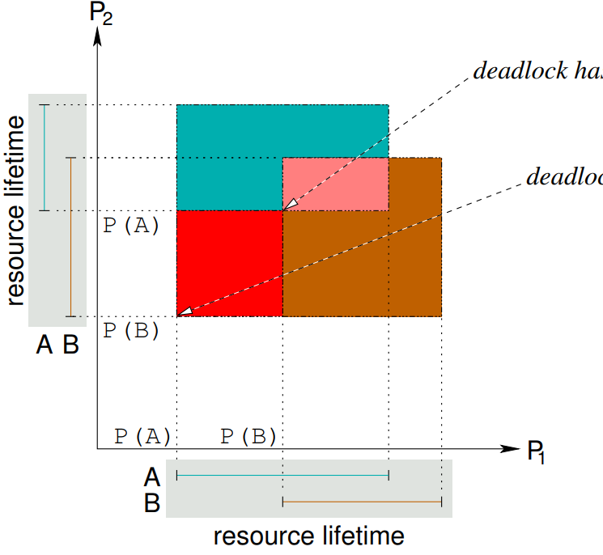
Deadlock Avoidance
pink: deadlock has happened
red: deadlock unavoidable, an unsafe state
no matter how scheduler behaves, the deadlock will happen
avoid allocation of P(A)
all white and non-red and non-pink rectangles: safe states, there is always at least one scheduling strategy which succeeds, i.e. does not lead to a deadlock
avoid allocation of P(B)
As an analytical approach, deadlock avoidance uses a-priori information (e.g. of program flow) to deduce that allocations of P(A) and P(B), respectively, at those time ranges would make a deadlock unavoidable.
To avoid an allocation, the resource allocations can either (i) be outright refused or (ii) the governing processes be put aback to long-term scheduling in the hope that the resource allocation can be granted when being revisited at the next dispatch.
Diagram courtesy of Wolfgang Schröder-Preikschat, “Concurrent Systems” (lecture), slide deck for lecture 9, p. 27

