Slide 1
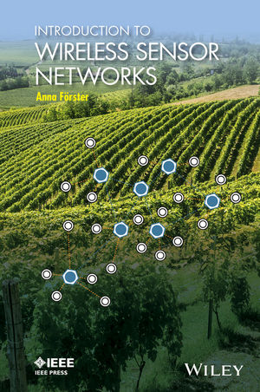
INTRODUCTION TO
WIRELESS SENSOR NETWORKS
CHAPTER 8:
LOCALIZATION TECHNIQUES
Anna Förster

Slide 2

OVERVIEW
Localization Challenges and Properties
  Location Information
  Precision and Accuracy
  Localization Costs
Pre-Deployment Schemes
Proximity Schemes
Ranging Schemes
  Triangulation
  Trilateration
Range-Based Localization
Range-Free Localization

Slide 3
Types of Location Information
Symbolic against physical location

Slide 4
Precision and Accuracy
Localization accuracy is the largest distance between the estimated and the real position of the sensor node.
Localization precision is how often a given accuracy is really achieved.

Slide 5
Precision and Accuracy
Example (left): Accuracy of 15 meters with 95% precision (19 out of 20 points are in a radius of 15 meters)
Typical GPS accuracy and precision

Slide 6
Costs
Financial costs: $$$
Space costs: how many space is required for a localization device on board
Communication costs: how much communication is required for localization
Energy costs: how much energy is required for localization
Infrastructural costs: do we need a special infrastructure to enable localization

Slide 7
Pre-Deployment schemes
Install location information before deployment:
Tell each item where it is (e.g. rooms, furniture, etc.)
Install GPS sensors

Slide 8
Proximity Schemes
Guess the approximate location of a node by seeing where are its neighbors
Example: node 1 is in room A, because its only neighbor is there too
Very error prone and imprecise
Fingerprinting can improve the performance

Slide 9
Location Mules
Less tedious than fingerprinting, but more expensive in terms of hardware:

Slide 10
Ranging schemes: Triangulation
Measure the angles between the node and the anchors
How to measure angles?
  Need for unidirectional antennas
Minimum of two anchors, mathematically not very challenging
Quite good precision

Slide 11
Ranging Schemes: Trilateration
Measure the distances between the node and the anchors
How to measure distance?
  Use signal strength (very imprecise)
  Use time difference of arrival of two different communication interfaces (e.g. radio and sound)
Minimum of three anchors, mathematically more challenging than triangulation

Slide 12
Time Difference of Arrival

Slide 13
Localization Algorithms
Range-Based Localization
A protocol (algorithm), which uses range-based techniques for localizing
Requires anchors (which know their locations precisely)
The node looks for anchors and localizes itself
The node can now also serve as anchor for others
  Iterative Localization
Range-Free Localization
A protocol, which combines ranging techniques with proximity schemes

Slide 14
Hop-Based Localization
Make experiments first and compute mean length of hop, e.g. here 26 meters
Use this metric to compute the distances between all nodes
Use trilateration

Slide 15
Point in Triangle (PIT)
Based on moving the node:
  If you move it in any direction and the distance to all anchors increase/decrease, then it is outside
Not very practical to move nodes around (unless robots)
Instead, use your neighbors as a “moved” version of yourself

Slide 16
Localization: Summary
Location information can be symbolic or physical
Pre-deployment methods include manual or semi-manual procedures of “burning” the right position information onto the right sensor nodes. This is a financially cheap and quite accurate but a very error-prone and tedious process.
Proximity-based methods look for communication neighbors with known positions (anchors) and simply take this information as their own. This is simple but not accurate.
Range-based algorithms first measure either the angles or the distances to known anchors and then use triangulation or trilateration to compute quite accurately their own locations. Performing the measurements is challenging and requires additional hardware (angles and distances) or are quite unreliable (distances like hops).

