Slide 1
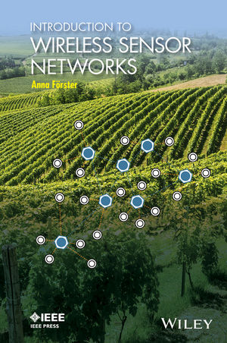
INTRODUCTION TO
WIRELESS SENSOR NETWORKS
CHAPTER 9:
SENSING TECHNIQUES
Anna Förster

Slide 2

OVERVIEW
Types of Sensors
Sensing Coverage
High-Level Sensors
The Human as a Sensor
Actuators
Sensor Calibration
Detecting Errors

Slide 3
Types of Sensors
Passive against active sensors
Omnidirectional against narrow-beam sensors

Slide 4
Sensing Coverage
Sensing coverage: maximum distance at which the sensor can still sense correctly the phenomenon
Sensing model: what happens if the distance is exceeded?
  Binary sensing model: the sensor works perfectly inside its sensing distance and not at all outside.
  Power law sensing model: the the sensor’s reliability decreases with increasing distance from the phenomenon.

Slide 5
High-Level Sensors
Also called software sensors
Combination of several sensors via sensor fusion
Special Case: Human as a sensor.
Example: Restaurant ratings, danger situations, etc.

Slide 6
Actuators
Closes the loop: sense – process – act
Motors, alarms, irrigation pumps, etc.

Slide 7
Sensor Calibration
Critical step before or while using a sensor
Makes sure that the delivered data is correct
Compares the sensor on hand with another, already calibrated one (or physical one, which does not need calibration)

Slide 8
Detecting Errors
Offline Error Detection: similar to calibration, test the sensor with various inputs
Online Error Detection: try to detect errors during normal work.
  Main problem: if the sensor data changes, is it the phenomenon that changed or is the sensor faulty?
  Solution 1: use several sensors and compare their readings
  Solution 2: observe the battery voltage (recall Chapter 2)

Slide 9
Sensing: Summary
Sensors build the most important part of sensor networks.
Different types of sensors exist such as active and passive sensors, omnidirectional and narrow band sensors. All sensors can be characterized by their:
Sensing coverage, which defines the maximum distance and area at which the sensor works reliably.
Sensing model, which defines how reliability changes with increasing distance from the sensor.
In practice, binary sensors are preferred, which work reliably in a predefined coverage area and do not work reliably outside of it.
The process of matching the output of a sensor to some physical entity (such as temperature in degree Celsius) is called calibration. Sensors need to be calibrated periodically to ensure that they still deliver correct results.
Sensor errors can be detected offline (before deployment) in the process of calibration or online (during deployment). The second is challenging due to changing sensor readings, which can come from changes in the environment or faulty sensors.

