Slide 1
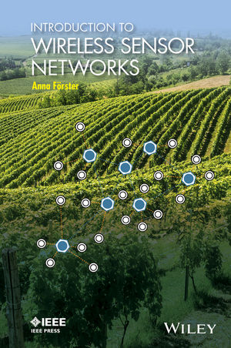
INTRODUCTION TO
WIRELESS SENSOR NETWORKS
CHAPTER 6:
DATA AGGREGATION AND CLUSTERING
Anna Förster

Slide 2

OVERVIEW
Clustering Techniques
  Random Clustering
  Nearest Sink
  Geographic Clustering
In-Network Processing and Data Aggregation
  Compression
  Statistical Techniques
Compressive Sampling

Slide 3
Clustering Techniques
Developed to handle very large networks

Slide 4
Random Clustering
The cluster heads are selected randomly among all nodes
Cluster head roles are updated from time to time to balance their energy consumption
Example: LEACH

Slide 5
Nearest Sink
Developed to balance better the sizes of the clusters
More than one sink deployed in a network (e.g. with more resources than other nodes)
Every sink announces itself via full-network broadcast
Every node selects the “nearest” sink – in terms of hops, ETX, delay, etc.

Slide 6
Geographic Clustering
Divides the network into geographic areas
One sink per area
All nodes belong to that single sink
Balances very well the size of clusters

Slide 7
In-Network Processing and Data Aggregation
Used usually together with clustering
Saves additional energy by not transmitting all data to the sink
Variants:
  Compression of data
  Statistical Techniques
  Compressive Sampling

Slide 8
Compression
Several packets get combined into a single one (recall that individual packets are costly, while larger packets are almost as costly as small ones)

Slide 9
Huffman Codes
Compresses the contents of the data packets
Based on observation: some letters/symbols are used more often than others
Consequence: use shorter codes for often used symbols
Compare: ASCII code uses the same code length for all characters

Slide 10
Model Prediction
Develop a mathematical model of the data
Example: Temperature in the room should be between 21° and 23°.
If the data matches the model, do not transmit the data
Very complex models can be developed (e.g. for soil temperature in a day-night rhythm)
Problem: if no data arrives, how to know that the node is still alive?
Solution: Heart-beat protocol. Sends a small packet every extended period of time (e.g. once per day)

Slide 11
Statistical Techniques
On the way to the sink, statistically evaluate the data.
Once statistically evaluated, the original data cannot be recovered

Slide 12
Compressive Sensing
Minimizes the number of required sensor data to fully depict the underlying process/signal.
Mathematically quite complex (refer to literature for more details)
Can save a lot of energy, if underlying process follows the mathematical model (not all natural processes do!)

Slide 13
Clustering and Data Aggregation: Summary
Clustering organizes the network into sub-networks called clusters. Clusters can be identified randomly or geographically. Each cluster gathers all of its data on a single node, called the cluster head, and then sends the data in a compressed or processed way to the sink.
Compression refers to minimizing the required communication overhead and storage for individually sampled data. For example, several data items can be unified in a single data packet or data compression techniques can be applied to further reduce their volume.
In-network processing refers to calculating some statistical values or to allow voting between the nodes of a cluster. For example, only the mean values can be transferred to the sink.
Compressive sensing refers to a concept from signal processing, which randomly samples a signal instead of continuously. This reduces the sampled data at the source directly and no further compression is needed.

Slide 14
Clustering and Data Aggregation: Summary
Clustering is a communication organization measure and needs to be used together with other techniques to achieve communication savings.
Compression and compressive sensing preserve the full properties of the originally sensed signal, and sometimes it can even be completely reconstructed. These two concepts are our preferred options.
Statistical in-network processing does not allow for reconstruction of the original signal, nor of all of its properties, and has to be used very carefully.

