Slide 1
BioStats
Konrad Krämer

Slide 2
Features
DataWrangling
Visualization
testing Assumption of the model
Correlations
Tests
Two groups can be tested via t-test
More than two groups:
Determine which groups differ from each other via PostHoc tests
Dose-response analysis
Create a statistical model

Slide 3
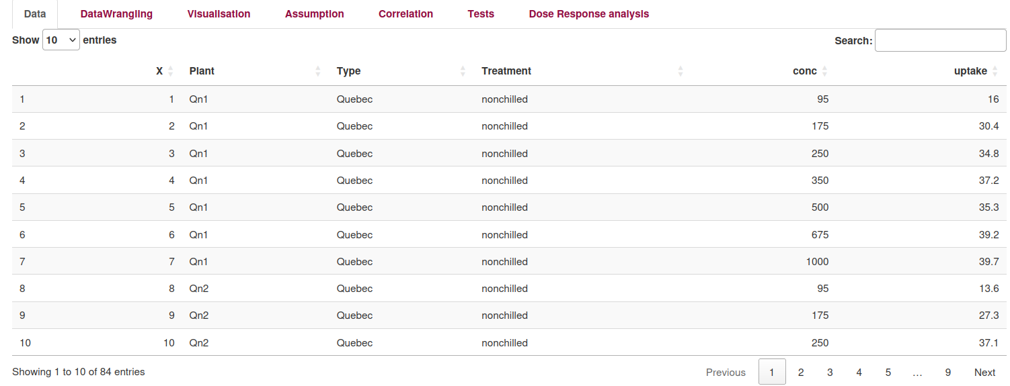
Supported data formats
Only tabular data stored in text, CSV or xlsx files can be used in BioStats. The table below displays a sample dataset in a tabular format.
Dataset

