Slide 1

Quiz2 Data Streaming
ณัฐพล สุวรรณโพธิพระ 6220412028
ภูมิพัฒน์ เจริญทรัพย์ 6220412027
ภููมิพิชญ์ เอี๊ยบทวี 6310412016

Slide 2
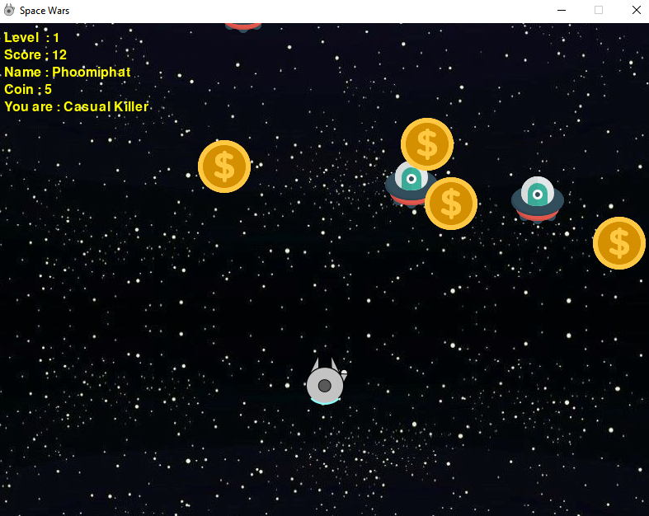
Program Overview
Host/Server
Score list
Decision Tree
Decision Tree
Decision Tree
Client 1
Client 2
Client 3

Slide 3
Program Overview
a0 = statistics.mean(A0) if len(A0) else 0
a1 = statistics.mean(A1) if len(A1) else 0
a2 = coin_count
a3 = destroyed_enemy_count
a4 = shots_count
a5 = a4 - a3
a6 = level
a7 = keyX_pressed_count
a8 = keyY_pressed_count
a9 = respawn_enemy_count
a10 = respawn_coin_count

Slide 4
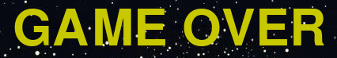
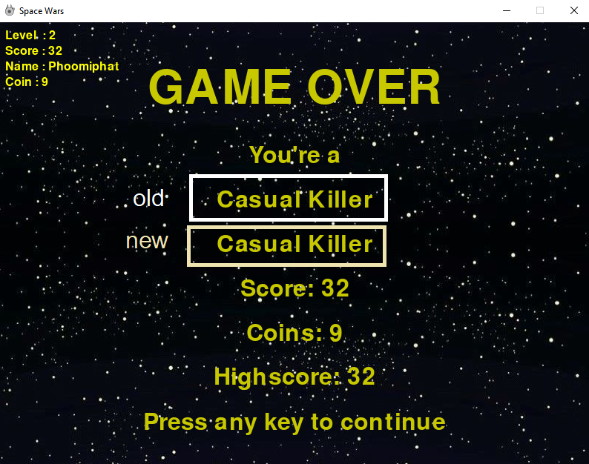
Program Overview
a0 = statistics.mean(A0) if len(A0) else 0
a1 = statistics.mean(A1) if len(A1) else 0
a2 = coin_count
a3 = destroyed_enemy_count
a4 = shots_count
a5 = a4 - a3
a6 = level
a7 = keyX_pressed_count
a8 = keyY_pressed_count
a9 = respawn_enemy_count
a10 = respawn_coin_count
Host/Server
Hoeffding Tree
Decision Tree
Decision Tree
Decision Tree
Hoeffding Tree
Hoeffding Tree
Hoeffding Tree
Client 1
Client 2
Client 3

Slide 5
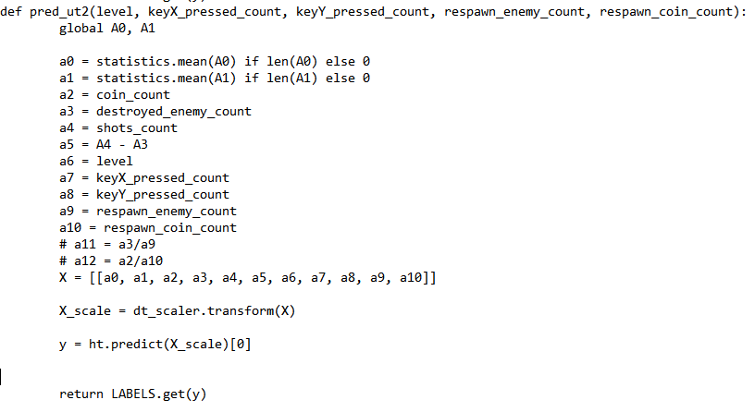
Code modification

Slide 6
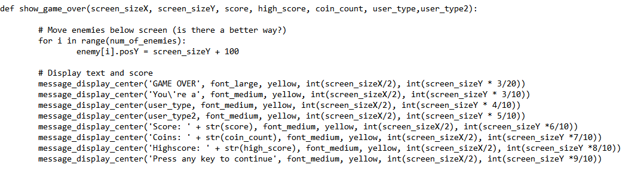
Code modification

Slide 7
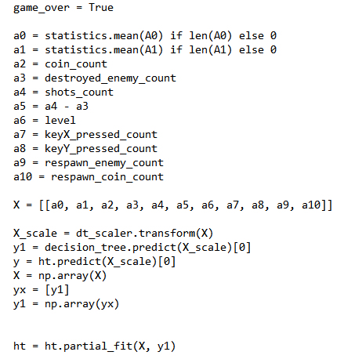
Code modification

Slide 8

Thank You

Slide 9
Program Overview
Host/Server
Score list
Decision Tree
Decision Tree
Decision Tree
Client 1
Client 2
Client 3

