Slide 1

Basics of neural networks with Tensorflow and Keras
Comănac Dragoș-Mihail

Slide 2
“Rules”
Ask questions anytime
Casual atmosphere
One idea
Feel free to contribute

Slide 3
Who?

Slide 4
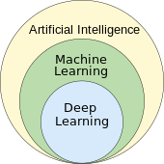
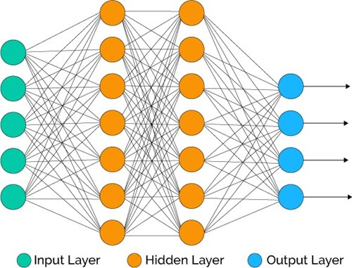
Why?
Data is the new gold

Slide 5

https://github.com/ComanacDragos/GDSC

Slide 6
NumPy
Multi-dimensional arrays
Fast mathematical operations
Vectorization
Good at linear algebra
Foundation for other libraries

Slide 7
Tensorflow
Used for building and training deep learning models
Works with Tensors (similar to NumPy arrays)
Works with GPUs and can be distributed
Keras
High level API for Tensorflow
Offers pre-built layers and models

Slide 8
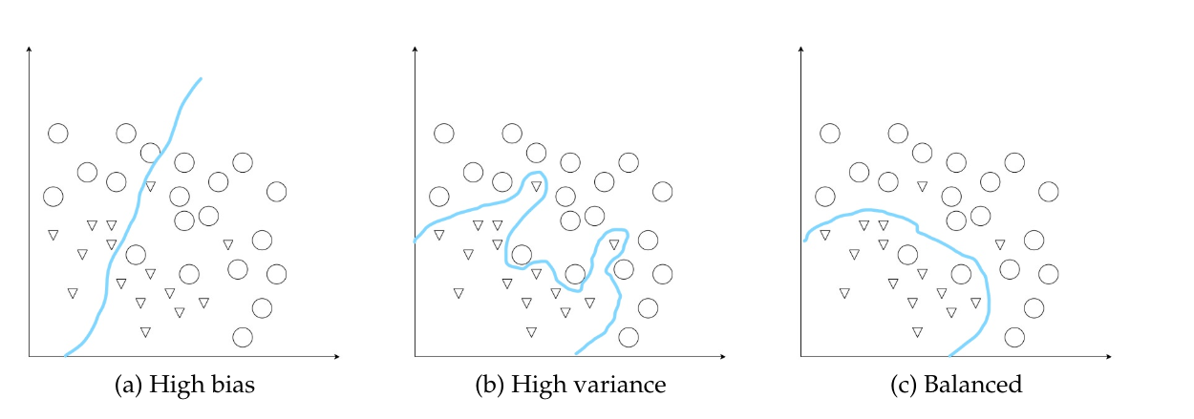
What are Neural Networks trying to learn?

Slide 9
Convolutional Layer

Slide 10
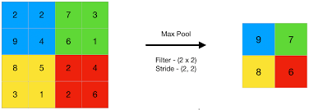
Pooling Layer

Slide 11
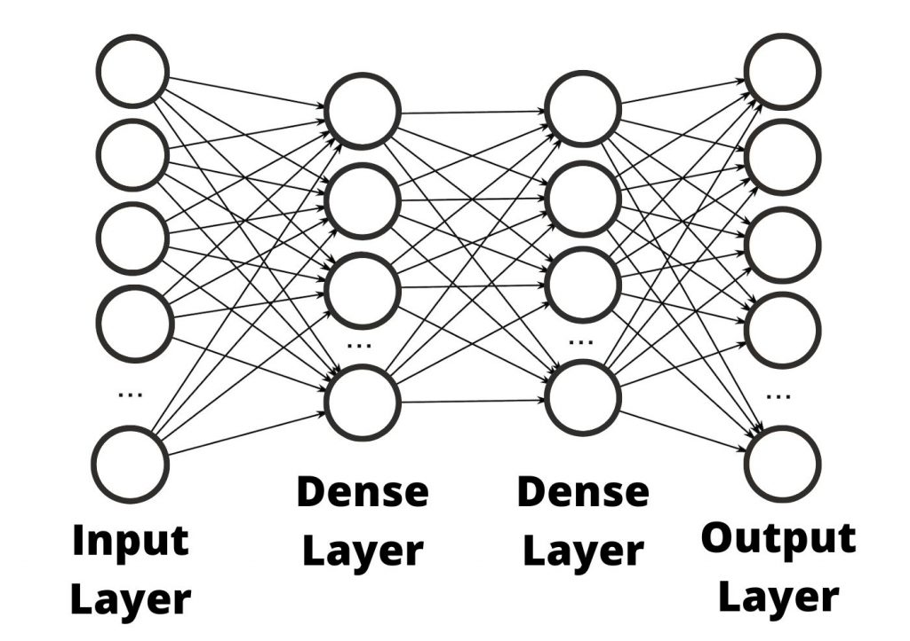
Dense Layer

Slide 12
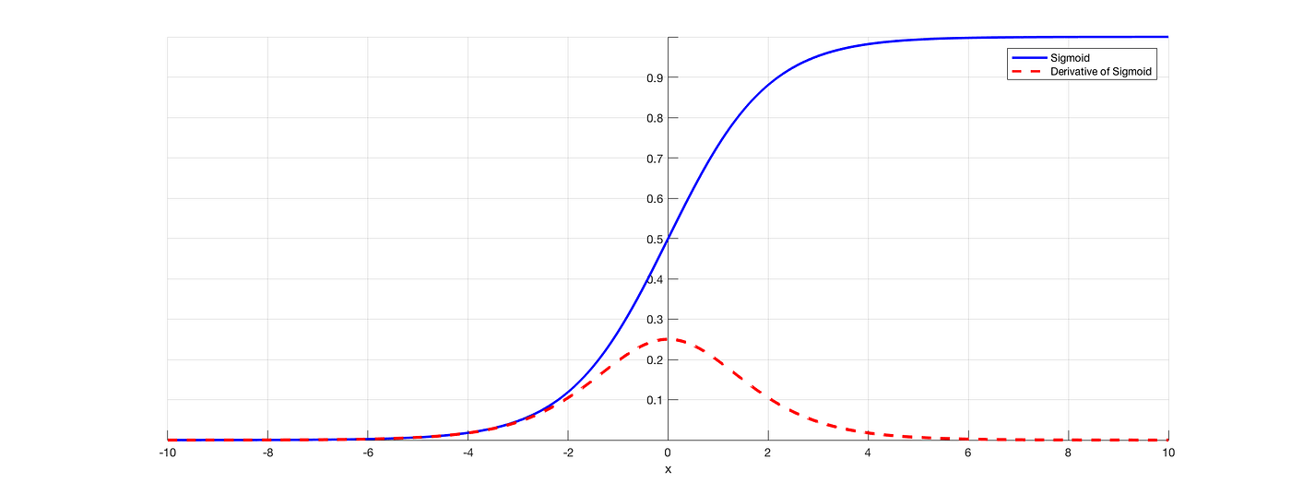
Activation functions Sigmoid

Slide 13
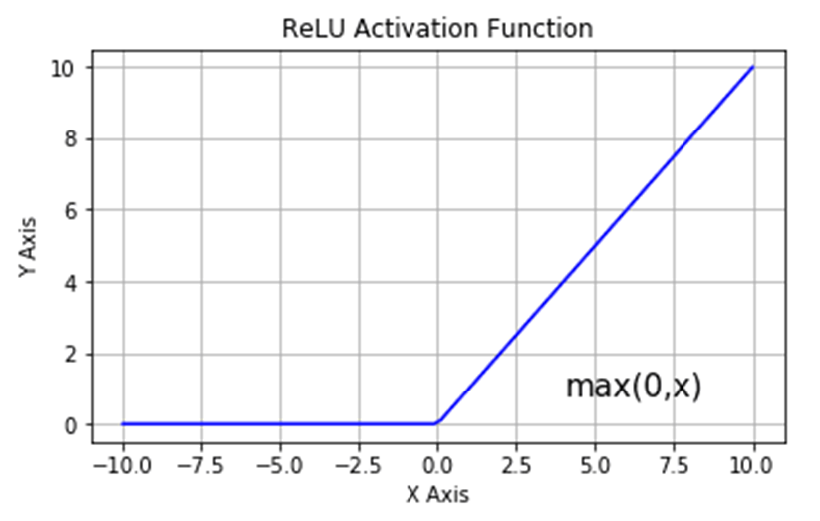
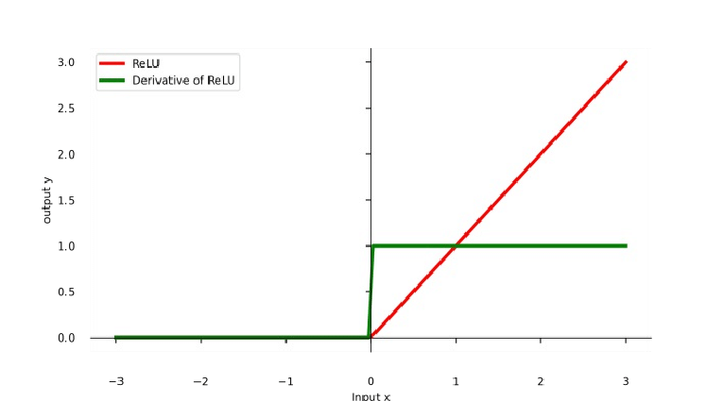
Activation functions ReLU

Slide 14
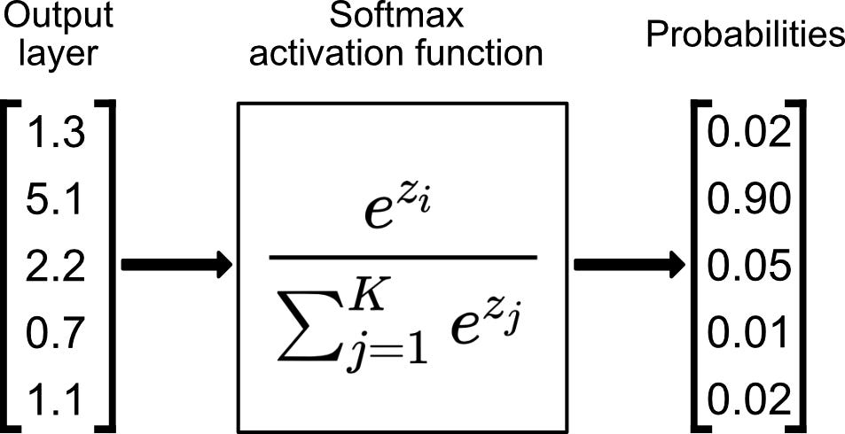
Activation functions Softmax

Slide 15
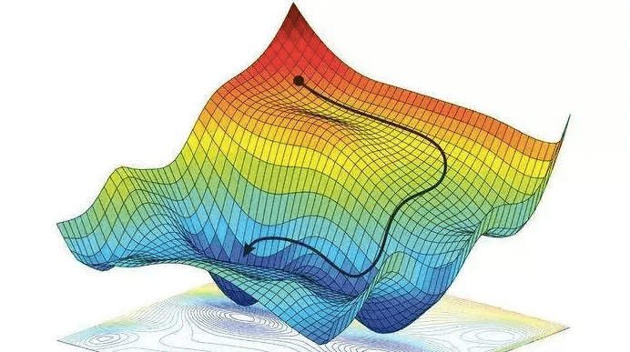
How are Neural Networks learning? Gradient descent

Slide 16
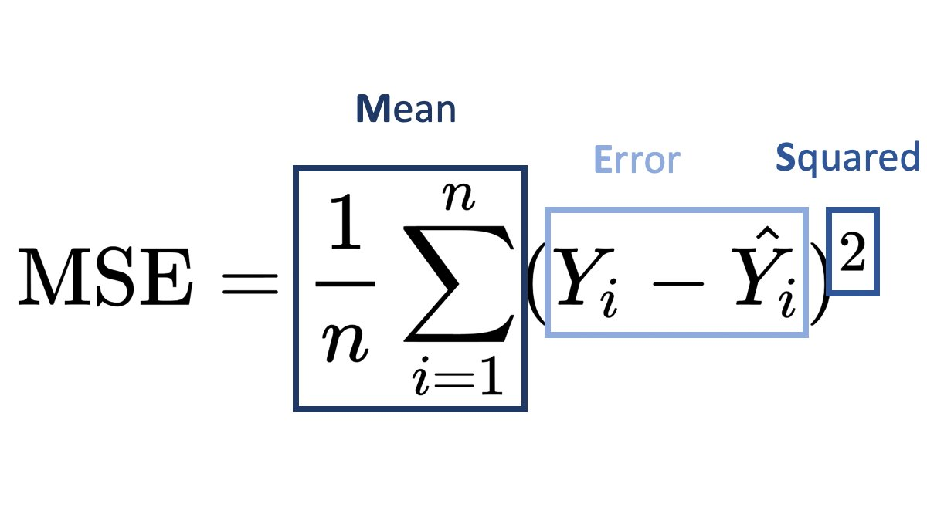
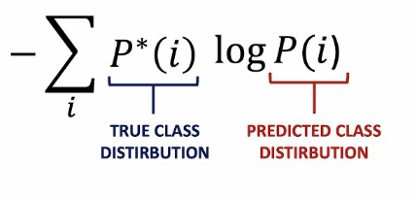
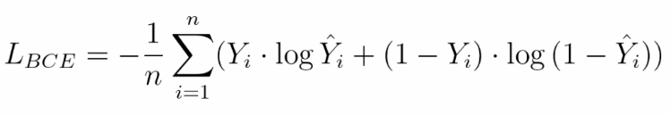
Loss
Cross entropy

Slide 17
How are Neural Networks learning? Backpropagation

Slide 18
Useful resources
Setup GPU: https://medium.com/analytics-vidhya/step-by-step-guide-to-setup-gpu-with-tensorflow-on-windows-laptop-c84634f59857
Recipe for training Neural Networks: https://karpathy.github.io/2019/04/25/recipe/
Coursera Deep learning specialization: https://www.coursera.org/specializations/deep-learning
Also, the same as above but free: https://www.youtube.com/@Deeplearningai/playlists
For second year students at UBB: Computer vision and deep learning optional course in the final year by Diana Laura Borza
For PyTorch enthusiasts: https://github.com/open-mmlab
Tensorflow docs: https://www.tensorflow.org/guide/keras/writing_a_training_loop_from_scratch

Slide 19
Conclusions

Slide 20
Thank you!

