Slide 1
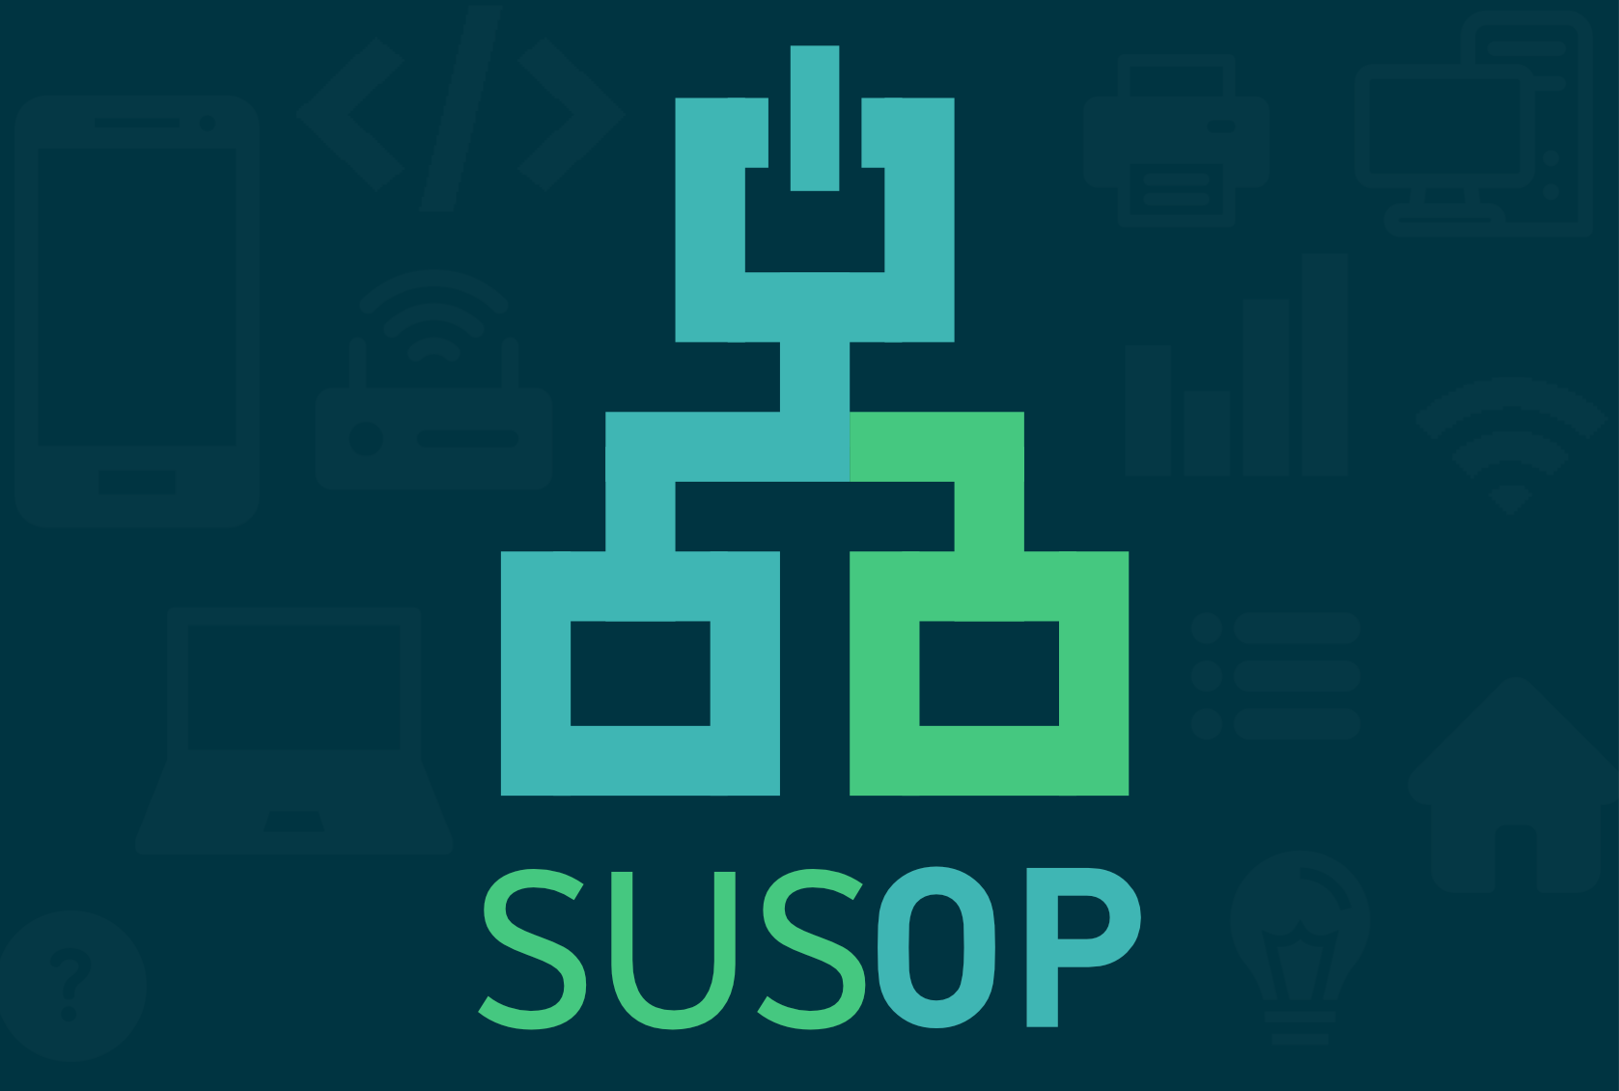
Notes:
Hi We are Susop
that stands for Sustainabilty and Optimization of Power Consumption for Network Devices

Slide 2
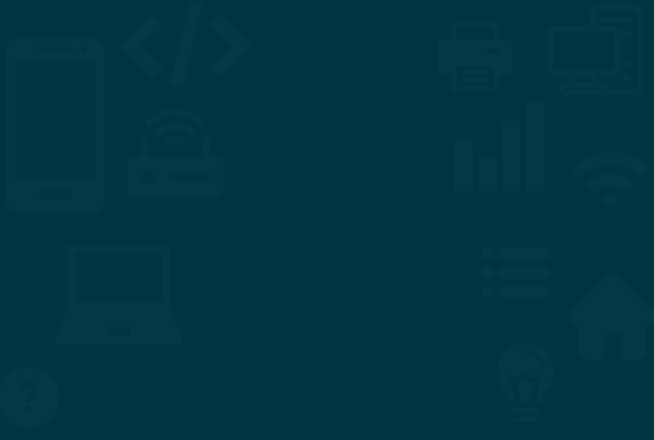
Notes:
Nowadays Always On Devices and generally clustered networks with many Routers become way more common. Both at home and at work you might have many Power Hungry Devices always communicating with the internet and always drawing Power.
This can both pose a huge security Risk and can consume huge unnecessary amounts of Power, especially in office spaces where many devices arent used during weekends, or people dont even realize how much they are wasting, for example if everyone has their own printer.

Slide 3
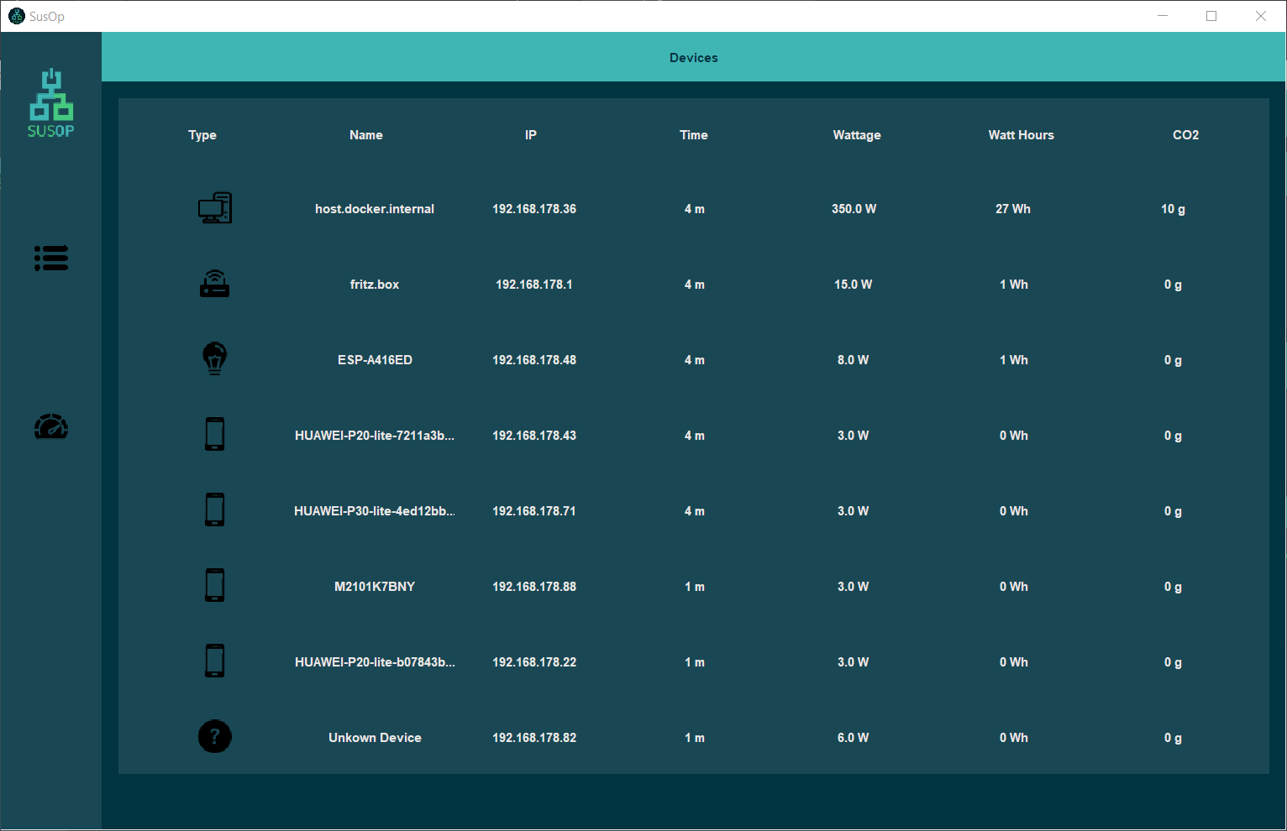
Notes:
So what we want to provide with Susop is a Power Consumption Monitor, that is very easy and intuitive to read (even for a complete non-tech user) both for Home and Business Use.
Here we monitor Device Activity in our Network, classify those Devices on Type, like Phones, Laptops, Lightbulbs and others, and then calculate an estimated Power Consumption for your Space.
We then convert this Power Consumption to grams of CO2 emitted via data provided by the German Ministry of Enviroments.

Slide 4
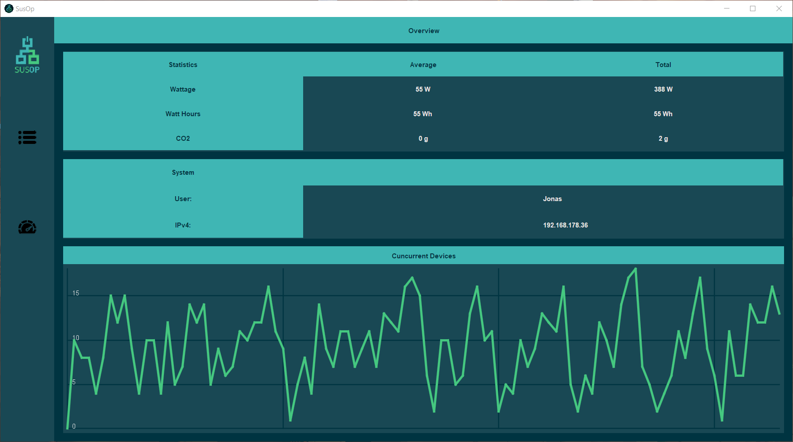
Notes:
We do all this to provide our Users with a better understanding of whats in their Network, but also simply to show the difference in consumption by devices
so for example imagine watching netflix on a tv, vs netflix on your phone, one has way better power usage
and also just the unnecessary consumption of othe devices.
We want to show our users how much of an enviromental impact all of these Devices can have. And we want to help find those Devices you might have never plugged out.
This all would provides an easy unobtrusive way to reduce Energy Waste in your Day to Day Life, both at home and at work, for your non-tech auntie or uncle… or for you, a highly skilled technician

Slide 5
Notes:
To further reduce waste, in the future we also want to build this tool decentralized, so you can run it on different Computers, but still monitor and share the data between them so you can get a clearer Picture.
So basically in the Future we want our Software to run both on many PCs, which is why we choose Java to implement it but maybe even on Phones, where we could transfer functionality easily from java.
Through this we want to share the data of our current Network between our Devices so we could get the most accurate Reading about the Energy Consumption and the UpTime of all Devices.

