Slide 1

Multiple Object Tracking for Video Analysis and Surveillance
Under the guidance of
Prof. Kanika Chalana
Computer Science Department
Dayananda Sagar College of Engineering.
Abhishek Battula [1DS19CS005]
Adarsh Shenoy [1DS19CS007]
Advitiya C S [1DS19CS013]
Akash Raghavendra [1DS19CS018]
Department of Computer Science & Engineering, DSCE

Slide 2
INTRODUCTION TO THE PROBLEM:
Multiple object tracking (MOT) which aims to estimate trajectories of multiple target objects in a video sequence, is a long-standing problem with many applications in mobile robotics, autonomous driving, and video surveillance analysis.
Tracking an object is not the same as object detection. Object detection is the process of locating an object of interest in a single frame. Tracking associates detections of an object across multiple frames.
Visual object tracking for targets such as pedestrians and vehicles in satellite and aerial imagery is a challenging task that has been addressed by only few works, compared to the huge number addressing pedestrian and vehicle tracking in ground imagery .Tracking in satellite and aerial imagery is much more complex. This is due to the moving cameras, large image sizes, different scales, large number of moving objects, tiny size of the objects , low frame rates, different visibility levels, and different atmospheric and weather conditions. The objective of the project is to develop a model that can accurately perform MOT on aerial image sequences.
Department of Computer Science & Engineering, DSCE

Slide 3
Contribution of Each project Members:
Abhishek Battula - 1DS19CS005 Implementation of UI using Tkinter Researched about feature extraction | Adarsh Shenoy - 1DS19CS007 Using YOLOV8 and DeepSORT to track objects Tried training with a custom dataset
Advitiya C S - 1DS19CS013 Implemented YOLO for feature extraction and detection Implementation of backend and OC-sort | Akash Raghavendra - 1DS19CS018 Implemented Hungarian Algorithm to match objects in multiple frames and researched different image filtering techniques. Implementation of UI using Tkinter
Department of Computer Science & Engineering, DSCE

Slide 4
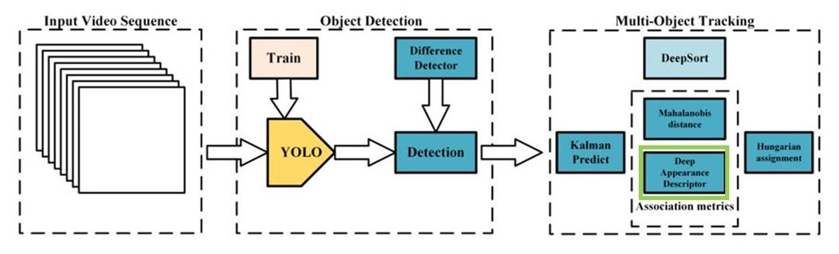
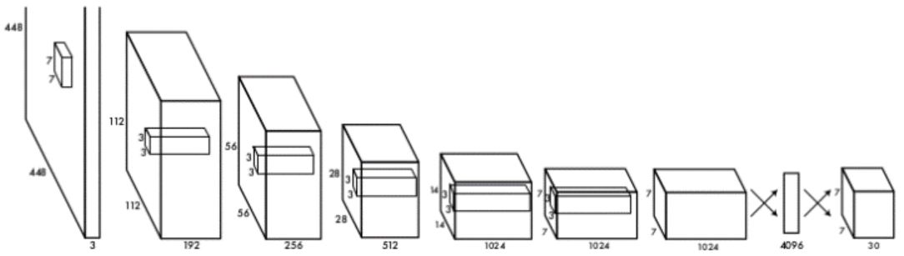
SYSTEM DIAGRAM / ARCHITECTURE:
System Architecture
YOLO Architecture
Department of Computer Science & Engineering, DSCE

Slide 5
Modules:
Feature Extraction
Detection
Re-Identification
Association
Department of Computer Science & Engineering, DSCE

Slide 6
Modules Description
Feature Extraction
Features refer to the learned representations of the input data that are used to make predictions or decisions. These features are automatically extracted by the deep neural network during the training process. The features learned by a deep neural network are crucial to its performance on a given task, and the choice of architecture and hyperparameters can have a significant impact on the quality of the learned features.
One of the most well-known architectures proposed for object detection using deep learning is “You Only Look Once” (YOLO) . The importance of deep learning to various applications, such as those in agriculture, medicine, surveillance, and monitoring systems, is increasing daily. The YOLO algorithm was first introduced in 2016, aiming to detect objects with a high speed and accuracy. This method introduced a new structure for object recognition systems. Owing to the significant attention it has received, different versions of YOLO have been implemented. YOLO stands for “You only look at the image once.” This term refers to the ability of the human visual system to detect objects at a glance. Therefore, the YOLO object recognition system is designed to provide a detection method that is similar to that of the human visual system. The YOLO algorithm consists of a 24-layer convolutional neural network (CNN) for feature extraction, and two fully connected layers for predicting the probabilities and coordinates of objects.
Department of Computer Science & Engineering, DSCE

Slide 7
Modules Description
Detection
The detection module is used in identifying and localizing objects in a given frame. It determines the center points of the objects and then regresses the corresponding center offsets to estimate the bounding box shapes simultaneously.
The module uses the detection specific features extracted from the feature-backbone as inputs. These features are passed through convolution and pooling layers inorder to determine the center points of every object. Combing all the obtained outputs, the regions that contain targets are determined
We use the help of YOLO for detecting objects. YOLO's key advantage is its real-time processing speed since it performs detection in a single pass through the network, making it suitable for real-time applications such as video analysis and autonomous vehicles
Department of Computer Science & Engineering, DSCE

Slide 8
Modules Description
Re-Identification
Re-identification in multiple object tracking refers to the process of identifying objects that have temporarily gone out of the field of view or have been occluded by other objects. It is important to maintain the identity of each object over time as they move through the scene. Re-identification algorithms typically use appearance features, such as color or shape, to match objects that have temporarily disappeared from the camera's view with objects that reappear later. These algorithms are critical for accurate tracking of objects in complex scenes with multiple occlusions, where maintaining the identity of each object is crucial for applications such as surveillance, autonomous driving, and robotics.
Simple online and realtime tracking (SORT) is a much simpler framework that performs Kalman filtering in image space and frame-by-frame data association using the Hungarian method with an association metric that measures bounding box overlap. There are different variations of this such as DeepSORT, BotSORT, OC-SORT, StrongSort. DeepSORT can be defined as the tracking algorithm which tracks objects not only based on the velocity and motion of the object but also the appearance of the object. A visual tracking algorithm called OC-SORT which stands for Observation-Centric Simple Online and Real-time Tracking extends the popular SORT algorithm and can be readily implemented for Multiple Object Tracking (MOT) without any training.
Department of Computer Science & Engineering, DSCE

Slide 9
Modules Description
Association
An affinity matrix encodes the pairwise similarity or dissimilarity between object detections in consecutive frames. The affinity matrix is a crucial component in the data association step of MOT, which aims to assign object detections in one frame to the corresponding objects in the next frame.
Once the affinity matrix is computed, it is typically used as input to a matching algorithm, such as the Hungarian algorithm or the linear assignment problem (LAP), to find the optimal assignment of detections across frames. The matching algorithm attempts to maximize the sum of the pairwise affinities between matched detections while ensuring that each detection is assigned to at most one object.
Based on the embeddings produced and estimated bounding boxes, the Hungarian algorithm is used to match objects among various frames and generate the trajectories.
Department of Computer Science & Engineering, DSCE

Slide 10
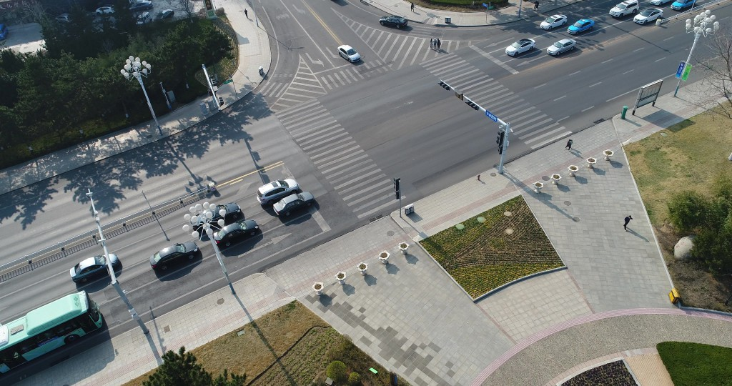
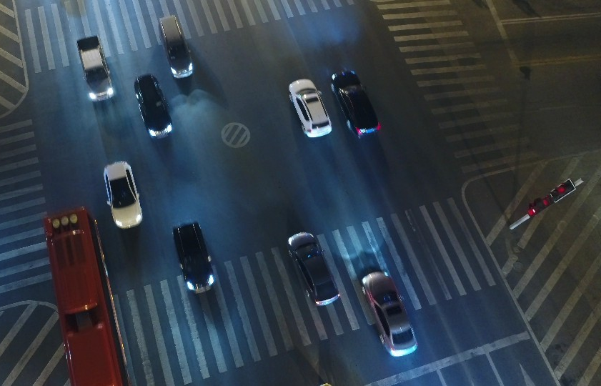
INPUT:
The UAV dataset consists of aerial images and videos captured by unmanned aerial vehicles.
Daytime Scene
Night Scene
Department of Computer Science & Engineering, DSCE

Slide 11
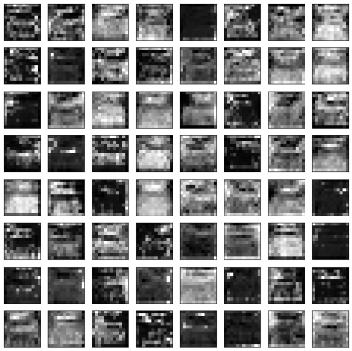
PREPROCESSING:
Department of Computer Science & Engineering, DSCE

Slide 12
ALGORITHM:
The video sequence frames are transformed into tensors and then stored in memory for further processing
These tensors are fed into the Feature Extraction module to extract the required features
Detection specific features are passed into the detection module to obtain bounding boxes for each object
YOLO divides an input image into a grid. If the center of an object falls into a grid cell, that grid cell is responsible for detecting that object. Each grid cell predicts B bounding boxes and confidence scores for those boxes.
Department of Computer Science & Engineering, DSCE

Slide 13
ALGORITHM :
Re-identification specific features are passed into the re-identification module. This helps identify objects that have temporarily gone out of the field of view or have been occluded.
If the object did infact re-appear, then its trajectories are matched across multiple camera views or frames in a video sequence
Based on the embeddings produced and estimated bounding boxes, the Hungarian algorithm is used to match objects among various frames and generate the trajectories.

Slide 14
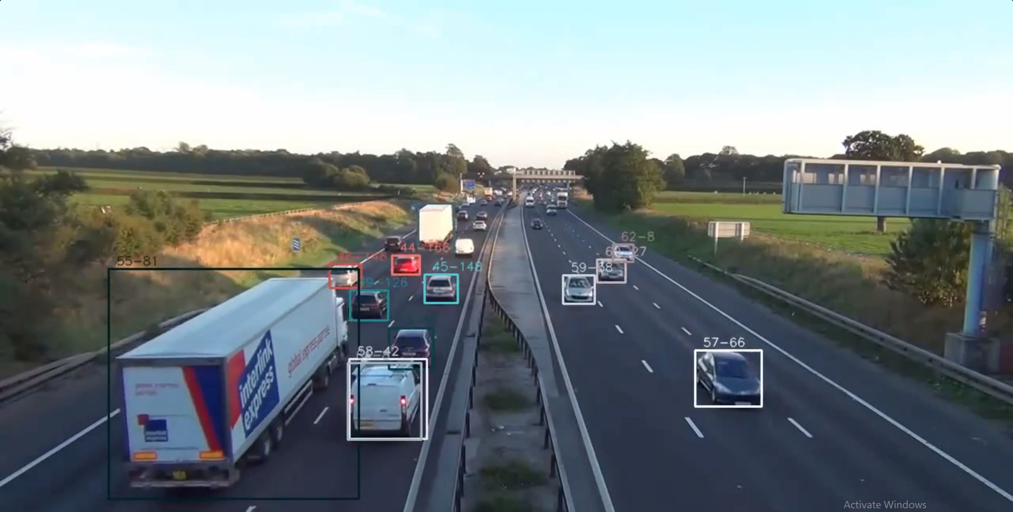
OUTPUT:
Department of Computer Science & Engineering, DSCE

Slide 15
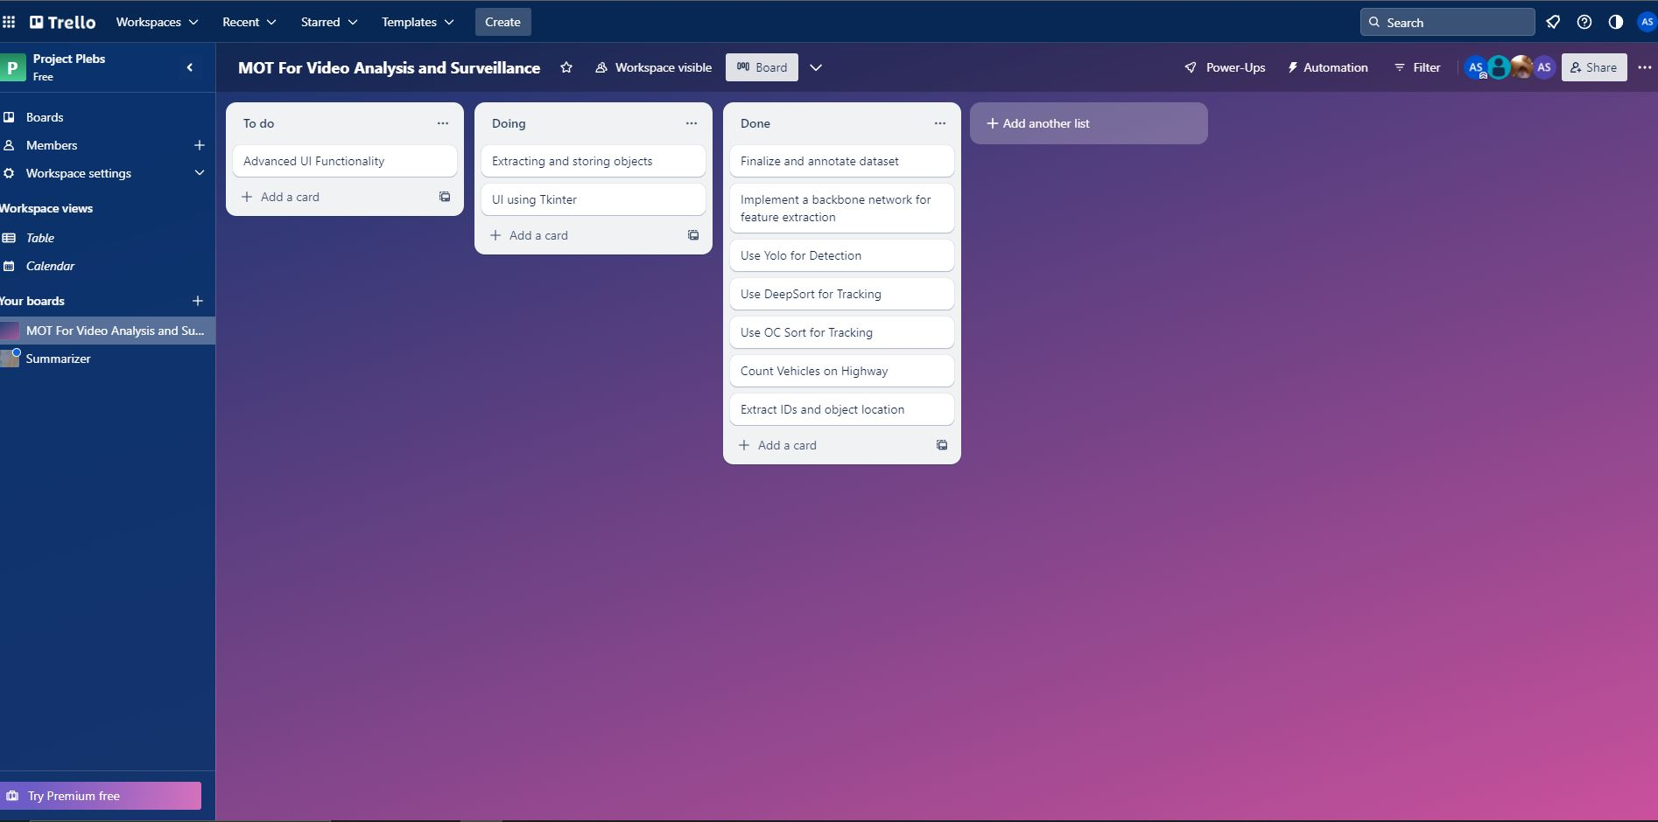
PROJECT TOOL SNAPSHOT:
Department of Computer Science & Engineering, DSCE

Slide 16
CO-GUIDE INTERACTION SUMMARY:
Use the latest YOLO architectures with better features.
Use 2 videos to present the detection capabilities preferably with both the videos having different landscapes.
Train the used model with different datasets.
Use a version control system.
Department of Computer Science & Engineering, DSCE

Slide 17
THANK YOU!
Department of Computer Science & Engineering, DSCE

