Slide 1
Lab 2: Support Vector Machines
Machine Learning – DD3431
Côme LASSARAT

Slide 2
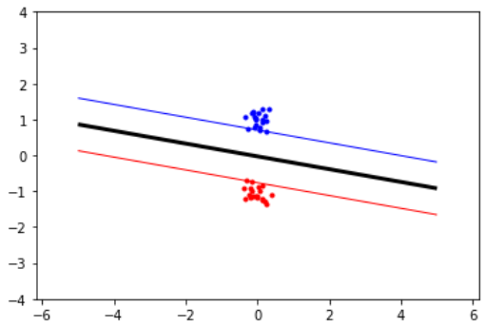
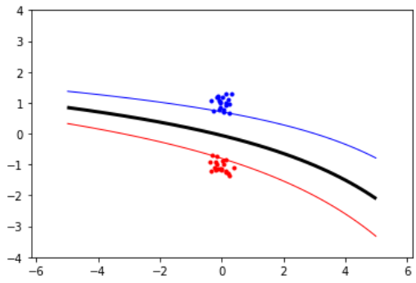
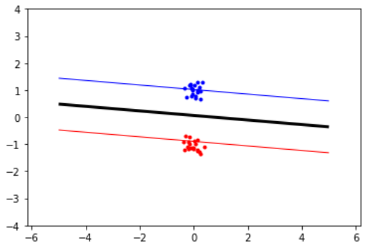
1) Moving around clusters and changing their size
Simple linearly separable data
C = None
Linear kernel
(’success’ = True)
C = None
P2 kernel
(’success’ = True)
C = 0.1
Linear kernel
(’success’ = True)

Slide 3
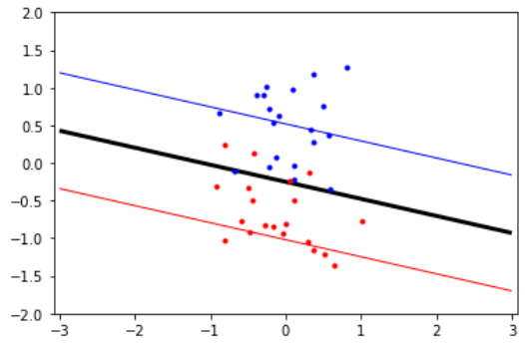
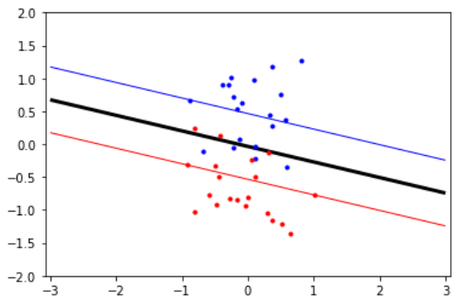
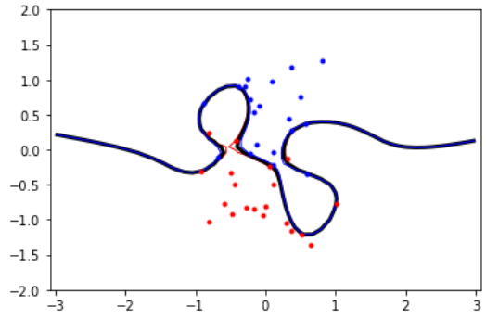
1) Moving around clusters and changing their size
Non-linearly separable data
C = None
Linear kernel
(’success’ = False)
C = 1
Linear kernel
(’success’ = True)
C = None
P10 kernel
(’success’ = True)

Slide 4
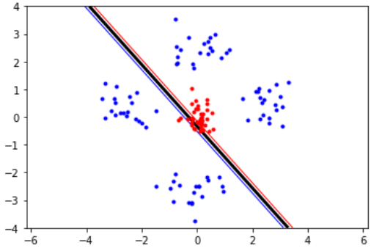
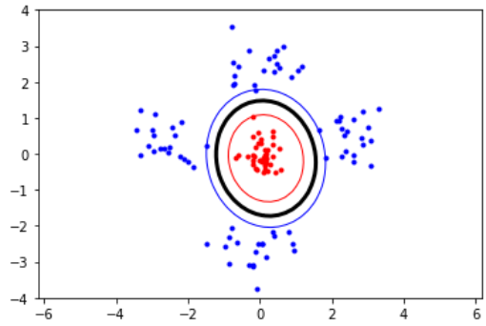
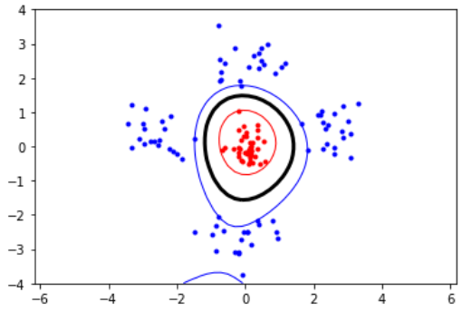
1) Moving around clusters and changing their size
Non-linearly separable data
C = None
Linear kernel
(’success’ = True)
C = None
P2 kernel
(’success’ = True)
C = None
P3kernel
(’success’ = True)

Slide 5
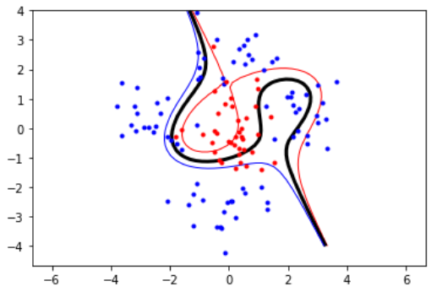
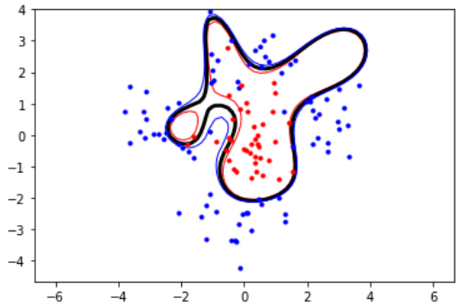
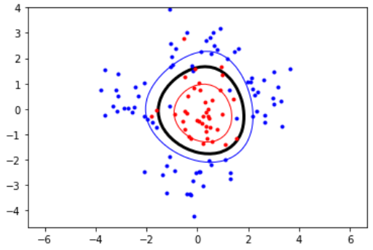
1) Moving around clusters and changing their size
Non-linearly separable data
C = None
P3 kernel
(’success’ = False)
C = None
RBF kernel
𝜎 = 2
(’success’ = False)
C = 0.05
P3 kernel
(’success’ = True)

Slide 6
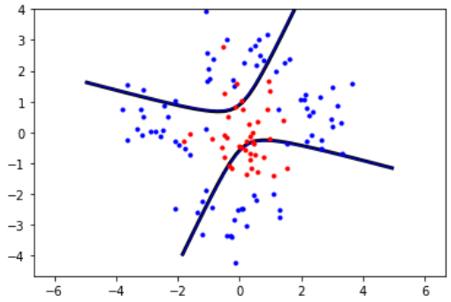
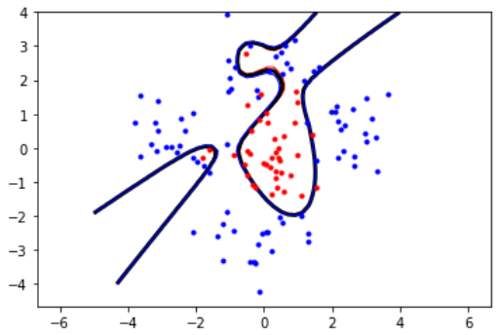
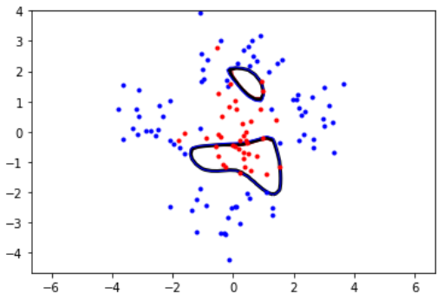
2) Influence of the non-linear kernels’ parameters
Polynomial kernel
C = None
P2 kernel
(’success’ = False)
C = None
P3 kernel
(’success’ = False)
C = None
P4 kernel
(’success’ = False)
C = None
P6 kernel
(’success’ = False)
High p = high variance – low bias (not necessarly for very high p)

Slide 7
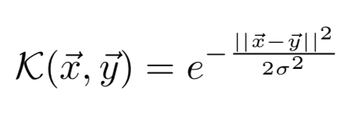
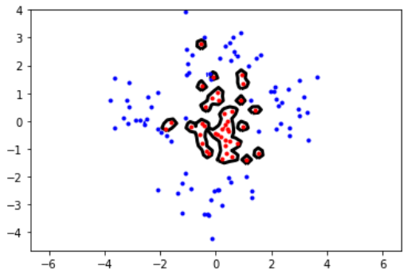
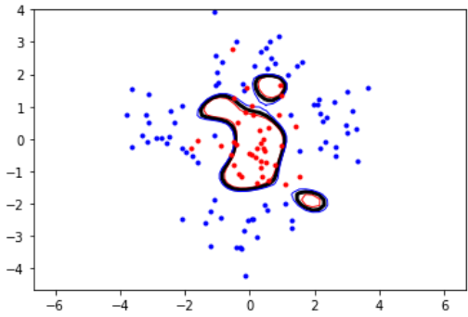
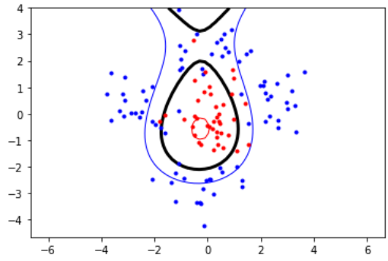
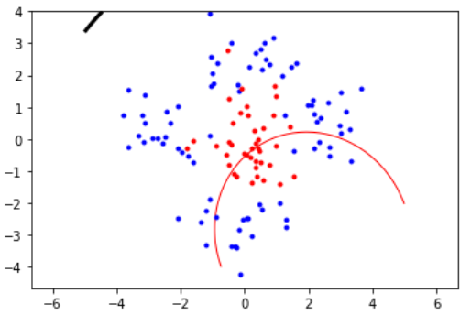
2) Influence of the non-linear kernels’ parameters
RBF kernel
C = None
RBF kernel
𝜎 = 0.1
(’success’ = True)
C = None
RBF kernel
𝜎 = 1
(’success’ = False)
C = None
RBF kernel
𝜎 = 10
(’success’ = False)
C = None
RBF kernel
𝜎 = 100
(’success’ = False)
Small 𝜎 = low bias – high variance

Slide 8
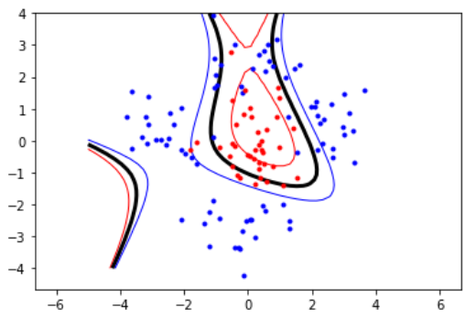
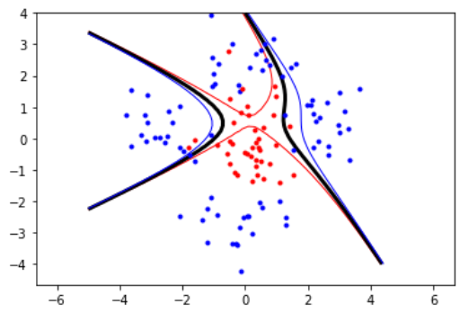
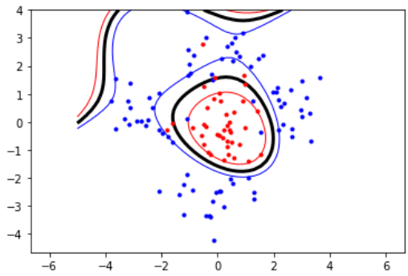
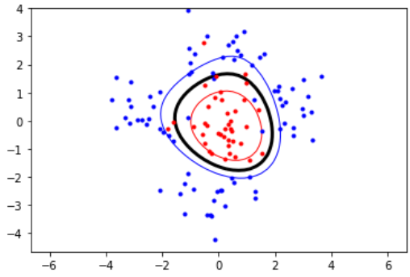
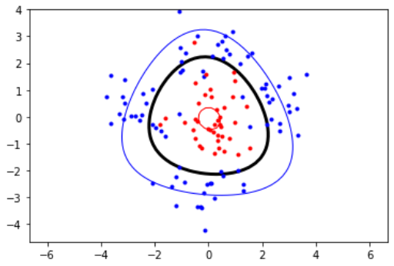
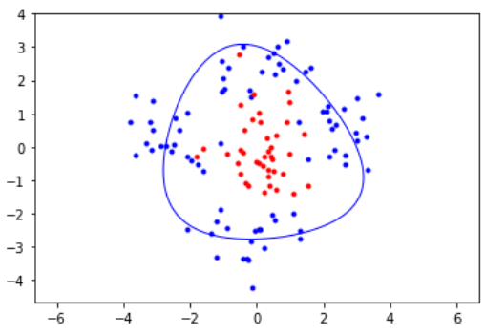
3) Influence of the slack parameter C
For the P3 kernel
C = 10,000,000
(’success’ = False)
C = 100,000
(’success’ = False)
C = 1000
(’success’ = False)
C = 10
(’success’ = True)
C = 0.1
(’success’ = True)
C = 0.001
(’success’ = True)
C = 0.0001
(’success’ = True)

Slide 9
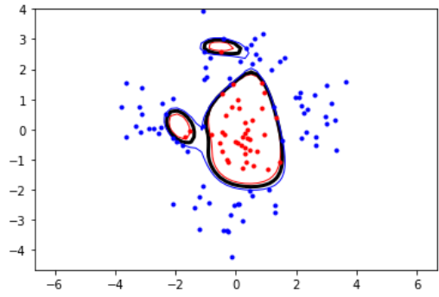
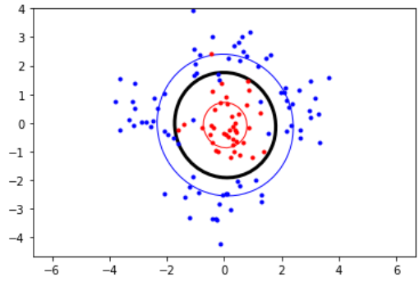
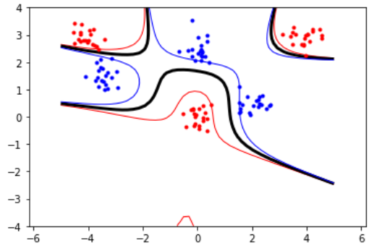
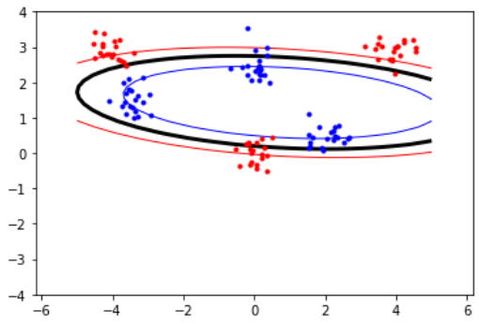


4) Slack or more complex model?
For data non-linearly separable but not overlapping → more complex model
For overlapping data → slack
C = None
RBF kernel
𝜎 = 1
(’success’ = False)
C = 0.01
P2 kernel
(’success’ = True)
C = None
P4 kernel
(’success’ = True)
C = 1
P2 kernel
(’success’ = True)

