Slide 1
Intelligent Text Editor
Kasen Ni
CSE518

Slide 2
Problem & Motivation
Goal:
Faster, smarter, flexible context-aware editing
• Static toolbars waste time searching for tools

Slide 3
Approach:
Flexible, adaptive interface
Integrated AI for text editor (with LLama3)

Slide 4
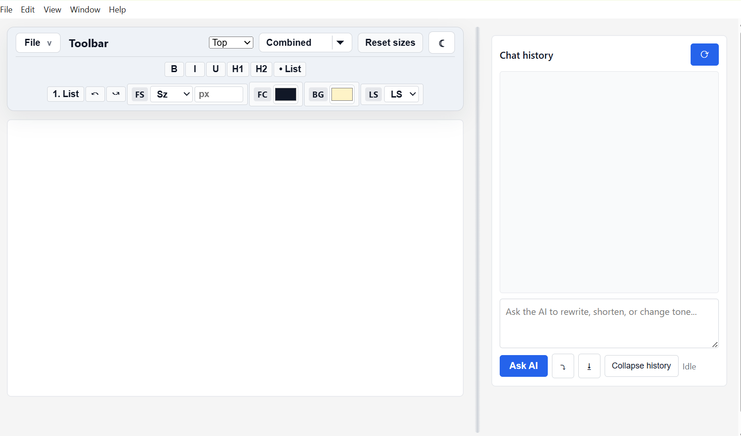
UI Interface

Slide 5
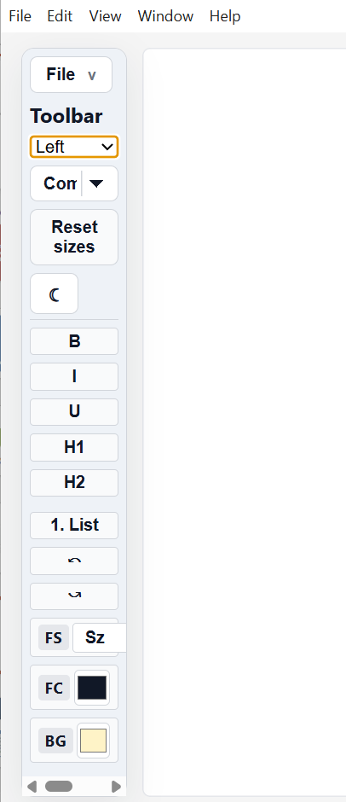
Flexible and responsive toolbar interface
Text editor tool symbols increases size and automatically switch position based on how frequently the user interacts with the symbols.

Slide 6
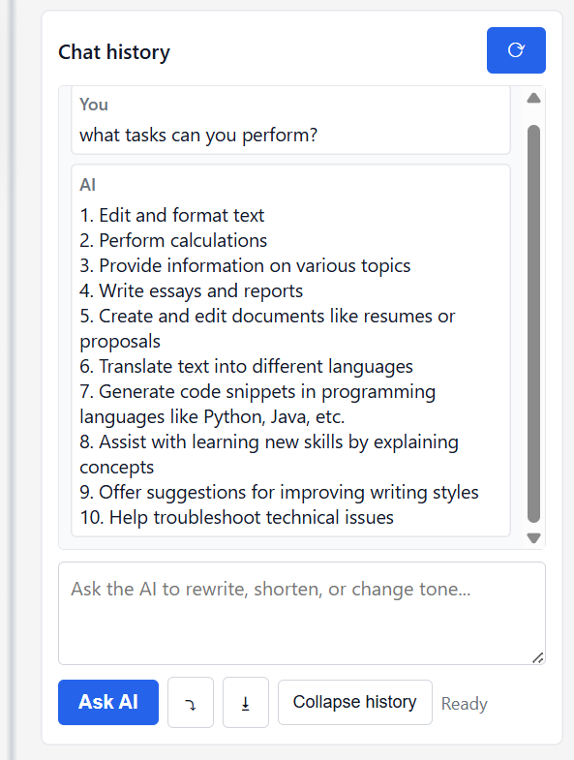
Integrated DeepSeek AI agent to assist with any user request
Apply changes directly into the text editor with just one single click
All previous chat history will be recorded
Support file upload and analysis along with text input

Slide 7
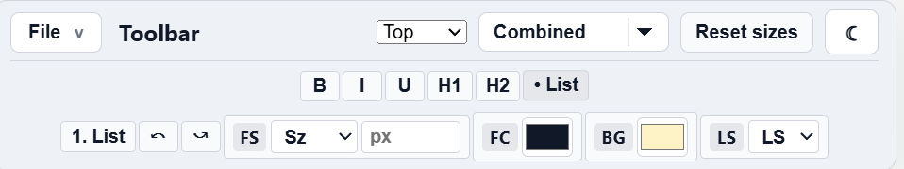
Flexible symbol re-position: user can freely drag the symbols into desired position for better experience

Slide 8
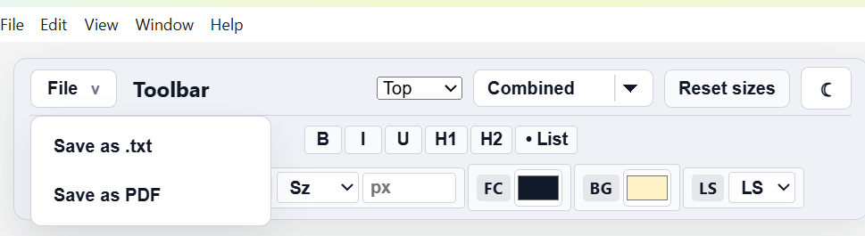
Save file when you are done!

Slide 9
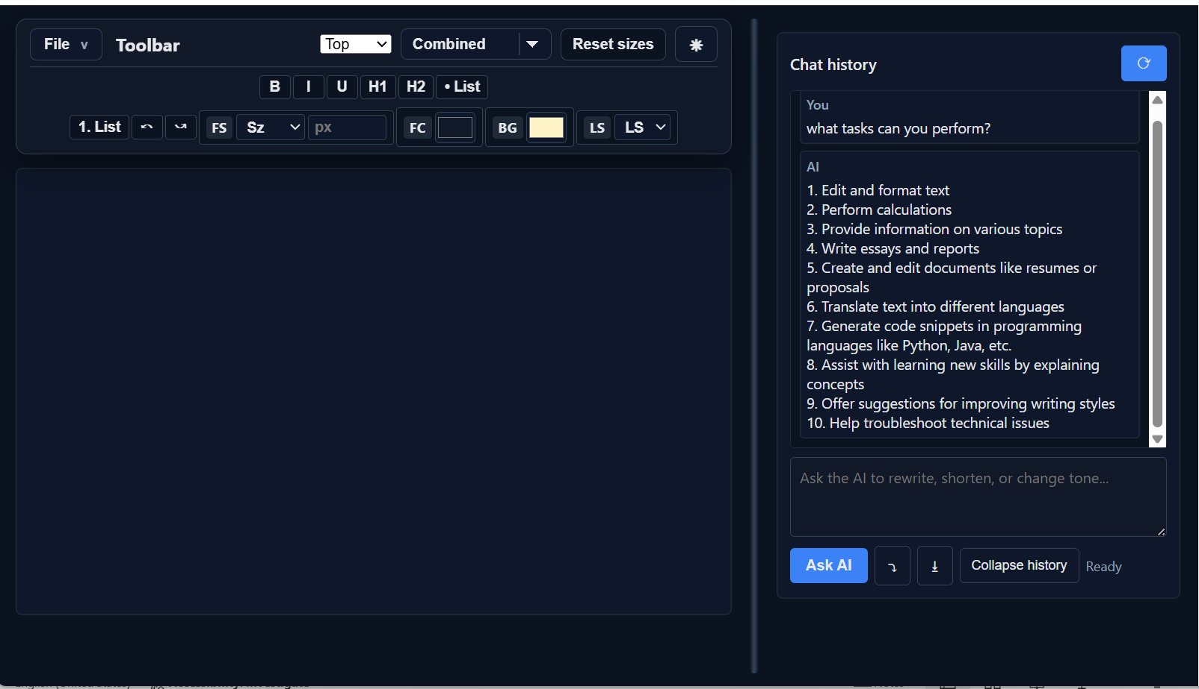
Switching between dark and light theme

Slide 10

User Evaluation
Due to local deployment of the model. The model response speed is limited and will require huge memory if the user chooses LLM with strong reasoning capability.
Some of the UI design can be further optimized to improve smoothness, such as toolbar symbols

Slide 11

Future work
Reposition the UI design according to user study and feedback to improve the experience
01
Build cloud environment to allow the user access the model remotely via cloud instead of utilizing the local resources.
02
Add more features to the text editor to line up with other famous text editor such as google doc and Microsoft words, while still ensuring ultra flexibility and reliable AI agent assistant.
03

Slide 12

Thank you

