Slide 1
R Coding Styles
Paraskevi Massara, PhD candidate
April 30th, 2020

Slide 2
Tidy Code
Speaking the same language
Sharing
Coordination
No universal "correct” coding definition.
Clear and concise code saves time and enhances collaboration
Working in teams: Agree on the coding style, tools and pipelines.
“Good coding style is like using correct punctuation. You can manage without it, but it sure makes things easier to read”.
Hadley Wickham

Slide 3
Assignment
Use only <- for assignment, not =
BUT passing values into the arguments of functions, use =
# Good
my_data <- read.csv()
# Bad
my_data = read.csv()
center <- function(data, midpoint = 0) {
new_data <- (data - mean(data)) + midpoint
return(new_data)
}

Slide 4
NAMING | Naming files
R scripts should have .R extension.
File names should be meaningful
File names should not contain / and spaces.
# Good
script.R
# Bad
script
# Good
clustering.R
# Bad
Untitled.R
# Bad
xhsjhj.R
# Good
read.csv("my_script.csv")
# Bad
read.csv("my script.csv")
Scripts usually signify actions, name accordingly
i.e.“growth_modeling.R”

Slide 5
NAMING | Naming variables
Variable names should be typically lowercase.
and short as possible
DO NOT use reserved words or R function names as variable names
Variable names should not contain /, . and spaces.
# Good
height
# Bad
Height
# Bad
c <- c()
df <- df()
T <- T is a shortcut of TRUE in R
mean <- mean()
plot(), summary(), table(), all(), file(), date(), length()
# Good
nPoints: for number of points
iPoints: for indices of points
my_df, new_df, cut_df
# Good
hospital_data
# Bad
hospital.data
hospital data
hospital/data
# Bad i.e. gut_microbiome_dataset <-
Dates: default to YYYY-MM-DD
Notes:
/ will return compilation error

Slide 6
NAMING | Naming variables (continue)
Avoid generic names with multiple occurrences. The variable names should show the purpose.
# Good
m_height <- mean()
# Bad
x <- mean()
a <- addition() # function names should be verbs

Slide 7
Syntax | Spacing
# Good
high_rate <- my_data[which(my_data$prc_value >= 50), ]
Put spaces AROUND all infix binary operators (e.g. =, +, *, ==, &&, <-, %*%)
Put a space after a coma
No spacing around code in parenthesis or square brackets.
Exceptions:
No spaces around “=” in functions from Bioconductor
No space for sub setting ($ and @)
# Bad
high_rate<-my_data[ which( my_data$prc_value>=50 ),]
# Fix spaces, number of characters per line in R studio
# Select all code in script
Ctrl + A
# Format code
Ctrl + Shift + A

Slide 8
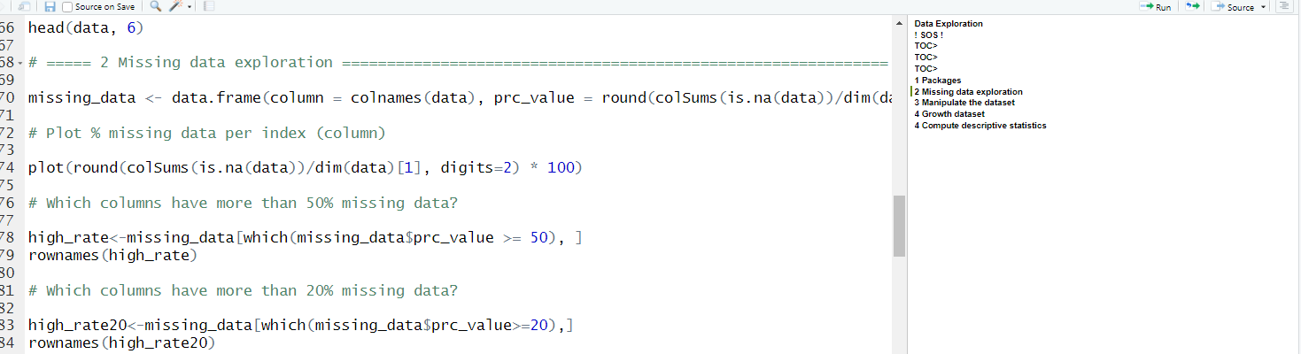
Structuring a script
Use table of contents, version details, date etc.
Install packages first
Use separators to make sections
Comment your code. Comments start with # followed by space and text

Slide 9
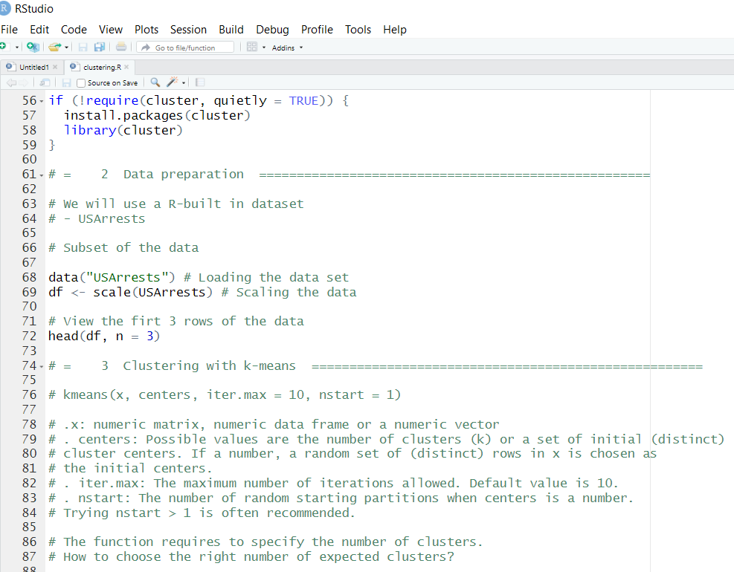
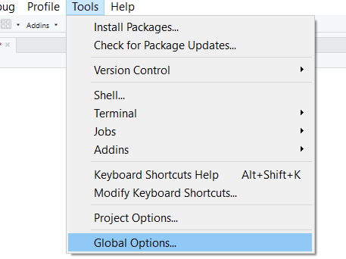
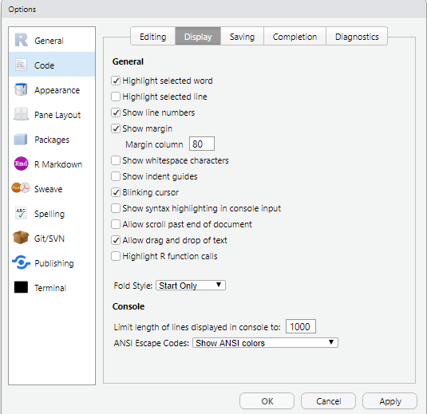
Structuring a script
To avoid horizontal scrolling limit yourself to 80 characters per line.
Notes:
Tools, global options, code, display, show margin

Slide 10
Don’t repeat code | Dry principle
# Convert Celsius to Kelvin
celsius_to_kelvin <- function(temp_C) {
temp_K <- temp_C + 273.15
return(temp_K)
}
# Loop through the sequence 1 to 5 printing the square of each number
for (j in 1:5)
{
print(j^2)
}
Functions
Loops

Slide 11
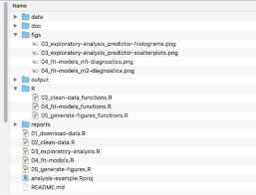
Organization | Using R projects
Create a directory for each project with subdirectories for:
Data (separate raw data, if necessary)
Code
Plots / Figs
Results / reports
https://support.rstudio.com/hc/en-us/articles/200526207-Using-Projects

Slide 12
Tips and Tricks
Conflicted packages:
Different R packages have functions with the same name.
Condition vs Assignment x<-5 # assign 5 to x,
x < -5 # compare x to -5
traceback() and options(error=recover) useful for debugging, easier to understand errors
chron::is.weekend()
tseries::is.weekend()
Notes:
Then our code's behavior will depend on the order in which the libraries were loaded.

Slide 13
Code cleaning Design R packages
Rclean (April 21, 2020) - GitHub
Code refactoring, code necessary to produce a specified result (e.g., an object a table or figure) can be isolated even when tangled with code for other results, visual of the code and the objects that they produce
cleanr (January 9, 2020) - CRAN
Checks for files too long or wide, functions with too many lines, too wide lines, too many arguments
https://ropensci.org/blog/2020/04/21/rclean/?fbclid=IwAR1EgvK_V1EmtTm6DYDDlPiSSHehcszcXrEVK6KABFMxiBCtiYoIvTCcizY

Slide 14
Good programming practices
Conference report "Good Programming Practices in Healthcare: Creating Robust Programs“, 2011
Rule of Clarity: Clarity is better than cleverness.
Rule of Composition: Design programs to be connected to other programs.
Rule of Simplicity: Design for simplicity; add complexity only where you must.
Rule of Transparency: Design for visibility to make inspection and debugging easier.
Rule of Robustness: Robustness is the child of transparency and simplicity.
Rule of Representation: Fold knowledge into data so program logic can be stupid and robust.
Rule of Least Surprise: In interface design, always do the least surprising thing.
Rule of Silence: When a program has nothing surprising to say, it should say nothing.
Rule of Repair: When you must fail, fail noisily and as soon as possible.
Rule of Economy: Programmer time is expensive; conserve it in preference to machine time.
Rule of Generation: Avoid hand-hacking; write programs.
Rule of Optimization: Prototype before polishing. Get it working before you optimize it.
Rule of Extensibility: Design for the future, because it will be here sooner than you think.

Slide 15
Resources
Happy families are alike;
Every unhappy family is unhappy in its own way.
Leo Tolstoy
https://www.r-bloggers.com/%F0%9F%96%8A-r-coding-style-guide/
http://adv-r.had.co.nz/Style.html
Google's R Style Guide (https://google.github.io/styleguide/Rguide.xml)
https://www.stat.ubc.ca/~jenny/STAT545A/block19_codeFormattingOrganization.html

