Slide 1

SMART INDIA HACKATHON 2026
SatQuery AI — ask your satellite in plain language
Problem Statement ID – 26167
Problem Statement Title – SatQuery AI: An Interactive Vision-Language
Assistant for Multimodal Remote Sensing Image Analysis through Text Queries
Theme – Space Technology
PS Category – Software
Team ID – [ to be filled ]
Team Name – x64

Slide 2
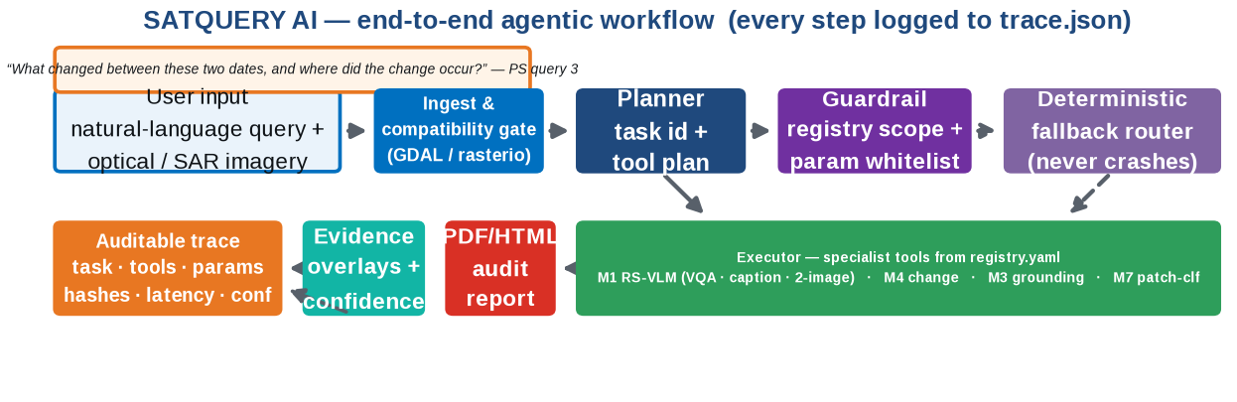
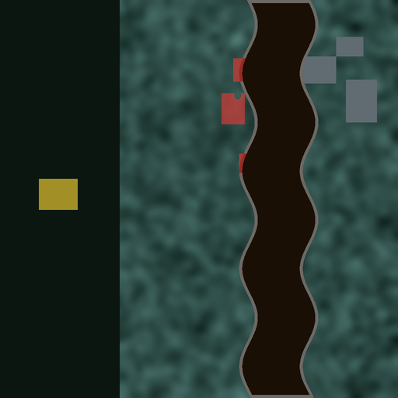
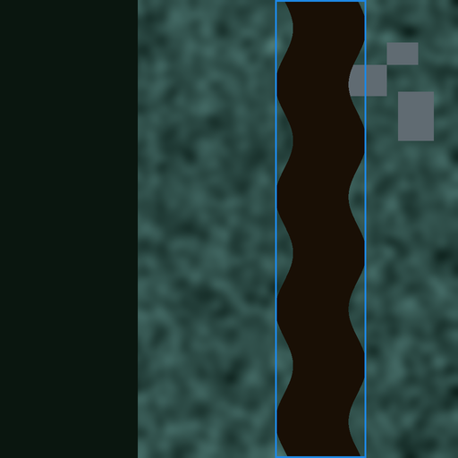
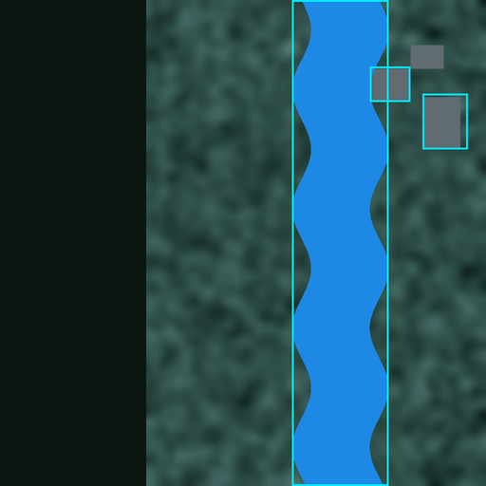
SATQUERY AI
x64
Proposed solution (idea / solution / prototype) · how it addresses the problem · innovation & uniqueness
Proposed Solution / Approach
Agentic by design: a natural-language query is planned into a sequence of specialist tools drawn from a predefined registry (PS P6–P8) — not one monolithic VLM.
Guardrailed execution: schema + parameter whitelist and a deterministic fallback router; incompatible inputs return a compatibility report — never a crash.
Auditable trace (the graded surface): every run logs task, tools + versions, parameters, input hashes, latency and confidence (P9–P10).
Evidence, not vibes: answers ship with change masks, grounding boxes and caption overlays, plus calibrated High/Med/Low badges and an optical↔SAR disagreement flag.
One-click audit report: downloadable PDF/HTML report per query — trace + evidence + confidence, ready for evaluation.
How it addresses the problem: turns expert GIS pipelines into a query box, and makes every answer checkable — the trust gap the PS itself names.
Representative PS queries we demo (verbatim):
1 “Describe the land-cover and major objects visible in this image.”
2 “Highlight the water body referred to in the query.”
3 “What changed between these two dates, and where did the change occur?”
4 “Use the optical and SAR images together to identify built-up and water-covered regions.”
5 “Has the built-up area increased, decreased, or remained unchanged?”
REAL PROTOTYPE OUTPUTS — thin end-to-end build (Window A)
change mask
grounding boxes
caption overlay
Innovation & Uniqueness
Trace as a product
the graded surface is a first-class UI + JSON artifact
Registry + guardrails
tools declared, params whitelisted, routing deterministic
Optical × SAR joint reasoning
optical gives spectra & context; SAR sees through cloud, day & night — paired focus (P1, P5)
RS-adapted, never generic
QLoRA on BigEarthNet.txt — generic VLMs explicitly insufficient (P12)
Honest confidence
calibrated badges, disagreement flags, reasoned abstention

Slide 3
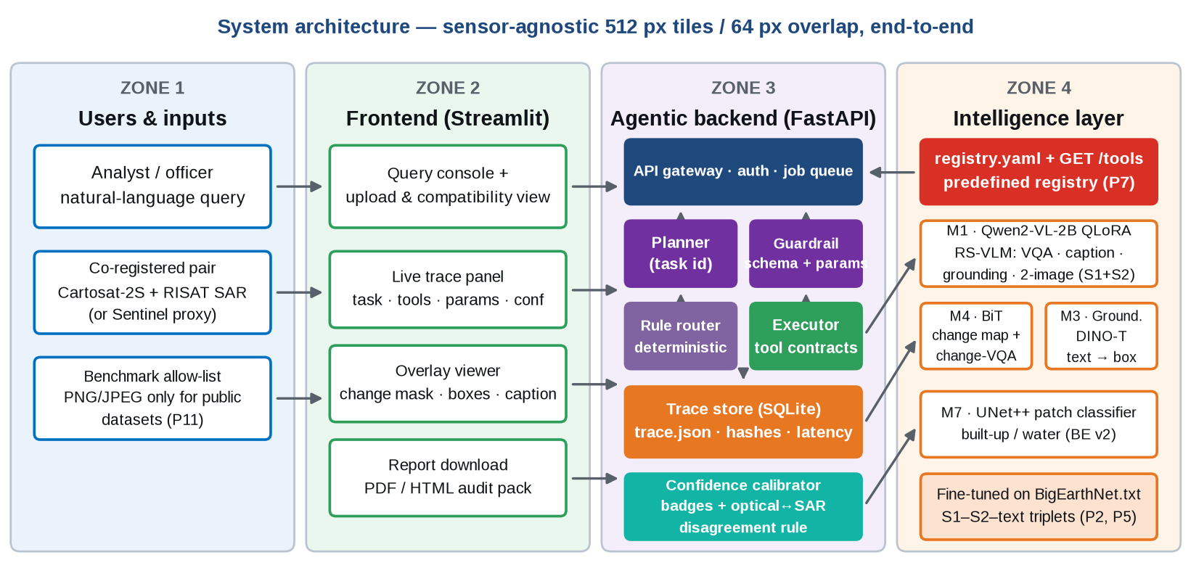
TECHNICAL APPROACH
x64
Technologies to be used · methodology & process for implementation (flow charts / images / working prototype)
Implementation Process
1
Ingest & validate
format · CRS · modality · co-registration · 512/64 tiling (GDAL)
2
Plan & guard
task id, tool selection from registry, parameter whitelist
3
Execute
specialists run per tile; every call writes to the trace
4
Fuse & calibrate
weighted geometric mean, High/Med/Low badges, disagreement rule
5
Visualise
change mask / boxes / caption streamed over the scene
6
Report
PDF/HTML audit pack + trace.json download
Technology stack
to be used
Python
FastAPI
Streamlit
GDAL / rasterio
PyTorch
Qwen2-VL (QLoRA)
Grounding DINO
UNet++ / BiT
Docker

Slide 4
FEASIBILITY AND VIABILITY
x64
Feasibility analysis · potential challenges & risks · strategies for overcoming these challenges
Feasibility
• Proven open weights & open source — Rs 0 licence cost.
• Prototype already runs end-to-end on a laptop (thin build, Window A).
• QLoRA 4-bit + 2B backbone fits free Kaggle / Colab GPUs.
• Tile-based 512 px / 64 overlap → sensor- & resolution-agnostic.
Viability
• 15-day dated build plan with daily checkpoints D1–D18.
• 3-model triage (M1/M4/M3) matches pooled free compute exactly.
• Demo-day safe: deterministic fallback + cached-answer mode.
• Metrics gates on public splits before every submission.
Practical Implementation
• Dockerised, offline deploy for the evaluation venue.
• Handles georeferenced Cartosat-2S + RISAT pairs by design (P14).
• Normalised metric tables (P15) in the final report.
• Same tool contracts from prototype → trained models.
01
Domain gap: trained on Sentinel (10–20 m), evaluated on Cartosat-2S (~1 m) + RISAT.
Tile-based, resolution-agnostic pipeline; week-1 proxy tests on public VHR + L-band.
01
02
Tight 6 GB VRAM at the evaluation venue.
QLoRA 4-bit + 2B backbone; heavy training on free 16 GB Kaggle GPUs.
02
Potential
Challenges
& Risks
Strategies
For Overcoming
Challenges
03
Hidden eval annotations & unpublished metric weights (G1).
Train on the PS-named public benchmarks; report normalised metric tables (P15).
03
04
Demo-day failure risk in front of judges.
Guardrail fallback router + cached answers; honest, scoped narration on stage.
04
05
15 days for 3 trained models.
Binding triage M1/M4/M3; dated checkpoints D1–D18; contracts frozen early.
05

Slide 5
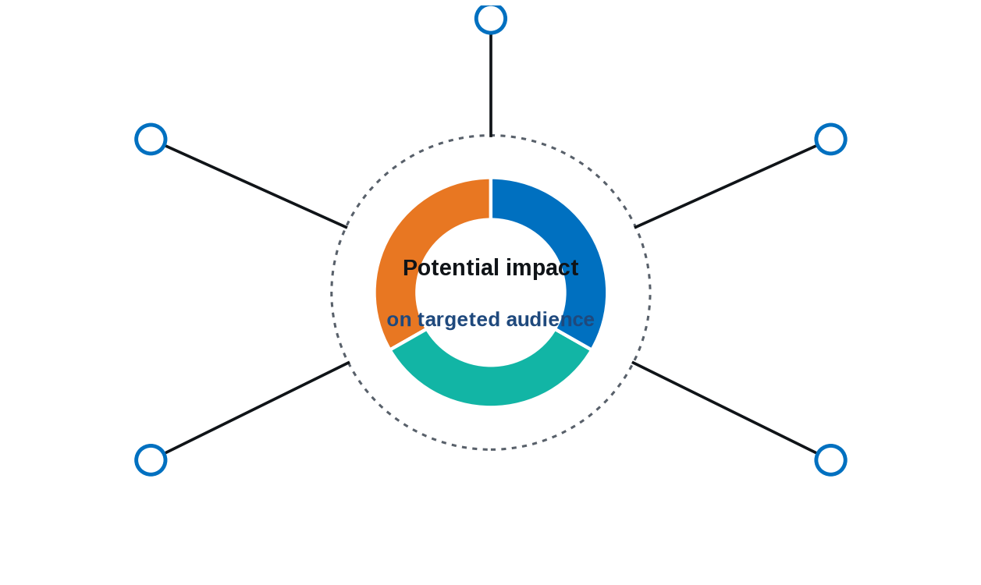
IMPACT AND BENEFITS
x64
Potential impact on the target audience · benefits of the solution (social, economic, environmental)
ISRO / SAC analysts: task answers with evidence in minutes, not scripting days.
Benefits of the solution
Social
“Democratizes satellite intelligence — any officer queries in plain language, the PS's own stated goal.”
Disaster cells: bi-temporal change maps + change-VQA for rapid damage triage.
Agriculture dept: water / crop queries in plain language — no GIS staff needed.
Economic
“One assistant replaces many single-task vendor pipelines; saves analyst-hours on every tasking cycle.”
Urban planners: auditable built-up growth counts from masks, not eyeballing.
Students & researchers: open traces + reports make RS science reproducible.
Environmental
“Faster spotting of floods, encroachment and water-body change → quicker response on the ground.”
“Every answer with evidence, confidence and an audit trail — satellite intelligence anyone can query.”

Slide 6
RESEARCH AND REFERENCES
x64
Details / links of the reference and research work
Official problem statement & portals
• SIH 2026 Problem Statement 26167 (ISRO): “SatQuery AI — An Interactive Vision-Language Assistant for Multimodal Remote Sensing Image Analysis through Text Queries” · sih.gov.in
• ISRO / Space Applications Centre: evaluation set of pre-georeferenced Cartosat-2S + RISAT pairs (P14) · isro.gov.in
Datasets & benchmarks named by the PS
• BigEarthNet.txt (primary adaptation data — 9.55 M annotations over 464 K S1–S2 pairs): arXiv:2603.29630 · huggingface.co/datasets/BIFOLD-BigEarthNetv2-0/BigEarthNet.txt
• VRSBench (NeurIPS'24 D&B — captioning, grounding, VQA): arXiv:2406.12384 · github.com/lx709/VRSBench
• RSVQA (Lobry et al., IEEE TGRS 2020) — single-image VQA volume.
• CDVQA (Yuan et al., TGRS 2022 — bi-temporal change VQA + semantic change maps): arXiv:2112.06343 · github.com/YZHJessica/CDVQA
• TAMMI (2025) — VQA over co-located VHR RGB + multispectral + SAR triplets; LEVIR-CD / WHU-CD for change-mask volume (github.com/justchenhao/Levir-CD).
Models & methods
• Qwen2-VL (2 B backbone, QLoRA 4-bit adaptation): arXiv:2409.12191 · QLoRA arXiv:2305.14314 · LoRA arXiv:2106.09685
• Grounding DINO (text-guided grounding base): arXiv:2303.05499
• UNet++ / BiT (change & patch-classifier heads): arXiv:1807.10165
Our groundwork (this submission)
• Clause-level PS analysis: all 15 binding clauses (P1–P15) mapped to design decisions; 5 known PS gaps logged (G1–G5).
• Working thin prototype: real ingestion (GDAL), registry + guardrail + fallback router, trace store, overlays and PDF reports — screenshots on slide 2.
• Dated 15-day build plan: three trained models (M1/M4/M3) with daily checkpoints and benchmark gates for the 20 Sep final submission.
Benchmark gates for the 20 Sep submission — zero-shot → adapted delta is our P12 compliance proof
Captioning
VRSBench test
CIDEr · BLEU-4 · METEOR · ROUGE-L
Grounding
VRSBench refs
box IoU ≥ 0.5 acc · COCO AP
Single-image VQA
RSVQA + VRSBench
exact match · soft accuracy
Change-VQA
CDVQA test
exact match over answer categories
Change map
CDVQA / QAG-360K
IoU · F1 · mIoU
All scores normalised before combining (P15); per-tool latency and confidence recorded in every trace.

