Slide 1
Flicker
See what’s in front of you
Team Zahlen
Sean Halloran
Stone Cleven

Slide 2
Features
Mazes full of pits to fall into
Intelligent light switch flicking AI that responds to player behavior
Increasing levels of difficulty
All 5 design restrictions

Slide 3
Target Audience
The Anxious Puzzle Solver
Lights turn on before pits, requiring quick response
The Patient Puzzle Solver
Lights turn on according to how much the player moves
Must make decisions based on limited information

Slide 4
Experience Goal
Surprise
Despair
Regret

Slide 5
Play Description
Tutorial levels
Player Death
Lightswitch AI
Lights flash on before pits
Lights flicker on more often the more often the player moves
Lights flicker off after a second

Slide 6
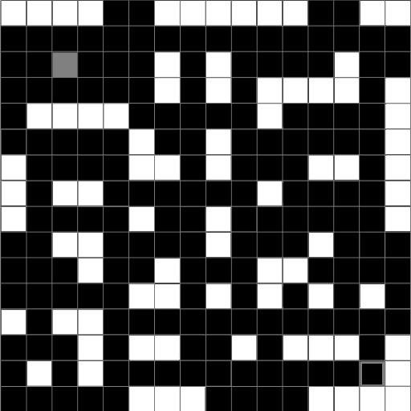
Later Levels
Lights off

Slide 7
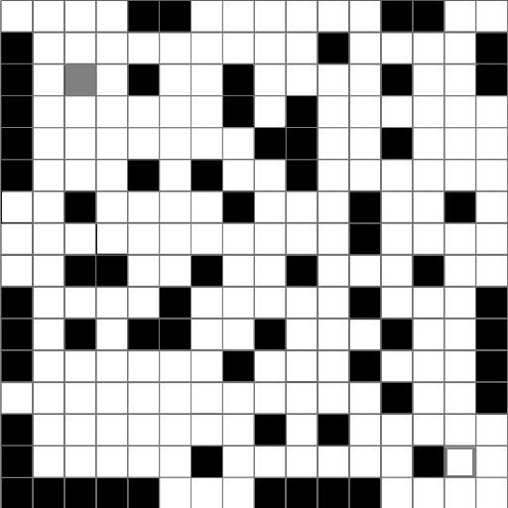
Later Levels
Lights on

Slide 8
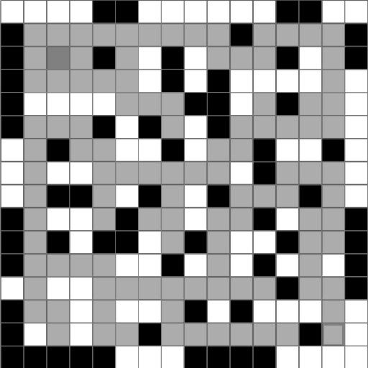
Later Levels

Slide 9
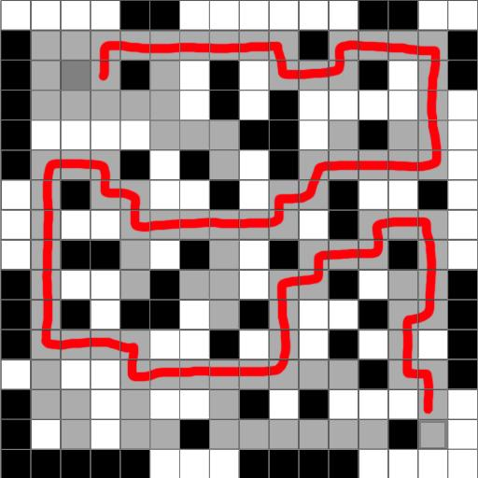
Later Levels

Slide 10
Questions?

