Slide 1
CHROMAWORKS
Fourth of July, all on your phone!
Team Zahlen
Sean Halloran
Stone Cleven

Slide 2
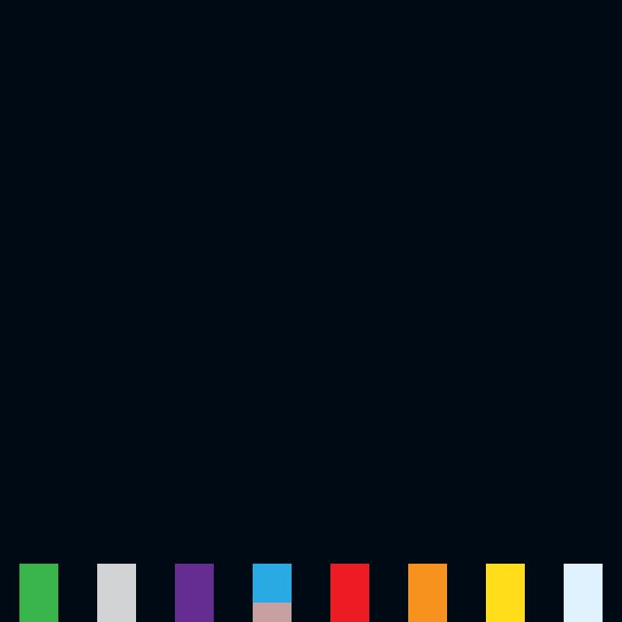
Features
Player can select one of eight colors at bottom of screen with click
Player can shoot a firework at desired location in sky with a second click
Player can detonate the firework with another click once it is fired into the sky
Background changes color when firework reaches destination
Fireworks take a long time to fade away, so that the player can paint the sky with many fireworks to make a colorful image

Slide 3
Startup
Click anywhere, something happens
Feedback for every action

Slide 4

Firework Selection
Radio button like selection scheme
Each fireworks cannon launches a different color firework and explosion

Slide 5
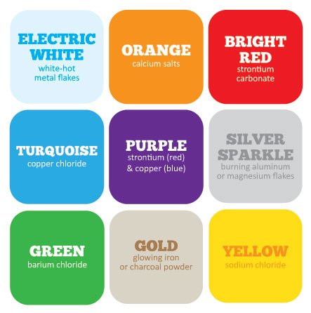
Color
Real fireworks are made by utilizing certain compounds to make the different colors.
We used this guide to pick the base colors for our fireworks and explosions.

Slide 6
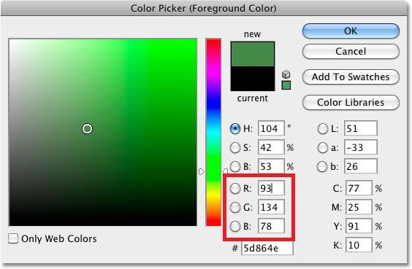
Color cont’d
Through trial and error in Photoshop, we found RGB value ranges to create random, but appropriate colors for the different explosions

Slide 7
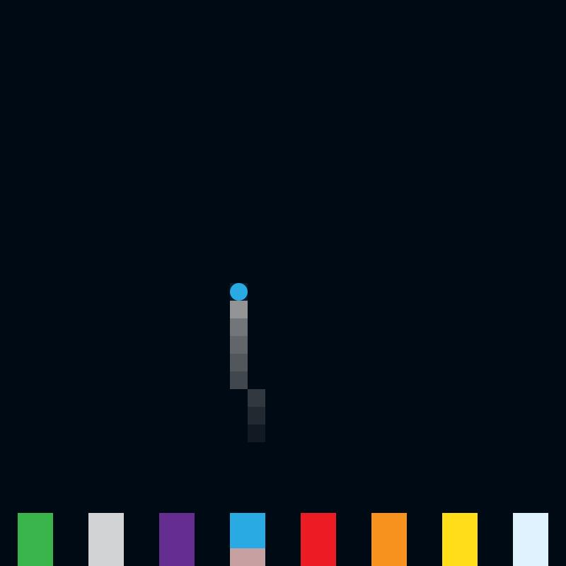
Shooting Fireworks
Tap sky to launch firework at that location
Sound effects
Smoke trail

Slide 8
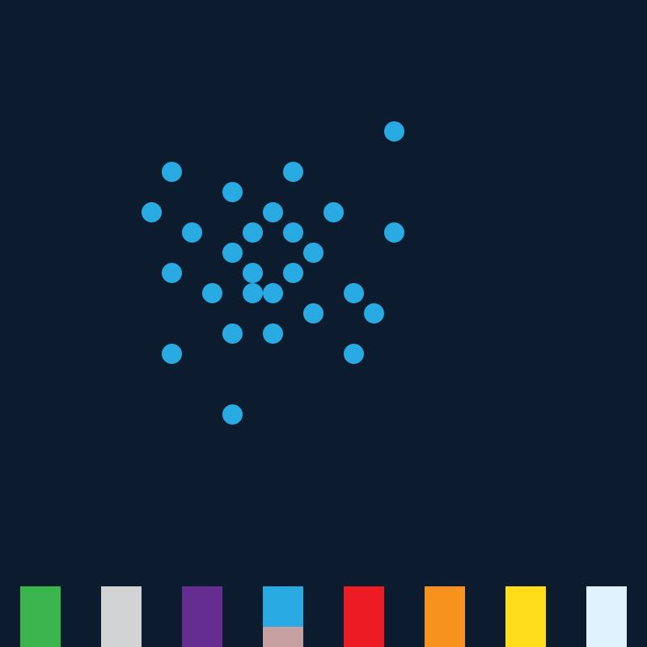
Detonating Fireworks
Tap again to detonate firework
Lights up night sky
Slowly fades away

