Slide 1
Dagger Touch
Aim and swipe!

Slide 2
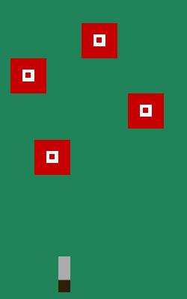
Features
Moving targets
Throwing daggers
Swipe to throw
Many levels
Changeable backgrounds for several seasons
Explosion effects

Slide 3
Experience Goal
Aiming projectiles
Throwing projectiles
Watching projectiles hit targets
Easy pick up and put down experience

Slide 4
Target Audience
Casual and mobile game players
People without much time
People in line at Starbucks
People stuck in a doctor’s office
People waiting for their number at the deli counter
People with only one hand

Slide 5

Play Description
Destroy the targets
Limited dagger throws
Multiple difficulties

Slide 6
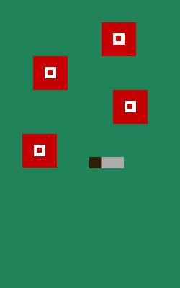
Controls
Touch the dagger, and swipe
Thrown in the direction of swipe
Speed controlled by swipe

Slide 7
Questions?

