Slide 1
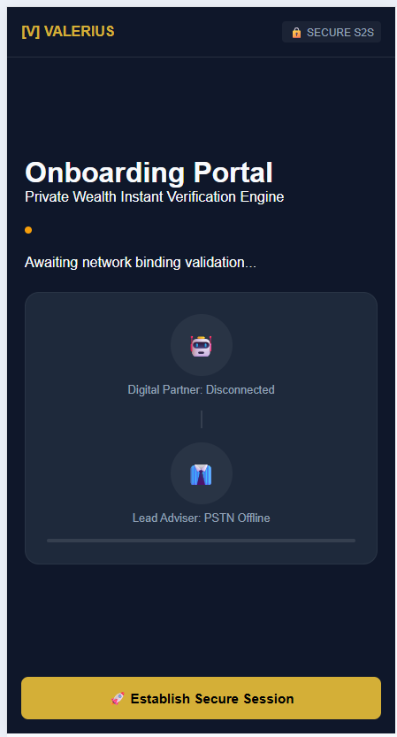

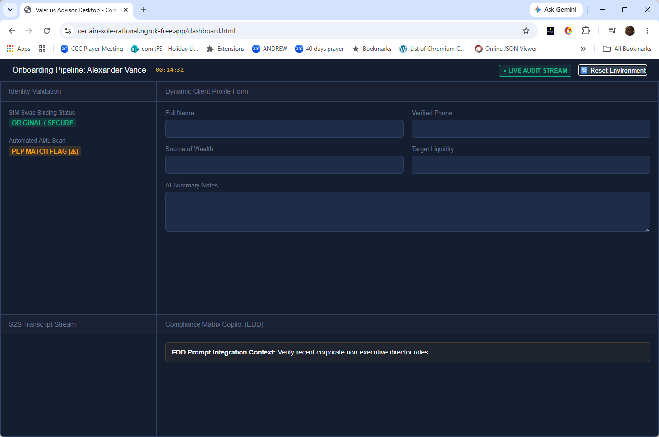
HNW Client on Smart-Phone
Mobile Identity Verification API 2.0 – Silent Carier Handshake
Digital Wealth Financial Adviser
Simultaneous Speech-to-Speech
(OpenAI gpt-realtime-2.1)
Financial Adviser Team (Dashboard)
Passive Listener ➔ Active Intervener Auto KYC form fields in JSON data
CAS Voice Shared Line

