Slide 1
Teradata 101
An Introduction to Teradata at eBay
By JOE FULLER (w/ thanks to Todd Walter of Teradata)
June 7, 2006

Slide 2
Agenda
Introduction
Teradata MPP Architecture
Shared Nothing
The BYNET
Parallelism
The “Magic” of the Row Hash
Optimizer Parallelization
Analytic Processing
In-Place Data Mining
TDQM Overview
Handling Node Failure
High Level Architecture – System Synchronization

Slide 3
Introduction
In the past …
A large mail order retailer with hundreds of thousands of customers.
Each customer had a hand-written index card in a giant card file.
Thousands of clerks!
Every order was added to the customer’s card
Suggestions written on the receipts.
Massively parallel processing with individualized CRM!
  Capturing and using detailed transactional information
How did the company handle increased customer and sales volumes?
  Hired more clerks!
  Bought more index cards and file cabinets!

Slide 4
Introduction (continued)
What does this have in common with Teradata?
“Share Nothing”
Take a big task
Slice it vertically in to a (large) number of smaller tasks
Perform these tasks independently
Balance the work so that each task finishes at the same time
Assign the task evenly among the physical resources
Communicate only at the beginning and the end of the task
Benefits
Large tasks complete in short elapsed time
Maximizes use of resources
Reduces communications bottlenecks

Slide 5
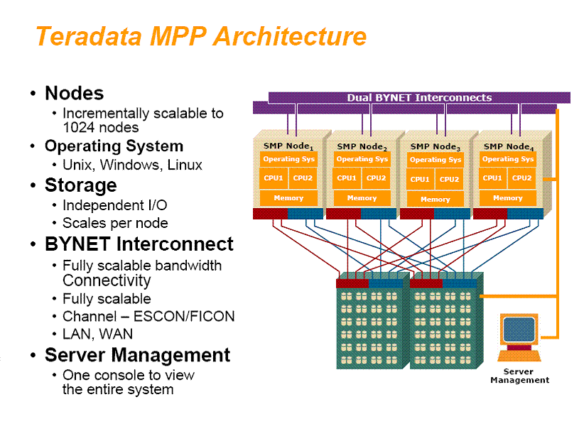
Teradata MPP Architecture

Slide 6
Shared Nothing – Dividing the Work
“Virtual Processors” (vprocs) do the work
Two Types
  AMP (Access Module Processors): Owns and operates on the data.
  PE (Parsing Engine): Handles SQL and external operations
Configure multiple VPROCs per hardware Node
  Take full advantage of SMP CPU and Memory
Each VPROC has many threads of execution
  Many operations taking place concurrently
  Each thread can do work for any user or transaction
Software is equivalent regardless of configuration
  No changes as the system grows from small SMP to huge MPP

Slide 7
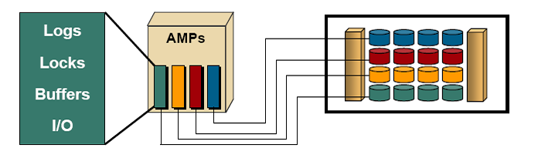
Shared Nothing – Dividing the Work
This is the basis of Teradata scalability.
  Each AMP owns an equal slice of the disk
  Only that AMP can read / write to that slice of the disk
No single point of control for any operation.
  I/O, Buffers, Locking, Logging, Dictionary
  Nothing is centralized
  Exponential communications costs are avoided

Slide 8
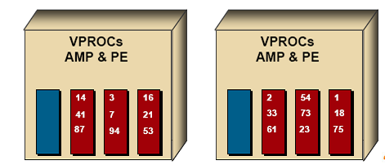
Shared Nothing – Dividing the Work
Data automatically distributed to the AMPs via hashing
Even distribution results in scalable performance
Hash map defined and maintained by the system
  2**32 Hash Codes, 64K buckets distributed evenly to the AMPs
Primary Index (PI) column(s) are hashed
Hash is always the same, for the same values
  Implications for distribution (and thus performance) if a large percent of the values hash the same!
No partitioning or re-partitioning ever required

Slide 9
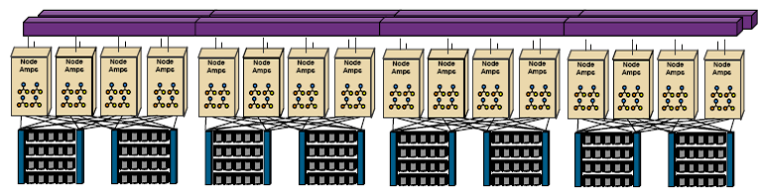
Shared Nothing Architecture
Delivers linear scalability
  Maximizes utilization of SMP resources
  To any size configuration
  Allows flexible configurations
  Incremental upgrades
Linear with a slope of 1 at any size

Slide 10
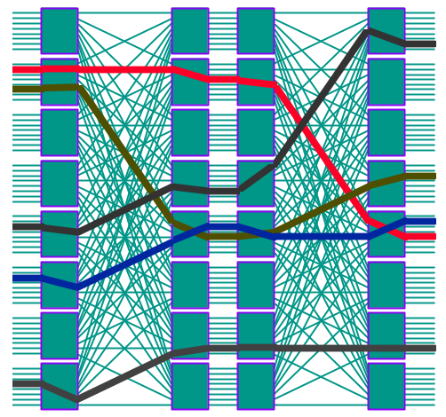
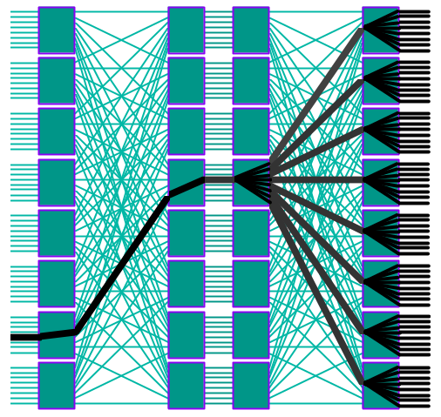
The BYNET
Optimized for Teradata ADW Performance
  V2.0 has linearly scalable bandwidth (up to 480MB/s per node)
  V3 has linearly scalable bandwidth (up to 752MB/s per node)
  BYNET Low Latency Interface (BLLI) - “lite” communication protocol
  Teradata exploits unique BYNET features: broadcast message support, row merge support, multi-fabric message traffic shaping, hardware guaranteed message delivery (including broadcast)
Proven High-Availability
  Each fabric is fault tolerant (multiple paths, redundant power & cooling)
  2 to 4 independent fabrics (no single point of failure)
Multiple Simultaneous
Point-to-Point Messaging
Broadcast Messaging
Node
Node
Node
The Teradata Optimizer chooses between Point-to-Point and Broadcast Messaging to select the most effective communication.
Node
Node
Node
Node
Node
Node
Node

Slide 11
Parallelism – Why is it Important?
Scan
Sort
Aggregate
A high degree of parallelism is desirable for analysis of large volumes of data
Work is divided among each unit of parallelism
More units = less time
Issue with traditional RDBMS’s
  1. Utilize few units
  2. Don’t parallelize all operations
  3. Sorts are notoriously slow
Merge &
Return
Time
Local Aggregates
Parallel Merge
Scan
Global Merge/Sort
& Return

Slide 12
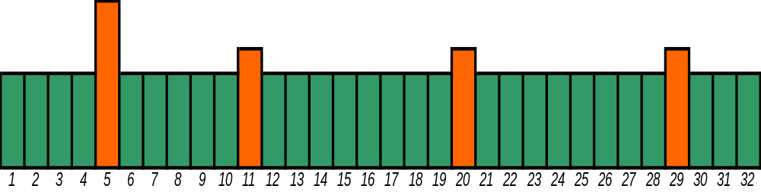
Parallelism – A Critical Assumption
Resources are best utilized if data can be uniformly distributed to each unit of parallelism (UoP)
Otherwise, query takes as long as the heaviest loaded UoP.
This one will finish last while the others are idle – known as a Hot AMP situation. This is caused by data skew.

Slide 13
The “Magic” of the Row Hash
Store rows in a table in row hash order (logically)
Direct access via Primary Index (PI)
  Hash the value
  Go directly to the row (routed by the BYNET)
Sort merge with no sort
  Joins which never require scans of the large table
  e.g. Star joins doesn’t need to hash join or spool the fact table and sort it to join
Used to distribute intermediate work
  Aggregation, joins, spools

Slide 14
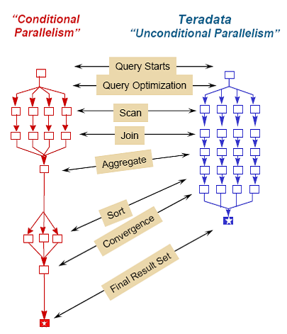
Optimizer Parallelization
Cost based optimizer
  Parallel aware
Rewrites built in and cost based
Parallelism is automatic
Parallelism is unconditional
Each step if fully parallelized
No single threaded operations
  Scans, joins, index access, aggregation, sort, insert, update, delete

Slide 15
Query Processing
Teradata SQL is ANSI compliant
  All functions, not just entry level
High performance algorithms
  Join, aggregation, sort
  Compiled expressions
Complex query features
  Derived tables, CASE expressions, all forms of sub-queries, Sampling …
  Big Limits – 64 table joins, 64 nesting levels
  1 MB (text) SQL / Views / Macros
The more complex, the better!

Slide 16
Query Processing
High Performance Views
  No penalty for using views
  Enables wide use for ease of use, security, privacy
Wide choice of indexes
  Unique and Non-Unique Secondary Indexes
  Dynamic Bit-Mapping
  Covered and Value Ordered
  Join, Aggregate Join and Sparse Join Indexes
Everything is Parallel
  No single threaded operations (scalability killers)
  Even schema operations are performed in parallel.
    Create table, create index, collect statistics…

Slide 17
Analytic Processing
A “new” type of SQL
    Queries that require an ordered set of rows
    With “report” breaks
    And qualification of result rows
    Plus availability of sum and count for the group
  With fully scalable algorithms
  SQL Functions just another result column
    Allows full query nesting
  For example, “Get me the bottom 1% of items sold by store…”
Move the processing from the reporting tool to the database
  Do the calculations where the data resides
  Only return the results set
  Using the parallel, scalable platform
  Rather than moving massive amounts of data, then performing the calculations

Slide 18
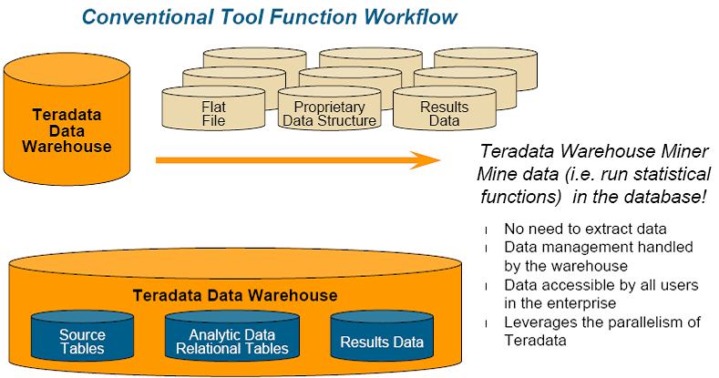
Teradata In-Place Data Mining

Slide 19
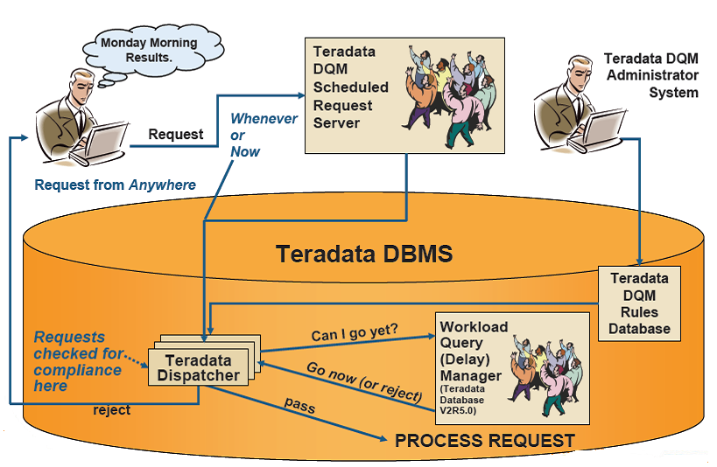
Teradata Dynamic Query Manager Overview

Slide 20
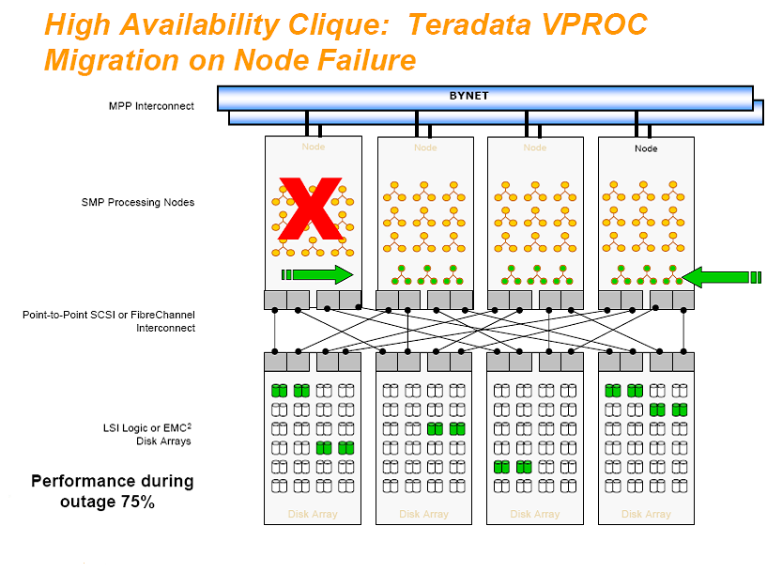
How Teradata Handles Node Failure

Slide 21
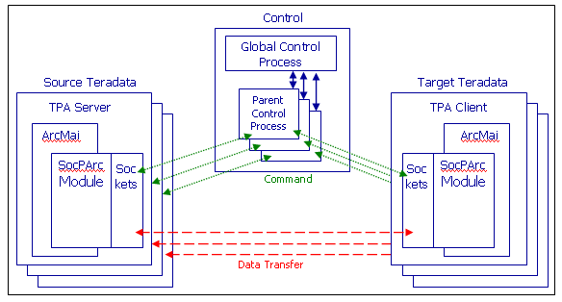
High Level Architecture – System Sync
Data Copy
Secondary
(WILDCAT)
Faster processors
Primary
(CARACAL)
Build & Ship Methodology
Analytic Data
(Derived Data: uas, esm, vcru, valve, gem)
Stage
Deeper Disk Drives
SocPArc
Acquisition
Acquisition
Stage
Load/Xform
Dual Load Methodology
Core Data
(Transactions: usr,bids,lstg,acct,chkout )
Acquisition
Load/Xform
Site
DMU Training: G:\Engineering\IT\InfoMgmt\Projects\Pre-Production\Teradata DR\4. Production Deployment\DMU Training.ppt

Slide 22
Questions?
Thank you for your attention!

