Slide 1




DynoScout 2024 eScouting Software Controllers Guide

Slide 2
Complete
Control Mapping

Slide 3
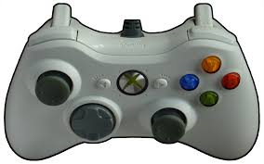
Auto Controls
Complete Transaction
Hold when Transacting: Flag
Acquire Loc
Exit Auto
Deliver
Leave
Hold + Press: HP in Amp
Hold + L/R: Robot Setup
X
Match Event
Hold + L/R: Select Scouter
Hold + U/D: Select Alt Scout
X
X
X

Slide 4
Tele-op Controls
Complete Transaction
Hold when Transacting: Flag
Enter Showtime
(& Start Climb Timer)
Acquire
Deliver
Press: Trap
Match Event

Slide 5
Showtime Controls
Complete Transaction
Hold when Transacting: Flag
Exit Showtime
Deliver
Press: Trap
Hold + L/R: Select End Status
Hold + L/R: Select Stage/Attempt
Hold + L/R: Select Strategy
Hold + L/R: Select Harmony
Match Event
X
Y
Stop Climb Timer
Hold : Reset Climb Timer
B
LT
A

