Slide 1
Prediction Of Droughts Using Machine Learning Algorithms
Maximilian See Tze Jie | 2102869A

Slide 2
Introduction
The pandemic, coupled with climate change and the Ukraine-Russian war, possess an ever-increasing threat to many developed and underdeveloped countries worldwide. To cushion the effects and help with the crisis, I have focused my research on the agricultural sector with regard to Predicting The Severity Of Droughts.

Slide 3
Data Preparation
Merging Of Datasets
Soil Data and Weather Conditions are being merged based on FIPS code. This allows us to have a visual representation and also information on not only weather but also soil quality in different parts of the country.
Transformation
Additional Columns On Severity and Soil Quality was added for data exploration. One-Hot-Encoding was used to further prepare the data for modelling
Data Cleaning
All null values were dropped date column was split into three categories, Year Month Day. All outliers outside of the IQR range were also dropped
Scaling
Scaling was implemented for feature selection and modelling. This is done to make variables share a similar scale. Scaling allows the algorithm to run faster. Scaling is also essential in distance based algorithms like KNN.

Slide 4
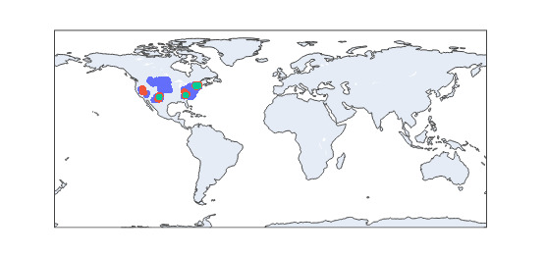
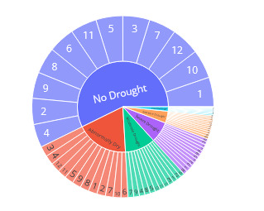
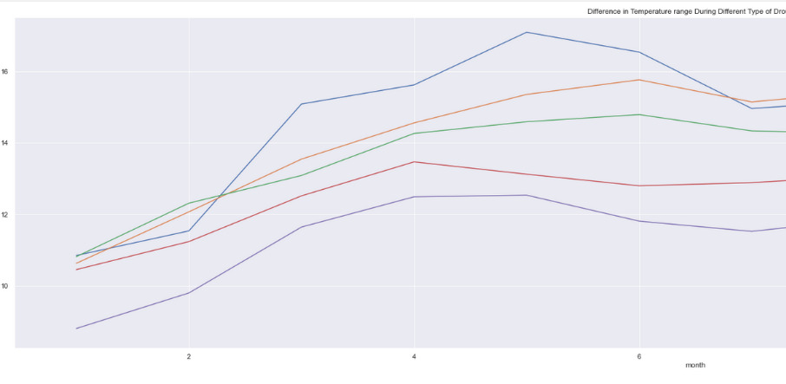
Data Exploration
Data Understanding
Most of our data is quantitative with soil quality being qualitative
Data Visualisation Techniques
Geolocation
Sunburst
Line Chart
Notes:
Data Visualisation Techniques
To allow easier interpretation and exploration binning has been implemented on the score column.
Segmentation of data into their respective Drought Severity allows us to view the conditions which may play a role in affecting Drought severity.
Geolocation identification using Plotly to view drought severity for a particular year
Geolocation of limitation of soil quality
Segmentation of data into their respective Drought Severity allows us to view the soil quality in the different levels of drought severity and deduce if they play a part.
If there is a difference in soil quality what role does It play In drought severity?
If there is a difference in a climate variable what role does it play in drought severity?
Sunburst to measure distribution.
Line chart to find relationship
Geolocation to understand the areas worse affected
They all play a part in understanding the data and finding interesting relationships between the features and its characteristics.

Slide 5
Methods
Decision Tree Algorithms Along With KNN & Regression Algorithms
Decision Tree Algorithms would be mainly used for this dataset Decision Trees are supervised learning methods used for classification and regression. Other complimentary algorithms such as KNN (Supervised) and Ensemble Learning Methods are chosen to ensure better representation. Our main goal is to create a model that predicts the value of a target variable by learning simple decision rules inferred from the given data. Decision trees and KNN consist of a few hyperparameters. The models will first use the default settings for the hyperparameters.
Notes:
Extensive models have been evaluated and chosen to further explore which models are the best for our data.
One of the lessons thought us to use as many models as possible
Some models we have used are XGB LGBM and Catboost, all are complex algorithms with its own unique characteristics.

Slide 6
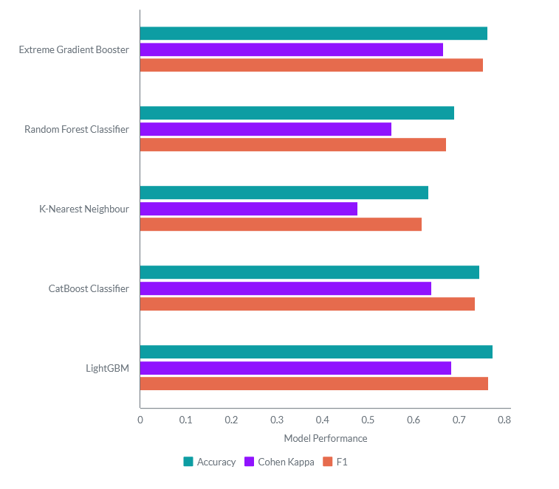
Model Development
Findings
The models performed reasonably well with only KNN and Random Forest performing poorly,
The average accuracy was around 0.695.
The highest accuracy is held by LGBM with 0.775
Cohen Kappa score is average for most models but the worse was KNN along with Random Forest with 0.479 & 0.553
Notes:
Overall score for models with no improvements are around 69.5 % which is still a okay accuracy score but not good enough to be accepted. Much much more improvements could be main such as SMOTE ad KNC or NCR

Slide 7
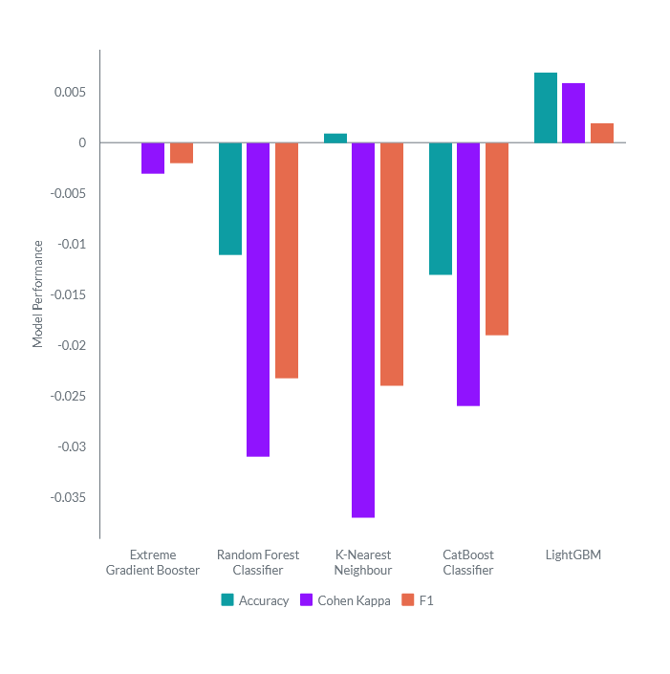
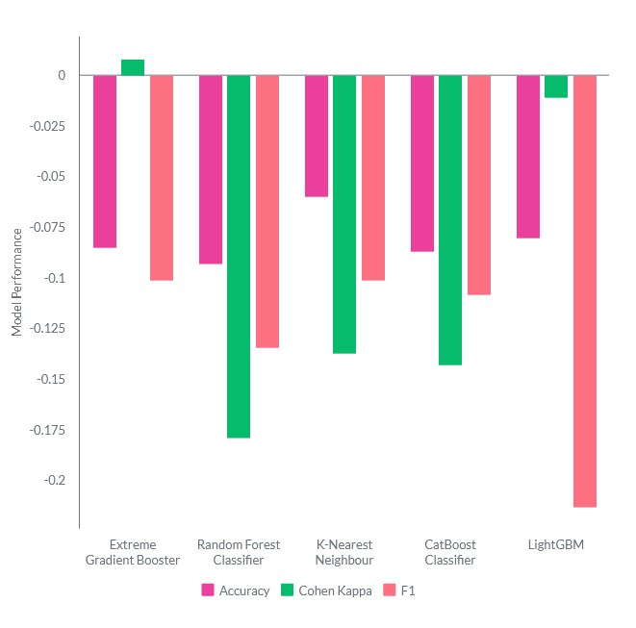
Improvements
SMOTE
KNC
RFECV
Used to find the most relevant feature for model development
SMOTE & KneighboursCleaner
SMOTE and KneighbourhoodCleaner generally saw a decline In overall performance.
KneighbourhoodCleaner saw the greatest decline in performance.
LGBM gained a little more accuracy, Copen Kappa and F1 score for SMOTE
GridSearchCV()
Grid Search was implemented to find the best hyperparameters for each model. Best Models were noted
Notes:
It might look like SMOTE performed badly, but enlarging the picture it allows us to see that the drop in performance is minor compared to KNC. This shows that SMOTE is the clear choice to go as it produces the least performance drop. Interestingly, After resampling, Cohen Kappa or F1 did not increase for most models..

Slide 8
Results & Analysis
GridSearchCV + SMOTE
Only the best models from SMOTE were chosen to have their hyperparameters tuned. The best models were analysed here

Slide 9
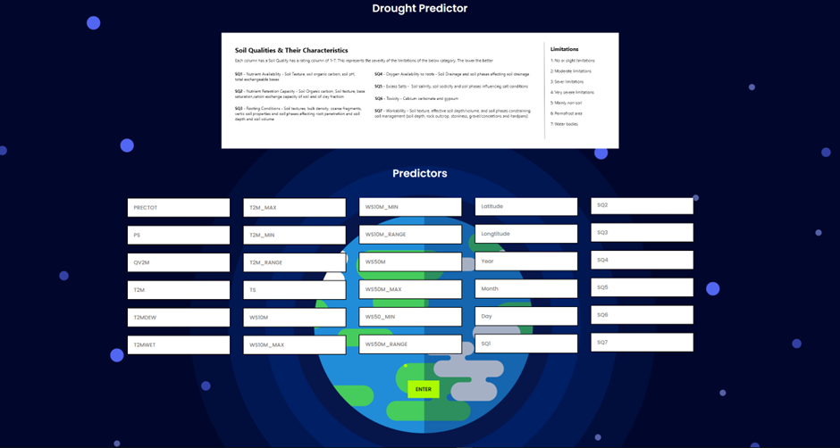
Conclusion
Gained a deeper understanding of what is our data
Gained insights from the data via EDA
Developed models and improved upon them using various techniques
Chose the best model for deployment
Deployment
“ The weather is the weather. You must deal with whatever is out there. ”

Slide 10
References
https://www.statisticssolutions.com/free-resources/directory-of-statistical-analyses/pearsons-correlation-coefficient/
https://towardsdatascience.com/machine-learning-basics-with-the-k-nearest-neighbors-algorithm-6a6e71d01761
https://catboost.ai/en/docs/references/training-parameters/common
https://www.kaggle.com/code/akshayasrinivasan2/drought-prediction-using-ml-algorithms
https://www.analyticsvidhya.com/blog/2017/06/which-algorithm-takes-the-crown-light-gbm-vs-xgboost/
https://openaccess.thecvf.com/content_ECCVW_2018/papers/11133/Wang_ESRGAN_Enhanced_Super-Resolution_Generative_Adversarial_Networks_ECCVW_2018_paper.pdf
https://www.kaggle.com/code/akshayasrinivasan2/drought-prediction-using-ml-algorithms
https://lightgbm.readthedocs.io/en/latest/Parameters-Tuning.html
https://medium.com/all-things-ai/in-depth-parameter-tuning-for-gradient-boosting-3363992e9bae
https://www.statisticshowto.com/probability-and-statistics/correlation-coefficient-formula/spearman-rank-correlation-definition-calculate/
https://scikit-learn.org/stable/modules/generated/sklearn.neighbors.KNeighborsClassifier.html
https://towardsdatascience.com/essential-things-you-need-to-know-about-f1-score-dbd973bf1a3

