Slide 2


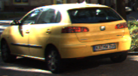










Preprocess
Train
Validate:
Find False Positives
Retrain:
Add more negative examples

Slide 3
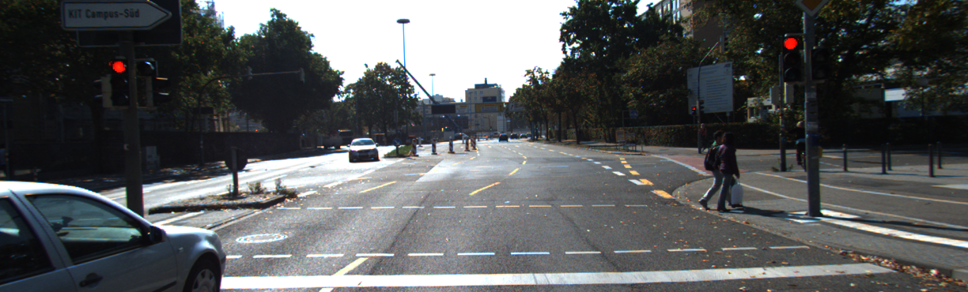
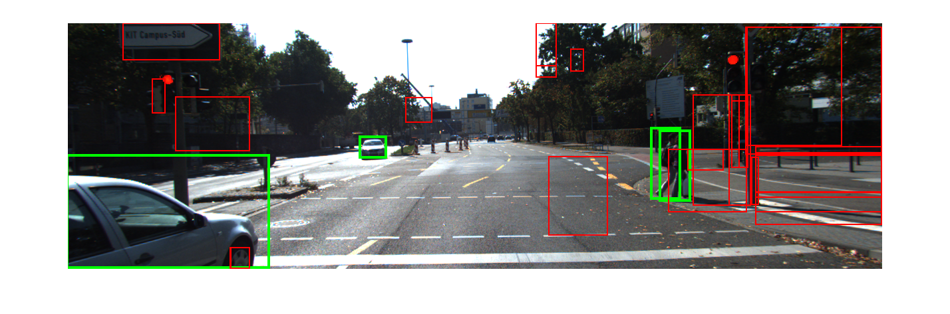
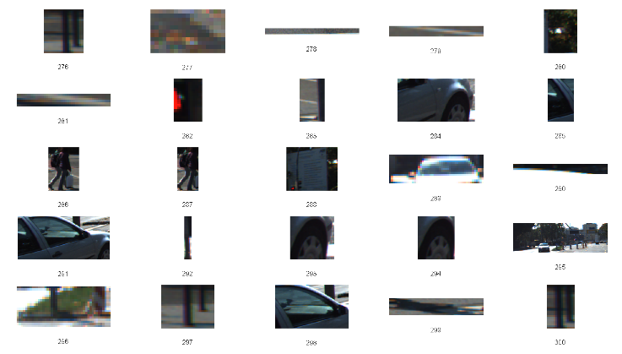
Extract Features
Weak Classifier:
Generate proposals
Strong Classifier:
Classify and locate bounding box

