Slide 1
Data Visualization Project BEA Data and Charts
Tanya Shen
Web Specialist at BEA and CDS Detailee
Notes:
Background blue = #265994

Slide 2
Project Description
Automation of the process on how to create charts. From an Excel spreadsheet, pull out the actual data and put them into a chart to illustrate a BEA news release.
Chart styles are bar charts, line graphs, and maps.
GDP, PI, Trade, and Transaction are press lock-up news releases. The automation process reduces stress during lockup hours, reduces labor and human errors before and during lockup hours, increases consistency on BEA website.
During lock up, we do not have any connection to the outside of the lockup room. We stay on local without network connection, the Internet, phones. This project is designed to work locally.

Slide 3
Method and Tool
Tool: JavaScript, C Sharp, Plotly
Method:
JavaScript plots a chart. C# does the automation process.
C# pulls data from a GDP Excel file, and updates the JS file.
Plotly builds the JS file. Then we modify the JS file to fit requirements of the chart.

Slide 4
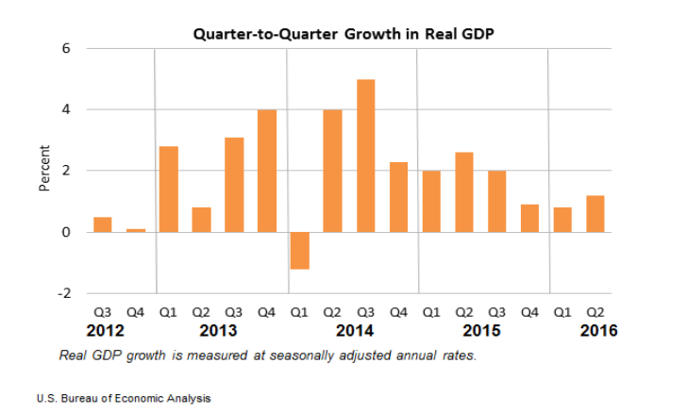
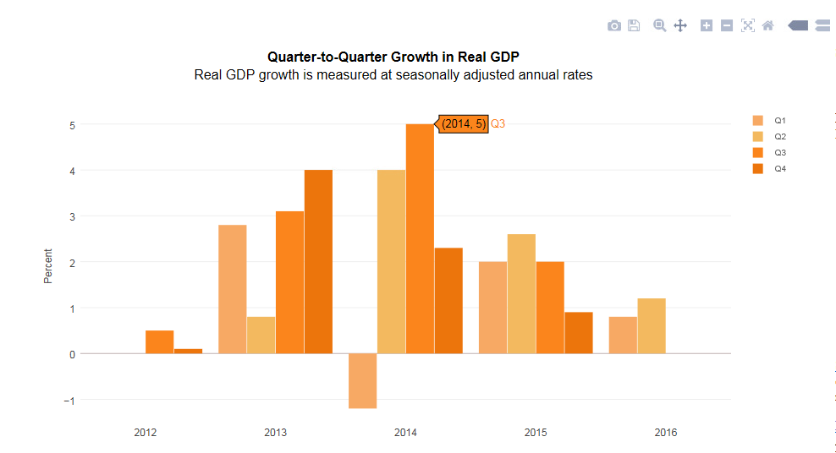
D3 (Dynamic Data Display) GDP chart
Current GDP chart on BEA website
New D3 GDP chart

Slide 5
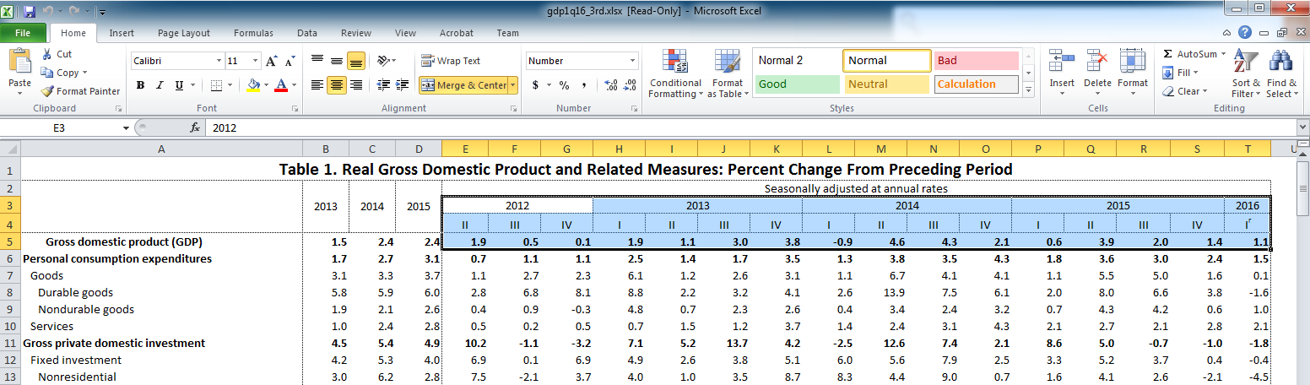
Automation: retrieve data from GDP excel file and update the JS file that plots GDP chart

Slide 6
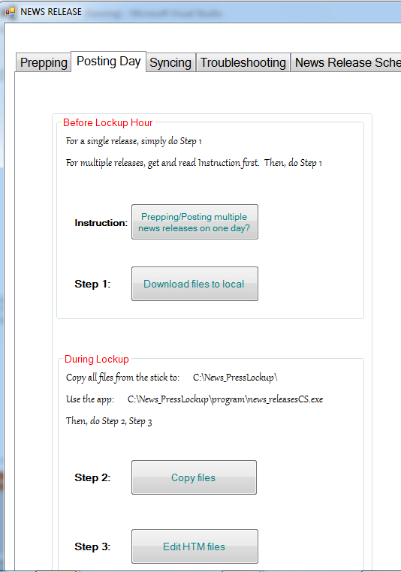
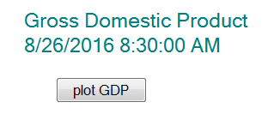
Automation: “plot GDP” button from the News Release-C# program plots GDP chart
When D3 GDP chart is launched to production, “plot GDP” button will be merged into “Step 2” of the “During Lockup” area.

Slide 7
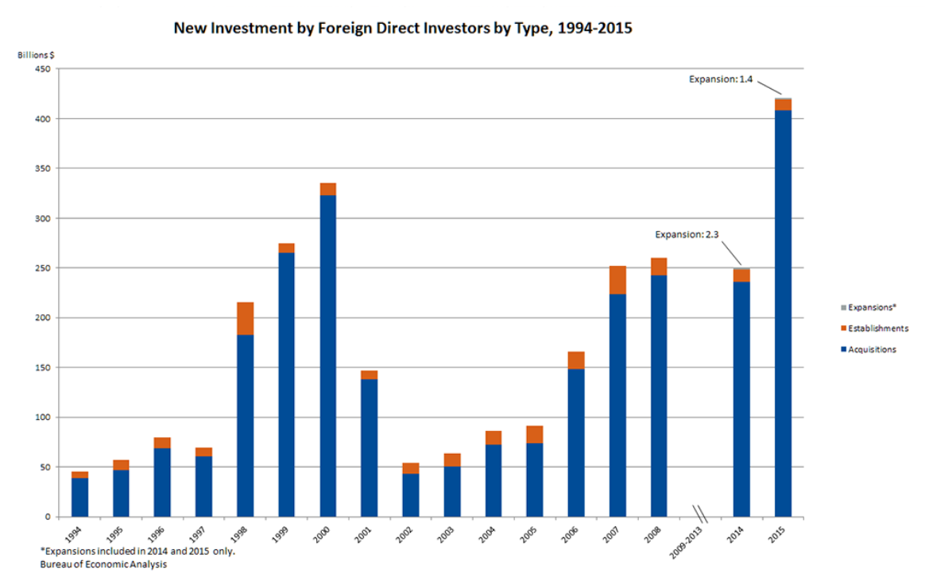
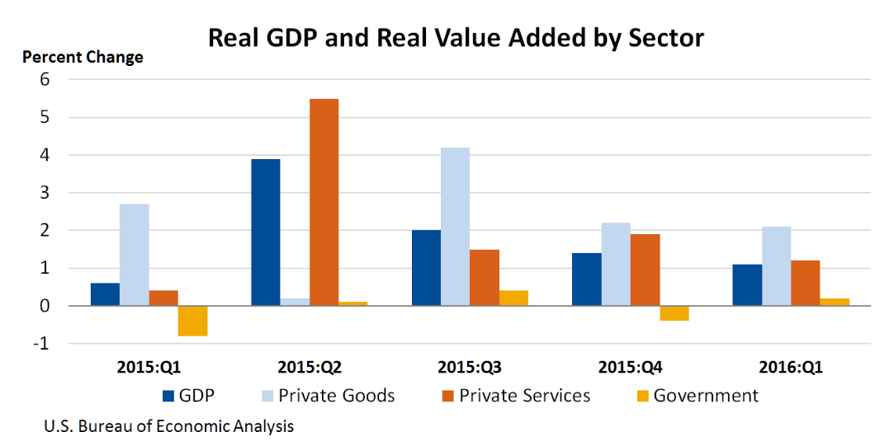
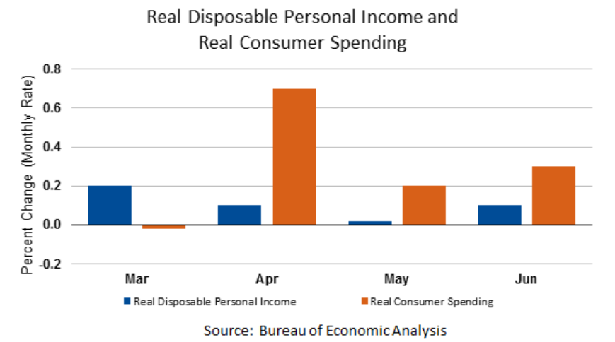
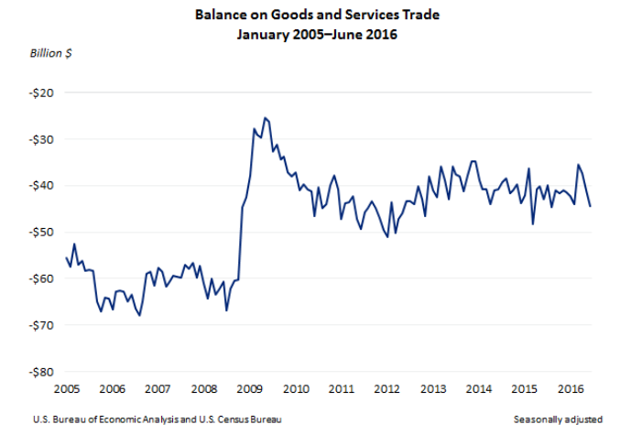
Other BEA charts in D3
Notes:
Foreign Direct Investment, Personal Income, GDP by Industry, International Trade in Goods and Services

Slide 8
Benefit of Participating in the Data Academy
Learned data visualization. Learned JavaScript, Python, Slack, and GitHub.
Learned how to tell stories with data.
Ability to plot interactive, D3, three dimension charts.
Help my agency to display charts with a more modern look using an automatic process.

