Slide 1
Test case prioritization with RL

Slide 2
What is the original paper about
They have a dataset of a test execution info for different programs.
Depending on the program and the test, executing these tests can take a lot of time.
So it makes sense to come up with a way to prioritize tests.
Run the tests that are more probable to fail first.
Run the tests that take a less time to run first.
They proposed to do this with RL.
To do so, they created some gym environments which follows the RL env paradigm
Each environment has states, steps, actions, and rewards

Slide 3
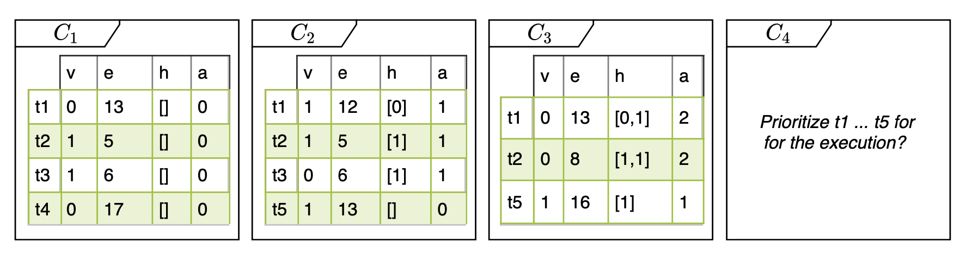
What is the original paper about
Each test case has two feature records:
Execution history (v, e, h, a):
V is the verdict: whether test was successful (0) or not (1).
E is the execution time.
H is the history record. Verdicts of this case in previous runs.
A is age. How many times this test was conducted.
Code base features: implicit in the data.

Slide 4
What is the original paper about
The have designed the environments as MDPs:
States: a list of tests to execute.
Action: sorting these tests.
Next state: another list of tests.
Reward: a measure of how good this sorting was (listwise, pointwise, pairwise).
They use APFD and NRPA to measure sorting
APFD (Average Percentage of Faults Detected): measures the weighted average of the percentage of faults detected by the execution of test cases in a certain order.
NRPA (Normalized Rank Percentile Average): how close a predicted ranking of items is to the optimal ranking.
And they are NOT related to each other.

Slide 5
What is the original paper about
The idea with the environments was smart ngl.
Instead of designing their own RL agents, they used stable baselines.
They would give the environment and data to a baselines agent and train it.
Testing was done on all the other cases in the environment to see how good the agent has learned.
Their results seem to be good as well.

Slide 6
What was our idea
During my masters I played around with hyperparameter optimization.
I also used Population Based Training (PBT).
Exchange models and hyperparams between agents in a population.
It can affect training and final results by a large margin.
In their code, they are using default hyperparameters to train the agents.
So based on our experience, we thought that PBT on this problem would results in better results.
Spoiler: it didn’t

Slide 7
What did I do
To do PBT, one must be able to interrupt training to exchange models and hyperparameters.
Stablebaselines2 which was used by them, is based on TF1.
TF1 does not allow any interruption in training after it has begun.
The only option was saving the models and hyperparams and then create new agents.
This doesn’t work since all optimizer information is lost.
So first step was migrating the code from SB2 to SB3 which is based on PyTorch.
Took around a month.

Slide 8
What did I do
After migration, PBT operations needed to be coded.
The implementation needed to be parallelized, else it would not be feasible.
SB3 does not support parallelized training.
It may be a bug of PyTorch.
Designing a workaround took a lot of time.
About a month.
I ran multiple experiments on Niagara.
Two weeks.

Slide 9
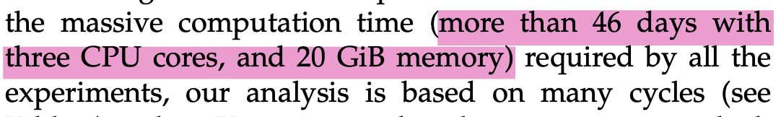
What did I do
Niagara has a 24 hour limit on running scripts.
I was limited on the scenarios I could run.
Most scenarios take A LOT of time for one complete run.
The results I got were not what I hoped they would be.
I reviewed the code from scratch to make sure I didn’t make any mistakes.
Two weeks was wasted here.

Slide 10
Talk is cheap, show me the results
My PBT operation is comprised of 80 agents.
Each agent has a randomly chosen learning rate and discount factor.
Exploration and exploitation happens in one sweep intervals.
After all the agents are finished, they are sorted descendingly by their APFDs.
I take the best 20% and the worst 20%.
The models and hyperparameters of the best 20% replace the worst’s.
After copying, the hyperparams of the worst are multiplied randomly by a number between 0.8 and 1.2.
This is done until training is finished.

Slide 11
Talk is cheap, show me the results
No matter how different the learning rates and discount factors are, the results between agents in the population don’t change.
An agent with a 0.0005 learning rate and 0.99 discount factor has the same results as an agent with a 0.0001 learning rate and 0.7 discount factor.
This goes against everything I learned and worked with in both NNs and RL.
Learning rate and discount factor are two of the most important hyperparams in DRL.
Changing any of these has drastic results but nothing is happening here.
So, something wasn’t right.

Slide 12
Talk is cheap, show me the results
I contacted the authors, their response was enlightening.
They are not using rewards for training their agent 🚩.
The metrics that they’re using (APFD and NRPA) are calculated during testing, not training.
Each step in the environment is one sweep of multiple tests 🚩.
There is no distinction between different tests and their relation.
I found a way to extract the rewards from environments.
They change between agents even though their APFD and NRPA are the same 🚩.
I also have dead agents.
This means my PBT is working correctly.

Slide 13
So?
This is not an RL problem.
At least not the way they have designed it.
Their results are good but I have no idea how they have gotten these results.
My results are the same even though my hyperparams are vastly different.
Again, this makes no sense.
I don’t know where to go next.

Slide 14
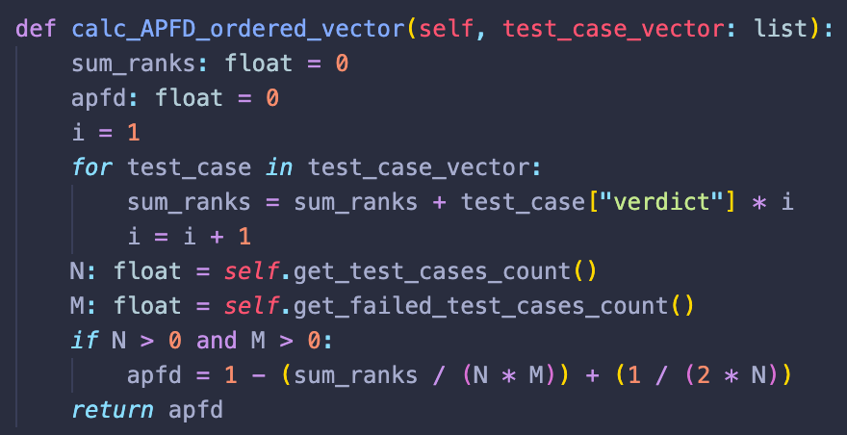
Lies and Deceit
I - For measuring the quality of sorting, we need a good KPI.
In the case of this work, the results are cleverly forced.
APFD is defined as a measure to calculate the quantity of sorting the test cases.
Problem is, there is no correct baseline for it.
In this work, APFD is calculated from sorting over predicted verdict. Hence, the sorting results will always be very close. That’s why APFD doesn’t change.

Slide 15
Lies and Deceit
II - For something to be framed as an RL problem, it needs to conform to the episodic environment paradigm.
Just going (state, action, reward) does not make it episodic.
The states need to have a relationship with each other.
It can be temporal, or causal. But there must be a connection.
The entire point is for the agent to learn such connections to make correct decisions.
Here’s how they’ve designed their environments.
State: ID of a test case, the time it took to run it and some other variables.
Action: predict where in the list the test case goes. (I’ll expand this)
Reward: pointwise, listwise, pairwies. Which has nothing to do with the final sorting. Except for listwise, there is no signal to provide insight to the agent.
Again, there is no relation between the states.

Slide 16
What are you trying to say?
Based on how this experiment designed, no matter what we do, we will have the same results that they did.
What about those RL KPIs that I told you to look into?
“Instead of ordering the test cases by 1s and 0s, count the number of fails and successes given a fixed time window”.
It will not make any sense for two reasons:
We don’t have a baseline to compare our results to.
“Then run their code with this environment code and compare the results!”
Can’t because their environment just predicts orderings. Not failures or successes (except for pointwise).
“Instead of ordering the test cases by 1s and 0s, measure the time it takes to find a fixed number of failures or successes”
Same as above

Slide 17
So what? Just give up?
My answer is yes.
Their code is not an RL code. It is just something that looks like one.
To turn it into an RL problem, we need to:
I - Design states so that they can be related to each other.
II - Design a reward function which signals the agent about the quality of its action correctly.
III - Design the actions.
IV - Come up with a new KPI which makes sense and is correct.
V - Then do everything else.
Above steps can be done but I personally don’t think it’ll be worth it.
It is a large coding and design problem which takes a lot of time.
Our final results may be even worse that theirs.

