Slide 1
Sales Forecasting for Retail
Domain: Data Science
By: Saksham Rawat
B.Tech CSE

Slide 2
Problem Statement
• Retail sales vary over time
• Poor forecasting leads to:
- Overstocking
- Stock shortages
Objective:
Predict future sales using historical data

Slide 3
Dataset Description
• Walmart Sales Dataset
• Features:
- Date
- Store
- Weekly Sales
- Holiday Flag
- CPI, Unemployment

Slide 4
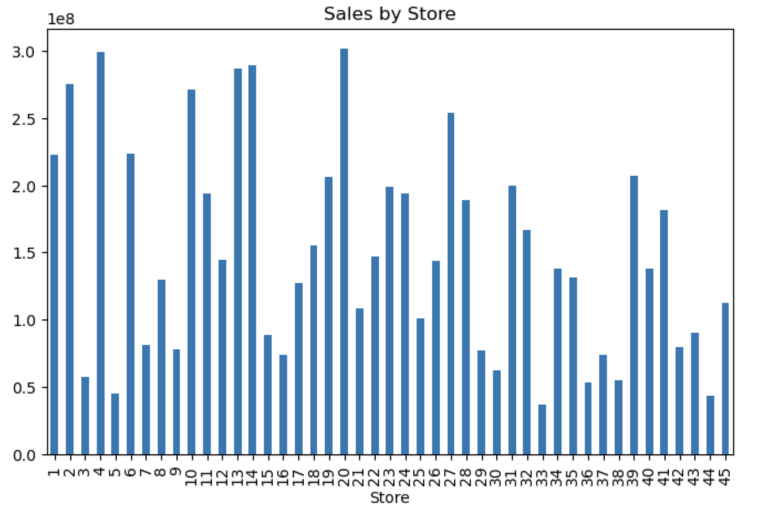
Exploratory Data Analysis
Store-wise variation

Slide 5
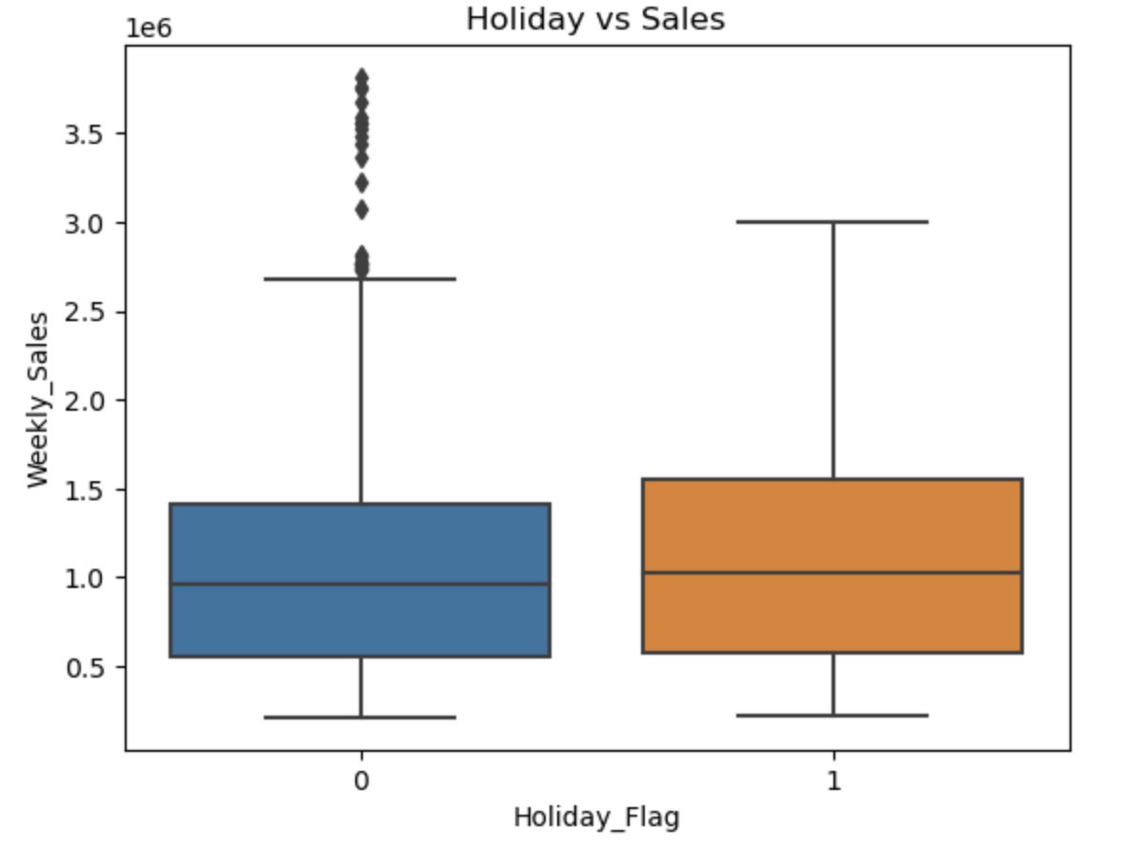
Holidays impact sales

Slide 6
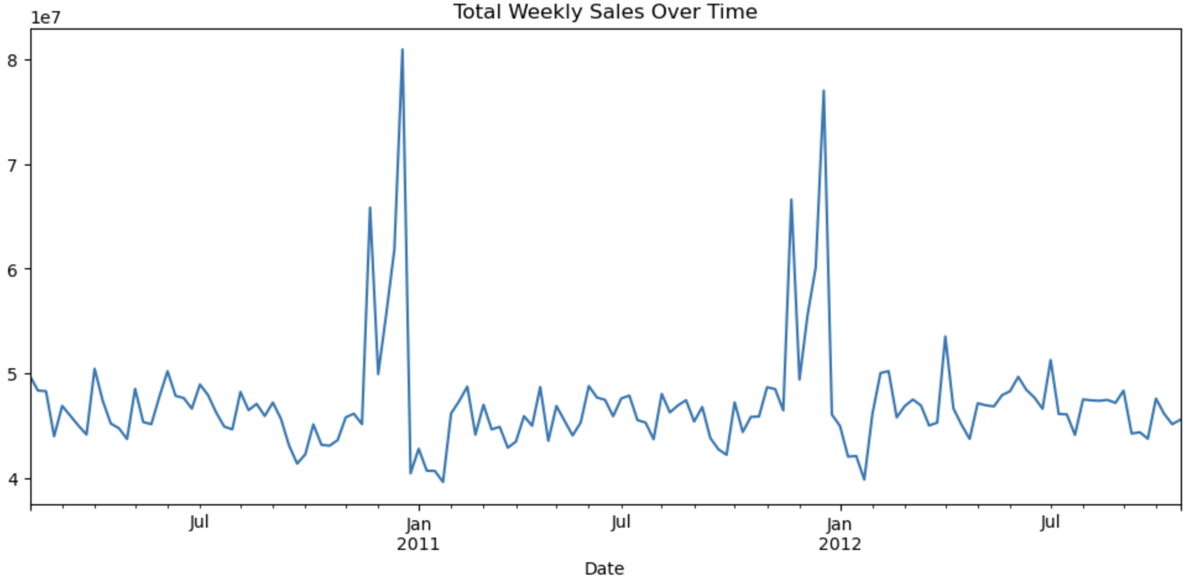
Seasonal trends observed

Slide 7
Feature Engineering & Model Used
Extracted:
- Year, Month, Week
Created lag feature:
- Previous week sales
Random Forest Regressor
Reasons:
- Handles complex patterns
- Reduces overfitting
- Works well with structured data

Slide 8
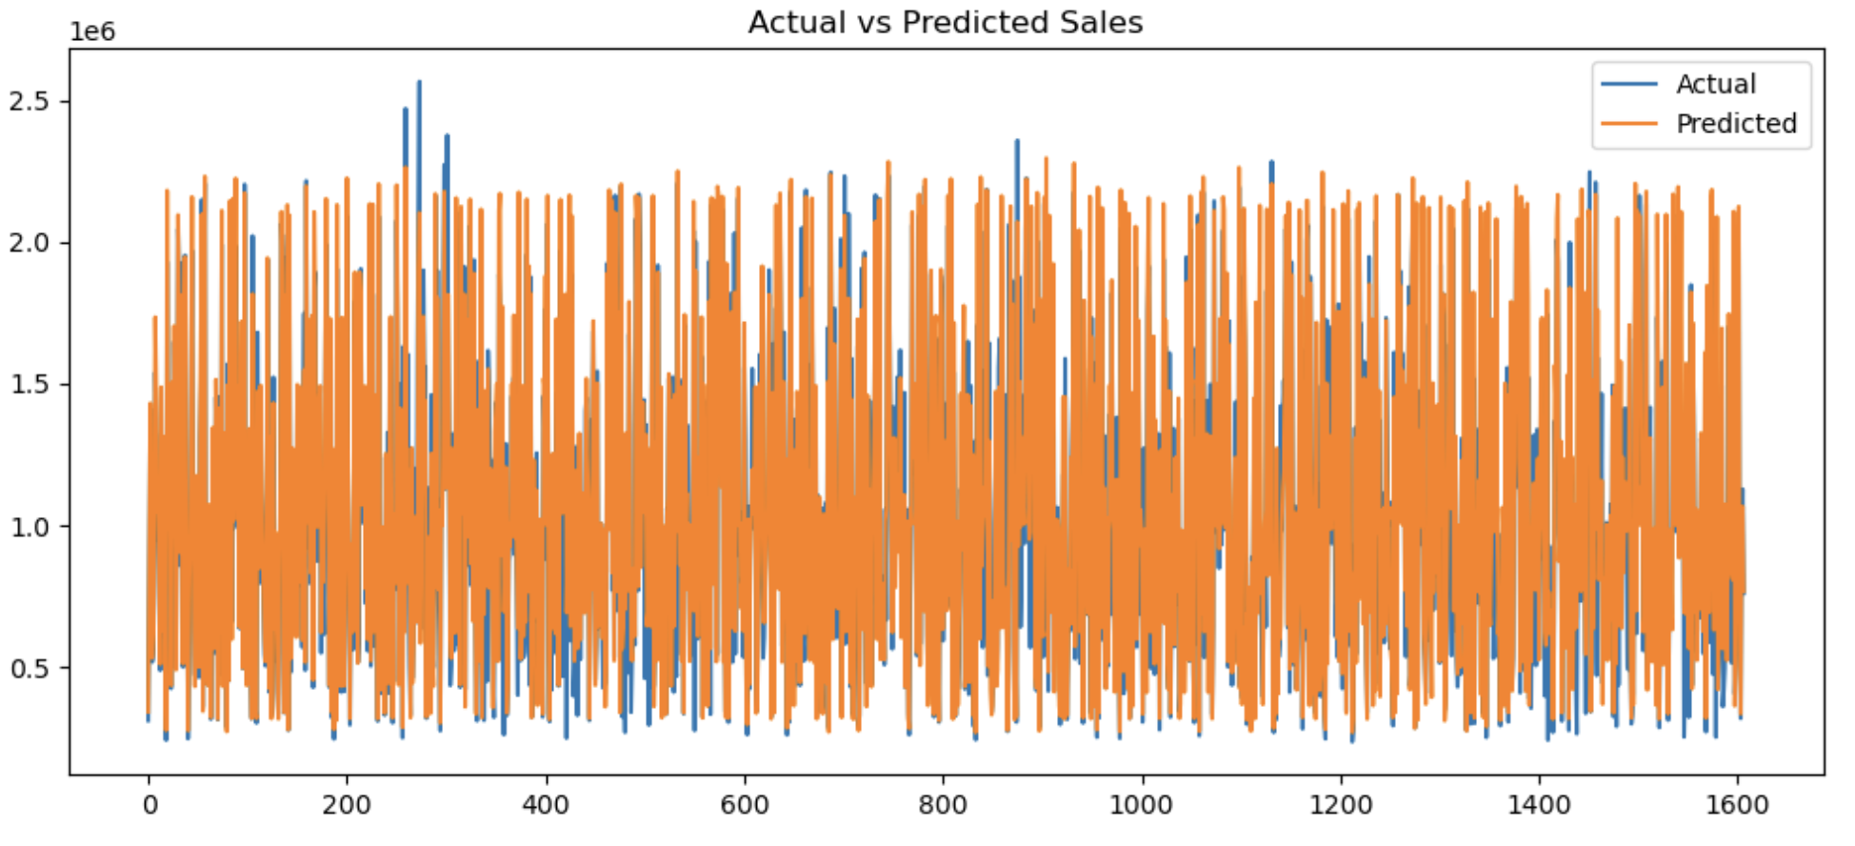
Results & Evaluation
Metric: RMSE

Slide 9
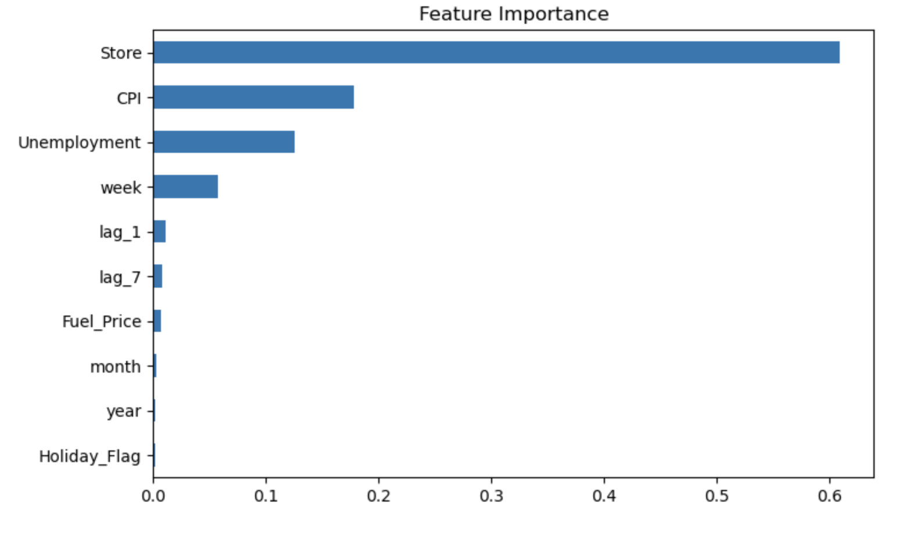
Feature Importance
Store is most important feature

Slide 10
Conclusion
Sales forecasting using ML is effective
Store plays major role
Model gives useful insights
FUTURE SCOPE
Use advanced models (XGBoost, ARIMA)
Add more features (promotions, weather)

Slide 11
Thank You

