Slide 1
FLAIR
The Federated External-Validation Network for ICU AI
Federated Learning Assessment for ICU Research
CLIF Consortium · FLAIR Working Group
MIMIC-CLIF · Rush · Northwestern Medicine · UChicago Medicine
278,065 ICU stays
FLAIR: Federated ICU Benchmark on CLIF 1

Slide 2
ICU AI has a trust bottleneck
Models for sepsis, extubation, mortality, and operations appear faster than evidence can validate them.
A strong internal AUC does not answer the clinical-scientific question.
The hard part is proving whether a model works somewhere it was not built.
FLAIR turns that question into a repeatable network test.
FLAIR: Federated ICU Benchmark on CLIF 2

Slide 3
The one-line value proposition
Develop models on public MIMIC-CLIF.
Validate them across independent hospitals.
Keep patient-level data inside each institution.
The model goes to the data. Only aggregate, cell-suppressed reports come back.
FLAIR: Federated ICU Benchmark on CLIF 3

Slide 4
The result that makes this urgent
Sepsis AUROC, frozen MIMIC-trained baseline:
MIMIC-CLIF internal: 0.697
Rush: 0.430
Northwestern Medicine: 0.449
UChicago Medicine: 0.440
A model that looked useful on public ICU data became worse than chance on the highest-stakes task at every external health system.
FLAIR: Federated ICU Benchmark on CLIF 4

Slide 5
Public benchmarks are necessary, but not sufficient
Public ICU benchmarks centralize test data; FLAIR federates testing at hospitals.
Public benchmarks are ideal for development; FLAIR adds external validation under real institutional variation.
Public test sets can saturate; FLAIR evaluation data never enter public hands.
FLAIR complements MIMIC, eICU, HiRID, YAIB, EHRSHOT, and MEDS.
FLAIR: Federated ICU Benchmark on CLIF 5

Slide 6
External validation is too slow today
Independent EHR validation usually requires one-off data-use agreements, local analyst time, and repeated reimplementation.
Flagship systems have taken years to reach only a handful of sites.
The Epic Sepsis Model fell to AUC 0.63 in independent evaluation, against vendor-claimed 0.76-0.83.
FLAIR changes the unit of work: from bespoke bilateral studies to a standing model-to-data protocol.
FLAIR: Federated ICU Benchmark on CLIF 6

Slide 7
The infrastructure gap: no standing ICU validation network
OHDSI / LEGEND federates OMOP studies, not an ICU benchmark catalog.
OpenSAFELY moves analytic code to secure data, but not critical-care model benchmarking.
MedPerf and FeTS prove model-to-data and federated training in imaging.
DREAM and EHR DREAM show challenge-style model-to-data evaluation.
Missing for ICU EHR: CLIF standardization + reusable, extensible tasks + governed federated evaluation.
FLAIR: Federated ICU Benchmark on CLIF 7

Slide 8
FLAIR is three coupled products
Data layer: CLIF critical-care standard plus public MIMIC-CLIF entry point.
Task layer: five inspectable Python tasks today; open, governed, PR-extensible catalog.
Protocol layer: committee-reviewed model-to-data execution with aggregate-only reports.
This is not another ICU model. It is the evidence layer models must pass through.
FLAIR: Federated ICU Benchmark on CLIF 8

Slide 9
FLAIR is open infrastructure for ICU evaluation standards
Open-source task definitions, feature contracts, report generation, and evaluation protocol.
A common way to define cohorts, prediction times, labels, splits, metrics, report bundles, and audit metadata.
New tasks are added as inspectable Python modules, not one-off private benchmark forks.
Contributions require MIMIC-CLIF reproducibility, clinician review, and multi-site governance sign-off.
Reusable, auditable, extensible ICU AI evaluation across the CLIF community.
FLAIR: Federated ICU Benchmark on CLIF 9

Slide 10
What each stakeholder gets
Model developers: credible external evidence without acquiring private ICU data.
Hospitals: local control, no patient-row sharing, comparable reports.
Journals and reviewers: audit hashes, reproducible task code, cohort summaries, confidence intervals, calibration where meaningful.
CLIF consortium: a high-value use case that makes CLIF adoption immediately useful.
Patients and public: less reliance on one-hospital claims.
FLAIR: Federated ICU Benchmark on CLIF 10

Slide 11
Why CLIF makes the network possible
CLIF maps ICU EHR content into shared relational tables and mCIDE categories.
Task code refers to shared table names and category values, not local EHR idiosyncrasies.
MIMIC-CLIF expresses MIMIC-IV in CLIF v2.1 with approximately 72,800 ICU stays.
Developers debug publicly, then run the same task/model contract across private CLIF sites.
CLIF is the portability layer. FLAIR is the validation layer.
FLAIR: Federated ICU Benchmark on CLIF 11

Slide 12
Developers can plug in at the representation they need
CLIF-native features: direct table-based extraction for models that operate on CLIF relations.
MEDS event stream: optional event-sequence export for MEDS-native pipelines.
Wide table: YAIB-style matrix for classical ML and one-row-per-prediction workflows.
FLAIR standardizes the task and evaluation contract, not the model architecture.
Model teams can use their preferred representation as long as outputs meet the prediction-file contract.
FLAIR can assist with supported data formats; the model owner controls feature engineering and modeling choices.
FLAIR: Federated ICU Benchmark on CLIF 12

Slide 13
The initial catalog covers decisions ICUs actually face
T1 ICU daily mortality — daily 07:00 — landmark — prevalence 0.125
T2 LTACH discharge — daily 07:00 — landmark — prevalence 0.062
T3 Extubation failure 24 h — at extubation — episodic — prevalence 0.054
T4 Sepsis (CDC ASE) 6 h — hourly — peak — prevalence 0.061
T5 Unplanned ICU readmission — ICU discharge — episodic — prevalence 0.093
One Python module per task; catalog acceptance requires MIMIC reproducibility, clinician face validity, and two-site sign-off.
FLAIR: Federated ICU Benchmark on CLIF 13

Slide 14
Sepsis is the stress test
CDC Adult Sepsis Event within 6 hours on an hourly, hospital-wide grid.
The prediction window ends strictly before onset: no future treatment signal.
Peak scoring collapses each stay to maximum risk, matching one-alarm operational use.
It is rare, high-stakes, and sensitive to practice-pattern shift.
If a sepsis model fails across hospitals, the field needs to know before deployment.
FLAIR: Federated ICU Benchmark on CLIF 14

Slide 15
Where FLAIR fits in the AI/CDSS lifecycle
Cohort + task: decide who is included, when prediction happens, and what counts as the outcome. FLAIR standard, community-extensible.
Feature engineering: turn clinical history into model inputs using CLIF-native, MEDS, or wide data. Model owner; FLAIR assists with formats.
Model development: train, tune, document, and freeze the algorithm. Model owner.
Federated evaluation: run the frozen artifact locally at each site using the same task and metrics. FLAIR protocol; site-approved.
Evidence report: return comparable, aggregate, cell-suppressed performance summaries. FLAIR report standard.
Encapsulation makes evaluation faster and cleaner: shared task logic, private models, repeatable reports.
FLAIR: Federated ICU Benchmark on CLIF 15

Slide 16
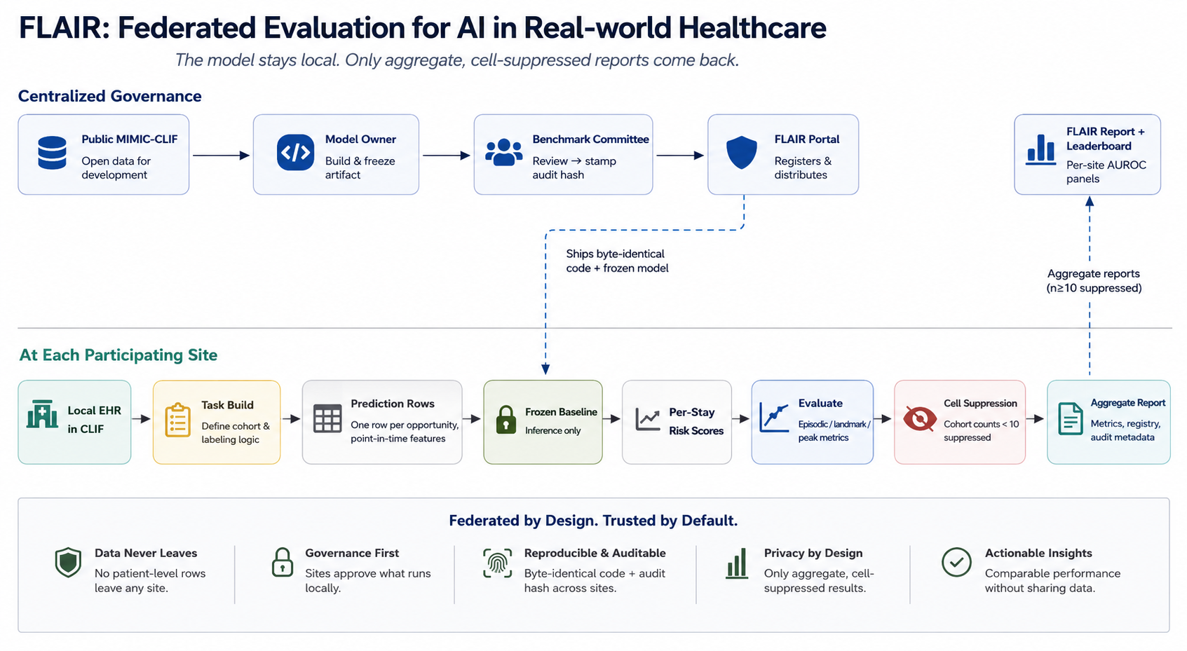
The model-to-data loop
Central governance approves and stamps the artifact; each site runs it locally on CLIF; only aggregate, cell-suppressed reports return.
FLAIR: Federated ICU Benchmark on CLIF 16

Slide 17
Governance is part of the product
Benchmark Committee reviews reproducibility, clinical face validity, task fit, and security.
Sites retain final approval over what runs locally.
Every report includes task hash, package version, split, report mode, n, prevalence, and threshold.
Counts below 10 are suppressed; sparse subgroups and calibration bins are withheld.
The network is usable because trust, review, and suppression are built in.
FLAIR: Federated ICU Benchmark on CLIF 17

Slide 18
Comparability safeguards make results credible
Stitched hospitalizations: fragmented clinical episodes are joined into one unit.
Strict point-in-time features: only data at or before prediction_dttm are used.
Pseudo-prospective external splits: oldest 75% train, newest 25% test at each site.
Audit hashes: sites can prove byte-identical task code and policy metadata.
FLAIR: Federated ICU Benchmark on CLIF 18

Slide 19
Evaluation matches the way a task is used
Episodic tasks: AUROC, AUPRC, ROC/PR curves, calibration, decision curves, subgroup AUROC.
Landmark tasks: per-landmark AUC curve plus pooled dynamic AUC, lead-time and skill plots.
Peak tasks: discrimination and subgroup metrics; calibration/DCA omitted to avoid peak-calibration distortion.
FLAIR measures operational behavior, not just row-level discrimination.
FLAIR: Federated ICU Benchmark on CLIF 19

Slide 20
The reference baseline is deliberately shippable
One frozen XGBoost model over point-in-time count features.
CLIF events map to a fixed 211-code Event List Format vocabulary.
Counts include only codes strictly before prediction time; units and discharge diagnoses are excluded.
Hyperparameters tuned once on MIMIC-CLIF; model and dictionary ship unchanged to sites for inference only.
The baseline is not the product. It exposes transport behavior.
FLAIR: Federated ICU Benchmark on CLIF 20

Slide 21
Four reporting sites; four onboarding
MIMIC-CLIF: 72,778 ICU stays; female 43.2%; age 67; SOFA 5.
Rush: 53,356 ICU stays; female 47.8%; age 63; SOFA 4.
Northwestern Medicine: 114,335 ICU stays; female 44.0%; age 66; SOFA 5.
UChicago Medicine: 37,596 ICU stays; female 43.5%; age 61; SOFA 6.
Consortium sites 5-8: onboarding placeholders.
278,065 ICU stays across four independent reporting health systems.
FLAIR: Federated ICU Benchmark on CLIF 21

Slide 22
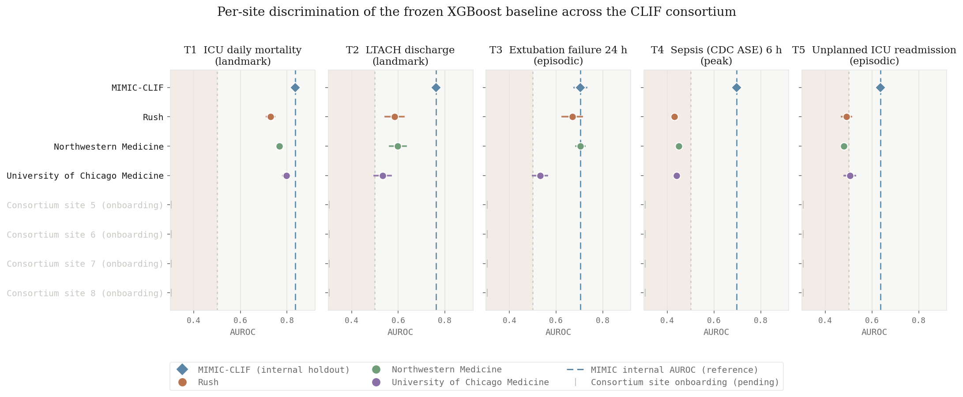
Per-site performance is the headline product
A single pooled AUROC would hide the story. FLAIR makes the per-site spread visible.
FLAIR: Federated ICU Benchmark on CLIF 22

Slide 23
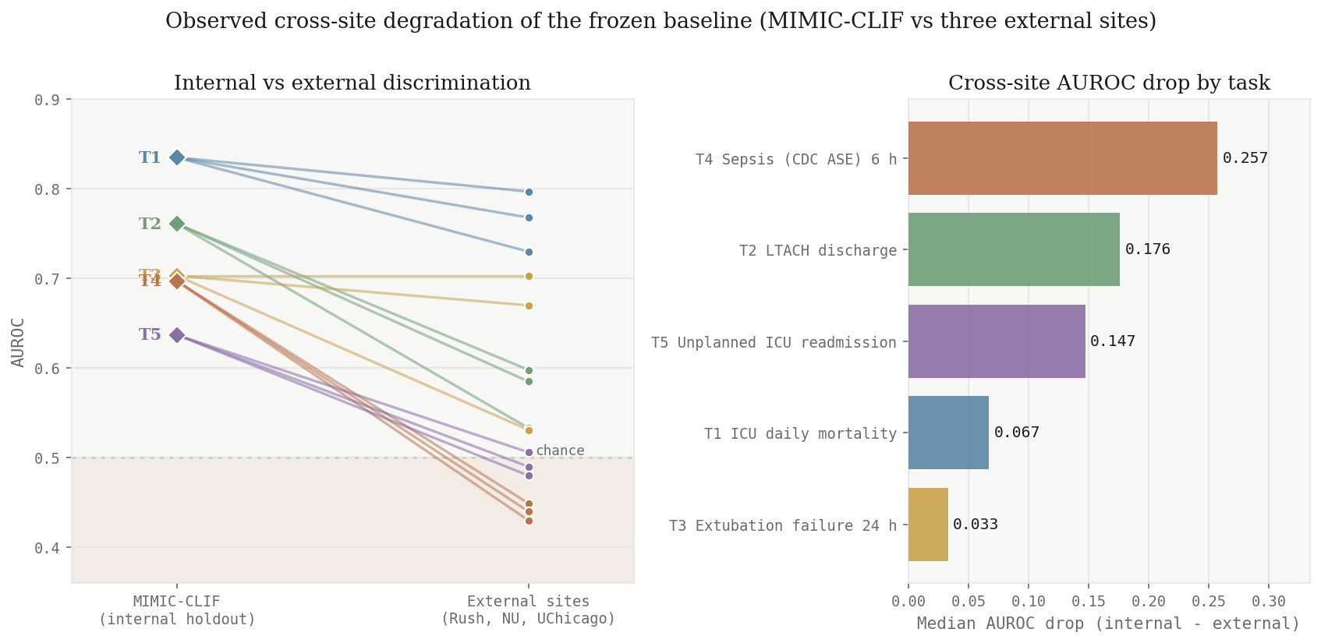
Strong internal discrimination does not survive transport
Median internal-to-external AUROC drop: sepsis 0.257, LTACH 0.176, readmission 0.147, mortality 0.067, extubation 0.033.
FLAIR: Federated ICU Benchmark on CLIF 23

Slide 24
Transportability is heterogeneous, not binary
Transports: mortality external 0.73-0.80 vs 0.835 internal.
Collapses: sepsis below chance everywhere; readmission near chance.
Splits: extubation matches MIMIC at Northwestern (0.703) but drops at UChicago (0.531).
Site effects are the signal.
FLAIR: Federated ICU Benchmark on CLIF 24

Slide 25
FLAIR's defensible advantages
Saturation resistance: evaluation data stay siloed and private.
Evaluation, not training: aggregate metrics leak less than federated-learning updates.
Auditability: byte-identical code and hashes make cohorts, labels, exclusions, and splits re-inspectable.
Extensibility: new tasks enter through PRs and multi-site governance.
Adoption flywheel: every CLIF site increases the value of every future model evaluation.
FLAIR: Federated ICU Benchmark on CLIF 25

Slide 26
What FLAIR is not claiming
It does not certify any model for bedside use.
It does not replace prospective silent trials or clinical-impact studies.
It does not move patient-level data or expose row-level errors centrally.
It currently covers structured EHR binary prediction tasks, not notes, waveforms, imaging, treatment effects, or generative outputs.
FLAIR is the pre-deployment evidence layer between local development and clinician-facing claims.
FLAIR: Federated ICU Benchmark on CLIF 26

Slide 27
The ask
Sites: map to CLIF, run approved artifacts locally, and contribute private external evidence without sharing private rows.
Developers: bring frozen models for auditable, multi-site validation.
Funders: invest in infrastructure that scales evidence, not just algorithms.
Develop on public MIMIC-CLIF. Validate federated.
FLAIR: Federated ICU Benchmark on CLIF 27

Slide 28
Takeaways
FLAIR fills the missing layer in ICU AI: external validation across real hospitals without patient-data movement.
CLIF makes the code portable; FLAIR makes evaluation governed, auditable, and reusable.
Open-source standards make tasks reusable and extensible, while model owners keep control of features and models.
Encapsulation lets the same evaluation run faster and more consistently across hospitals.
The contribution is not a model; it is a reproducible way to ask whether ICU models behave alike across institutions.
FLAIR: Federated ICU Benchmark on CLIF 28

Slide 29
Thank you
FLAIR — Federated Learning Assessment for ICU Research
github.com/clif-consortium/FLAIR
MIMIC-CLIF · Rush · Northwestern Medicine · UChicago Medicine
278,065 ICU stays
FLAIR: Federated ICU Benchmark on CLIF 29

