Slide 1

Course Project Student Management
Member: Nguyễn Quang Vinh - B2105727

Slide 2
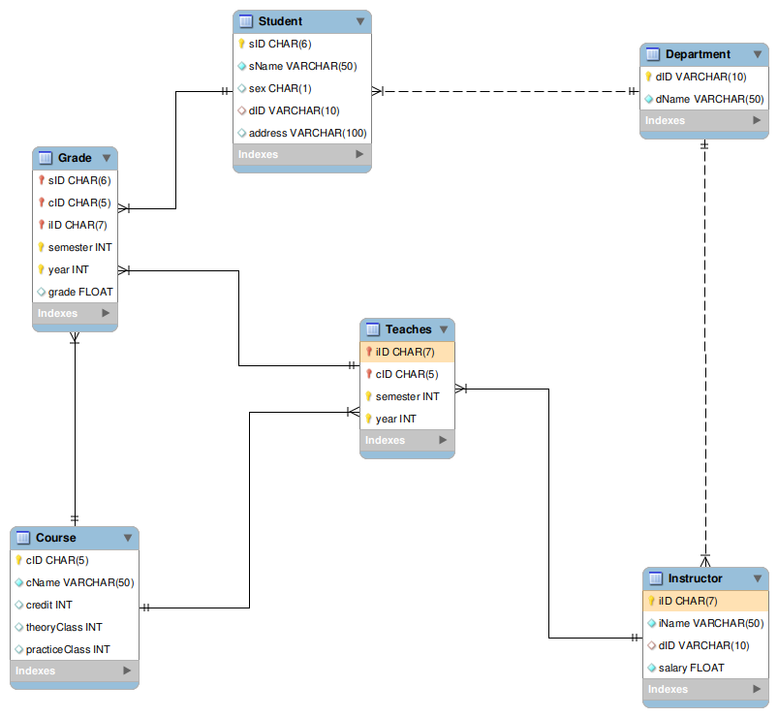
Schema

Slide 3
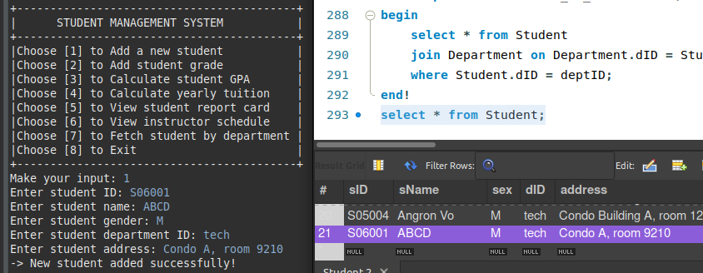
ADD_STUDENT

Slide 4
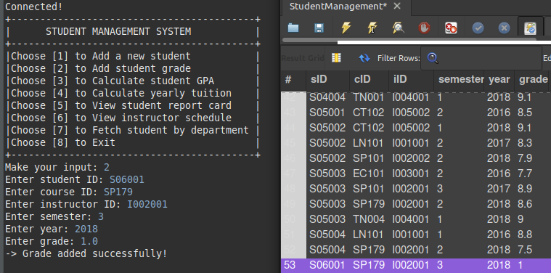
ADD_GRADE

Slide 5
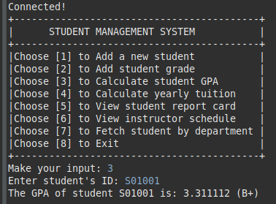
CALCULATE_GPA

Slide 6
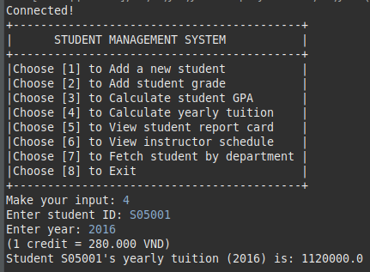
YEARLY_TUITION

Slide 7
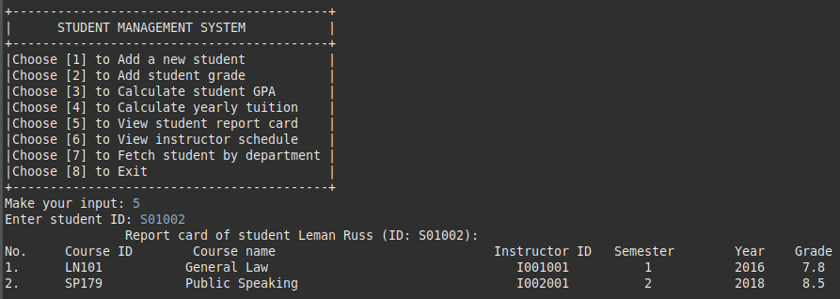
REPORT_CARD

Slide 8
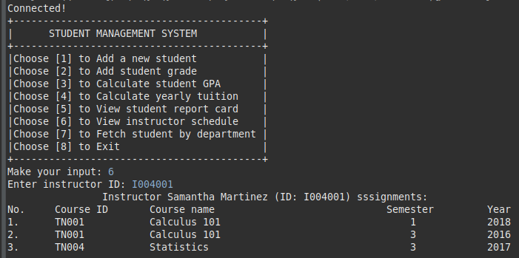
INSTRUCTOR_SCHEDULE

Slide 9
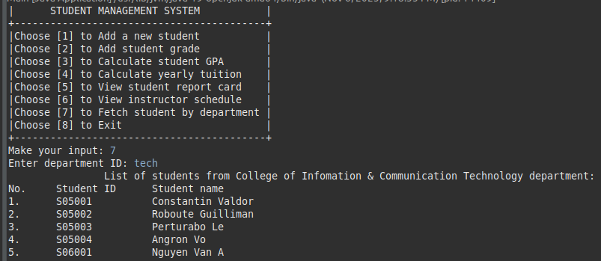
STUDENT_BY_DEPARTMENT

Slide 10

Thank you for listening!

