Slide 1

Course Project: Student Management
Member: Nguyễn Quang Vinh - B2105727

Slide 2
List of Services
Add a new student
Add student grade
Calculate student GPA
Calculate yearly tuition
View student report card
View instructor schedule
Fetch student by department

Slide 3
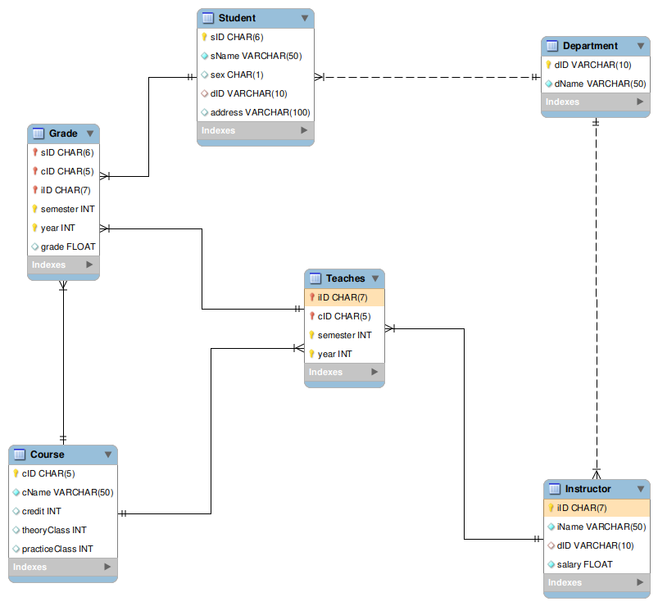
Schema

Slide 4
Stored Procedures
ADD_STUDENT (IN ID char(6), IN Name varchar(50), IN gender char(1), IN deptID varchar(10),IN addr varchar(100))
ADD_GRADE (IDs char(6), IDc char(5), IDi char(7), sems int, yer int, point float)
REPORT_CARD (IN IDs char(6))
INSTRUCTOR_SCHEDULE (IN ID char(7))
STUDENT_BY_DEPARTMENT (IN deptID varchar(10))

Slide 5
Stored Functions
CALCULATE_GPA ( ID char(6) )
YEARLY_TUITION ( IDs char(6), yar int )

Slide 6
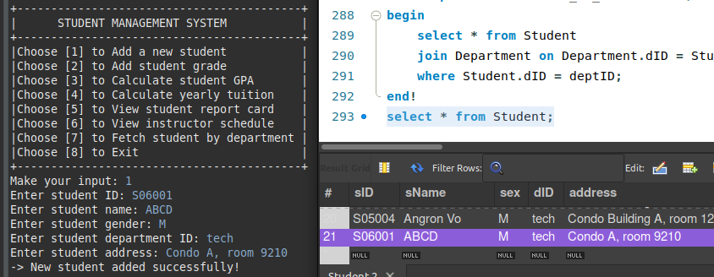
ADD_STUDENT

Slide 7
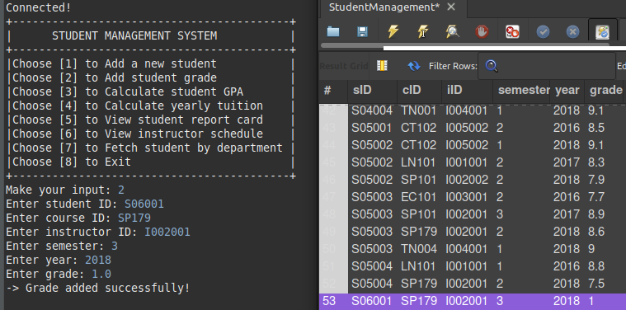
ADD_GRADE

Slide 8
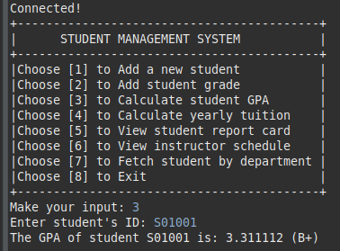
CALCULATE_GPA

Slide 9
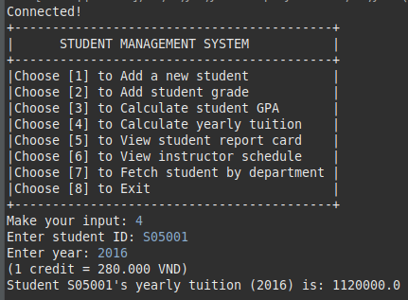
YEARLY_TUITION

Slide 10
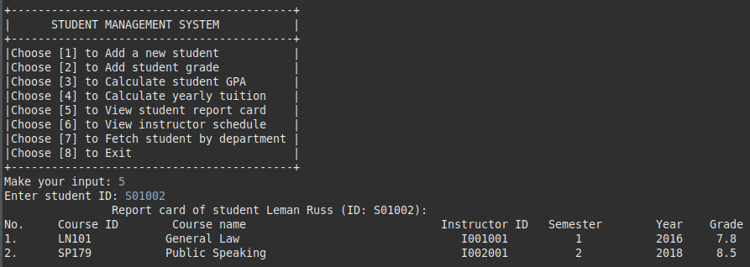
REPORT_CARD

Slide 11
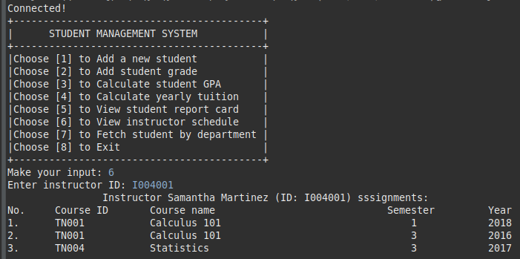
INSTRUCTOR_SCHEDULE

Slide 12
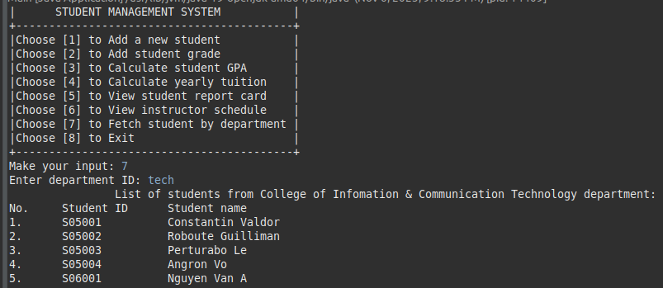
STUDENT_BY_DEPARTMENT

