Slide 1
CAN THO UNIVERSITY
SCHOOL OF INFORMATION & COMMUNICATION TECHNOLOGY
INFORMATION TECHNOLOGY HIGH-QUALITY PROGRAM
GRADUATION THESIS
DEVELOPING A MUSHROOM IDENTIFICATION
APPLICATION
Advisor: Dr. Bùi Võ Quốc Bảo
Student: Nguyễn Quang Vinh (B2105727)
Notes:
Hello everyone, I am Quang Vinh, thanks for coming to my thesis defense presentation today, titled: “Developing a Mushroom Identification Application. Advised by Dr. BVQB

Slide 2
Content
Part 1: Introduction
Part 2: Theoretical Basis & Systems Analysis
Part 3: Implementation
Part 4: Conclusion
Notes:
The presentation consists of 4 parts:
1. The Introduction
2. Then Theoretical basis and systems analysis
3. Then Implementation
4. And finally, the Conclusion

Slide 3
Part 1: Introduction
Notes:
Part 1: Introduction

Slide 4
1.1. Problem Description
Mushroom identification is difficult for beginners due to subtle similarities.
Traditional methods require prior knowledge and are prone to errors.
Misidentification can cause serious health risks.
Growing interest in foraging has increased demand for reliable, accessible tools
Existing digital solutions are often limited by high cost or restrictive freemium models.
Notes:
It is known that Mushroom identification is a difficult task for beginners - due to how similar most species look, which can lead to possibly lethal errors EVEN with prior knowledge.
And with the increase in interest in foraging hobby, there has been demand for an accessible and beginner-friendly tool
| |
That does not have the users dealing with an expensive subscription or a restrictive freemium model

Slide 5
1.2. Purpose of the Study
The primary purpose of this study is to develop a beginner-friendly Android application that supports safe mushroom identification, promotes safe foraging practices and self-learning.
Notes:
And thus spawn this thesis which aims to develop a beginner-friendly application
| |
that supports mushroom identification as well as promotes safe foraging practices, and self-learning.

Slide 6
1.3. Objectives & Scope
Objectives:
Build an app that delivers reliable AI-based identification.
Combine image inference, search, history, and map features.
Design a fast client-server architecture with intuitive UI/UX.
Scope:
Android app using Flutter, server inference via PyTorch + Lightning.ai.
Local SQLite storage and a bundled JSON.
Integration of iNaturalist API.
Notes:
The Objectives of the thesis is to :
1. Build an app that combine AI-based image identification with local storage
2. Along with a search feature and interactable forage map DELIVERED with a fast client-server architecture and intuitive UI/UX
As for the scope:
1. The application is built with Flutter and integrated with the iNaturalist API.
2. With server inference task done via PyTorch on Lightning.ai server
3. And local storage is handled by SQLite and bundled JSON

Slide 7
Part 2: Theoretical Basis & Systems Analysis
Notes:
Part 2: Theoretical Basis & Systems Analysis

Slide 8
2.1. Key Technologies
Flutter/Dart: Cross-platform UI framework for fast Android development.
SQLite + JSON: Local data storage and offline mushroom information.
OpenStreetMap + iNaturalist API: Interactive map and community observations.
PyTorch + Kaggle: Training and testing the ViT model.
FastAPI + LitServe (Lightning.ai): Deploying and serving the model.
Notes:
Key technologies employed include:
1. Flutter and Dart for the UI
2. SQLite and JSON for local storage
3. OpenStreetMap Data (via CARTO Basemap) with the iNaturalist API for the interactive map feature
4. PyTorch and Kaggle for training and testing the AI model
5. And FastAPI with LitServe on Lightning.ai for deploying the model

Slide 9
2.2. Vision Transformer Model
Google/vit-base-patch16-224-in21k (Pre-trained on ImageNet-21k)
  Lightweight
  Good for subtle details and complex textures
Variables | Value
Model | google/vit-base-patch16-224-in21k
Input Size | 224x224
Batch Size | 64
Learning rate | 3e-5 (ViT) and 1e-3 (classifier)
Decay | 1e-4
Epoch | 32
Scheduler | CosineAnnealingLR with T_max=10
Label smoothing | 0.1
Loss function | CrossEntropyLoss
Num classes | 80
Notes:
The model used is Google – Vit-base-patch16, pretrained on ImageNet-21k dataset:
Chosen for being lightweight
While offer good performance on identifying subtle detail and complex textures
And below is a table detailing the hyper-parameter used for the training of the model
Learning rates(ViT backbone): A ViT low learning rate combined with data augmentation was used to improve generalization which helped to mitigate overfitting as well as to avoid destroying pretrained features.
Learning rates (Classifier head): A higher learning rate allows the new classifier to learn faster.
Weight decay : Adds regularization to reduce overfitting by discouraging overly large weights.
Label smoothing : Prevents the model from becoming overconfident and improves generalization.
Scheduler: Gradually reduces the learning rate to stabilize training and improve final performance.
A transformer is a neural network that uses attention to learn relationships between different parts of the input. In a Vision Transformer, the image is split into patches, and attention allows the model to understand how these patches relate to each other, enabling it to capture global patterns

Slide 10
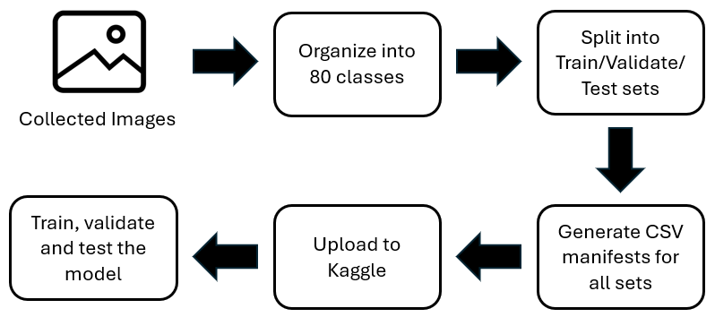
2.3. Dataset & Augmentation
Dataset: 80 classes × 200 images each (16,000 total).
Sources: iNaturalist, Kaggle, WildFoodUK, blogs.
Notes:
The custom dataset consists of 80 classes with exactly 200 samples each
Sourced mostly from iNaturalist with the rest coming from Kaggle public dataset, WildFoodUK site and various other personal blogs.
The images were first organized by class when collected, then split into train, validate, and test sets using a Python script, with another script generate the CSV manifests for each set.
The dataset is then uploaded to Kaggle, and augmentation was applied to the train set during training
- Data augmentation is applied only to the training set to increase data diversity and improve generalization.
- The validation and test sets are kept unchanged so that model performance is evaluated on unseen data to ensure reliable results.

Slide 11
2.3. Dataset & Augmentation
Set | Percentage | Image per class | Total images | Purpose
Train | 80% | 160 | 12800 | Training the model with data augmentation
Validate | 10% | 20 | 1600 | Monitoring training results
Test | 10% | 20 | 1600 | Final performance evaluation
Total | 100% | 200 | 16000
Notes:
This is the table showing the dataset partitioning, the dataset is split into the ratio of 8:1:1

Slide 12
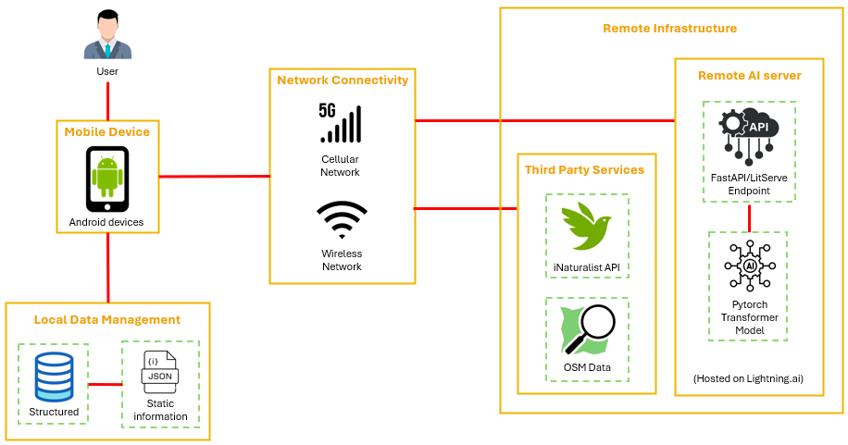
2.4. System Architecture Overview
Notes:
The architecture of the application has the app connect to the internet to:
pull data from open street map and iNaturalist through their public API to be used for the forage map feature
It connect to the lightning.ai server for the inference task
While the result of each inference is stored to the SQLite data (result are confidence_score and predicted_class which is the mushroom name),
The json file is there, containing all information of all 80 classes to be used for data retrieve in search feature and post inference

Slide 13
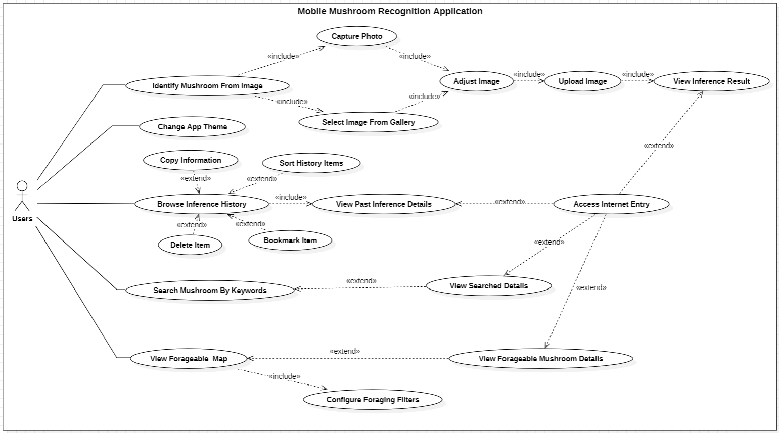
2.5. Use Case Overview
Notes:
The following slides shows the Overview of the app Use case

Slide 14
Part 3: Implementation
Notes:
Part 3: Implementation

Slide 15
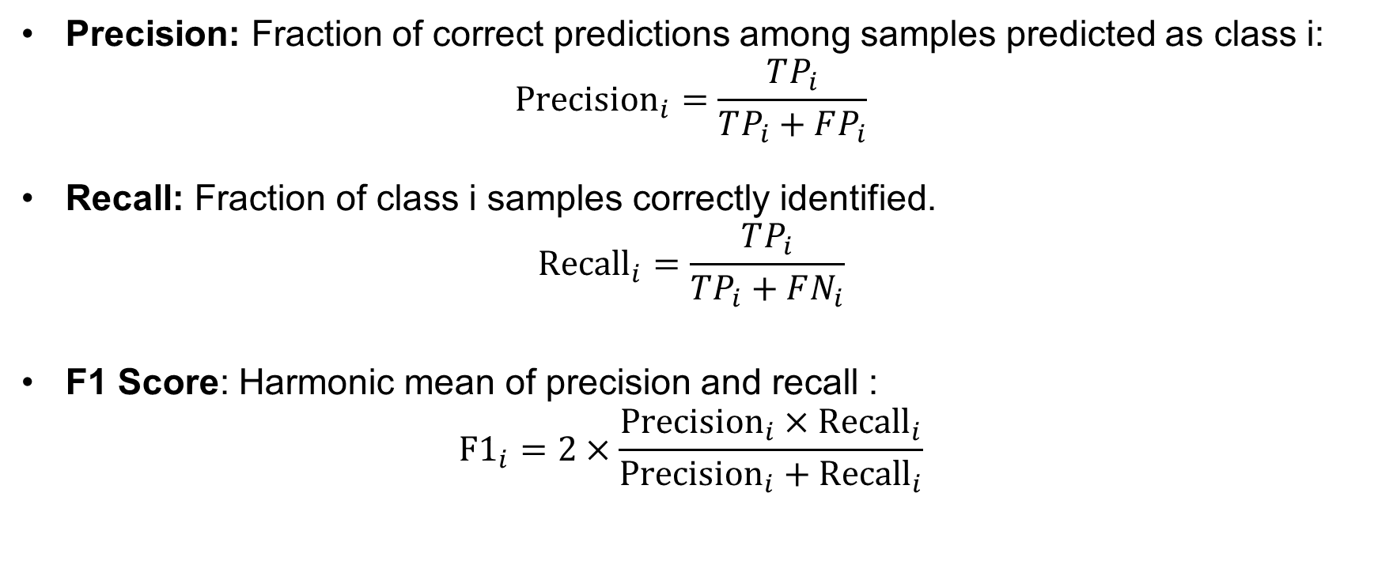
3.1. Model Evaluation Metrics
Precision: Fraction of correct predictions among samples predicted as class i:
$${\text{Precision}}_{i}=\frac{TP_{i}}{TP_{i}+FP_{i}}$$
Recall: Fraction of class i samples correctly identified.
$${\text{Recall}}_{i}=\frac{TP_{i}}{TP_{i}+FN_{i}}$$
F1 Score: Harmonic mean of precision and recall :
$${\text{F}\text{1}}_{i}=2×\frac{{\text{Precision}}_{i}×{\text{Recall}}_{i}}{{\text{Precision}}_{i}+{\text{Recall}}_{i}}$$
Notes:
The Model is evaluated on the metric of precision, recall and F1 score for each of the 80 classes
- Precision: The percentage of the times the model correctly predict a class over the overall positive prediction. Meaning it shows how often the model reliably predict a class correctly. The higher the number the better
- Recall: The percentage of the times the model correctly predict a class over the overall correct prediction. Meaning it shows how well the model detect all relevant samples. The higher the less the model miss the correct class.
- F1: Hormonic mean of precision and recall. It combines precision and into a single value, to see if the model perform well on both. So, it acts as a check to see whether or not the model actually does well on both precision and recall. The higher the better.

Slide 16
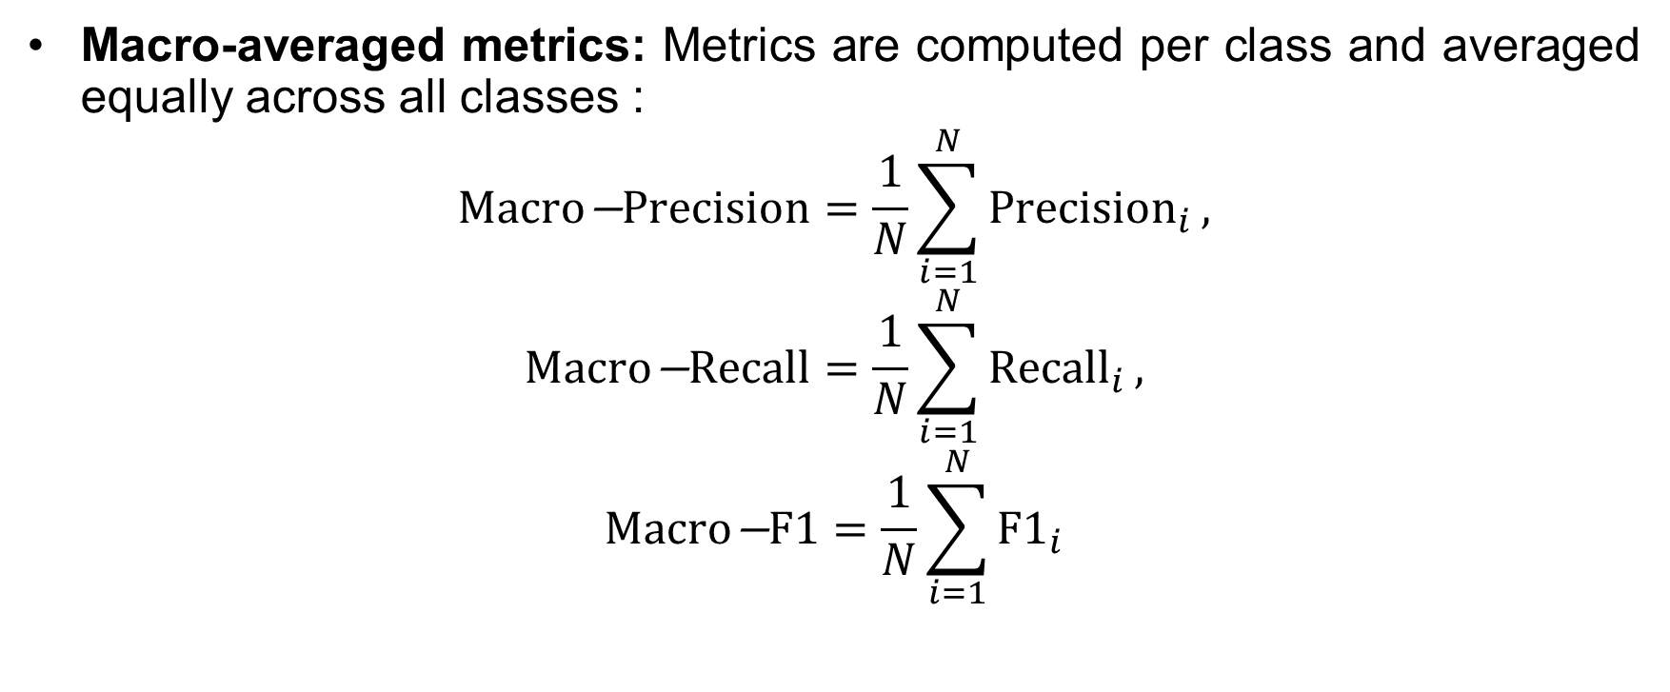
3.1. Model Evaluation Metrics
Macro-averaged metrics: Metrics are computed per class and averaged equally across all classes :
$$\text{Macro}\text{−}\text{Precision}=\frac{1}{N}\sum_{i=1}^{N}{{\text{Precision}}_{i}},$$
$$\text{Macro}\text{−}\text{Recall}=\frac{1}{N}\sum_{i=1}^{N}{{\text{Recall}}_{i}},$$
$$\text{Macro}\text{−}\text{F}\text{1}=\frac{1}{N}\sum_{i=1}^{N}{{\text{F}\text{1}}_{i}}$$
Notes:
then the average is calculated across all classes to ensure equal class contribution

Slide 17
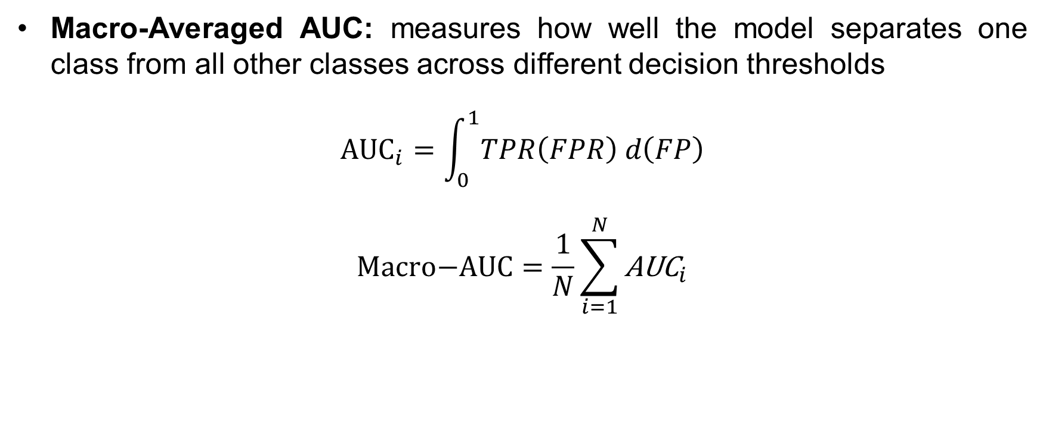
3.1. Model Evaluation Metrics
Macro-Averaged AUC: measures how well the model separates one class from all other classes across different decision thresholds
$${\text{AUC}}_{i}=\int_{0}^{1}{TPR\left(FPR\right) d\left(FP\right)}$$
$$\text{Macro}\text{−}\text{AUC}=\frac{1}{N}\sum_{i=1}^{N}{{\text{AUC}}_{i}}$$
Notes:
The AUC value also follows the same approach across all classes
- ROC-AUC: measures how well the model separates one class from all other classes across different decision thresholds. The higher the better.

Slide 18
3.2. Model Results
Model | Macro-Averaged Precision | Macro-Averaged Recall | Macro-Averaged F1 Score | Macro-Averaged AUC
ViT | 0.89 | 0.88 | 0.88 | 0.998
ResNet-50 | 0.85 | 0.84 | 0.84 | 0.997
EfficientNetB4 | 0.84 | 0.83 | 0.83 | 0.996
MobileNetV3 | 0.83 | 0.82 | 0.82 | 0.995
Notes:
The result of the implementation has the ViT model perform consistently higher than all baseline models on the custom dataset

Slide 19
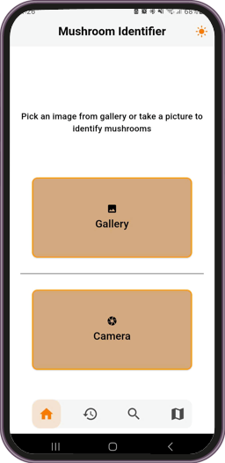
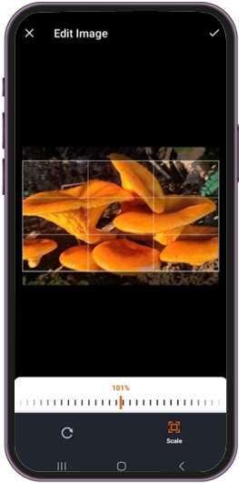
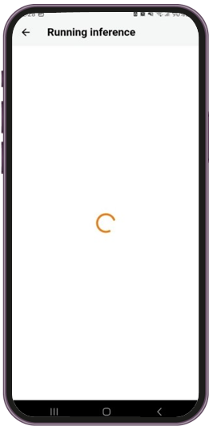
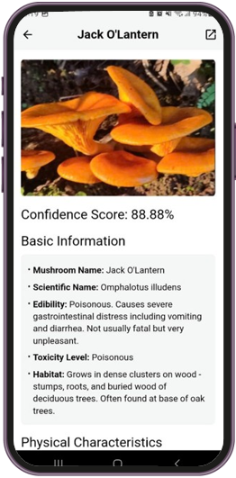
3.3. Mushroom Identification UI Implementation
Notes:
The following slides are result of the UI implementation for the Mushroom identification feature,

Slide 20
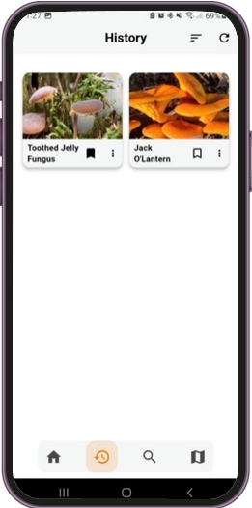
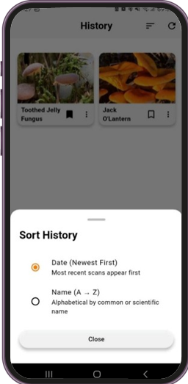
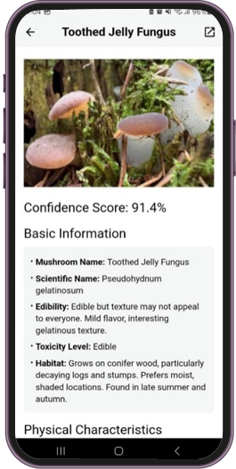
3.3. History UI Implementation
Notes:
History feature

Slide 21
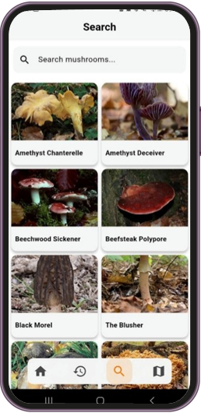
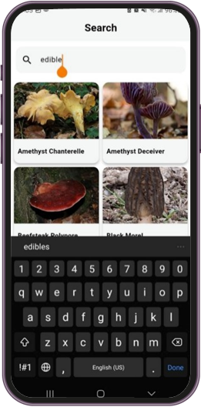
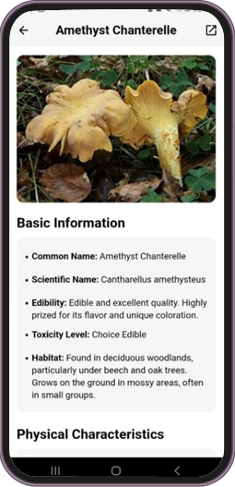
3.3. Search UI Implementation
Notes:
Search feature

Slide 22
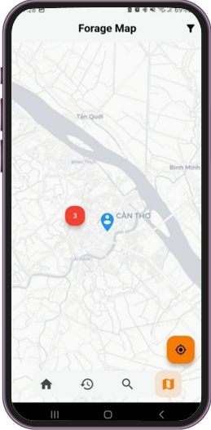
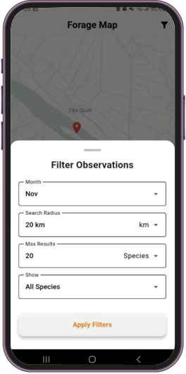
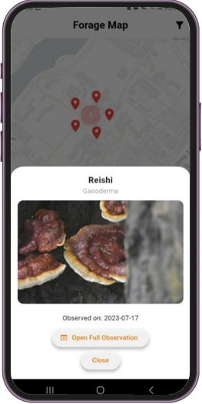
3.3. Forage Map UI Implementation
Notes:
And finally, the forage map feature

Slide 23
Part 4: Conclusion
Notes:
Part 4: Conclusion

Slide 24
4.1. Achieved Results & Limitations
ACHIVED RESULTS:
Developed a beginner-friendly Android app for mushroom identification
Real-Time image recognition using a server-side ViT model with local storage
Keyword search powered by a bundled JSON dataset
Interactable map integrated with iNaturalist API.
LIMITATIONS:
Limited and undiversified training data.
Low accuracy in several classes
Some features remain underdeveloped
Notes:
ACHIVED:
In the end, the thesis successfully delivered a beginner-friendly Android application that features:
1. A real-time image recognition with local storage,
2. A Keyword-searchable mushroom feature
3. And an interactive map integrated with iNaturalist API.
LIMITATIONS:
As for the limitations which include:
A relatively constrained dataset,
Low accuracy in several classes,
And some features remain underdeveloped.

Slide 25
4.2. Development Direction
Expand recognition feature to other wild forageables.
Use larger ViT variants for better performance.
Improve the dataset and augmentation strategy to reduce overfitting.
Upgrade keyword search to a chatbot.
Add a feature where user can submit observation to iNaturalist website through the forage map feature.
Notes:
For future improvements, I plan to:
1. Expand the recognition feature to other wild edibles.
2. Use a larger ViT variant for better performance.
3. Expand the dataset and improve the augmentation strategy to reduce overfitting.
4. Upgrade the keyword search feature to a chatbot.
5. Add a feature where user can submit observation to iNaturalist website through the forage map feature.

Slide 26
THANK YOU VERY MUCH
Can Tho University
Notes:
This concludes my presentation.
Thank you for listening

