Slide 1
Lab Course Motion Planning
Sebastian Kaster
Technical University Munich
April 27, 2018

Slide 2
Overview Model
Additional Parameters
(time horizon)
SPOT
Traffic Scenario
Occupancy

Slide 3
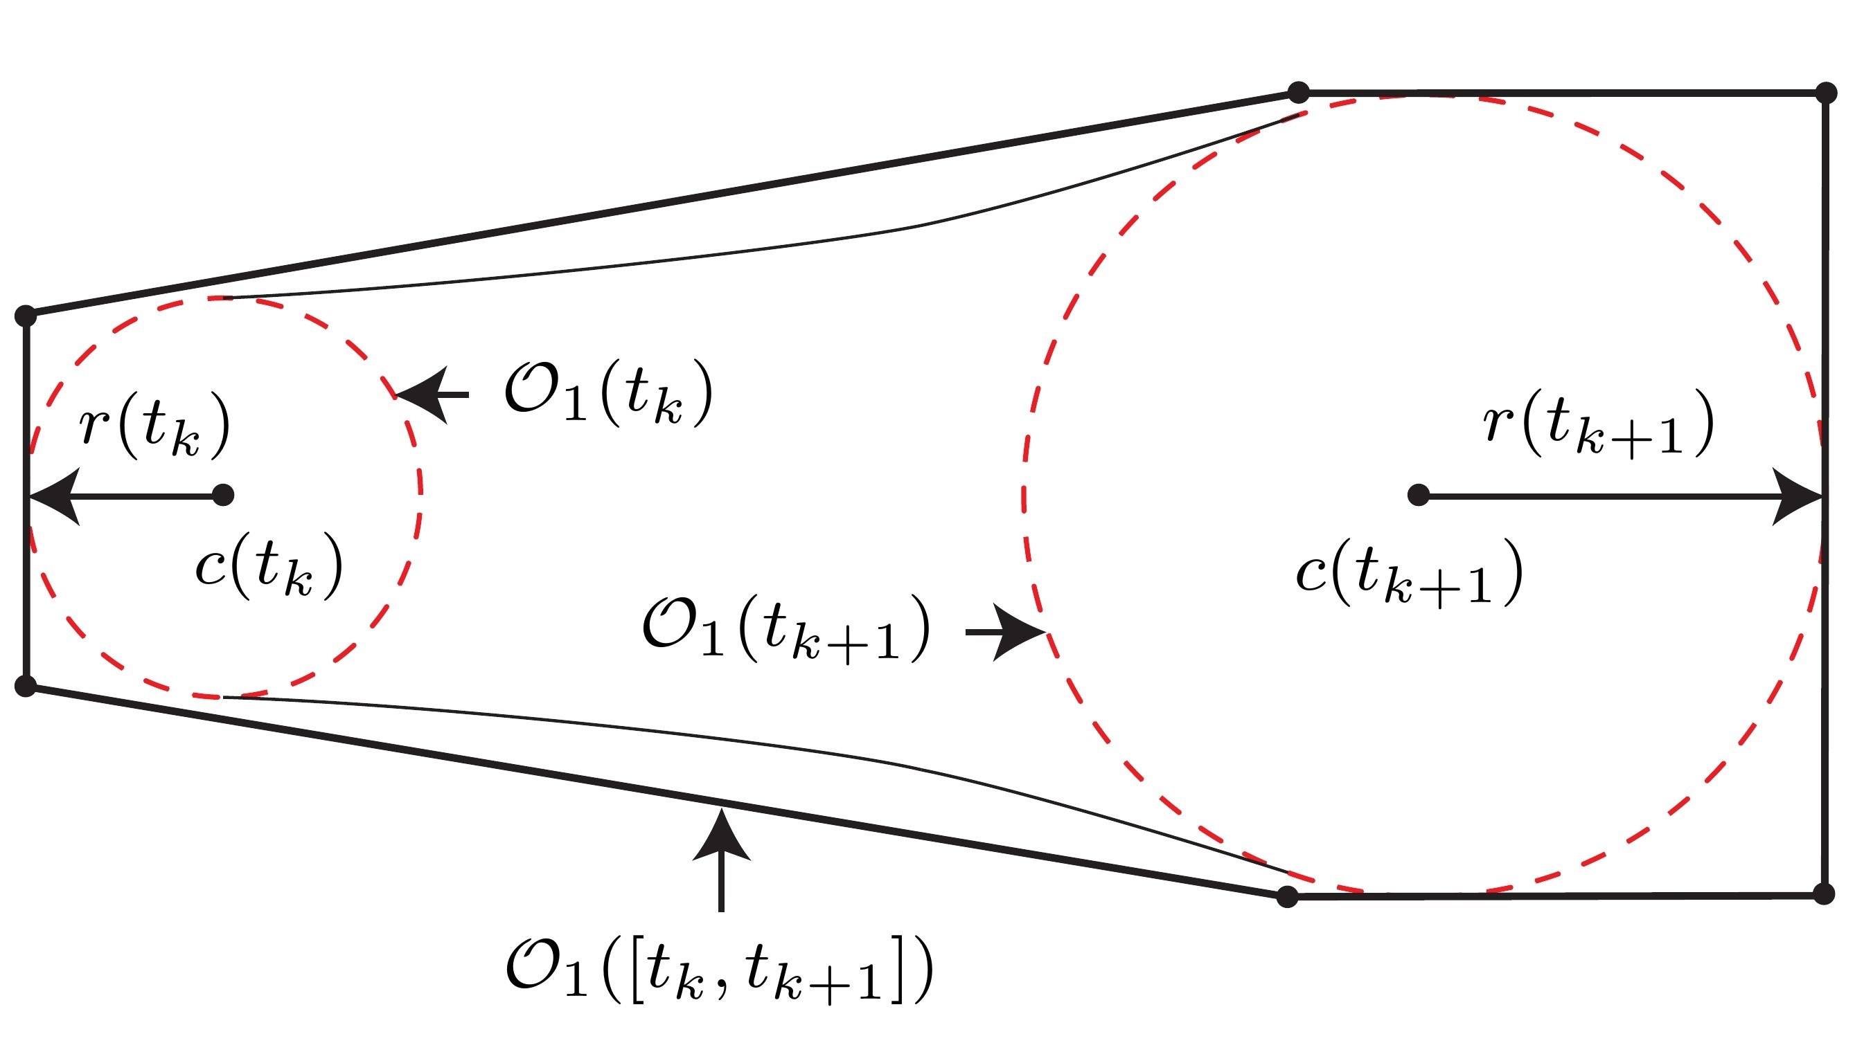
Acceleration-Based Occupancy (M1)

Slide 4
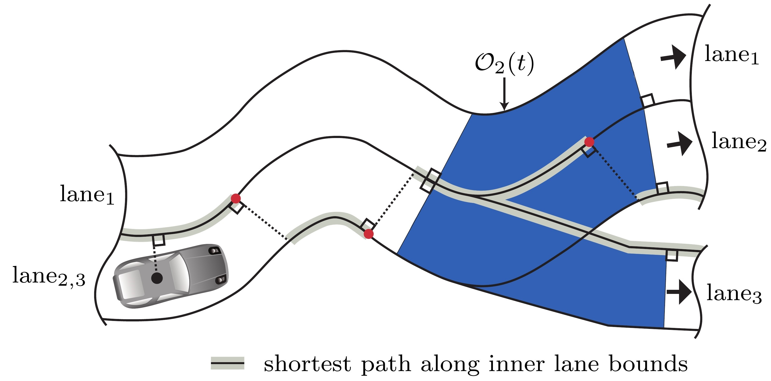
Lane-Following Occupancy (M2)

Slide 5
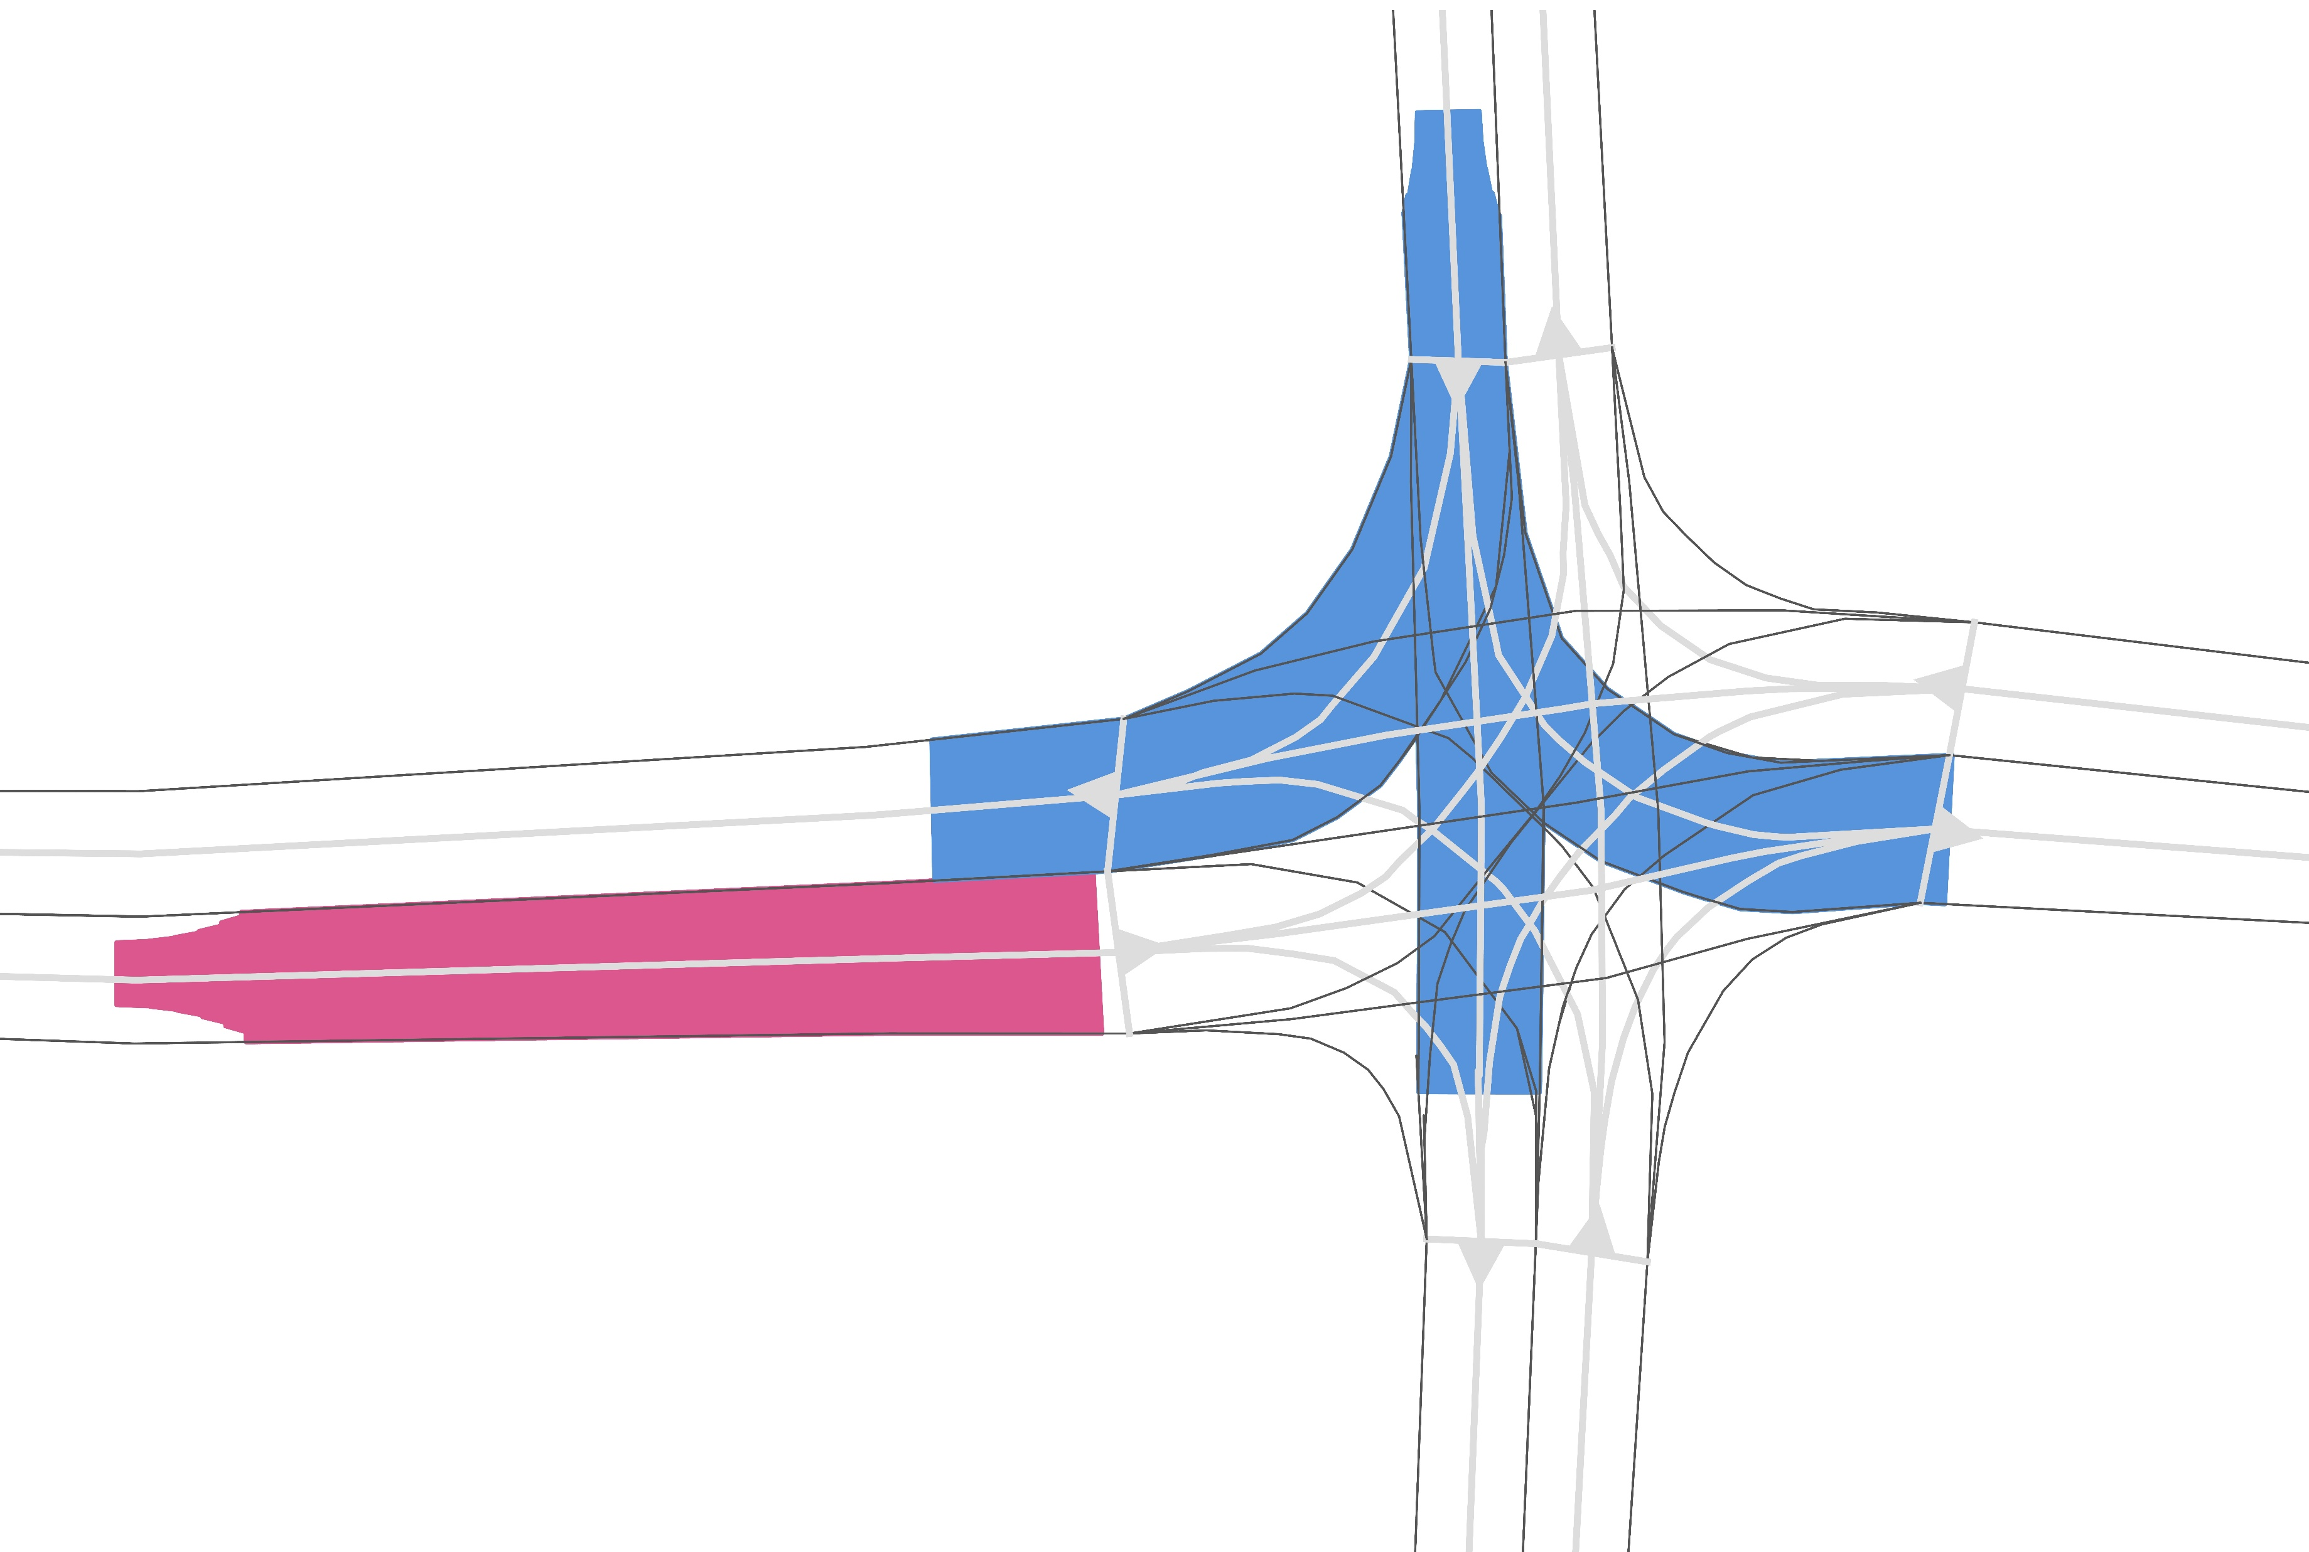
Overall Occupancy
Scenario: GER_Ffb_1

Slide 6
Agenda
Connect spot with autonomous driving framework
Scenario
Autonomous
Driving
SPOT
Occupancy

Slide 7
Agenda
Connect spot to autonomous driving framework
Reduce velocity in curves
Add further unit tests

