Slide 1
SPOT: A Tool for Set-Based Prediction of Traffic Participants
Sebastian Kaster
Technical University Munich
March 15, 2018

Slide 2
Motivation
Trajectory safe → no intersection with occupancies of other traffic participants
Calculation of a bunch of occupancies is time consuming
    → Use a fast programming language!

Slide 3
Overview Model
Additional Parameters
(time horizon)
SPOT
Traffic Scenario
Occupancy

Slide 4
CommonRoad
XML format for specifying road traffic scenarios
Consists of represantations for
  Road network
  Obstacles (static, dynamic)
  Ego vehicle
  Goal region

Slide 5
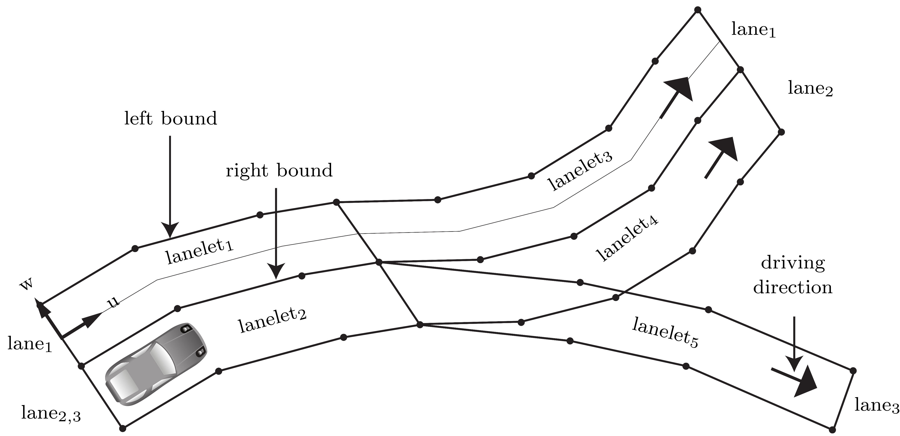
Road Network
Consists of lanelets → construct lanes

Slide 6
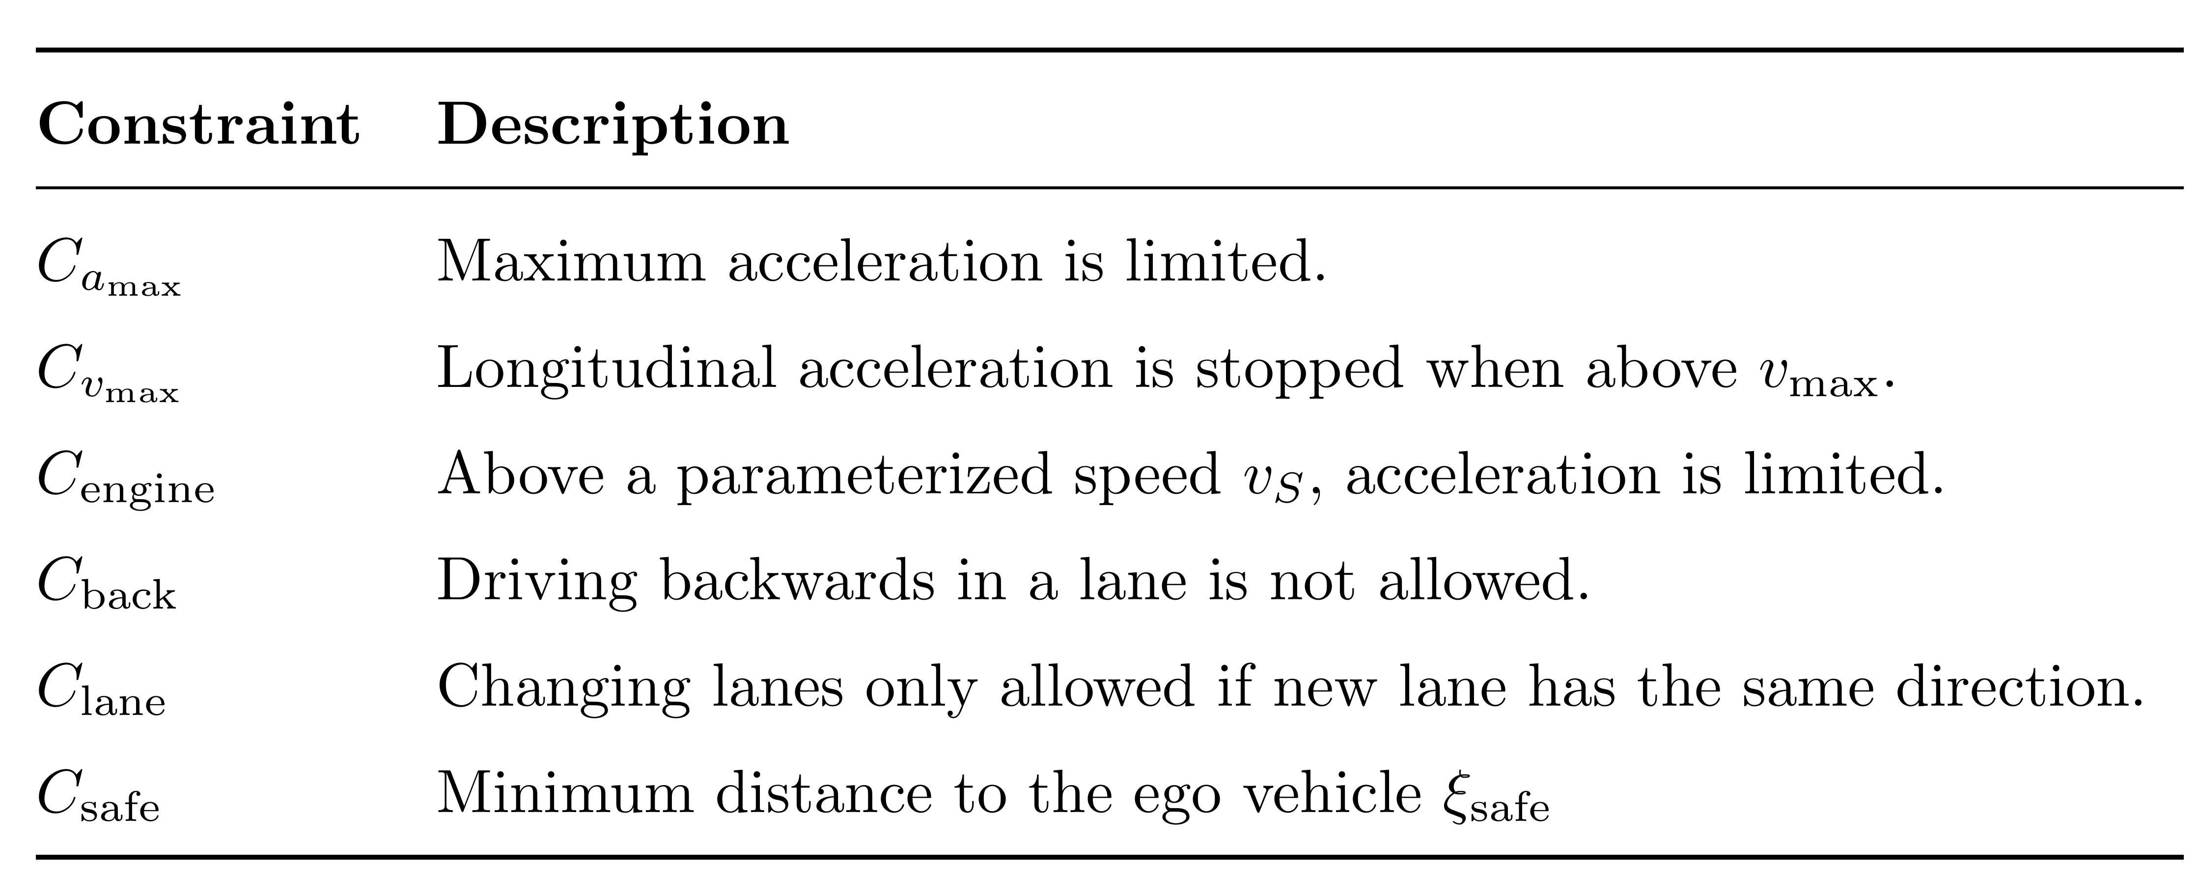
Constraints for Traffic Participants

Slide 7
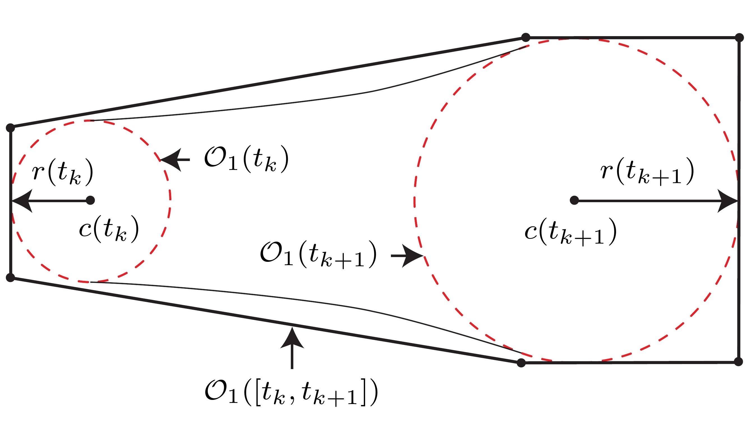
Acceleration-Based Occupancy (M1)
Considers $C_{a_{max}}$

Slide 8
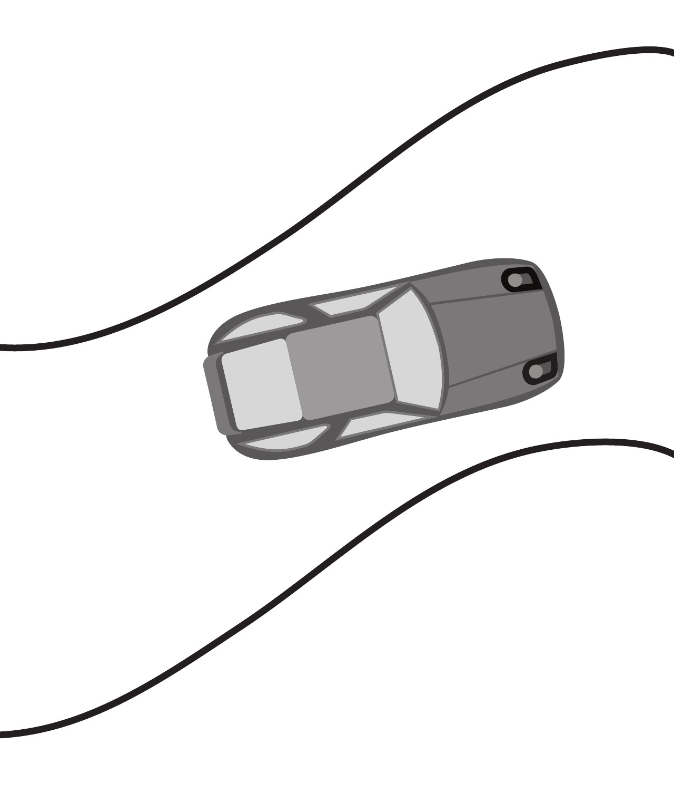
Acceleration-Based Occupancy (M1)
Add object dimensions, rotate, translate

Slide 9
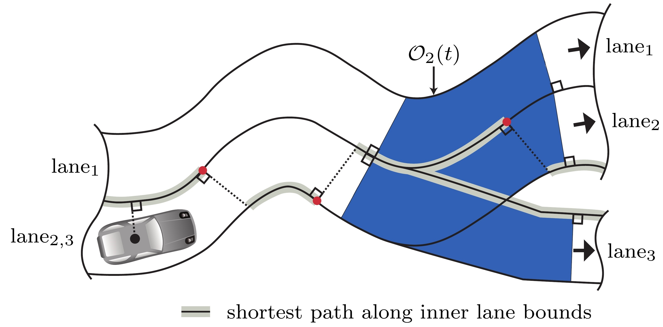
Lane-Following Occupancy (M2)
Considers $C_{a_{max}}$, $C_{v_{max}}$, $C_{engine}$, $C_{Lane}$ and $C_{back}$

Slide 10
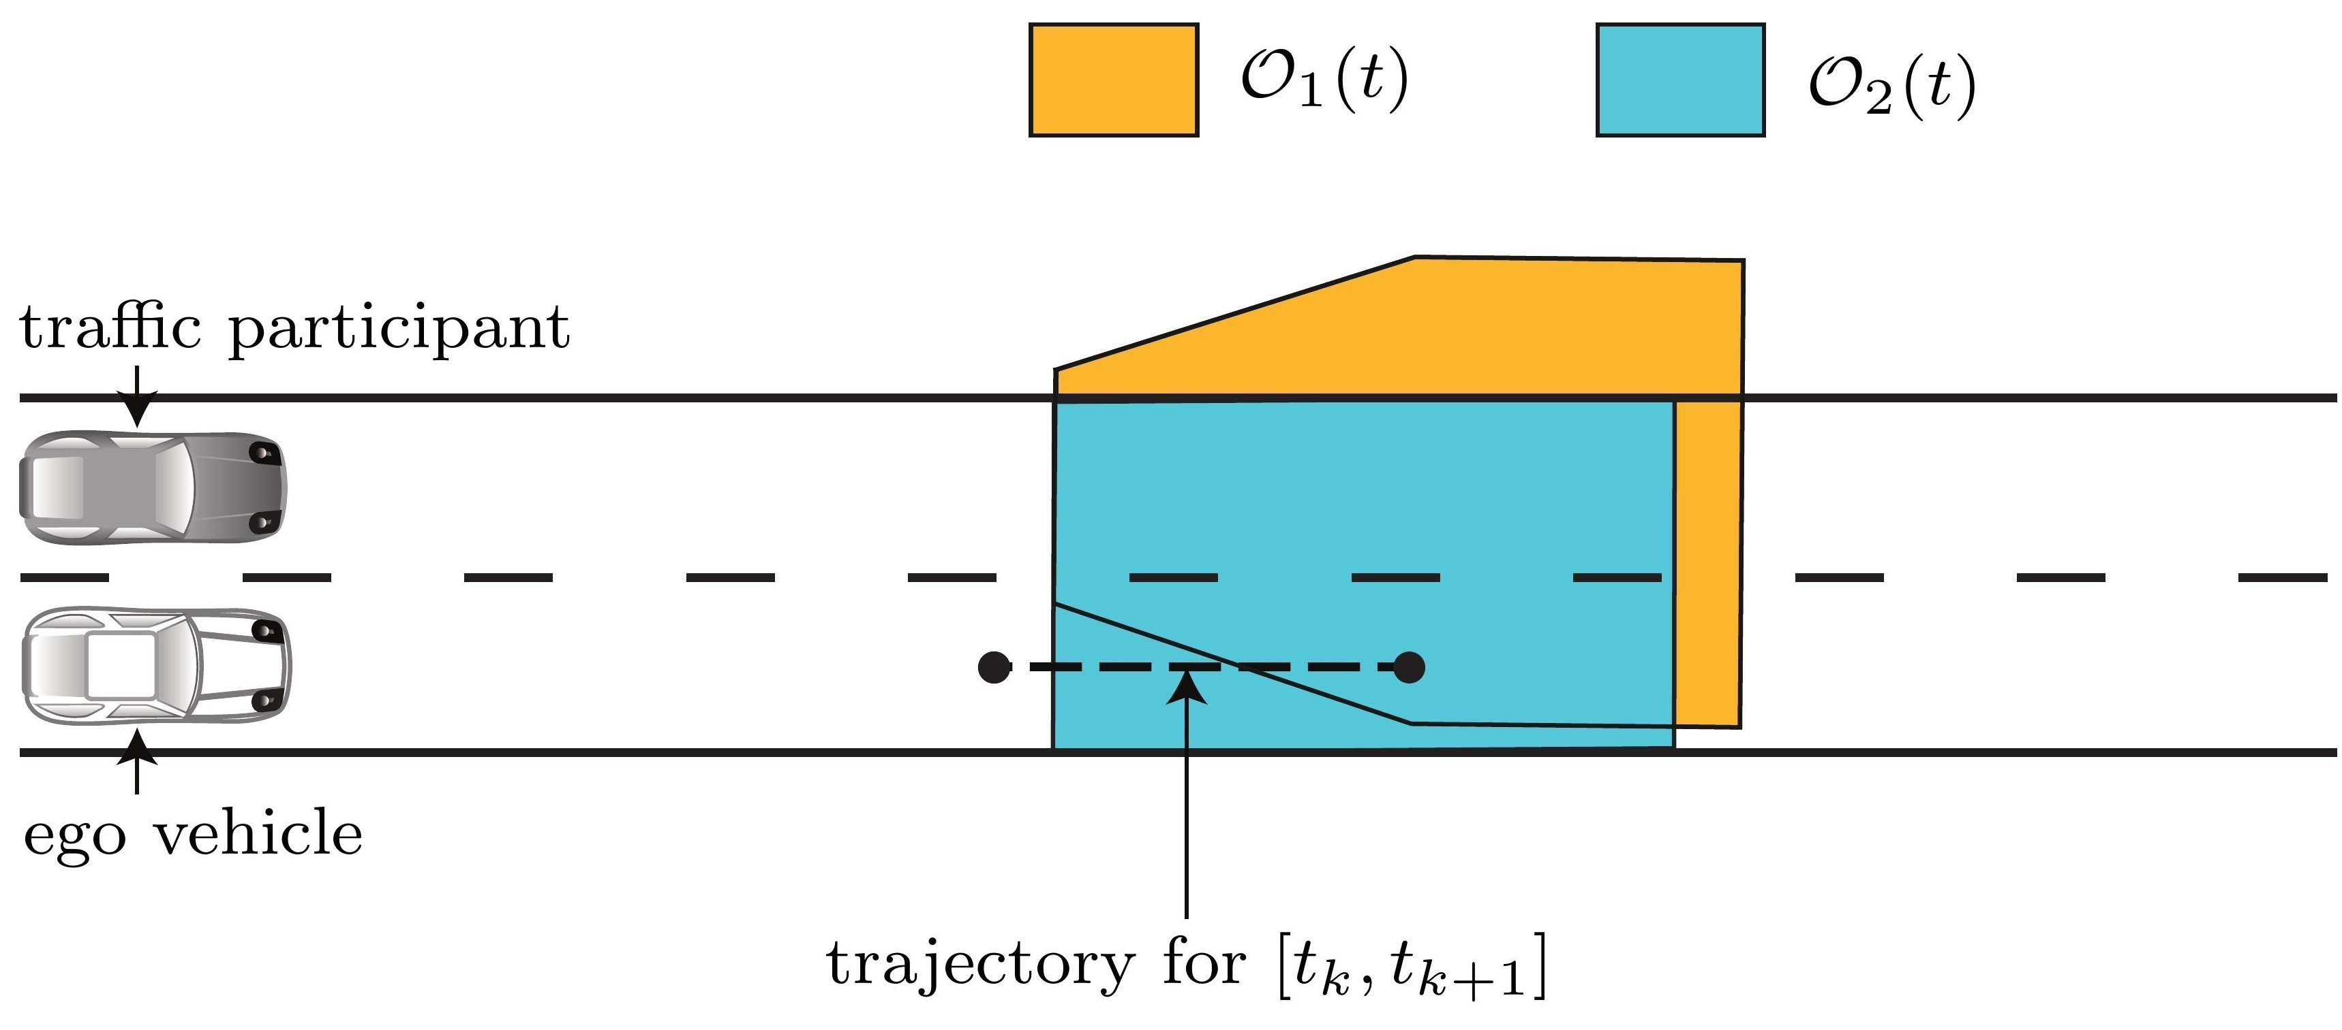

Overall Occupancy
Intersection of M1 and M2 for every time interval
  $O_{1}(t)∩ O_{2}$($t$)

Slide 11
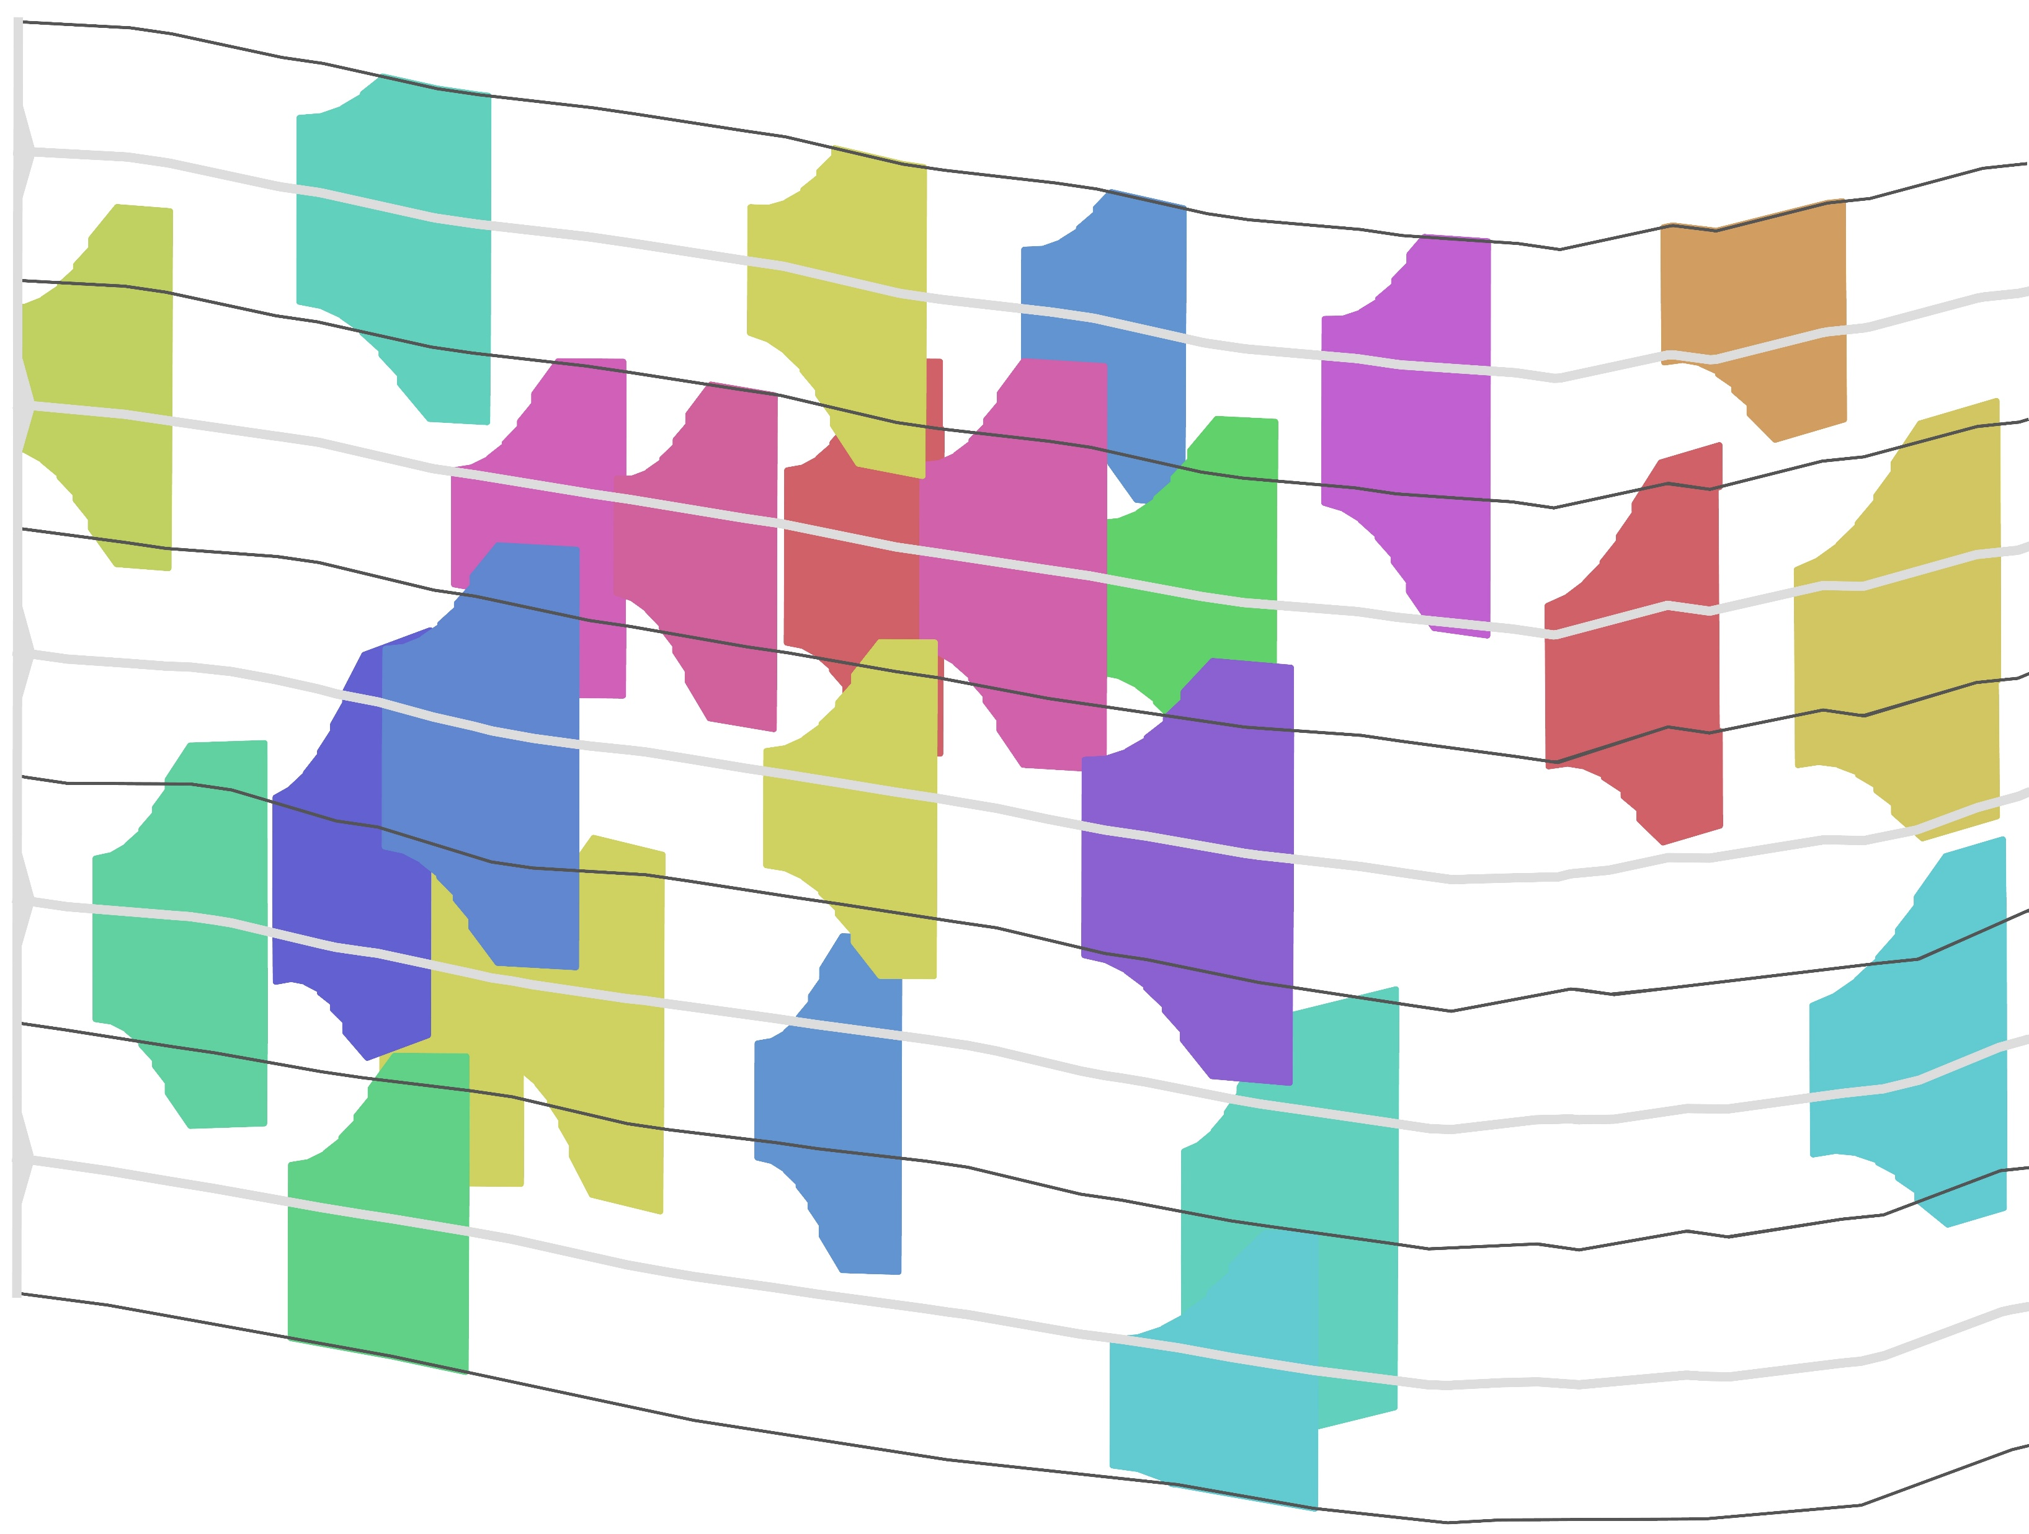
Overall Occupancy - Example 1
Scenario: NGSIM_US101_5

Slide 12
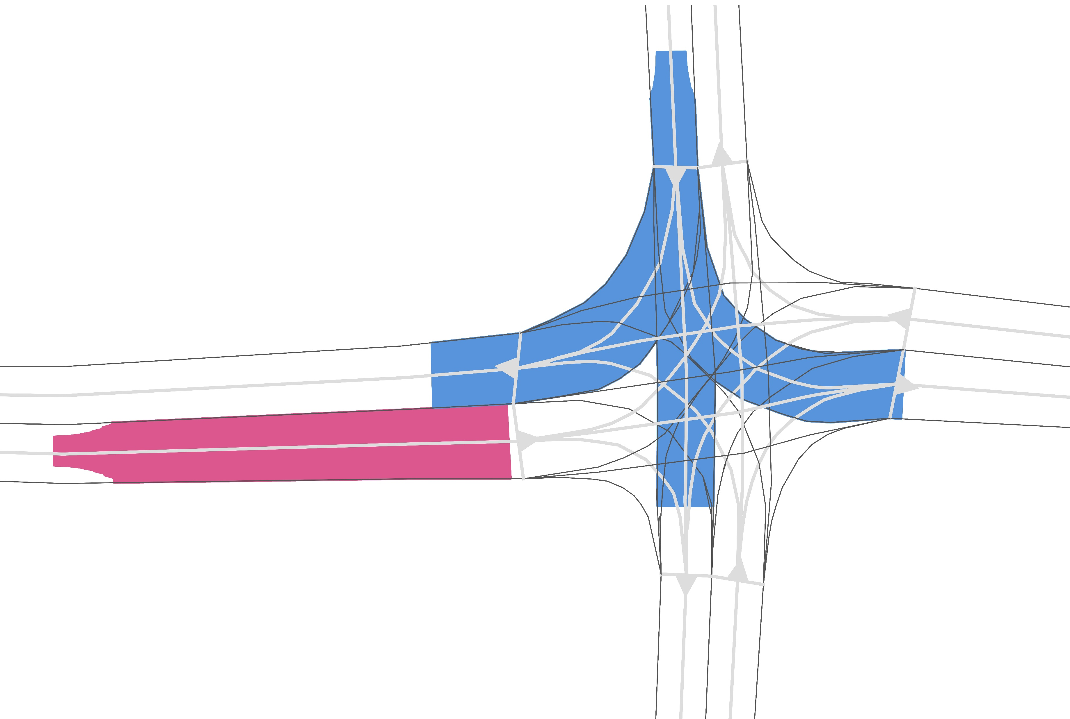
Overall Occupancy - Example 2
Scenario: GER_Ffb_1

Slide 13
Overview Implementation
Get lanelets
Construct lanes
Calculate shortest path
Get obstacles
Compute occupancy
  Acceleration-Based Occupancy (M1)
  Lane-Following Occupancy (M2)
  Intersection of M1 and M2
Repeat from step 4 with t + ∆t

Slide 14
Overview Implementation
Get lanelets
Construct lanes
Calculate shortest path
Get obstacles
Compute occupancy
  Acceleration-Based Occupancy (M1)
  Lane-Following Occupancy (M2)
  Intersection of M1 and M2
Repeat from step 4 with t + ∆t
Parallelize!

Slide 15
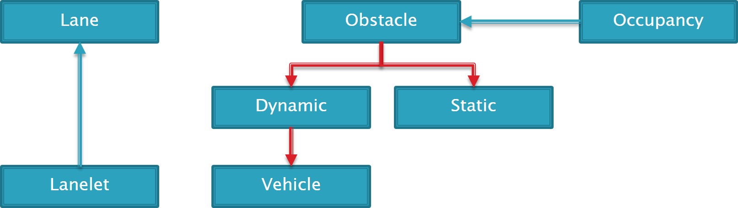
Class Diagram

Slide 16
Some Implementation Details
pugi-xml
std::vector used for lanelets, lanes and obstacles
Boost-library:
  Intersection of polygons
  Convex-Hull
OpenMP
  Parallelization

Slide 17
Benchmark
Scenario: NGSIM_US101_3, 15 cars, 6 Lanes, 2 sec. time horizon, 20 time intervals

Slide 18
Future & Current Work
Add other traffic participants: cyclists, pedestrians
Add arbitrary shape of cars
Shrink Over-Approximations:
  Reduce velocity in curves
Optimize Performance
Integration into ROS

Slide 19
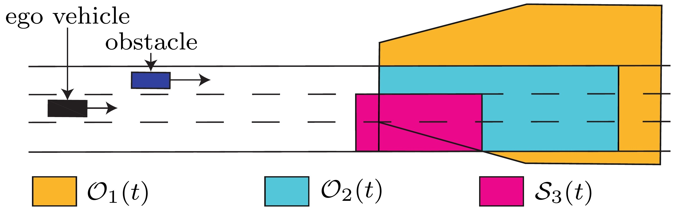

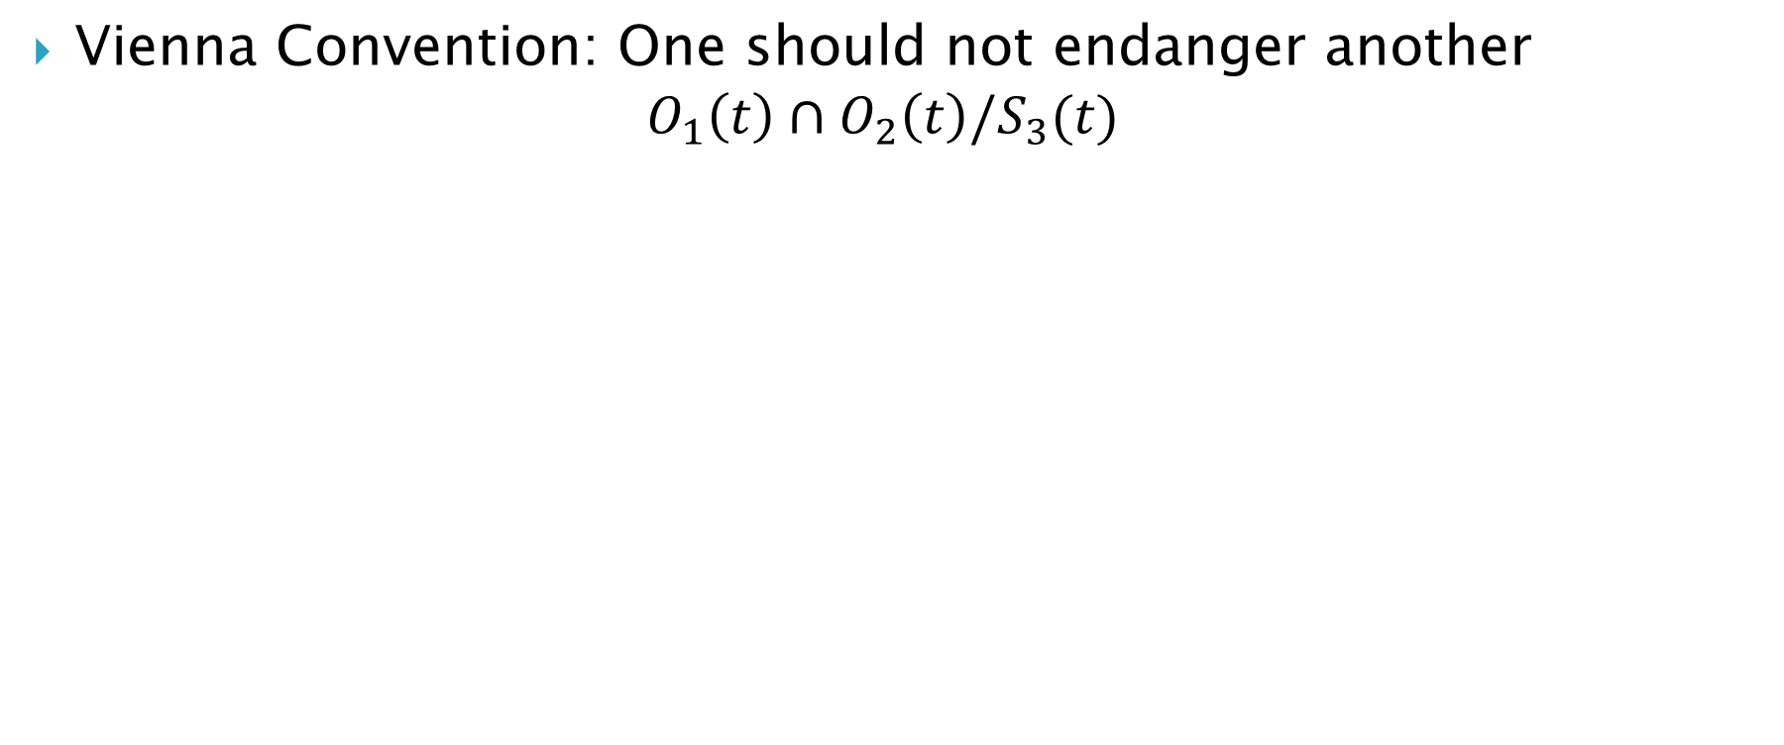
Safe Distance Space $S_{3}(t)$
Vienna Convention: One should not endanger another
$$O_{1}\left(t\right)∩O_{2}\left(t\right){/S}_{3}(t)$$

