Slide 1
SPOT: A Tool for Set-Based Prediction of Traffic Participants
Sebastian Kaster
Technical University Munich
March 15, 2018

Slide 2
Motivation
trajectory is safe if the occupancy does not intersect with the occupancy of any other traffic participant
Calculation of a bunch of occupancies is time consuming
    → Use a fast programming language!

Slide 3
Model
Additional Parameters (time-horizon)
SPOT
CommonRoad
Occupancy

Slide 4
CommonRoad
XML format for specifying road traffic scenarios
Consists of represantions for
  Road network
  Road participants
    Static → parked vehicle, construction zone, unknown
    Dynamic → car
      Not considered for now: pedestrians, cyclists

Slide 5
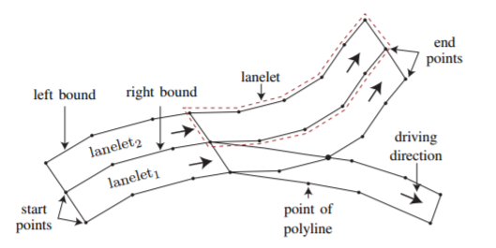
Road Network
Consists of lanelets
  Road segments
  defined by its left and right bound (polyline)

Slide 6
Lanes
union of lanelets which are longitudinally adjacent
Algorithm:
    Start from the lanelets with no predecessors
    Construct lanes by recursively combining successors
    If there is a fork or crossroad duplicate the lane

Slide 7
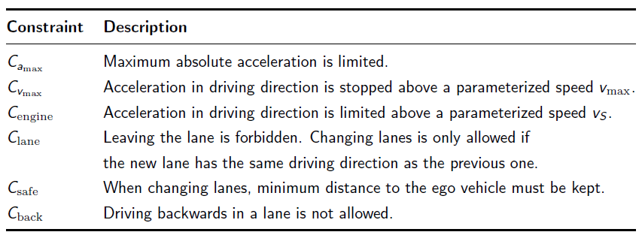
Constraints for Traffic Participants

Slide 8
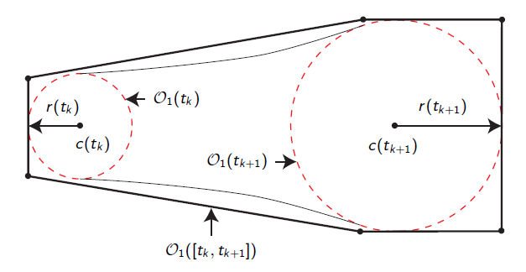
Acceleration-Based Occupancy (M1)

Slide 9
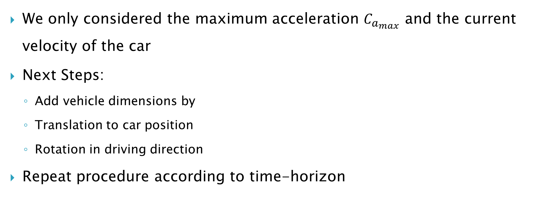
Acceleration-Based Occupancy
We only considered the maximum acceleration $C_{a_{max}}$ and the current velocity of the car
Next Steps:
  Add vehicle dimensions by
  Translation to car position
  Rotation in driving direction
Repeat procedure according to time-horizon

Slide 10
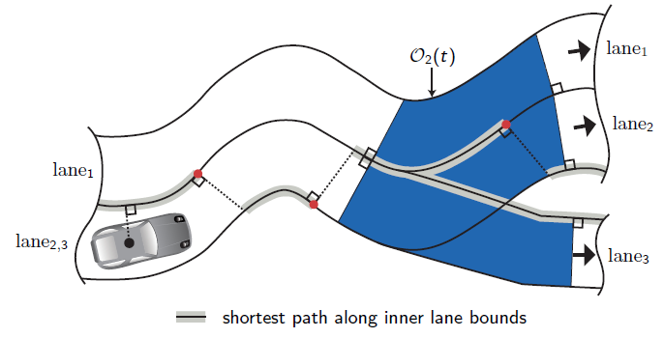
Lane-Following Occupancy (M2)

Slide 11
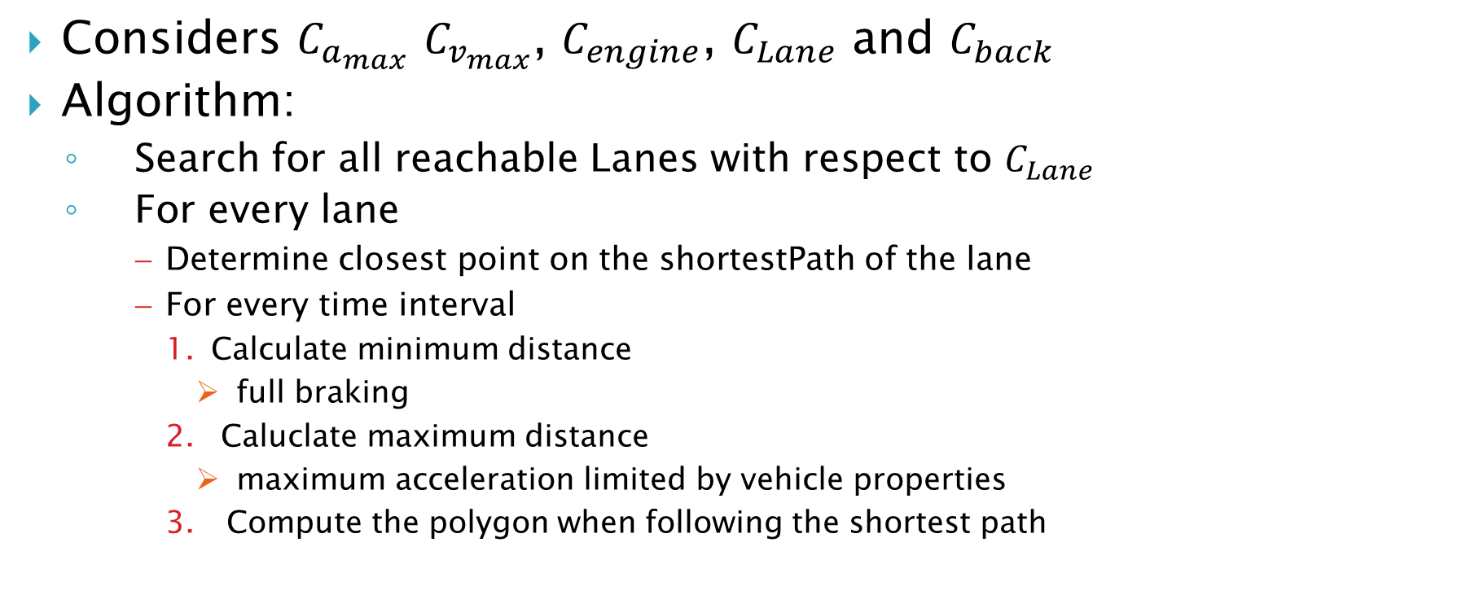
Lane-Following Occupancy (M2)
Considers $C_{a_{max}}$ $C_{v_{max}}$, $C_{engine}$, $C_{Lane}$ and $C_{back}$
Algorithm:
  Search for all reachable Lanes with respect to $C_{Lane}$
  For every lane
      Determine closest point on the shortestPath of the lane
      For every time interval
        Calculate minimum distance
          full braking
        Caluclate maximum distance
          maximum acceleration limited by vehicle properties
        Compute the polygon when following the shortest path

Slide 12
Reachable Lanes
Get the lanes the object is located in
Deconstruct lanes into lanelets
Recursively get adjacent lanelets with same driving direction
Add the lanes which are composed of those lanelets
Delete duplicates

Slide 13
Shortest Path

Slide 14
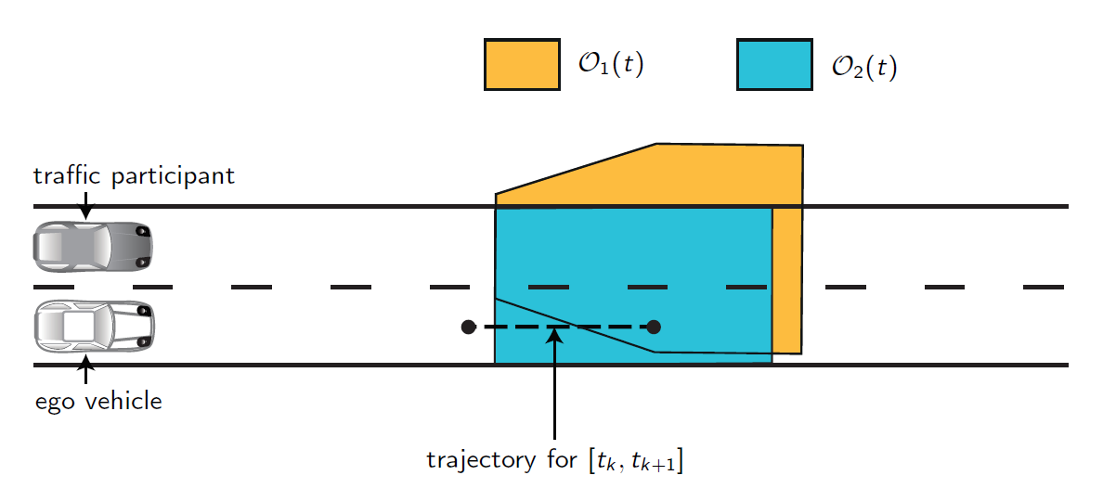

Overall-Occupancy
Intersection of M1 and M2 for every time interval
  $O_{1}(t)∩ O_{2}$(t)

Slide 15
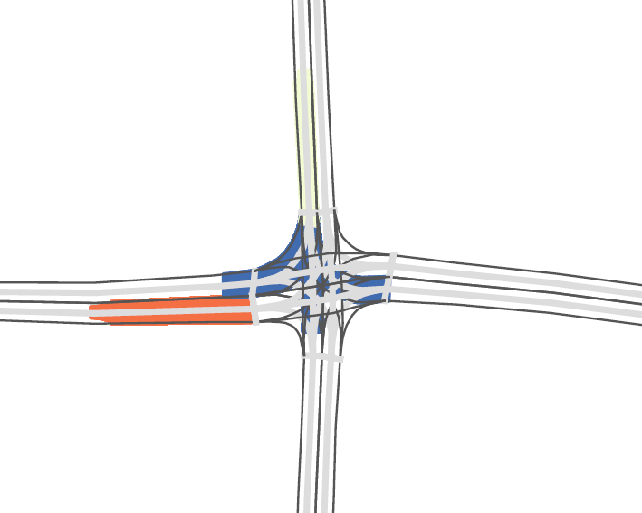
Overall Occupancy

Slide 16
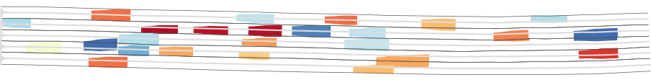
Overall Occupancy

Slide 17
Overview Implementation
Get lanelets
Construct lanes
Calculate shortest-path
Get obstacles
Compute occupancy
  Acceleration-Based Occupancy (M1)
  Lane-Following Occupancy (M2)
  Intersection of M1 and M2
Repeat from step 4 with t + ∆t

Slide 18
Overview Implementation
Get lanelets
Construct lanes
Calculate shortest-path
Get obstacles
Compute occupancy
  Acceleration-Based Occupancy (M1)
  Lane-Following Occupancy (M2)
  Intersection of M1 and M2
Repeat from step 4 with t + ∆t
Parallelize!

Slide 19
Class Diagram
Lane
Obstacle
Occupancy
Dynamic
Static
Lanelet
Vehicle

Slide 20
Some Implementation Details
pugi-xml for read-in data
std::vector used for laneltes, lanes and obstacles
Boost-library:
  Intersection of polygons
  Convex-Hull
OpenMP
  Parallelization

Slide 22
Future & Current Work
Add other traffic participants: cyclists, pedestrians
Shrink Over-Approximations:
  Reduce velocity in curves
Add arbitrary shape of cars
Optimize Performance
Integration into ROS

Slide 23
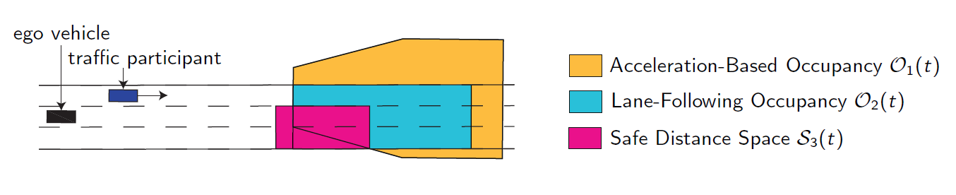

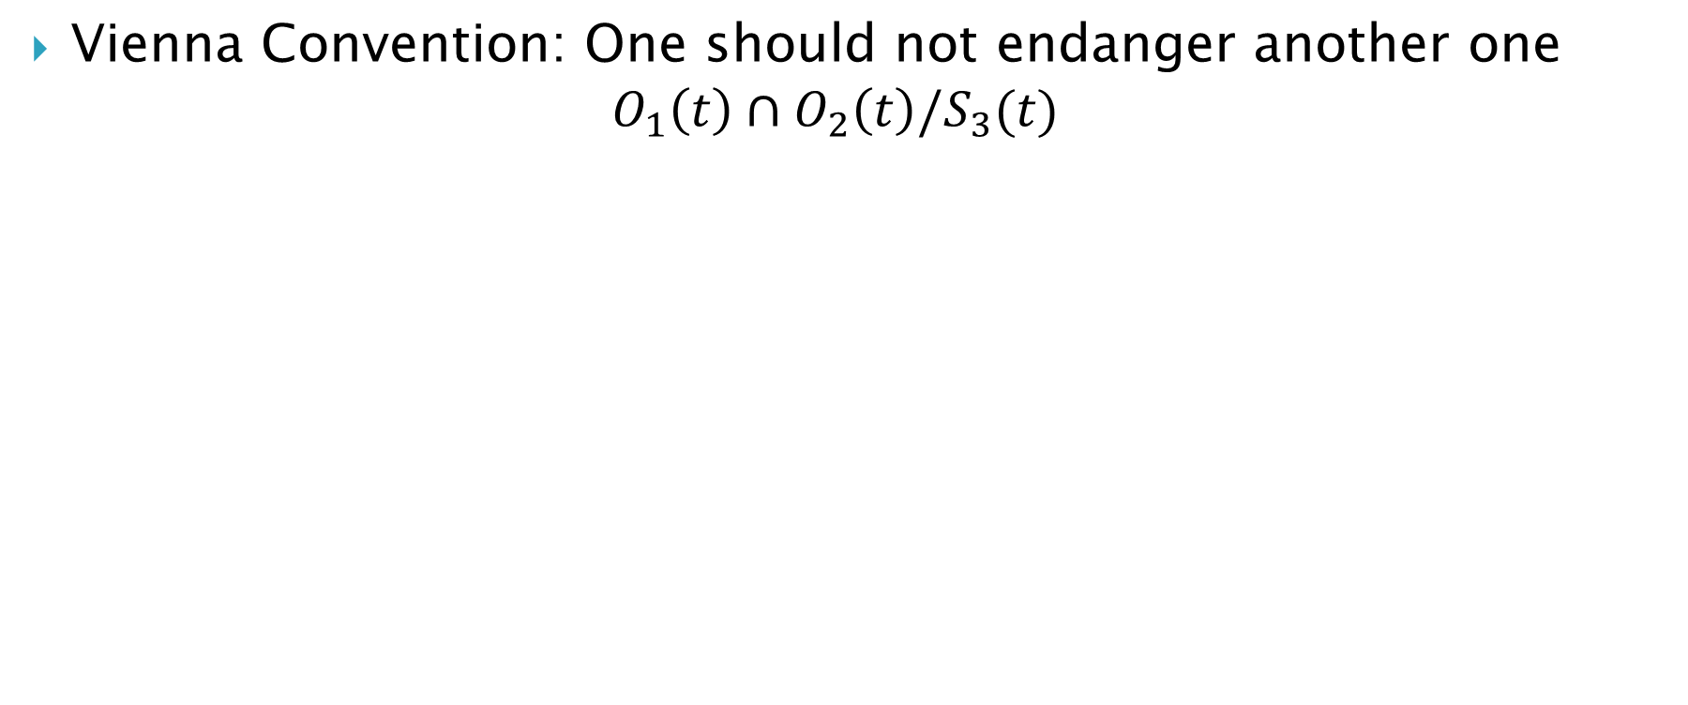
Safe Distance Space $S_{3}(t)$
Vienna Convention: One should not endanger another one
$$O_{1}\left(t\right)∩O_{2}\left(t\right){/S}_{3}(t)$$

