Slide 1
ODPHP Network Architecture
ODPHP Hosting Update
Presented to: ODPHP
Submitted by: CommunicateHealth, Inc.
July 11, 2017

Slide 2
Background and Introduction

Slide 3
Background
ODPHP’s hosting agreement with Triple-I will expire in October 2017
Triple-I’s contract with HHS is expiring, so a transition of the HHS hosting provider is expected

Slide 4
Introduction
ODPHP’s servers can run on any of the following types of servers:
On-premise – Physical servers at a datacenter (the current ODPHP environment)
Cloud-based – A series of interconnected servers
Managed – Platform-specific, cloud-based hosting, which is finely tuned for the needs of the platform

Slide 5
Benefits of Current Hosting
HHS security
HHS patch schedule

Slide 6
Drawbacks of Current Hosting
Not scalable
Stability issues
Responsiveness/Ownership issues

Slide 7
Infrastructure Requirements

Slide 8
Infrastructure Requirements
ODPHP’s infrastructure must be:
Secure
Staffed to provide timely patching
Highly available
Highly performant (speedy to return data)

Slide 9
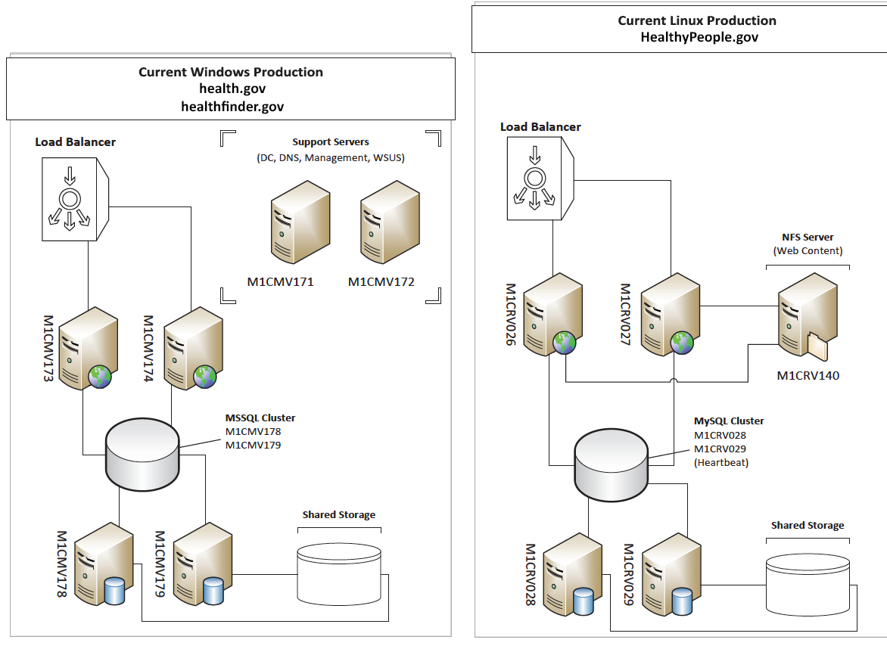
Current Network Diagram
https://communicatehealth.box.com/s/n7d6sv0kiciay6yc0fblk0pgadrrh01f
Notes:
Pilot Light
At the DNS level, there should be a health check on the application load balancer. Failure of the health checks should redirect traffic to a highly available static site on an independent network.
Application
The application needs to be highly available and highly performant. To be highly available, the application needs to be auto-balanced between application servers in separate locations on separate networks. To be highly performant, the application servers must either autoscale or be provisioned to handle the application at peak traffic.
The application runs on a LAMP stack and the codebase is managed in a git repository.
Database
The database needs to be highly available and highly performant. Read replicas should either be automatically instantiated or pre-provisioned to satisfy the needs of the application at peak traffic.
The database must be mySQL compatible.
CDN
The application’s static assets (images, videos, pdfs, etc.) should be hosted separately from the application, preferably on a highly available CDN.
Caching proxy
The network should be set up to allow a caching proxy.

Slide 10
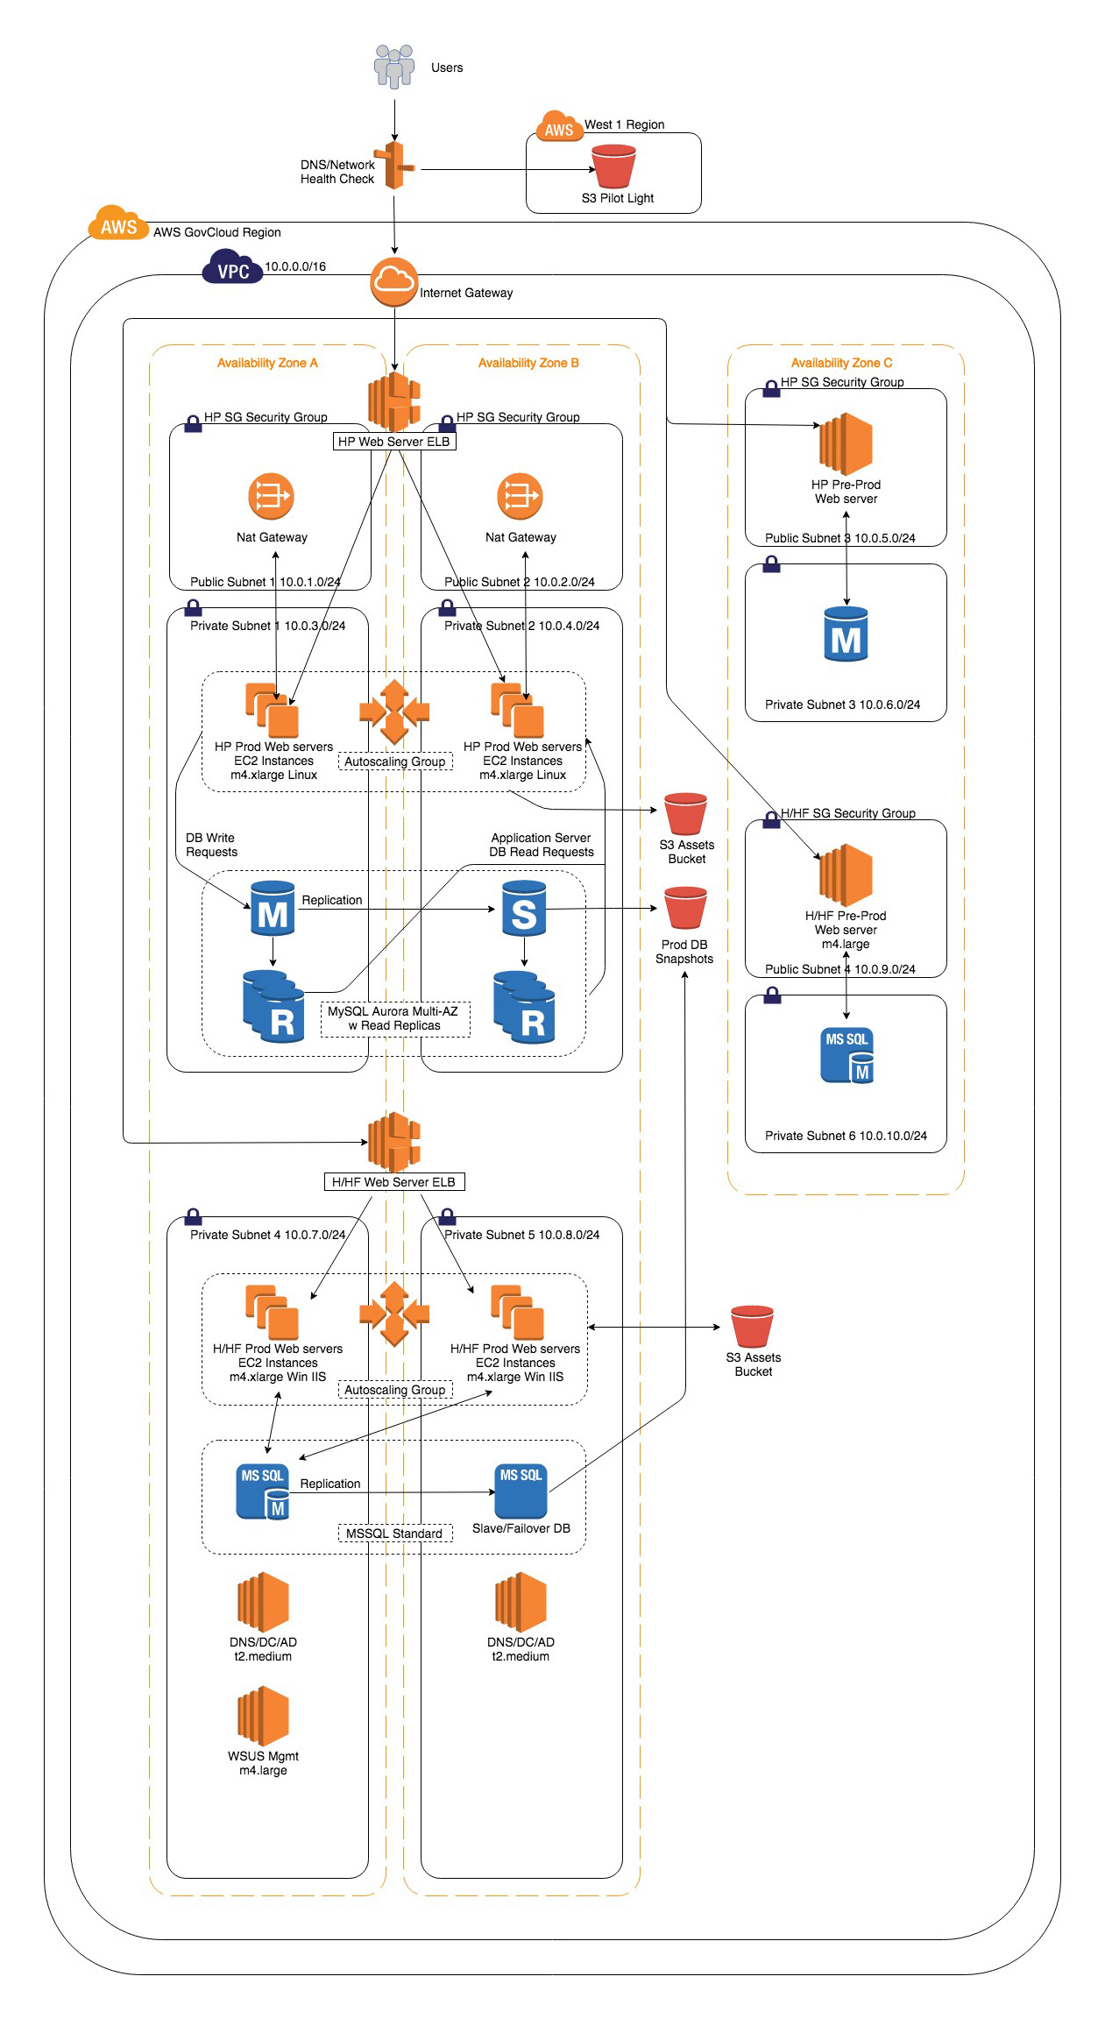
Proposed Network Diagram
https://communicatehealth.box.com/s/oeyjzvhf0idqpxapcaozitkfct6wns13
Notes:
Pilot Light
At the DNS level, there should be a health check on the application load balancer. Failure of the health checks should redirect traffic to a highly available static site on an independent network.
Application
The application needs to be highly available and highly performant. To be highly available, the application needs to be auto-balanced between application servers in separate locations on separate networks. To be highly performant, the application servers must either autoscale or be provisioned to handle the application at peak traffic.
The application runs on a LAMP stack and the codebase is managed in a git repository.
Database
The database needs to be highly available and highly performant. Read replicas should either be automatically instantiated or pre-provisioned to satisfy the needs of the application at peak traffic.
The database must be mySQL compatible.
CDN
The application’s static assets (images, videos, pdfs, etc.) should be hosted separately from the application, preferably on a highly available CDN.
Caching proxy
The network should be set up to allow a caching proxy.

Slide 11
Benefits of Proposed Network
Pilot Light
At the DNS level, a health check is performed on the application load balancer. Failure of the health checks will redirect traffic to a highly available static site on an independent network.
Application
To be highly available, the application will be auto-balanced between application servers in separate locations on separate networks.
To be highly performant, the application servers will either autoscale or be provisioned to handle the application at peak traffic.

Slide 12
Benefits of Proposed Network (cont.)
Database
Read replicas will be either automatically instantiated or pre-provisioned to satisfy the needs of the application at peak traffic.
Content Delivery Network (CDN)
The application’s static assets (images, videos, pdfs, etc.) will be hosted separately from the application, preferably on a highly available CDN to ensure fast load times and proper shared assets between the 2 application servers

Slide 13
Options

Slide 14
Amazon Web Services (AWS)
1

Slide 15
Benefits of AWS
Highly available
Highly performant
Highly scalable – able to grow with ODPHP’s needs as demand increases
Secure

Slide 16
Drawbacks of AWS
No longer receiving HHS Security and Patching support
Patching would be performed exclusively by Dataprise
Additional paperwork required during the transition, including ATO paperwork

Slide 17
Estimated Cost of AWS
Approximately $7,800/month
Estimated based on current usage
Monthly charges are based on usage, so actual monthly bills will vary
Amazon cost calculator link

Slide 18
Managed Hosting
2

Slide 19
Benefits of Managed Hosting
Specifically dedicated to Drupal
Hardware and software are specifically tuned to run Drupal websites in the most efficient manner
Management and patching of the hosting environment would be handled by the vendor

Slide 20
Drawbacks of Managed Hosting
Locked into the host’s specific hardware and software configuration
Only available to run a Drupal website, so we would need other hosting for the Windows sites
Additional paperwork required during the transition, including ATO paperwork

Slide 21
Providers and Estimated Cost
Providers
Pantheon
Acquia
Cost
Approximately $1,500/month

Slide 22
HHS Hosting Provider
3

Slide 23
Benefits of HHS Provider
HHS security
HHS patch schedule
Fixed pricing

Slide 24
Benefits/Drawbacks/Costs of HHS Provider
TBD based on HHS contracting selection

Slide 25
Summary

Slide 26
Next Steps
CH recommends that ODPHP weigh the pros and cons of the selected HHS provider against the other 2 options outlined here
In the meantime, ODPHP can consider the challenges of a variable price contract (for scalable service) versus a fixed price contract (paying for performance at peak potential traffic)
ODPHP and CH to discuss any additional research or information that the CH team can provide

