Slide 1
Week 3: Memory
Or: why you walked into the kitchen and stood there

Slide 2
1. Sensory memory: everything, for about half a second.
2. Short-term memory: about seven things, for about twenty seconds.
3. Long-term memory: the attic. Huge, dusty, hard to search.

Slide 3
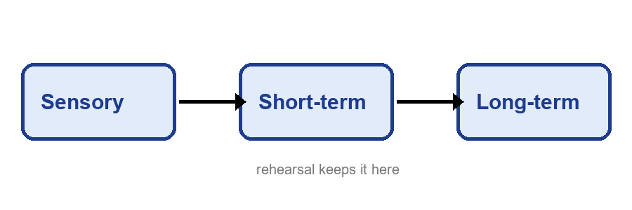
Memory

Slide 4
Memory
Encoding, storage and retrieval are three separate jobs, and each can fail on its own. You can store something perfectly and still fail to retrieve it, which is why the answer arrives in the shower an hour after the quiz. Context helps retrieval: studying where you will be tested, or at least in a similar state, improves recall. Sleep consolidates. Cramming produces confidence that is not, regrettably, the same thing as memory. Spacing your study across days beats one long session, even when it feels slower, because forgetting a little between sessions makes the next retrieval do more work.

Slide 5
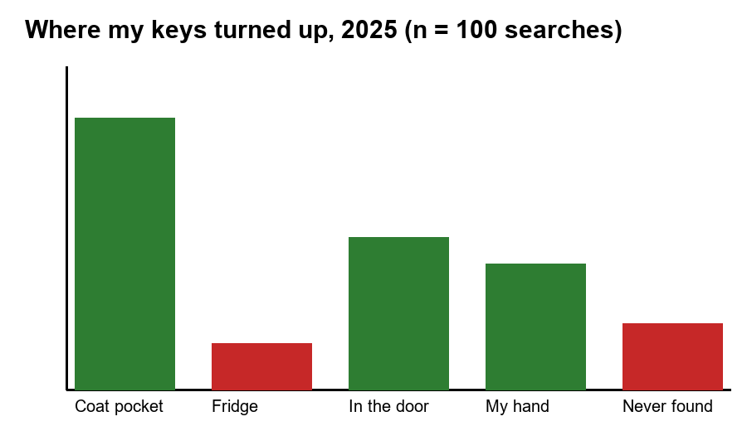
A completely scientific study

Slide 6
Myth or fact?
We only use ten percent of our brains
Sleep helps you remember what you studied
Goldfish have a three-second memory
Testing yourself beats rereading your notes

Slide 7
Questions? (I will forget them by Wednesday. Email me.)

