Slide 1
Track Your Volunteers’ Ability to Serve
Randy Aufrecht
Community Bible Church-San Antonio

Slide 2
Randy Aufrecht
Rocketchat: @randya
Randy.Aufrecht@cbc.email
www.communitybible.com
Notes:
Been in Church IT since 1996
First website in Microsoft Frontpage
Long list of Databases: Custom AREV, Shelby v5, ACS, The City, CCB
Been using Rock since 2018.
8th RX 4th time speaking
After last RX moved to SATX

Slide 3




Randy Aufrecht
Rocketchat: @randya
Randy.Aufrecht@cbc.email
www.communitybible.com
Notes:
Been married for 35 years this September
Have 2 adult kids, 1 in SA
If you want to know why I moved…
Plus 1 more due on my birthday in a few weeks.

Slide 4
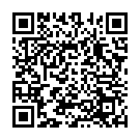
Overview
The Volunteer Capacity Indicator (VCI) is a system designed to enhance the safety and security of church volunteers by clearly indicating their eligibility to serve in various roles.
Notes:
My recipe is in the community recipe page
We call this system “Volunteer Capacity Indicator” or VCI
Designed to enhance the safety and security of the church
Indicates their eligibility to serve in their various roles

Slide 5
Problem
Having too many badges indicating a person's completion of volunteer-related Eligibility/Safety tasks can make it difficult to assess a volunteer’s true eligibility and may introduce safety and security vulnerabilities. Each church evaluates the safety and security of their volunteers differently. The VCI framework helps to standardize this process.
Notes:
Why did we create the VCI?
Too many ways a person might not be able to serve: Background Check, Safety Awareness Training, Signals
Hopefully, this framework will give you a single location to check on your volunteers

Slide 6
What is a VCI?
Beyond qualifications of age, skill-set, and background checks, the VCI system indicates a specific level of eligibility/safety for various volunteer opportunities:
Black: Unauthorized to Volunteer
Red: Unauthorized to Volunteer at this Time
Orange: All Star Requires Updated Authorizations
Blue: Authorized All Star for Adults Only
Yellow: Authorized All Star Minor and Conditional
Green: Authorized All Star for All
Grey: All Star Status Under Evaluation
Purple: High Capacity All Star
Notes:
These levels can be customized to your needs

Slide 7
Setting Up the VCI
To set up the VCI:
Create Attribute Matrix Template
Create attributes for Level, Person Responsible, Added Date, Evaluation Date, and Notes.
Define the Volunteer Capacity Indicator as a Person Attribute.
Place the VCI Person Attribute on a secure block for editing by the safety/security team.

Slide 8
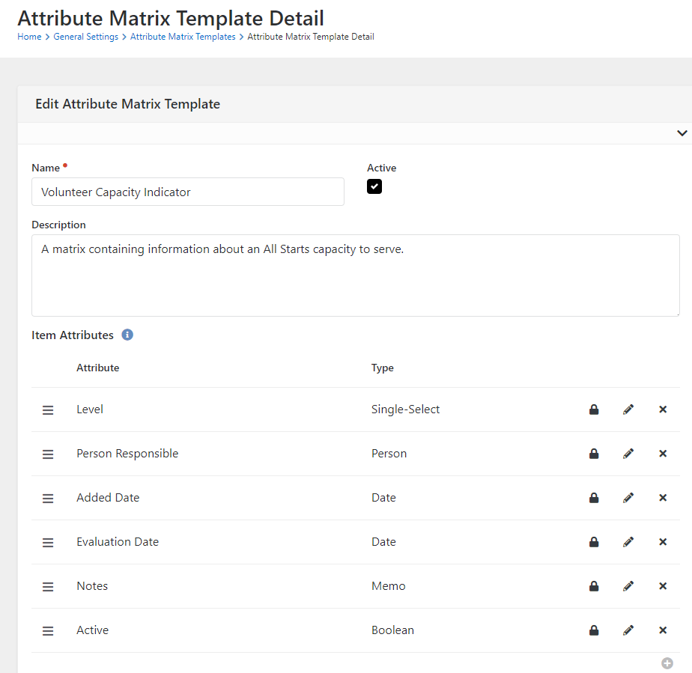
Setting Up the VCI

Slide 9
Attribute Matrix
Groups like attributes together
Allows for multiple groups of attributes
Display whole Matrix with Lava Object

Slide 10
Attribute Matrix
{% assign vci = Person | Attribute:'VCI','Object’ %}
{% for item in vci.AttributeMatrixItems %}
{{ vci | Attribute:'Level’ }}
… {% endfor %}

Slide 11
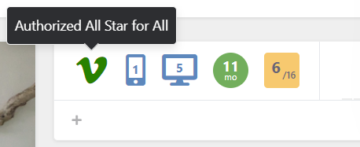
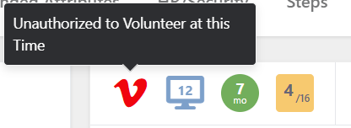
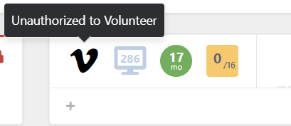
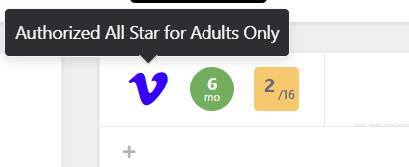
Badge
Badge shows staff the VCI level of the person.
Doesn’t give them details of why.

Slide 12
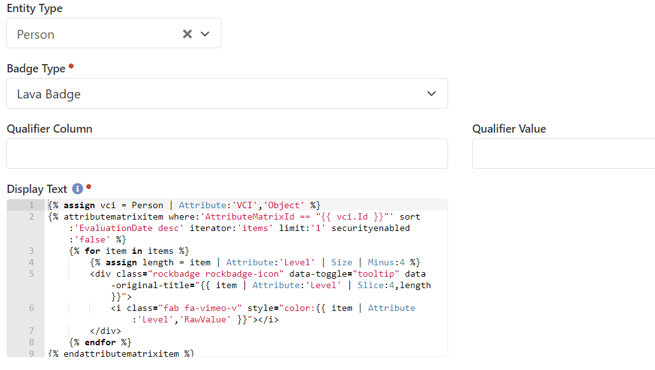
Badge

Slide 13
Automating the VCI Process
The VCI process can be automated using workflows and job triggers:
Notifications are sent when a volunteer's VCI changes or expires.
Automation updates the VCI level upon expiration and triggers necessary notifications.
Notes:
There are 2 types of automations
A Workflow Trigger starts Email Notifications which are sent to Connectors and Serve Team Leaders
The VCI Level can be automated based on dates and other criteria you may have.

Slide 14
Evaluating Volunteer Capacity
VCI levels are evaluated based on:
Background checks – Every Year
Safety Awareness Training – Every 2 Years
Age-specific requirements – Must be 18+ for Background Checks
Automated workflows adjust VCI levels as necessary based on these evaluations.
Notes:
These are what CBC uses for our renewals and requirements

Slide 15
Generating Reports
Create dynamic reports to monitor VCI statuses:
Use SQL queries to filter and sort VCI data.
Generate reports on evaluation dates and automated changes.
Customize reports to fit the needs of your ministry.

Slide 16
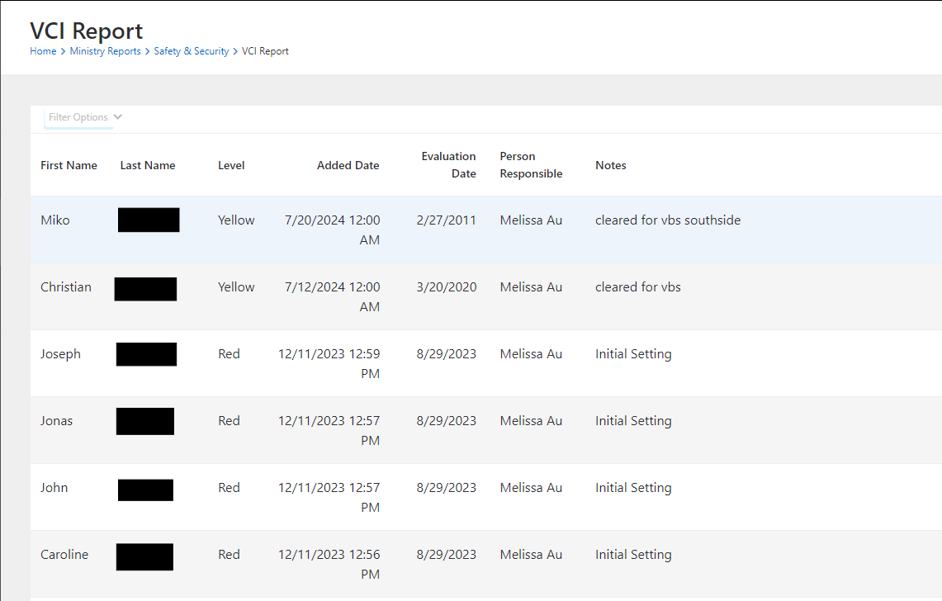
Generating Reports

Slide 17
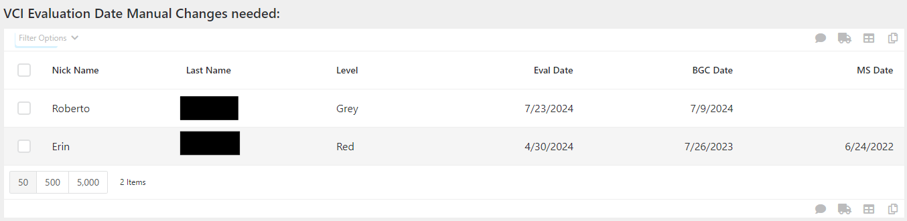
Generating Reports

Slide 18
Bonus Content
Additional automation options:
At the Evaluation Date, a workflow runs that automates changes
The changes are based on the current level and values of critical attributes
An added report that shows the changes that occurred with the job

Slide 19
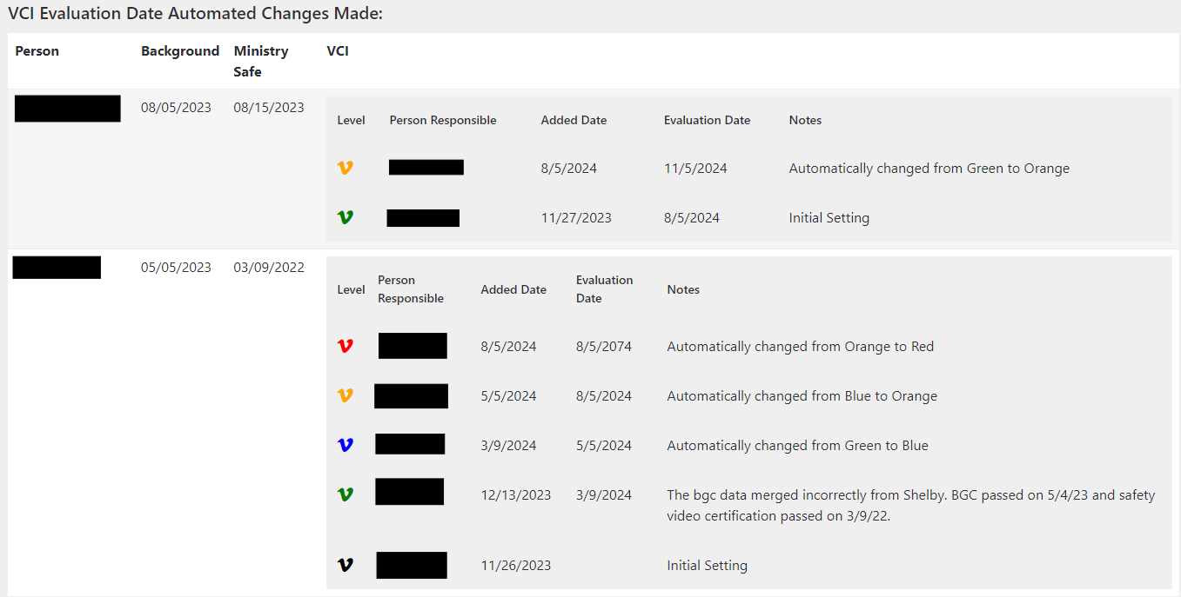
Bonus Content

Slide 20
Q&A
Randy Aufrecht Rocketchat: @randya Randy.Aufrecht@cbc.email

