Slide 1
UDP Sockets Programming
Datagram service (UDP): “unguaranteed” delivery
Creating UDP sockets (blocking).
  Client
  Server
Sending data.
Receiving data.

Slide 2
Socket Calls for Connectionless Protocol
The basic structure of a client/server UDP communication
Server
Socket()
Client
Bind()
Socket()
Recvfrom()
Sendto()
Blocks until data received
recvfrom()
Process request
Blocks until data received
Sendto()
Process reply

Slide 3
sendto
int sendto (SOCKET s,
const char* bytesToSend,
int nBytes,
int flags
struct sockaddr *to,
int sizeOfSockaddr);
  to is a struct sockaddr_in
    struct sockaddr_in
      short sin_family // address family
      u_short sin_port // port number
      struct in_addr sin_addr //IP address (32-bits)
    sizeOfSockaddr is sizeof(struct sockaddr_in)

Slide 4
recvfrom
int recvfrom (SOCKET s,
char* receivedData,
int nBytes,
int flags
struct sockaddr *from,
int sizeOfSockaddr);
  to is a struct sockaddr_in
    struct sockaddr_in
      short sin_family // address family
      u_short sin_port // port number
      struct in_addr sin_addr //IP address (32-bits)
    sizeOfSockaddr is sizeof(struct sockaddr_in)

Slide 5
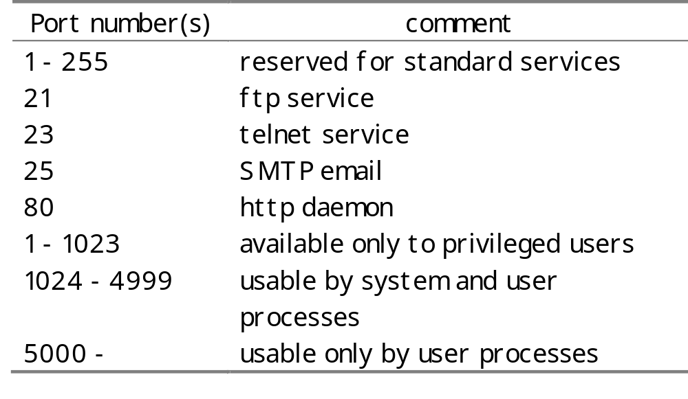

Slide 6
Multicast Addresses and Groups
IP address range: 224.0.0.0 to 239.255.255.255
To create a multicast group, select a random address from 225.0.0.0 to 238.255.255.255. After which, create an InetAddress object for that address and start sending it data.
Sending Multicast Data
Communication is connectionless. Datagrams are simply UDP datagrams addressed to a multicast group.
Need to set the Time-to-Live (TTL) value properly for the datagram to be received properly. TTL ( 0 – 255 ) is approximately the number of routers a frame goes through before it is discarded.
TTL values are:
0 for localhost; 1 for local subnet; … 255 for worldwide.

Slide 7
Broadcast (255.255.255.255)
With the UDP protocol you can send a packet so that all workstations on the network will see it. (TCP doesn’t allow broadcasting.)
To send broadcast packets, you must first enable the SO_BROADCAST option with the setsockopt() function. Then you simply send packets out using a special broadcast address.
The universal broadcast address is 255.255.255.255. Its advantage is that it’s generic. The disadvantage is that, because it can theoretically refer to every IP-connected machine on the planet, many network nodes will drop universal broadcast packets.
SubNet Broadcast Address:
u_long host_addr = inet_addr("172.16.77.88"); // local IP addr
u_long net_mask = inet_addr("255.255.224.0"); // LAN netmask
u_long net_addr = host_addr & net_mask; // 172.16.64.0
u_long dir_bcast_addr = net_addr | (~net_mask); // 172.16.95.255

